Slide 1
Z
Zuhoo Android App
Complete Project Guide & Interview Preparation
Java · Spring Boot · Android · MVVM

Slide 2
Agenda
01
Project Intro & Roles
02
Tech Stack & Architecture
03
Networking & Real-time Chat
04
Core Modules
05
UI/UX Redesign — Case Study
06
Project by the Numbers
Zuhoo Android — Project Presentation
2

Slide 3
Project Introduction
What?
A native Android companion app for a multi-tenant SaaS platform (Zuhoo/BusinessOS)
Why?
Not a full replica of the web app — only what matters most on mobile (requests, invoices, chat)
Backend
Spring Boot (Java) — shares the same database as the Angular web app
Zuhoo Android — Project Presentation
3

Slide 4
Three Roles, One App
CLIENT
COMPANY_OWNER
EMPLOYEE
Request services, pay invoices, live chat with the company
Handle requests, manage staff
Same as owner, with narrower permissions
Zuhoo Android — Project Presentation
4

Slide 5
Tech Stack
Java
Retrofit + OkHttp
Room
LiveData + ViewModel
Core language — kept consistent with the backend
Type-safe REST networking
Offline read cache
MVVM state management
Material Components
Firebase (FCM)
Hand-rolled STOMP
Hand-rolled DI
XML + ViewBinding UI
Push notifications
Real-time chat, ~120 lines
AppGraph — instead of Hilt
Zuhoo Android — Project Presentation
5

Slide 6
Architecture — How Data Flows
Activity
(UI)
→
ViewModel
(state)
→
Repository
(abstraction)
→
Retrofit
(network)
→
Spring Boot
Backend
8 screens have a ViewModel (complex list screens); the rest call the Repository directly — every layer isn't mandatory everywhere.
Zuhoo Android — Project Presentation
6

Slide 7
A Key Engineering Decision
Why hand-rolled DI, not Dagger/Hilt?
"Plain manual DI is fine for an app this size" — the build-time cost of an annotation processor would have outweighed its benefit. Proof that not every tool belongs everywhere.
"Match solution complexity to actual need, not to what's trendy."
Zuhoo Android — Project Presentation
7

Slide 8
Core Modules
H
HR
F
Finance
Leave, Expense, Timesheet, Attendance (Selfie+GPS), Payroll
Invoice, SSLCommerz Payment, Wallet, Catalog
S
Service Desk
C
CRM & More
Dynamic Forms, Real-time Chat, 6 Workflow Dialogs
Leads, Directory, Global Search, Company Overview
Zuhoo Android — Project Presentation
8

Slide 9
UI/UX Redesign — The Problem (Before)
✕
No spacing/typography system existed
✕
Dashboard was a wall of 15 stacked buttons
✕
3 different form-input patterns (Spinner, bare TextView, TextInputLayout)
✕
8 near-duplicate StatusBadge classes, no badge shape at all
✕
Not a single back arrow across 45 screens
Zuhoo Android — Project Presentation
9

Slide 10
The Solution — One Central Design System
✓
✓
Spacing Scale
Typography Scale
4/8/12/16/20/24/32dp — a single consistent series
9 TextAppearance styles, clear hierarchy
✓
✓
StatusBadgeView
StateView
Pill-shaped badge + tone icon, never color-only
Empty/Loading/Error — one shared component
Zuhoo Android — Project Presentation
10

Slide 11
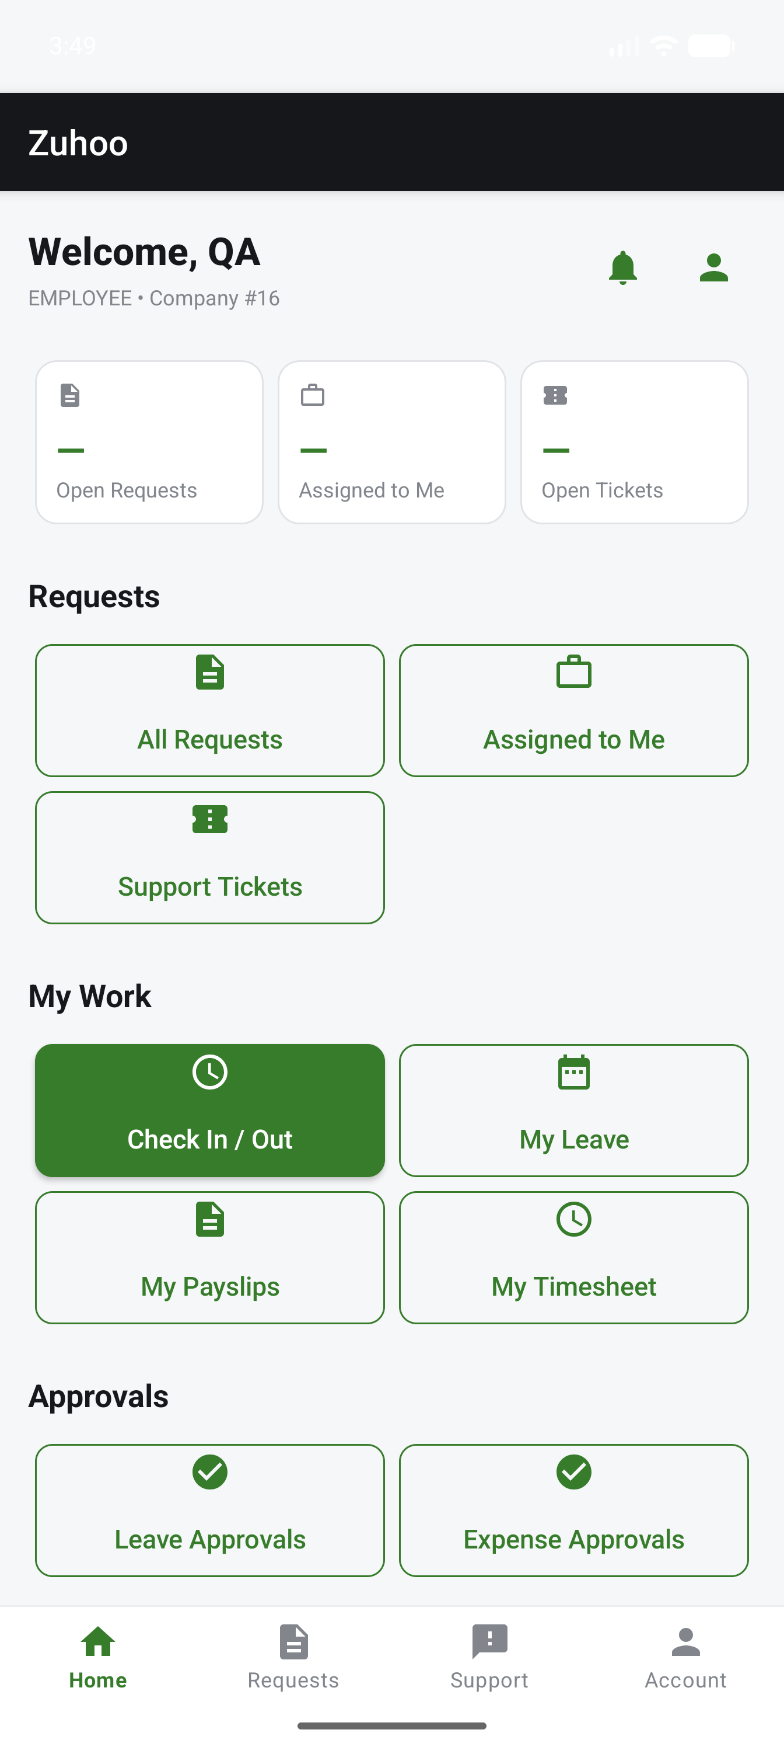
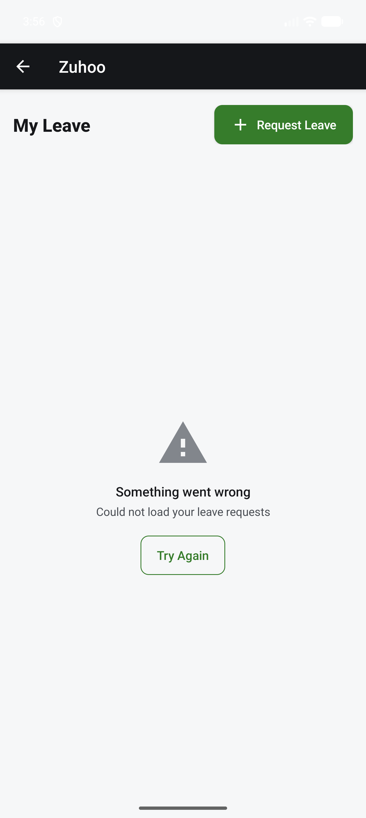
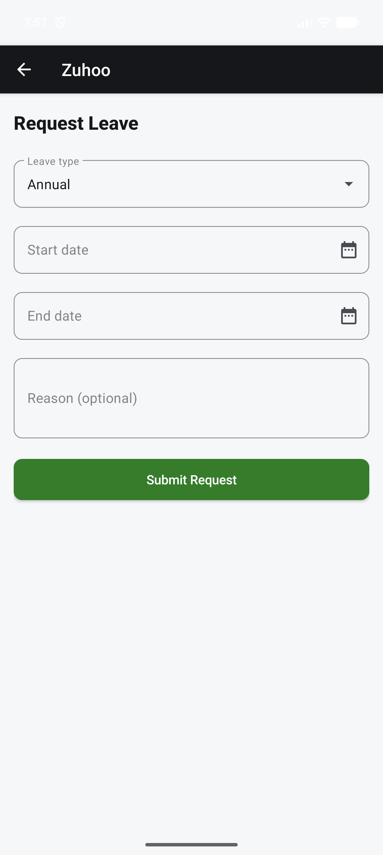
The Result — In the Real App
Zuhoo Android — Project Presentation
11
Dashboard — Icon-led Quick Actions Grid
Error State — icon+title+retry button
Form — Material Dropdown + Date Field

Slide 12
Verification Process
1
2
3
→
→
Build
Emulator
Screenshot
./gradlew assembleDevDebug after every batch
Ran the real app on an Android emulator
Visually verified every screen
Zuhoo Android — Project Presentation
12

Slide 13
The Project by the Numbers
45
247
63+
568×2
Activities
Java Files
API Endpoints
Strings (2 languages)
Zuhoo Android — Project Presentation
13

Slide 14
Z
Thank You
For the complete detailed book, see:
docs/project-book/

