Slide 1
Chapter 1. Introduction
What Is Data Mining?
Data Mining: An Essential Step in Knowledge Discovery
Diversity of Data Types for Data Mining
Mining Various Kinds of Knowledge
Data Mining: Confluence of Multiple Disciplines
Data Mining and Applications
Data Mining and Society
Summary

Slide 2
What Is Data Mining?
We live in a world where vast amounts of data are generated constantly and rapidly
Data mining is the process of discovering interesting patterns, models and other kinds of knowledge in large data sets
  “Data mining”: a misnomer? It should be “knowledge mining from data”
  Other terms: Knowledge mining from data, KDD (Knowledge Discovery from Data), pattern discovery, knowledge extraction, data analytics, information harvesting
Data mining is a young, dynamic, and promising field
Example: Data mining turns a large collection of data into knowledge
  Google’s Flu Trends found a close relationship between the number of people who search for flu-related info. and the number of people who have flu symptoms
    It can estimate flu activity up to two weeks faster than traditional systems

Slide 3
Data Mining: An Essential Step in Knowledge Discovery
Knowledge Discovery Process
  Data preparation
    Data cleaning
    Data integration
    Data transformation
    Data selection
  Data mining
  Pattern/model evaluation
  Knowledge presentation

Slide 4
Diversity of Data Types for Data Mining (I)
Structured vs. unstructured data
  Structured: uniform, record- or table-like structures, defined by data dictionaries, with a fixed set of attributes, each with a fixed set of value ranges and semantic meaning
    Ex. Data stored in relational databases, data cubes, data matrices, and many data warehouses
  Semi-structured: allow a data object to contain a set value, a small set of heterogeneous typed values, or nested structures, or to allow the structure of objects or sub-objects to be defined flexibly and dynamically
  Data having certain structures with clearly defined semantic meaning, such as transactional data set, sequence data set (e.g., time-series data, gene or protein data, or Weblog data)
  Graph or network data: A more sophisticated type of semi-structured data set
  Unstructured data: text data and multimedia (e.g., audio, image, video) data
The real-world data can often be a mixture of structured, semi-structured data and unstructured data
Notes:
Structured Data: This is organized data that fits neatly into tables or spreadsheets, like numbers, dates, and strings. Examples include databases and Excel files.
Semi-Structured Data: This is somewhat organized data that doesn't fit neatly into tables but still has some structure. Examples include JSON files, XML files, and email metadata.
Unstructured Data: This is data that doesn't have a predefined structure, making it hard to organize in tables. Examples include text documents, images, videos, and social media posts.
These categories help in understanding how data can be stored, managed, and analyzed.

Slide 5
Diversity of Data Types for Data Mining (II)
Data associated with different applications
  Different applications: different data sets and require different data analysis methods
    Sequence data: Biological sequences vs. shopping transaction sequences
    Time-series: ordered set of numerical values with equal time interval
    Spatial, temporal and spatiotemporal data
    Graph and network data: Social networks, computer communication networks, biological networks, and information networks may carry rather different semantics
  On the same data set, finding different kinds of patterns: require different mining methods
    Ex. software programs: finding plagiarized modules vs. finding copy-and-paste bugs
Stored vs. streaming data
  Stored data: Finite, stored in various kinds of large data repositories
  Streaming data (e.g., video surveillance or remote sensing): Dynamic, constantly coming, infinite, real-time response―posing challenges on effective data mining
Notes:
Data Associated with Different Applications
Different Applications
Different applications require different data sets and analysis methods: The type of data and the
analysis techniques vary widely depending on the application domain. Understanding these variations helps in choosing the appropriate data mining methods.
Types of Data
Sequence Data: This type includes data where the order of elements matters. Examples are:
Biological sequences: Such as DNA, RNA, or protein sequences, where the order of nucleotides or amino acids is crucial.
Shopping transaction sequences: Where the order of purchased items may provide insights into customer behavior and preferences.
Time-Series Data: This consists of ordered sets of numerical values with equal time intervals between them. Examples include:
Stock prices: Recorded at regular intervals (e.g., daily closing prices).
Weather data: Such as hourly temperature readings.
Spatial, Temporal, and Spatiotemporal Data: This includes data that is related to space (location), time, or both. Examples are:
Spatial data: Geographical information such as maps or satellite imagery.
Temporal data: Data related to time points or periods, such as historical event logs.
Spatiotemporal data: Data that includes both spatial and temporal information, such as the movement of objects over time (e.g., tracking the movement of vehicles or animals).
Graph and Network Data: This represents relationships and interactions within a set of entities. Examples are:
Social networks: Showing connections between individuals (e.g., Facebook or LinkedIn networks).
Computer communication networks: Such as the internet, where nodes represent computers and edges represent communication links.
Biological networks: Such as protein-protein interaction networks.
Information networks: Such as citation networks in academic papers.
On the Same Data Set, Finding Different Kinds of Patterns
Different mining methods for the same data set: Depending on the patterns or insights sought, various methods might be used to analyze the same data set.
Example: In software programs:
Finding plagiarized modules: This involves detecting duplicate or near-duplicate code blocks, possibly using similarity detection techniques.
Finding copy-and-paste bugs: This requires identifying repetitive code that might introduce errors, often through static code analysis or pattern matching.
Stored vs. Streaming Data
Stored Data
Finite and stored in various kinds of large data repositories: This type of data is static and does not change once stored. Examples include:
Databases: Where data is structured and stored in tables.
Data warehouses: Where large volumes of historical data are stored for analysis and reporting.
Streaming Data
Dynamic, constantly incoming, infinite data requiring real-time response: This type of data is continuously generated and needs to be processed on the fly. Examples include:
Video surveillance: Continuous video feed that needs real-time analysis for security monitoring.
Remote sensing: Data from sensors (e.g., weather stations, satellites) that continuously stream data for immediate analysis.
Challenges and Techniques
Challenges: Each type of data and application comes with its own set of challenges in terms of data collection, storage, processing, and analysis. For instance:
Sequence data might require specialized algorithms for pattern recognition.
Time-series data might need forecasting models like ARIMA or LSTM.
Spatial data might involve geographic information systems (GIS) and spatial analysis techniques.
Streaming data demands real-time processing capabilities, often utilizing frameworks like Apache Kafka or Apache Flink.
Understanding these types of data and their respective challenges helps in selecting the appropriate data mining techniques and tools, leading to more effective and insightful analysis.

Slide 6
Mining Various Kinds of Knowledge
Multidimensional Data Summarization
Mining Frequent Patterns, Associations, and Correlations
Classification and Regression for Predictive Analysis
Cluster Analysis
Deep Learning
Outlier Analysis
Are All Mining Results Interesting?

Slide 7
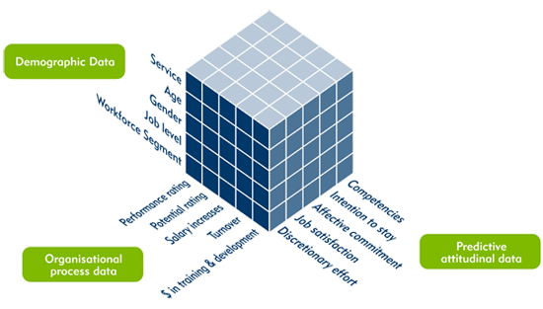
Multidimensional Data Summarization
Information integration and data warehouse construction
  Data cleaning, transformation, integration, and multidimensional data model
Data cube technology
  Scalable methods for computing (i.e., materializing) multidimensional aggregates
  OLAP (online analytical processing)
Multidimensional concept description: Characterization and discrimination
  Generalize, summarize, and contrast data characteristics, e.g., dry vs. wet region
Notes:
The image discusses multidimensional data summarization and highlights several key components and techniques used in the process. Here's a detailed explanation of each point:
Multidimensional Data Summarization
Information Integration and Data Warehouse Construction
Data Cleaning, Transformation, Integration, and Multidimensional Data Model:
Data Cleaning: The process of detecting and correcting (or removing) corrupt or inaccurate records from a dataset. It ensures that the data is accurate and consistent.
Data Transformation: Converting data from one format or structure into another. This may involve aggregating data, normalizing, or encoding it.
Data Integration: Combining data from different sources into a single, unified view. This is crucial for creating a comprehensive data warehouse.
Multidimensional Data Model: Organizing data into dimensions and facts, typically represented as a data cube. This model allows for more intuitive data analysis and querying.
Data Cube Technology
Scalable Methods for Computing (i.e., Materializing) Multidimensional Aggregates:
Data Cubes: A data cube is a multi-dimensional array of values, typically used to describe data along some measure of interest. Each cell in the cube represents an aggregate value of interest, such as total sales or average temperature.
Materializing Aggregates: Precomputing the results of aggregations for quick retrieval. This is essential for scalable data analysis because it reduces the computation time during query processing.
OLAP (Online Analytical Processing):
OLAP Tools: These tools allow for the interactive analysis of multidimensional data from multiple perspectives. They support complex queries, such as slicing, dicing, drilling down, and rolling up the data.
Multidimensional Concept Description: Characterization and Discrimination
Characterization: Describing the general features of the data. This involves summarizing the data to provide a high-level overview, often using techniques such as data aggregation or generalization.
Discrimination: Differentiating between different data classes or categories. This involves identifying the distinctive features that separate one class from another.
Generalize, Summarize, and Contrast Data Characteristics:
Generalization: Abstracting low-level data to a higher conceptual level. For instance, converting specific data points into broader categories.
Summarization: Providing concise descriptions of data sets. This could involve creating summary statistics like mean, median, and standard deviation.
Contrasting Data Characteristics: Comparing different data sets or categories to highlight their differences. For example, contrasting the characteristics of data from dry vs. wet regions.
Example: Data Cube Visualization
The image also includes an example of a data cube with different dimensions:
Demographic Data: Age, gender, job level, workforce segment.
Organizational Process Data: Performance ratings, potential ratings, salary increases, turnover, training and development.
Predictive Attitudinal Data: Competencies, intention to stay, affective commitment, discretionary effort.
By using multidimensional data summarization techniques, one can integrate various data sources, clean and transform the data, and then organize it into a multidimensional data model. This allows for efficient and comprehensive analysis, providing valuable insights through OLAP tools and data cube technology.

Slide 8
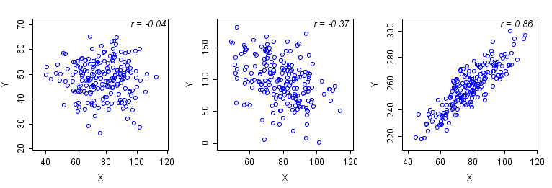
Pattern Discovery: Mining Frequent Patterns, Associations, and Correlations
Frequent patterns (or frequent itemsets)
  What items are frequently purchased together in your Walmart?
Association and Correlation Analysis
A typical association rule
    Diaper → Beer [0.5%, 75%] (support, confidence)
  Are strongly associated items also strongly correlated?
How to mine such patterns and rules efficiently in large datasets?
How to use such patterns for classification, clustering, and other applications?
Notes:
Pattern Discovery: Mining Frequent Patterns, Associations, and Correlations
Frequent Patterns (or Frequent Itemsets)
Definition: Frequent patterns are sets of items, sequences, or substructures that appear frequently in a dataset. In the context of retail, this could mean items that are often bought together.
Example Question: What items are frequently purchased together in a store like Walmart? Identifying such patterns can help in optimizing store layout, inventory management, and targeted marketing.
Association and Correlation Analysis
Association Analysis: This involves finding interesting relationships (associations) between variables in large databases. An association rule is a popular method used in data mining.
Typical Association Rule Example:
Rule: Diaper → Beer
Support: 0.5% (This means that 0.5% of all transactions in the dataset contain both diapers and beer.)
Confidence: 75% (This means that 75% of the transactions that contain diapers also contain beer.)
Correlation Analysis: This involves measuring the statistical relationships between two variables. The correlation coefficient (r) indicates the strength and direction of a linear relationship between variables.
Graphs with Different Correlation Coefficients:
r = 0.04: Almost no correlation.
r = -0.37: Moderate negative correlation.
r = 0.86: Strong positive correlation.
Are Strongly Associated Items Also Strongly Correlated?
This question addresses whether items that frequently appear together (high support and confidence) also show a strong correlation. It's important to note that association does not necessarily imply correlation, and vice versa.
Mining Patterns and Rules Efficiently in Large Datasets
Efficiency: Discovering frequent patterns and associations in large datasets requires efficient algorithms due to the potential size and complexity of the data.
Algorithms: Some popular algorithms for this purpose include Apriori, FP-Growth, and Eclat.
Challenges: Handling large datasets, ensuring computational efficiency, and reducing memory usage are key challenges.
Applications of Patterns and Rules
Classification: Using discovered patterns to classify data into predefined categories.
Clustering: Grouping similar data points together based on the discovered patterns.
Other Applications: Including anomaly detection, recommendation systems, market basket analysis, and more.
Summary
Understanding and discovering frequent patterns, associations, and correlations in data can provide valuable insights for various applications. Efficiently mining these patterns requires robust techniques and algorithms, especially when dealing with large datasets. These discovered patterns can then be applied to enhance decision-making in areas like retail, marketing, healthcare, and more.

Slide 9
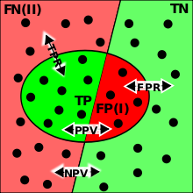
Classification and Regression for Predictive Analysis
Classification and label prediction
  Construct models (functions) based on some training examples
  Describe and distinguish classes or concepts for future prediction
    Ex. 1. Classify countries based on (climate)
    Ex. 2. Classify cars based on (gas mileage)
  Predict some unknown class labels
Typical methods
  Decision trees, naïve Bayesian classification, support vector machines, neural networks, rule-based classification, pattern-based classification, logistic regression, …
Typical applications:
  Credit card fraud detection, direct marketing, classifying stars, diseases, web-pages, …
Notes:
Classification and Label Prediction
Construct Models (Functions) Based on Training Examples:
This involves using a set of training data, where the outcome or label is known, to build a model that can predict the label of new, unseen data.
Describe and Distinguish Classes or Concepts for Future Prediction:
Example 1: Classify countries based on climate.
Example 2: Classify cars based on gas mileage.
The goal is to create clear distinctions between different categories based on the features of the data, enabling accurate predictions for new instances.
Predict Some Unknown Class Labels:
Once the model is trained, it can be used to predict the class labels of new, unknown data points.
Typical Methods
Decision Trees: A model that makes decisions based on a series of binary (yes/no) questions about the features of the data.
Naïve Bayesian Classification: A probabilistic model based on Bayes' theorem, assuming independence between features.
Support Vector Machines (SVM): A model that finds the hyperplane that best separates different classes in the feature space.
Neural Networks: Models inspired by the human brain, consisting of layers of interconnected nodes (neurons) that can learn complex patterns.
Rule-Based Classification: A model that uses a set of if-then rules for classification.
Pattern-Based Classification: This involves identifying patterns in the data that correspond to different classes.
Logistic Regression: A statistical model that uses a logistic function to model binary outcomes.
Typical Applications
Credit Card Fraud Detection: Using transaction data to predict whether a transaction is fraudulent or not.
Direct Marketing: Identifying which customers are most likely to respond to a marketing campaign.
Classifying Stars: Categorizing stars based on their characteristics (e.g., brightness, size).
Disease Classification: Predicting the presence of a disease based on patient data.
Web Pages Classification: Categorizing web pages into different topics or genres.
Visual Explanation (Confusion Matrix)
The image includes a confusion matrix, which is used to evaluate the performance of a classification model:
TP (True Positive): The model correctly predicts the positive class.
FP (False Positive): The model incorrectly predicts the positive class.
TN (True Negative): The model correctly predicts the negative class.
FN (False Negative): The model incorrectly predicts the negative class.
Precision (PPV - Positive Predictive Value): The ratio of true positives to the sum of true positives and false positives.
Recall (TPR - True Positive Rate): The ratio of true positives to the sum of true positives and false negatives.
FPR (False Positive Rate): The ratio of false positives to the sum of false positives and true negatives.
NPV (Negative Predictive Value): The ratio of true negatives to the sum of true negatives and false negatives.
Understanding these concepts and techniques allows for the effective use of classification and regression in predictive analytics, enabling accurate predictions and informed decision-making across various applications.

Slide 10
Cluster Analysis
Unsupervised learning (i.e., Class label is unknown)
Group data to form new categories (i.e., clusters), e.g., cluster houses to find distribution patterns
Principle: Maximizing intra-class similarity & minimizing interclass similarity
Many methods and applications
Notes:
Cluster Analysis
Unsupervised Learning
Definition: In unsupervised learning, the class labels of the data are unknown. The algorithm tries to learn the underlying structure of the data without any labeled training examples.
Objective: The main goal is to find hidden patterns or intrinsic structures in the data.
Group Data to Form New Categories (Clusters)
Clustering: The process of grouping a set of objects in such a way that objects in the same group (cluster) are more similar to each other than to those in other groups (clusters).
Example: Clustering houses to find distribution patterns based on features like price, size, and location.
Principle
Maximizing Intra-Class Similarity: Within a cluster, the data points should be as similar as possible to each other. This is achieved by minimizing the distance (or dissimilarity) between the points within the same cluster.
Minimizing Interclass Similarity: Data points in different clusters should be as different as possible. This is achieved by maximizing the distance between points in different clusters.
Methods and Applications
Many Methods:
K-means Clustering: Partitions the data into K clusters, with each data point belonging to the cluster with the nearest mean.
Hierarchical Clustering: Builds a tree of clusters, where each node is a cluster consisting of its children clusters.
DBSCAN (Density-Based Spatial Clustering of Applications with Noise): Clusters data based on the density of data points, capable of finding arbitrarily shaped clusters and dealing with noise.
Gaussian Mixture Models (GMM): Assumes that the data is generated from a mixture of several Gaussian distributions and assigns a probability to each data point for belonging to each cluster.
Applications:
Market Segmentation: Grouping customers based on purchasing behavior.
Social Network Analysis: Detecting communities within social networks.
Image Segmentation: Partitioning an image into meaningful regions.
Anomaly Detection: Identifying unusual data points that do not fit into any cluster.
Document Clustering: Organizing a large collection of documents into smaller groups of related documents.
Visual Representation
The image includes a scatter plot with clusters represented by different colors. This visual representation shows how data points are grouped into clusters based on their similarities.
Cluster analysis is a versatile tool in data mining that helps in understanding the structure of the data and uncovering hidden patterns, making it useful across various domains and applications.

Slide 11
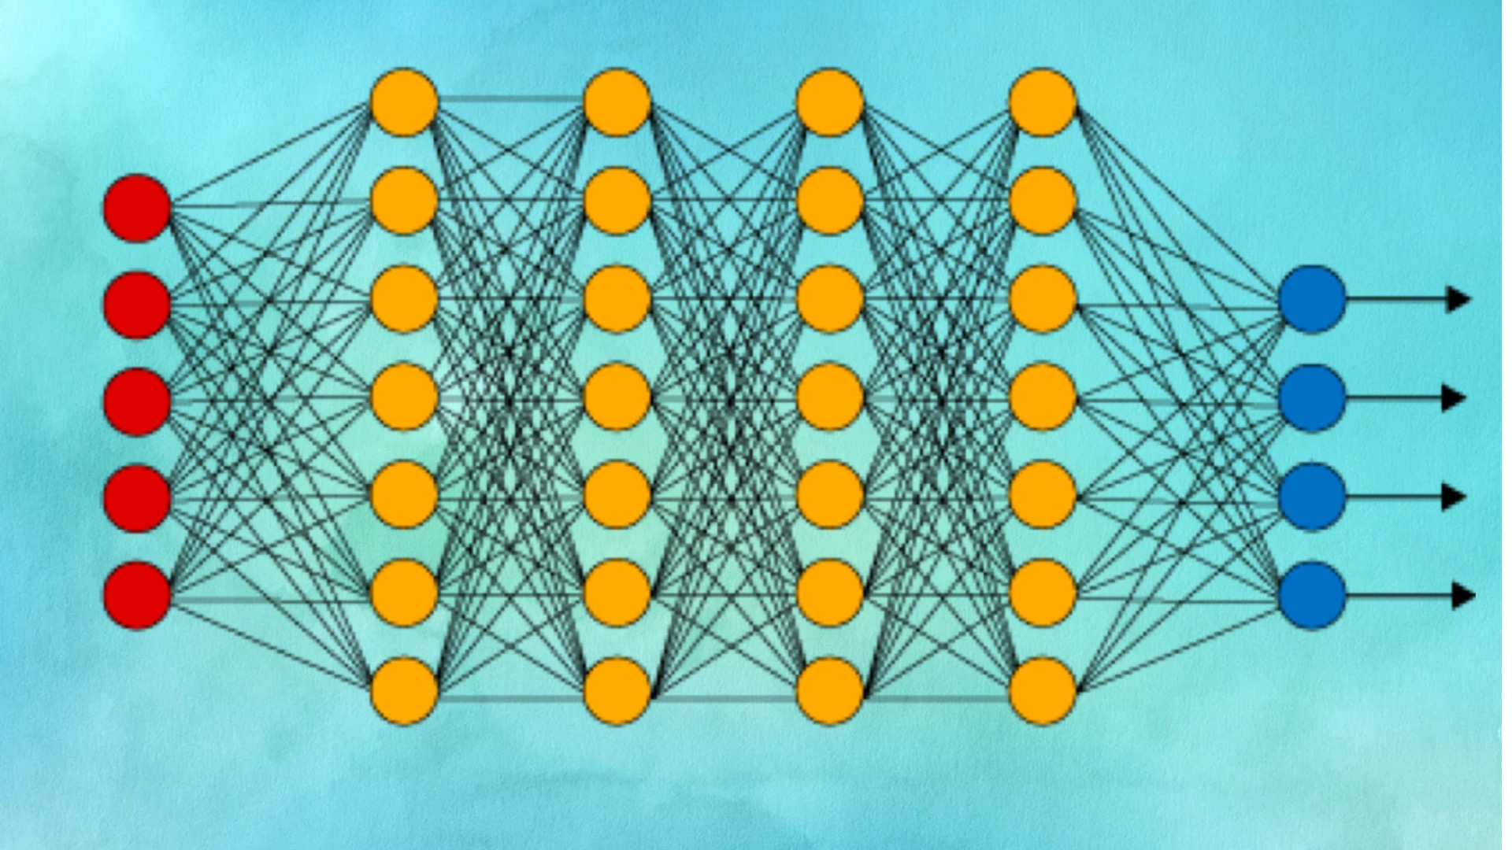
Deep Learning
Deep learning: A fast expanding dynamic frontier in machine learning
Deep learning has developed various neural network architectures
  Feed-forward neural networks
  Convolutional neural networks
  Recurrent neural networks
  Graph neural networks
  Transformer
Deep learning has broad applications in computer vision, natural language processing, machine translation, social network analysis, and so on
Deep learning has been reshaping a variety of data mining tasks
  Ex. classification, clustering, outlier detection, and reinforcement learning
Notes:
Deep Learning
A Fast Expanding Dynamic Frontier in Machine Learning
Definition: Deep learning is a subset of machine learning involving neural networks with many layers (hence "deep"). It is particularly powerful in learning from large amounts of data and capturing complex patterns.
Neural Network Architectures
Feed-Forward Neural Networks (FFNN): The simplest type of artificial neural network, where connections between nodes do not form cycles. It consists of an input layer, one or more hidden layers, and an output layer. Each neuron in one layer is connected to every neuron in the next layer.
Convolutional Neural Networks (CNN): Especially useful for processing grid-like data such as images. CNNs use convolutional layers that apply a set of filters to the input, capturing spatial hierarchies in data. Commonly used in image and video recognition.
Recurrent Neural Networks (RNN): Designed to recognize patterns in sequences of data. Unlike feed-forward networks, RNNs have connections that form cycles, allowing them to maintain a memory of previous inputs. This makes them suitable for tasks like language modeling and time series prediction.
Graph Neural Networks (GNN): Used for data structured as graphs. GNNs can model relationships and interactions between nodes (entities) and edges (connections) in a graph. Applications include social network analysis and molecular structure analysis.
Transformer: A type of neural network architecture that relies on self-attention mechanisms to process sequences of data. Transformers have revolutionized natural language processing (NLP) by enabling models like BERT and GPT, which are capable of understanding and generating human language with high accuracy.
Broad Applications
Computer Vision: Tasks such as image recognition, object detection, and segmentation.
Natural Language Processing (NLP): Applications include language translation, sentiment analysis, and text generation.
Machine Translation: Automatically translating text from one language to another.
Social Network Analysis: Understanding and extracting insights from social media and networks.
Others: Including speech recognition, autonomous driving, and more.
Reshaping Data Mining Tasks
Classification: Categorizing data into predefined classes.
Clustering: Grouping data into clusters of similar items.
Outlier Detection: Identifying unusual data points that differ significantly from the majority.
Reinforcement Learning: Training models to make a sequence of decisions by rewarding them for good decisions and penalizing them for bad ones.
Visual Representation
The image includes a neural network diagram with multiple layers (input layer, hidden layers, and output layer), illustrating the structure of a feed-forward neural network.
Summary
Deep learning has revolutionized many fields by enabling the creation of models that can learn from large amounts of data and make accurate predictions. The development of various neural network architectures has expanded the capabilities and applications of deep learning, making it a vital tool in modern data science and artificial intelligence.

Slide 12
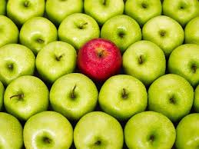
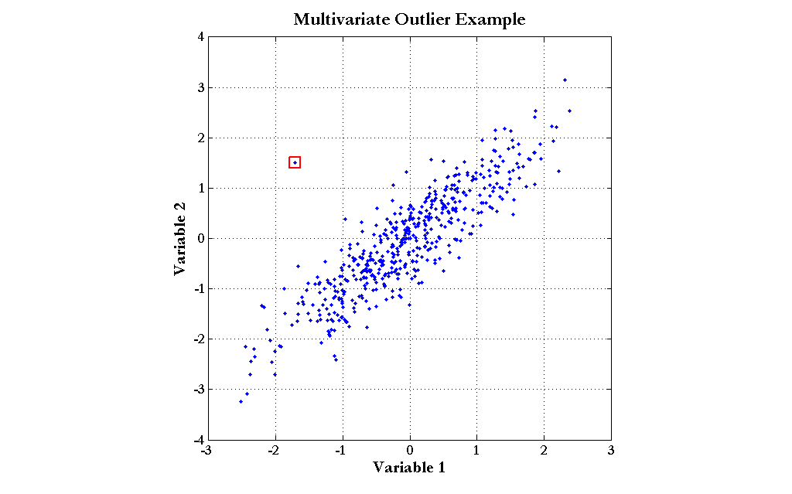
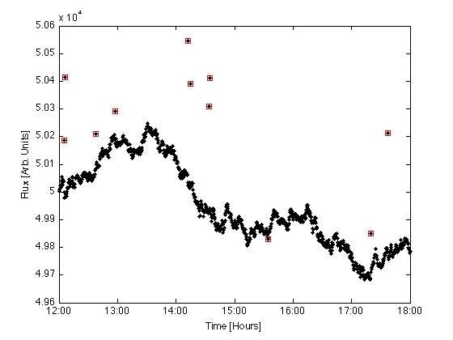
Outlier Analysis
Outlier analysis
  Outlier: A data object that does not comply with the general behavior of the data
  Noise or exception?―One person’s garbage could be another person’s treasure
  Methods: by product of clustering or regression analysis, …
  Useful in fraud detection, rare events analysis
Notes:
Outlier Analysis
Definition of an Outlier
Outlier: A data object that does not comply with the general behavior of the data. Outliers are significantly different from the majority of data points and can be identified through various statistical and machine learning methods.
Noise or Exception?
Noise vs. Exception: Determining whether an outlier is just noise (irrelevant data) or a significant exception (meaningful data) is crucial. The phrase "one person’s garbage could be another person’s treasure" emphasizes that outliers in some contexts may be valuable insights in others. For example, a transaction might look suspicious (an outlier) but could be a legitimate purchase by a high-spending customer.
Methods for Detecting Outliers
Byproduct of Clustering or Regression Analysis: Outliers can be detected as part of other analytical processes:
Clustering: In clustering, data points that do not fit well into any cluster can be considered outliers.
Regression Analysis: In regression analysis, data points that deviate significantly from the predicted values can be identified as outliers.
Specific Outlier Detection Techniques: Algorithms designed specifically for outlier detection, such as Isolation Forest, Local Outlier Factor (LOF), and Statistical Methods (e.g., Z-score, IQR).
Applications
Fraud Detection: Outlier analysis is widely used in detecting fraudulent activities. Unusual patterns in transactions, login attempts, or account activities can indicate potential fraud.
Rare Events Analysis: Identifying and analyzing rare events, such as network intrusions, equipment failures, or rare diseases, often involves detecting outliers.
Visual Representations
Apple Example: The image of a red apple among green apples visually represents an outlier. This highlights how outliers stand out from the majority.
Time Series Plot: The plot with red points above and below a time series indicates outliers in a time-based dataset, showing deviations from the expected trend.
Scatter Plot: The scatter plot with a single red square away from the dense blue points indicates a multivariate outlier, showing a data point that deviates significantly from the general pattern.
Summary
Outlier analysis is a critical tool in data mining and statistical analysis for identifying and understanding anomalies in data. It is applicable in various fields, such as fraud detection, quality control, and rare event detection, providing valuable insights that might be missed when focusing solely on the majority of data points. By distinguishing between noise and significant exceptions, outlier analysis helps in making informed decisions and improving data quality.

Slide 13
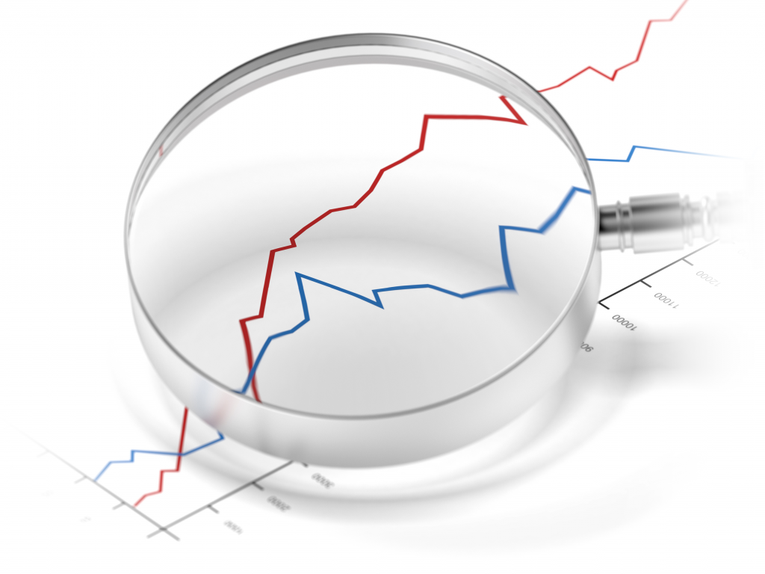
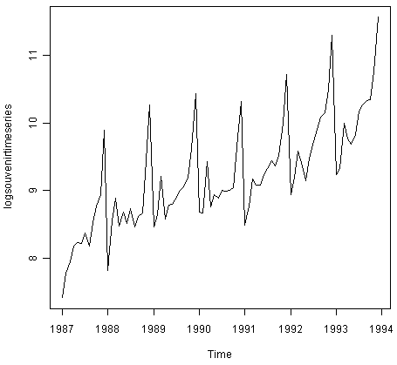
Other Data Mining Functions: Time and Ordering: Sequential Pattern, Trend and Evolution Analysis
Sequence, trend and evolution analysis
  Trend, time-series, and deviation analysis
    e.g., regression and value prediction
  Sequential pattern mining
    e.g., buy digital camera, then buy large memory cards
  Periodicity analysis
  Motifs and biological sequence analysis
    Approximate and consecutive motifs
  Similarity-based analysis
Mining data streams
  Ordered, time-varying, potentially infinite, data streams

Slide 14
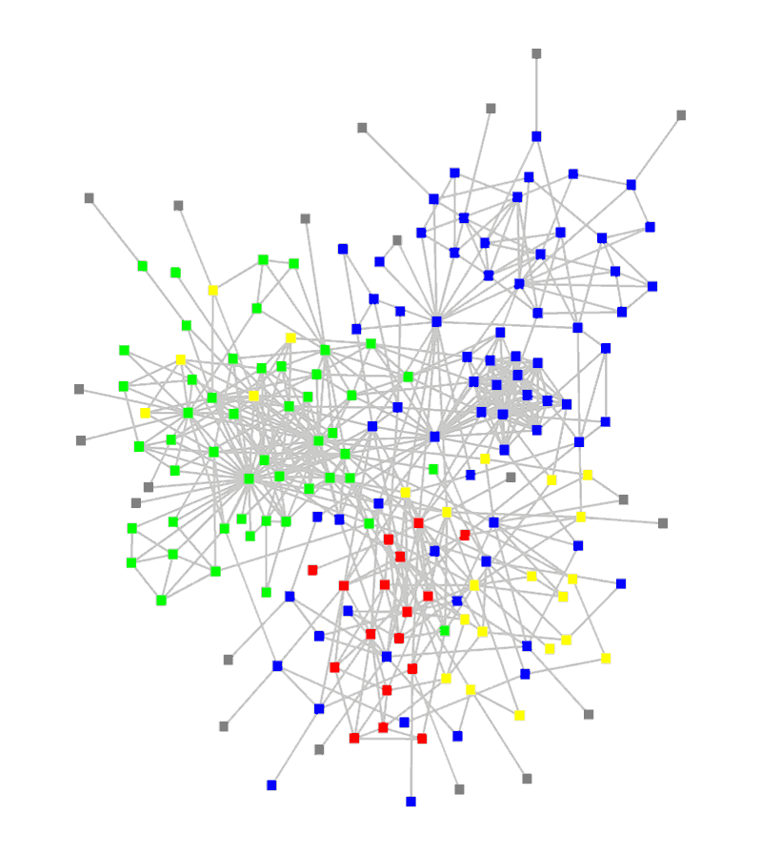
Other Data Mining Functions: Structure and Network Analysis
Graph mining
  Finding frequent subgraphs (e.g., chemical compounds), trees (XML), substructures (web fragments)
Information network analysis
  Social networks: actors (objects, nodes) and relationships (edges)
    e.g., author networks in CS, terrorist networks
  Multiple heterogeneous networks
    A person could be multiple information networks: friends, family, classmates, …
  Links carry a lot of semantic information: Link mining
Web mining
  Web is a big information network: from PageRank to Google
  Analysis of Web information networks
    Web community discovery, opinion mining, usage mining, …

Slide 15

Evaluation of Knowledge
Are all mined knowledge interesting?
  One can mine tremendous amount of “patterns”
  Some may fit only certain dimension space (time, location, …)
  Some may not be representative, may be transient, …
Evaluation of mined knowledge → directly mining only interesting knowledge?
  Descriptive vs. predictive
  Coverage
  Typicality vs. novelty
  Accuracy
  Timeliness
  …

Slide 16
Data Mining: Confluence of Multiple Disciplines

Slide 17
Why Confluence of Multiple Disciplines?
Tremendous amount of data
  Algorithms must be scalable to handle big data
High-dimensionality of data
  Micro-array may have tens of thousands of dimensions
High complexity of data
  Data streams and sensor data
  Time-series data, temporal data, sequence data
  Structure data, graphs, social and information networks
  Spatial, spatiotemporal, multimedia, text and Web data
  Software programs, scientific simulations
New and sophisticated applications
Notes:
Add a definition/description of “traditional data analysis”.

Slide 18

Data Mining and Applications
Web page analysis: classification, clustering, ranking
Collaborative analysis & recommender systems
Basket data analysis to targeted marketing
Biological and medical data analysis
Data mining and software engineering
Data mining and text analysis
Data mining and social and information network analysis
Built-in (invisible data mining) functions in Google, Microsoft, LinkedIn, Meta, …
Major dedicated data mining systems/tools
  SAS, MS SQL-Server Analysis Manager, Oracle Data Mining Tools)

Slide 19
Data Mining and Society
Data mining technology may benefit society
  Ex.: Help scientific discovery, business management, economy recovery, and security protection (e.g., the real-time discovery of intruders and cyberattacks)
Need to guard against the misuse of data mining
  Data mining also poses the risk of unintentionally disclosing some confidential business or government information and disclosing an individual’s personal information
Studies on data security in data mining and privacy-preserving data publishing and data mining are important, ongoing research theme
  The philosophy is to observe data sensitivity and preserve data security and people’s privacy while performing successful data mining
These and other related issues will be discussed throughout the book

Slide 20
Summary
Data mining: Discovering interesting patterns and knowledge from massive amounts of data
A KDD process includes data cleaning, data integration, data selection, transformation, data mining, pattern evaluation, and knowledge presentation
Different data mining method on a wide variety of data
Data mining functionalities: summarization, pattern discovery, classification, clustering, deep learning, outlier analysis, trend and outlier analysis, …
Data mining is a confluence of multiple disciplines
Data mining has broad applications
Promote secure data mining to benefit society

