Slide 1
Electric Circuits
AP Physics B

Slide 2
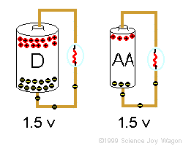
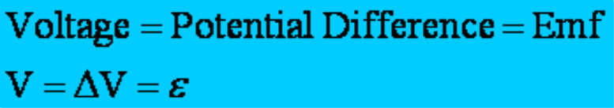
Potential Difference =Voltage=EMF
In a battery, a series of chemical reactions occur in which electrons are transferred from one terminal to another. There is a potential difference (voltage) between these poles.
The maximum potential difference a power source can have is called the electromotive force or (EMF), ε. The term isn't actually a force, simply the amount of energy per charge (J/C or V)

Slide 3
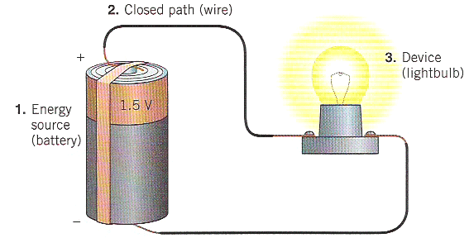
A Basic Circuit
All electric circuits have three main parts
A source of energy
A closed path
A device which uses the energy
If ANY part of the circuit is open the device will not work!

Slide 4
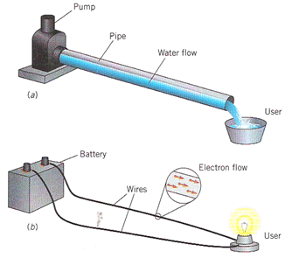
Electricity can be symbolic of Fluids
Circuits are very similar to water flowing through a pipe
A pump basically works on TWO IMPORTANT PRINCIPLES concerning its flow
There is a PRESSURE DIFFERENCE where the flow begins and ends
A certain AMOUNT of flow passes each SECOND.
A circuit basically works on TWO IMPORTANT PRINCIPLES
There is a "POTENTIAL DIFFERENCE aka VOLTAGE" from where the charge begins to where it ends
The AMOUNT of CHARGE that flows PER SECOND is called CURRENT.

Slide 5
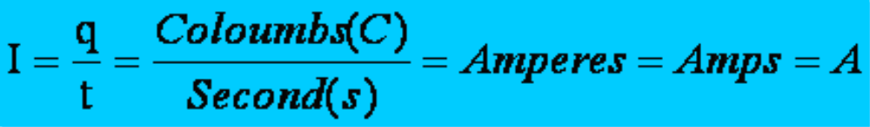
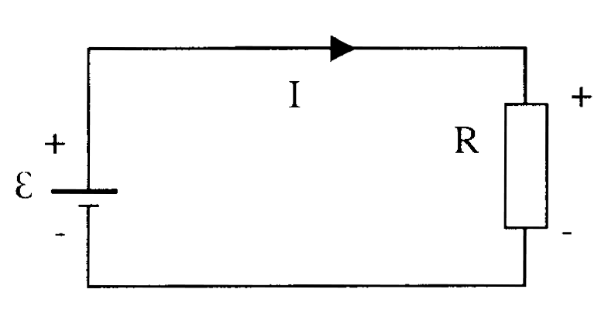
Current
Current is defined as the rate at which charge flows through a surface.
The current is in the same direction as the flow of positive charge (for this course)
Note: The “I” stands
for intensity

Slide 6
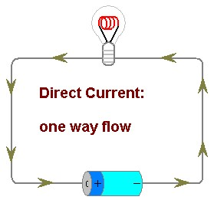
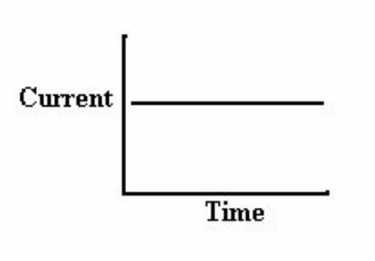
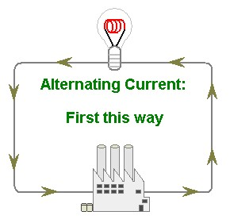
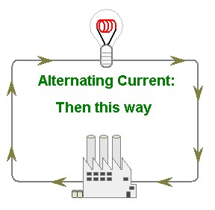
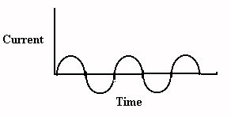
There are 2 types of Current
DC = Direct Current - current flows in one direction
Example: Battery
AC = Alternating Current- current reverses direction many times per second. This suggests that AC devices turn OFF and
ON. Example: Wall outlet (progress energy)

Slide 7
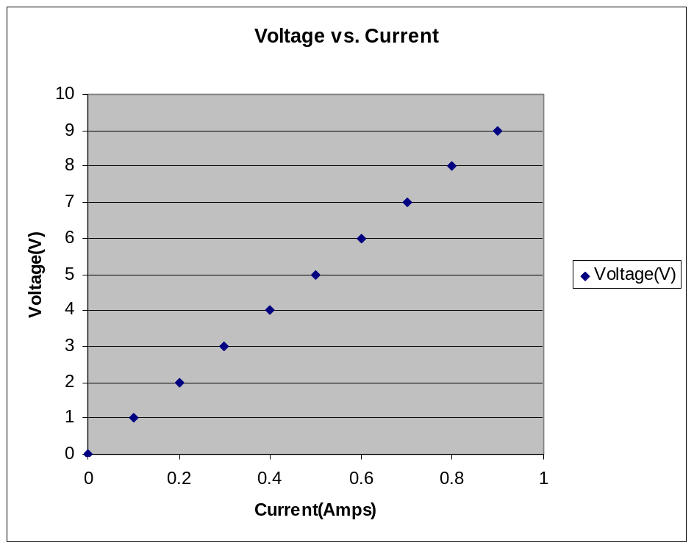
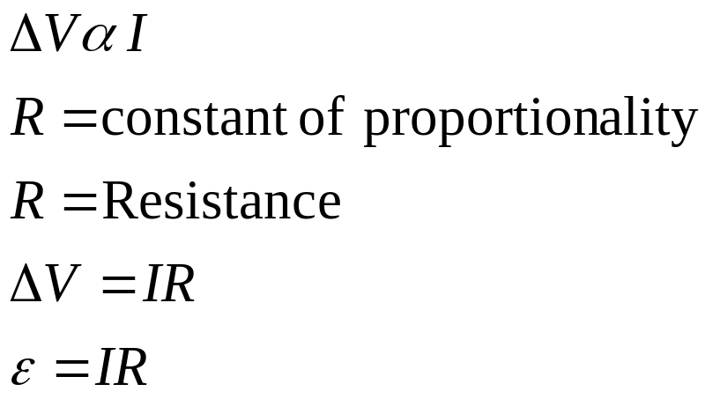
Ohm’s Law
“The voltage (potential difference, emf) is directly related to the current, when the resistance is constant”
R= resistance = slope
Since R=ΔV/I, the resistance is the SLOPE of a ΔV vs. I graph

Slide 8
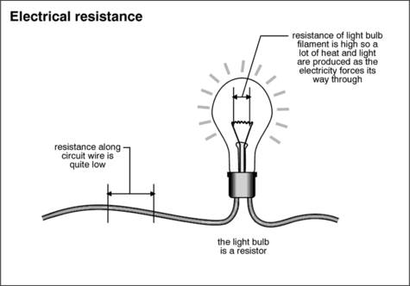
Resistance
Resistance (R) – is defined as the restriction of electron flow. It is due to interactions that occur at the atomic scale. For example, as electron move through a conductor they are attracted to the protons on the nucleus of the conductor itself. This attraction doesn’t stop the electrons, just slow them down a bit and cause the system to waste energy.
The unit for resistance is the OHM, Ω

Slide 9
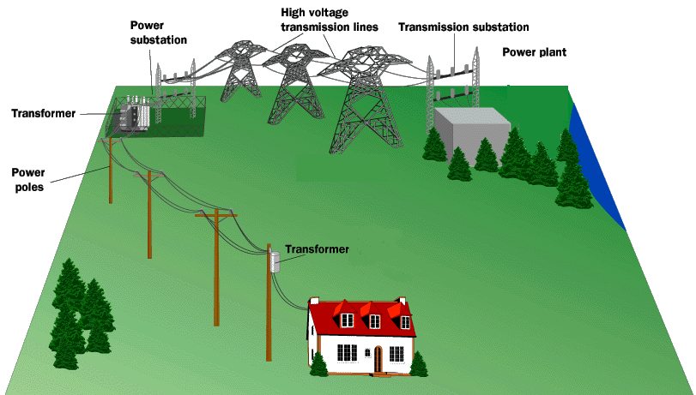
Electrical POWER
We have already learned that POWER is the rate at which work (energy) is done. Circuits that are a prime example of this as batteries only last for a certain amount of time AND we get charged an energy bill each month based on the amount of energy we used over the course of a month…aka POWER.

Slide 10
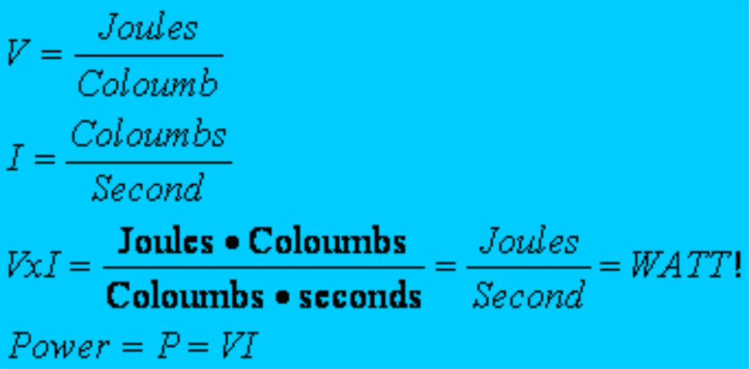
POWER
It is interesting to see how certain electrical variables can be used to get POWER. Let’s take Voltage and Current for example.

Slide 11
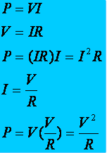
Other useful power formulas
These formulas can also be used! They are simply derivations of the POWER formula with different versions of Ohm's law substituted in.

Slide 12
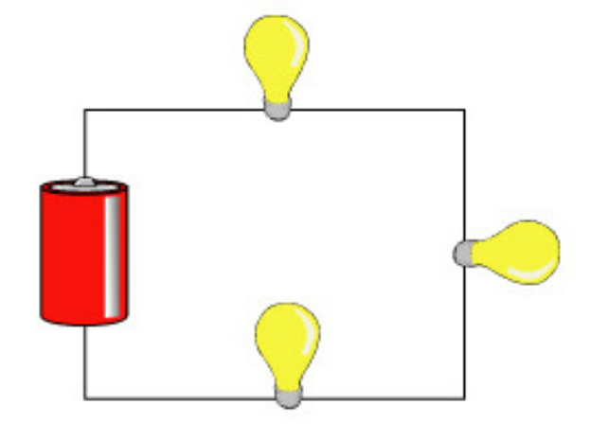
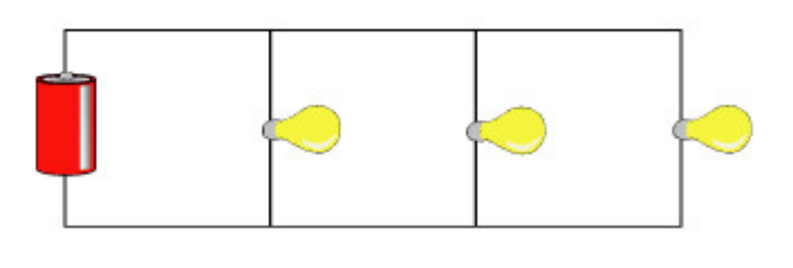
Ways to Wire Circuits
There are 2 basic ways to wire a circuit. Keep in mind that a resistor could be ANYTHING ( bulb, toaster, ceramic material…etc)
Series – One after another
Parallel – between a set of junctions and parallel to each other

Slide 13
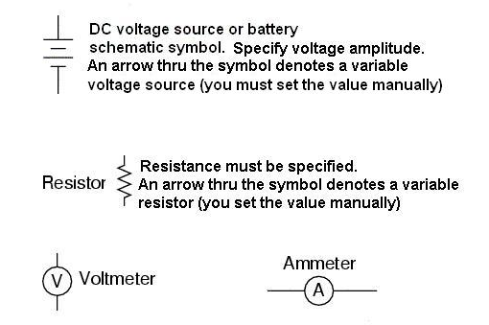
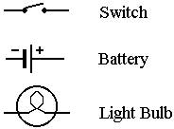
Schematic Symbols
Before you begin to understand circuits you need to be able to draw what they look like using a set of standard symbols understood anywhere in the world
For the battery symbol, the LONG line is considered to be the POSITIVE terminal and the SHORT line , NEGATIVE.
The VOLTMETER and AMMETER are special devices you place IN or AROUND the circuit to measure the VOLTAGE and CURRENT.

Slide 14

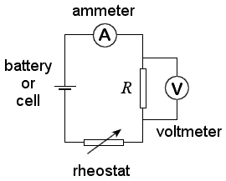
The Voltmeter and Ammeter
The voltmeter and ammeter cannot be just placed anywhere in the circuit. They must be used according to their DEFINITION.
Current goes THROUGH the ammeter
Since a voltmeter measures voltage or POTENTIAL DIFFERENCE it must be placed ACROSS the device you want to measure. That way you can measure the CHANGE on either side of the device.
Voltmeter is drawn ACROSS the resistor
Since the ammeter measures the current or FLOW it must be placed in such a way as the charges go THROUGH the device.

Slide 15
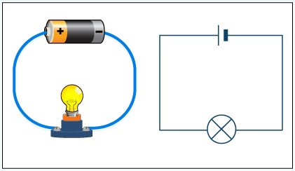
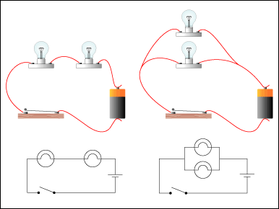
Simple Circuit
When you are drawing a circuit it may be a wise thing to start by drawing the battery first, then follow along the loop (closed) starting with positive and drawing what you see.

Slide 16

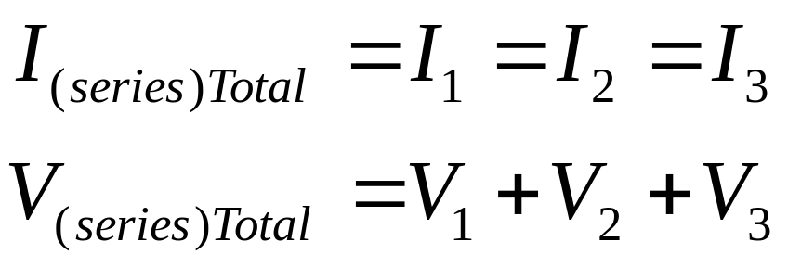
Series Circuit
In in series circuit, the resistors are wired one after another. Since they are all part of the SAME LOOP they each experience the SAME AMOUNT of current. In figure, however, you see that they all exist BETWEEN the terminals of the battery, meaning they SHARE the potential (voltage).

Slide 17
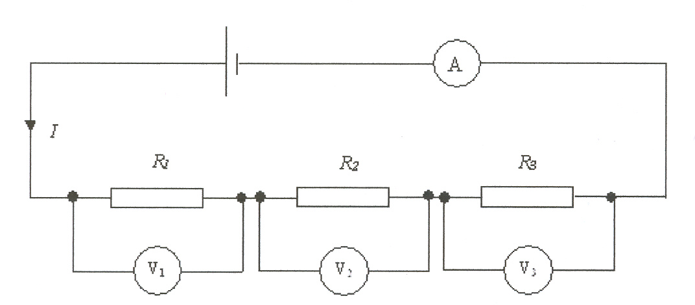
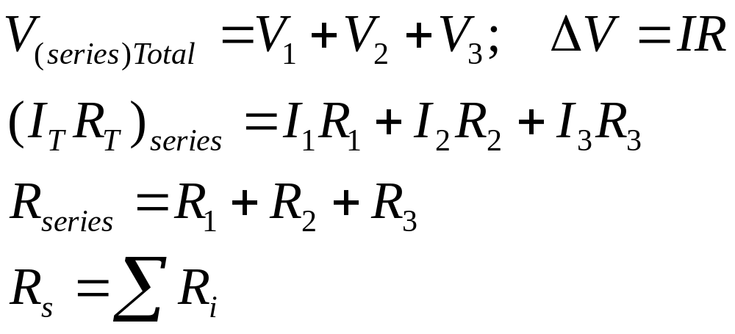
Series Circuit
As the current goes through the circuit, the charges must USE ENERGY to get through the resistor. So each individual resistor will get its own individual potential voltage). We call this VOLTAGE DROP.
Note: They may use the terms “effective” or “equivalent” to mean TOTAL!

Slide 18
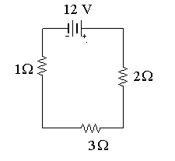
Example
A series circuit is shown to the left.
What is the total resistance?
What is the total current?
What is the current across EACH resistor?
What is the voltage drop across each resistor?( Apply Ohm's law to each resistor separately)
R(series) = 1 + 2 + 3 = 6Ω
ΔV=IR 12=I(6) I = 2A
They EACH get 2 amps!
V_{1Ω}=(2)(1)= 2 V V_{3Ω}=(2)(3)= 6V V_{2Ω}=(2)(2)= 4V
Notice that the individual VOLTAGE DROPS add up to the TOTAL!!

Slide 19
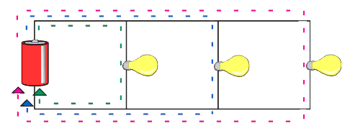
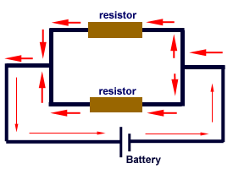
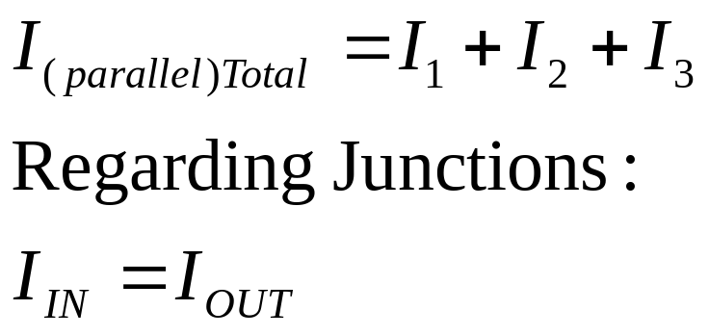
Parallel Circuit
In a parallel circuit, we have multiple loops. So the current splits up among the loops with the individual loop currents adding to the total current
It is important to understand that parallel circuits will all have some position where the current splits and comes back together. We call these JUNCTIONS.
The current going IN to a junction will always equal the current going OUT of a junction.
Junctions

Slide 20
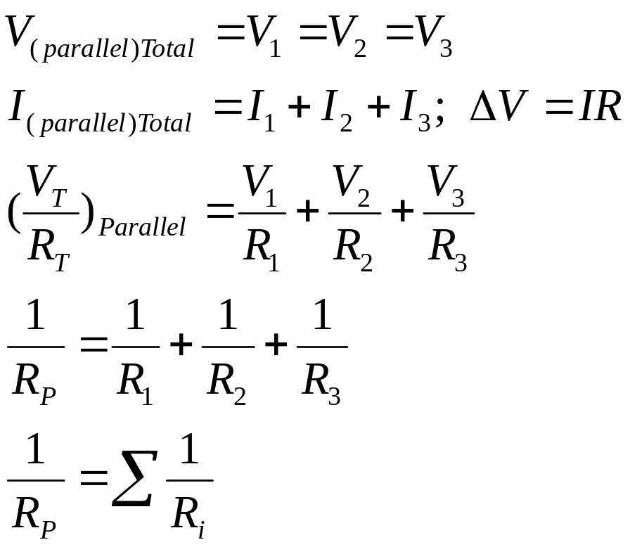
Parallel Circuit
Notice that the JUNCTIONS both touch the POSTIVE and NEGATIVE terminals of the battery. That means you have the SAME potential difference down EACH individual branch of the parallel circuit. This means that the individual voltages drops are equal.
ΔV
This junction touches the POSITIVE terminal
This junction touches the NEGATIVE terminal

Slide 21
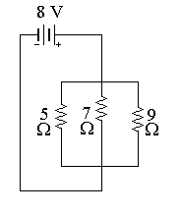
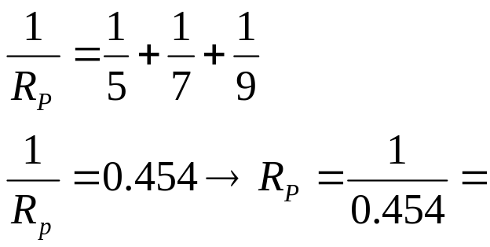
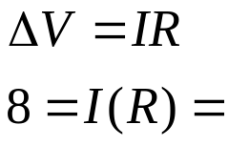
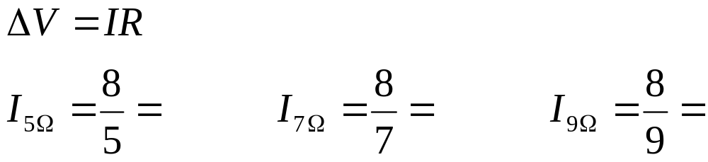
Example
To the left is an example of a parallel circuit.
a) What is the total resistance?
b) What is the total current?
c) What is the voltage across EACH resistor?
d) What is the current drop across each resistor? (Apply Ohm's law to each resistor separately)
2.20 Ω
3.64 A
8 V each!
Notice that the individual currents ADD to the total.
1.6 A
1.14 A
0.90 A

Slide 22
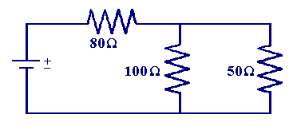
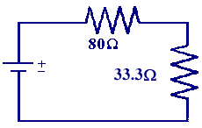
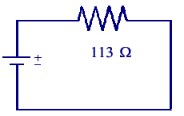
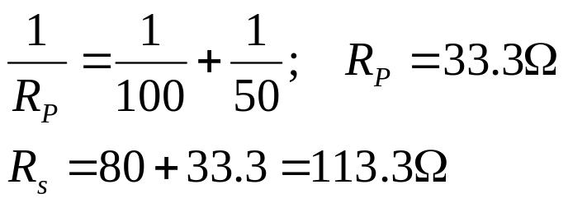
Compound (Complex) Circuits
Many times you will have series and parallel in the SAME circuit.
Solve this type of circuit from the inside out.
WHAT IS THE TOTAL RESISTANCE?

Slide 23
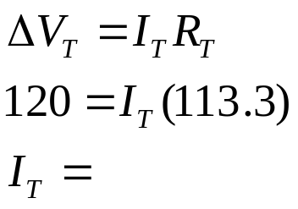
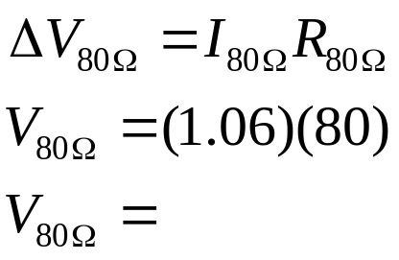
Compound (Complex) Circuits
Suppose the potential difference (voltage) is equal to 120V. What is the total current?
1.06 A
What is the VOLTAGE DROP across the 80Ω resistor?
84.8 V

Slide 24
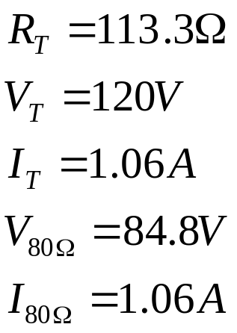
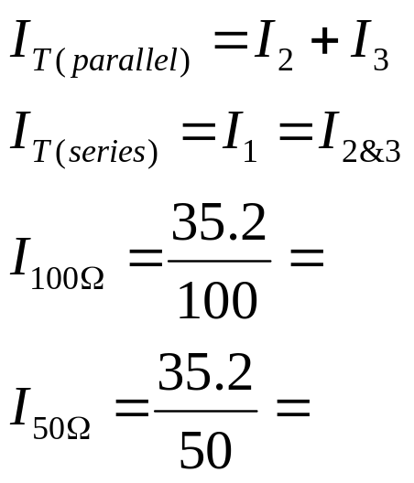
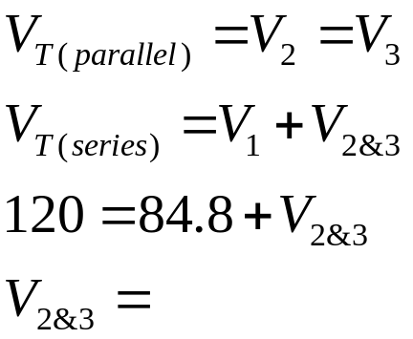
Compound (Complex) Circuits
What is the current across the 100Ω and 50Ω resistor?
What is the VOLTAGE DROP across the 100Ω and 50Ω resistor?
0.352 A
Add to 1.06A
35.2 V Each!
0.704 A

