Slide 1
CPE220 Electric Circuit Analysis
Chapter 4:
Circuit Theorems

Slide 2
Chapter 4
4.1
Linear and Superposition
To handle complex circuits, many circuit theorems have been developed to simplify circuit analysis. Most theorems are applicable to linear circuits. Hence, we will first discuss the concept of circuit linearity. Then, we will discuss some useful circuit theorems such as superposition, source transformation, Thévenin's and Norton's theorems, and maximum power transfer.
A linear element
An element having a linear voltage-current relationship.
A linear dependent source
A voltage/current source whose value is a linear combination of voltages or currents in other branches.

Slide 3
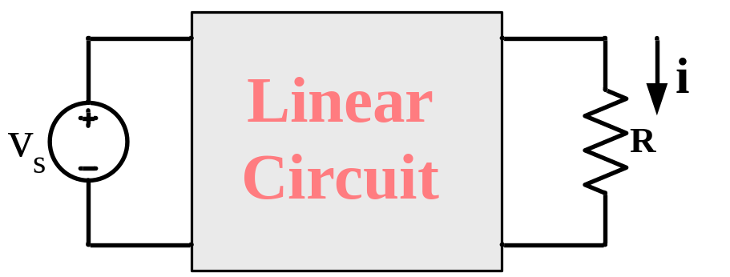
For example, a linear resistor is characterized by Ohm's law:
v = Ri or i = Gv
where R and G are constant.
A circuit having both the homogeneity (scaling) property and the additivity property is defined as a linear circuit.
Figure 4.1
A linear circuit with input v_{s} and output i.
Fig. 4.1 illustrates a linear circuit having the input (also called the excitation) v_{s} and the output (also called the response) i.

Slide 4
For a resistor, for example, if the current is increased by a constant k, then the voltage increases by the same amount k. That is,
Scaling Property
kv = k(iR).
(4.1)
The additivity property is a property that the response to a sum of inputs is the sum of the responses to each input applied separately.
Additivity Property

Slide 5
For the linear resistor, if the response v₁ to the input current i₁ is defined as:
v₁ = i₁R
(4.2)
and the response v₂ to the input current i₂ is defined as:
v₂ = i₂R
(4.3)
Then applying (i₁ + i₂) will give
v = (i₁+i₂)R = i₁R + i₂R = v₁ + v₂
(4.4)
In general, a circuit is linear if it is both homogeneous and additive.
a circuit composed entirely of independent sources, linear dependent sources, and linear elements.

Slide 6
Superposition
The superposition principle states that the voltage across (or current through) an element in a linear circuit is the algebraic sum of the voltages across (or currents through) that element due to each independent source acting alone.
Basic Procedure for Apply Superposition Principle:
1. Zero out (deactivate, “kill”) all independent sources except one source. Determine the output (voltage or current) due to that active source.
2. Repeat step 1 for each of the other independent sources.

Slide 7
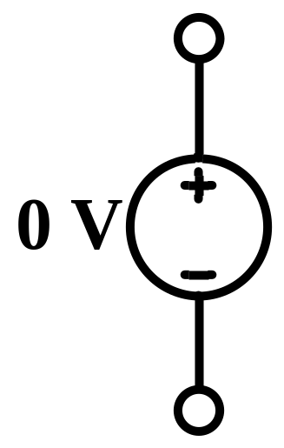

3. Determine the total voltage (or current) by adding algebraically all the voltage (or current) due to the independent sources.
Zeroed out (deactivated) independent voltage source
Reduce a voltage source to zero volts.
No voltage drop across terminals, but current still can flow through
i
i
That is, a voltage source set to zero acts like a short circuit.

Slide 8
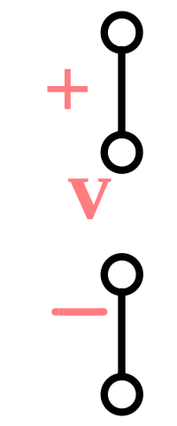
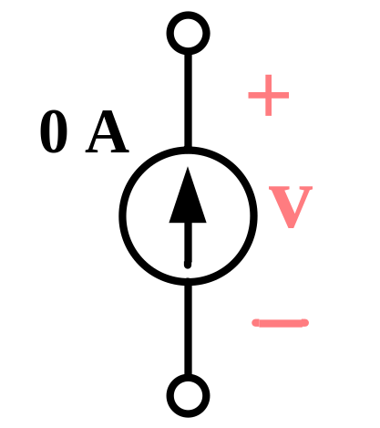
Zeroed out (deactivated) independent current source
Reduce a current source to zero amps.
No current flows, but there is voltage across the terminals.
That is, a current source set to zero acts like an open circuit.
The superposition principle is based on linearity. Hence, it is not applicable to the effect on power due to each source because the power absorbed by a resistor depends on the square of the voltage or current.

Slide 9
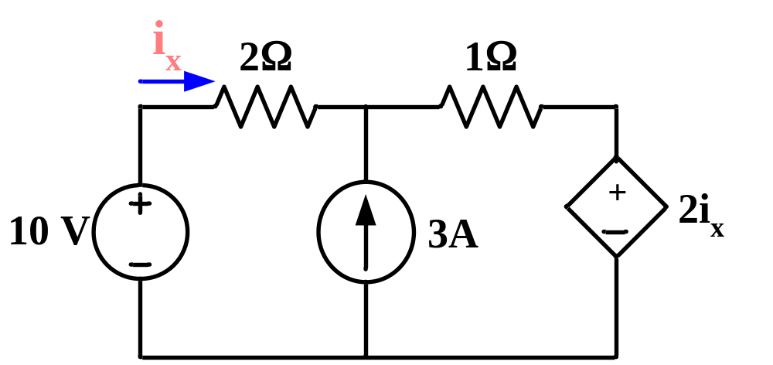
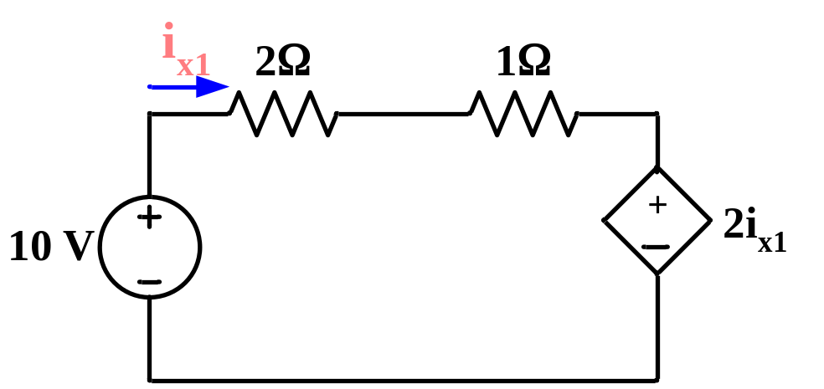
Example 4.1
For the given circuit, determine the value of i_{x} using the superposition principle.
Solution:
Deactivate the current source 3A by open circuit:

Slide 10
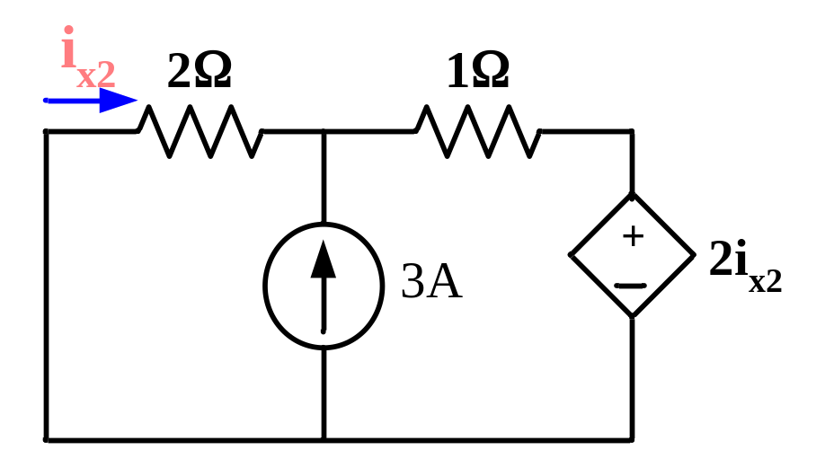
KVL in loop:
2i_{x1} + i_{x1} + 2i_{x1} = 10
i_{x1} = 2
Deactivate the voltage source 10V by short circuit:
+
v
-
KCL @ the top node:
v - 2i_{x2}
v
+
= 3
(1)
1
2

Slide 11
Since the voltage across the resistor 2Ω equal to v (the voltage across the current source). That is,
v = 2(-i_{x2})
(2)
Substitute Eq. 2 into Eq. 1, we get
i_{x2} = -0.6 A.
Hence, the total current i_{x} equal to
i_{x} = i_{x1} + i_{x2} = 1.4 A.
Ans.

Slide 12
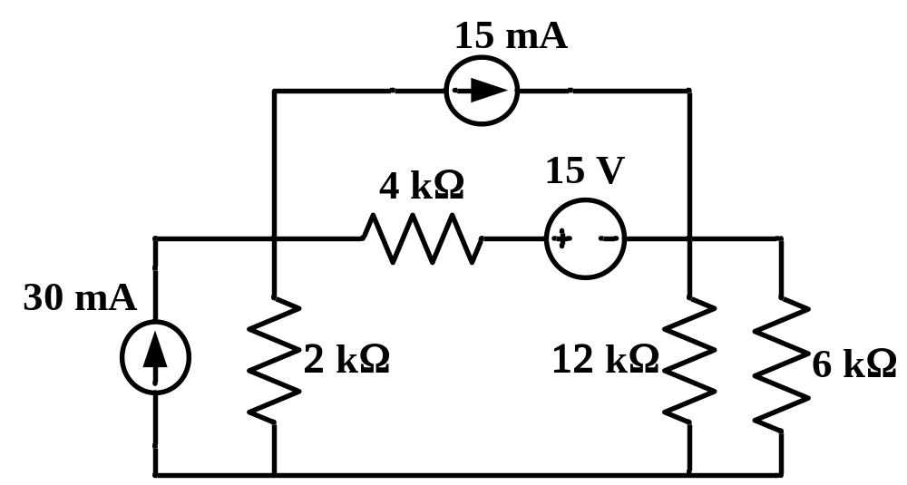
Example4.2
Determine the current "i" flowing through the 12 kΩ resistor in the following circuit.
i
Solution:
Source 30 mA. acting alone
12 kΩ || 6kΩ
4 kΩ

Slide 13
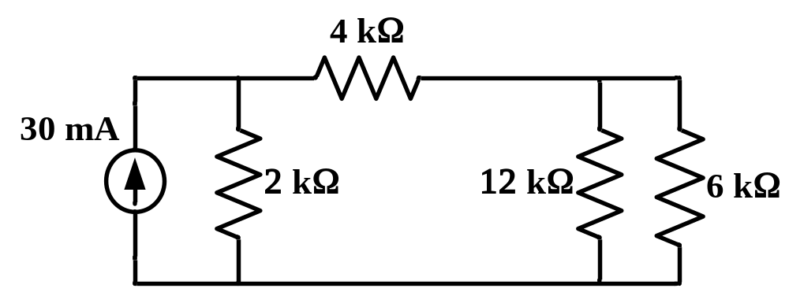
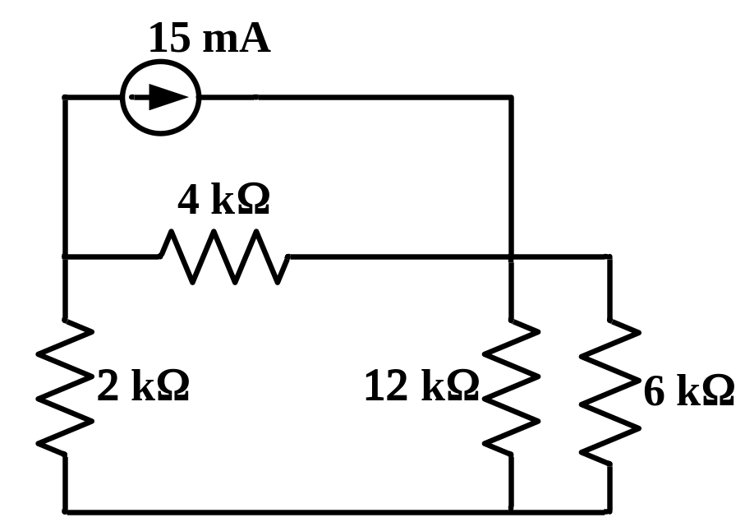
i₁
i₁ = ((2*30)/10)*6/18 = 2 mA
Source 15 mA. acting alone
i₂
i₂ = ((4*15)/10)*6/18 = 2 mA

Slide 14
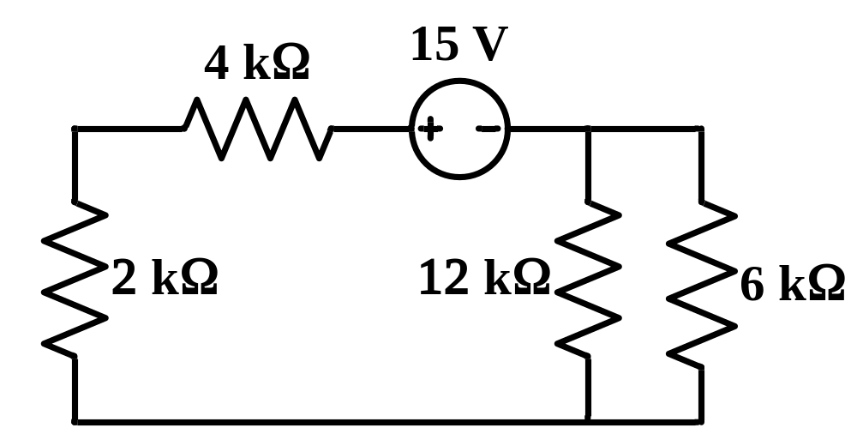
Source 15 V. acting alone
i₃
i₃ = -(15/10)*6/18 = -0.5 mA
i = i₁ + i₂ + i₃ = 2 + 2 - 0.5 = 3.5 mA
Ans.

Slide 15
4.2
Source Transformations
4.2.1 Practical Voltage Sources
A practical voltage source is an ideal voltage source "v_{s}" having a series internal resistor R_{s} as shown in Fig. 4.2.
R_{s}
i_{L}
+
v_{L}
–
v_{s}
+
–
load
R_{L}
Practical Voltage Source
Figure 4.2
A model of practical voltage source which is an ideal voltage source connecting in series with a resistor R_{s}.

Slide 16
From KVL, the terminal voltage “v_{L}” is expressed as:
v_{L} = v_{s} - R_{s}i_{L}
(4.5)
Practically, the very small value of R_{s} is desirable, so that v_{L} is then approximately v_{s}. The plot of Eq. 4.5, called a "load-line", is shown in Fig. 4.3 which is a linear relationship.
When the value of R_{L} is very large (R_{L} = ∞), there is no current flowing through R_{L}. That is, i_{L} = 0. Hence the internal source " v_{s}" is also the external open-circuit voltage (v_{Loc}) or
v_{Loc} = v_{s}, when i_{L} = 0.
(4.6)

Slide 17
i_{L}
i_{Lsc} =
v_{s}
Ideal Source
R_{s}
Practical Source
0
v_{L}
v_{Loc} = v_{s}
Figure 4.3
The I-V relationship of a load R_{L} connected to the practical voltage source v_{s}.
On the other hand, when the value of R_{L} is very small (R_{L} = 0), there is no voltage across R_{L}. That is, v_{L} = 0. Hence the short-circuit current (i_{Lsc}) is expressed as:
v_{s}
i_{Lsc} =
when v_{L} = 0.
(4.7)
R_{s}

Slide 18
Examples of practical voltage sources are automobile battery, battery-operated tools, electronics, etc. With continued operation, the battery "runs down", and its internal resistance increases. Hence, the internal voltage drop increases and the terminal voltage "v" decreases.
4.2.2 Practical Current Sources
A practical current source is an ideal current source "i_{s}" having a parallel internal resistor R_{p} as shown in Fig. 4.4.
From KCL, the load current “i_{L}” is expressed as:
v_{L}
i_{L} = i_{s} -
(4.8)
R_{p}

Slide 19
i_{L}
+
v_{L}
–
i_{s}
R_{p}
load
R_{L}
Practical Current Source
Figure 4.4
A model of practical current source which is an ideal current source connecting parallel with a resistor R_{p}.
Practically, the very large value of R_{p} is desirable, so that i_{L} is then approximately i_{s}. The plot of Eq. 4.8, called a "load-line", is shown in Fig. 4.5 which is again a linear relationship.

Slide 20
i_{L}
Ideal Source
i_{Lsc} = i_{s}
Practical Source
0
v_{L}
v_{Loc} = R_{p}i_{s}
Figure 4.5
The I-V relationship of a load R_{L} connected to the practical current source i_{s}.
Similarly, the external open-circuit voltage (v_{Loc}) and the short-circuit current (i_{Lsc}) are expressed as following:
v_{Loc} = R_{p}i_{s}, when i_{L} = 0.
(4.9)
and

Slide 21
i_{Lsc} = i_{s}
when v_{L} = 0.
(4.10)
4.2.3 Equivalent Practical Sources
Two sources are said to be equivalent if they produce the same values of v_{L} and i_{L} or identical terminal voltages.
R_{s}
i_{L}
i_{L}
v_{s}
+
v_{L1}
–
load
i_{s}
+
v_{L2}
–
load
+
–
R_{p}
(a)
(b)
Figure 4.6
A practical voltage source (a) and a practical current source (b).
From Fig. 4.6, the terminal voltages v_{L} from both circuits can be determined as:

Slide 22
For the practical voltage source (Fig. 4.6a),
v_{L1} = v_{s} - R_{s}i_{L}
(4.11)
For the practical current source (Fig. 4.6b),
v_{L2} = R_{p}(i_{s} - i_{L})
(4.12)
v_{L1} will equal v_{L2} if and only if
v_{s} = R_{p} i_{s}
R_{s} = R_{p}
(4.13)
Notes
1. “Equivalent” means looking back toward the ideal source from the external terminals.

Slide 23
2. The current i_{L} is the same for both circuits. However, the current through R_{s} and the current through R_{p} are not the same!
3. The most common mistake made in applying source transformation is not observing the correct polarity of the two sources for equivalence. The polarity of the voltage source v_{s} in one form must be such that it tends to make the current flowing in the direction of the current i_{L} is in the other form as shown in Fig. 4.7.
6 Ω
3 V
–
+
≡
1/2 A
6 Ω
(a) Transforming voltage source to current source.

Slide 24
2 Ω
≡
8 A
2 Ω
16 V
+
–
(b) Transforming current source to voltage source.
Figure 4.7
Transformation of independent sources.
From Fig. 4.7 the head of the current source arrow corresponds to the “+” terminal of the voltage source.
4. The primary use of this transformation is to convert a circuit a single-loop circuit or a single-node-pair circuit when no such circuit existed before the transformation.

Slide 25
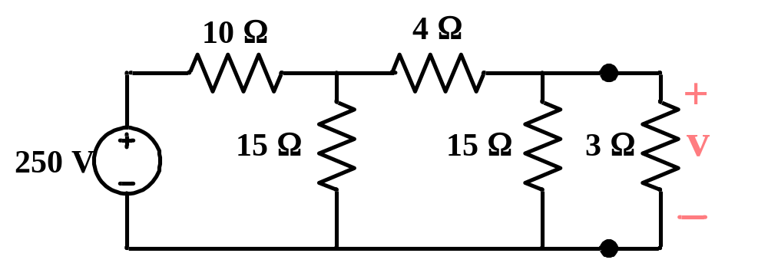
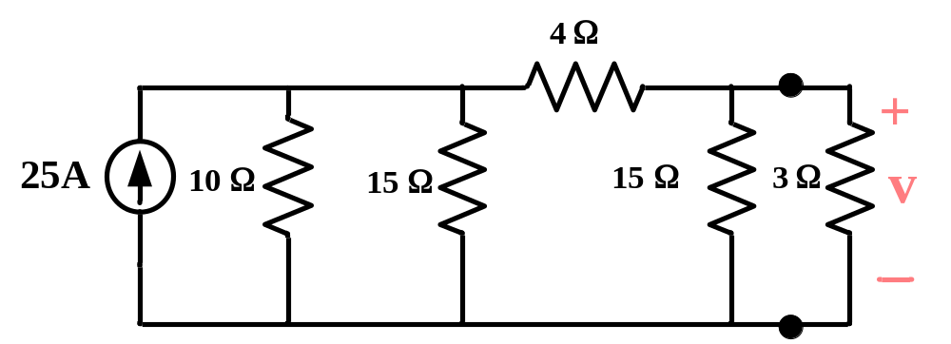
Example4.3
Determine the voltage ”v" in the following circuit using source transformation.
Solution:
Using source transformation, the above circuit can be simplified as following:
Step 1: Transform 250V-voltage source in series with 10 Ω to current source

Slide 26
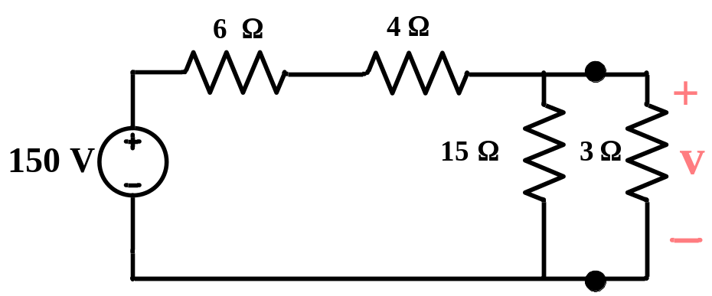
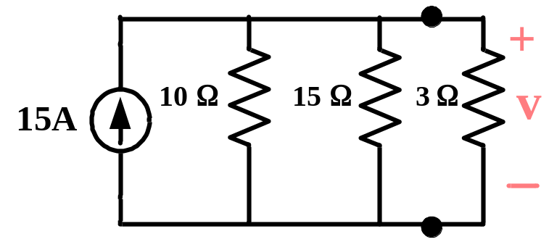
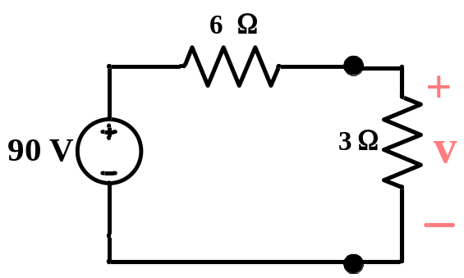
Step 2: Transform 25A-current source in parallel with 10 Ω and 15 Ω to voltage source
Step 3: Transform 150V-voltage source in series with 6 Ω and 4 Ω to current source
Step 4: Transform 15A-current source in parallel with 10 Ω and 15 Ω to voltage source
v = 90*3/9
= 30 V.
Ans.

Slide 27
Audio Amplifier
A simple amplifier designed to increase the magnitude of the voltage from a microphone and apply it to a speaker is shown. The corresponding model is also shown.
i_{b}
i_{Speaker}
10 Ω
v_{s}
R_{L}=8 Ω
+
–
Microphone
Speaker
10 Ω
i_{b}
+
v_{speaker}
_
sinωt mV
+
–
100 i_{b}
250 Ω
8 Ω
From the model we obtain
1sinωt mV
i_{b} =
= 3.846 sinωt μA
10Ω + 250Ω

Slide 28
This is the controlling variable for the controlled source, and the speaker current is
i_{speaker} = -100ib = -100*3.846 sinωt μA
= -0.3846sinωt mA
Hence the voltage across the speaker terminals is
v_{speaker} = 8Ω * i_{speaker} = -3.077sinωt mV
We may say that the amplifier provides a voltage gain of 3.077mV / 1 mV = 3.077. More elaborate amplifers giving much larger voltage gains are designed in electronics courses, but they also use the basic controlled-source model of the transistor as well as the circuit analysis principles we are studying. Only the complexity of the circuit model changes.

Slide 29
-3
4
x 10
3
v_{speaker}
2
v_{s}
1
0
-1
-2
-3
-4
0
2
4
6
8
10
Figure 4.8
Plots of v_{s} and v_{speaker}.
4.3
Thévenin and Norton
Equivalent Circuits
It is quite often in practice that an electrical circuit has only one particular variable element while others are fixed. As a typical example, a household outlet terminal may be connected to different appliances

Slide 30
constituting a variable load. For this situation, the entire circuit will be analyzed all over again each time this variable element is changed. To avoid this problem, Thévenin or Norton theorem can be used to split the original circuit into two parts connected to each other via terminal "a-b" as shown in Fig. 4.9(b).
Original
Circuit
(a)
i
a
Linear two-terminal circuit
+
Linear
or
Nonlinear
v
_
b
Network A
Network B
(b)

Slide 31



i
a
+
v
Load
_
b
Network A
Network B
(c)
Figure 4.9
(a) The original circuit. (b) and (c) The circuit in (a) is split into two parts.
The circuit in Fig. 4.9(b) consists of two networks, A and B, connected to each other via the terminal "a-b". In general network"B" is the load and may be linear or nonlinear circuit. Network" A", however, is usually a linear two-terminal circuit of the original circuit exclusive of the load. Hence, network" A" may contain independent sources, dependent sources

Slide 32
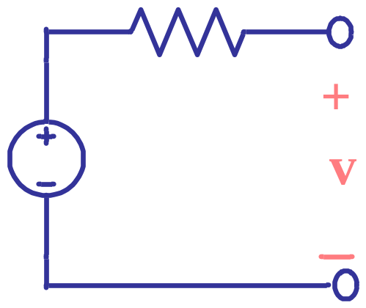
and resistors,or any other linear element. However, it requires that no dependent sources in "A" is controlled by a voltage or current in "B", and vice versa.
Such the linear two-terminal circuit in Fig. 4.9 can be replaced by either Thévenin or Norton equivalent circuit as shown in Fig. 4.10.
R_{Th}
a
V_{Th}
Load
b
Network A
Network B
(a)

Slide 33
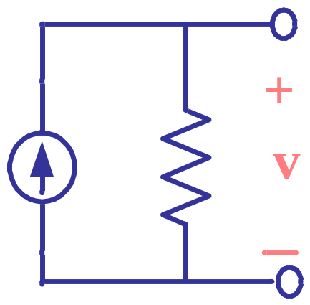
a
I_{N}
R_{N}
Load
b
Network A
Network B
(b)
Figure 4.10
(a) Thévenin equivalent circuit. (b) Norton equivalent circuit.
Thévenin's theorem states that
A linear two-terminal circuit can be replaced by an equivalent circuit consisting of a voltage source V_{Th} in series with a resistor R_{Th}, where V_{Th} is

Slide 34
the open-circuit voltage at the terminals and R_{Th} is the input or equivalent resistance at the terminals when all the independent sources are zeroed out.
Similarly, Norton theorem states that
A linear two-terminal circuit can be replaced by an equivalent circuit consisting of a voltage source I_{N} in parallel with a resistor R_{N}, where I_{N} is the short-circuit current through the terminals and R_{N} is the input or equivalent resistance at the terminals when all the independent sources are zeroed out.

Slide 35
The two circuits in Fig. 4.9 and Fig. 4.10(a) are said to be equivalent if they have the same voltage-current relation at their terminals. To do so, suppose we make the terminals "a-b" open-circuited by removing the network "B" (load), no current flows. Hence, the open-circuit voltage across the terminal "a-b" in Fig. 4.9 must be equal to the voltage source V_{Th} in Fig. 4.10(a).
a
Linear two-terminal circuit
+
v_{oc}
_
b
That is,
V_{Th} = v_{oc}
(4.14)

Slide 36
From Fig. 4.10(a), with the load disconnected and terminals "a-b" open-circuited, the input resistance R_{in} (or equivalent resistance) of the dead circuit (all independent sources are zeroed out) at the terminal "a-b" is equal to the Thévenin resistance R_{Th}. That is,
R_{Th} = R_{in}
(4.15)
Similarly, to find the Norton current I_{N}, it is evident that the two circuits in Fig. 4.9 and Fig. 4.10(b) are equivalent if the terminals "a-b" is short-circuited. Thus,
a
Linear two-terminal circuit
i_{sc}
b

Slide 37
I_{N} = i_{sc}
(4.16)
By using source transformation, we can see that the Norton resistance R_{N} is equal to the Thévenin resistance R_{Th}. That is,
R_{N} = R_{Th}
(4.17)
Similarly, the Norton current source I_{N} can be determined as following:
V_{Th}
I_{N} =
(4.18)
R_{Th}

Slide 38
In summary,
R_{Th} or R_{N} is the equivalent resistance between the terminals "a-b" with (1) network "B" (load) disconnected, (2) the independent sources in network"A" set to 0 ("killed"), and (3) the dependent sources in network "A" unchanged.
V_{Th} is the open-circuit voltage of network"A", obtained with network" B" disconnected.
I_{N} is the short-circuit current at terminals "a-b".
4.3.1 Thévenin or Norton Resistance
The Thévenin or Norton resistance can be determined by considering two cases:

Slide 39
No dependent sources in network "A": In this case, R_{Th} or R_{N} is the input resistance of the network looking back between terminals "a" and "b" as illustrated in Fig. 4.11.
a
Linear circuit with all independent sources are zeroed out
R_{Th} = R_{in}
b
Figure 4.11
Thévenin or Norton resistance when there are no dependent sources in network "A".
Network "A" has dependent sources: In this case, we cannot turned off all dependent sources since they are

Slide 40
controlled by circuit variables. We can determine the Thévenin or Norton resistance by either one of these following three methods:
v_{oc}
Method 1: R_{Th} (R_{N}) =
i_{sc}
Method 2: Apply an independent current source at terminals "a-b".
Method 3: Apply an independent voltage source at terminals "a-b".
Example4.4
Find the Thévenin equivalent for network "A" in the following circuit.

Slide 41
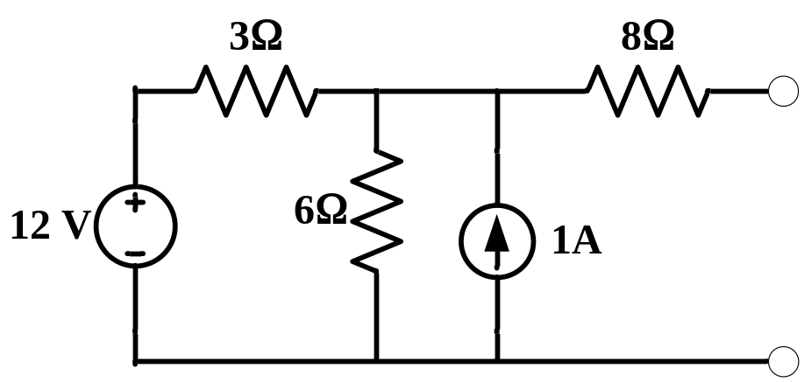
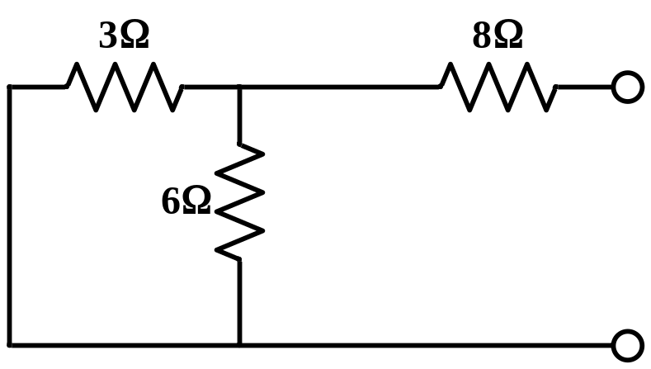
a
Load
b
Network A
Network B
Solution:
a
R_{Th} = R_{in}
b
R_{Th} = 8 + 3 // 6 = 10 Ω

Slide 42
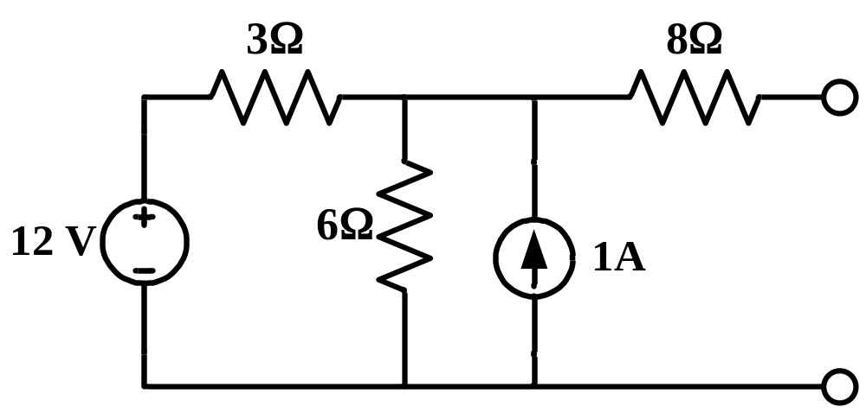
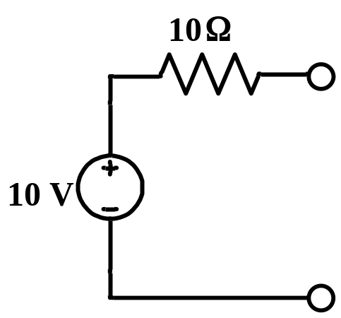
a
+
v_{oc}
_
b
KCL: (v_{oc} - 12)/3 + v_{oc}/6 -1 = 0
v_{oc} = 10 V.
Thus, the Thévenin equivalent is:
a
b
Ans.

Slide 43
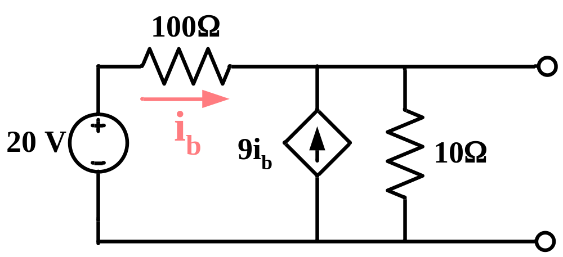
Example4.5
Find the Thévenin resistance in the following circuit.
a
b
Solution:
From the given circuit above, the open-circuited voltage can be determine as following:
v_{oc} - 20
v_{oc}
- 9i_{b} +
= 0
(1)
100
10

Slide 44
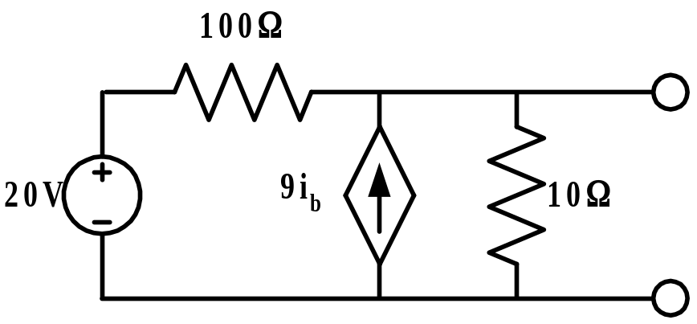
20 - v_{oc}
i_{b} =
(2)
100
From Eq. (1) and (2), we get
v_{oc} = 10 V.
R_{Th} can be evaluated by either one of these following methods:
v_{oc}
R_{Th} =
Method 1:
i_{sc}
a
i_{b}
i_{sc}
b
Apply superposition theorem
i_{sc} = i_{b} + 9i_{b}

Slide 45
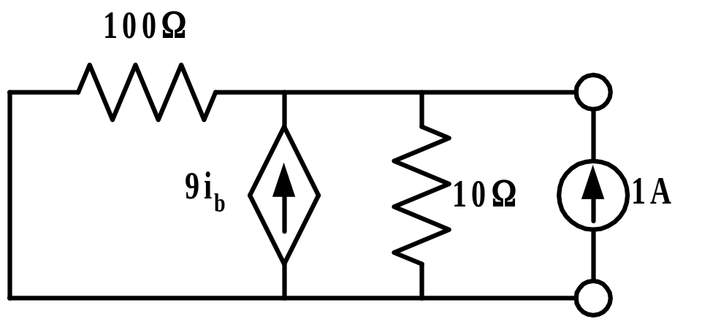
20
Since i_{b} = = 0.2 A., then
100
i_{sc} = 0.2 + 1.8 = 2 A.
Hence R_{Th} = 10/2 = 5 Ω
Method 2: Apply a current source
a
+
i_{b}
v
_
b
KCL:
v/100 - 9i_{b} + v/10 = 1
(3)
i_{b} = -v/100
(4)
From Eq. (3) and (4), we get v = 5 V.
v = 5 V.

Slide 46
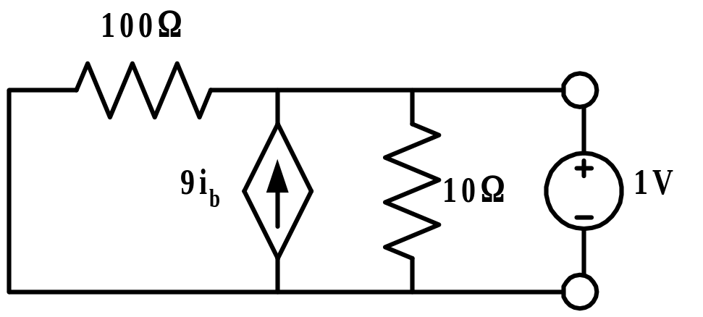
Thus, R_{Th} = 5/1 = 5 Ω.
Method 3: Apply a voltage source
i
a
i_{b}
b
(5)
Since i_{b} = -(1/100) = -0.01 A.
KCL:
i = -i_{b} - 9i_{b} + (1/10)
(6)
Substitute Eq. (5) into (6), we get
i = 0.2 A.
Thus, R_{Th} = 1/0.2 = 5 Ω.
Ans.

Slide 47
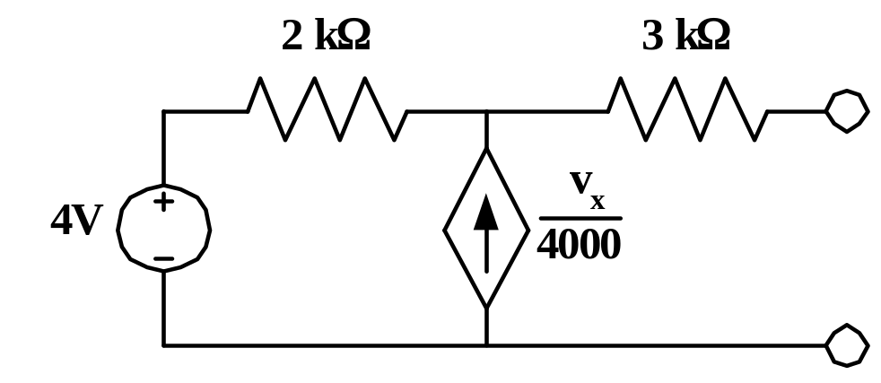
Example4.6
Determine the Thévenin equivalent of the following circuit.
a
+
v_{x}
_
b
Solution:
KCL:
v_{x} - 4
v_{x}
=
2000
4000
Hence v_{oc} = v_{x} = 8 V.
If terminals “a-b” is short-circuited, v_{x} = 0, then (v_{x}/4000) = 0. Hence, i_{sc} will be as following:

Slide 48
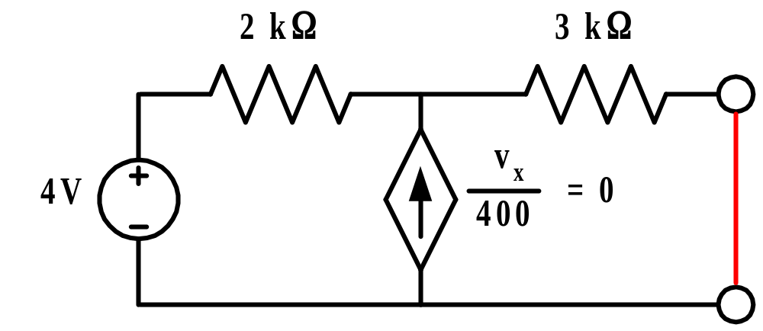
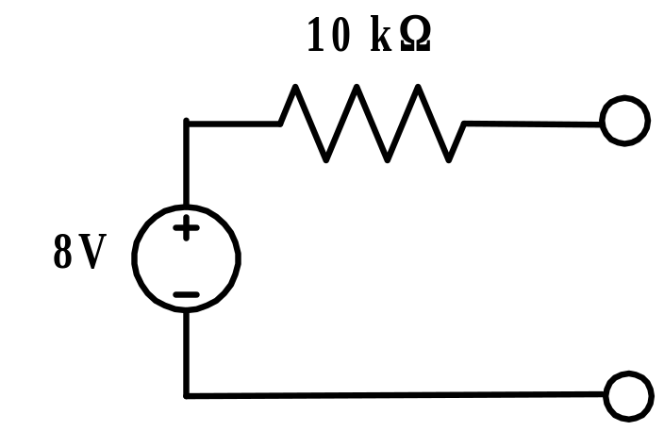
i_{sc}
i_{sc} = 4/(2 kΩ + 3 kΩ) A.
Thus, R_{Th} = 8*(5 kΩ/4) = 10 kΩ and the Thévenin equivalent circuit is
Ans.

Slide 49
Case Summary
Case 1. Independent sources only. (No dependent sources are present.)
1. With the sources in, calculate v_{oc}.
2. Set the sources to 0 and calculate R_{Th} , by combining resistances if possible. Or, go back to step 1, calculate i_{sc} and calculate the ratio v_{oc} / i_{sc} for R_{Th} .
Case 2. Independent and dependent sources.
With the sources in, calculate v_{oc} and i_{sc}. Then calculate the ratio v_{oc} / i_{sc} for R_{Th} .
or
With the independent sources set to 0, apply a voltage source (current source) and calculate the corresponding source current (source voltage), and then calculate R_{Th} as the ratio of the source voltage to the source current.

Slide 50
Case 3. No independent sources, some dependent sources.
v_{oc} and i_{sc} are 0.
Apply a voltage (current) source and calculate the current (voltage) and calculate their ratio for R_{Th} .
4.4
Maximum Power Transfer
Electrical circuits in general is designed to have minimum power losses in the transmission and distribution system. However, some applications especially in the areas of communication require to maximize the power delivered to a load. In this section we will consider the condition of the electrical circuit when the maximum power is transferred to the load which is called the “maximum power transfer theorem”.

Slide 51
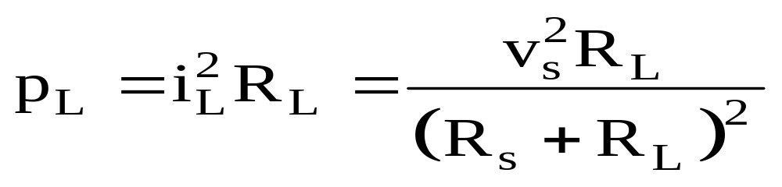
Let we consider the circuit having only the practical voltage source and the load R_{L} as shown in Fig. 4.12.
R_{s}
i_{L}
+
v_{L}
–
v_{s}
+
–
load
R_{L}
Practical Voltage Source
Figure 4.12
Redrawn o f Fig. 4.2 (pp. 140).
For the circuit in Fig. 4.12, the power delivered to the load R_{L} is equal to
(4.19)

Slide 52
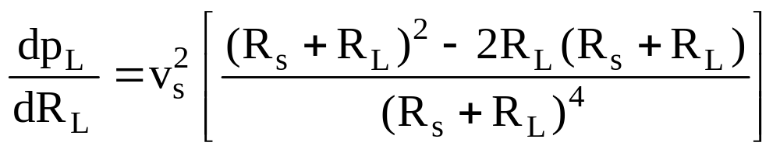
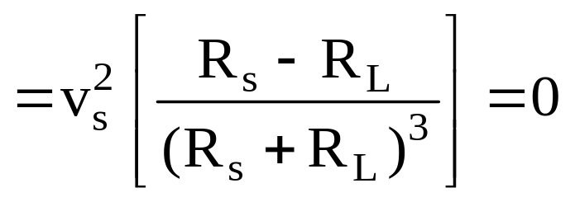
To find the value of R_{L} that absorbed a maximum power from the practice voltage source "v_{s}", we differentiate p_{L} in Eq. 4.19 with respect to R_{L} and set the result equal to zero. We get
(4.20)
Eq. 4.20 implies that
R_{s} - R_{L} = 0
or
R_{s} = R_{L}
(4.21)

Slide 53
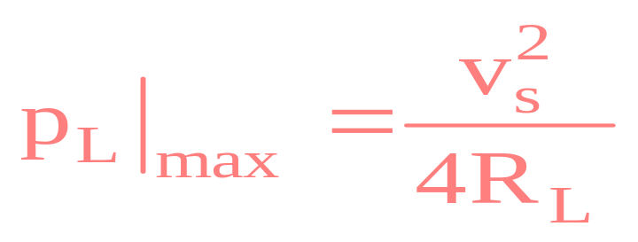
Thus, the maximum power transfer theorem states that
A practical source supplies a maximum power to the load resistance R_{L} for which R_{L} is equal to the internal resistance R_{s} of the practical source.
The amount of maximum power transferred is evaluated by substituting Eq. 4.21 into Eq. 4.19, for
(4.22)

Slide 54
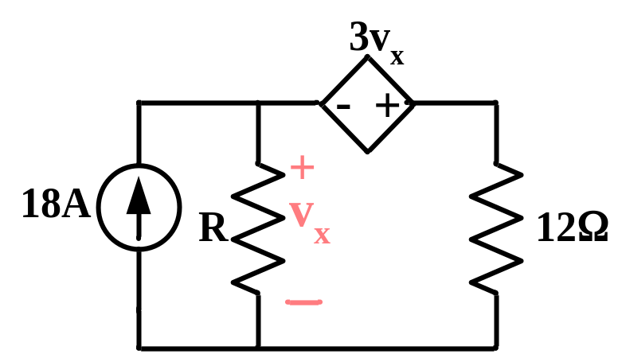
Example4.7
Determine the value of R for max power and the the max power absorbed by R.
Solution:
Find the Thévenin equivalent that R sees, and then use it to calculate the maximum power absorbed by R.
KVL: v_{oc} = 12*18 - 3v_{oc} or v_{oc} = 54 V.
and i_{sc} = 18 A. Thus, R_{Th} = 54/18 = 3 Ω
R = 3 Ω and p_{L} = (54)2/(4*3) = 243 W
Ans.

Slide 55
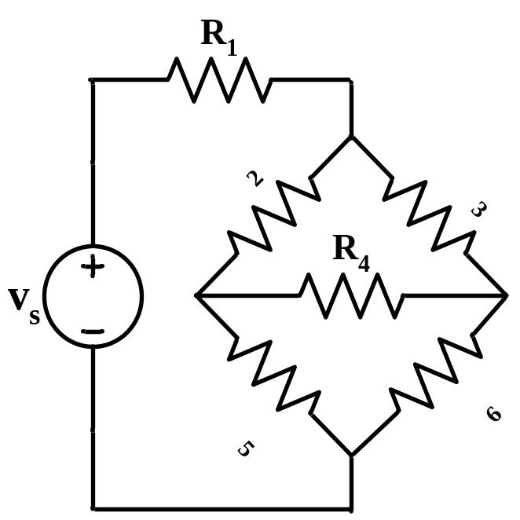
4.5
Delta-Wye Transformations
The combination of resistors mentioned previously is either in parallel or in series combination. Situation often arise in circuit analysis where such combination do not exist, for example the circuit in Fig. 4.13.
Figure 4.13
The bridge network
Resistors R₁ through R₆ in the circuit of Fig. 4.13 are neither in series nor in parallel. In this situation, this circuit can

Slide 56
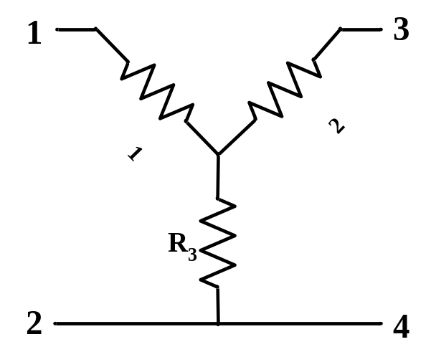
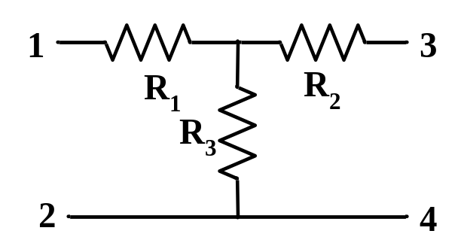
be simplified by using three-terminal equivalent network which are the wye (Y) or tee (T) network shown in Fig. 4.14 and the delta (Δ) or pi (Π) network shown in Fig. 4.15. These networks may occur by themselves or as part of a larger network. They are used in three-phase networks, electrical filters, and matching networks. In this section, we will discuss how to apply delta-wye transformation in the analysis of the network.
(a)
(b)
Figure 4.14
(a) A wye (Y) network consisting of three resistors. (b) Same network drawn as a tee (T) network.

Slide 57
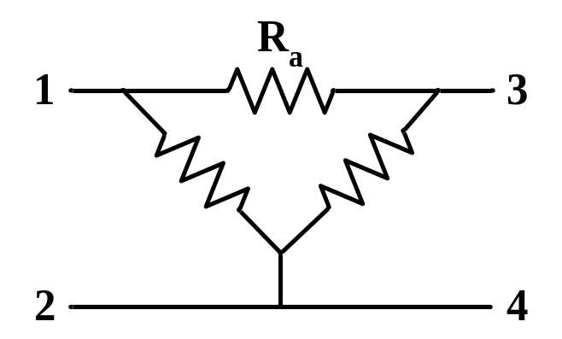
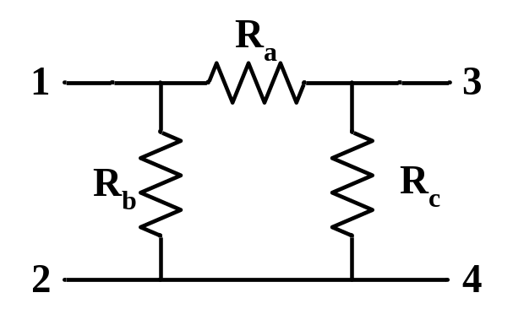
(a)
(b)
Figure 4.15
(a) A delta (Δ) network consisting of three resistors. (b) Same network drawn as a pi (Π) network.
Delta to Wye Conversion
Suppose the circuit contains a delta configuration. Let consider the network in Fig. 4.16 where we superimpose a wye network on the existing delta network. The conversion is performed based on the concept that the resistance between each pair of nodes in the Δ network must be the

Slide 58
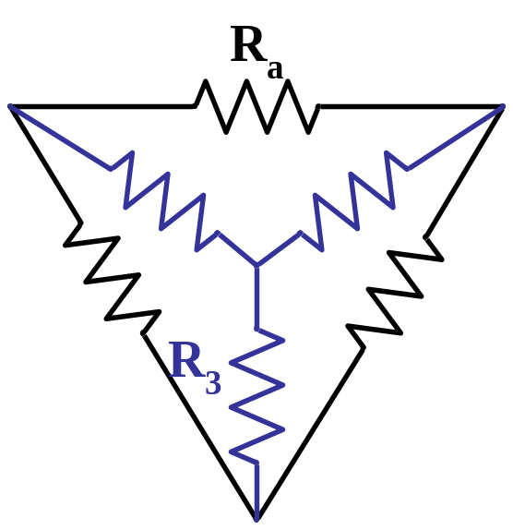
same as the resistance between the same pair of nodes in the Y network.
1
3
2
Figure 4.16
Superposition of Y and Δ network as an aid in transforming one to the other.
For terminals 1 and 2 in Fig. 4.16,
R₁₂ (Y) = R₁ + R₃
(4.22)
R₁₂ (Δ) = R_{b} || (R_{a} + R_{c})
(4.23)

Slide 59
Eq. 4.22 must be equal to Eq. 4.23. That is,
R_{b}(R_{a} + R_{c})
R₁ + R₃ =
(4.24)
R_{a} + R_{b} + R_{c}
Similarly,
R_{a}(R_{b} + R_{c})
R₁ + R₂ =
(4.25)
R_{a} + R_{b} + R_{c}
R_{c}(R_{b} + R_{a})
R₂ + R₃ =
(4.26)
R_{a} + R_{b} + R_{c}
Subtract Eq. 4.26 from Eq. 4.24, we get
R_{a}(R_{b} - R_{c})
R₁ - R₂ =
(4.27)
R_{a} + R_{b} + R_{c}
Add Eq. 4.25 and Eq. 4.27, we get

Slide 60
R_{a}R_{b}
R₁ =
(4.28)
R_{a} + R_{b} + R_{c}
Subtract Eq. 4.27 from Eq. 4.25, we get
R_{a}R_{c}
R₂ =
(4.29)
R_{a} + R_{b} + R_{c}
Subtract Eq. 4.28 from Eq. 4.24, we get
R_{b}R_{c}
R₃ =
(4.30)
R_{a} + R_{b} + R_{c}
From Eq. 4.28 to 4.30, we can state that
Each resistor in the Y network is the product of the resistors in the two adjacent Δ branches, divided by the sum of the three Δ resistors.

Slide 61
Wye to Delta Conversion
Now, let consider the circuit containing the wye (Y) configuration and suppose it is more convenient to analyze the circuit with a delta (Δ) network in place. Hence, we need to converse the Y network into the Δ network.
We note from Eq. 4.28 to 4.30 that
R_{a}R_{b}R_{c}
R₁R₂ + R₂R₃ + R₃R₁ =
R_{a} + R_{b} + R_{c}
(4.31)
Divide Eq. 4.31 by each of Eqs. 4.28 to 4.30 results to the following equations:
R₁R₂ + R₂R₃ + R₃R₁
R_{a} =
(4.32)
R₃

Slide 62
R₁R₂ + R₂R₃ + R₃R₁
R_{b} =
(4.33)
R₂
R₁R₂ + R₂R₃ + R₃R₁
R_{c} =
(4.34)
R₁
From Eq. 4.32 to 4.34, we can state that
Each resistor in the Δ network is the sum of all possible products of Y resistors taken two at a time, divided by the opposite Y resister.
The delta (Δ) and wye (Y) networks are said to be balanced when
R_{a} = R_{b} = R_{c} = R_{Δ} , R₁ = R₂ = R₃ = R_{Y} .
(4.35)

Slide 63
For the balanced Y and Δ networks, the conversion formulas can be simplified as following:
R_{Δ} = 3R_{Y} , for the balanced
(4.36)
load network.

