Slide 1
EE 369
Power Systems Engineering
Lecture 1
Introduction
Slides by: Tom Overbye, University of Illinois
With additions by Ross Baldick, University of Texas

Slide 2
Simple Power System
Every power system has three major components:
  generation: source of power, ideally with a specified voltage and frequency
  load or demand: consumes power; ideally with a constant resistive value
  transmission system: transmits power; ideally as a perfect conductor
Additional components include:
  distribution system: local reticulation of power,
  control equipment: coordinate supply with load.

Slide 3
Complications
No ideal voltage sources exist.
Loads are seldom constant and are typically not entirely resistive.
Transmission system has resistance, inductance, capacitance and flow limitations.
Simple system has no redundancy so power system will not work if any component fails.

Slide 4
Power
Power:
  Instantaneous rate of consumption of energy,
  How hard you work!
Power Units:
Watts = voltage x current for dc (W)
kW – 1 x 10³ Watt
MW – 1 x 10⁶ Watt
GW – 1 x 10⁹ Watt
Installed U.S. generation capacity is about
900 GW ( about 3 kW per person)
Maximum load of Austin about 2500 MW.
Maximum load of UT campus about 50 MW.

Slide 5
Energy
Energy:
  Integration of power over time,
  energy is what people really want from a power system,
  How much work you accomplish over time.
Energy Units:
Joule = 1 watt-second (J)
kWh – kilowatthour (3.6 x 10⁶ J)
Btu – 1055 J; 1 MBtu=0.292 MWh
U.S. electric energy consumption is about 3600 billion kWh (about 13,333 kWh per person, which means on average we each use 1.5 kW of power continuously).

Slide 6
Power System Examples
Electric utility: can range from quite small, such as an island, to one covering half the continent
  there are four major interconnected ac power systems in North America, each operating at 60 Hz ac; 50 Hz is used in some other countries.
Airplanes and Spaceships: reduction in weight is primary consideration; frequency is 400 Hz.
Ships and submarines.
Automobiles: dc with 12 volts standard and, in the future, 42 volts.
Battery operated portable systems.

Slide 7
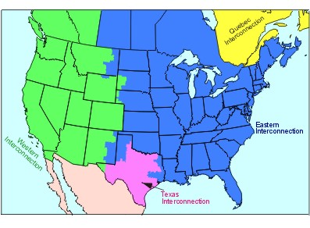
North America Interconnections

Slide 8
Electric Systems in Energy Context
Class focuses on electric power systems, but we first need to put the electric system in context of the total energy delivery system.
Electricity is used primarily as a means for energy transportation:
  Use other sources of energy to create electricity, and electricity is usually converted into another form of energy when used
  Electricity is used by transforming into another form of energy.
About 40% of US energy is transported in electric form.

Slide 9
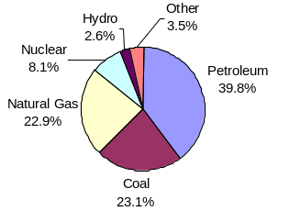
Sources of Energy - US
Total for 2003
was 98.2 Quad
(Quadrillion
Btu [million billion]),
of which
38.3 Quad was
consumed for
electricity and
26.8 Quad
for transportation
Total Annual US Energy
Expenditures are about $900 Billion
Over 85% is from fossil fuels

Slide 10
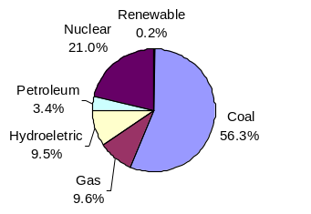
Electricity Generation Sources in US

Slide 11
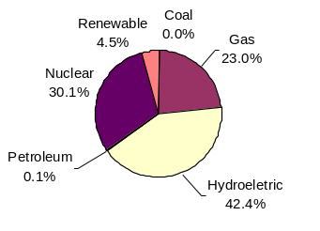
Generation Sources in California
Oregon is
85% Hydro,
while
Washington
State is
82% Hydro

Slide 12
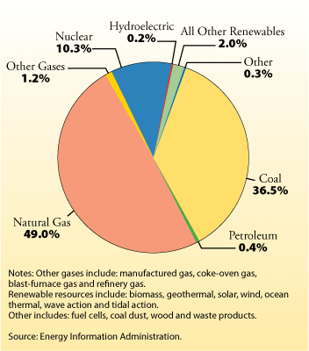
Generation Sources in Texas

Slide 13
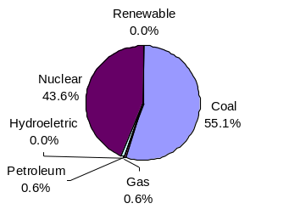
Generation Sources in Illinois

Slide 14
Energy Economics
Electric generating technologies involve a tradeoff between fixed costs (primarily capital costs to build them) and operating costs
  Nuclear, wind, and solar high fixed costs, but low operating costs,
  Natural gas has low fixed costs but relatively high operating costs (dependent upon fuel prices)
  Coal in between.
Total average costs depend on fixed costs, operating costs, and capacity factor (ratio of average power production to capacity).

Slide 15
Ball park operating Costs
Nuclear: $10/MWh
Coal: $40/MWh
Wind: $5/MWh
Hydro: few $/MWh
Solar: $0/MWh
Natural Gas: cost in $/MWh is 7 to 20 times fuel cost in $/MBtu; for example, with $8/MBtu gas, cost is $56/MWh to $160/MWh.
Note, to get price in cents/kWh take price in $/MWh and divide by 10.

Slide 16
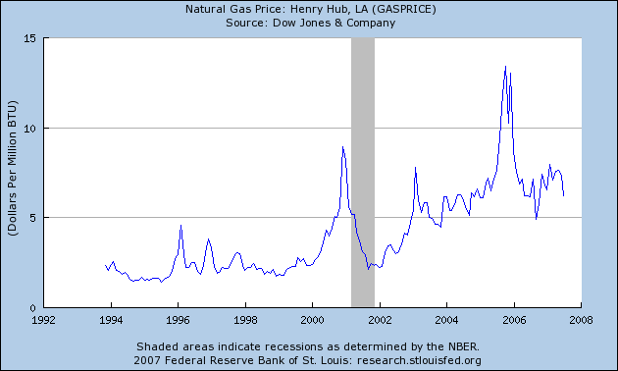
Natural Gas Prices – to 2007

Slide 17
Goals of Power System Operation
Supply load (users) with electricity at
  specified voltage (110 ac volts common for residential),
  specified frequency,
  at minimum cost consistent with operating constraints, safety, etc.

Slide 18
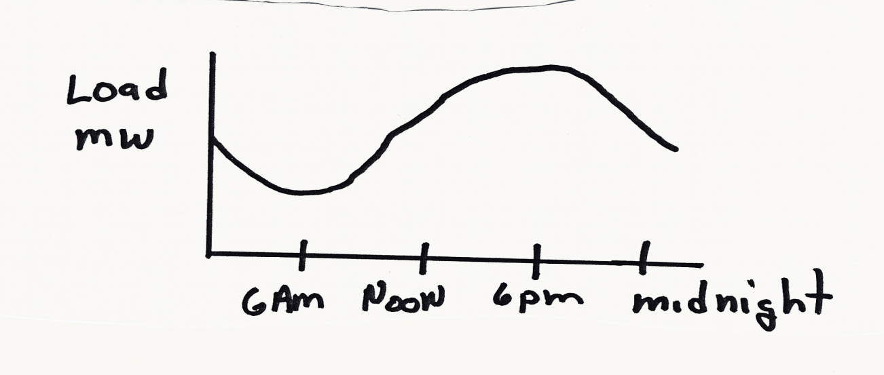
Major Impediments
Load is constantly changing:
Power system is subject to disturbances, such as lightning strikes.
Engineering tradeoffs between reliability and cost.

Slide 19
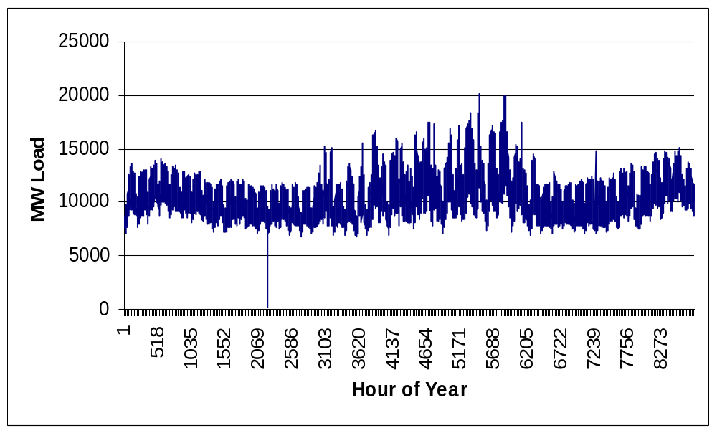
Example Yearly Electric Load

Slide 20
Course Syllabus (chapters 1 to 7 and 11)
Introduction and review of complex power, phasors & three phase (chapter 2),
Transformers and per-unit system (chapter 3),
Transmission line parameters (chapter 4),
Power flow analysis (chapter 6),
Symmetrical faults (chapter 7),
Power system controls (chapter 11),
Economic system operation (chapter 11),
Optimal power flow (chapter 11),
Deregulation and restructuring.

Slide 21
Brief History of Electric Power
Early 1880’s – Edison introduced Pearl Street dc system in Manhattan supplying 59 customers.
1884 – Sprague produces practical dc motor.
1885 – invention of transformer.
Mid 1880’s – Westinghouse/Tesla introduce rival ac system.
Late 1880’s – Tesla invents ac induction motor.
1893 – First 3 phase transmission line operating at 2.3 kV.

Slide 22
History, cont’d
1896 – ac lines deliver electricity from hydro generation at Niagara Falls to Buffalo, 20 miles away.
Early 1900’s – Private utilities supply all customers in area (city); recognized as a natural monopoly; states step in to begin regulation.
By 1920’s – Large interstate holding companies control most electricity systems.

Slide 23
History, cont’d
1935 – Congress passes Public Utility Holding Company Act to establish national regulation, breaking up large interstate utilities (repealed 2005).
1935/6 – Rural Electrification Act brought electricity to rural areas.
1930’s – Electric utilities established as vertical monopolies.

Slide 24
Vertical Monopolies
Within a particular geographic market, the electric utility had an exclusive franchise
Generation
In return for this exclusive
franchise, the utility had the
obligation to serve all
existing and future customers
at rates determined jointly
by utility and regulators
It was a “cost plus” business
Transmission
Distribution
Customer Service

Slide 25
Vertical Monopolies
Within its service territory each utility was the only game in town.
Neighboring utilities functioned more as colleagues than competitors.
Utilities gradually interconnected their systems so by 1970 transmission lines crisscrossed North America, with voltages up to 765 kV.
Economies of scale (bigger is cheaper per unit capacity) coupled with growth in demand resulted in decreasing average costs.
Decreasing average costs resulted in decreasing prices, so most every one was happy.

Slide 26
History, cont’d -- 1970’s
1970’s brought inflation, stagnation of growth, increased fossil-fuel prices, calls for conservation and growing environmental concerns.
Increasing prices replaced decreasing ones.
In that context, U.S. Congress passed Public Utilities Regulator Policies Act (PURPA) in 1978, which mandated utilities must purchase power from independent generators located in their service territory (modified 2005).
PURPA introduced some competition.

Slide 27
History, cont’d – 1990’s & 2000’s
Major opening of industry to competition occurred as a result of National Energy Policy Act of 1992.
This act mandated that utilities provide “nondiscriminatory” access to the high voltage transmission.
Goal was to set up true competition in generation.
Texas followed suit in 1996 and 1999.
Result over the last few years has been a dramatic restructuring of electric utility industry (for better or worse!)
Energy Bill 2005 repealed PUHCA; modified PURPA.

Slide 28
Utility Restructuring
Driven by significant regional variations in electric rates.
Goal of competition is to reduce prices through the introduction of competition and its incentives for technological innovation.
Allow consumers to choose their electricity supplier.

Slide 29
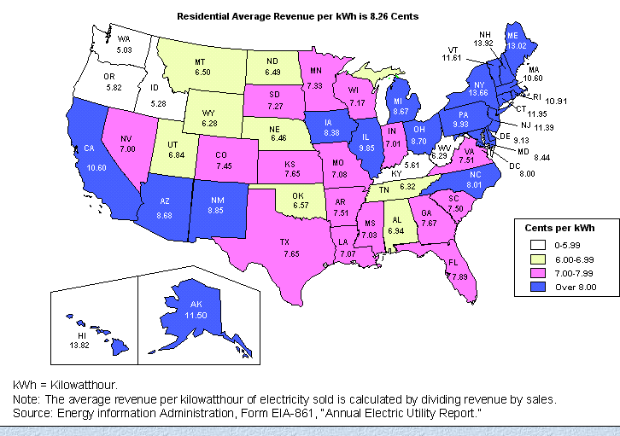
State Variation in Retail Electricity Prices

Slide 30
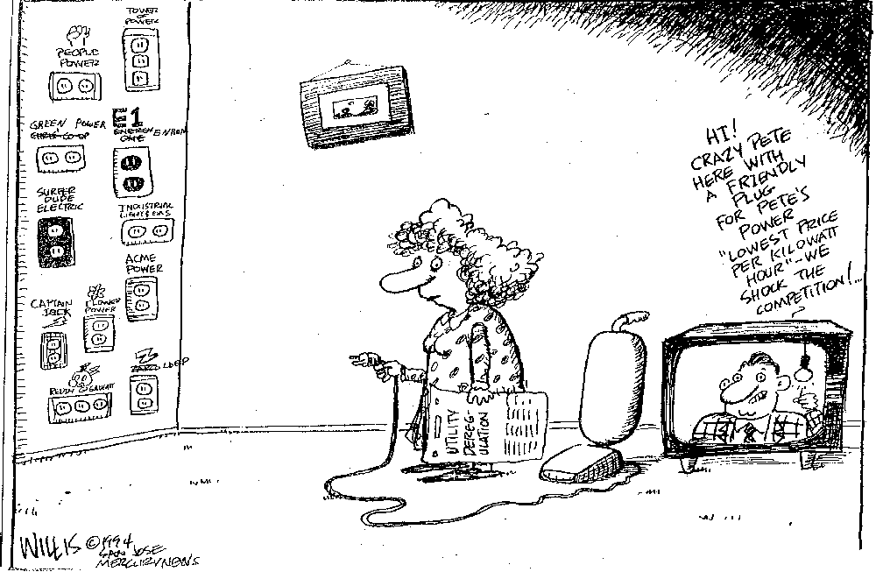
Customer Choice

Slide 31
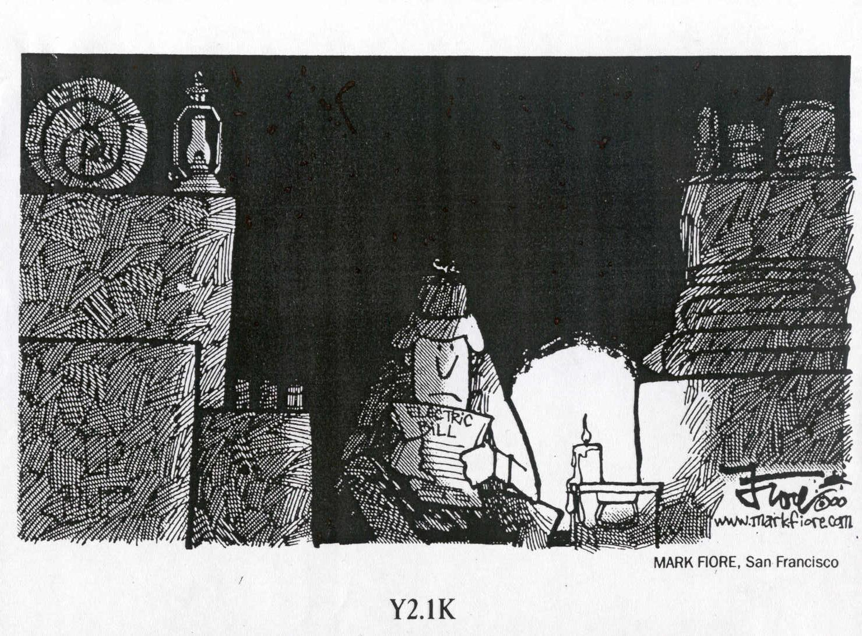
The Result for California in 2000/1
OFF
OFF

Slide 32

The California-Enron Effect
WA
MT
ND
VT
ME
OR
MN
ID
SD
WI
NH
WY
NY
MA
MI
RI
NV
IA
PA
CT
NE
OH
NJ
UT
IL
IN
DE
DC
CO
W
VA
VA
MD
CA
KS
MO
KY
AZ
TN
NC
NM
OK
AR
SC
MS
AL
GA
TX
LA
AK
FL
HI
electricity
restructuring
delayed
restructuring
suspended
restructuring
no activity
Source : http://www.eia.doe.gov/cneaf/electricity/chg_str/regmap.html

Slide 33
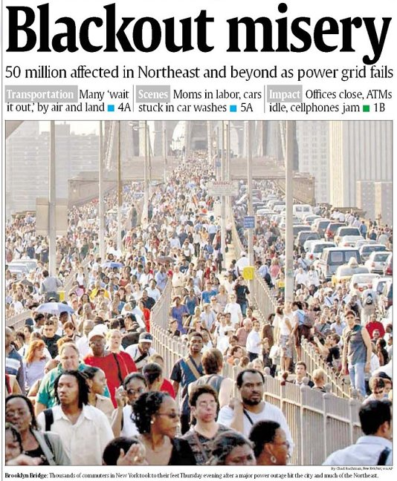
August 14th, 2003 Blackout

