Slide 1
EE 369
POWER SYSTEM ANALYSIS
Lecture 10
Transformers, Load & Generator Models, YBus
Tom Overbye and Ross Baldick

Slide 2
Announcements
Homework 7 is 3.1, 3.4, 3.8, 3.10, 3.14, 3.16, 3.19; due October 13.
Homework 8 is 3.21, 3.23, 3.28, 3.29, 3.38, 3.49, 3.60; due October 20.
Start reading Chapter 6 for lectures 11 and 12.

Slide 3
Load Tap Changing Transformers
LTC transformers have tap ratios that can be varied to regulate bus voltages.
The typical range of variation is ±10% from the nominal values, usually in 33 discrete steps (0.0625% per step).
Because tap changing is a mechanical process, LTC transformers usually have a 30 second deadband to avoid repeated changes to minimize wear and tear.
Unbalanced tap positions can cause “circulating vars;” that is, reactive power flowing from one winding to the next in a three phase transformer

Slide 4
Phase Shifting Transformers
Phase shifting transformers are used to control the phase angle across the transformer.
Since power flow through the transformer depends upon phase angle, this allows the transformer to regulate the power flow through the transformer.
Phase shifters can be used to prevent inadvertent "loop flow" and to prevent line overloads.

Slide 5
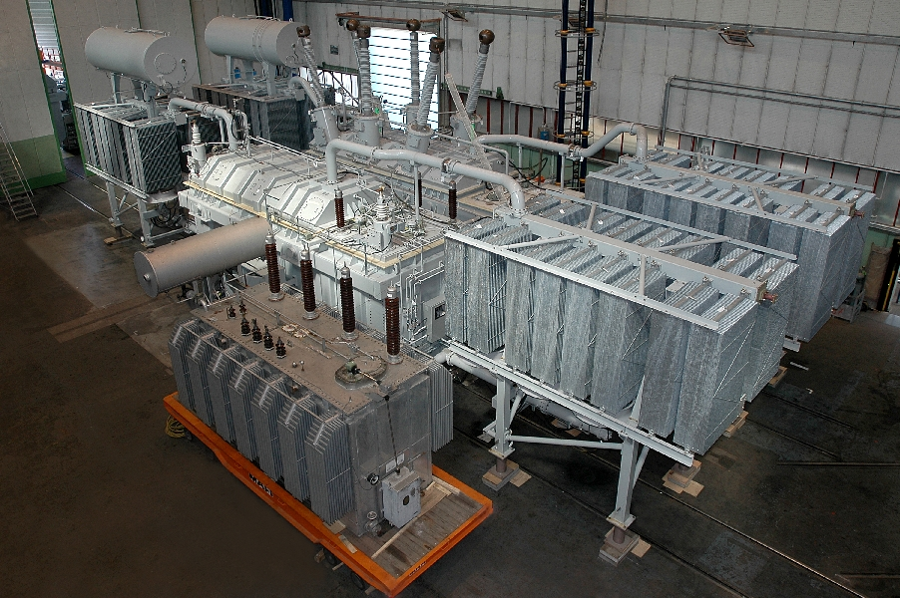
Phase Shifting Transformer Picture
Costs about $7 million,
weighs about 1.2
million pounds
230 kV 800 MVA Phase Shifting Transformer During factory testing
Source: Tom Ernst, Minnesota Power

Slide 6
Autotransformers
Autotransformers are transformers in which the primary and secondary windings are coupled magnetically and electrically.
This results in lower cost, and smaller size and weight.
The key disadvantage is loss of electrical isolation between the voltage levels. This can be an important safety consideration when a is large. For example in stepping down 7160/240 V we do not ever want 7160 on the low side!

Slide 7
Load Models
Ultimate goal is to supply loads with electricity at constant frequency and voltage.
Electrical characteristics of individual loads matter, but usually they can only be estimated
  actual loads are constantly changing, consisting of a large number of individual devices,
  only limited network observability of load characteristics
Aggregate models are typically used for analysis
Two common models
  constant power: S_{i} = P_{i} + jQ_{i}
  constant impedance: S_{i} = |V|² / Z_{i}

Slide 8
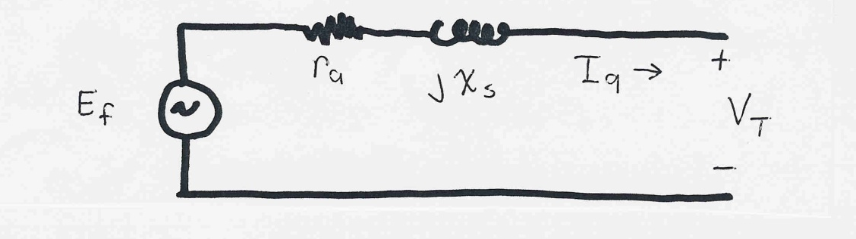
Generator Models
Engineering models depend on the application.
Generators are usually synchronous machines:
  important exception is wind generators,
For generators we will use two different models:
  (in 369) a steady-state model, treating the generator as a constant power source operating at a fixed voltage; this model will be used for power flow and economic analysis.
  (in 368L) a short term model treating the generator as a constant voltage source behind a possibly time-varying reactance.

Slide 9
Power Flow Analysis
We now have the necessary models to start to develop the power system analysis tools.
The most common power system analysis tool is the power flow (also known sometimes as the load flow):
  power flow determines how the power flows in a network
  also used to determine all bus voltages and all currents,
  because of constant power models, power flow is a nonlinear analysis technique,
  power flow is a steady-state analysis tool.

Slide 10
Linear versus Nonlinear Systems
A function H is linear if
H(α₁μ₁ + α₂μ₂) = α₁H(μ₁) + α₂H(μ₂)
That is:
1) the output is proportional to the input
2) the principle of superposition holds
Linear Example: y = H(x) = c x
y = c(x₁+x₂) = cx₁ + c x₂
Nonlinear Example: y = H(x) = c x²
y = c(x₁+x₂)² ≠ c(x₁)² + c(x₂)²

Slide 11
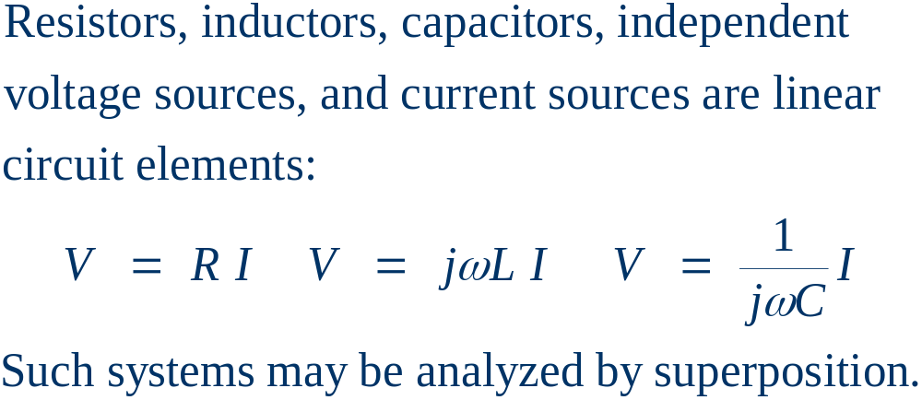
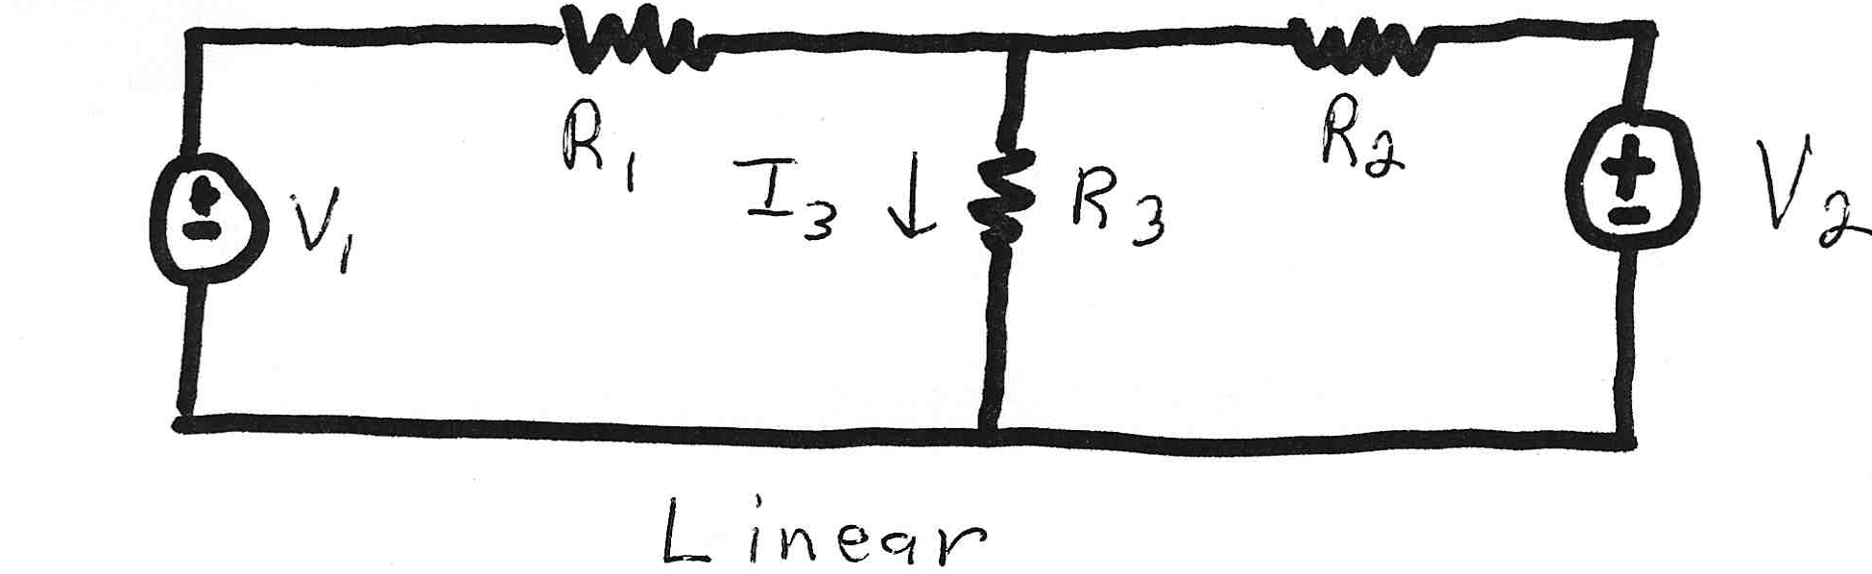
Linear Power System Elements

Slide 12
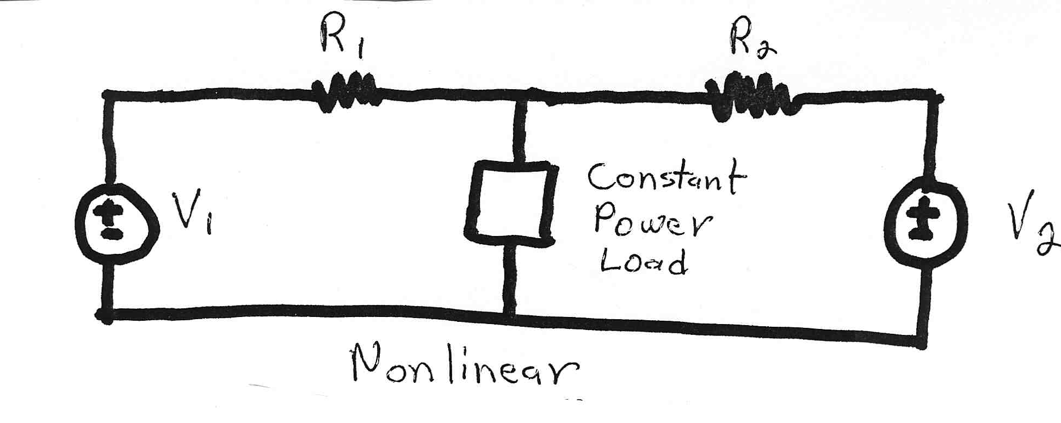
Nonlinear Power System Elements
Constant power loads and generator injections are nonlinear and hence systems with these elements cannot be analyzed (exactly) by superposition.
Nonlinear problems can be very difficult to solve,
and usually require an iterative approach.

Slide 13
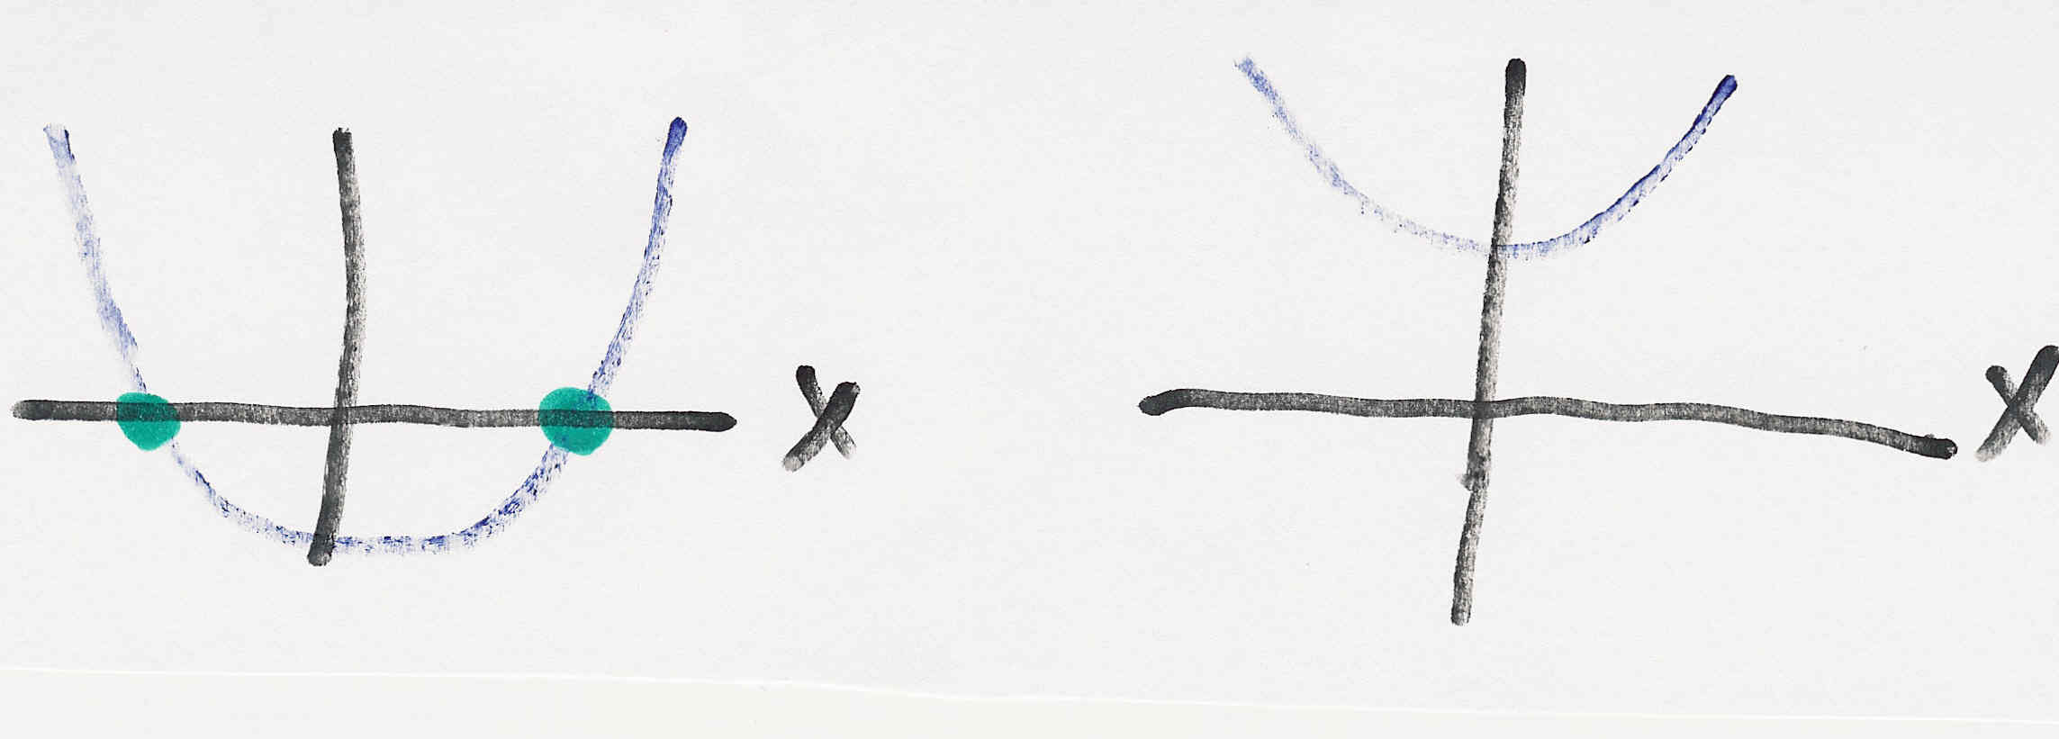
Nonlinear Systems May Have Multiple Solutions or No Solution
Example 1: x² - 2 = 0 has solutions x = ±1.414…
Example 2: x² + 2 = 0 has no real solution
f(x) = x² - 2
f(x) = x² + 2
two solutions where f(x) = 0
no solution to f(x) = 0

Slide 14
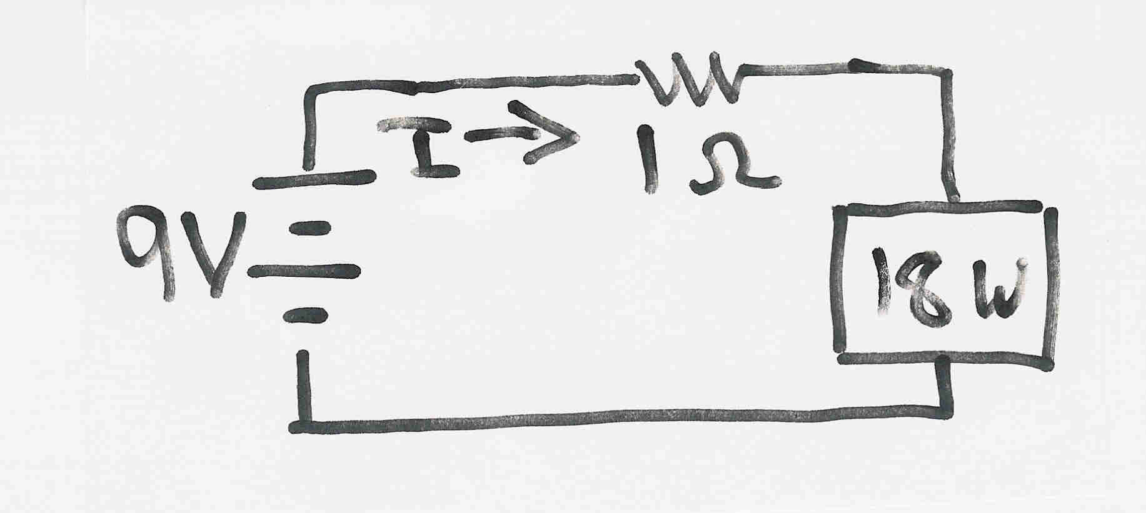
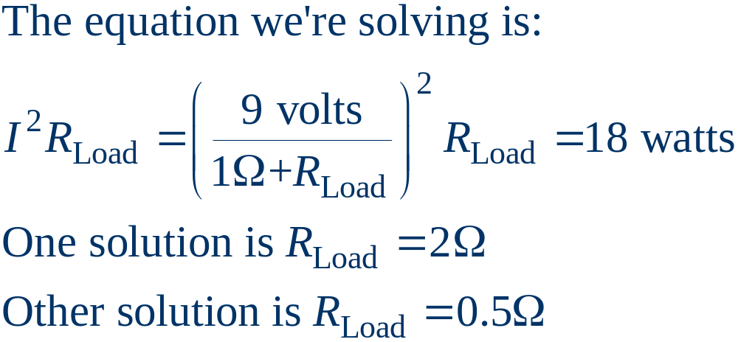
Multiple Solution Example 3
The dc system shown below has two solutions for a value of load resistance that results in 18 W dissipation in the load:
That is, the 18 watt
load is an unknown
resistive load R_{Load}
A different
problem:
What is the
resistance to
achieve maximum
P_{Load}?

Slide 15
Bus Admittance Matrix or Y_{bus}
First step in solving the power flow is to create what is known as the bus admittance matrix, often called the Y_{bus}.
The Y_{bus} gives the relationships between all the bus current injections, I, and all the bus voltages, V, I = Y_{bus} V
The Y_{bus} is developed by applying KCL at each bus in the system to relate the bus current injections, the bus voltages, and the branch impedances and admittances.

Slide 16
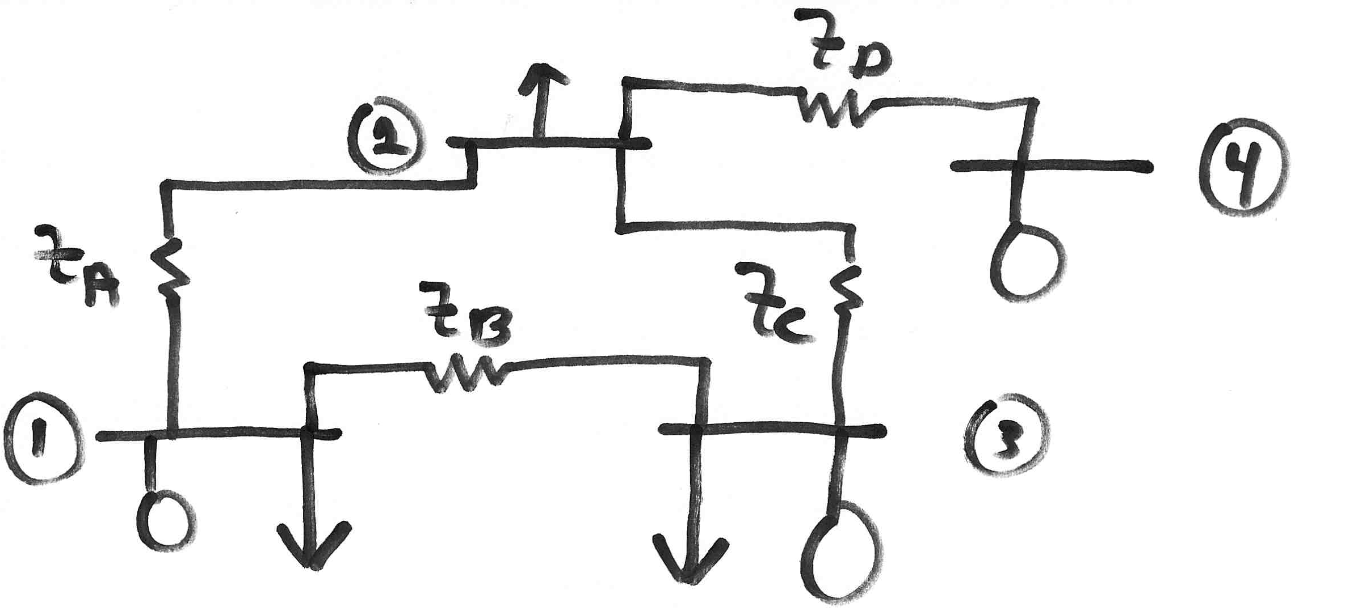
Y_{bus} Example
Determine the bus admittance matrix for the network
shown below, assuming the current injection at each
bus i is I_{i} = I_{Gi} - I_{Di} where I_{Gi} is the current injection
into the bus from the generator and I_{Di} is the current
flowing into the load.

Slide 17
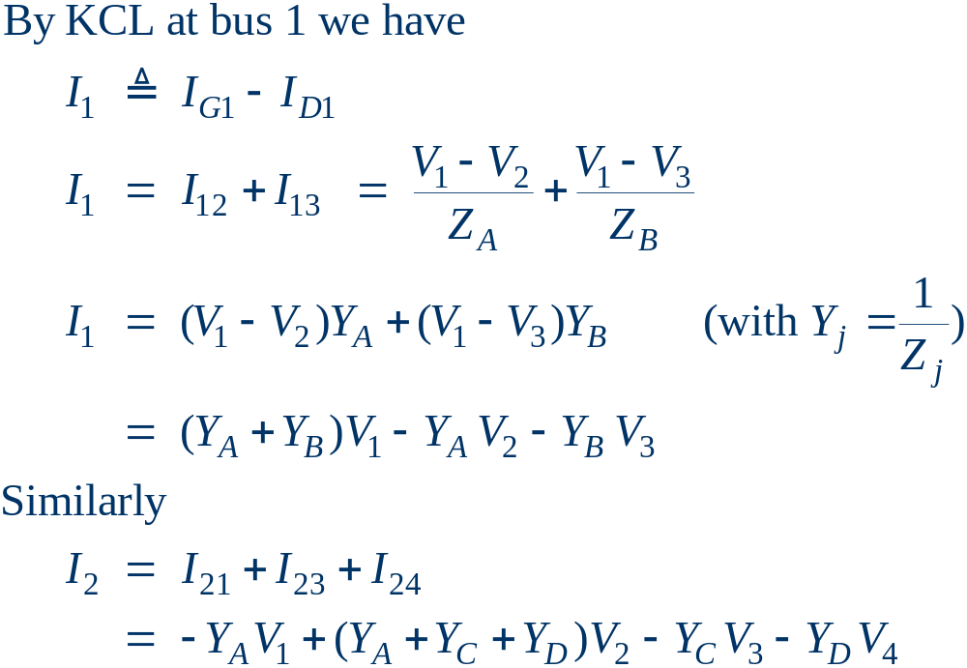
Y_{bus} Example, cont’d

Slide 18
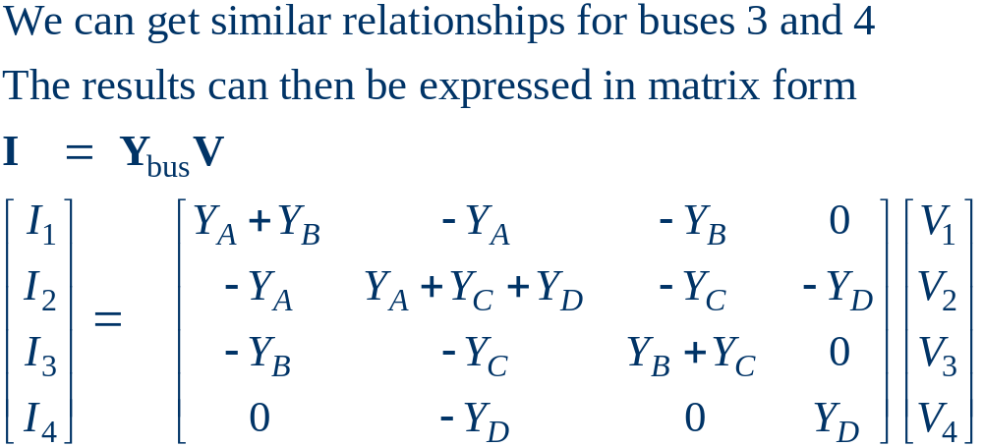
Y_{bus} Example, cont’d
For a system with n buses, Y_{bus} is an n by n
symmetric matrix (i.e., one where Y_{buskl} = Y_{buslk}).
From now on, we will mostly write Y for Y_{bus},
but be careful to distinguish Y_{kl} from line admittances.

Slide 19
Y_{bus} General Form
The diagonal terms, Y_{kk}, are the self admittance terms, equal to the sum of the admittances of all devices incident to bus k.
The off-diagonal terms, Y_{kl}, are equal to the negative of the admittance joining the two buses.
With large systems Y_{bus} is a sparse matrix (that is, most entries are zero):
  sparsity is key to efficient numerical calculation.
Shunt terms, such as in the equivalent π line model, only affect the diagonal terms.

Slide 20
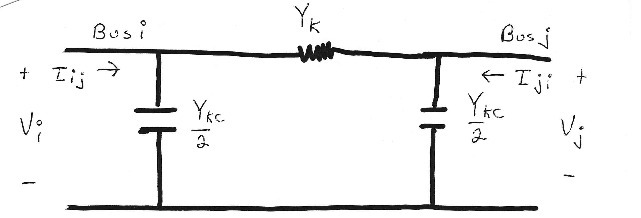
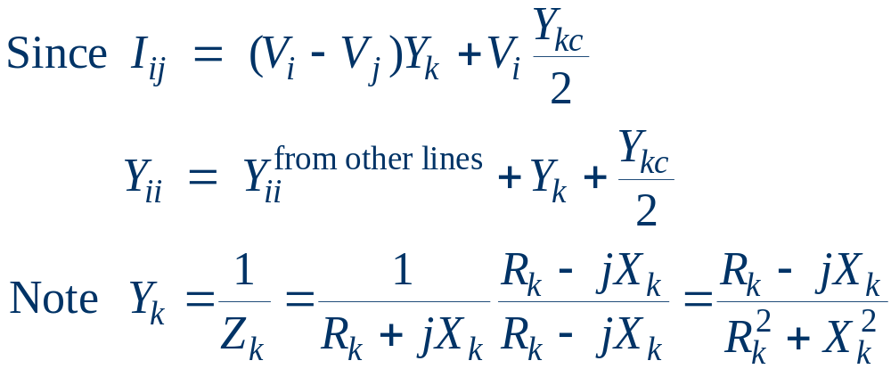
Modeling Shunts in the Y_{bus}

Slide 21
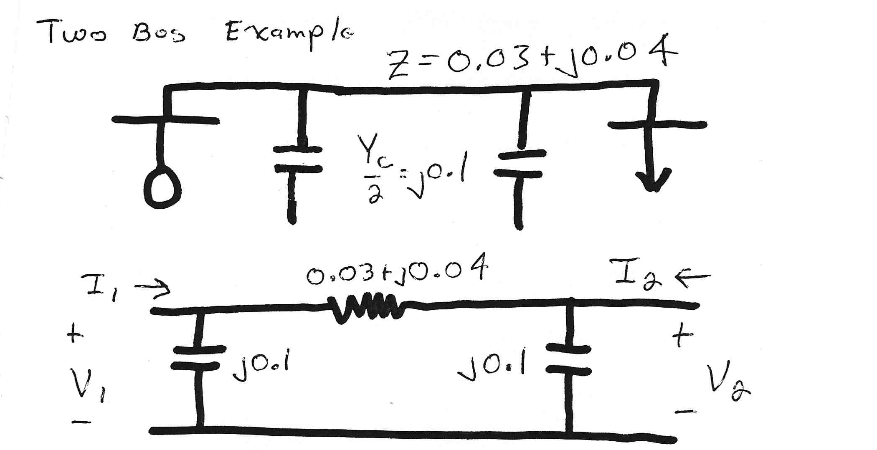
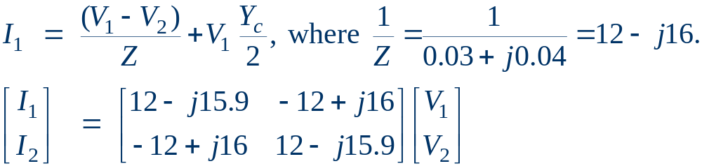
Two Bus System Example

Slide 22
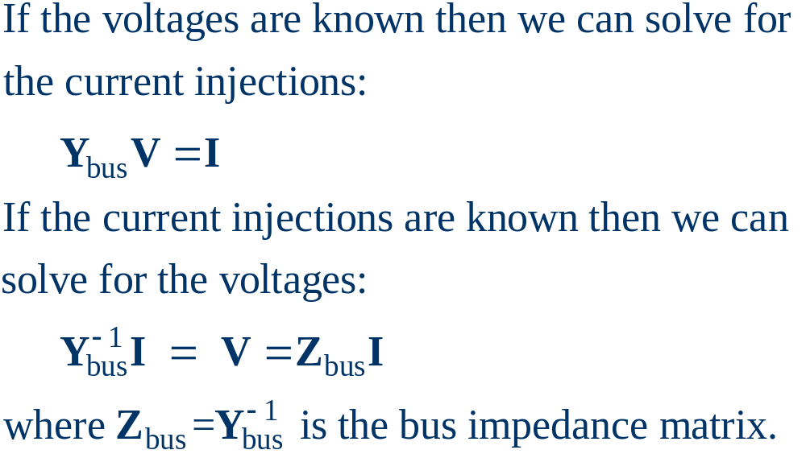
Using the Y_{bus}

Slide 23
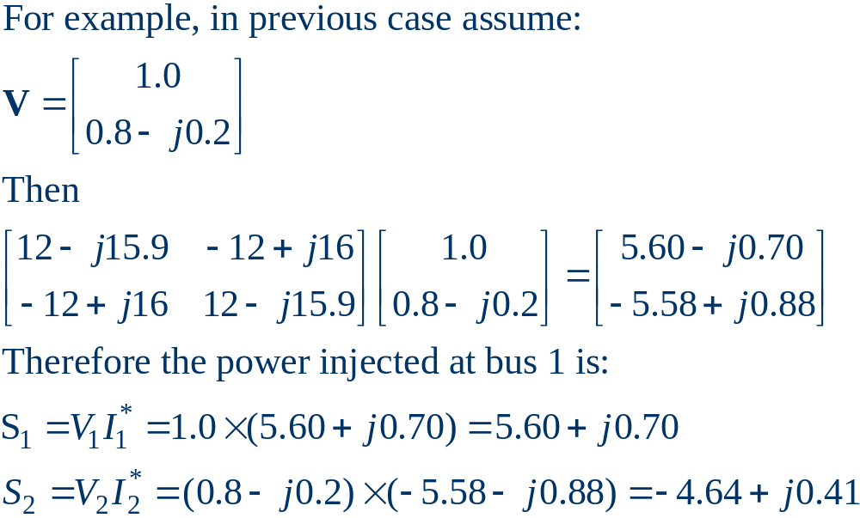
Solving for Bus Currents

Slide 24
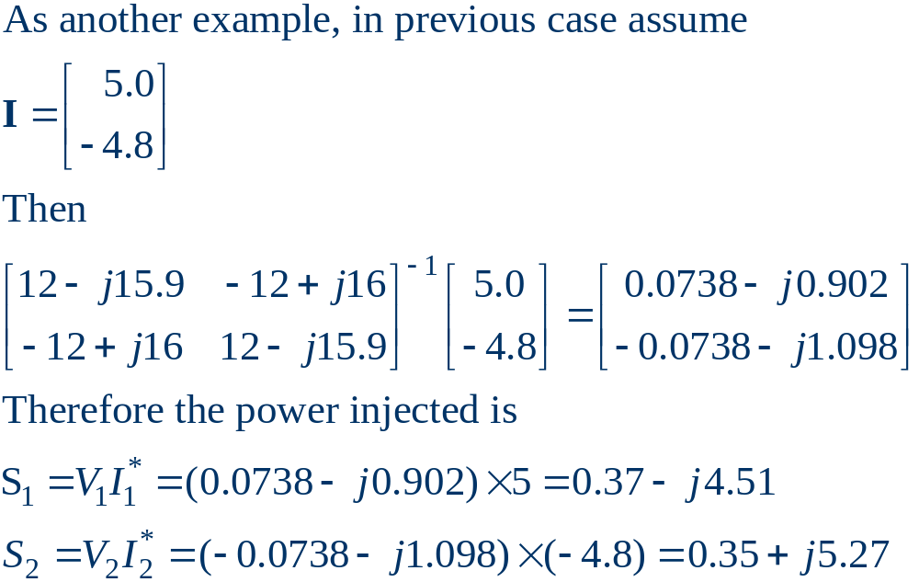
Solving for Bus Voltages

Slide 25
Power Flow Analysis
When analyzing power systems we know neither the complex bus voltages nor the complex current injections.
Rather, we know the complex power being consumed by the load, and the power being injected by the generators and their voltage magnitudes.
Therefore we can not directly use the Y_{bus} equations, but rather must use the power balance equations.

Slide 26
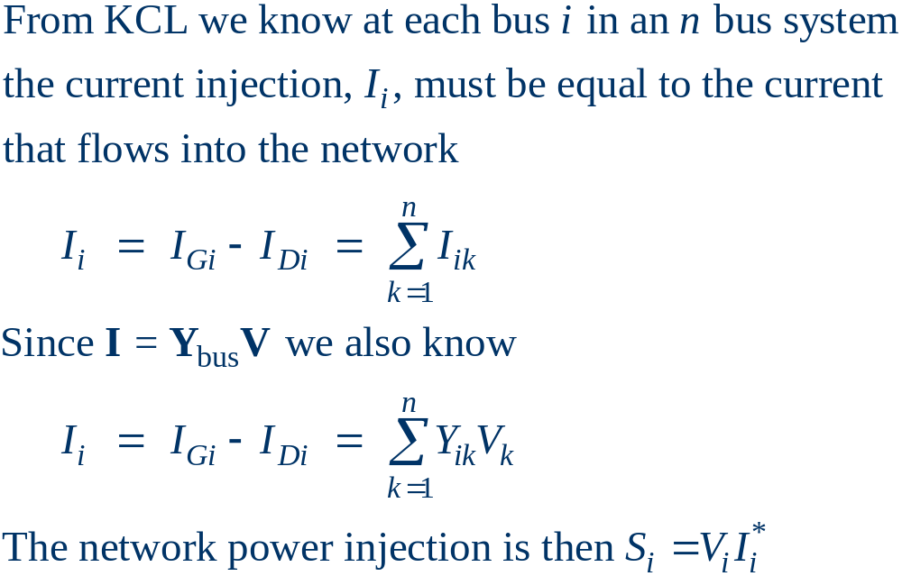
Power Balance Equations

Slide 27
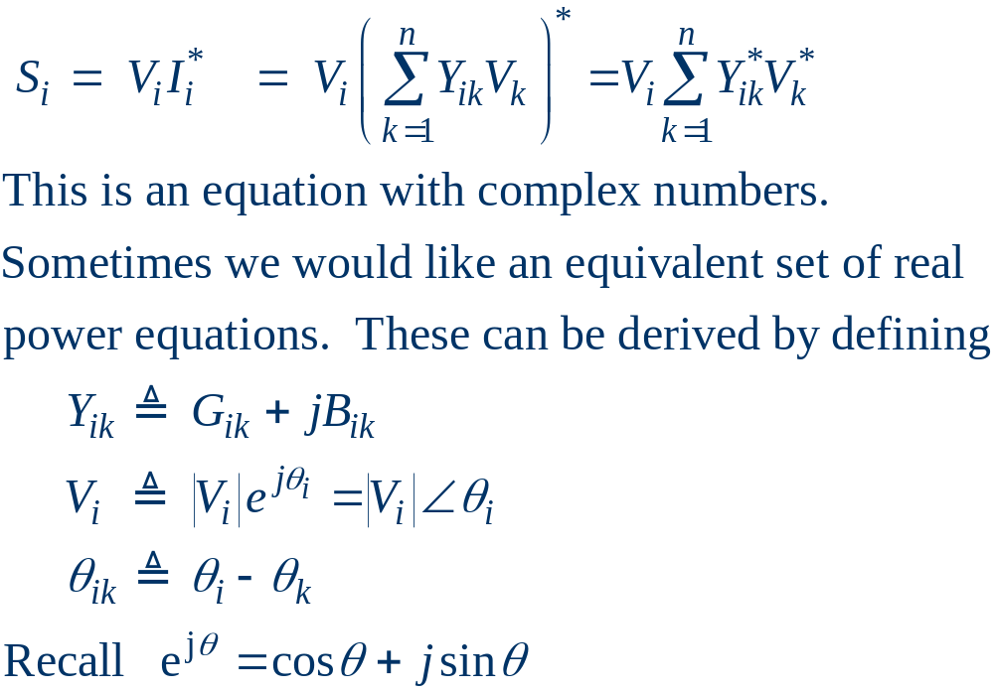
Power Balance Equations, cont’d

Slide 28
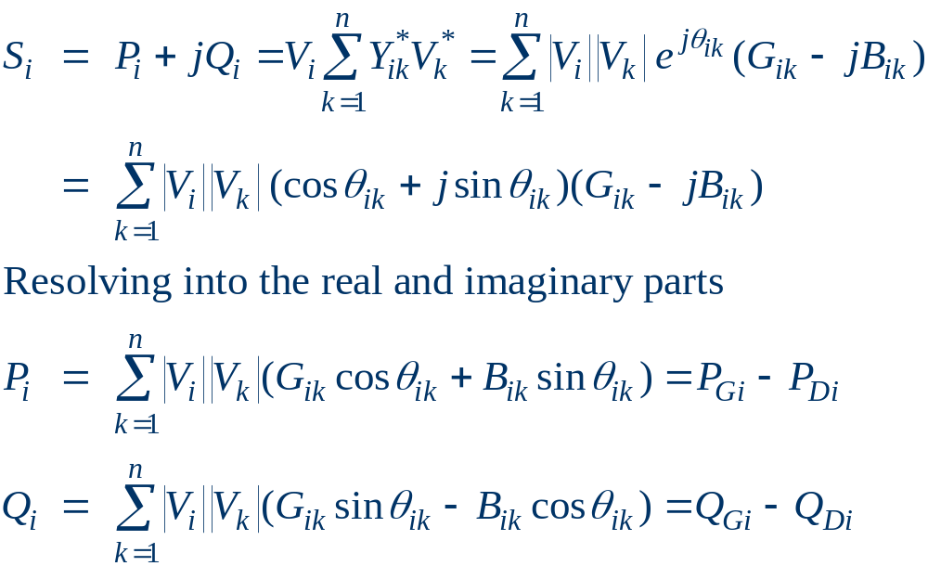
Real Power Balance Equations

Slide 29
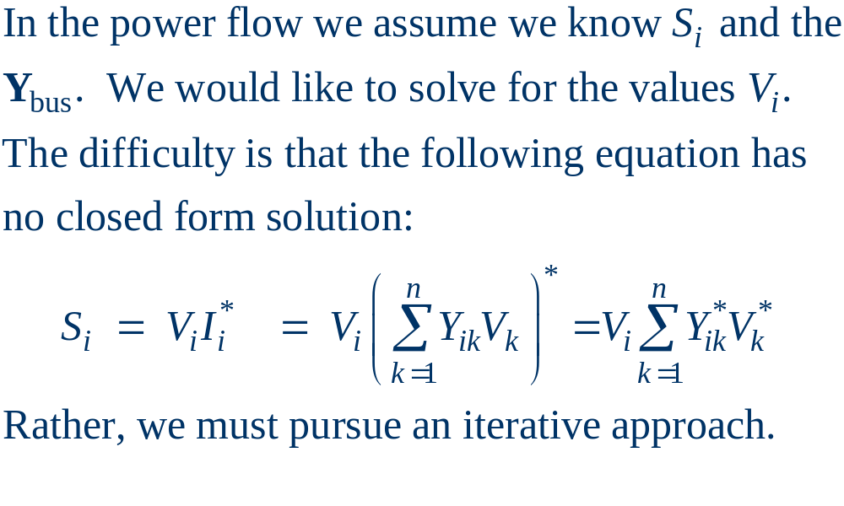
Power Flow Requires Iterative Solution

Slide 30
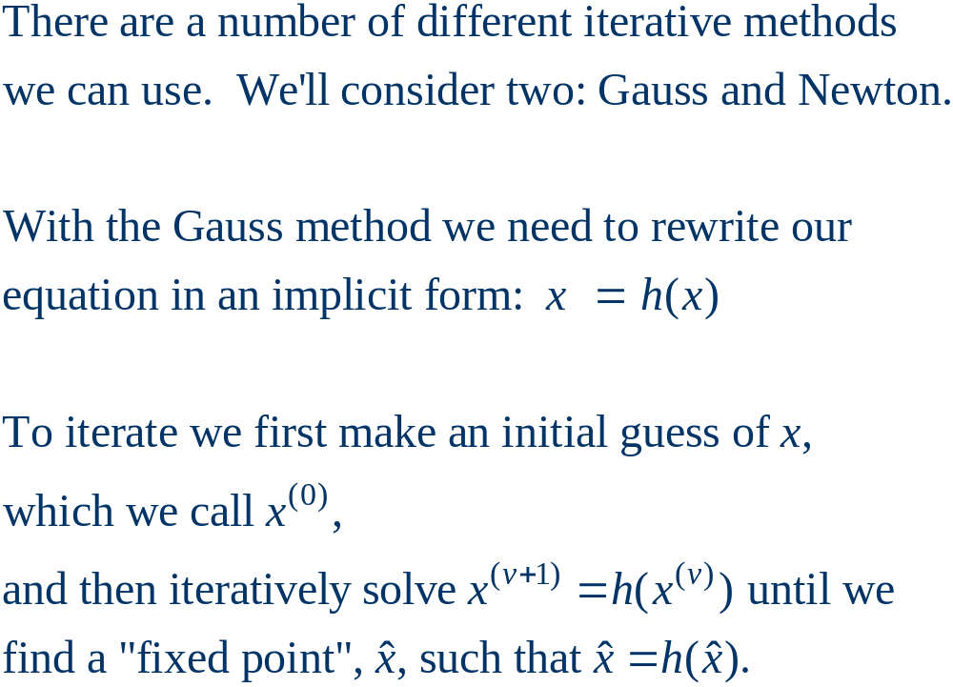
Gauss (or Jacobi) Iteration

Slide 31
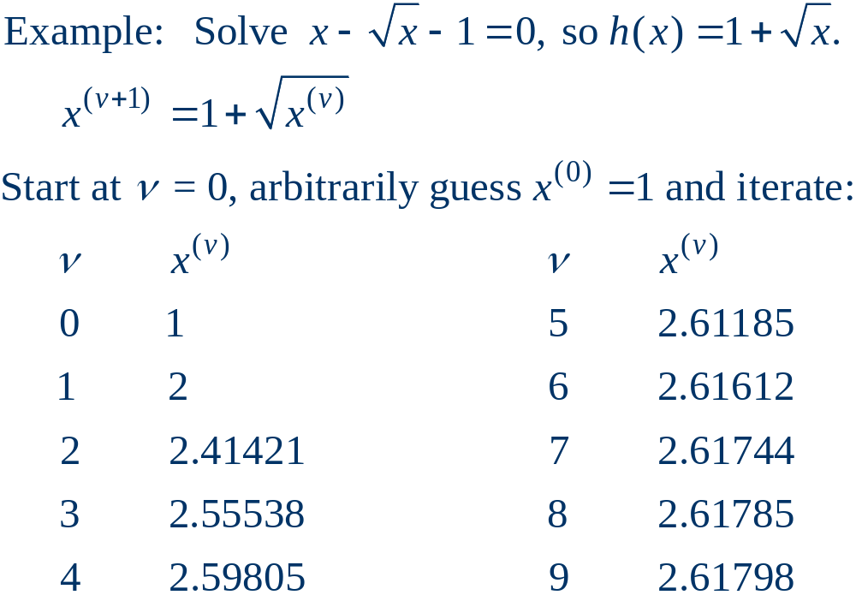
Gauss Iteration Example

Slide 32
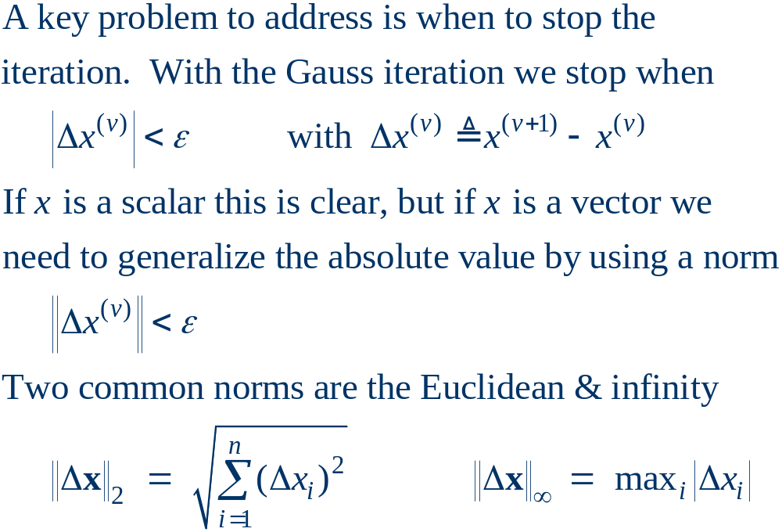
Stopping Criteria

Slide 33
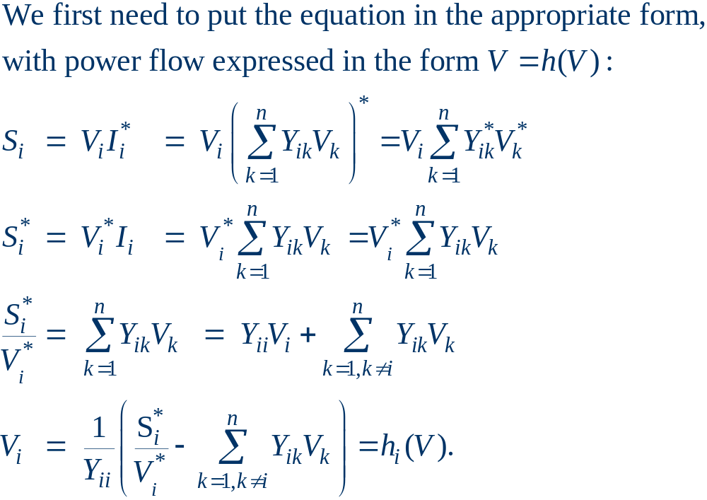
Gauss Power Flow

