Slide 1
EE 369
POWER SYSTEM ANALYSIS
Lecture 11
Power Flow
Tom Overbye and Ross Baldick

Slide 2
Announcements
Tour of UT chilling plant during class on Thursday, November 3. Meet Mr. Mack Andrews just North of San Jacinto garage at beginning of class.
Start reading Chapter 6 for lectures 11 and 12.
Homework 9 is: 6.2, 6.12, 6.13, 6.14, fourth edition: 6.9, 6.10, 6.22; fifth edition: 6.6, 6.7, 6.23; due October 27.
Read (fourth edition) Chapter 11, concentrating on sections 11.4 and 11.5; (fifth edition) Chapter 12, concentrating on sections 12.4 and 12.5.
Homework 10 is fourth edition: 6.27, 6.35, 6.36, 6.44, 6.46, 6.57, 11.24, 11.29; fifth edition 6.28, 6.36, 6.37, 6.45, 6.51, 6.57, 12.24, 12.28; due November 3. Turn in to in box next to my office door.

Slide 3
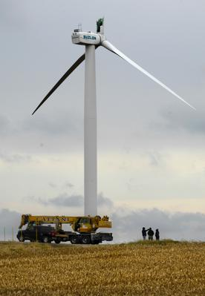
Wind Blade Failure
In recent years, a 140 foot,
6.5 ton blade broke off from a
Suzlon Energy wind turbine.
The wind turbine is located
in Illinois. Suzlon Energy is
one of the world’s largest
wind turbine manufacturers;
its shares fell 39% following
the accident. No one was hurt
and wind turbines failures
are extremely rare events.
(Vestas and Siemens turbines
have also failed.)
Photo source: Peoria Journal Star

Slide 4
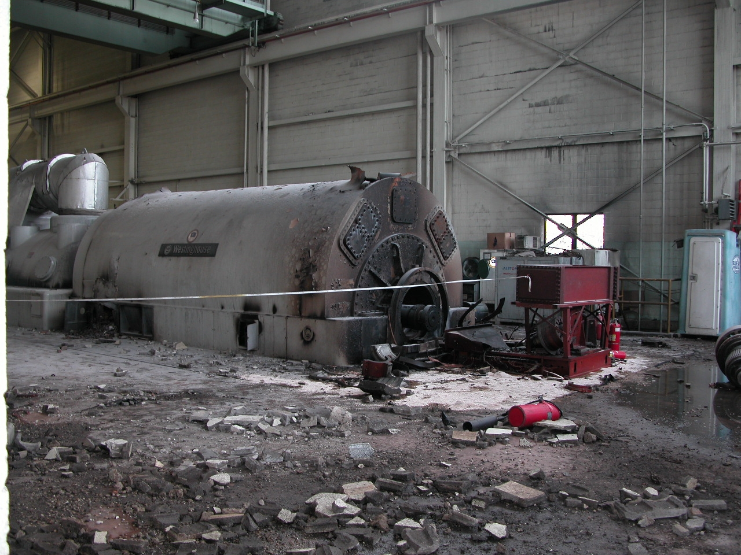
Thermal Plants Can Fail As Well: Another Illinois Failure, Fall 2007

Slide 5
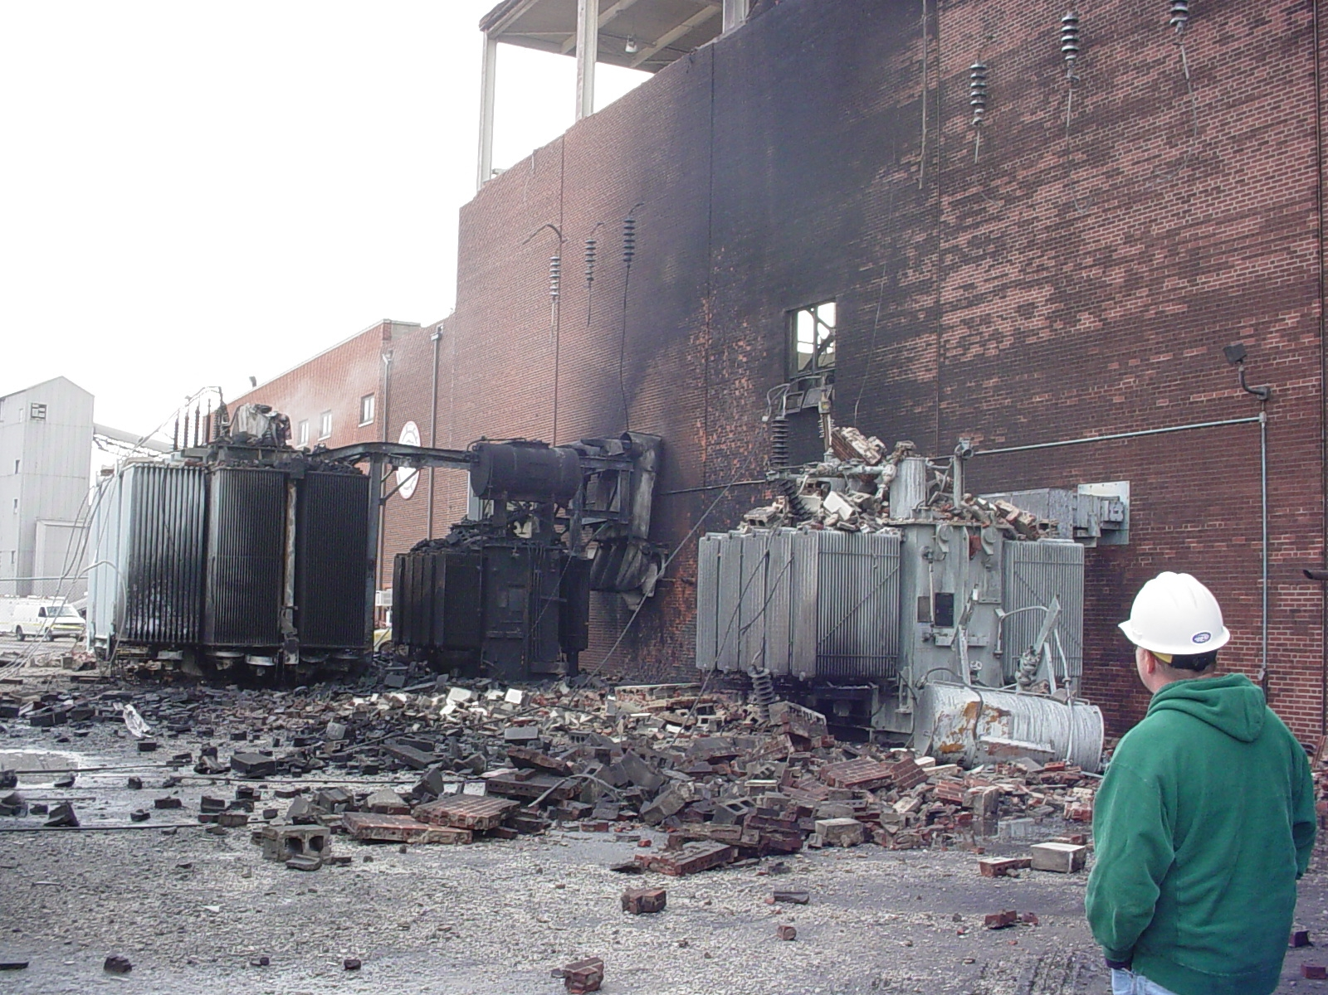
Springfield, Illinois City Water, Light and Power Explosion, Fall 2007

Slide 6
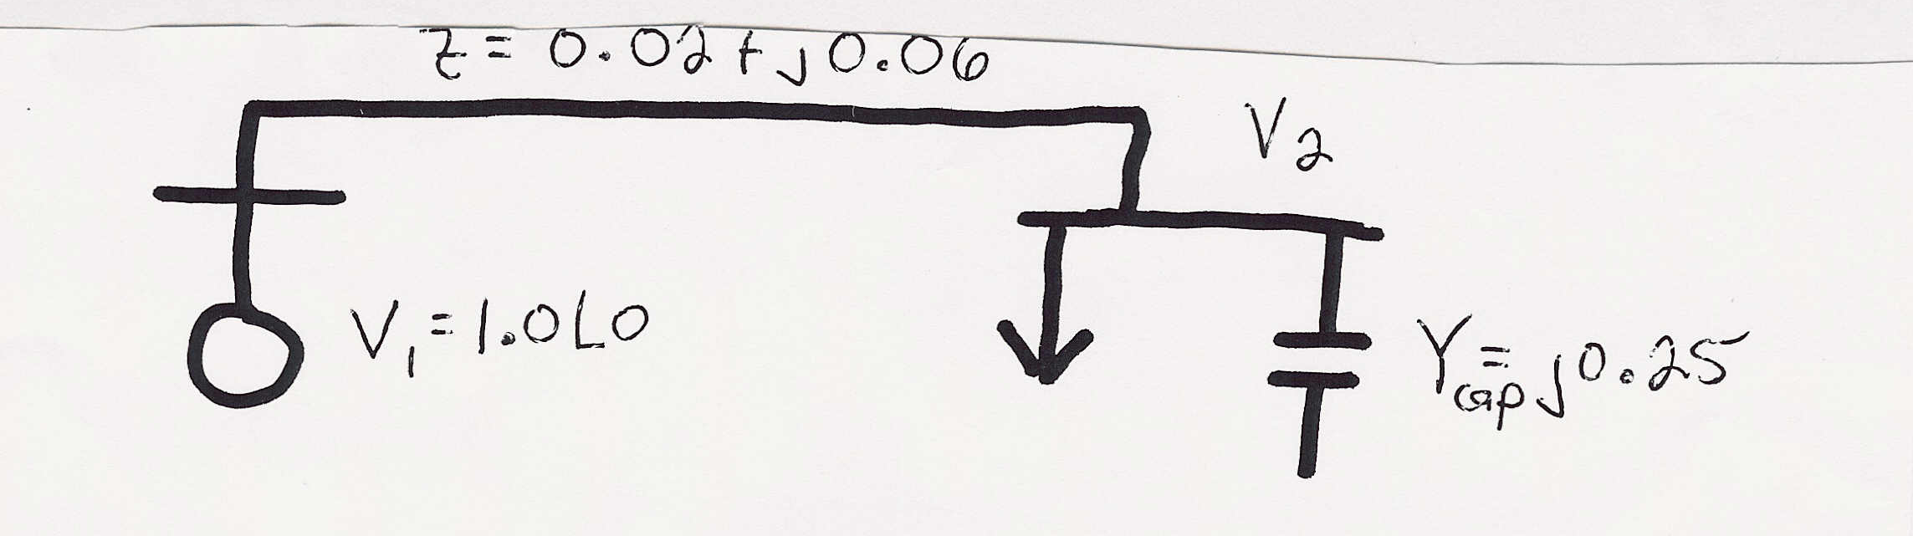
Gauss Two Bus Power Flow Example
A 100 MW, 50 MVAr load is connected to a generator through a line with z = 0.02 + j0.06 p.u. and line charging of 5 MVAr on each end (100 MVA base).
Also, there is a 25 MVAr capacitor at bus 2.
If the generator voltage is 1.0 p.u., what is V₂?
S_{Load} = 1.0 + j0.5 p.u.

Slide 7
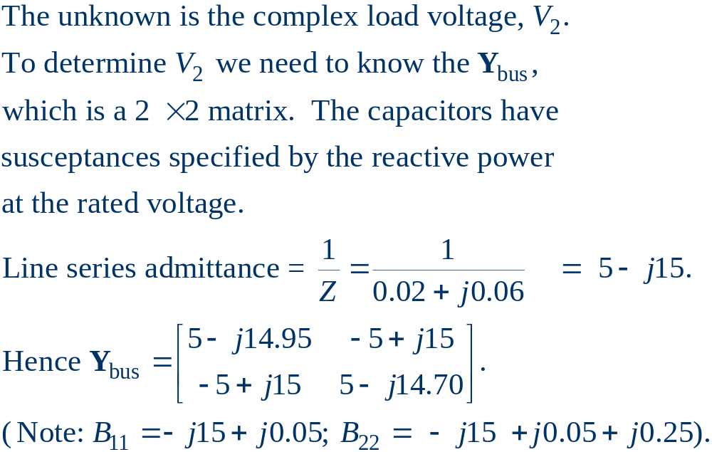
Gauss Two Bus Example, cont’d

Slide 8
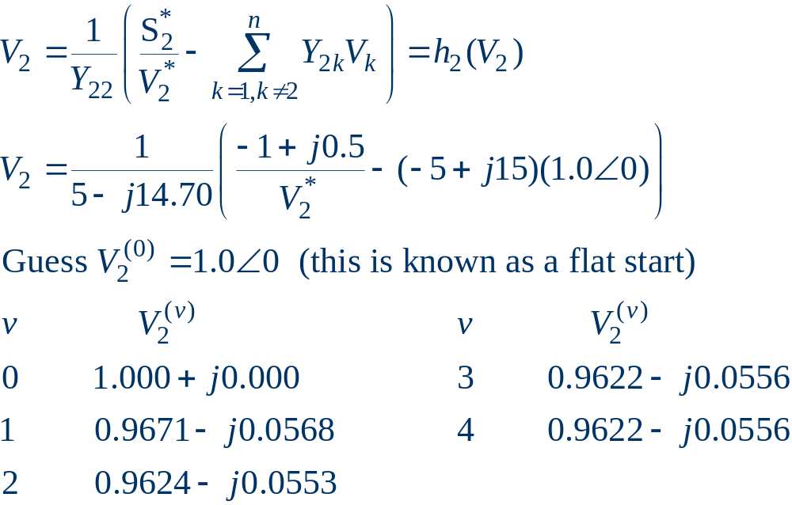
Gauss Two Bus Example, cont’d

Slide 9
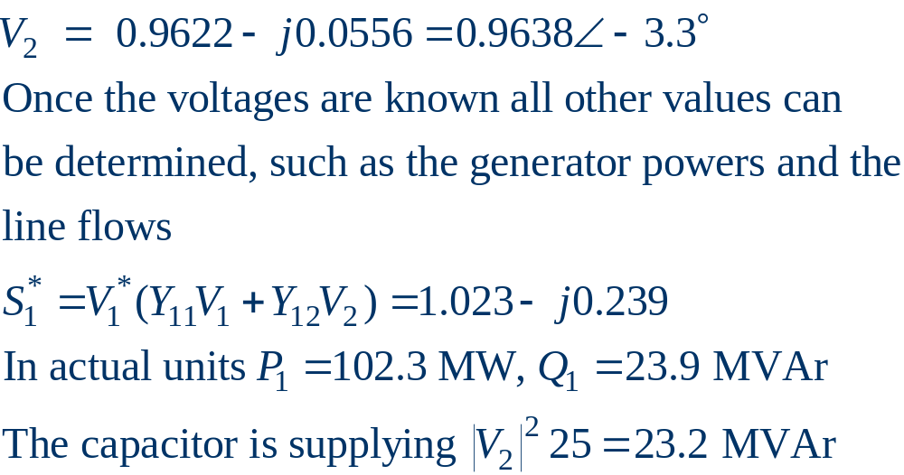
Gauss Two Bus Example, cont’d

Slide 10
Slack Bus
In previous example we specified S₂ and V₁ and then solved for S₁ and V₂.
We can not arbitrarily specify S at all buses because total generation must equal total load + total losses.
We also need an angle reference bus.
To solve these problems we define one bus as the “slack” bus. This bus has a fixed voltage magnitude and angle, and a varying real/reactive power injection. In the previous example, this was bus 1.

Slide 11
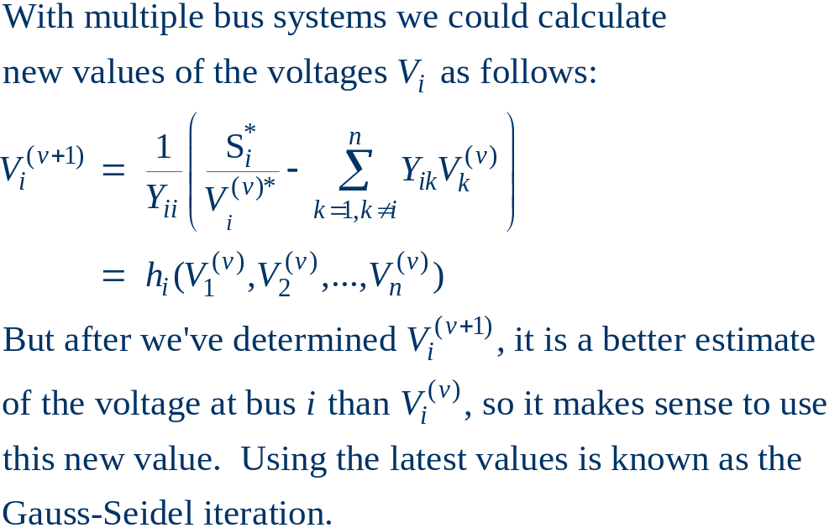
Gauss for Systems with Many Buses

Slide 12
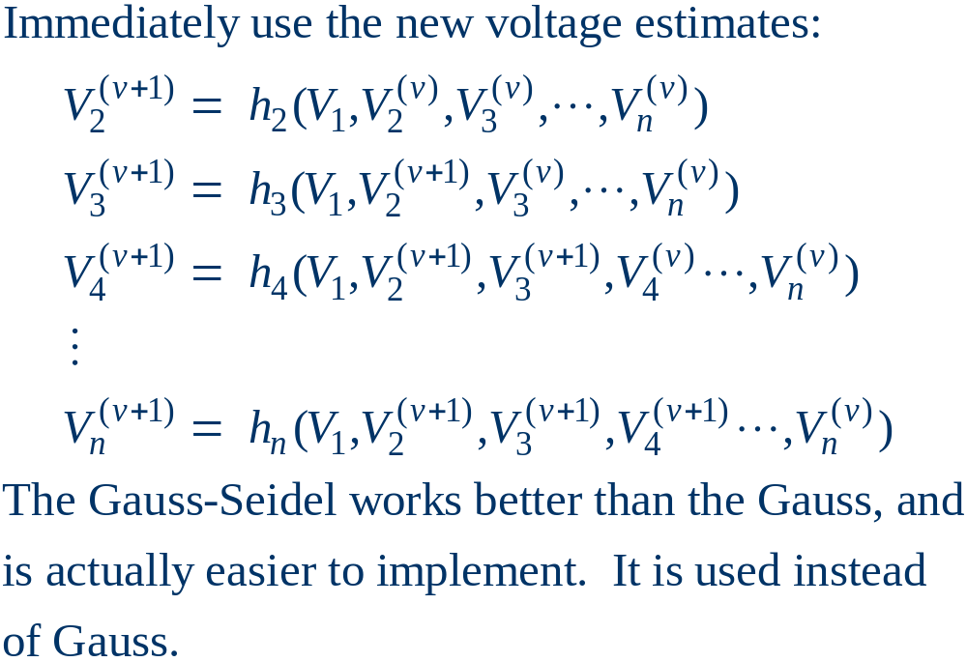
Gauss-Seidel Iteration

Slide 13
Three Types of Power Flow Buses
There are three main types of power flow buses
  Load (PQ) at which P andQ are fixed; iteration solves for voltage magnitude and angle.
  Slack at which the voltage magnitude and angle are fixed; iteration solves for P andQ injections
  Generator (PV) at which P and |V| are fixed; iteration solves for voltage angle and Q injection
    special coding is needed to include PV buses in the Gauss-Seidel iteration

Slide 14
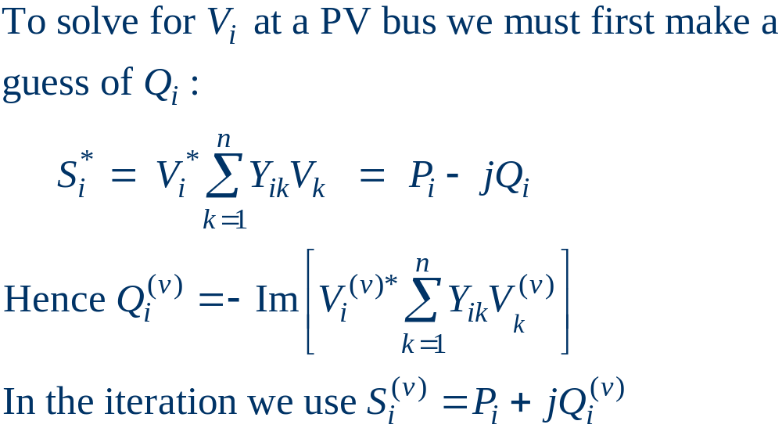
Inclusion of PV Buses in G-S

Slide 15
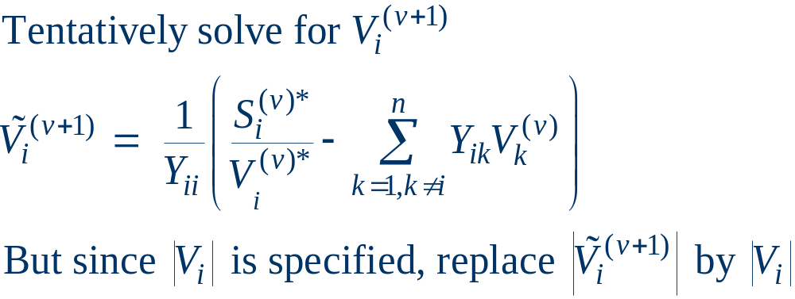
Inclusion of PV Buses, cont'd

Slide 16
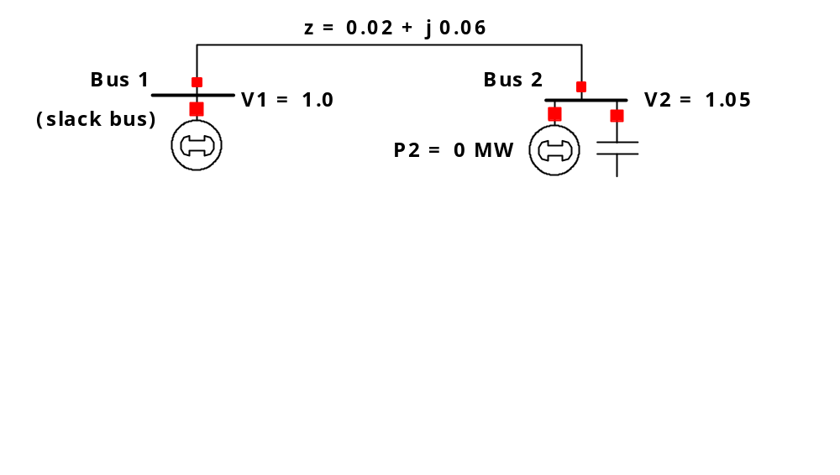
Two Bus PV Example
Consider the same two bus system from the previous
example, except the load is replaced by a generator

Slide 17
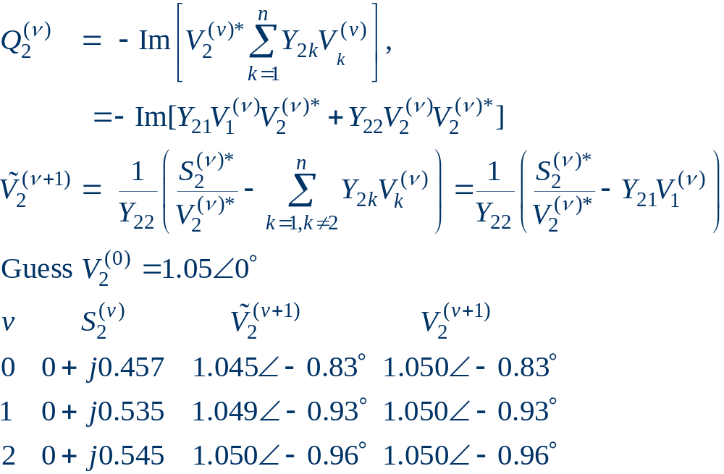
Two Bus PV Example, cont'd

Slide 18
Generator Reactive Power Limits
The reactive power output of generators varies to maintain the terminal voltage; on a real generator this is done by the exciter.
To maintain higher voltages requires more reactive power.
Generators have reactive power limits, which are dependent upon the generator's MW output.
These limits must be considered during the power flow solution.

Slide 19
Generator Reactive Limits, cont'd
During power flow once a solution is obtained, need to check if the generator reactive power output is within its limits
If the reactive power is outside of the limits, then fix Q at the max or min value, and re-solve treating the generator as a PQ bus
  this is know as "type-switching"
  also need to check if a PQ generator can again regulate
Rule of thumb: to raise system voltage we need to supply more VArs.

Slide 20
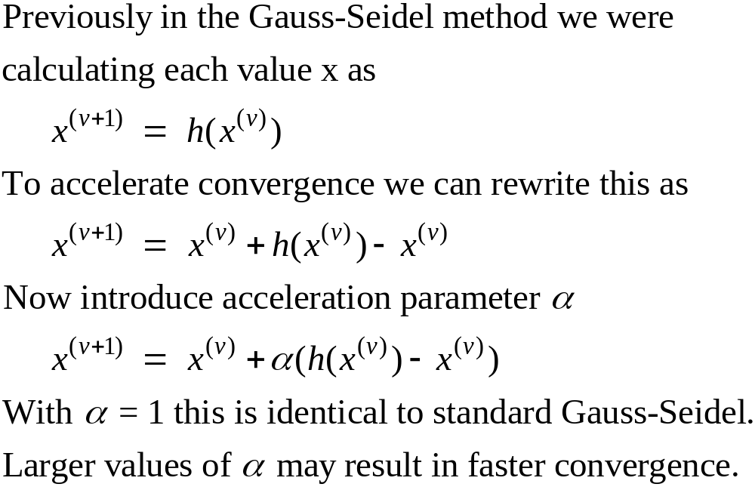
Accelerated G-S Convergence

Slide 21
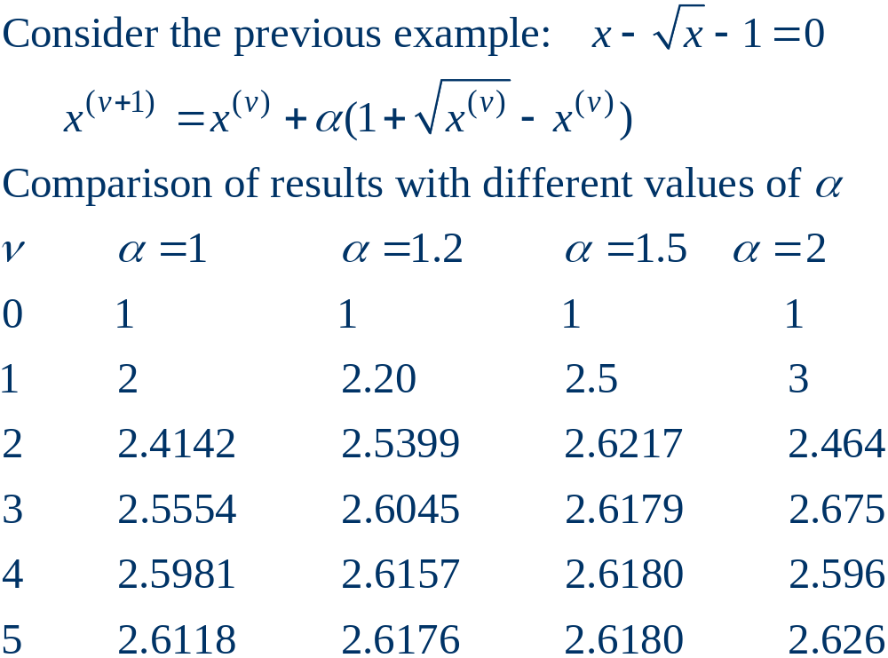
Accelerated Convergence, cont’d

Slide 22
Gauss-Seidel Advantages
Each iteration is relatively fast (computational order is proportional to number of branches + number of buses in the system).
Relatively easy to program.

Slide 23
Gauss-Seidel Disadvantages
Tends to converge relatively slowly, although this can be improved with acceleration.
Has tendency to fail to find solutions, particularly on large systems.
Tends to diverge on cases with negative branch reactances (common with compensated lines)
Need to program using complex numbers.

Slide 24
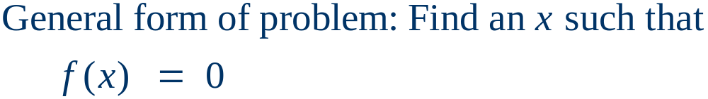
Newton-Raphson Algorithm
The second major power flow solution method is the Newton-Raphson algorithm
Key idea behind Newton-Raphson is to use sequential linearization

Slide 25
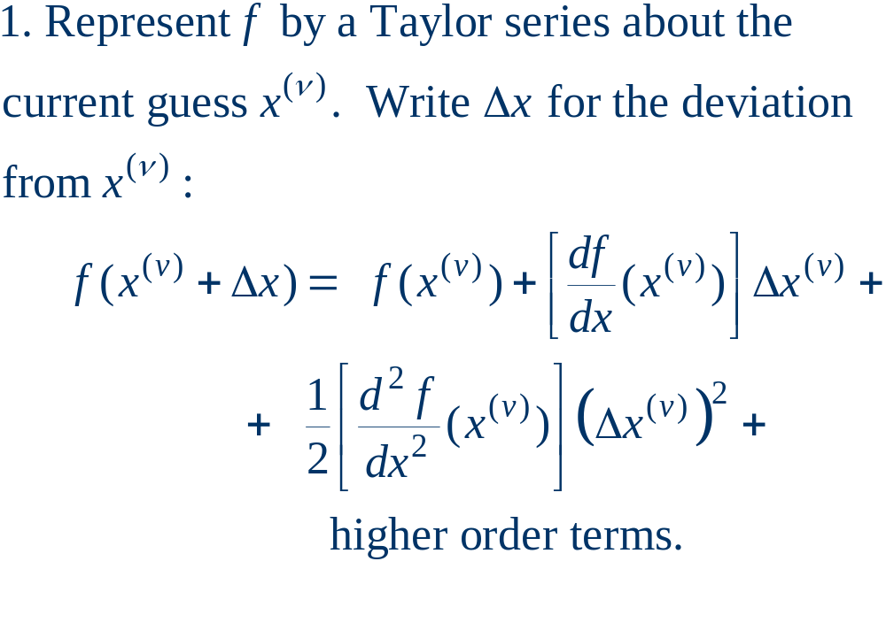
Newton-Raphson Method (scalar)

Slide 26
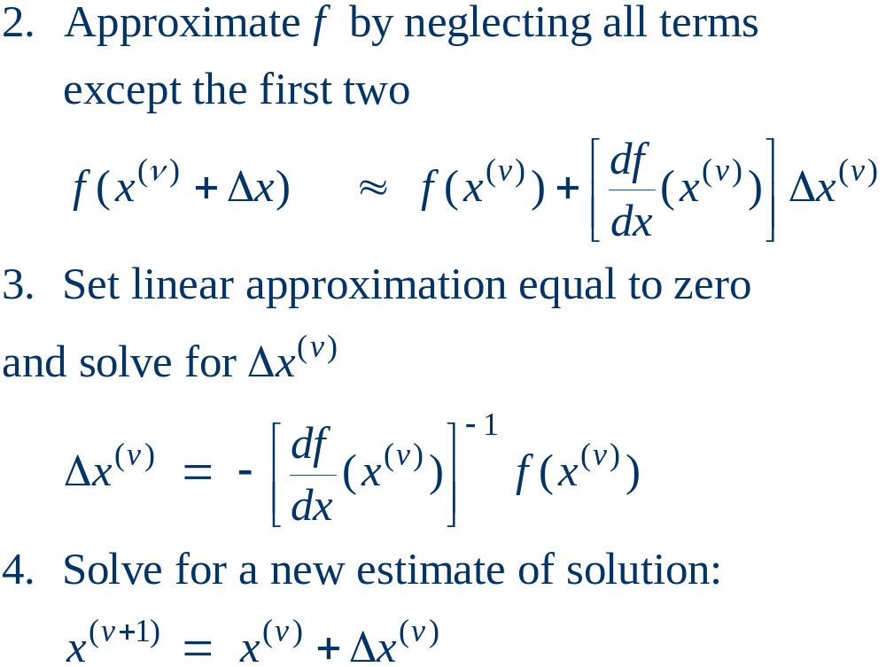
Newton-Raphson Method, cont’d

Slide 27
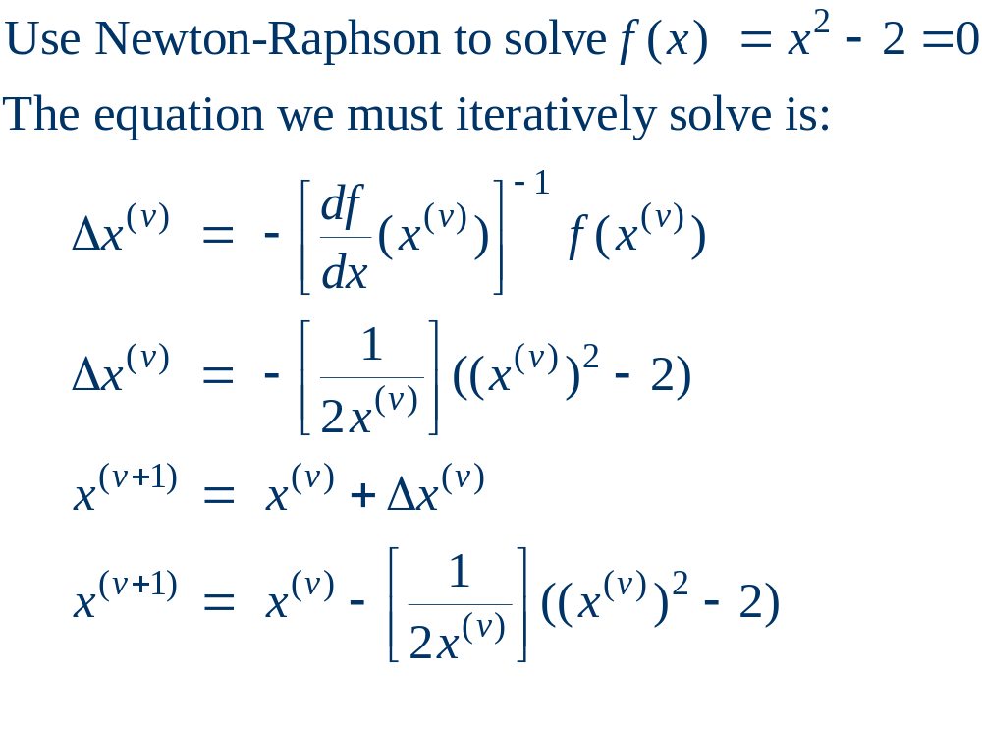
Newton-Raphson Example

Slide 28
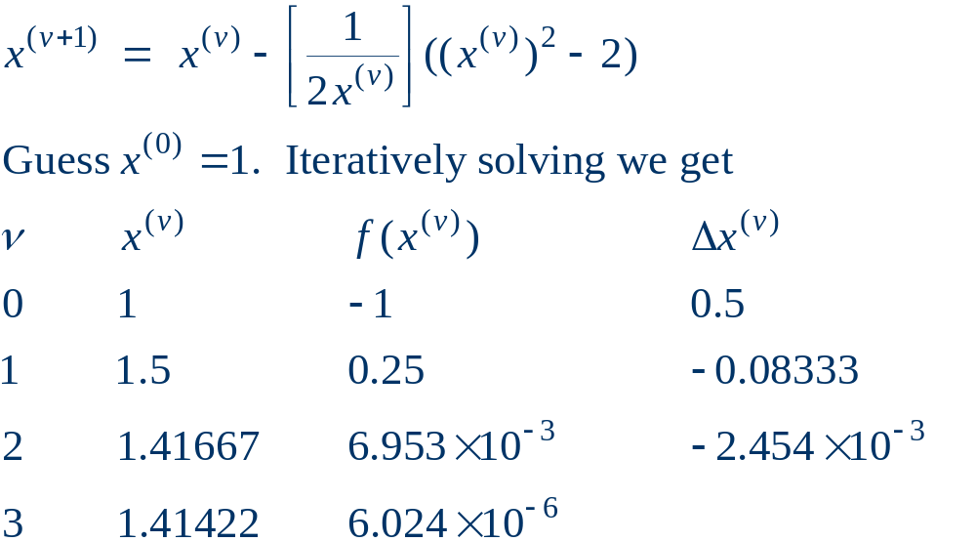
Newton-Raphson Example, cont’d

Slide 29
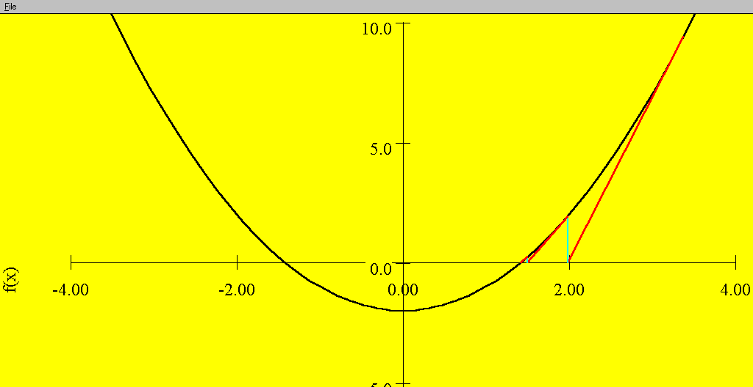
Sequential Linear Approximations
At each
iteration the
N-R method
uses a linear
approximation
to determine
the next value
for x
Function is f(x) = x² - 2 = 0.
Solutions are points where
f(x) intersects x axis.

Slide 30
Newton-Raphson Comments
When close to the solution the error decreases quite quickly -- method has “quadratic” convergence.
f(x^{(v)}) is known as the mismatch, which we would like to drive to zero.
Stopping criteria is when ⏐f(x^{(v)}) ⏐ < ε
Results are dependent upon the initial guess. What if we had guessed x⁽⁰⁾ = 0, or x⁽⁰⁾ = -1?
A solution’s region of attraction (ROA) is the set of initial guesses that converge to the particular solution. The ROA is often hard to determine.

Slide 31
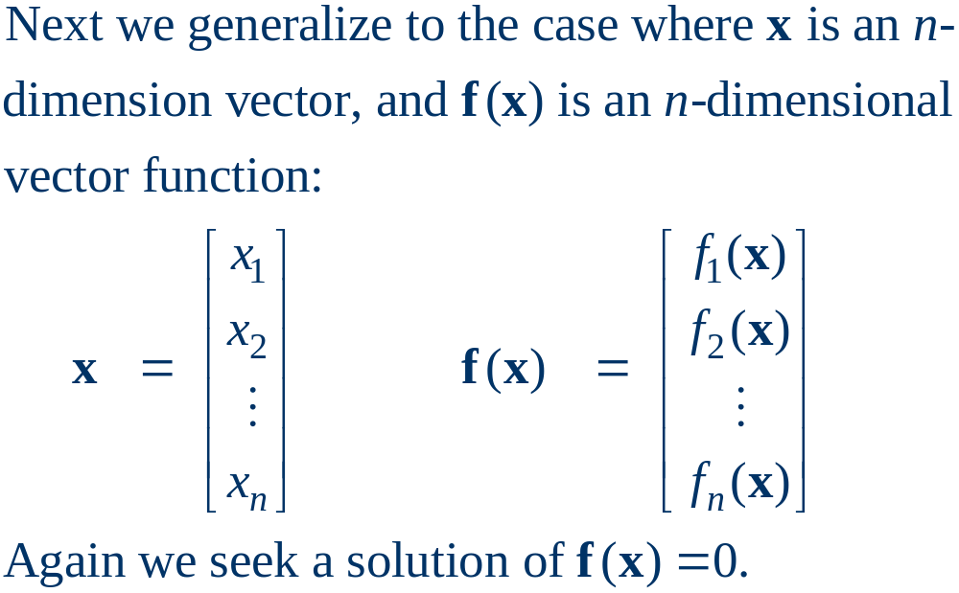
Multi-Variable Newton-Raphson

Slide 32
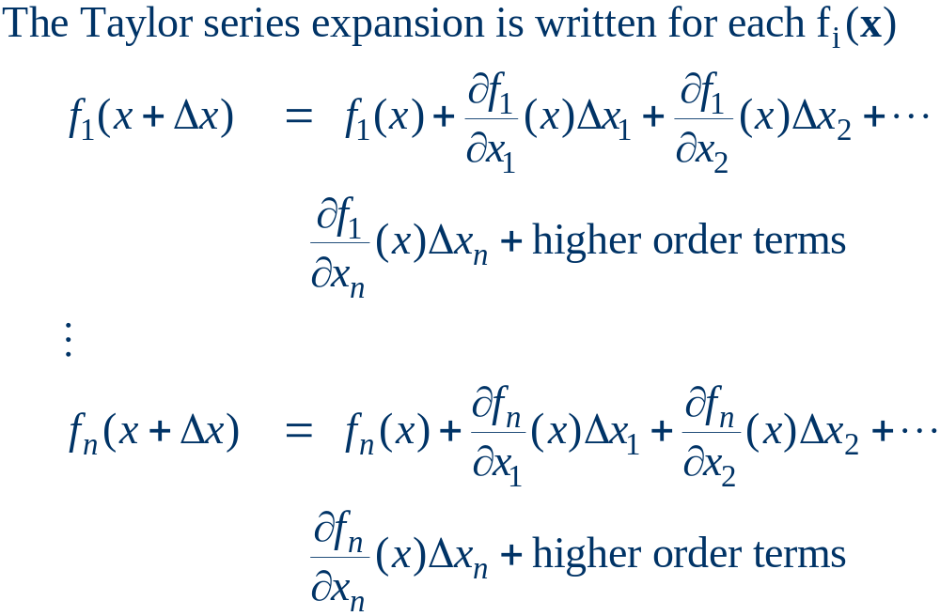
Multi-Variable Case, cont’d

Slide 33
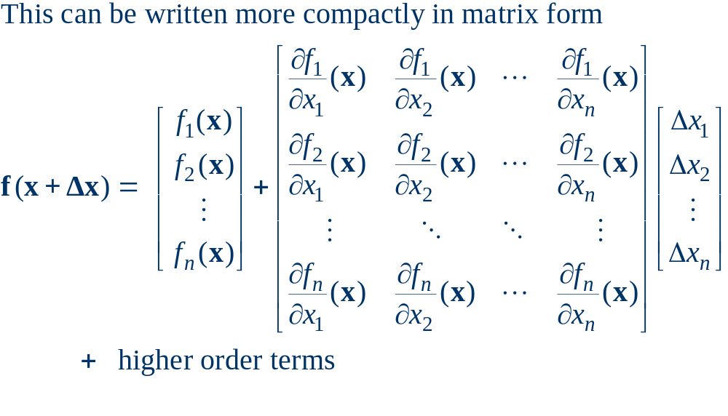
Multi-Variable Case, cont’d

Slide 34
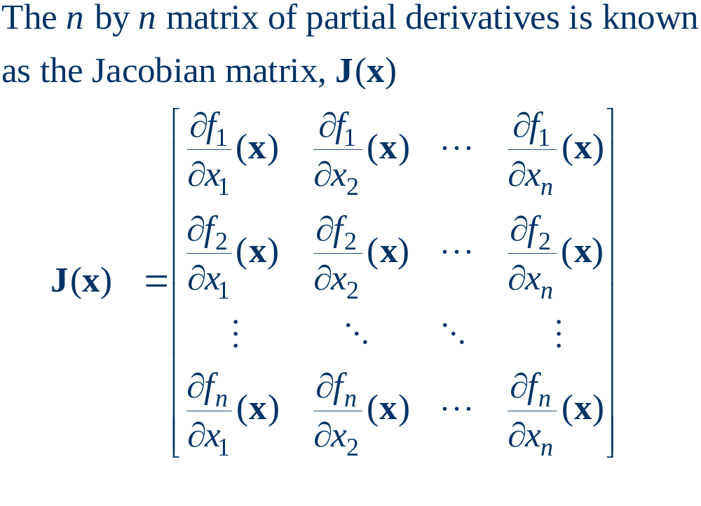
Jacobian Matrix

Slide 35
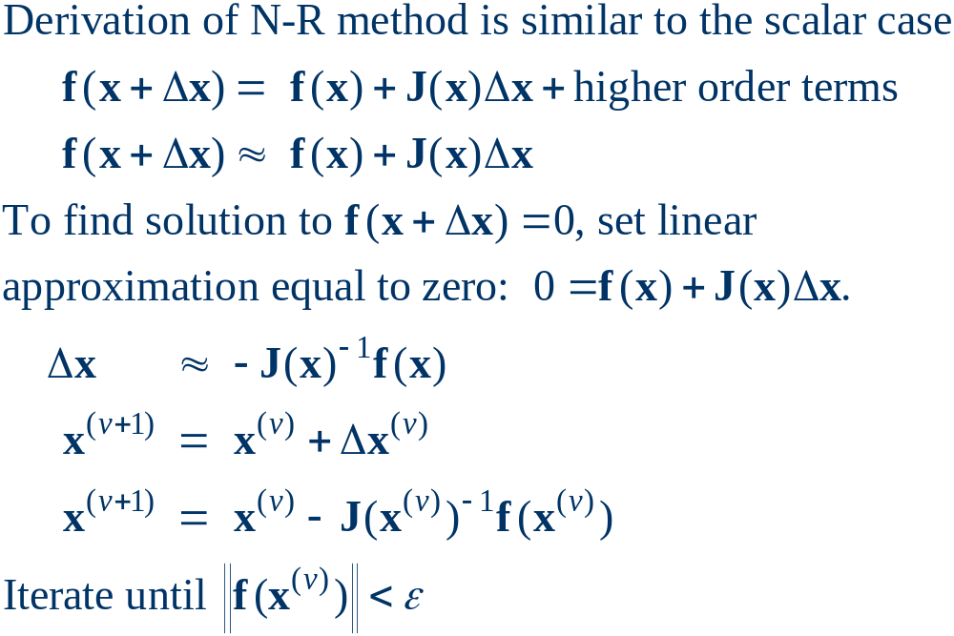
Multi-Variable N-R Procedure

Slide 36
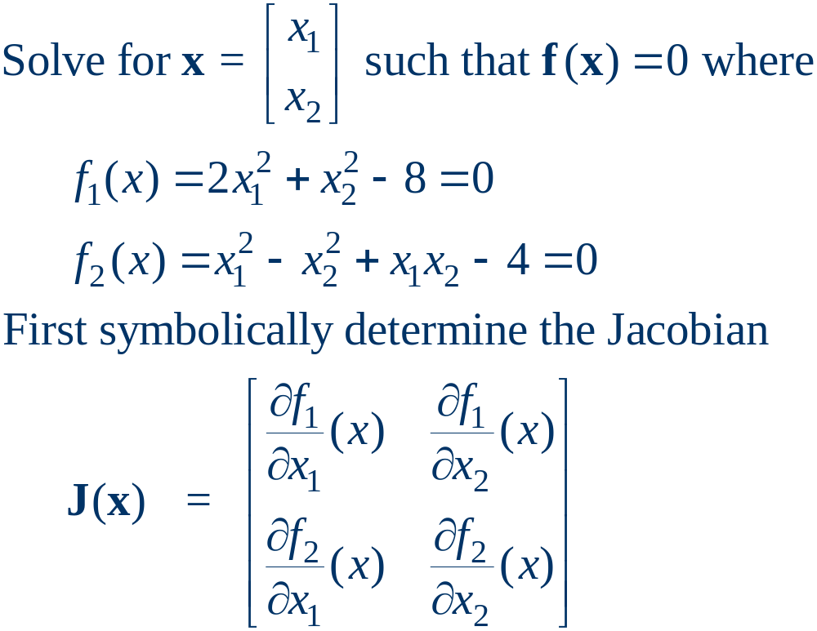
Multi-Variable Example

Slide 37
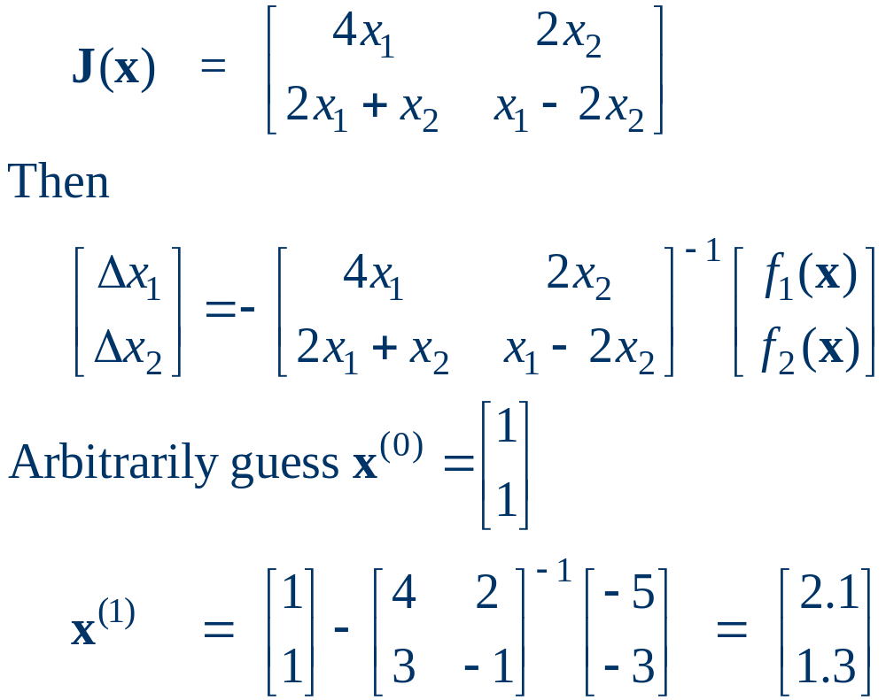
Multi-variable Example, cont’d

Slide 38
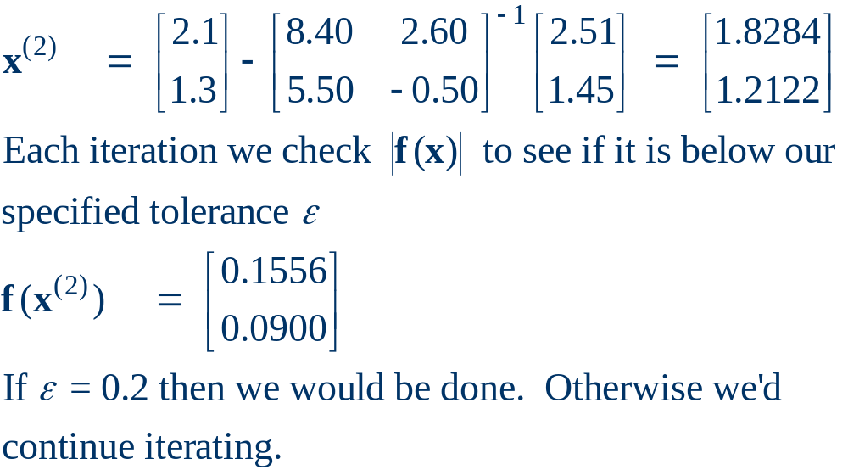
Multi-variable Example, cont’d

