Slide 1
EE 369
POWER SYSTEM ANALYSIS
Lecture 12
Power Flow
Tom Overbye and Ross Baldick

Slide 2
Announcements
Tour of UT chilling plant during class on Thursday, November 3. Meet Mr. Mack Andrews just North of San Jacinto garage at beginning of class.
Homework 9 is: 6.2, 6.12, 6.13, 6.14, fourth edition: 6.9, 6.10, 6.22; fifth edition: 6.6, 6.7, 6.23; due October 27.
Read Chapter 6 and (fourth edition) Chapter 11, concentrating on sections 11.4 and 11.5; (fifth edition) Chapter 12, concentrating on sections 12.4 and 12.5.
Homework 10 is fourth edition: 6.27, 6.35, 6.36, 6.44, 6.46, 6.57, 11.24, 11.29; fifth edition 6.28, 6.36, 6.37, 6.45, 6.51, 6.57, 12.24, 12.28; due November 3. Turn in to “in box” next to my office door.

Slide 3
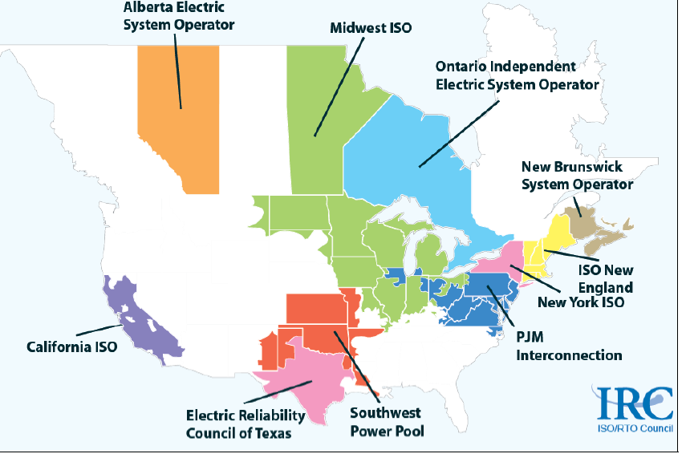
Power System Planning
Source: Midwest ISO MTEP08 Report

Slide 4
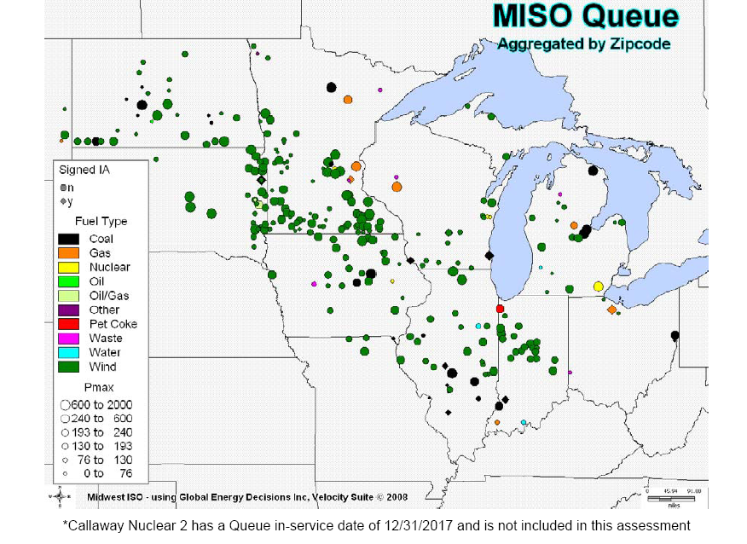
MISO Generation Queue
Source: Midwest ISO MTEP08 Report

Slide 5
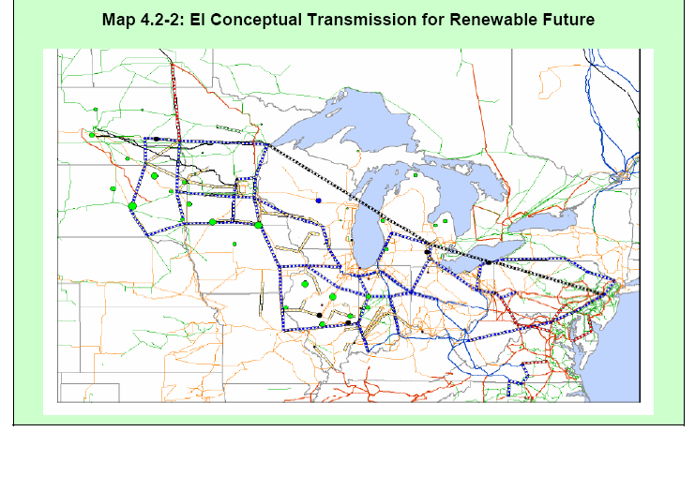
MISO Conceptual EHV Overlay
Black lines are DC, blue lines are 765kV, red are 500 kV
Source: Midwest ISO MTEP08 Report

Slide 6
ERCOT
Also has considerable wind and expecting considerable more!
“Competitive Renewable Energy Zones” study identified most promising wind sites,
Building around $5 billion (original estimate, now closer to $7 billion) of transmission to support an additional 11 GW of wind.

Slide 7
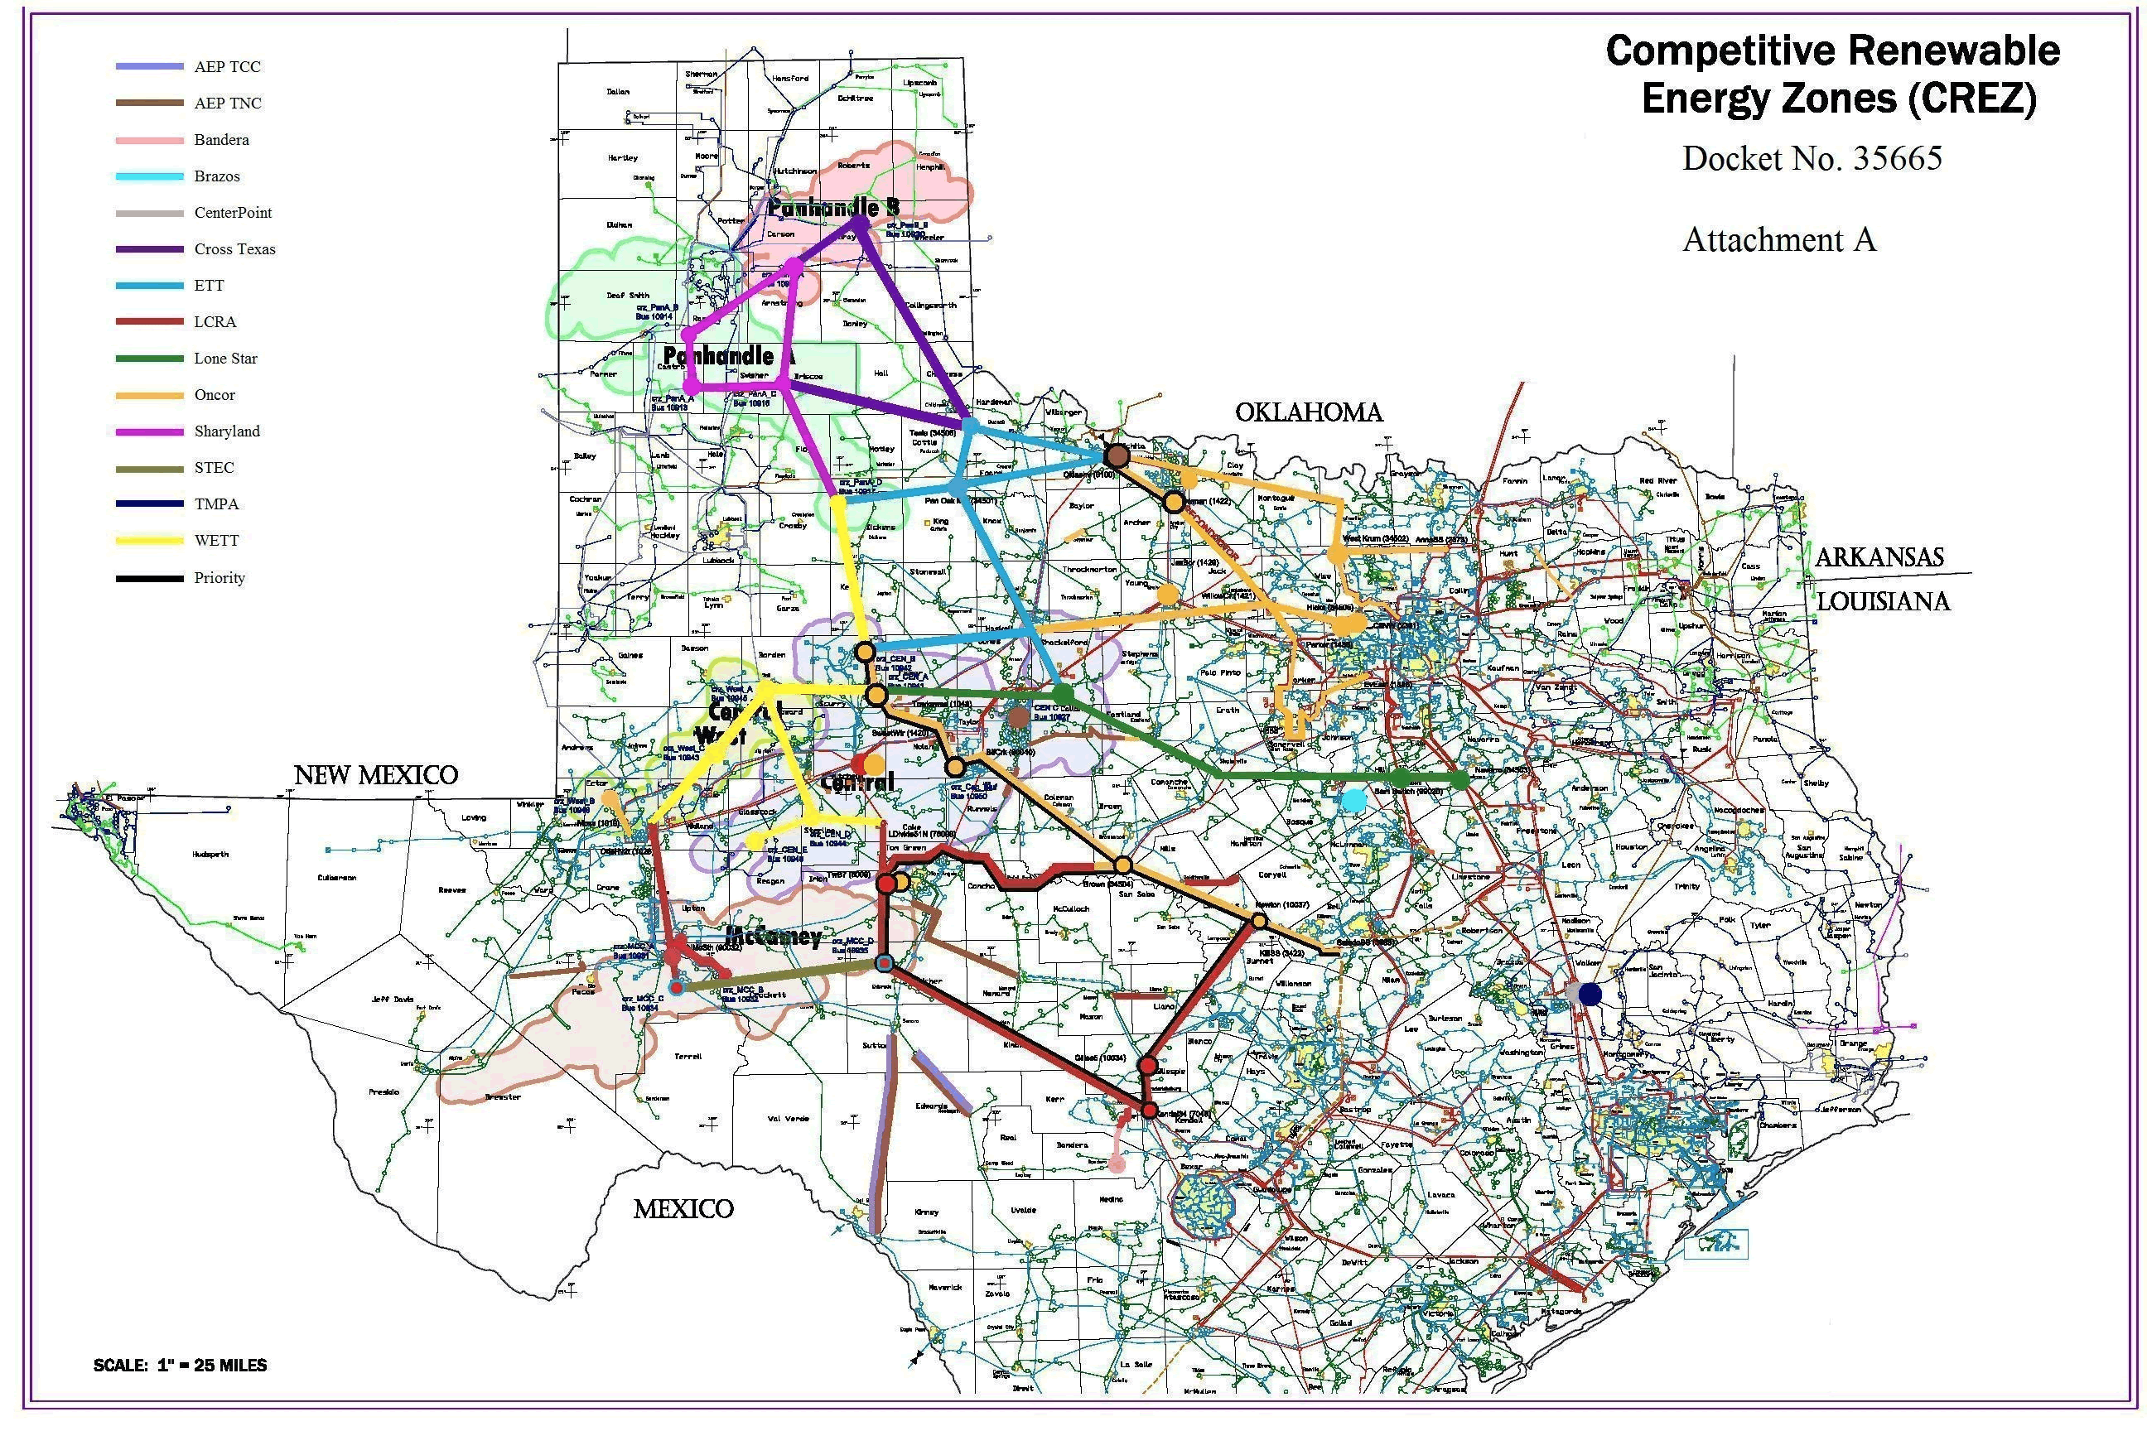
CREZ Transmission Lines

Slide 8
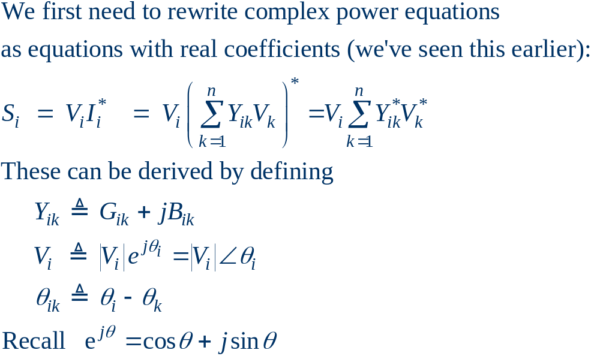
NR Application to Power Flow

Slide 9
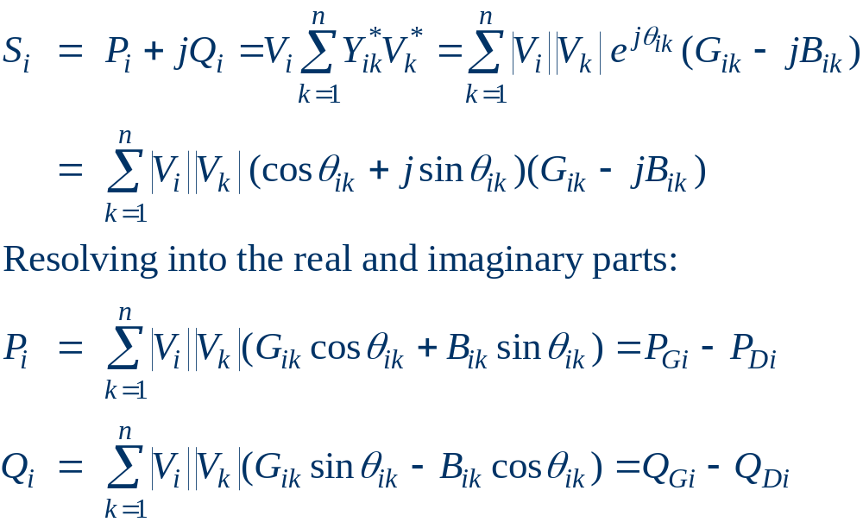
Real Power Balance Equations

Slide 10
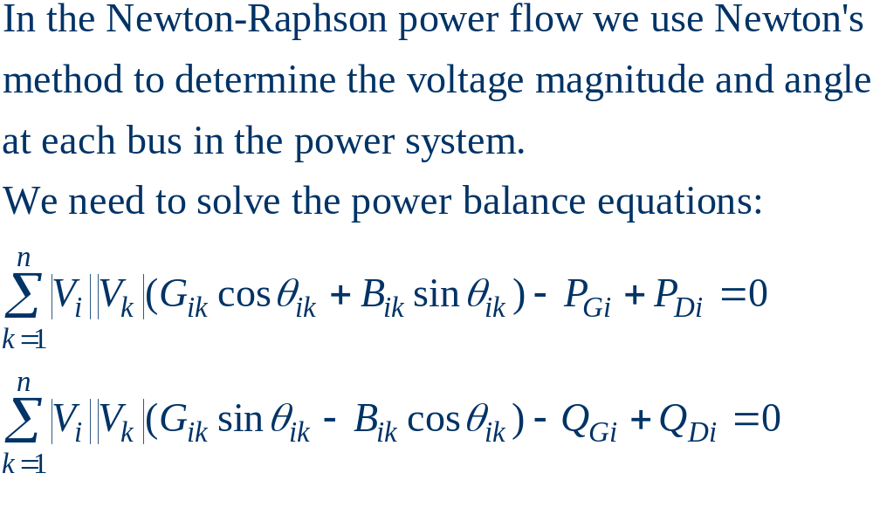
Newton-Raphson Power Flow

Slide 11
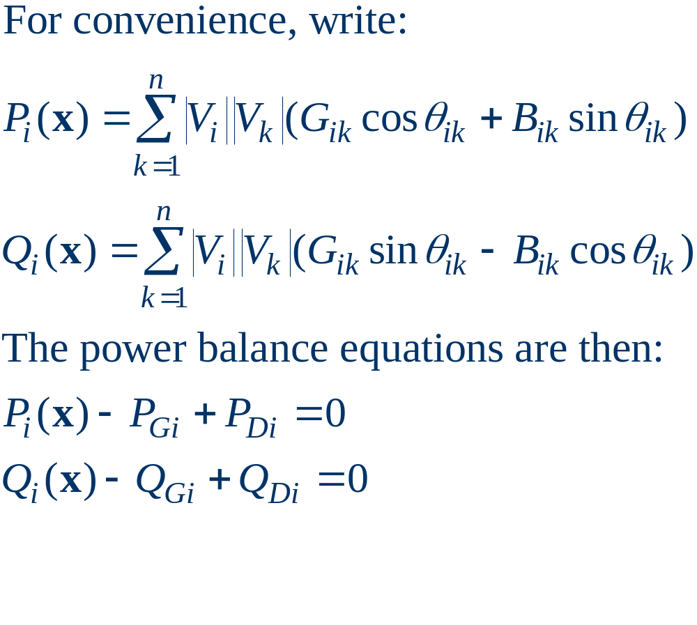
Power Flow Variables

Slide 12
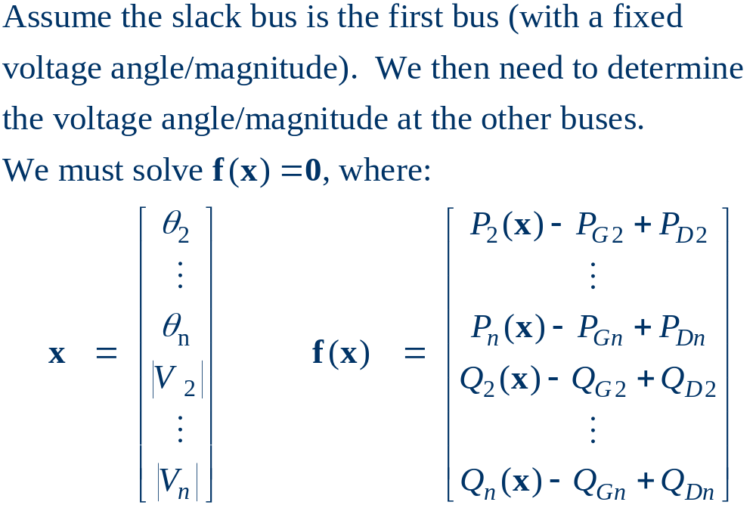
Power Flow Variables

Slide 13
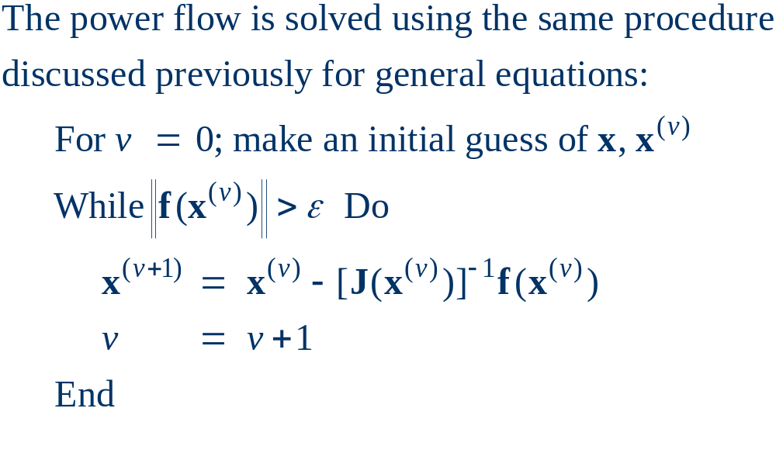
N-R Power Flow Solution

Slide 14
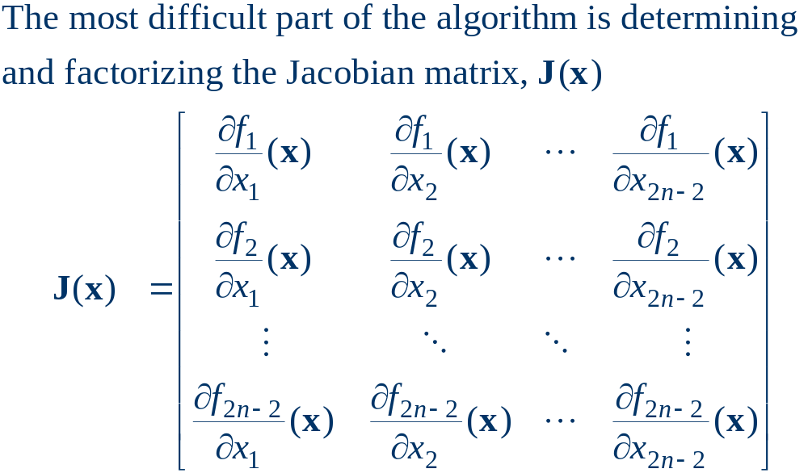
Power Flow Jacobian Matrix

Slide 15
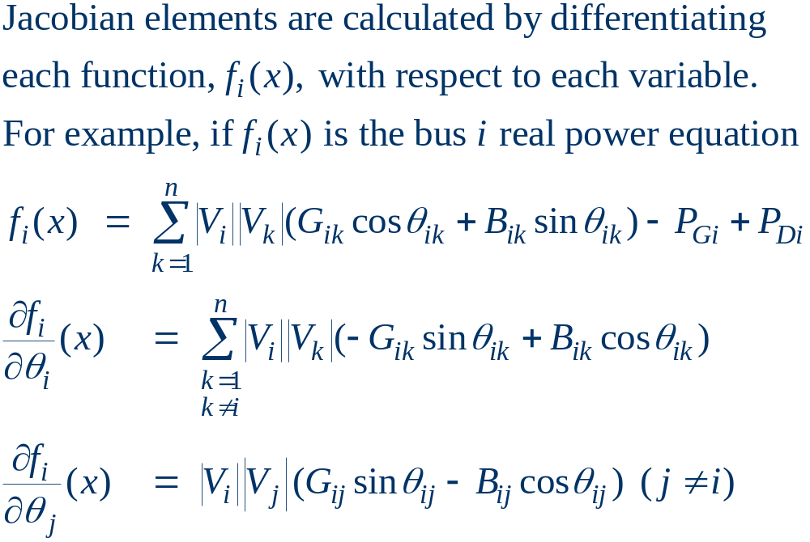
Power Flow Jacobian Matrix, cont’d

Slide 16
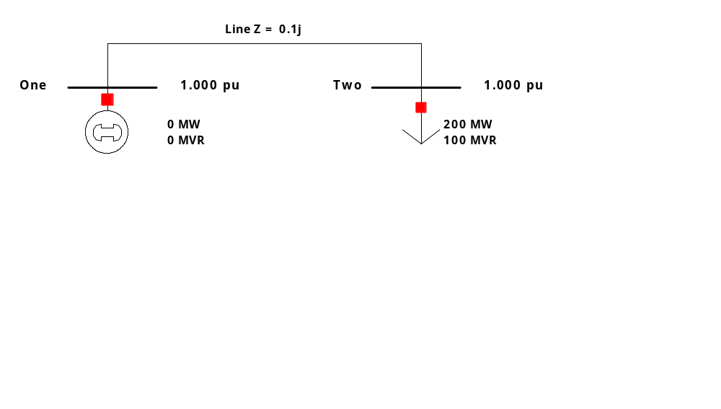
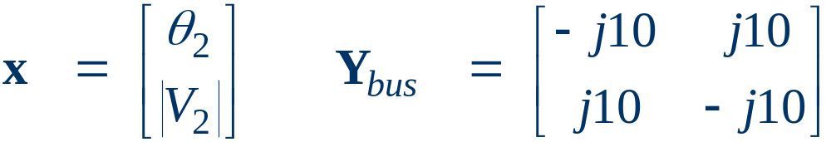
Two Bus Newton-Raphson Example
For the two bus power system shown below, use the
Newton-Raphson power flow to determine the
voltage magnitude and angle at bus two. Assume
that bus one is the slack and S_{Base} = 100 MVA.

Slide 17
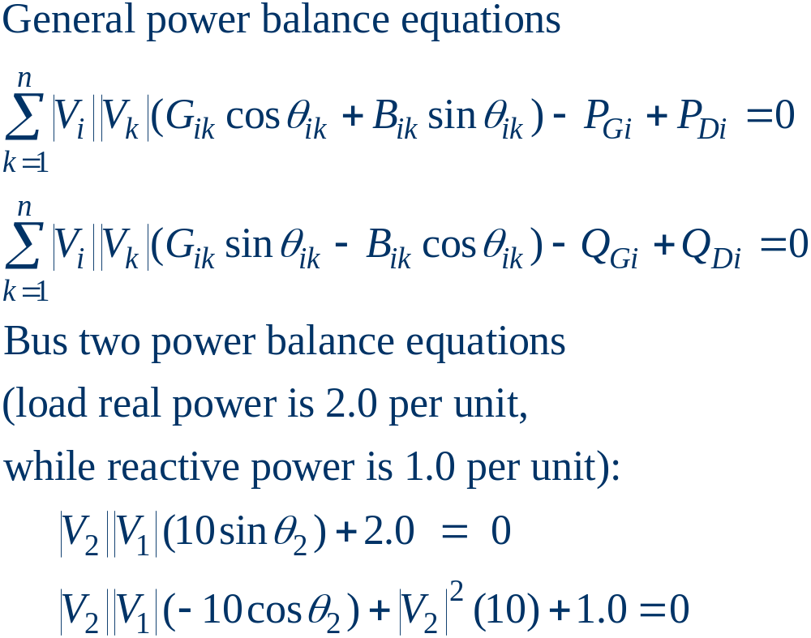
Two Bus Example, cont’d

Slide 18
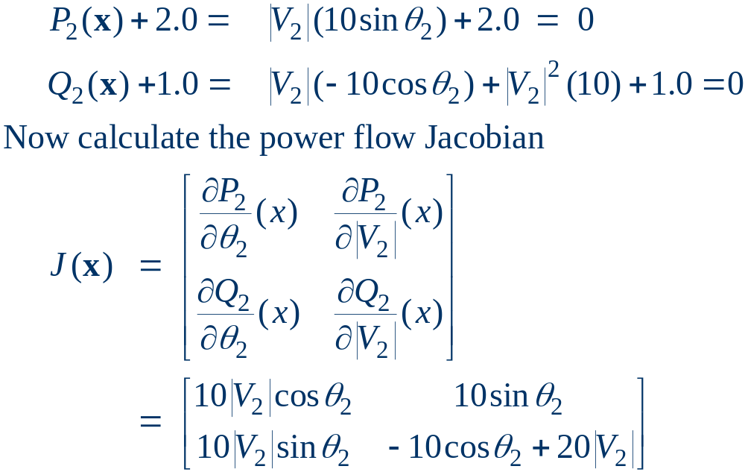
Two Bus Example, cont’d

Slide 19
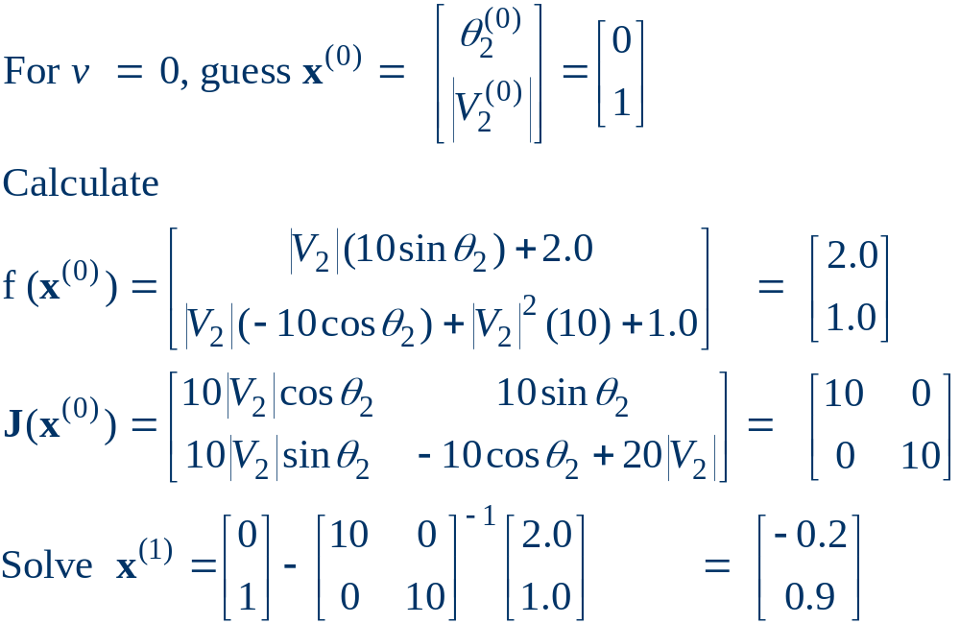
Two Bus Example, First Iteration

Slide 20
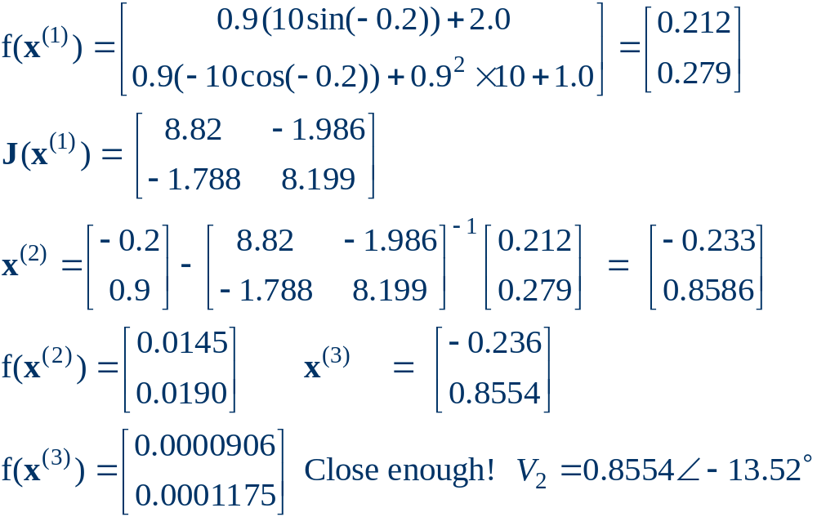
Two Bus Example, Next Iterations

Slide 21
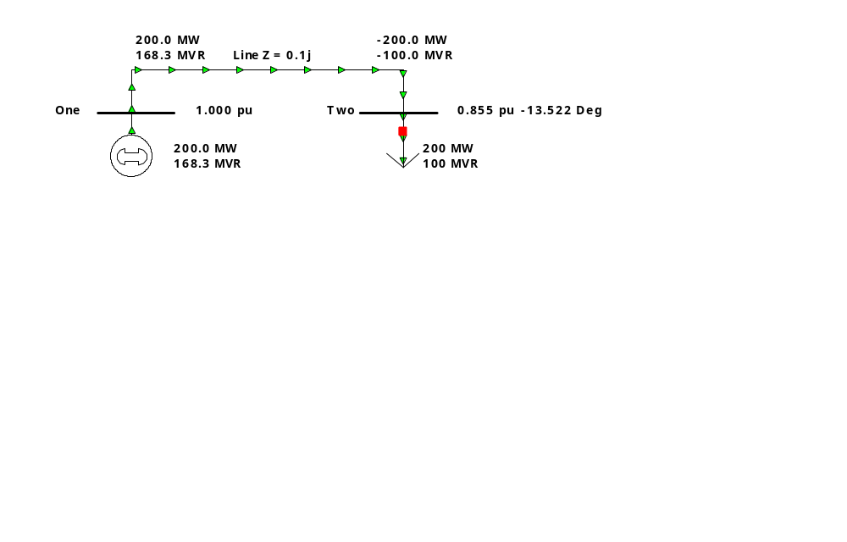
Two Bus Solved Values
Once the voltage angle and magnitude at bus 2 are
known we can calculate all the other system values,
such as the line flows and the generator reactive
power output

Slide 22
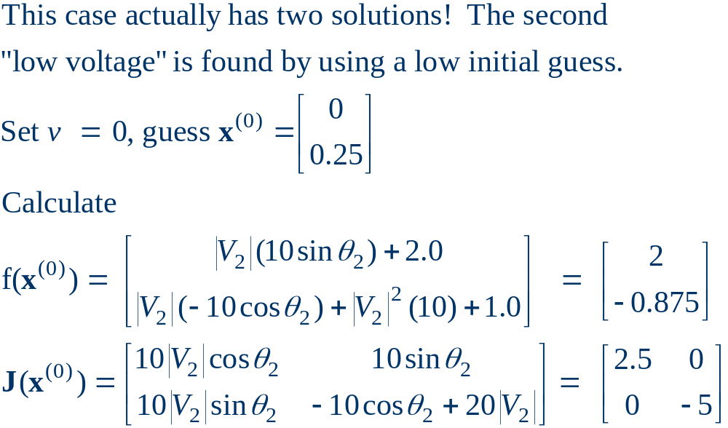
Two Bus Case Low Voltage Solution

Slide 23
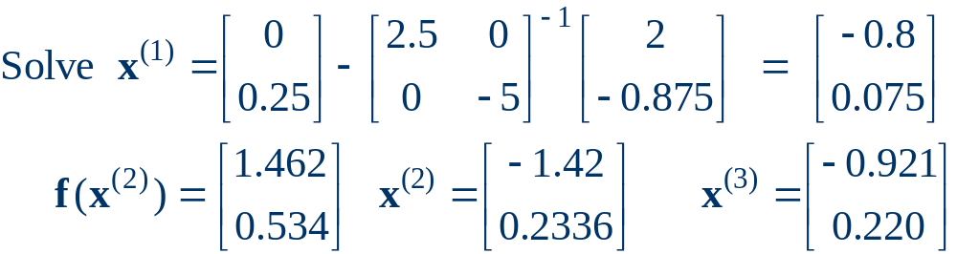
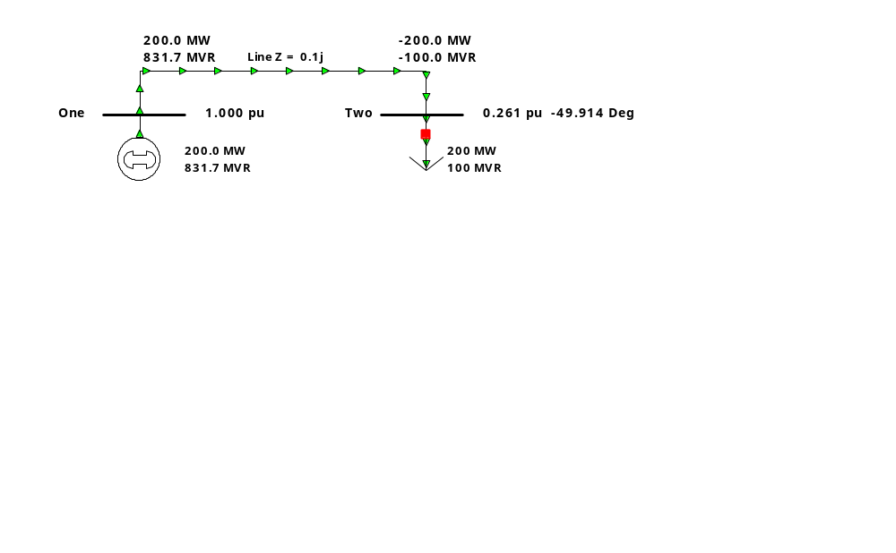
Low Voltage Solution, cont'd
Low voltage solution

Slide 24
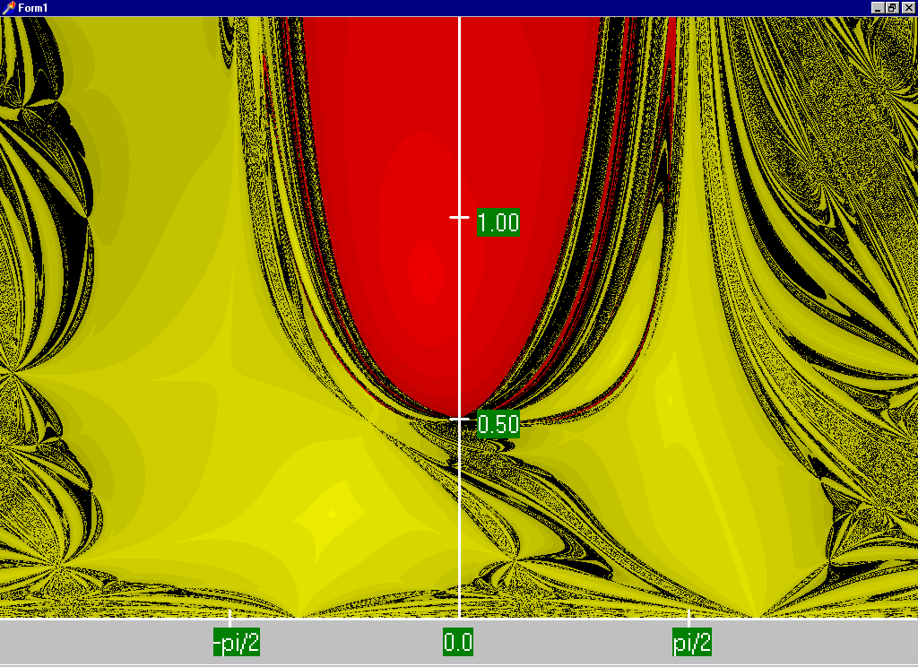
Two Bus Region of Convergence
Graph shows the region of convergence for different initial
guesses of bus 2 angle (horizontal axis) and magnitude (vertical axis).
Red region
converges
to the high
voltage
solution,
while the
yellow region
converges
to the low
voltage
solution
Maximum
of 15
iterations

Slide 25
PV Buses
Since the voltage magnitude at PV buses is fixed there is no need to explicitly include these voltages in x nor write the reactive power balance equations:
  the reactive power output of the generator varies to maintain the fixed terminal voltage (within limits), so we can just set the reactive power product to whatever is needed.
  An alternative is these variations/equations can be included by just writing the explicit voltage constraint for the generator bus:
  |V_{i} | – V_{i setpoint} = 0

Slide 26
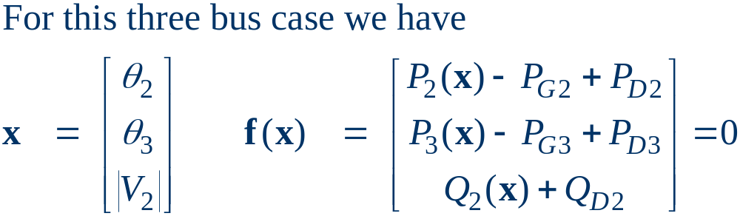
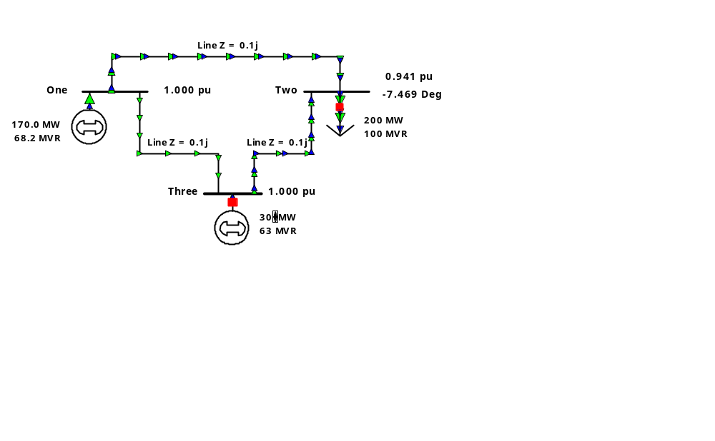
Three Bus PV Case Example

Slide 27
PV Buses
With Newton-Raphson, PV buses means that there are less unknown variables we need to calculate explicitly and less equations we need to satisfy explicitly.
Reactive power balance is satisfied implicitly by choosing reactive power production to be whatever is needed, once we have a solved case (like real power at the slack bus).
Contrast to Gauss iterations where PV buses complicated the algorithm.

Slide 28
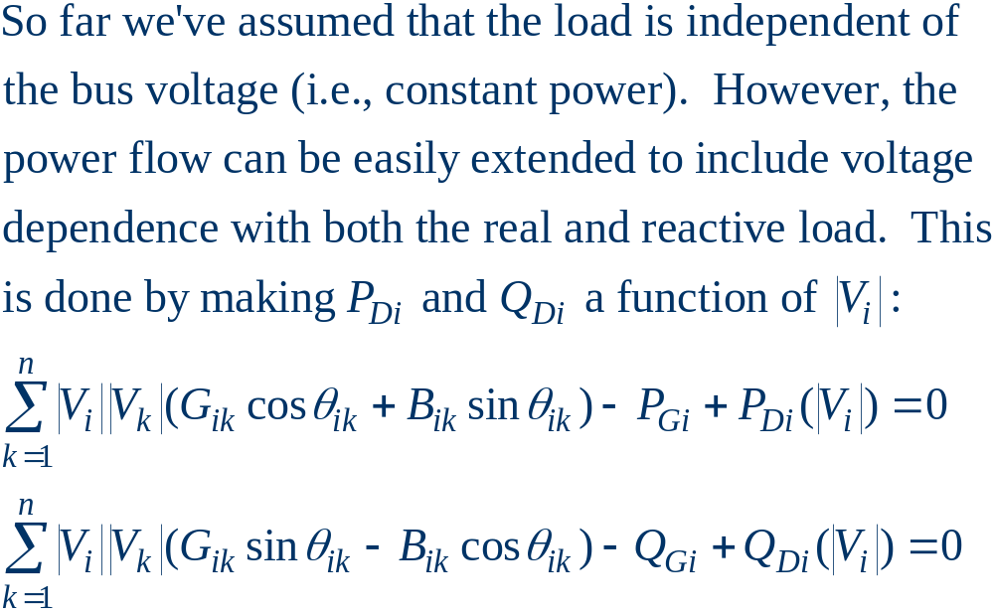
Modeling Voltage Dependent Load

Slide 29
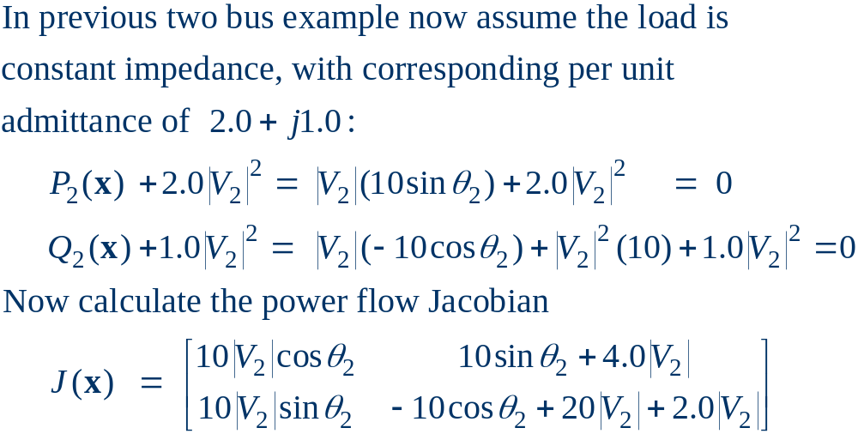
Voltage Dependent Load Example

Slide 30
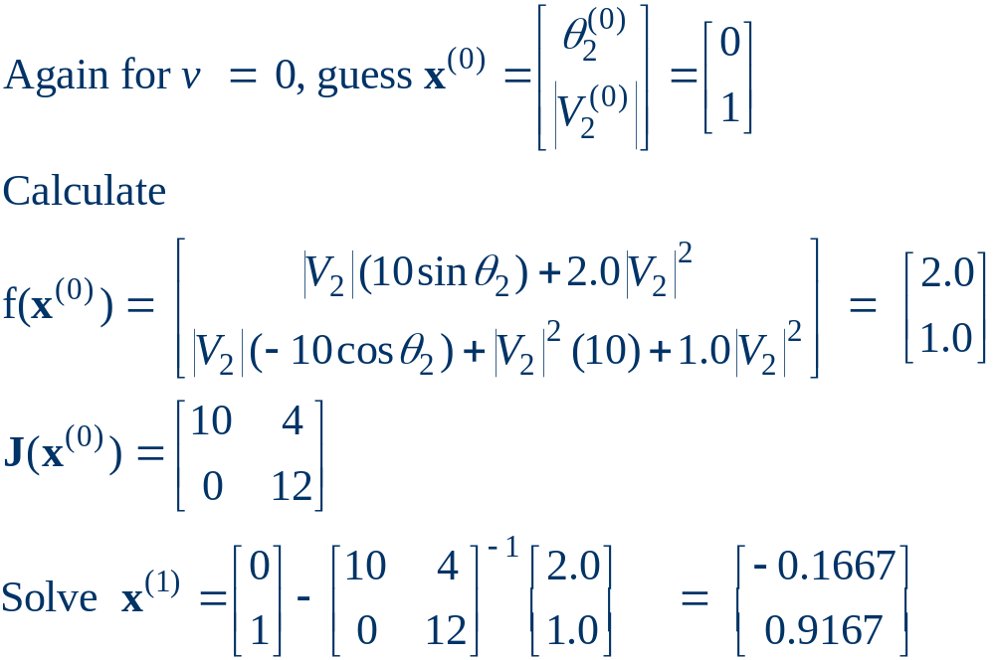
Voltage Dependent Load, cont'd

Slide 31
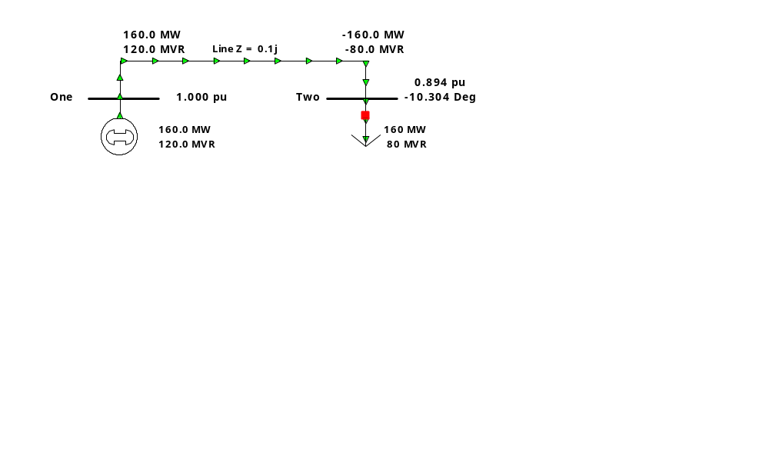
Voltage Dependent Load, cont'd
With constant impedance load the MW/MVAr load at
bus 2 varies with the square of the bus 2 voltage
magnitude. This if the voltage level is less than 1.0,
the load is lower than 200/100 MW/MVAr

Slide 32
Solving Large Power Systems
Most difficult computational task is inverting the Jacobian matrix (or solving the update equation):
  factorizing a full matrix is an order n³ operation, meaning the amount of computation increases with the cube of the size of the problem.
  this amount of computation can be decreased substantially by recognizing that since Y_{bus} is a sparse matrix, the Jacobian is also a sparse matrix.
  using sparse matrix methods results in a computational order of about n^{1.5}.
  this is a substantial savings when solving systems with tens of thousands of buses.

Slide 33
Newton-Raphson Power Flow
Advantages
  fast convergence as long as initial guess is close to solution
  large region of convergence
Disadvantages
  each iteration takes much longer than a Gauss-Seidel iteration
  more complicated to code, particularly when implementing sparse matrix algorithms
Newton-Raphson algorithm is very common in power flow analysis

