Slide 1
EE 369
POWER SYSTEM ANALYSIS
Lecture 16
Economic Dispatch
Tom Overbye and Ross Baldick

Slide 2
Announcements
Read (fourth edition) Chapter 11, concentrating on sections 11.4 and 11.5; (fifth edition) Chapter 12, concentrating on sections 12.4 and 12.5.
Read Chapter 7.
Homework 12 is fourth edition: 11.19, 11.20, 11.21, 11.27, 11.28; fifth edition: 12.20, 12.21, 12.26, 12.27 due Tuesday November 22 (note change of date!)

Slide 3
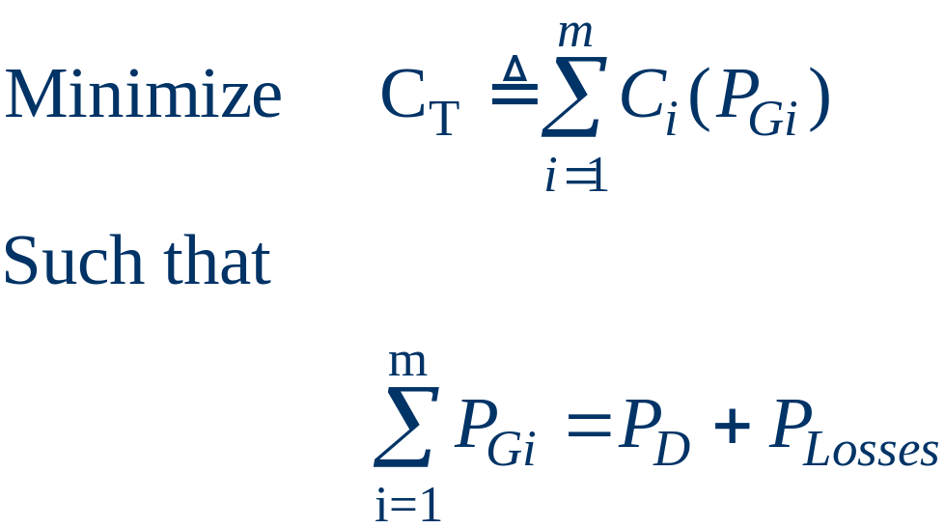
Economic Dispatch: Formulation
The goal of economic dispatch is to determine the generation dispatch that minimizes the instantaneous operating cost, subject to the constraint that total generation = total load + losses
Initially we'll
ignore generator
limits and the
losses

Slide 4

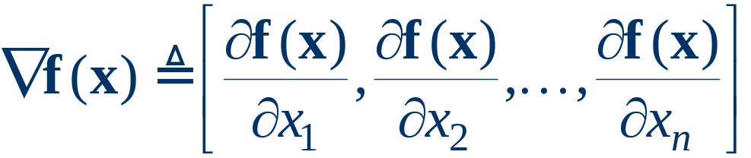
Unconstrained Minimization
This is a minimization problem with a single equality constraint
For an unconstrained minimization a necessary (but not sufficient) condition for a minimum is the gradient of the function must be zero,
The gradient generalizes the first derivative for multi-variable problems:

Slide 5
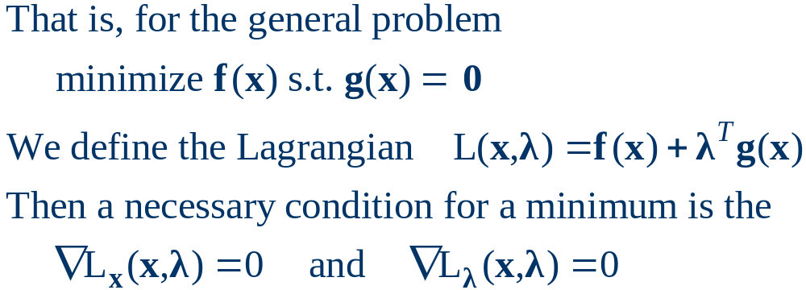
Minimization with Equality Constraint
When the minimization is constrained with an equality constraint we can solve the problem using the method of Lagrange Multipliers
Key idea is to represent a constrained minimization problem as an unconstrained problem.

Slide 6
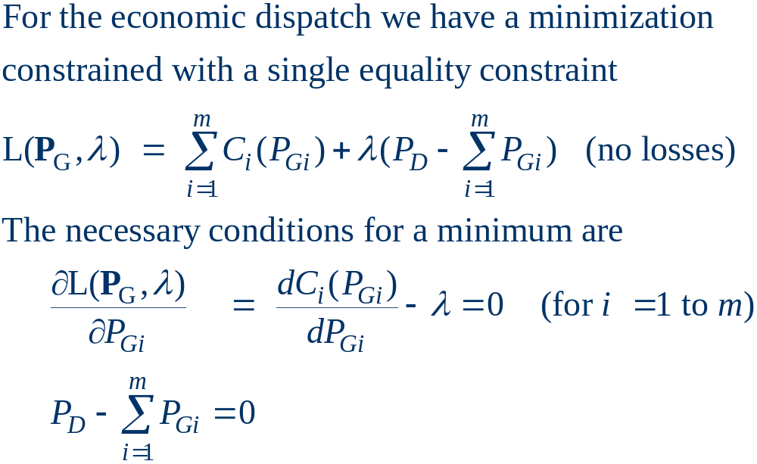
Economic Dispatch Lagrangian

Slide 7
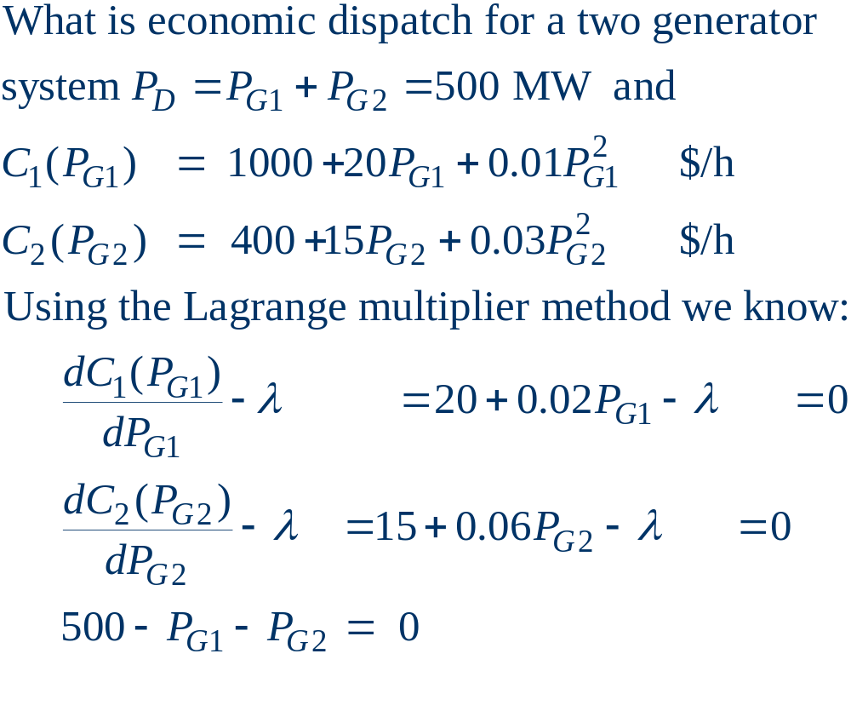
Economic Dispatch Example

Slide 8
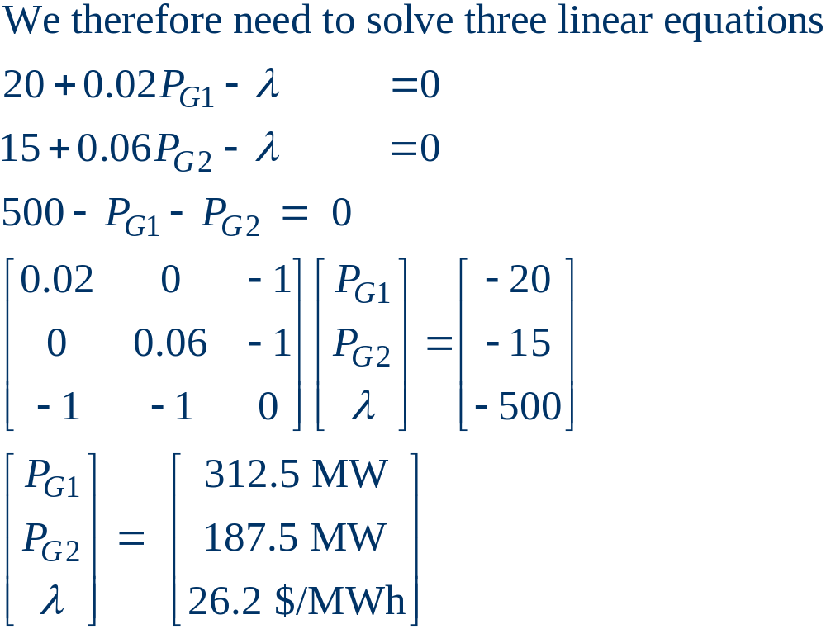
Economic Dispatch Example, cont’d

Slide 9
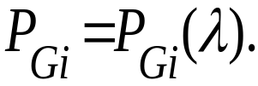
Lambda-Iteration Solution Method
The direct solution using Lagrange multipliers only works if no generators are at their limits.
Another method is known as lambda-iteration
  the method requires that there to be a unique mapping from a value of lambda (marginal cost) to each generator’s MW output:
  for any choice of lambda (marginal cost), the generators collectively produce a total MW output
  the method then starts with values of lambda below and above the optimal value (corresponding to too little and too much total output), and then iteratively brackets the optimal value.

Slide 10
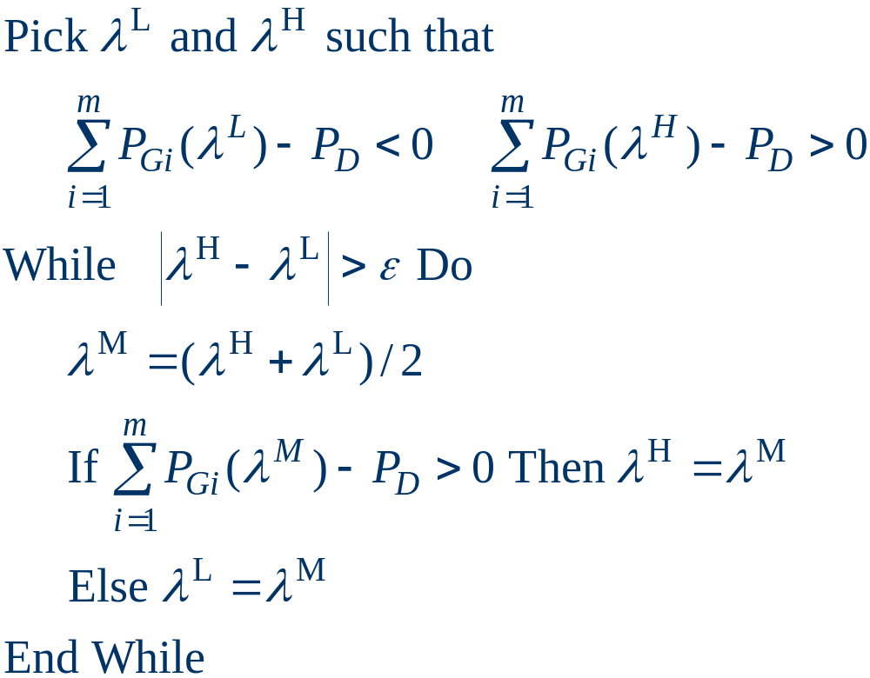
Lambda-Iteration Algorithm

Slide 11
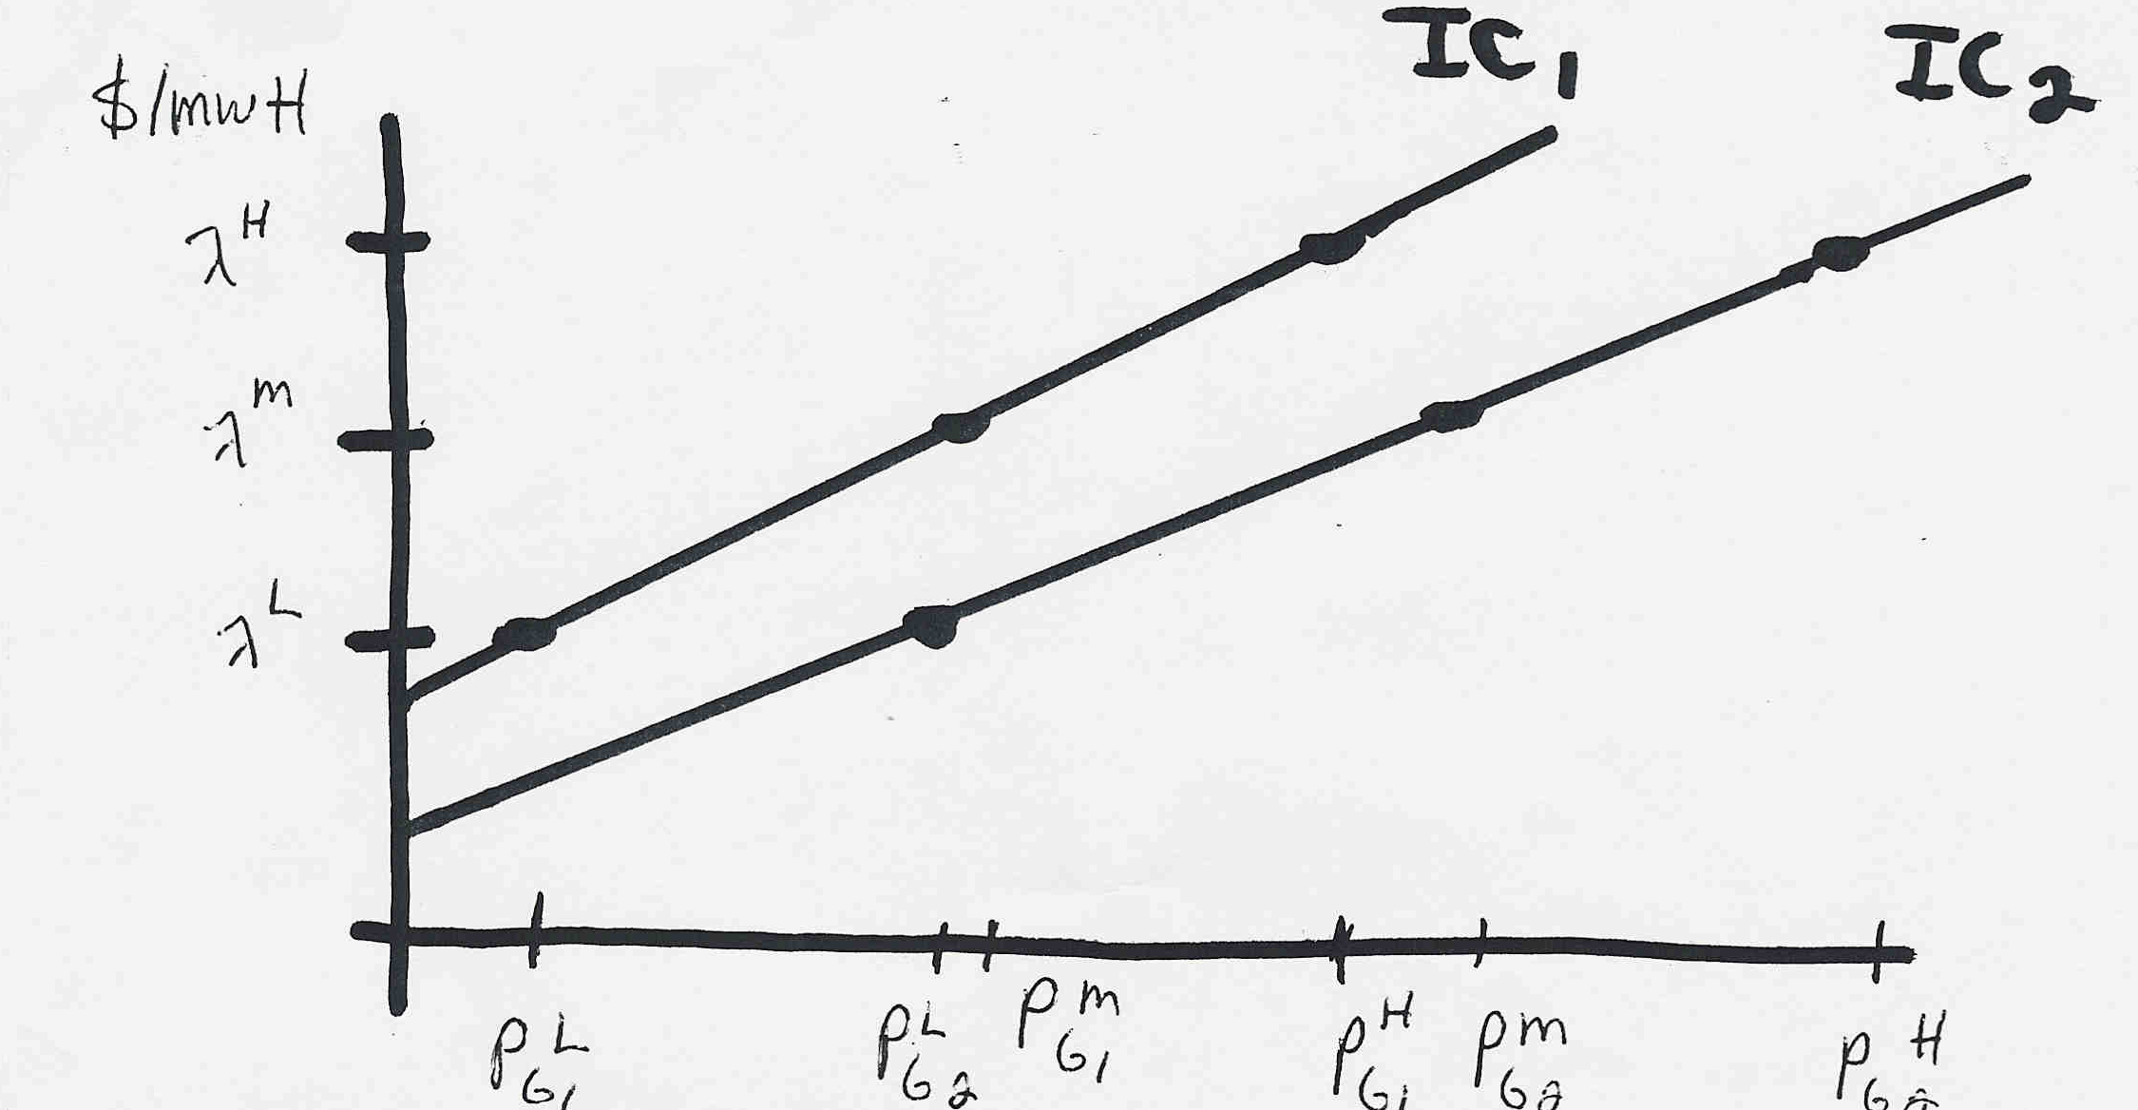
Lambda-Iteration: Graphical View
In the graph shown below for each value of lambda
there is a unique P_{Gi} for each generator. This
relationship is the P_{Gi}(λ) function.

Slide 12
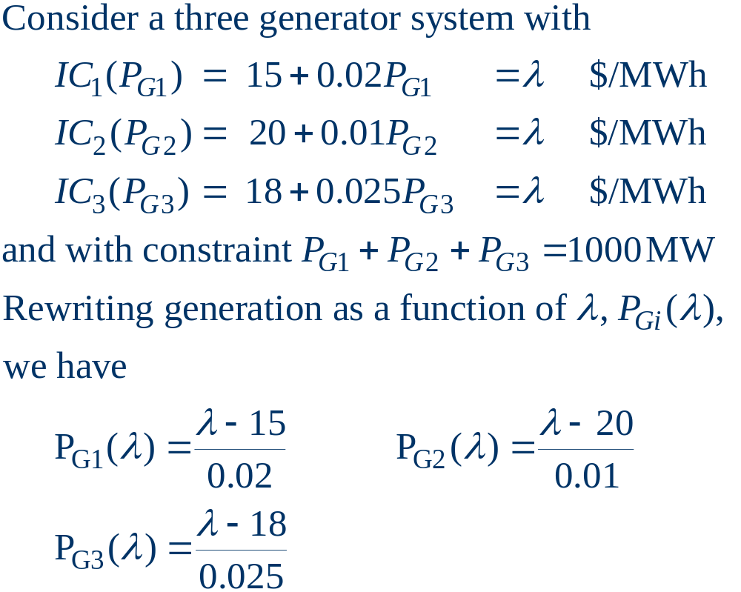
Lambda-Iteration Example

Slide 13
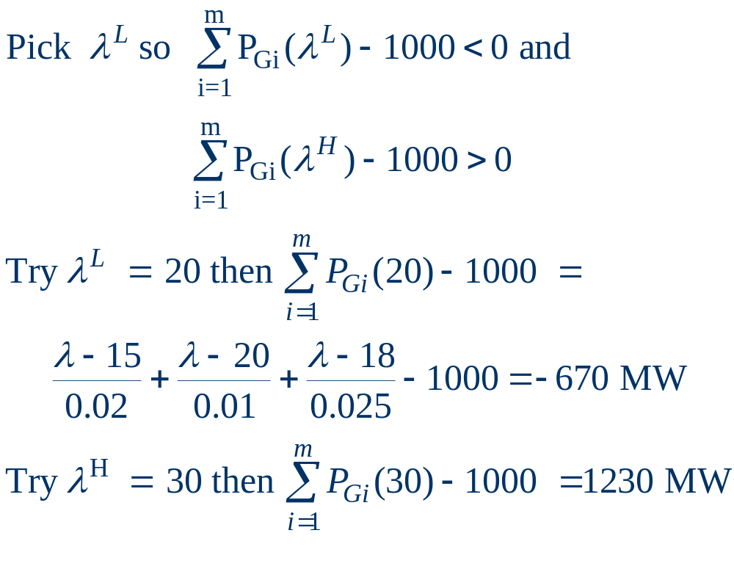
Lambda-Iteration Example, cont’d

Slide 14
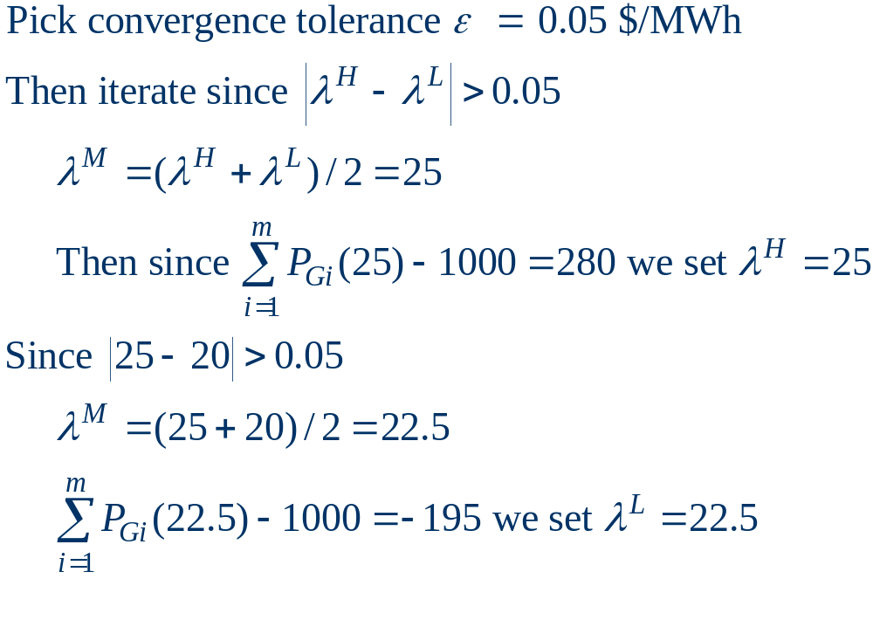
Lambda-Iteration Example, cont’d

Slide 15
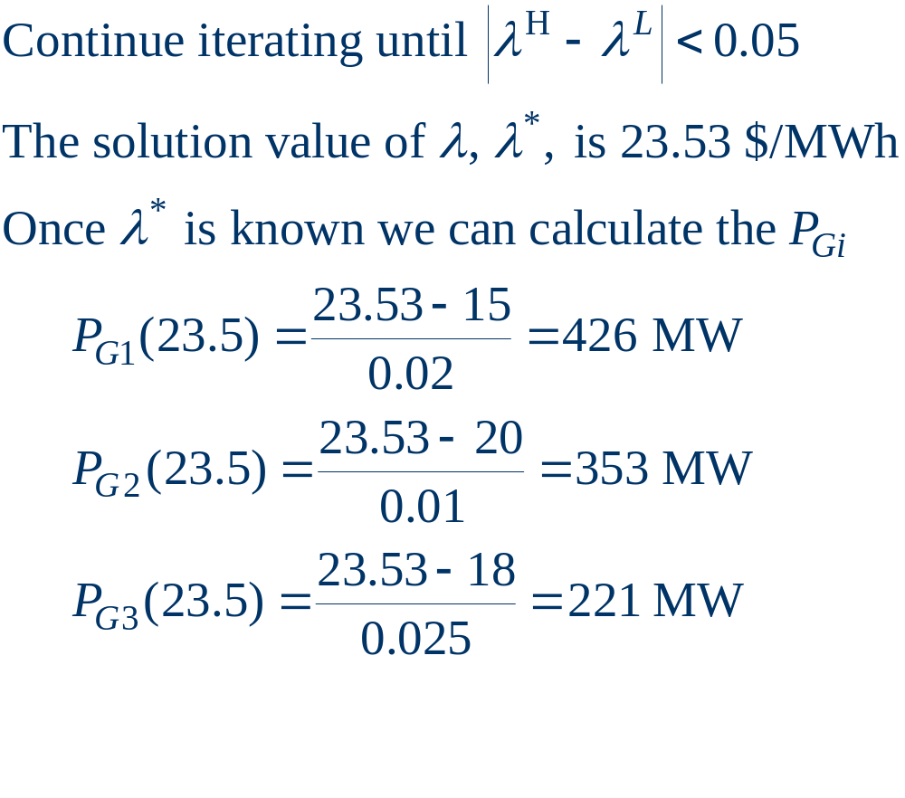
Lambda-Iteration Example, cont’d

Slide 16
Generator MW Limits
Generators have limits on the minimum and maximum amount of power they can produce
Typically the minimum limit is not zero.
Because of varying system economics usually many generators in a system are operated at their maximum MW limits:
  Baseload generators are at their maximum limits except during the off-peak.

Slide 17
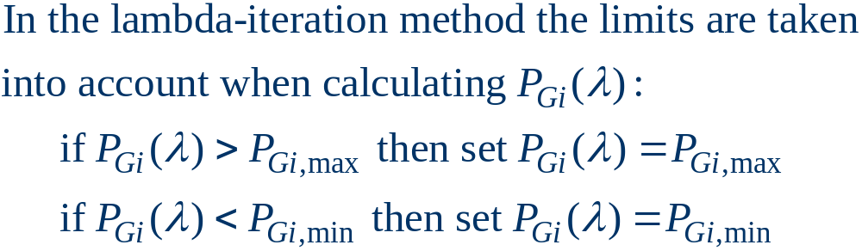
Lambda-Iteration with Gen Limits

Slide 18
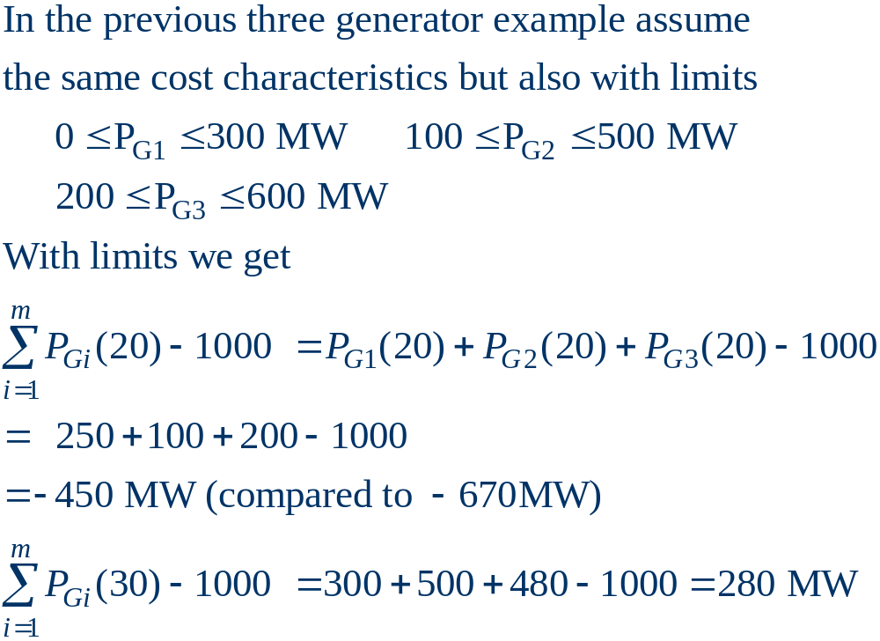
Lambda-Iteration Gen Limit Example

Slide 19
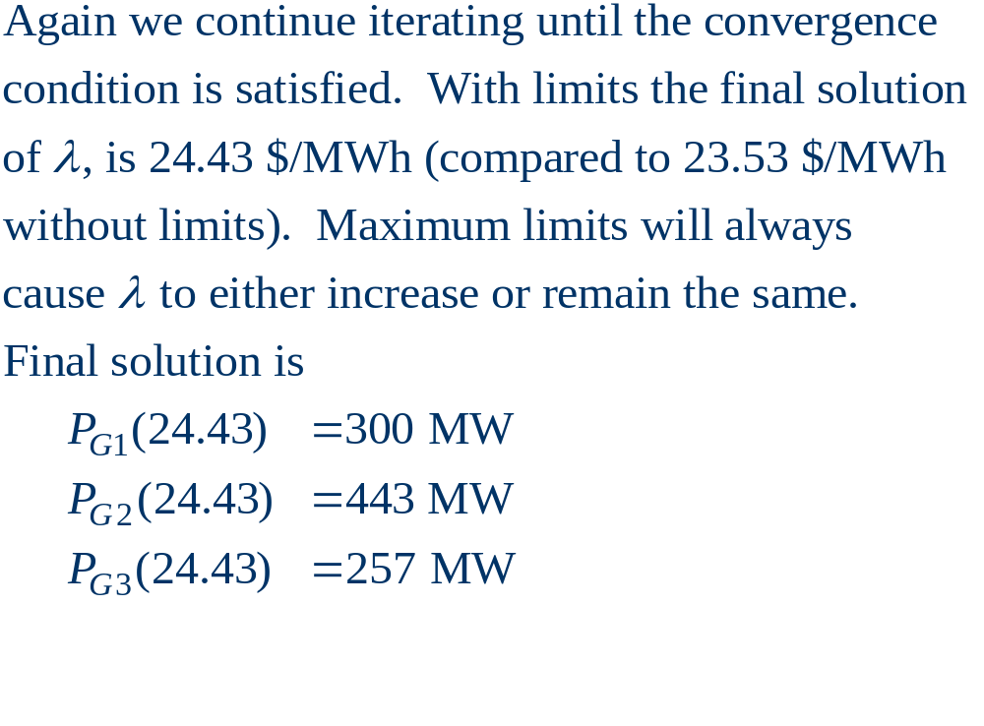
Lambda-Iteration Limit Example,cont’d

Slide 20
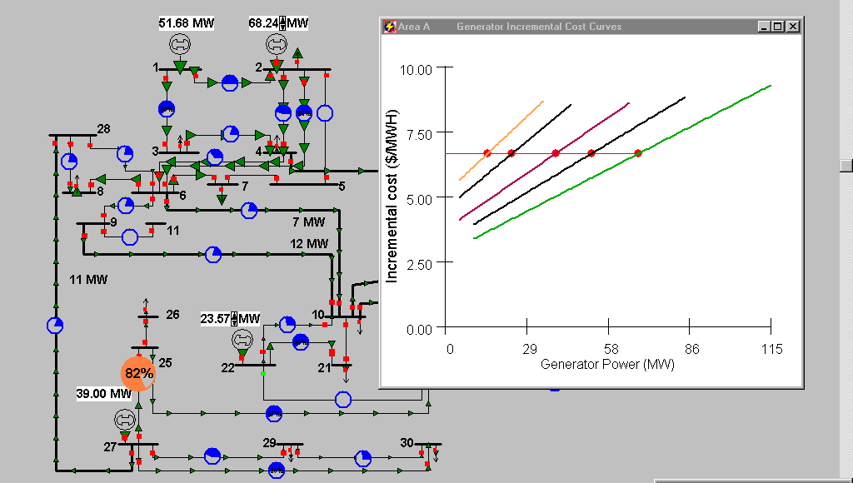
Thirty Bus ED Example
Case is economically dispatched without considering
the incremental impact of the system losses

Slide 21
Back of Envelope Values
Incremental costs can be roughly approximated by a constant value:
  $/MWhr = fuelcost * heatrate + variable O&M
  Typical heatrate for a coal plant is 10, modern combustion turbine is 10, combined cycle plant is 7 to 8, older combustion turbine 15.
  Fuel costs ($/MBtu) are quite variable, with current values around 2 for coal, 7 for natural gas, 0.5 for nuclear, probably 10 for fuel oil.
  Hydro costs tend to be quite low, but are fuel (water) constrained.

Slide 22
Aside: Levelized Cost of Generation, operating costs plus paying off capital.
Technology | $/MWh (2007 Dollars) (IOU)
Advanced Nuclear | 104
Wind – Class 5 | 67
Solar – Photovoltaic | 686
Solar – Concentrating | 434
Solar – Parabolic Trough | 281
Ocean Wave (Pilot) | 838
Small Scale Hydro | 118
Geothermal | 63
Keep in mind these numbers involve LOTs of assumptions
that can drastically affect the value, and that many
technology costs are site dependent.
Source: California Energy Commission:
http://energyalmanac.ca.gov/electricity/levelized_costs.html

Slide 23
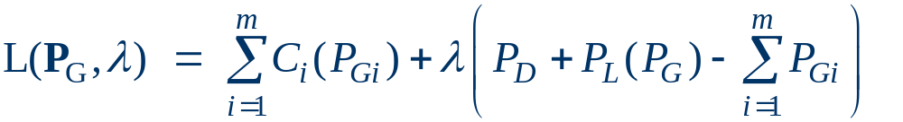
Inclusion of Transmission Losses
The losses on the transmission system are a function of the generation dispatch.
In general, using generators closer to the load results in lower losses
This impact on losses should be included when doing the economic dispatch
Losses can be included by slightly rewriting the Lagrangian:

Slide 24
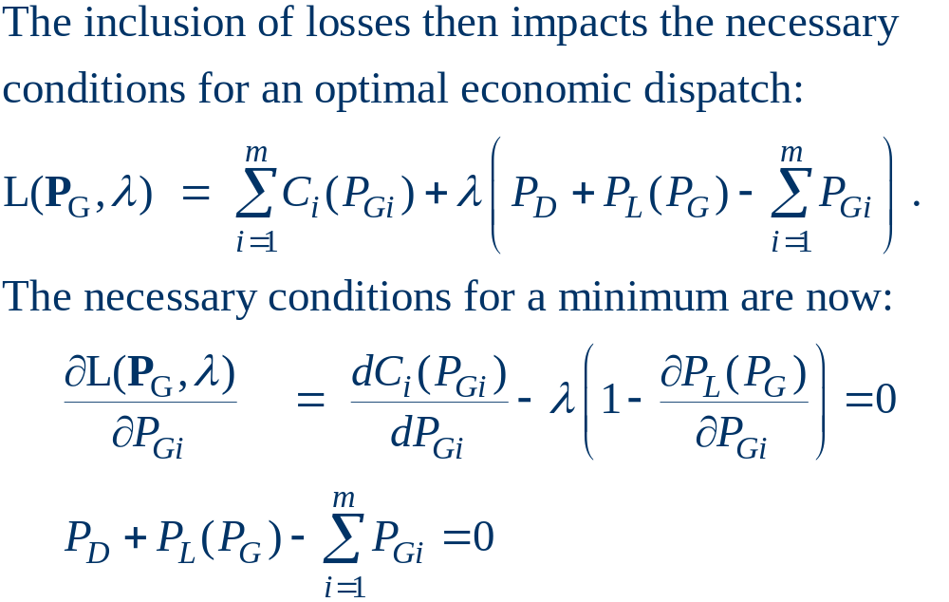
Impact of Transmission Losses

Slide 25
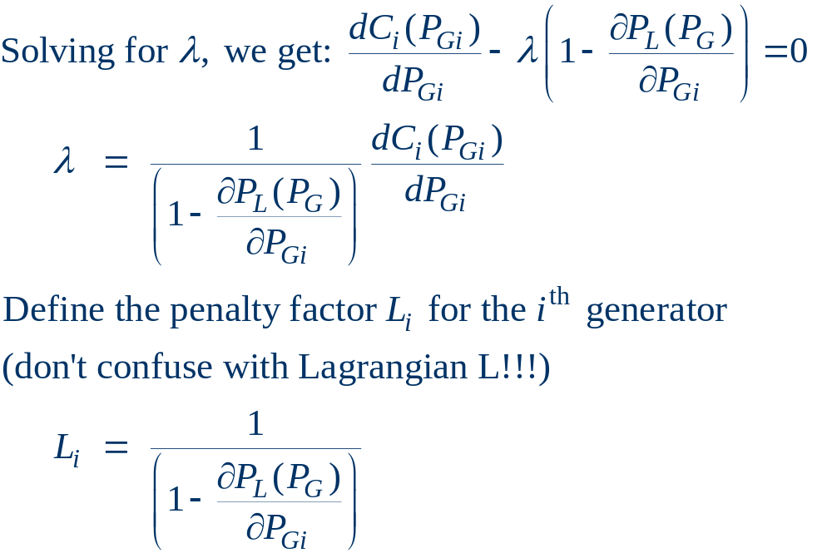
Impact of Transmission Losses
The penalty factor
at the slack bus is
always unity!

Slide 26
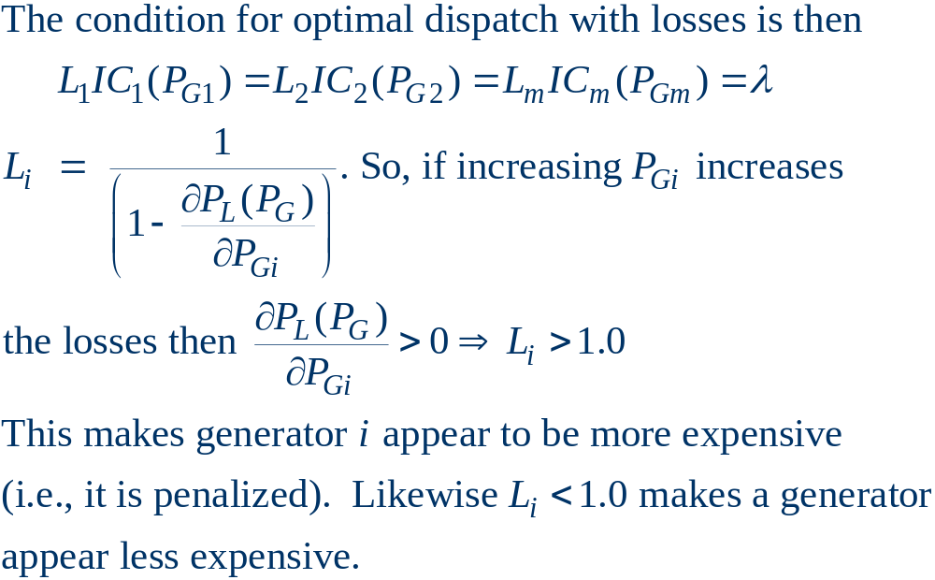
Impact of Transmission Losses

Slide 27
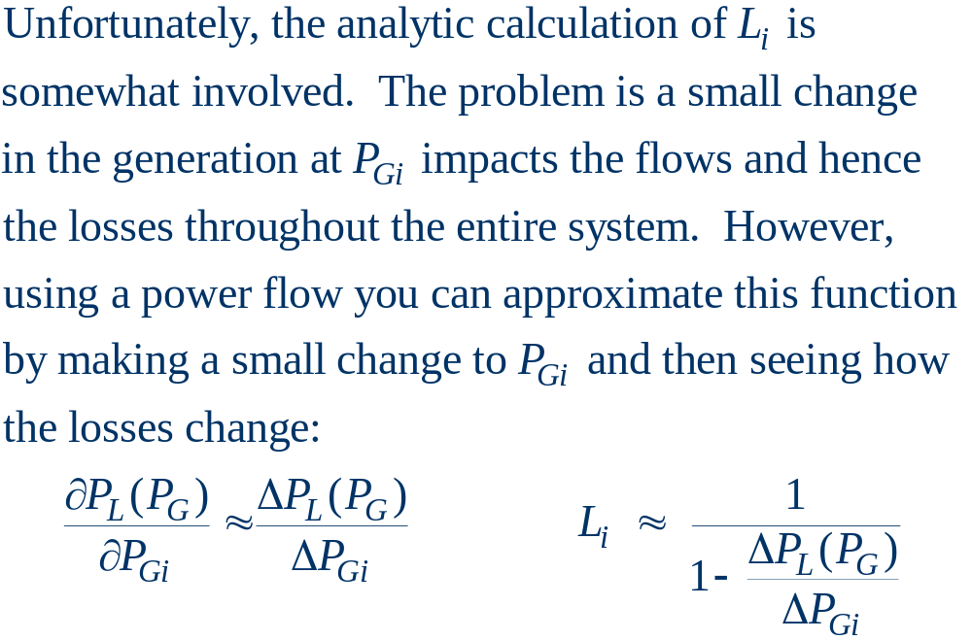
Calculation of Penalty Factors

Slide 28
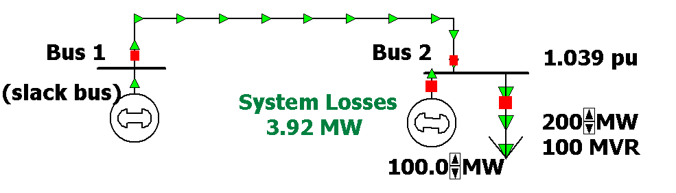
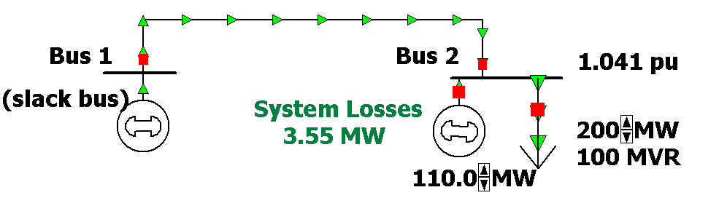
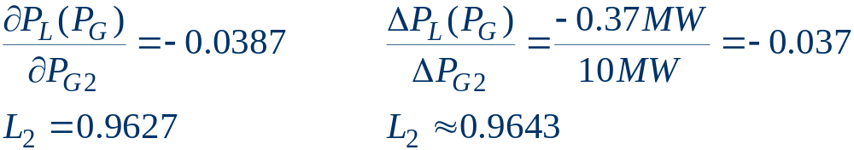
Two Bus Penalty Factor Example

Slide 29
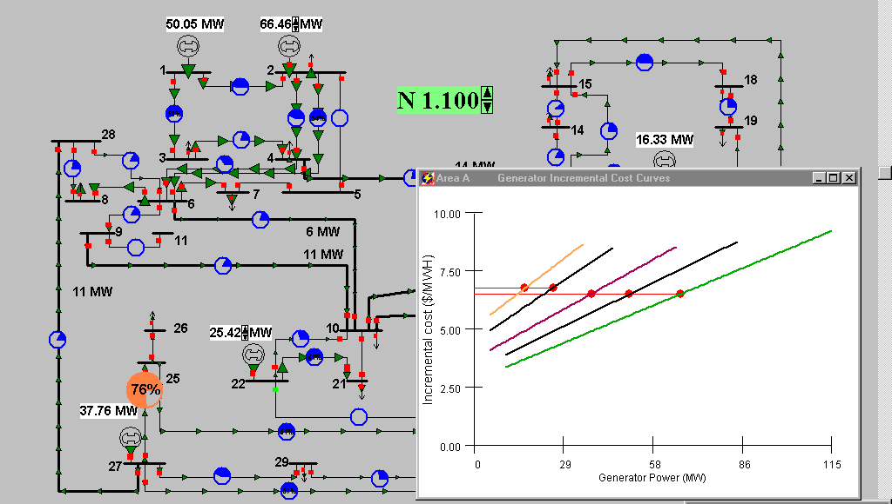
Thirty Bus ED Example
Because of the penalty factors the generator incremental
costs are no longer identical.

Slide 30
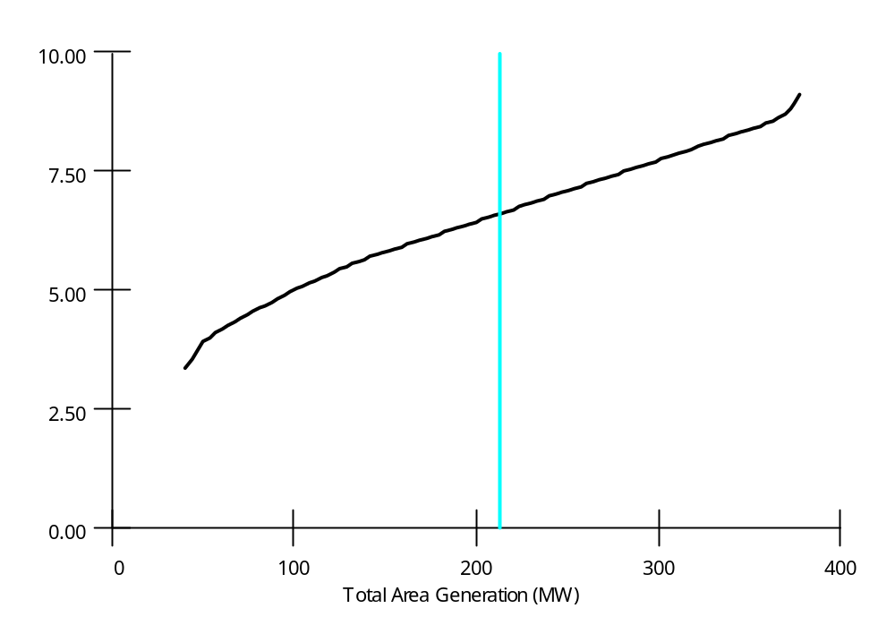
Area Supply Curve
The area supply curve shows the cost to produce the
next MW of electricity, assuming area is economically
dispatched
Supply
curve for
thirty bus
system

Slide 31
Economic Dispatch - Summary
Economic dispatch determines the best way to minimize the current generator operating costs.
The lambda-iteration method is a good approach for solving the economic dispatch problem:
  generator limits are easily handled,
  penalty factors are used to consider the impact of losses.
Economic dispatch is not concerned with determining which units to turn on/off (this is the unit commitment problem).
Basic form of economic dispatch ignores the transmission system limitations.

