Slide 1
EE369
POWER SYSTEM ANALYSIS
Lecture 3
Three Phase, Power System Operation
Tom Overbye and Ross Baldick

Slide 2
Reading and Homework
For lecture 3 read Chapters 1 and 2
For lectures 4 through 6 read Chapter 4
  we will not be covering sections 4.7, 4.11, and 4.12 in detail,
  We will return to chapter 3 later.
HW 2 is 2.27, 2.28, 2.30, 2.32, 2.33, 2.35, 2.37, 2.40 (need to install PowerWorld); due Thursday 9/8.
HW 3 is 2.41, 2.43, 2.46, 2.49, 2.50, 2.51, 2.52; due Thursday 9/15.

Slide 3
Per Phase Analysis
Per phase analysis allows analysis of balanced 3φ systems with the same effort as for a single phase system.
Balanced 3φ Theorem: For a balanced 3φ system with:
  All loads and sources Y connected,
  No mutual Inductance between phases.

Slide 4
Per Phase Analysis, cont’d
Then
  All neutrals are at the same potential,
  All phases are COMPLETELY decoupled,
  All system values are the same “sequence” as sources. That is, peaks of phases occur in the same order. The sequence order we’ve been using (phase b lags phase a and phase c lags phase a) is known as “positive” sequence; in EE368 we’ll discuss negative and zero sequence systems.

Slide 5
Per Phase Analysis Procedure
To do per phase analysis
Convert all Δ load/sources to equivalent Y’s.
Solve phase “a” independent of the other phases
Total system power S = 3 V_{a} I_{a}*
If desired, phase “b” and “c” values can be determined by inspection (i.e., ±120° degree phase shifts)
If necessary, go back to original circuit to determine line-line values or internal Δ values.

Slide 6
Per Phase Example
Assume a 3φ, Y-connected generator with V_{an} = 1∠0° volts supplies a Δ-connected load with Z_{Δ} = -jΩ through a transmission line with impedance of j0.1Ω per phase. The load is also connected to a Δ-connected generator with V_{a’’b’’} = 1∠0° through a second transmission line which also has an impedance of j0.1Ω per phase.
Find
1. The load voltage V_{a’b’}
2. The total power supplied by each generator, S_{Y} and S_{Δ}

Slide 7
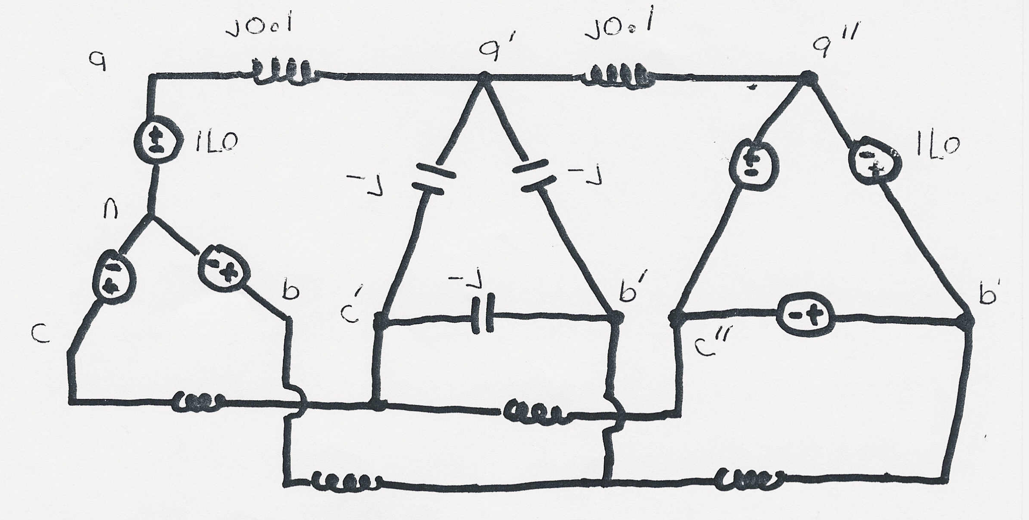
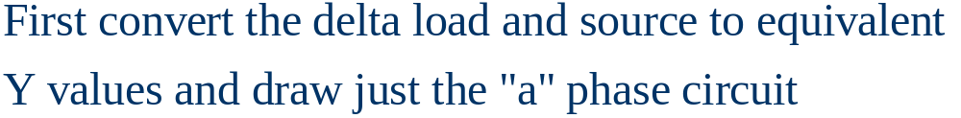
Per Phase Example, cont’d
+
-

Slide 8
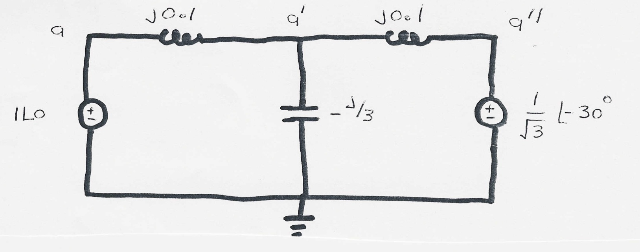
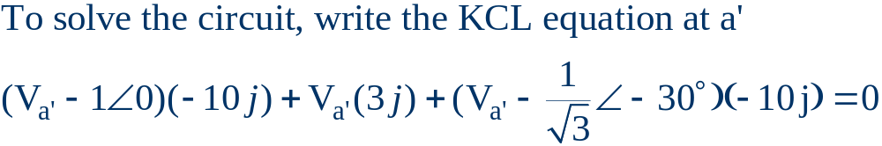
Per Phase Example, cont’d

Slide 9
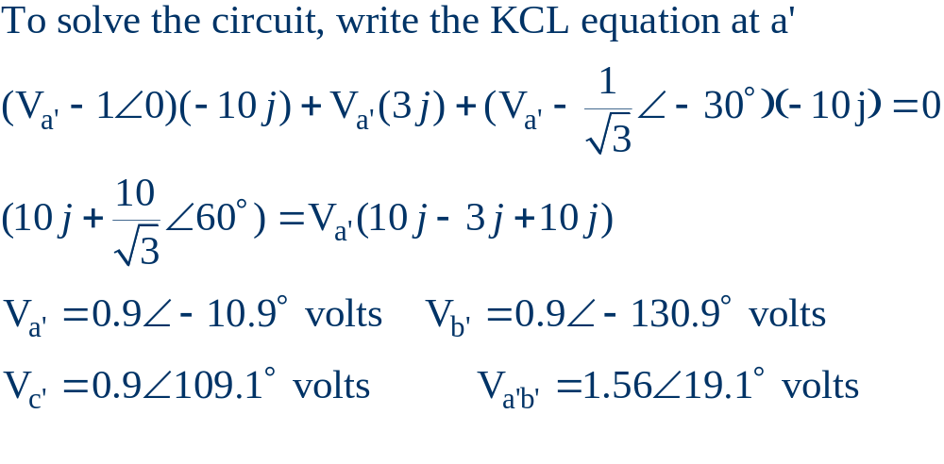
Per Phase Example, cont’d

Slide 10
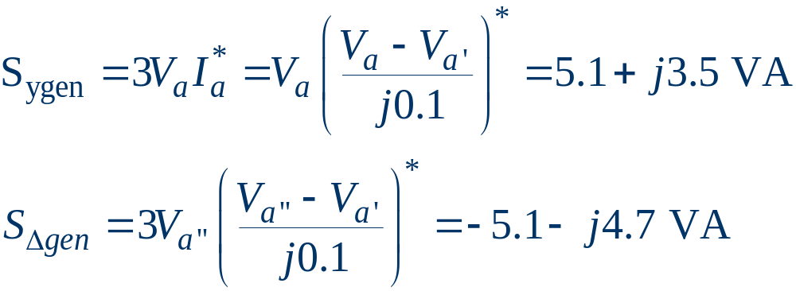
Per Phase Example, cont’d

Slide 11
Power System Operations Overview
Goal is to provide an intuitive feel for power system operation
Emphasis will be on the impact of the transmission system
Introduce basic power flow concepts through small system examples

Slide 12
Power System Basics
All power systems have three major components: Generation, Load and Transmission/Distribution.
Generation: Creates electric power.
Load: Consumes electric power.
Transmission/Distribution: Transmits electric power from generation to load.
  Lines/transformers operating at voltages above 100 kV are usually called the transmission system. The transmission system is usually networked.
  Lines/transformers operating at voltages below 100 kV are usually called the distribution system (radial).

Slide 13
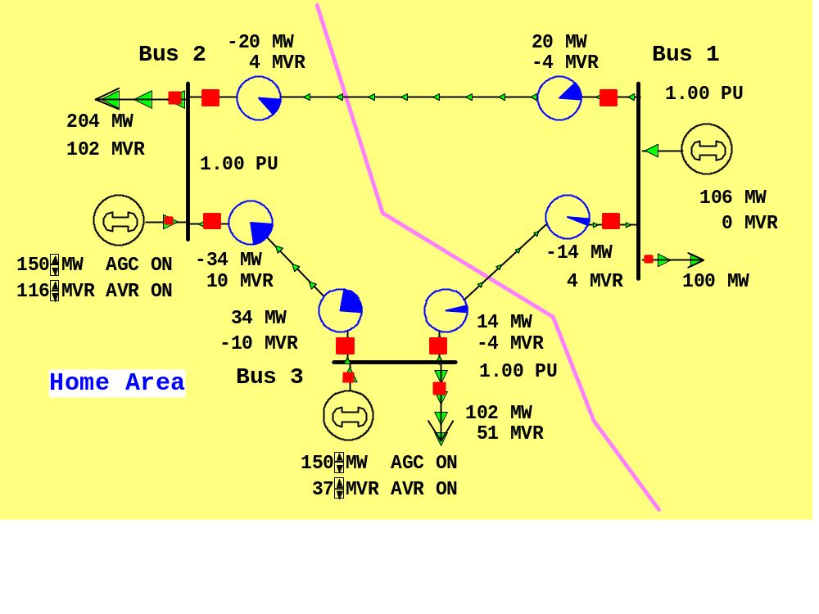
Small PowerWorld Simulator Case
Load with
green
arrows
indicating
amount
of MW
flow
Note the
power
balance at
each bus
Used
to control
output of
generator
Direction of arrow is used to indicate
direction of real power (MW) flow

Slide 14
Power Balance Constraints
Power flow refers to how the power is moving through the system.
At all times in the simulation the total power flowing into any bus MUST be zero!
This is due to Kirchhoff’s current law. It can not be repealed or modified!
Power is lost in the transmission system.

Slide 15
Basic Power Control
Opening a circuit breaker causes the power flow to (nearly) instantaneously change.
No other way to directly control power flow in an AC transmission line.
By changing generation we can indirectly change this flow.

Slide 16
Transmission Line Limits
Power flow in transmission line is limited by heating considerations.
Losses (I² R) can heat up the line, causing it to sag.
Each line has a limit:
  Simulator does not allow you to continually exceed this limit.
  Many transmission owners use winter/summer limits.
  Some transmission owners are moving to “dynamic” ratings that consider temperature etc.

Slide 17
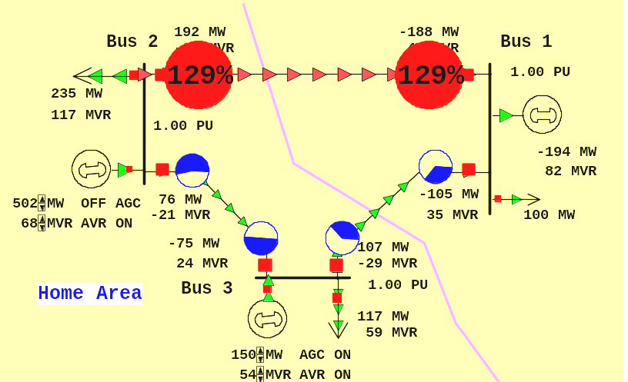
Overloaded Transmission Line

Slide 18
Interconnected Operation
Power systems are interconnected across large distances. For example most of North America east of the Rockies is one system, most of North America west of the Rockies is another.
Most of Texas and Quebec are each interconnected systems.
Individual transmission owners in the East and West own and operate parts of the system, which is referred to as a “balancing area” (or an “operating area” or “area”).
ERCOT is operated as one area.

Slide 19
Control Area
(or Balancing Authority Area)
Transmission lines that join two areas are known as tie-lines.
The net power out of an area is the sum of the flow on its tie-lines.
The flow out of an area is equal to:
total gen - total load - total losses = tie-flow

Slide 20
Area Control Error (ACE)
The area control error is a combination of:
  the deviation of frequency from nominal, and
  the difference between the actual flow out of an area and the scheduled flow.
Ideally the ACE should always be zero.
Because the load is constantly changing, each area must constantly change its generation to “chase” the ACE.
In ERCOT, ACE is predominantly due to frequency deviations from nominal.

Slide 21
Automatic Generation Control
Automatic generation control (AGC) is used to automatically change generation to keep the ACE close to zero.
Usually the utility control center or independent system operator calculates ACE based upon tie-line flows and frequency; then the AGC module sends control signals out to the generators every couple of seconds to adjust generation.

Slide 22
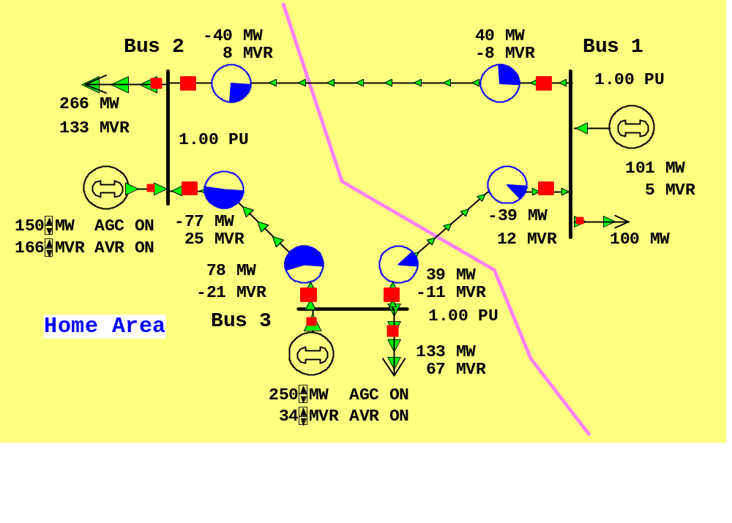
Three Bus Case on AGC
Generation
is automatically
changed to match
change in load
Net tie flow is
close to zero

