Slide 1
EE369
POWER SYSTEM ANALYSIS
Lecture 4
Power System Operation, Transmission Line Modeling
Tom Overbye and Ross Baldick

Slide 2
Reading and Homework
For lectures 4 through 6 read Chapter 4
  we will not be covering sections 4.7, 4.11, and 4.12 in detail,
  We will return to chapter 3 later.
HW 3 is 2.41, 2.43, 2.46, 2.49, 2.50, 2.51, 2.52; due Thursday 9/15.
HW 4 is problems (not multiple choice questions!) 4.2, 4.10, 4.11, 4.13, 4.15, 4.23, 4.25 (assume Cardinal conductor and look up GMR in Table A.4); due Thursday 9/22.

Slide 3
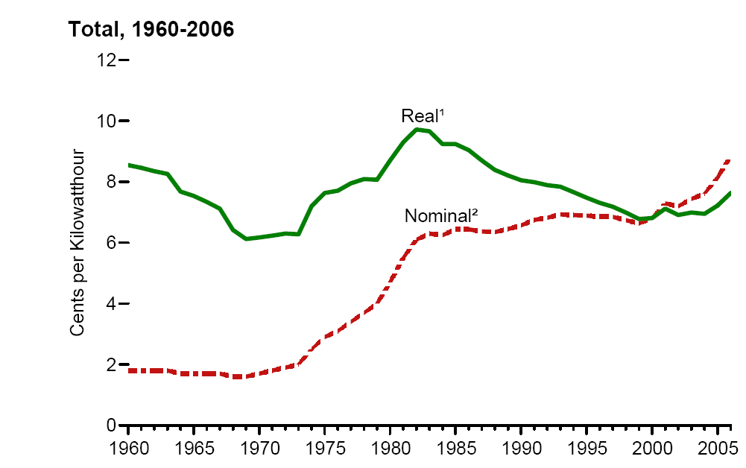
Retail Electricity Prices
Source: EIA 2006 Annual Energy Review, Fig 8.10

Slide 4
Generator Costs
There are many fixed and variable costs associated with power systems, which ultimately contribute to determining retail electricity prices.
The major variable operating cost is associated with generation, primarily due to fuel costs.
Fuel cost to generate a MWh can vary widely.
For some types of units, such as hydro, “fuel” costs are zero but the limit on total available water gives it an implicit value.
For thermal units it is much easier to characterize costs.

Slide 5
Economic Dispatch
Economic dispatch (ED) determines the least operating cost dispatch of generation for a portfolio of generators.
Consider the variable operating cost of a generator, graphed as $/h versus MW.
The marginal costs are the derivative of the variable costs.
For a lossless system, least cost dispatch occurs when all the generators have equal marginal costs (or as close as possible to this).
IC₁(P_{G,1}) = IC₂(P_{G,2}) = … = IC_{m}(P_{G,m})

Slide 6
“Physical” power Transactions
Power transactions are contracts to transfer power.
Contracts can be for any amount of time at any price for any amount of power.
Scheduled power transactions between areas are called “interchange” and are implemented by modifying the area ACE:
ACE = P_{actual,tie-flow} – P_{sched}
…and then controlling the generation to bring ACE towards zero.
For ERCOT, interchange is only relevant over asynchronous connections to Eastern and Mexico.
In Eastern and Western Interconnection, interchange occurs between areas connected by AC lines.

Slide 7
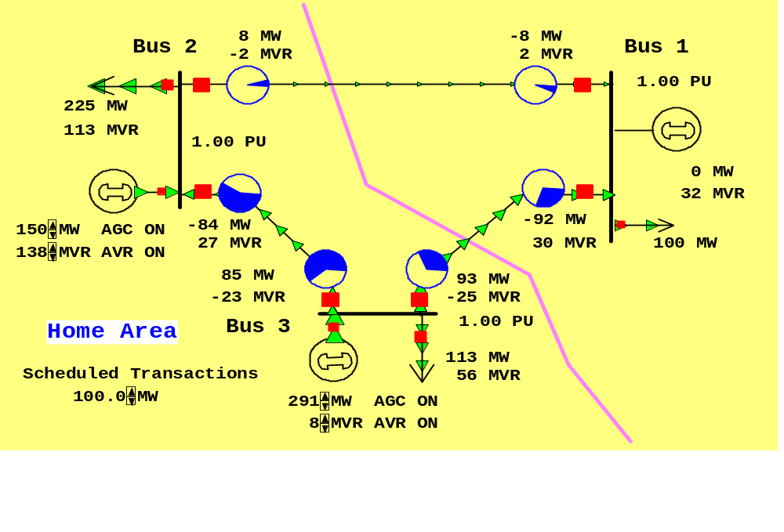
100 MW Transaction between areas in Eastern or Western
Scheduled
100 MW
Transaction from Left to Right
Net tie-line
flow is now
100 MW

Slide 8
Security Constrained ED
Transmission constraints often limit ability to use lower cost power.
Such limits require deviations from what would otherwise be minimum cost dispatch in order to maintain system “security.”
In three bus case the generation at bus 3 must be limited to avoid overloading the line from bus 3 to bus 2.

Slide 9
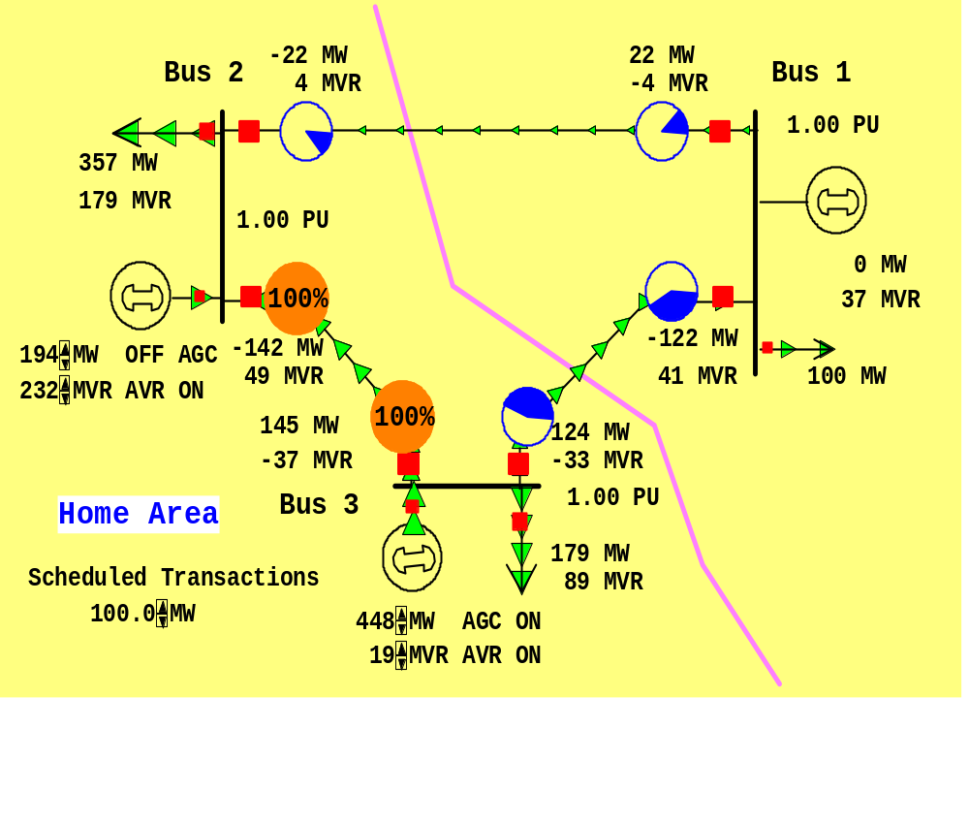
Security Constrained Dispatch
Need to change dispatch to keep line
from bus 3 to bus 2 from overloading

Slide 10
Multi-Area Operation
In multi-area system, areas with direct interconnections can transact according to rules:
  In Eastern interconnection up to “nominal” thermal interconnection capacity,
  In Western interconnection there are more complicated rules
Actual power flows through the entire network according to the impedance of the transmission lines.
Economically uncompensated flow through other areas is known as “parallel path” or “loop flows.”
Since ERCOT is one area, all of the flows on AC lines are inside ERCOT and there is no uncompensated flow on AC lines.

Slide 11
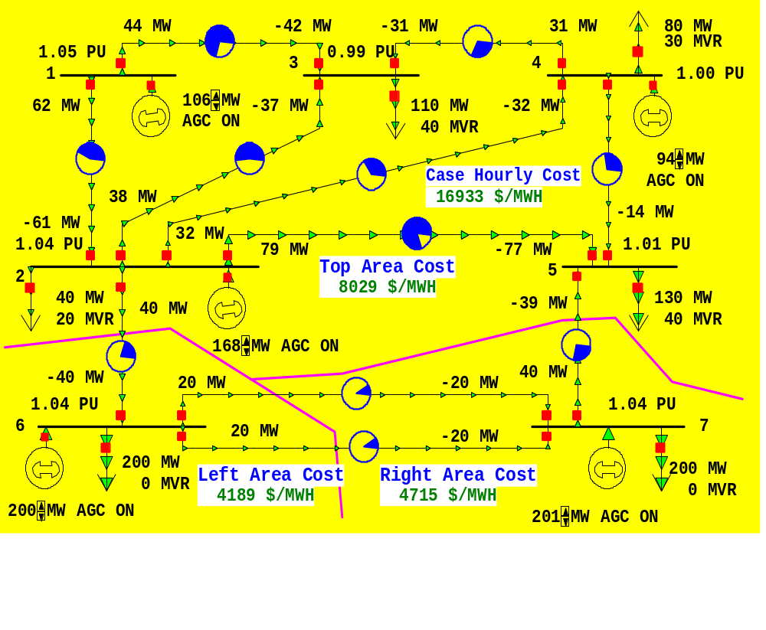
Seven Bus Case: One-line
System has
three areas
Top area
has five
buses
No net
interchange
between
Any areas.
Left area
has one
bus
Right area has one
bus

Slide 12
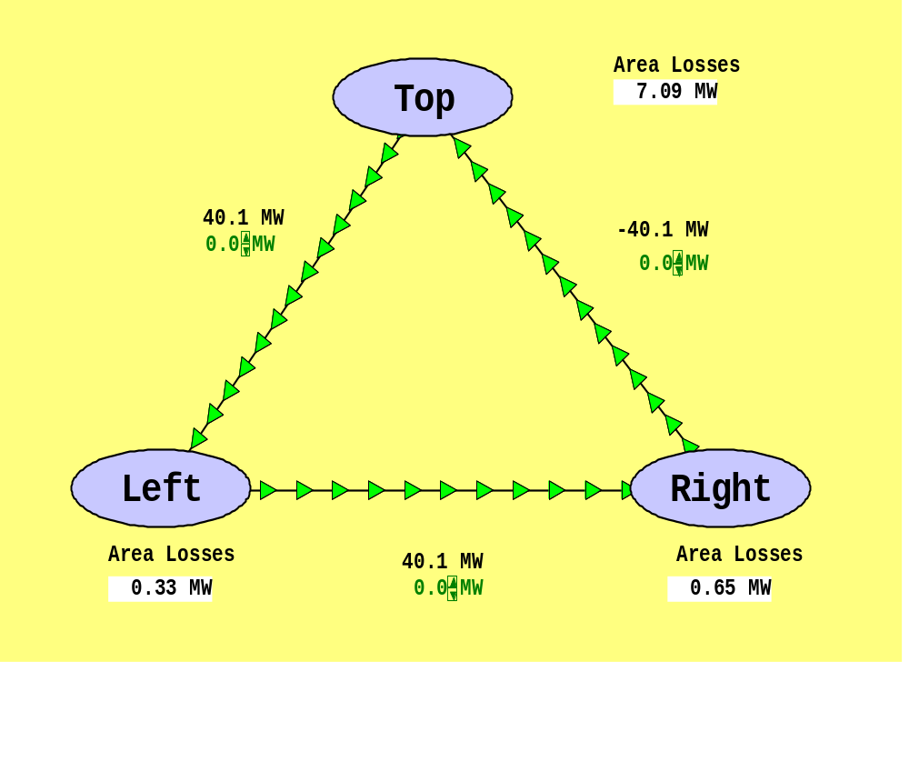
Seven Bus Case: Area View
Actual
flow
between
areas
System has
40 MW of
“Loop Flow”
Scheduled
flow
Loop flow can result in higher losses

Slide 13
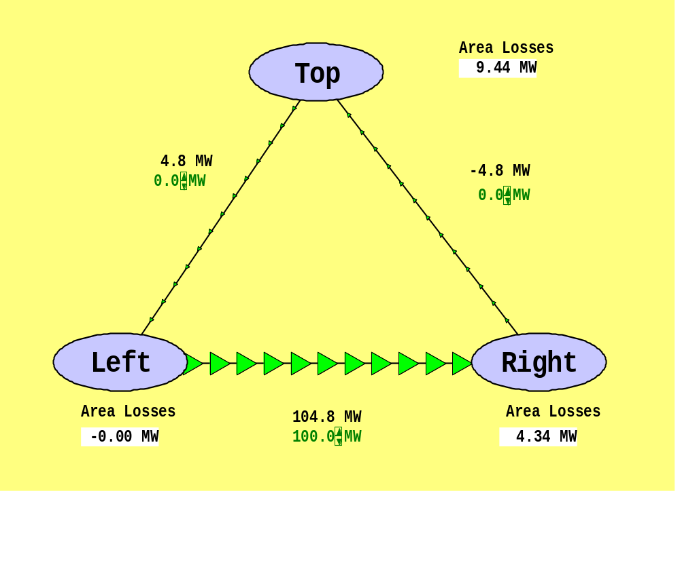
Seven Bus - Loop Flow?
Note that
Top’s
Losses have
increased
from
7.09MW to
9.44 MW
100 MW Transaction
between Left and Right
Transaction has actually decreased
the loop flow

Slide 14
Pricing Electricity
Cost to supply electricity to bus is called the locational marginal price (LMP) at that bus.
Some electric markets price energy at LMP:
  ERCOT began this in December 2010.
In there were no transmission limitations then the LMPs would be the same at all buses.
Transmission constraints result in differing LMPs at buses.
Determination of LMPs requires the solution of an “Optimal Power Flow” (OPF).

Slide 15
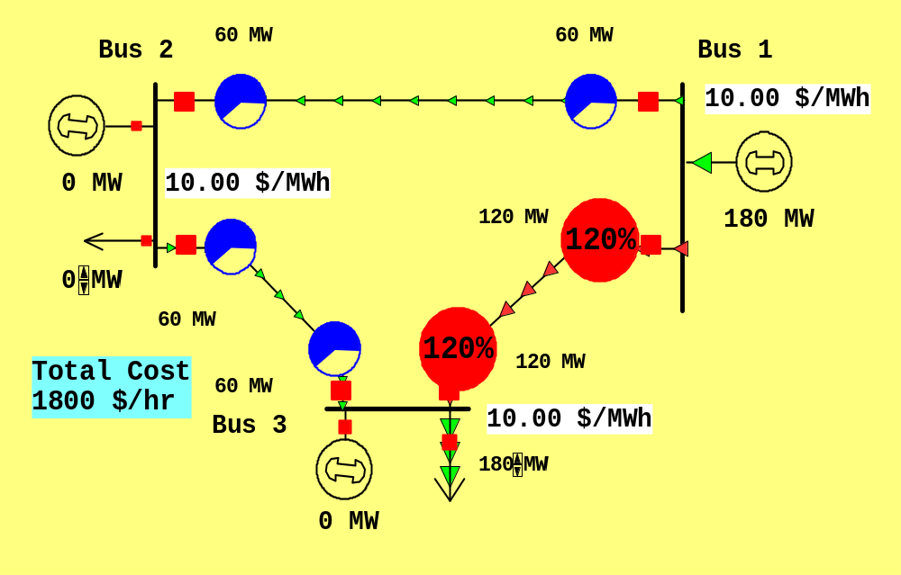
3 BUS LMPS - OVERLOAD IGNORED
Gen 2’s
cost
is $12
per
MWh
Gen 1’s
cost
is $10
per
MWh
Line from Bus 1 to Bus 3 is over-loaded; all buses have same marginal cost

Slide 16
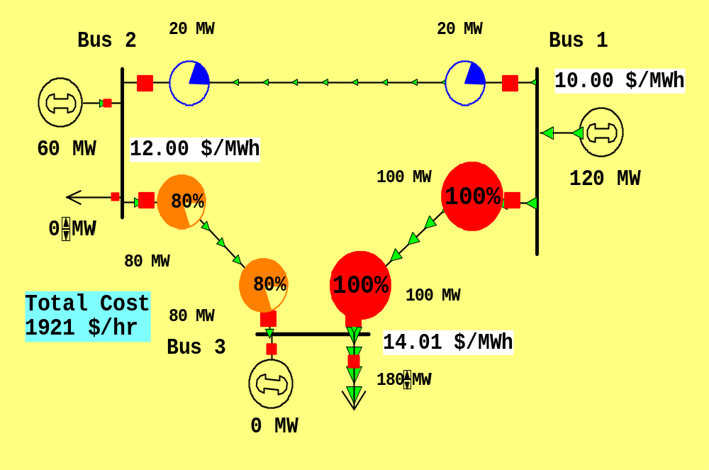
LINE OVERLOAD ENFORCED
Line from 1 to 3 is no longer overloaded, but now
the marginal cost of electricity at bus 3 is $14 / MWh

Slide 17
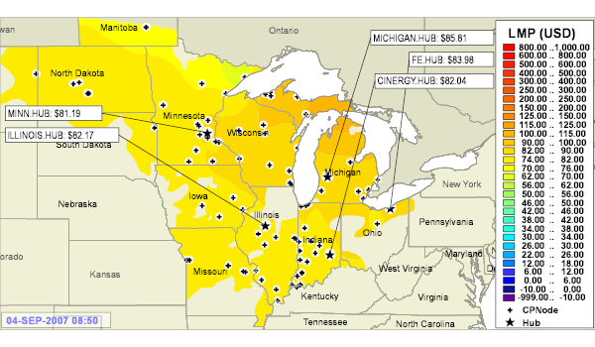
LMPs at 8:55 AM on one day in Midwest.
Source: www.midwestmarket.org

Slide 18
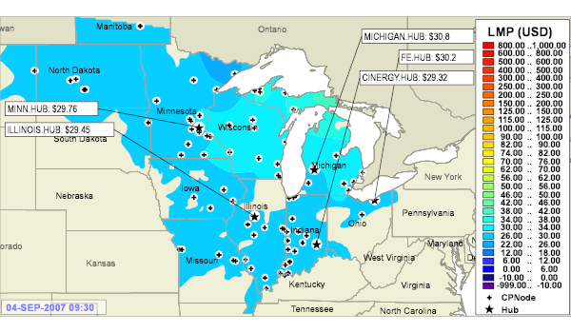
LMPs at 9:30 AM on same day

Slide 19
Development of Line Models
Goals of this section are:
develop a simple model for transmission lines, and
gain an intuitive feel for how the geometry of the transmission line affects the model parameters.

Slide 20
Primary Methods for Power Transfer
The most common methods for transfer of electric power are:
Overhead ac
Underground ac
Overhead dc
Underground dc
The analysis will be developed for ac lines.

Slide 21
Magnetics Review
Magnetomotive force: symbol F, measured in ampere-turns, which is the current enclosed by a closed path,
Magnetic field intensity: symbol H, measured in ampere-turns/meter:
  The existence of a current in a wire gives rise to an associated magnetic field.
  The stronger the current, the more intense is the magnetic field H.
Flux density: symbol B, measured in webers/m² or teslas or gauss (1 Wb /m² = 1T = 10,000G):
  Magnetic field intensity is associated with a magnetic flux density.

Slide 22


Magnetics Review
Magnetic flux: symbol measured in webers, which is the integral of flux density over a surface.
Flux linkages measured in weber-turns.
  If the magnetic flux is varying (due to a changing current) then a voltage will be induced in a conductor that depends on how much magnetic flux is enclosed (“linked”) by the loops of the conductor, according to Faraday’s law.
Inductance: symbol L, measured in henrys:
  The ratio of flux linkages to the current in a coil.

Slide 23
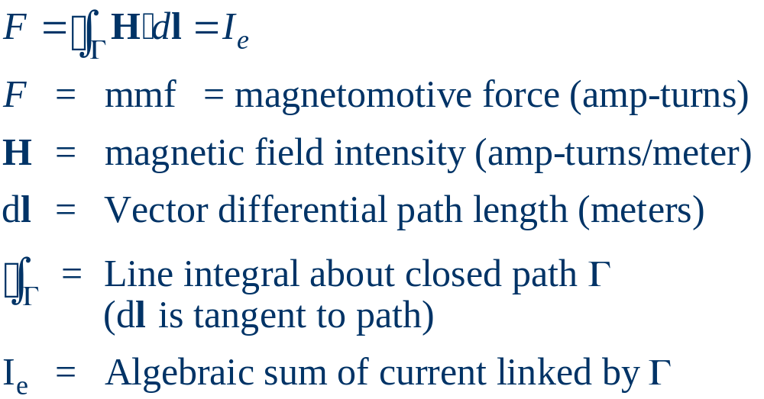
Magnetics Review
Ampere’s circuital law relates magnetomotive force (the enclosed current) and magnetic field intensity:

Slide 24
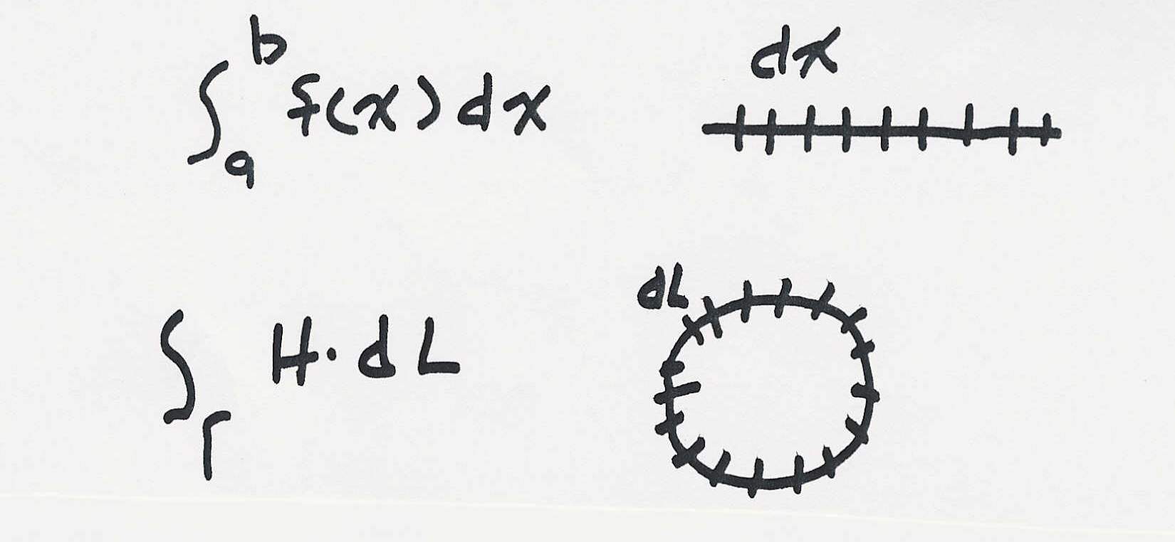
Line Integrals
Line integrals are a generalization of “standard” integration along, for example, the x-axis.
Integration along the
x-axis
Integration along a
general path, which
may be closed
Ampere’s law is most useful in cases of symmetry,
such as a circular path of radius x around an infinitely
long wire, so that H and dl are parallel, |H| is constant,
and |dl| integrates to equal the circumference 2πx.

Slide 25
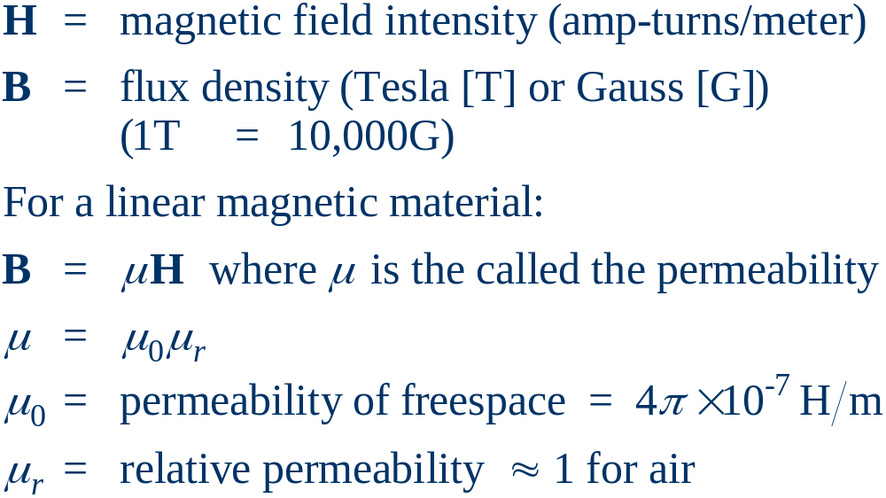
Flux Density
Assuming no permanent magnetism, magnetic field intensity and flux density are related by the permeability of the medium.

Slide 26
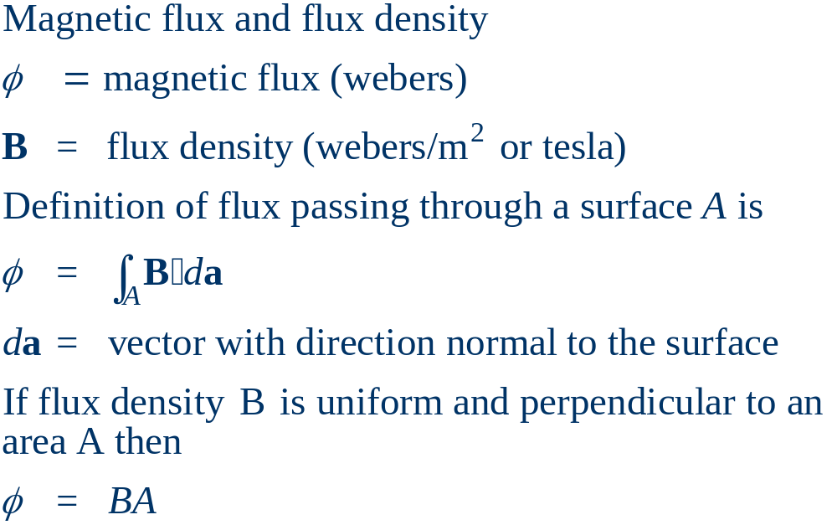
Magnetic Flux

Slide 27
Magnetic Fields from Single Wire
Assume we have an infinitely long wire with current of I =1000A.
Consider a square, located between 4 and 5 meters from the wire and such that the square and the wire are in the same plane.
How much magnetic flux passes through the square?

Slide 28

Magnetic Fields from Single Wire
Magnetic flux passing through the square?
Easiest way to solve the problem is to take advantage of symmetry.
As an integration path, we’ll choose a circle with radius x, with x varying from 4 to 5 meters, with the wire at the center, so the path encloses the current I.
Direction of H is given
by the “Right-hand” Rule

Slide 29
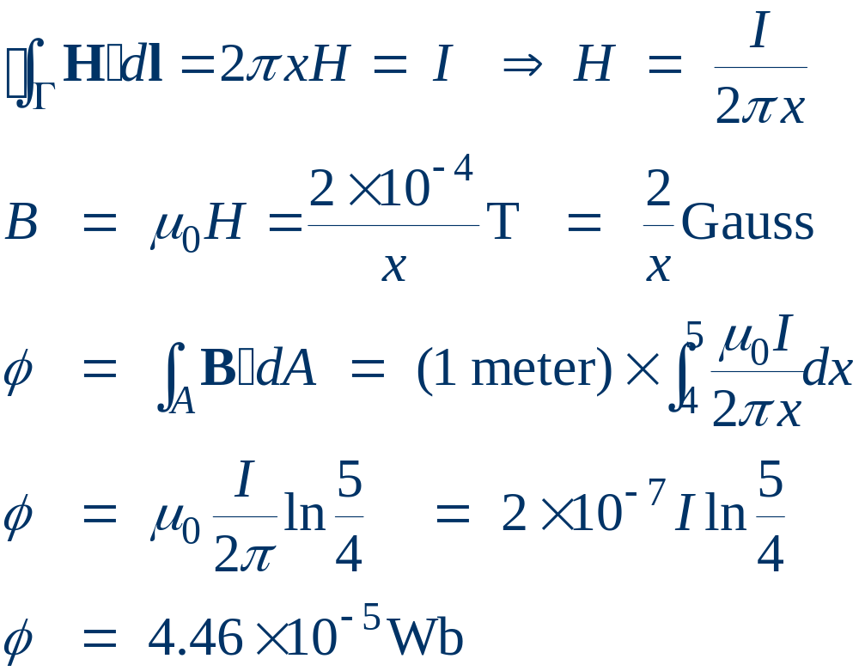
Single Line Example, cont’d
H is perpendicular
to surface of square
For reference, the earth’s magnetic field is about 0.6 Gauss (Central US)

Slide 30
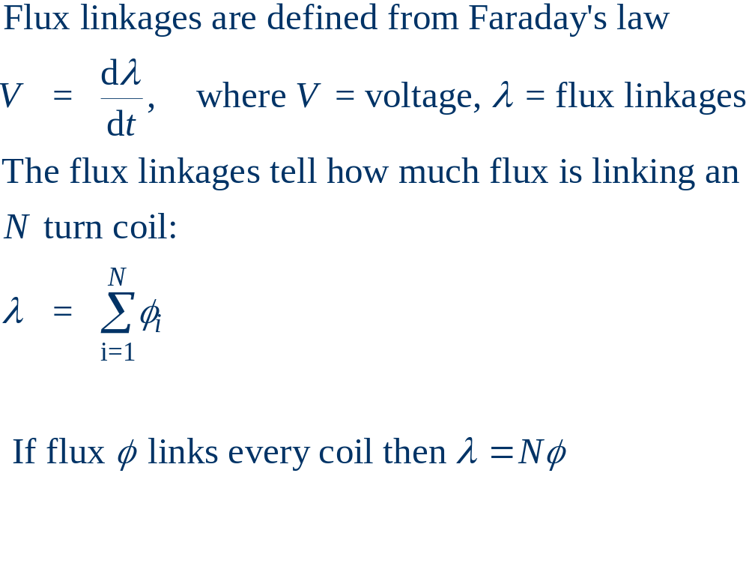
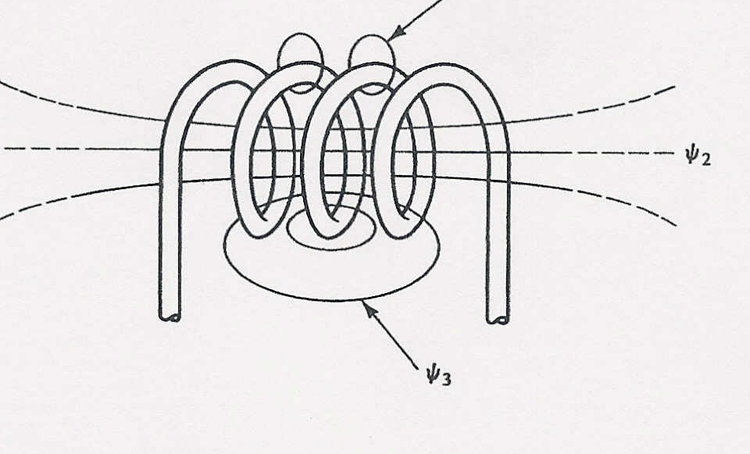
Flux linkages and Faraday’s law

Slide 31
Inductance
For a linear magnetic system; that is, one where B = μ H,
we can define the inductance, L, to be the constant of proportionality relating the current and the flux linkage: λ = L I,
where L has units of Henrys (H).

