Slide 1
EE369
POWER SYSTEM ANALYSIS
Lecture 6
Development of Transmission Line Models
Tom Overbye and Ross Baldick

Slide 2
Homework
HW 5 is problems 4.32, 4.33, 4.36, 4.38, 5.7, 5.16, 5.18; is due Thursday, September 29.

Slide 3
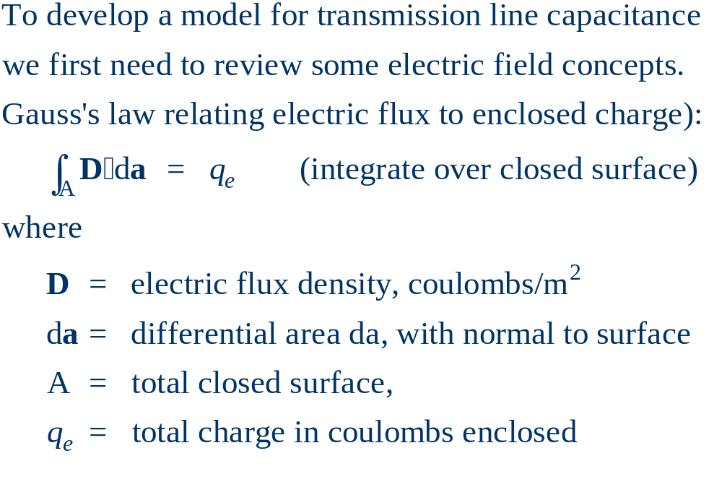
Review of Electric Fields

Slide 4
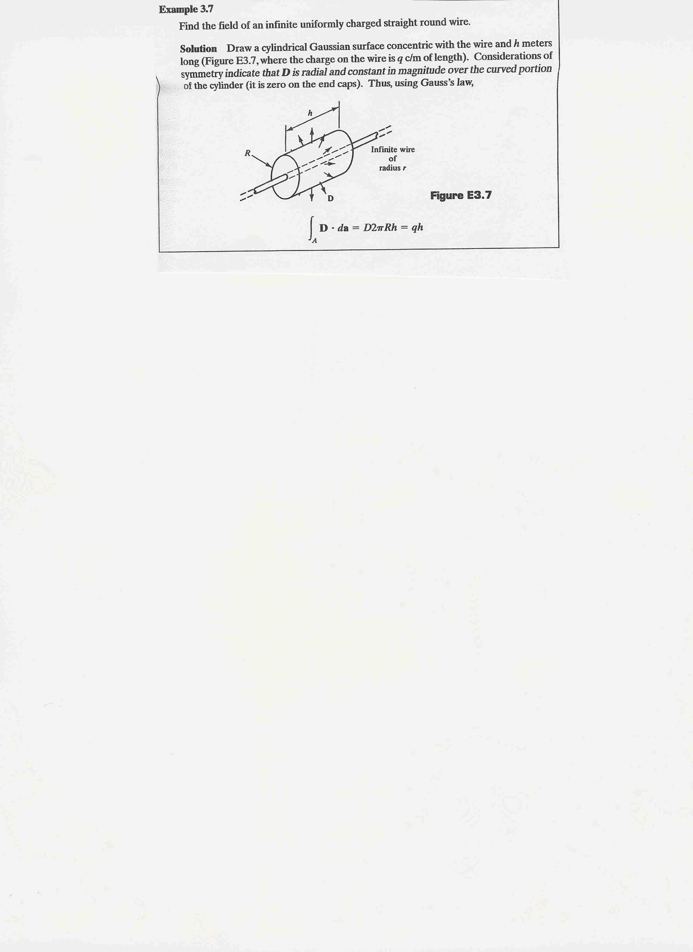
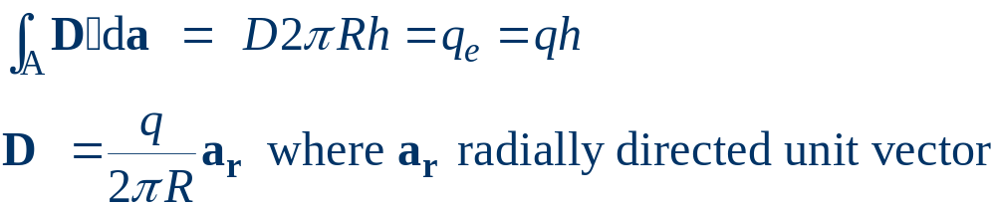
Gauss’s Law Example
Similar to Ampere’s Circuital law, Gauss’s Law is most useful for cases with symmetry.
Example: Calculate D about an infinitely long wire that has a charge density of q coulombs/meter.
Since D comes
radially out,
integrate over the
cylinder bounding
the wire.
D is perpendicular
to ends of cylinder.

Slide 5
Electric Fields
The electric field, E, is related to the electric flux density, D, by
D = ε E
where
E = electric field (volts/m)
ε = permittivity in farads/m (F/m)
ε = ε_{o} ε_{r}
ε_{o} = permittivity of free space (8.854×10⁻¹² F/m)
ε_{r} = relative permittivity or the dielectric constant
(≈1 for dry air, 2 to 6 for most dielectrics)

Slide 6
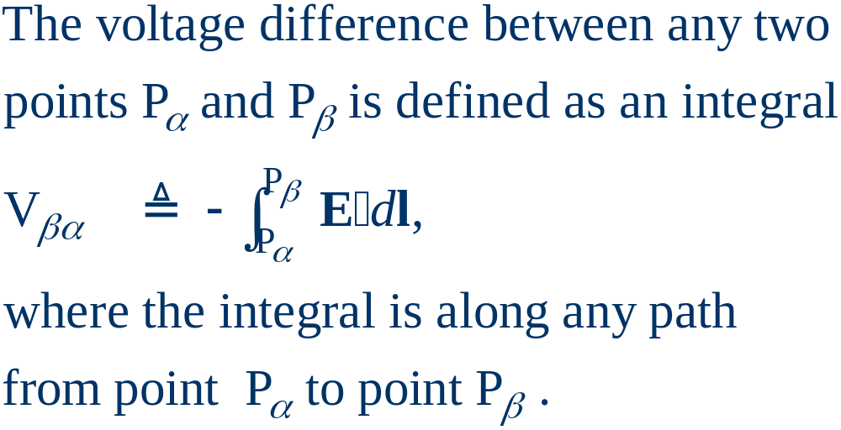
Voltage Difference

Slide 7
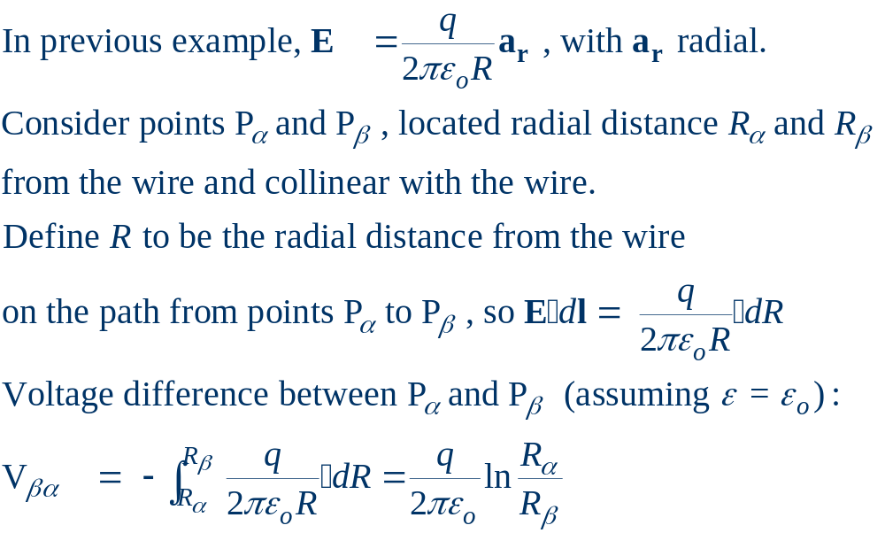
Voltage Difference

Slide 8
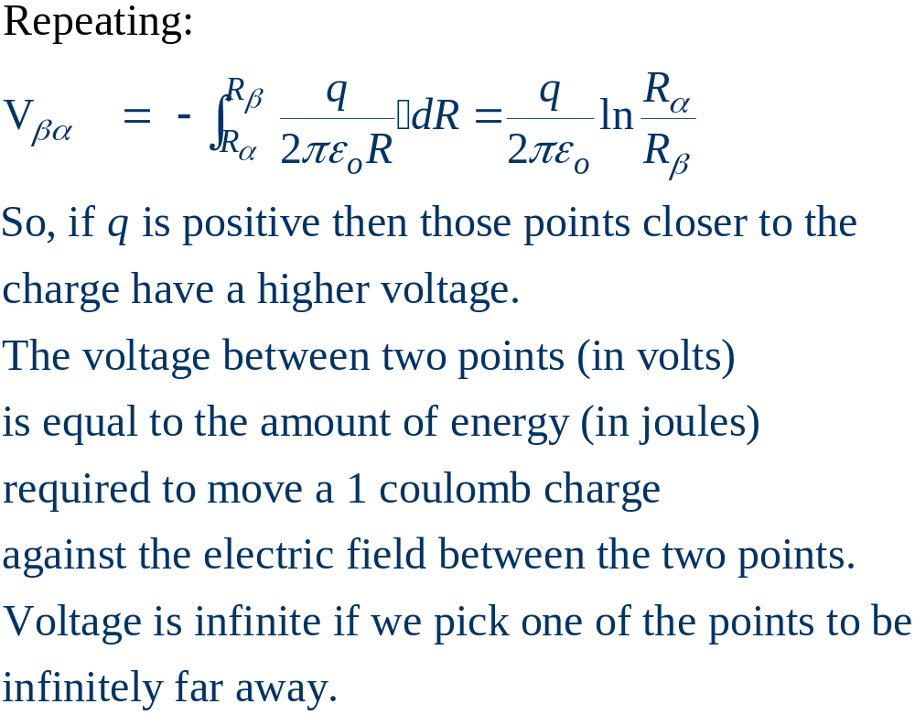
Voltage Difference, cont’d

Slide 9
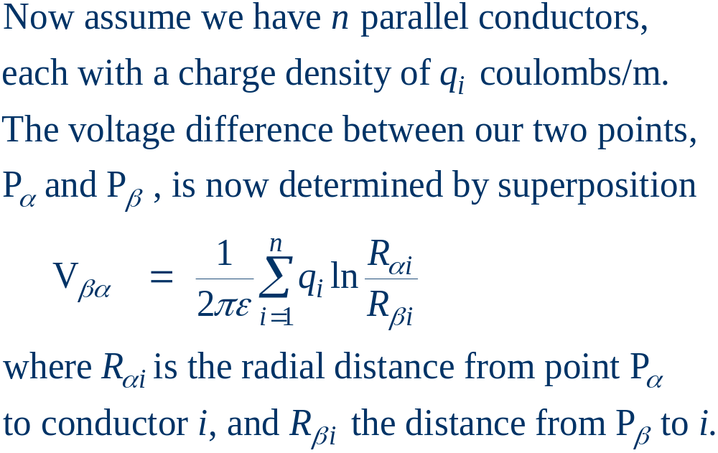
Multi-Conductor Case

Slide 10
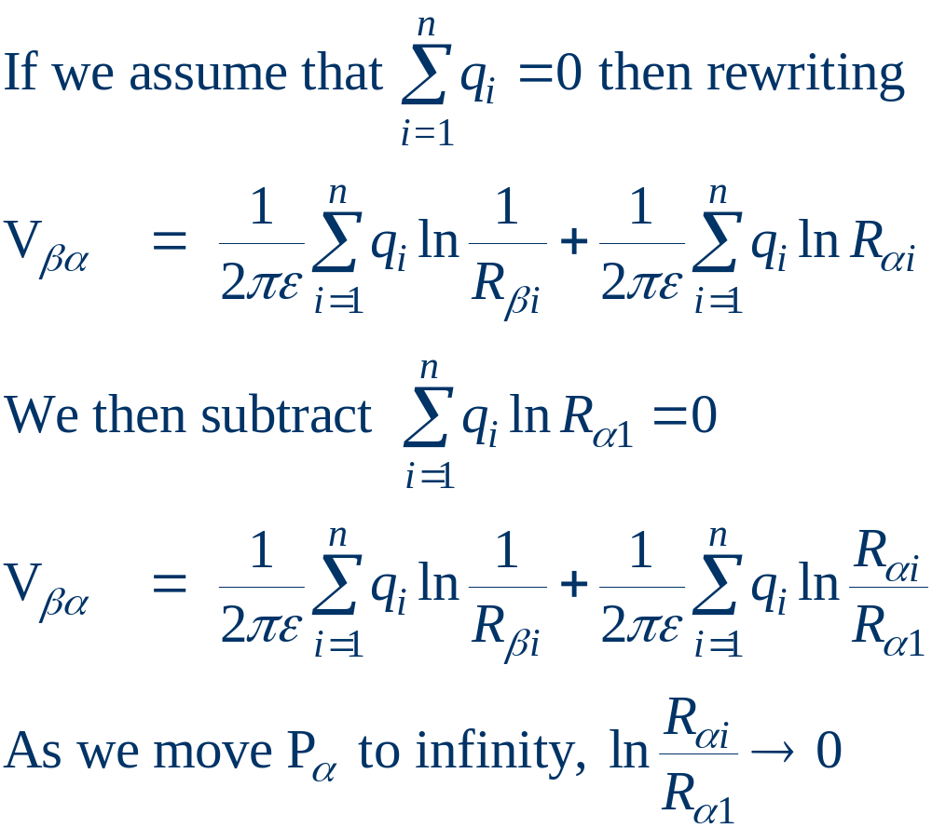
Multi-Conductor Case, cont’d

Slide 11
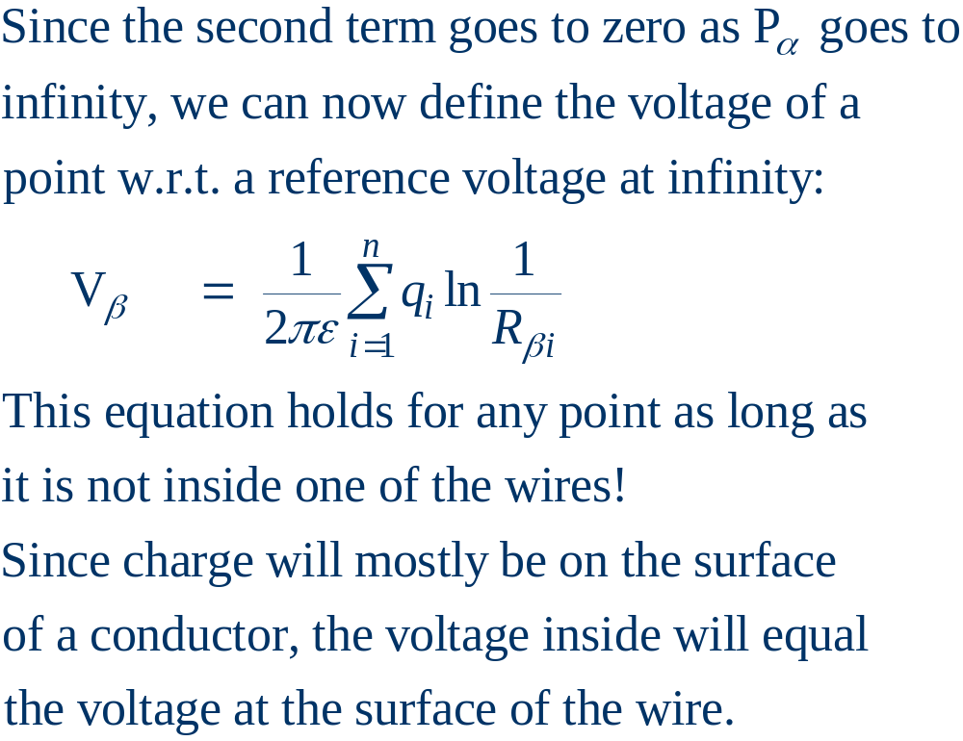
Absolute Voltage Defined

Slide 12
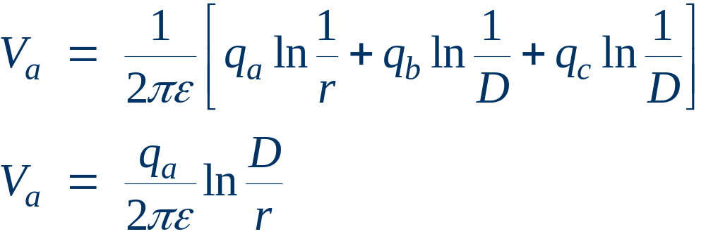
Three Conductor Case
A
Assume we have three
infinitely long conductors,
A, B, & C, each with radius r
and distance D from the
other two conductors.
Assume charge densities such
that q_{a} + q_{b} + q_{c} = 0
C
B

Slide 13
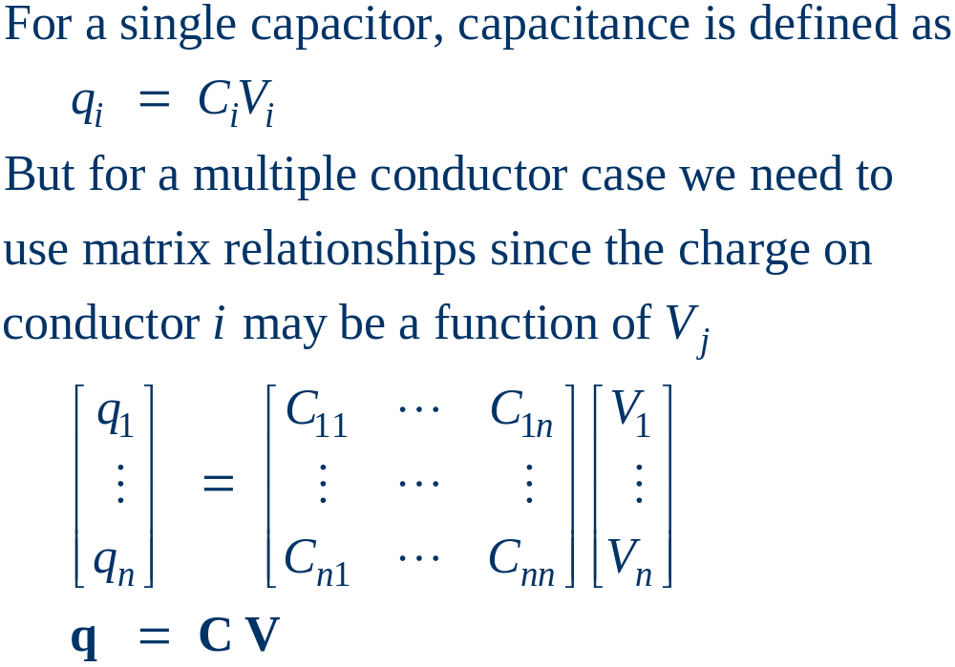
Line Capacitance

Slide 14
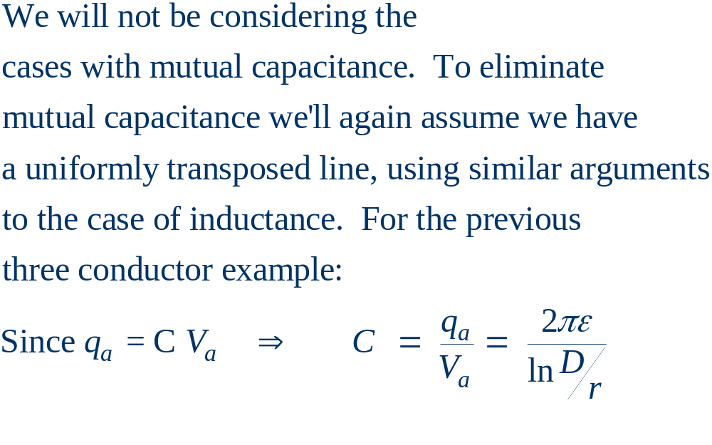
Line Capacitance, cont’d

Slide 15
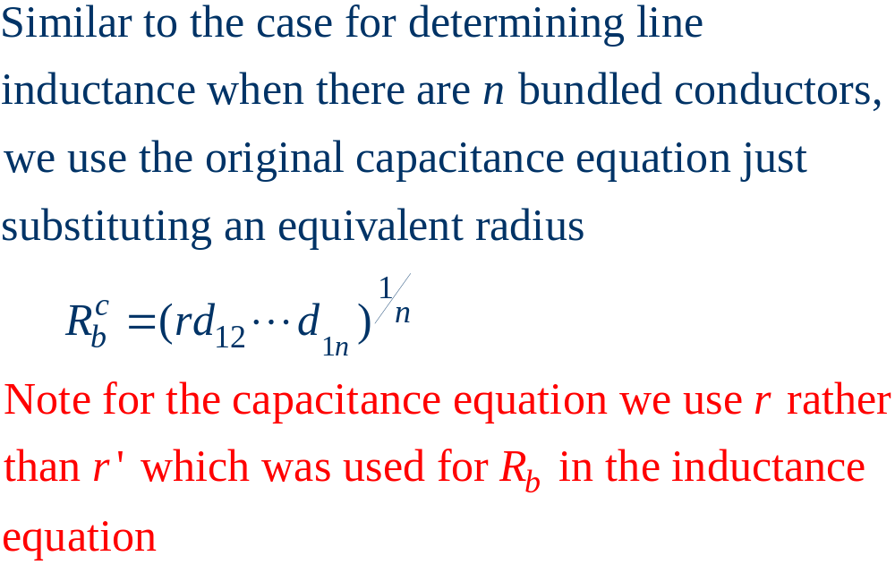
Bundled Conductor Capacitance

Slide 16
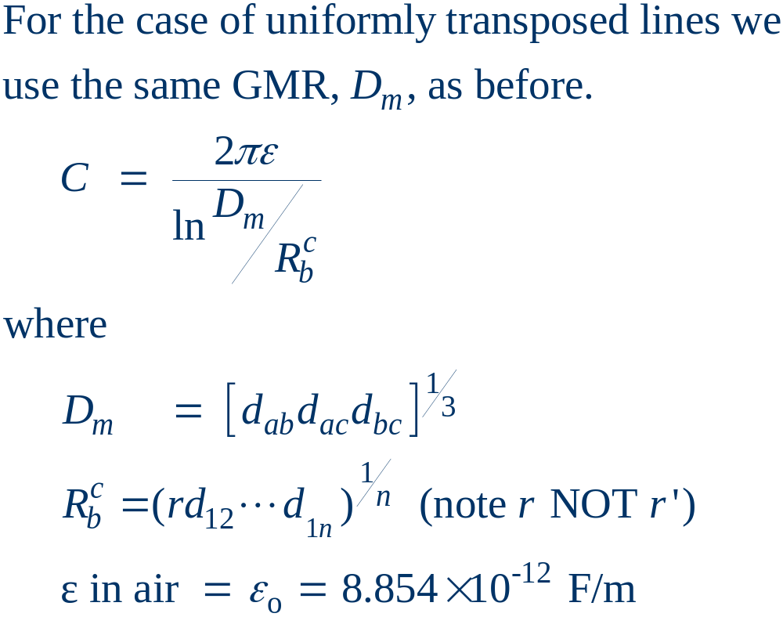
Line Capacitance, cont’d

Slide 17
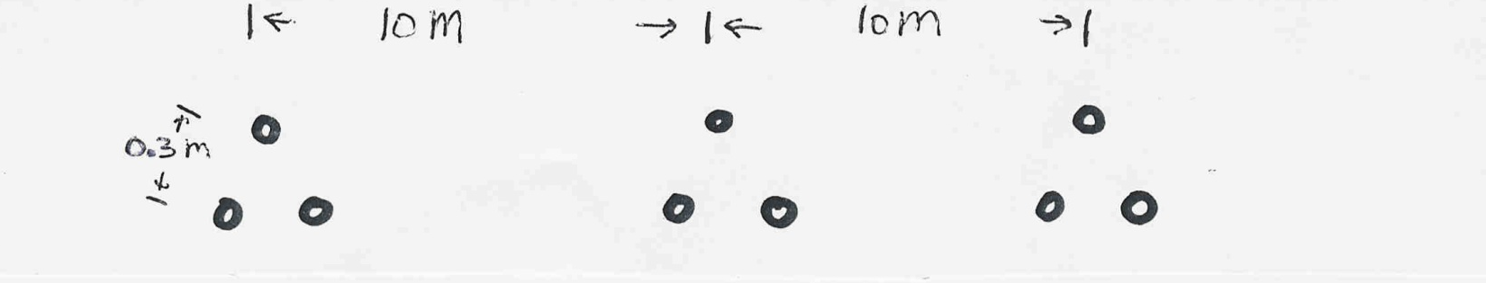
Line Capacitance Example
Calculate the per phase capacitance and susceptance
of a balanced 3φ, 60 Hz, transmission line with horizontal phase spacing of 10m using three conductor bundling with a spacing between conductors in the bundle of 0.3m. Assume the line is uniformly transposed and the conductors have a a 1cm radius.

Slide 18
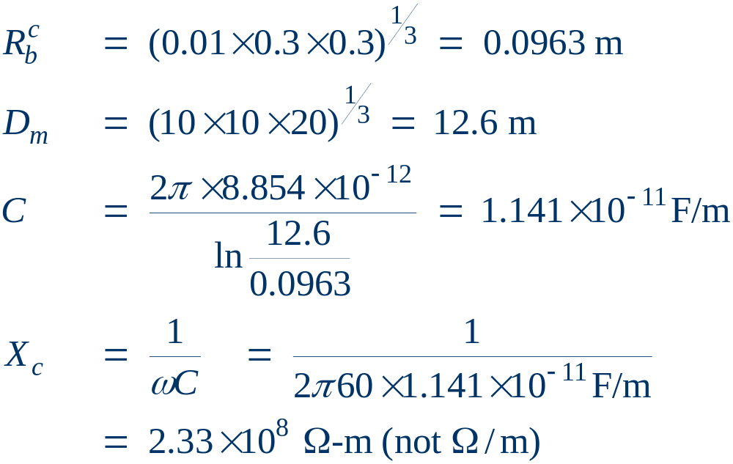
Line Capacitance Example, cont’d

Slide 19
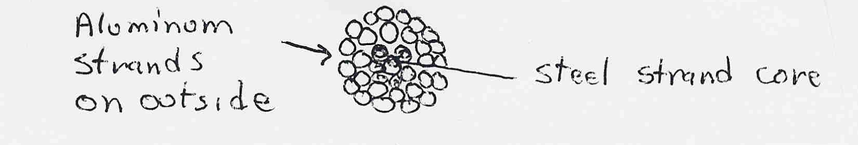
Line Conductors
Typical transmission lines use multi-strand conductors
ACSR (aluminum conductor steel reinforced)
conductors are most common. A typical Al. to St. ratio is about 4 to 1.

Slide 20
Line Conductors, cont’d
Total conductor area is given in circular mils. One circular mil is the area of a circle with a diameter of 0.001, and so has area π × 0.0005² square inches
Example: what is the area of a solid, 1” diameter circular wire?
Answer: 1000 kcmil (kilo circular mils)
Because conductors are stranded, the equivalent radius must be provided by the manufacturer. In tables this value is known as the GMR and is usually expressed in feet.

Slide 21
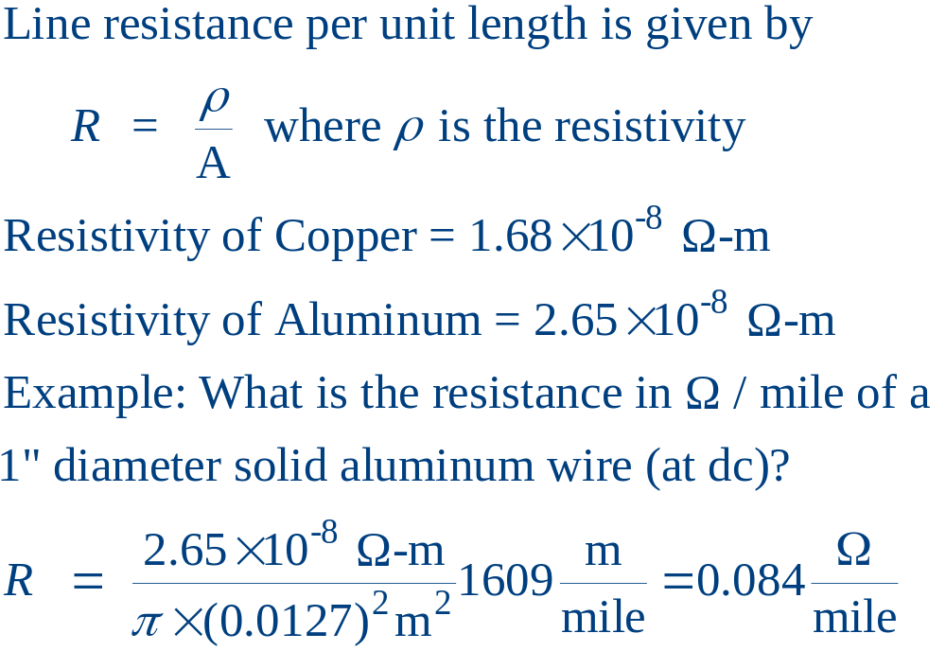
Line Resistance

Slide 22
Line Resistance, cont’d
Because ac current tends to flow towards the surface of a conductor, the resistance of a line at 60 Hz is slightly higher than at dc.
Resistivity and hence line resistance increase as conductor temperature increases (changes is about 8% between 25°C and 50°C)
Because ACSR conductors are stranded, actual resistance, inductance, and capacitance needs to be determined from tables.

Slide 23
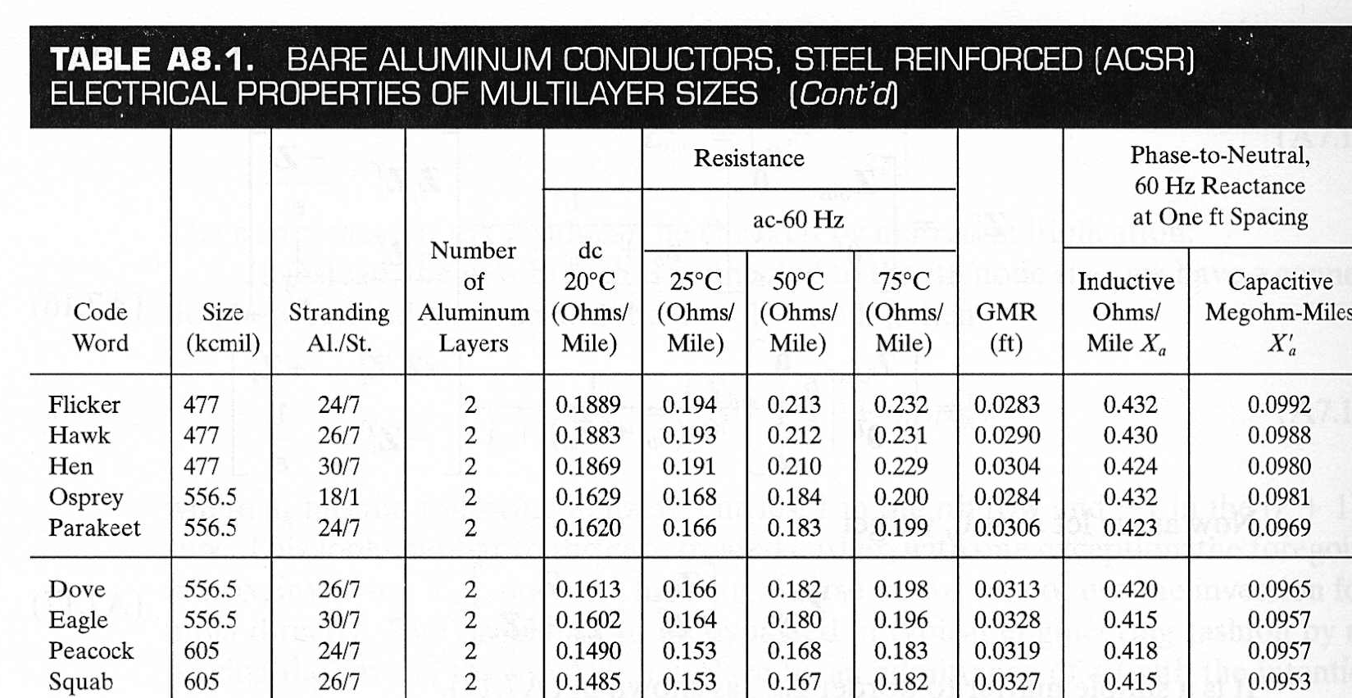
ACSR Table Data (Similar to Table A.4)
GMR is equivalent to r’
Inductance and Capacitance
assume a D_{m} of 1 ft.

Slide 24
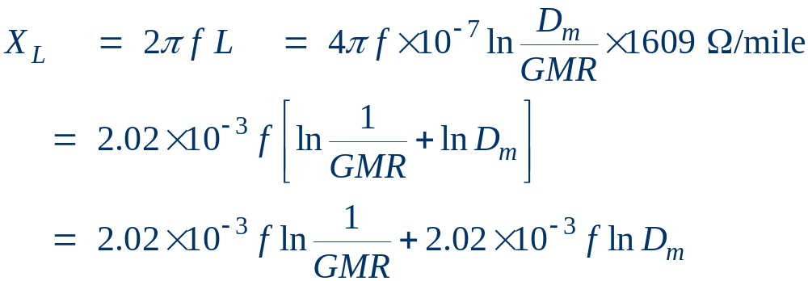
ACSR Data, cont’d
Term from table,
depending on conductor type,
but assuming a one foot spacing
Term independent
of conductor, but
with spacing D_{m} in feet.

Slide 25
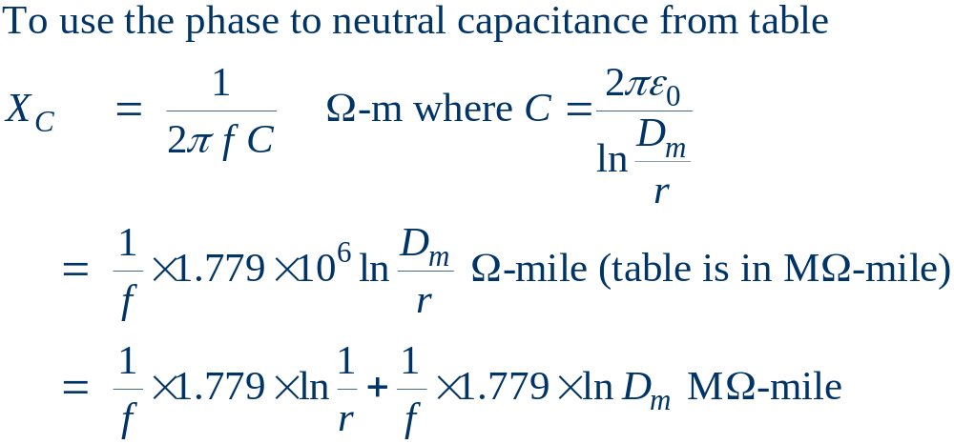
ACSR Data, Cont.
Term from table,
depending on conductor type,
but assuming a one foot spacing
Term independent
of conductor, but
with spacing D_{m} in feet.

Slide 26
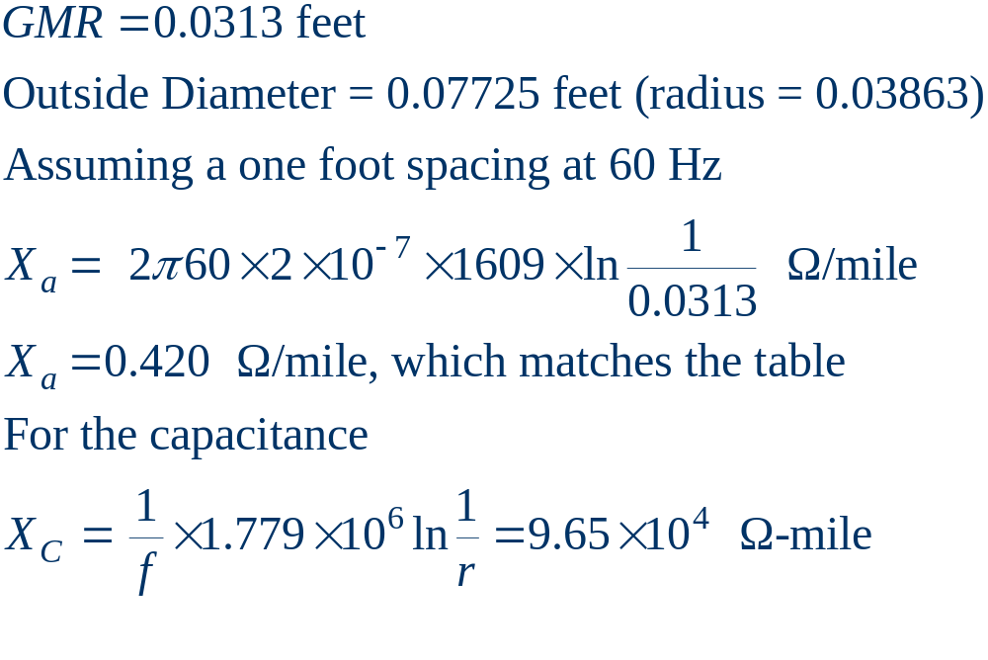
Dove Example

Slide 27
Additional Transmission Topics
Multi-circuit lines: Multiple lines often share a common transmission right-of-way. This DOES cause mutual inductance and capacitance, but is often ignored in system analysis.
Cables: There are about 3000 miles of underground ac cables in U.S. Cables are primarily used in urban areas. In a cable the conductors are tightly spaced, (< 1ft) with oil impregnated paper commonly used to provide insulation
  inductance is lower
  capacitance is higher, limiting cable length

Slide 28
Additional Transmission topics
Ground wires: Transmission lines are usually protected from lightning strikes with a ground wire. This topmost wire (or wires) helps to attenuate the transient voltages/currents that arise during a lighting strike. The ground wire is typically grounded at each pole.
Corona discharge: Due to high electric fields around lines, the air molecules become ionized. This causes a crackling sound and may cause the line to glow!

Slide 29
Additional Transmission topics
Shunt conductance: Usually ignored. A small current may flow through contaminants on insulators.
DC Transmission: Because of the large fixed cost necessary to convert ac to dc and then back to ac, dc transmission is only practical for several specialized applications
  long distance overhead power transfer (> 400 miles)
  long cable power transfer such as underwater
  providing an asynchronous means of joining different power systems (such as the Eastern and ERCOT grids).

