Slide 1
EE 369
POWER SYSTEM ANALYSIS
Lecture 7
Transmission Line Models
Tom Overbye and Ross Baldick

Slide 2
Announcements
For lectures 7 to 9 read Chapter 5.
HW 5 is problems 4.32, 4.33, 4.36, 4.38, 5.7, 5.16, 5.18; is due Thursday, September 29.
Midterm September 29 will cover through material in Homework 4:
  Bring in page of notes, calculator, writing implements.
Homework 6 is 5.14, 5.23, 5.26, 5.27, 5.28, 5.33, 5.37, 5.43; due October 6.

Slide 3
Transmission Line Models
Previous lectures have covered how to calculate the distributed series inductance, shunt capacitance, and series resistance of transmission lines:
  That is, we have calculated the inductance L, capacitance C, and resistance r per unit length,
  We can also think of the shunt conductance g per unit length,
  Each infinitesimal length dx of transmission line consists of a series impedance rdx + jωLdx and a shunt admittance gdx + jωCdx,
In this section we will use these distributed parameters to develop the transmission line models used in power system analysis.

Slide 4
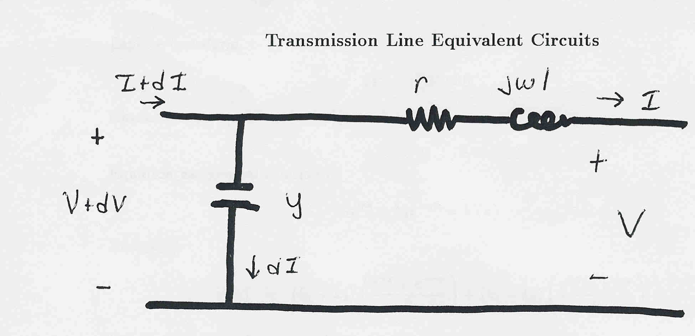
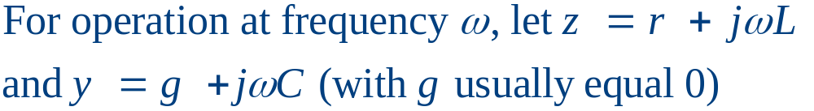
Transmission Line Equivalent Circuit
Our current model of an infinitesimal length of transmission line is shown below:
dx
dx
Units on
z and y are
per unit
length!
dx

Slide 5
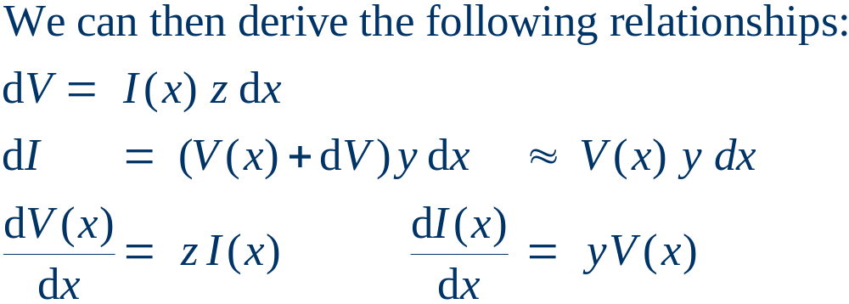
Derivation of V, I Relationships
dx
dx
dx

Slide 6
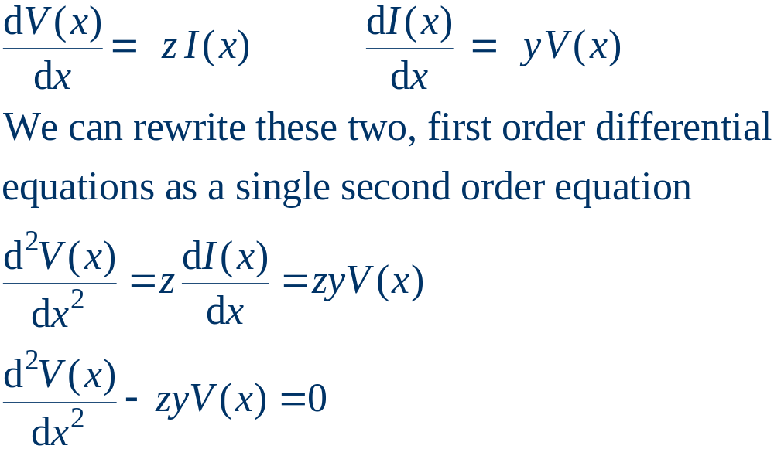
Setting up a Second Order Equation

Slide 7
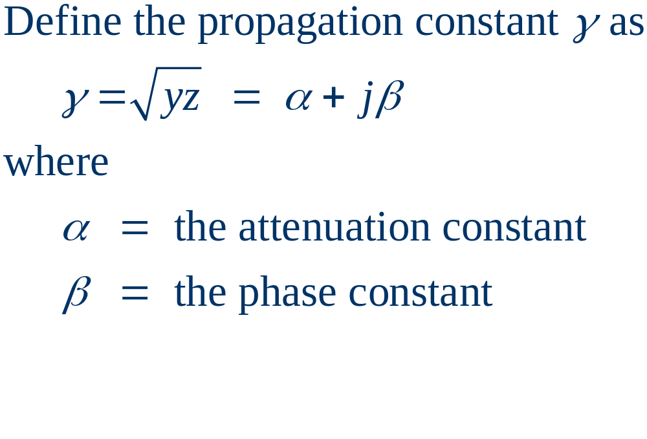
V, I Relationships, cont’d

Slide 8
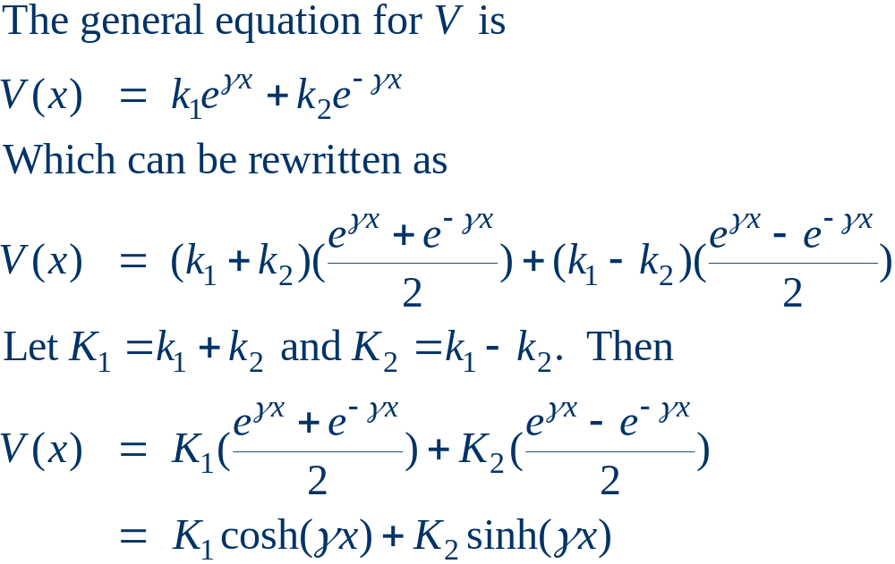
Equation for Voltage

Slide 9
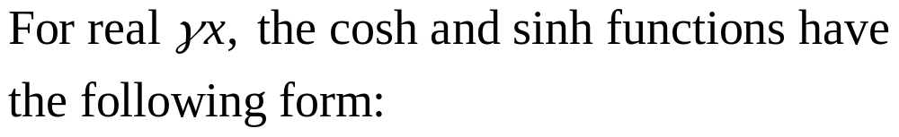
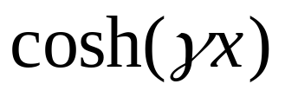
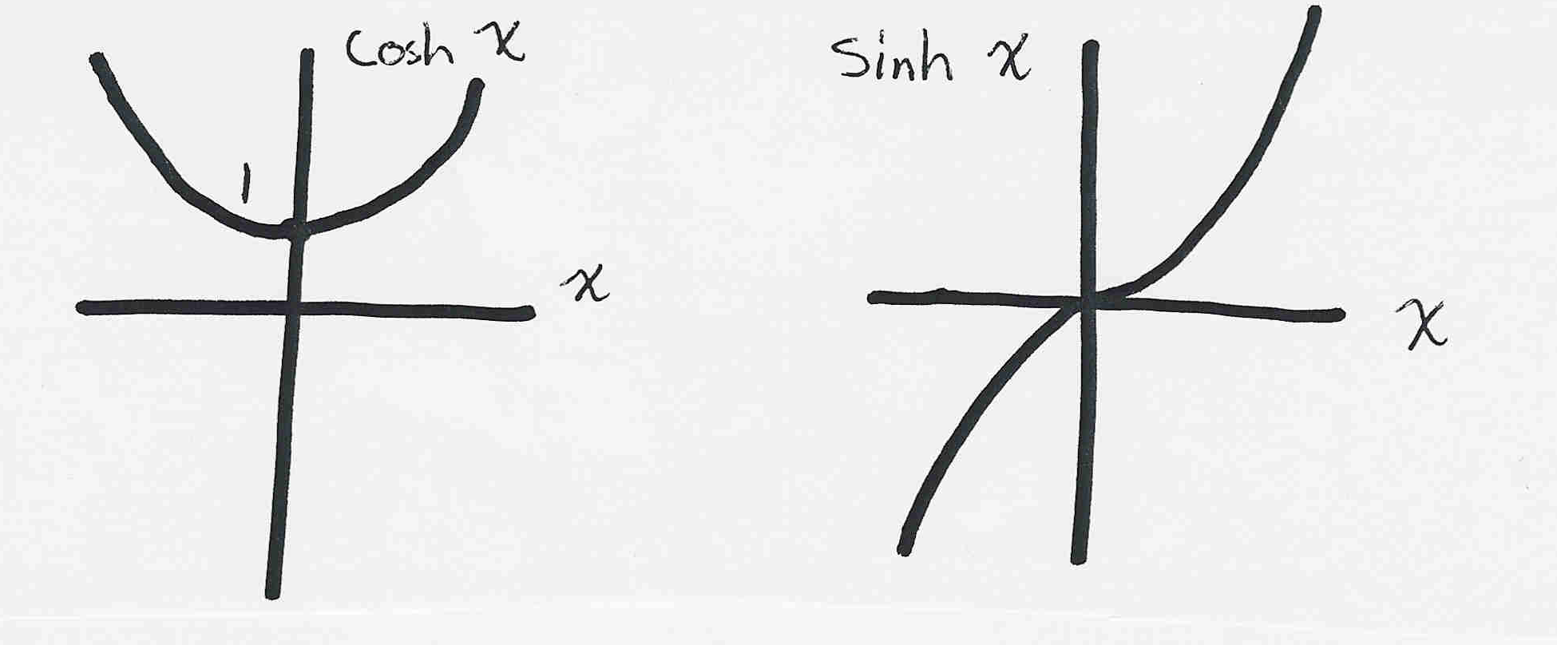
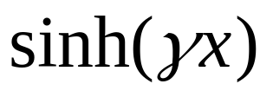
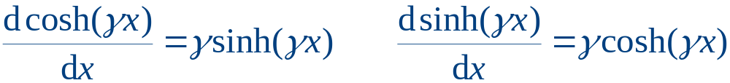
Real Hyperbolic Functions

Slide 10
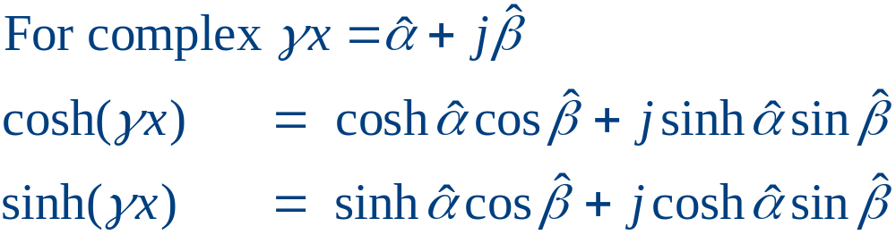
Complex Hyperbolic Functions

Slide 11
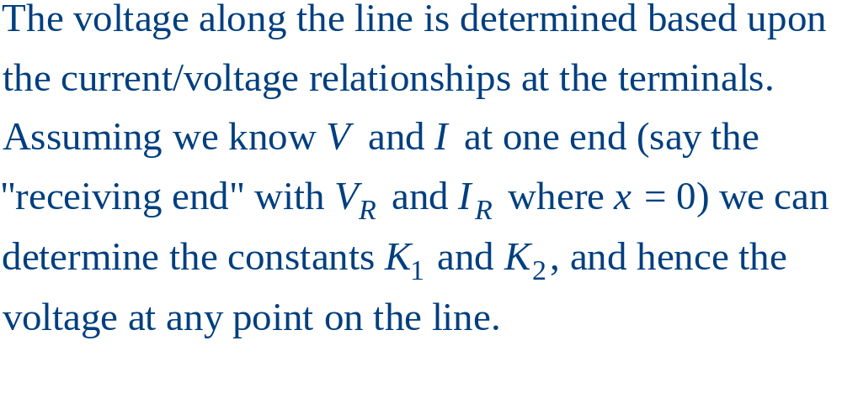
Determining Line Voltage

Slide 12
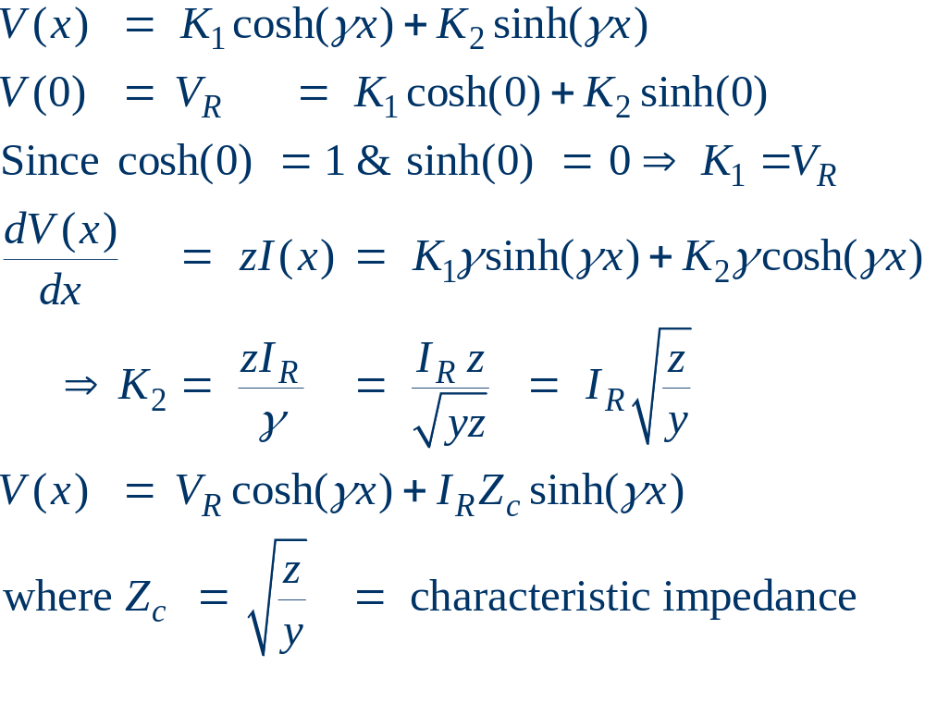
Determining Line Voltage, cont’d

Slide 13
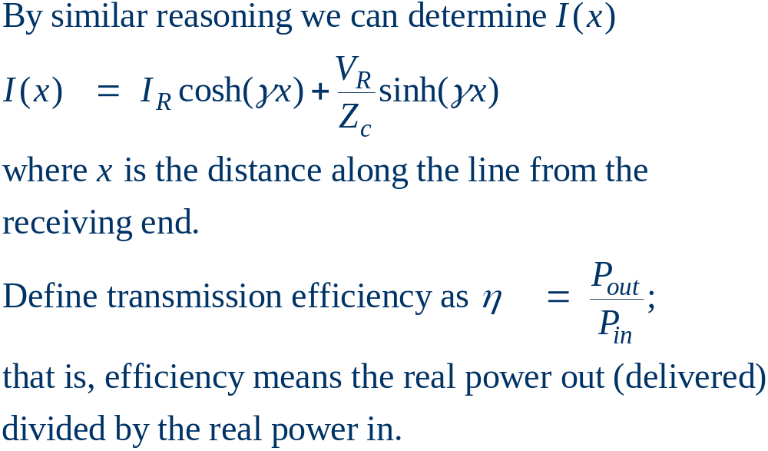
Determining Line Current

Slide 14
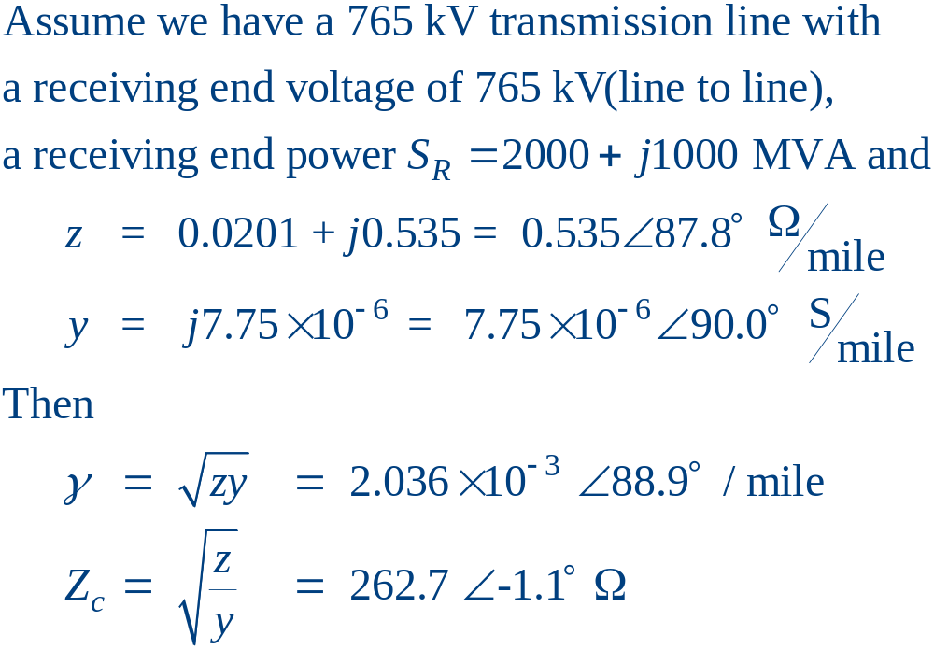
Transmission Line Example

Slide 15
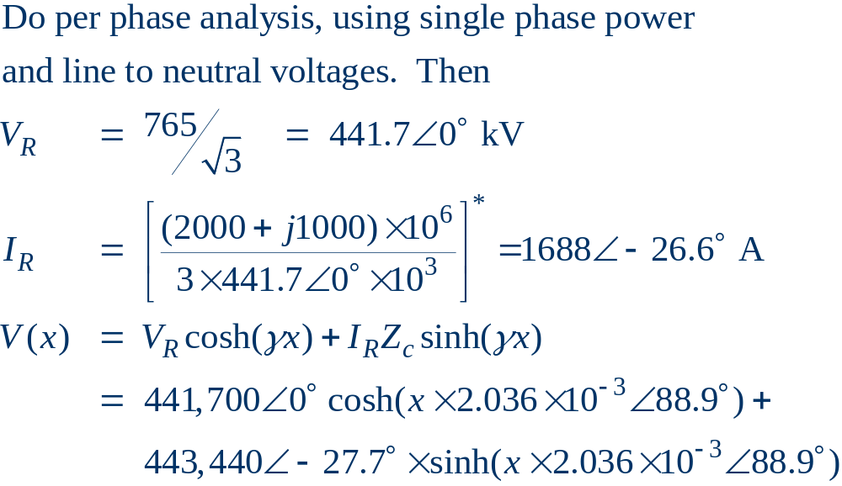
Transmission Line Example, cont’d

Slide 16
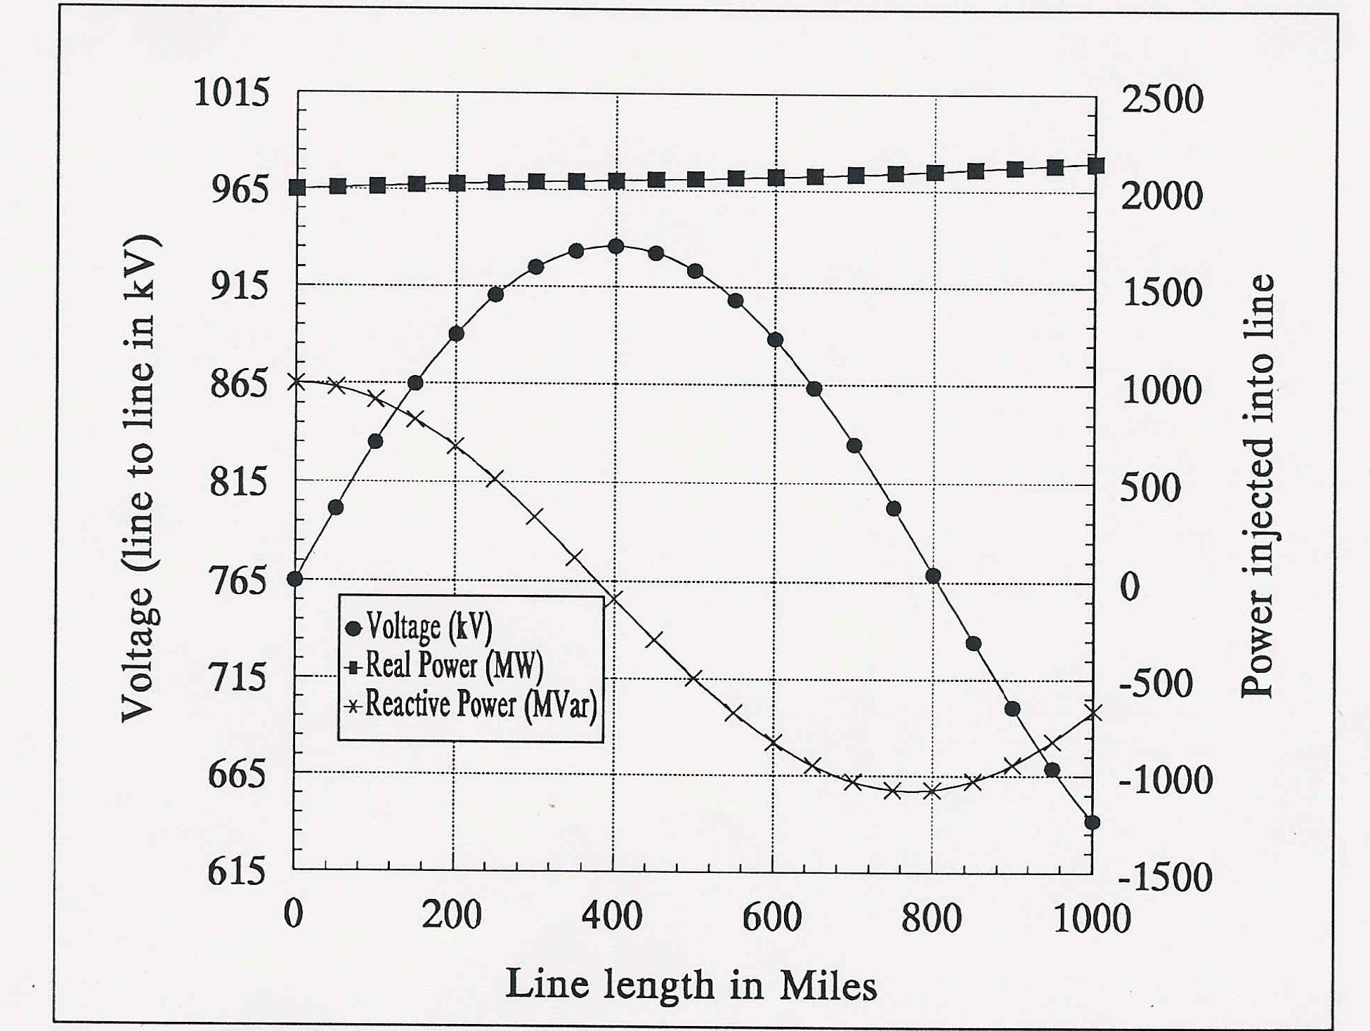
Transmission Line Example, cont’d
Receiving end
Sending end

Slide 17
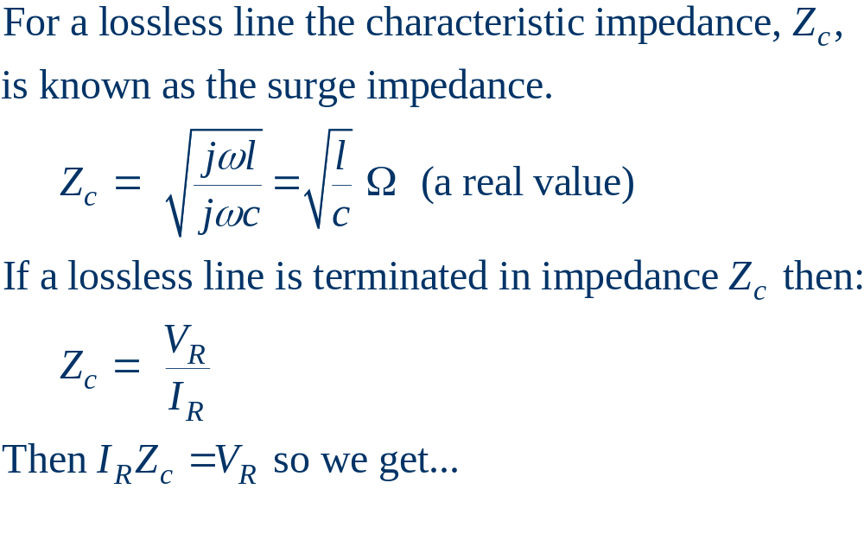
Lossless Transmission Lines

Slide 18
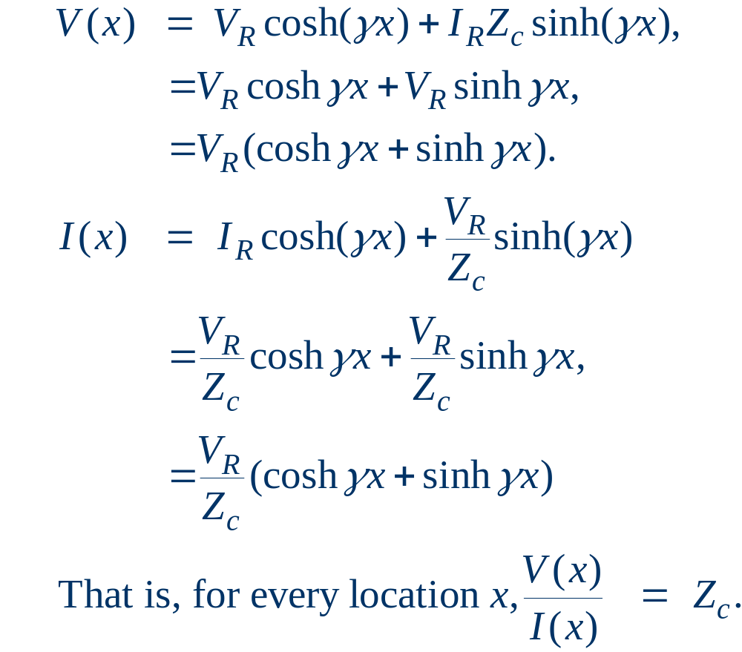
Lossless Transmission Lines

Slide 19
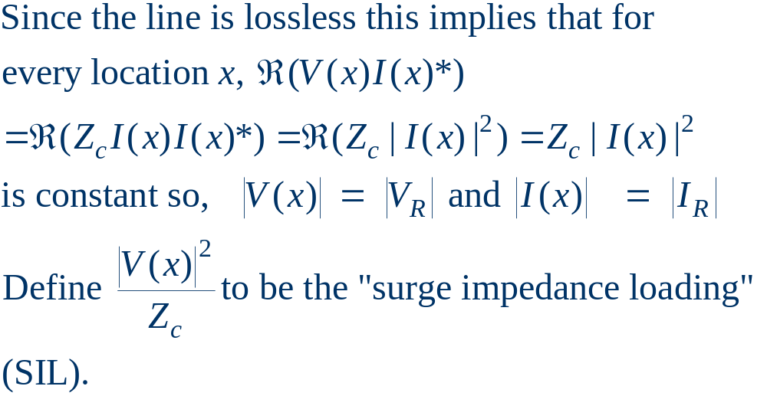
Lossless Transmission Lines
If load power P > SIL then line consumes vars; otherwise line generates vars.

Slide 20

Transmission Matrix Model
Oftentimes we’re only interested in the terminal characteristics of the transmission line. Therefore we can model it as a “black box:”
I_{S}
I_{R}
+
Transmission
Line
+
V_{S}
V_{R}
-
-

Slide 21
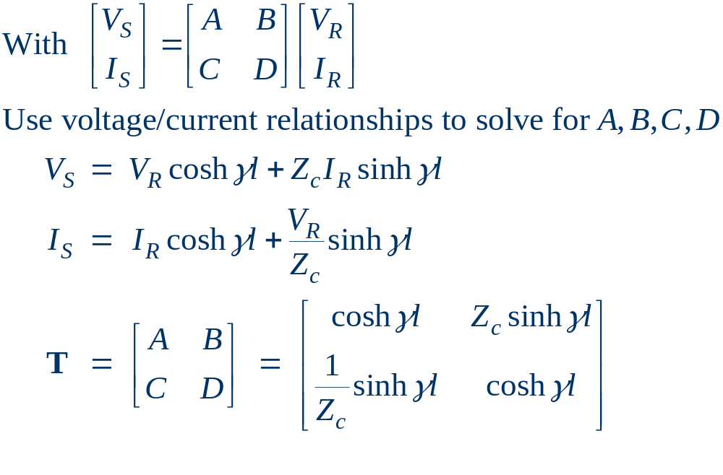
Transmission Matrix Model, cont’d

Slide 22

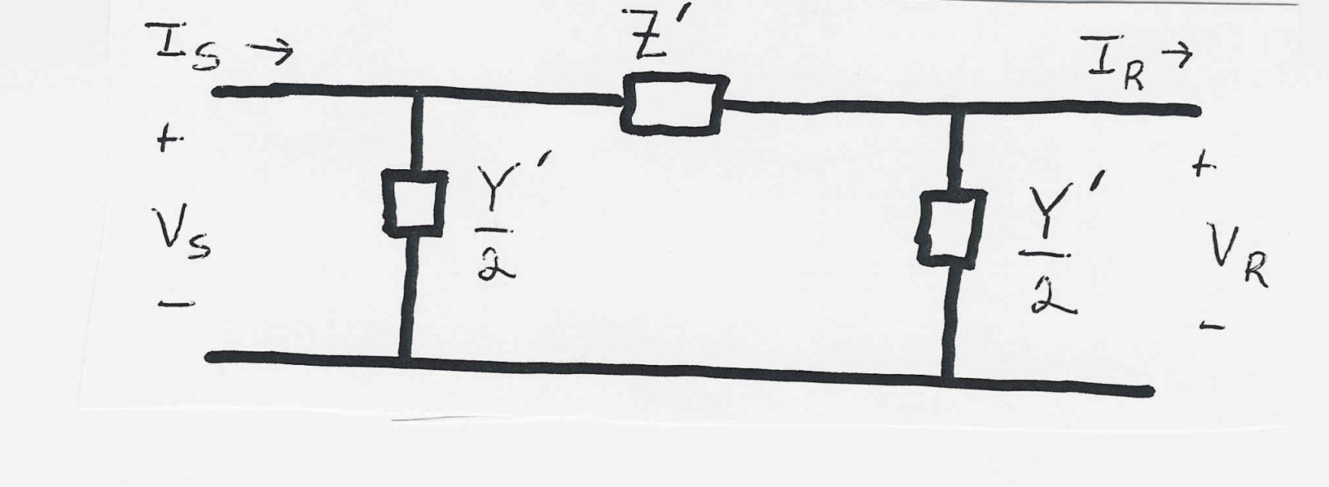
Equivalent Circuit Model
Next we’ll use the T matrix values to derive the
parameters Z' and Y' that match the behavior
of the equivalent circuit to that of the T matrix.
We do this by first finding the relationship
between sending and receiving end for the
equivalent circuit.

Slide 23
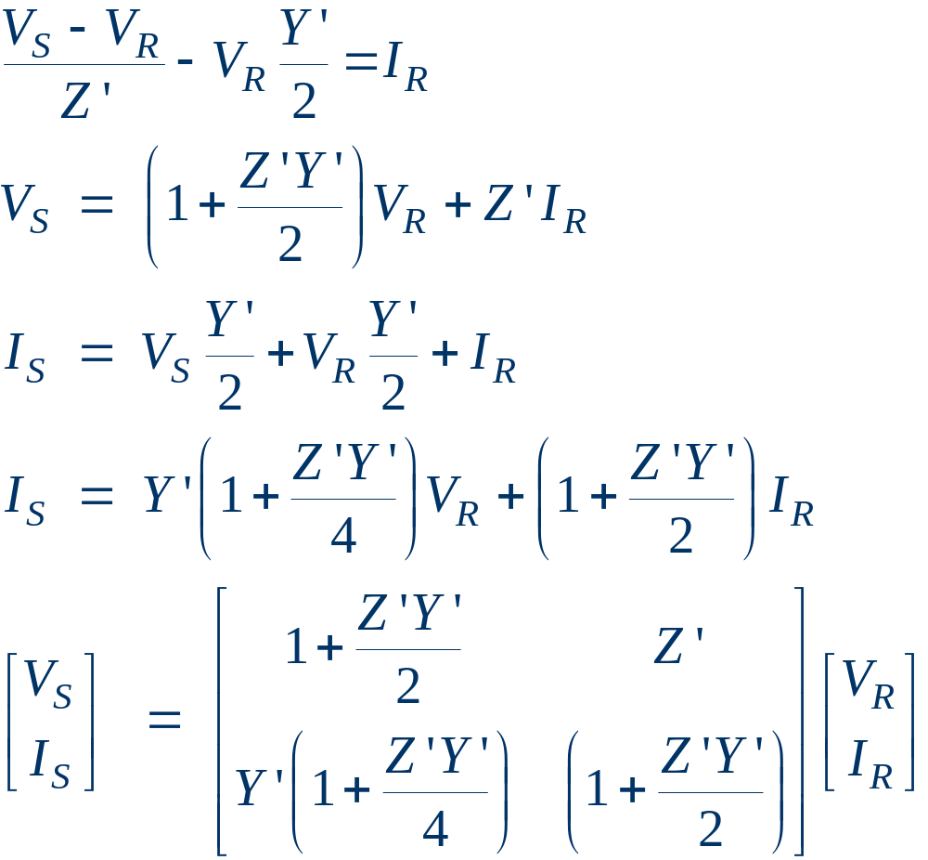

Equivalent Circuit Parameters

Slide 24
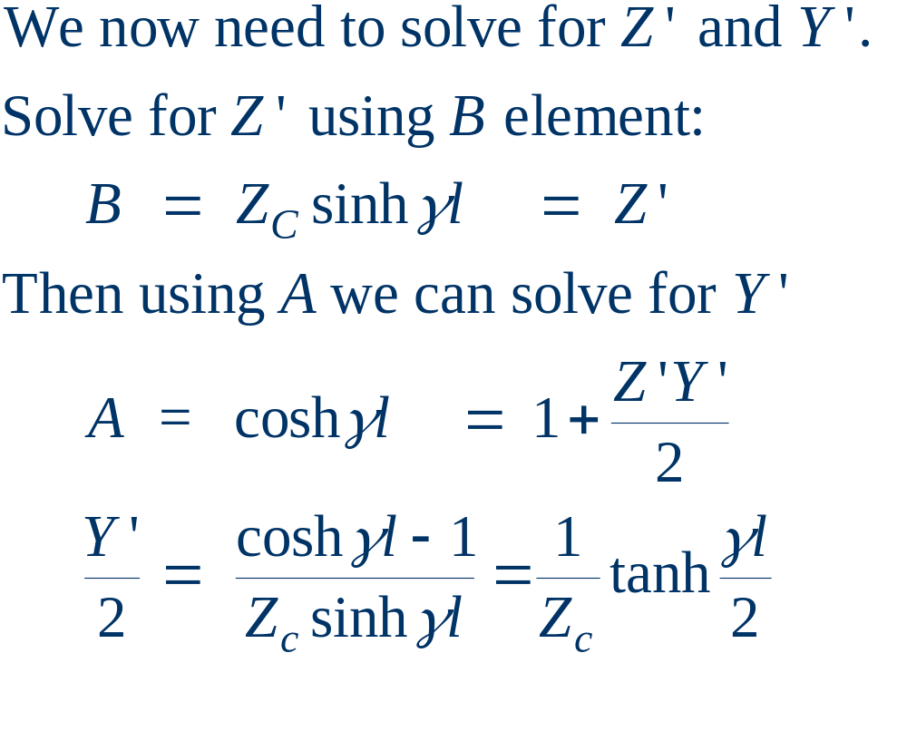
Equivalent circuit parameters

Slide 25
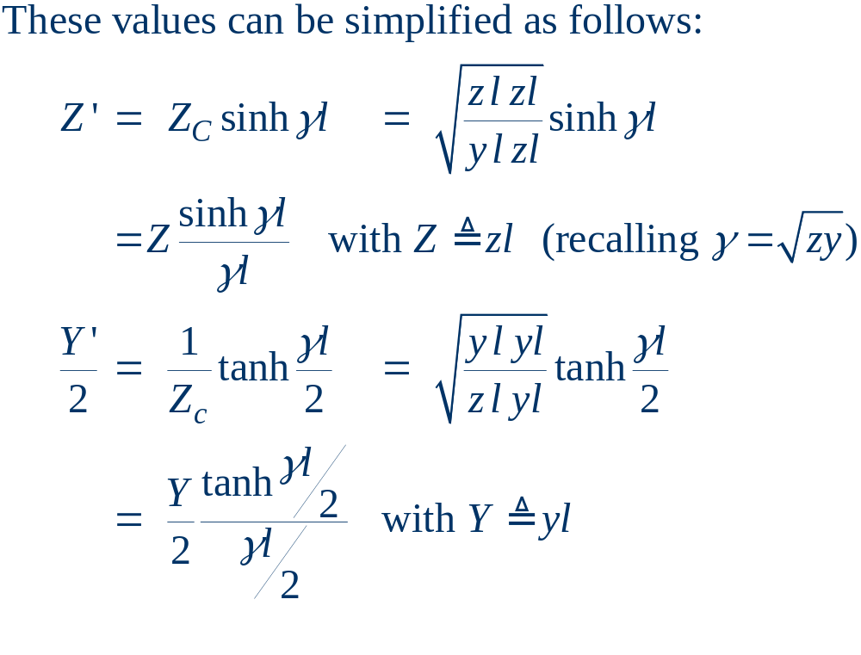
Simplified Parameters

Slide 26
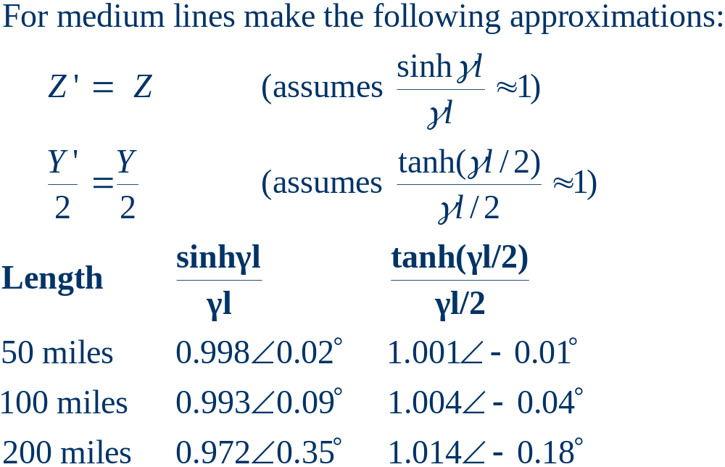
Simplified Parameters

Slide 27
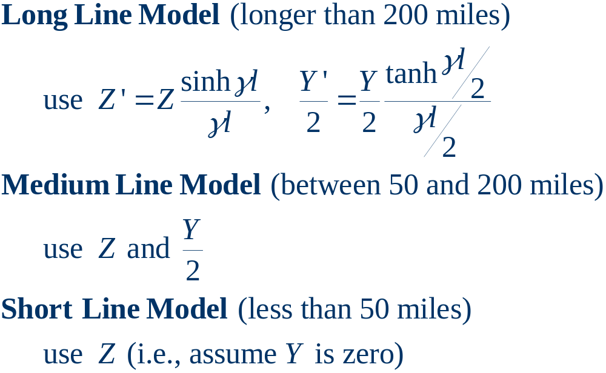
Three Line Models

Slide 28
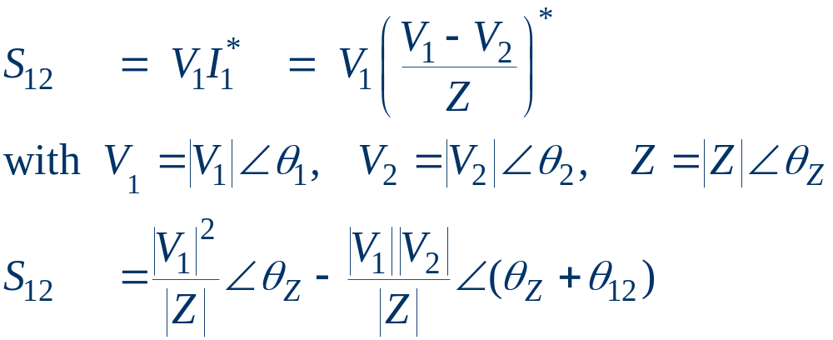
Power Transfer in Short Lines
Often we'd like to know the maximum power that could be transferred through a short transmission line
I₁
I₂
+
Transmission
Line with
Impedance Z
+
V₁
S₁₂
S₂₁
V₂
-
-

Slide 29
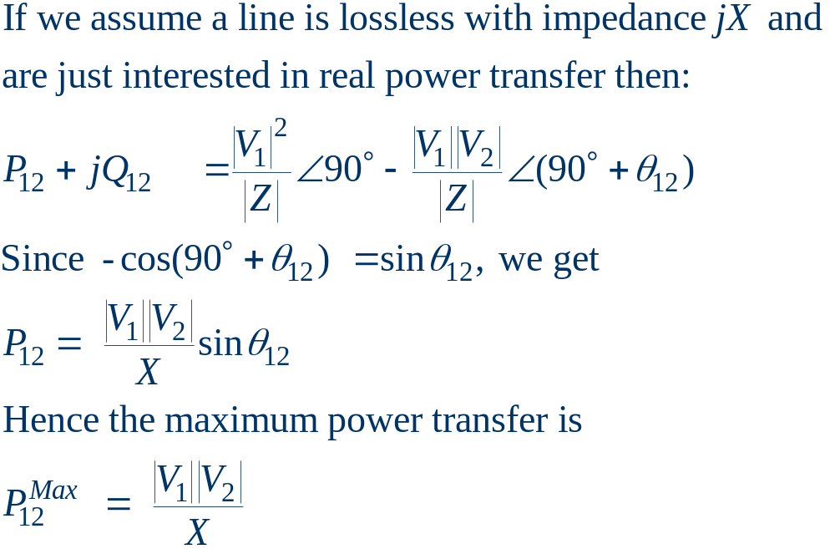
Power Transfer in Lossless Lines

Slide 30
Limits Affecting Max. Power Transfer
Thermal limits
  limit is due to heating of conductor and hence depends heavily on ambient conditions.
  For many lines, sagging is the limiting constraint.
  Newer conductors limit can limit sag. For example, in 2004 ORNL working with 3M announced lines with a core consisting of ceramic Nextel fibers. These lines can operate at 200 degrees C.
  Trees grow, and will eventually hit lines if they are planted under the line.

Slide 31
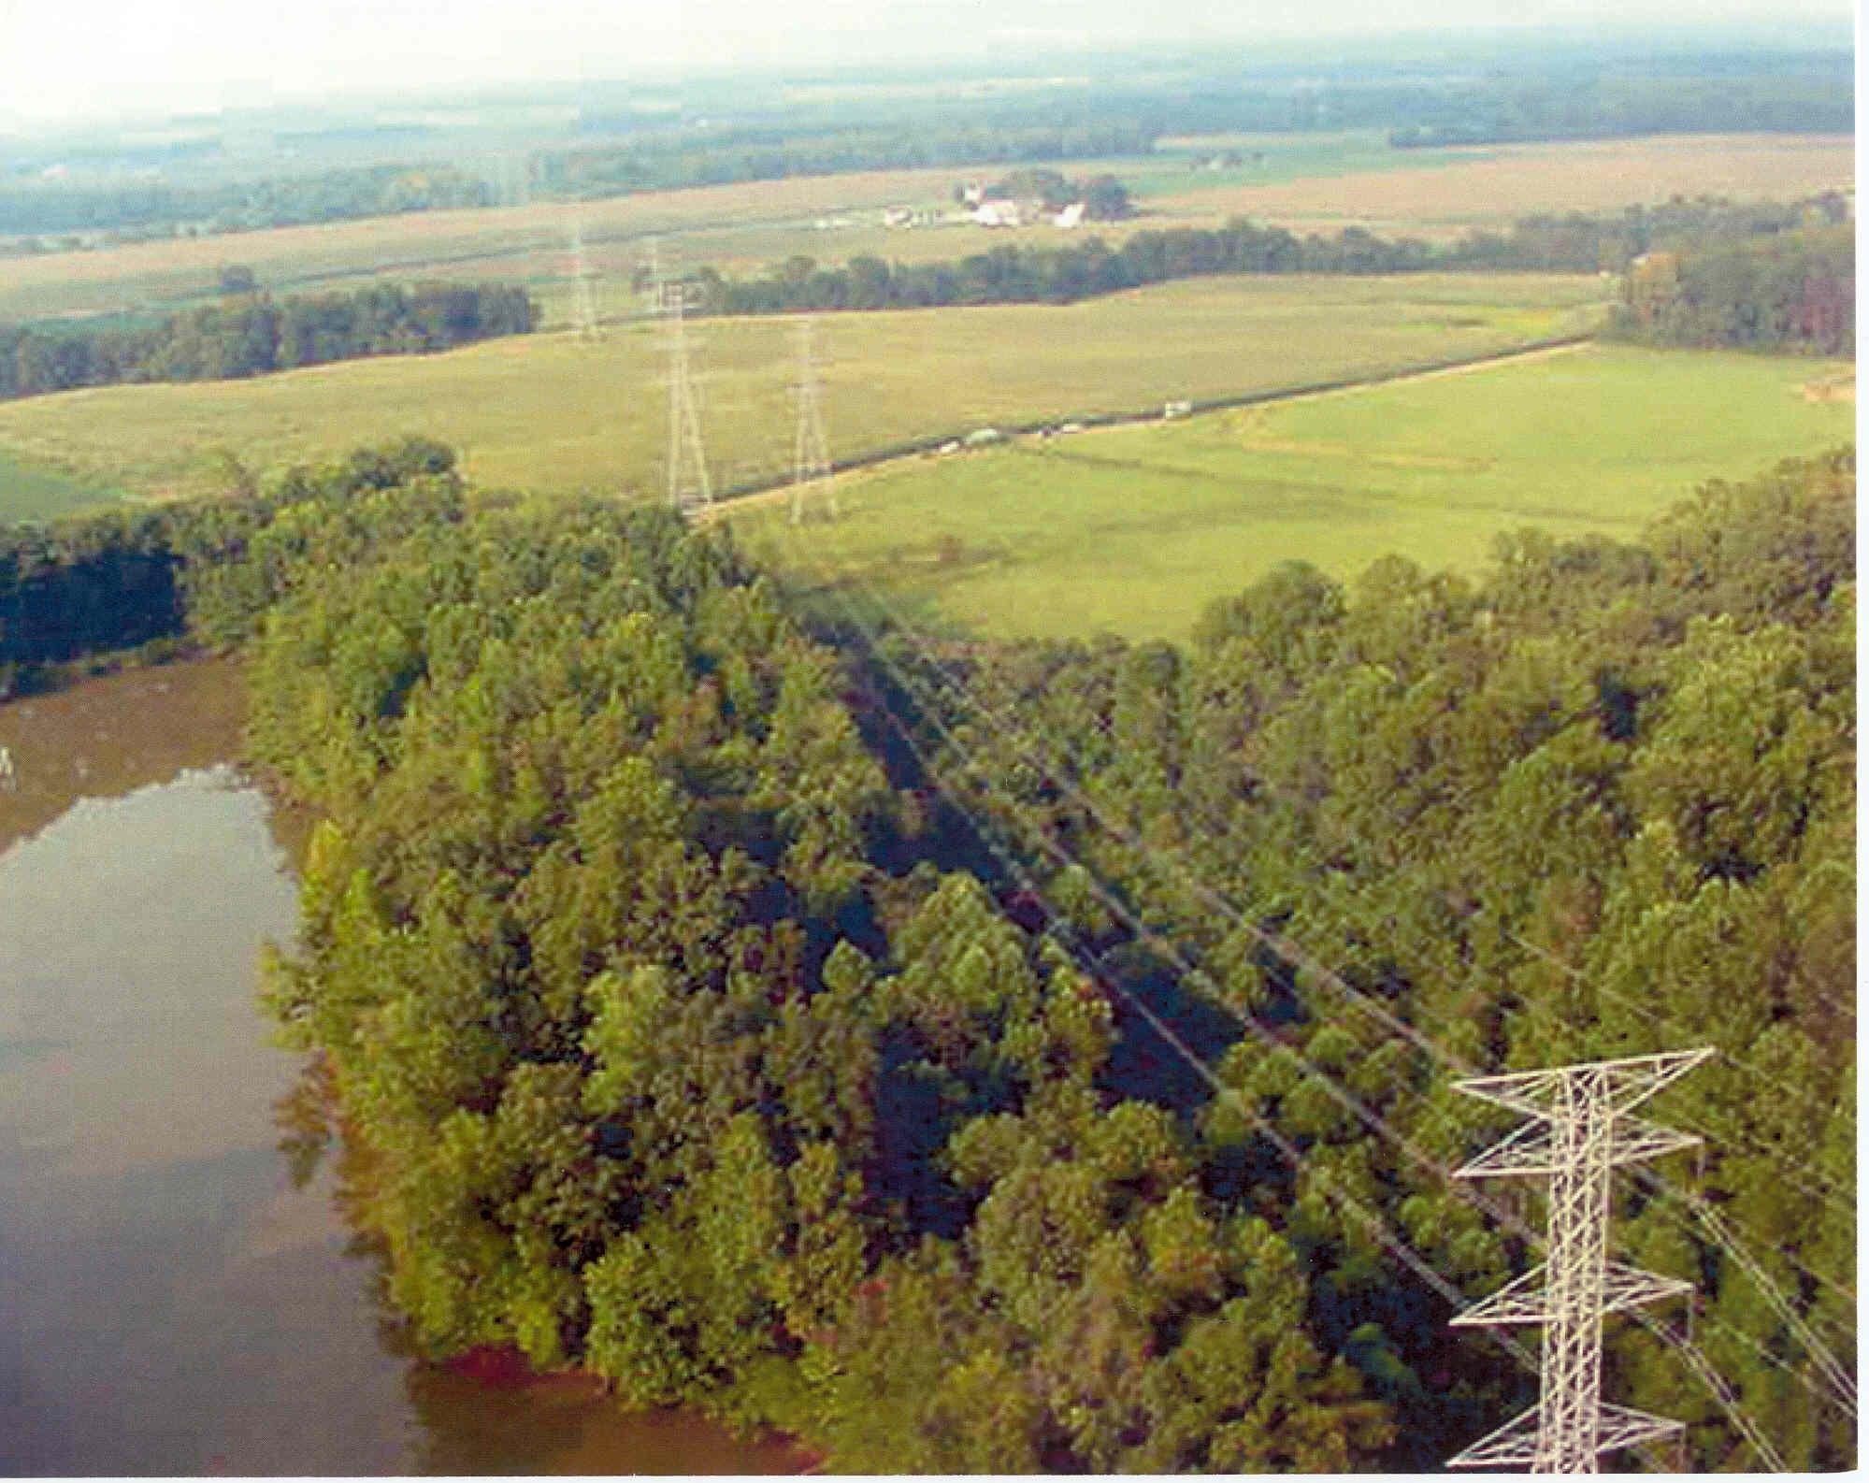
Tree Trimming: Before

Slide 32
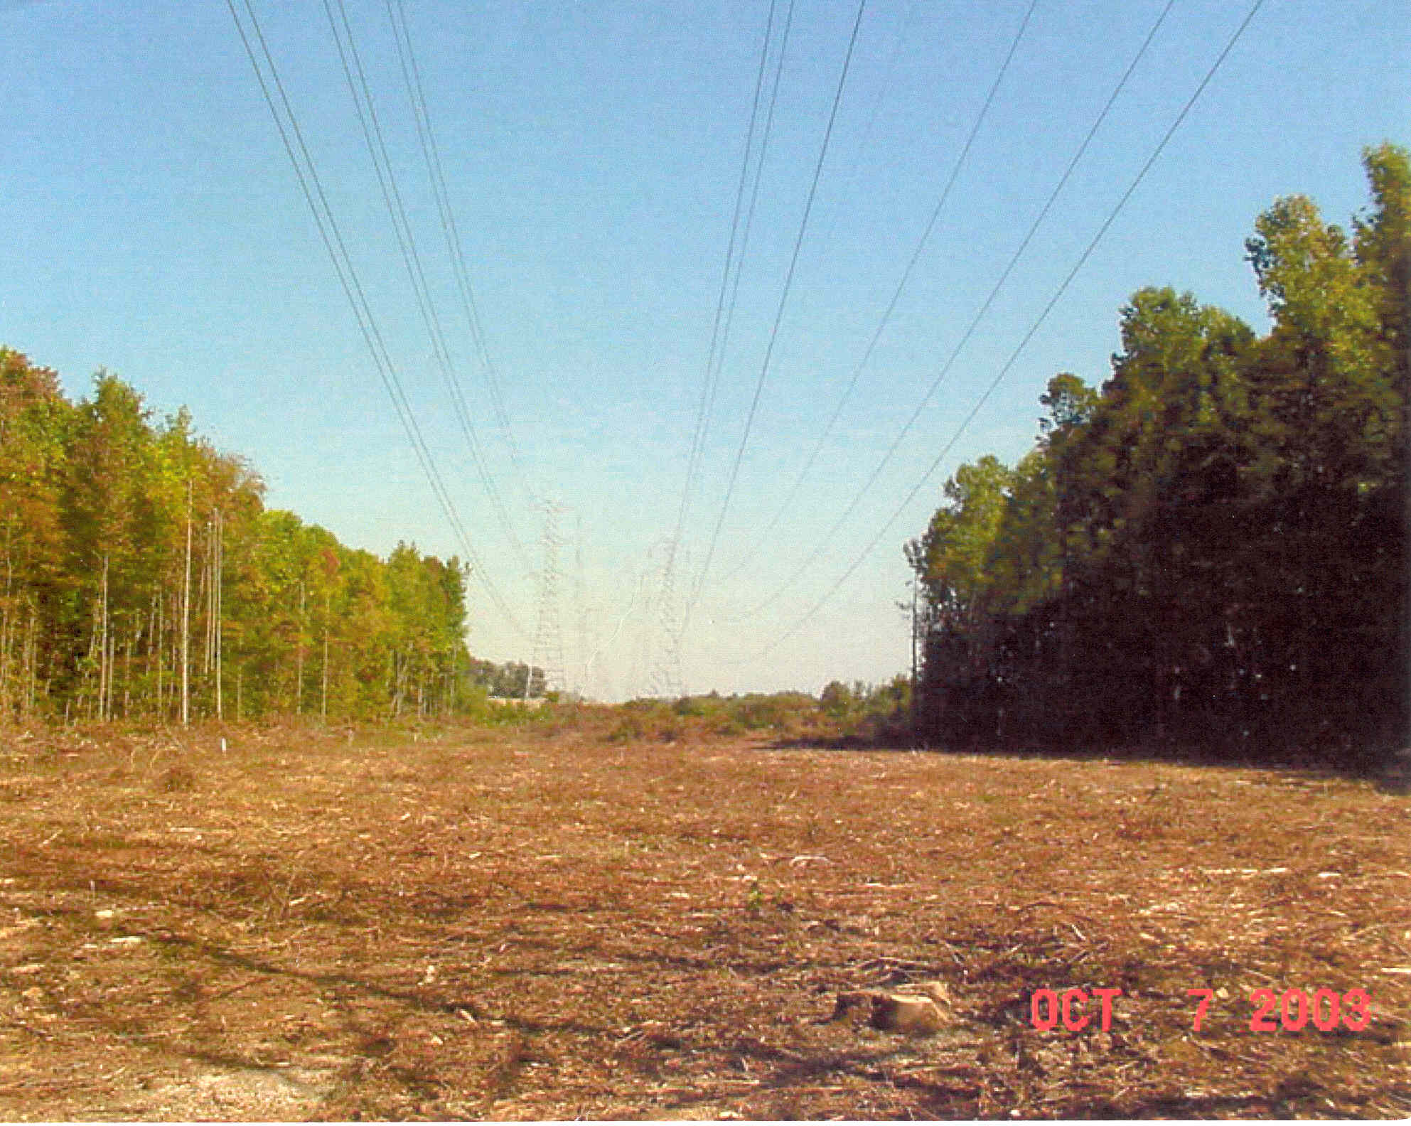
Tree Trimming: After

Slide 33
Other Limits Affecting Power Transfer
Angle limits
  while the maximum power transfer occurs when line angle difference is 90 degrees, actual limit is substantially less due to multiple lines in the system
Voltage stability limits
  as power transfers increases, reactive losses increase as I²X. As reactive power increases the voltage falls, resulting in a potentially cascading voltage collapse.

