Slide 1
EE 369
POWER SYSTEM ANALYSIS
Lecture 8
Transformers, Per Unit
Tom Overbye and Ross Baldick

Slide 2
Announcements
For lectures 8 to 10 read Chapter 3
Homework 6 is 5.14, 5.23, 5.26, 5.27, 5.28, 5.33, 5.37, 5.43; due October 6.
Tour of the UT power plant during class, Tuesday, October 11. Meet Mr. Mack Andrews in the area between ACES and the power plant, adjacent to 24th Street.
Homework 7 is 3.1, 3.4, 3.8, 3.10, 3.14, 3.16, 3.19; due October 13.
Homework 8 is 3.21, 3.23, 3.28, 3.29, 3.38, 3.49, 3.60; due October 20.

Slide 3
Announcements
Tour of ERCOT Met Center facility during class, November 3.
Mr. John Adams will be showing you around the ERCOT facility, including the control room.
If you a foreign national please email me your nationality and your passport number.
I will be sending a list of all attendees to ERCOT so that they can prepare badges.
You will need to get to the Met Center in your own cars, but I will facilitate car-pooling for anyone who does not have a car.

Slide 4
Transformers Overview
Power systems are characterized by many different voltage levels, ranging from 765 kV down to 220/110 volts.
Transformers are used to transfer power between different voltage levels.
The ability to inexpensively change voltage levels is a key advantage of ac systems over dc systems.
In this section we’ll development models for the transformer and discuss various ways of connecting three phase transformers.

Slide 5
Ideal Transformer
First we review the voltage/current relationships for an ideal transformer
  no real power losses
  magnetic core has infinite permeability
  no leakage flux
We’ll define the “primary” side of the transformer as the side that usually receives power from a line etc, and the secondary as the side that usually delivers power to a load etc:
  primary is usually the side with the higher voltage, but may be the low voltage side on a generator step-up transformer.

Slide 6
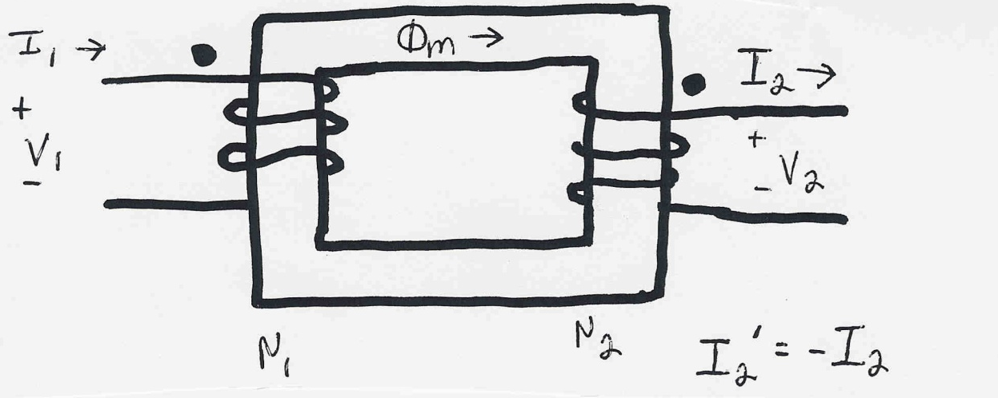
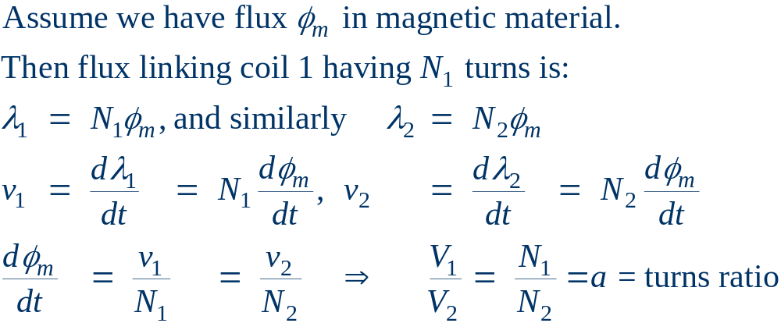
Ideal Transformer Relationships
Note that I₂ and I₂’
are in opposite directions

Slide 7
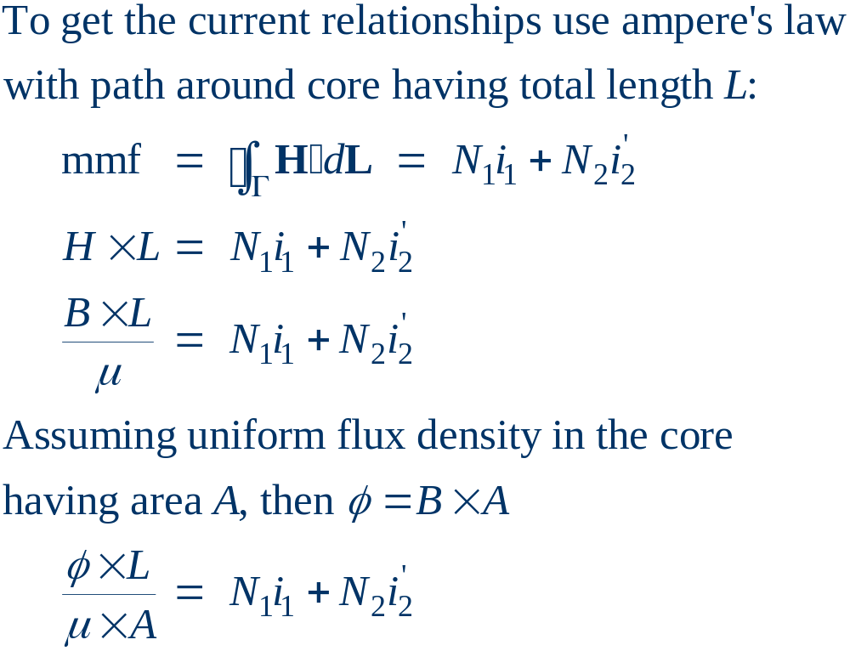
Current Relationships

Slide 8
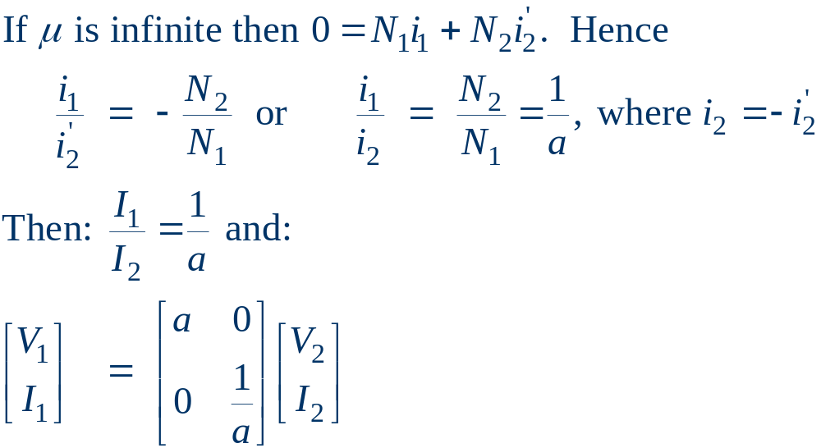
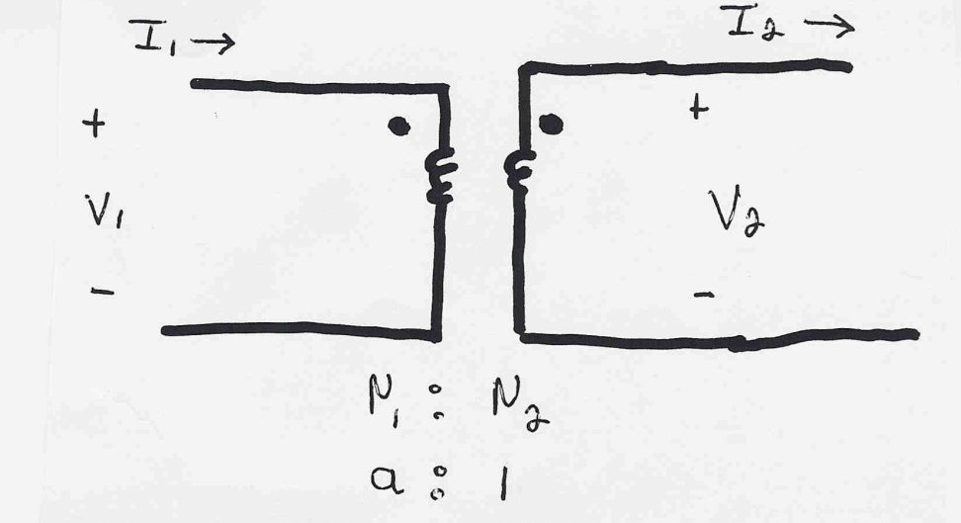
Current/Voltage Relationships

Slide 9
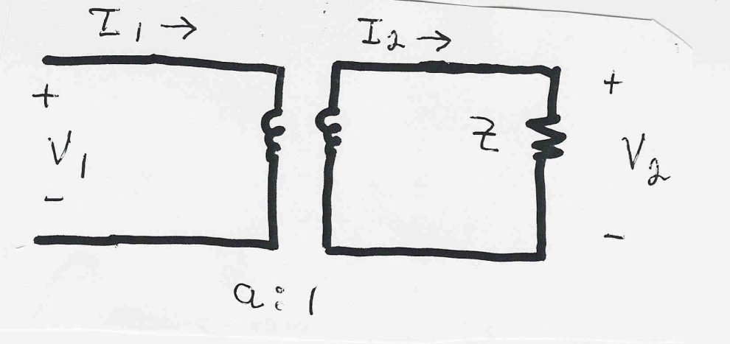
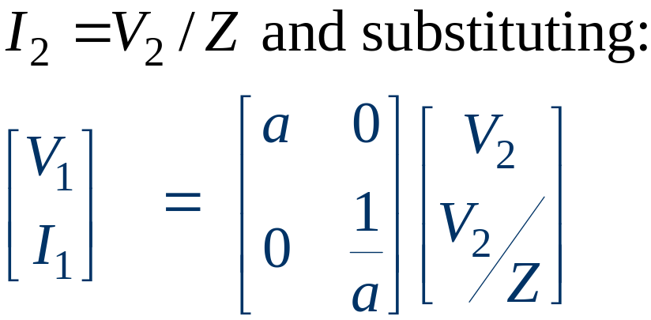
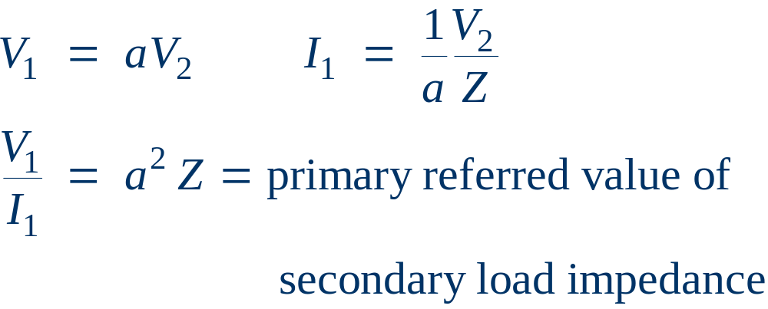
Impedance Transformation Example
Example: Calculate the primary voltage and current for an impedance load Z on the secondary

Slide 10
Real Transformers
Real transformers
  have losses
  have leakage flux
  have finite permeability of magnetic core
Real power losses
  resistance in windings (I² R)
  core losses due to eddy currents and hysteresis

Slide 11


Transformer Core losses
Eddy currents arise because of changing flux in core.
Eddy currents are reduced by laminating the core
Hysteresis losses are proportional to area of BH curve
and the frequency
These losses are reduced by using material with a
“thin” BH curve

Slide 12
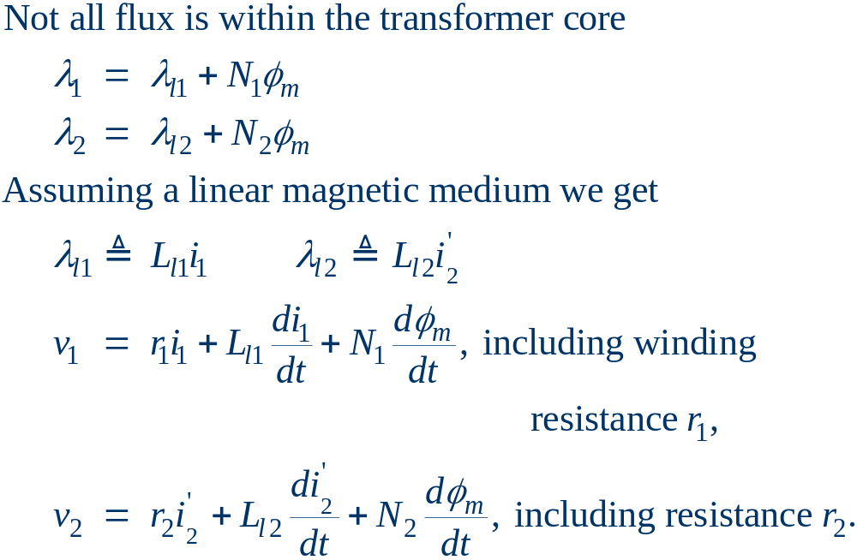
Effect of Leakage Flux

Slide 13
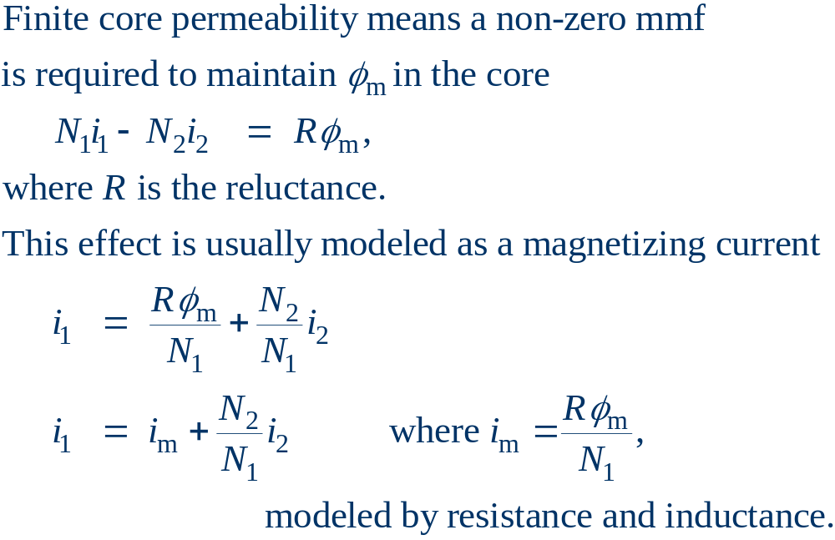
Effect of Finite Core Permeability

Slide 14

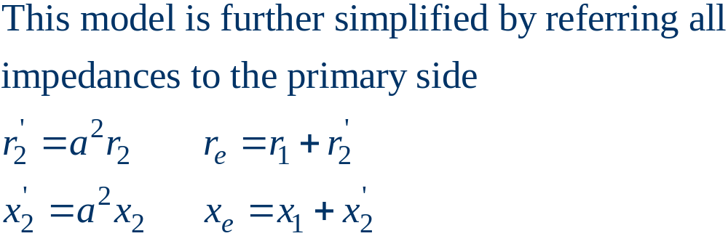
Transformer Equivalent Circuit
Using the previous relationships, we can derive an
equivalent circuit model for the real transformer

Slide 15
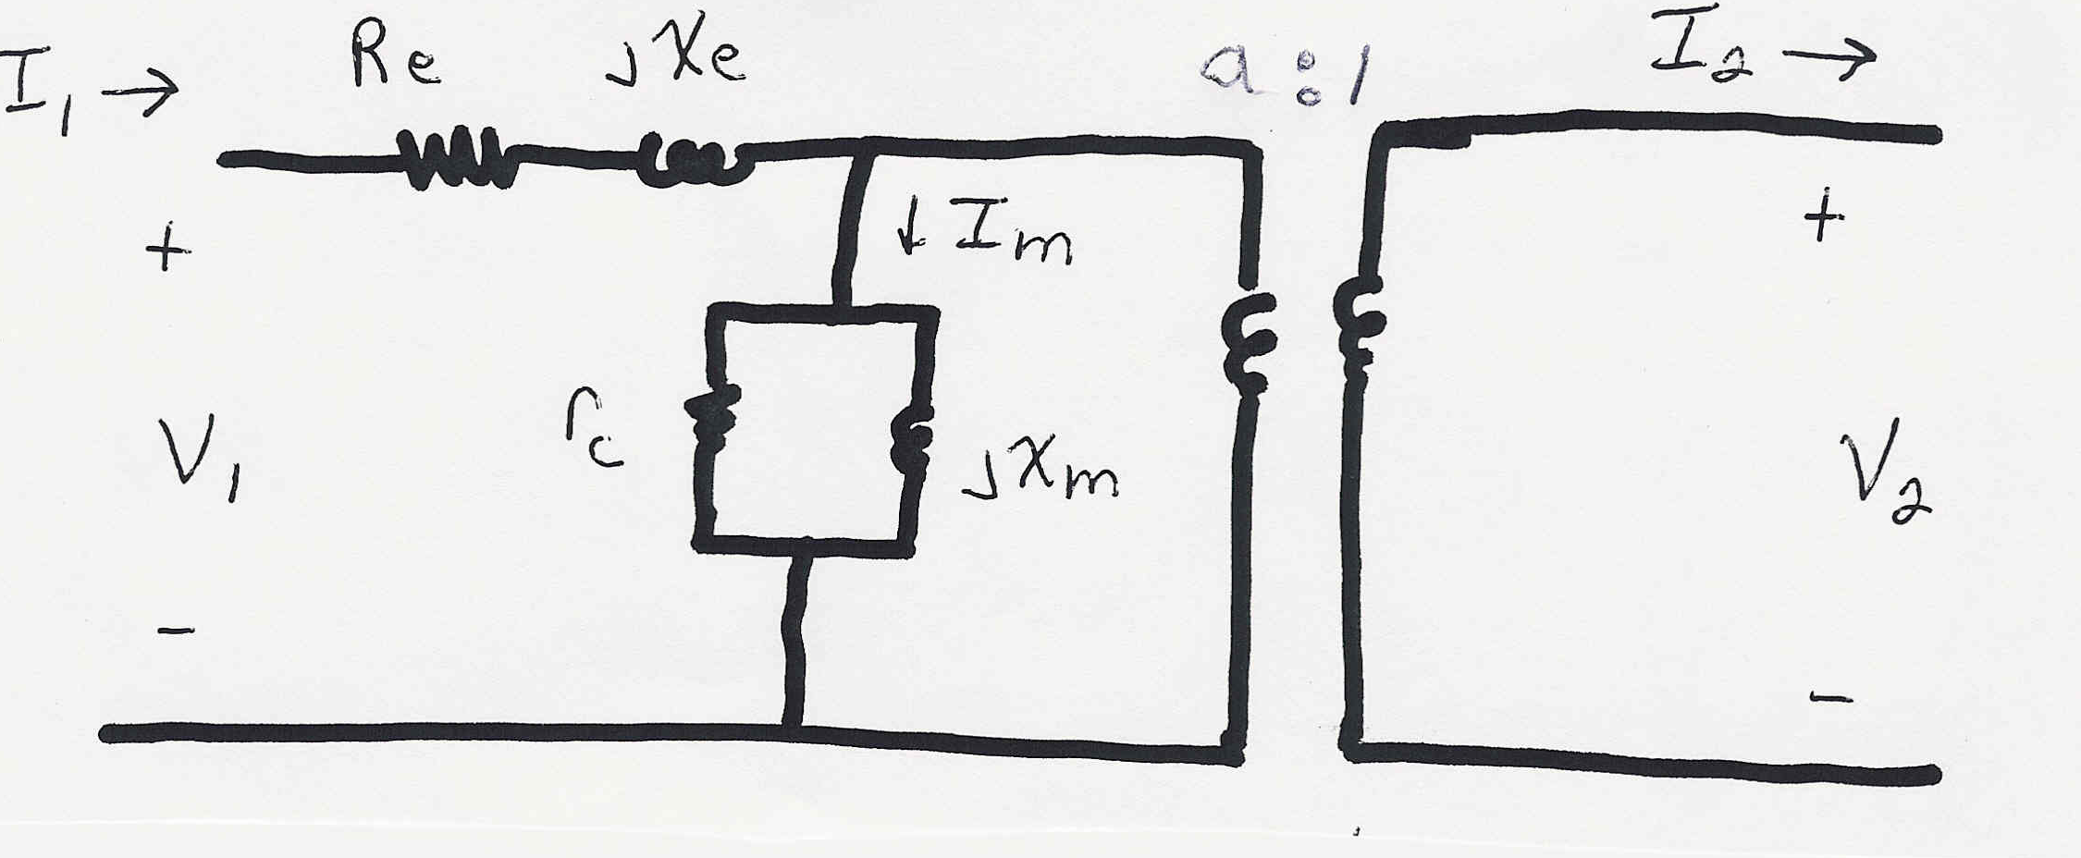
Simplified Equivalent Circuit

Slide 16
Calculation of Model Parameters
The parameters of the model are determined based upon:
  nameplate data: gives the rated voltages and power
  open circuit test: rated voltage is applied to primary with secondary open; measure the primary current and losses (the test may also be done applying the voltage to the secondary, calculating the values, then referring the values back to the primary side).
  short circuit test: with secondary shorted, apply voltage to primary to get rated current to flow; measure voltage and losses.

Slide 17
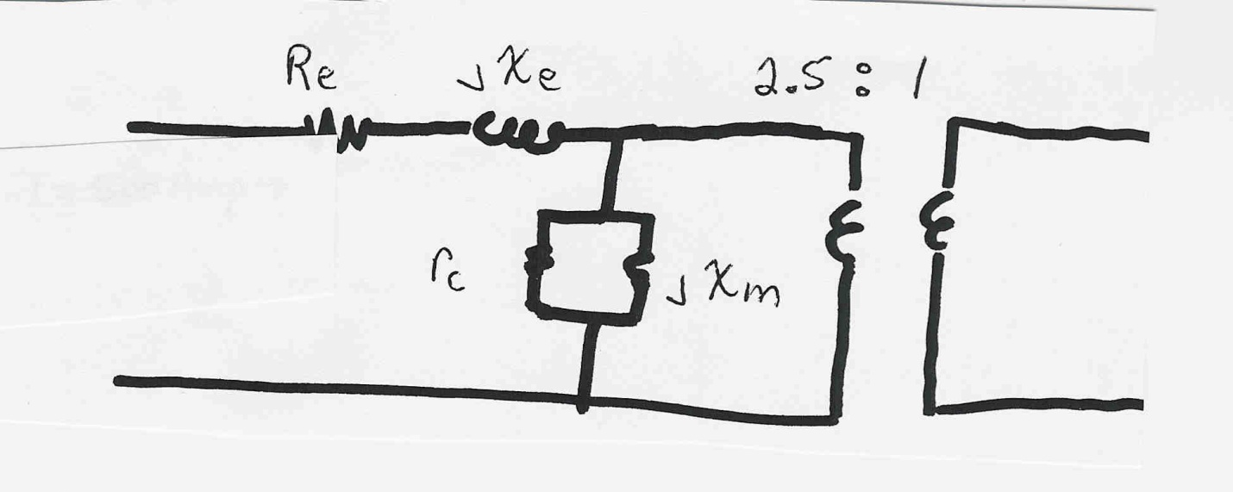
Transformer Example
Example: A single phase, 100 MVA, 200/80 kV transformer has the following test data:
  open circuit: 20 amps, with 10 kW losses
  short circuit: 30 kV, with 500 kW losses
Determine the model parameters.

Slide 18
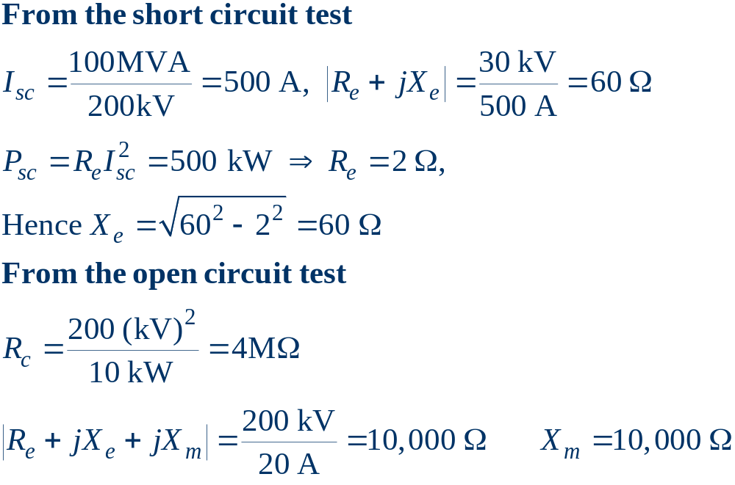
Transformer Example, cont’d

Slide 19
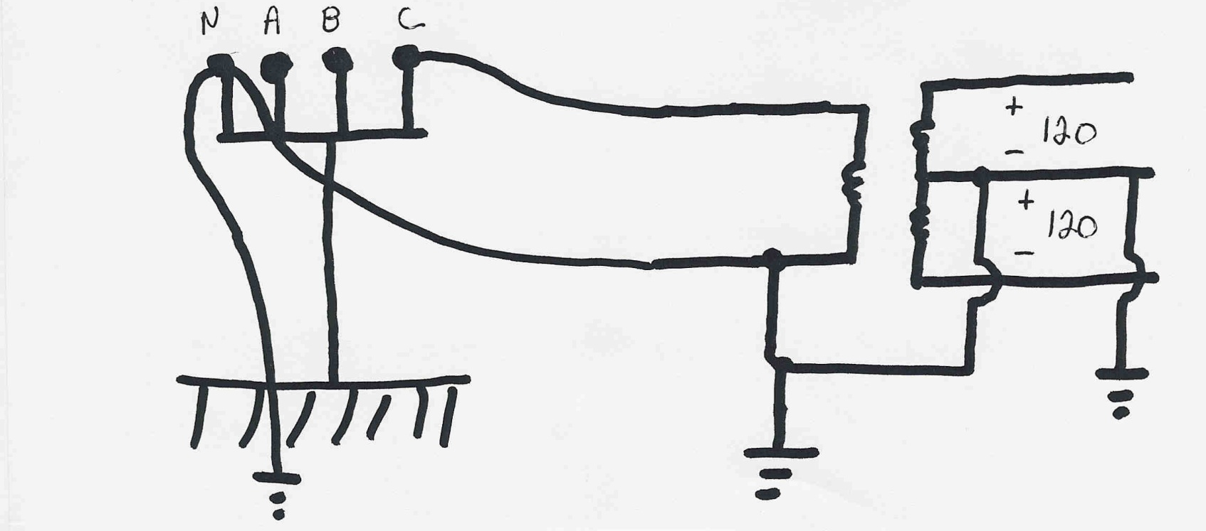
Residential Distribution Transformers
Single phase transformers are commonly used in
residential distribution systems. Most distribution
systems are 4 wire, with a multi-grounded, common
neutral.

Slide 20

Per Unit Calculations
A key problem in analyzing power systems is the large number of transformers.
  It would be very difficult to continually have to refer impedances to the different sides of the transformers
This problem is avoided by a normalization of all variables.
This normalization is known as per unit analysis.

Slide 21
Per Unit Conversion Procedure, 1φ
Pick a 1φ VA base for the entire system, S_{B}
Pick a voltage base for each different voltage level, V_{B}. Voltage bases are related by transformer turns ratios. Voltages are line to neutral.
Calculate the impedance base, Z_{B}= (V_{B})²/S_{B}
Calculate the current base, I_{B} = V_{B}/Z_{B}
Convert actual values to per unit
Note, per unit conversion affects magnitudes, not
the angles. Also, per unit quantities no longer have
units (i.e., a voltage is 1.0 p.u., not 1 p.u. volts)

Slide 22
Per Unit Solution Procedure
Convert to per unit (p.u.) (many problems are already in per unit)
Solve
Convert back to actual as necessary

Slide 23
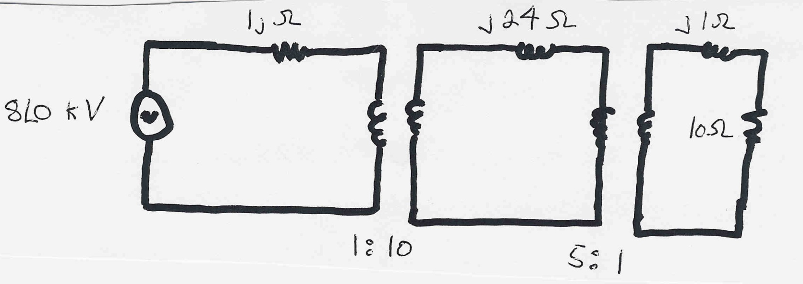
Per Unit Example
Solve for the current, load voltage and load power
in the circuit shown below using per unit analysis
with an S_{B} of 100 MVA, and voltage bases of
8 kV, 80 kV and 16 kV, respectively.
Original Circuit

Slide 24
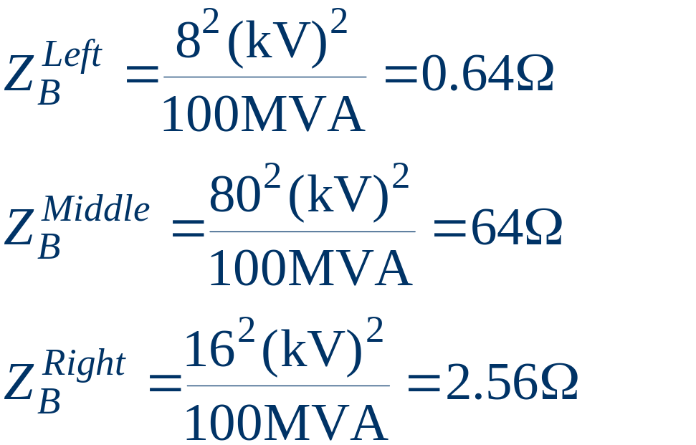
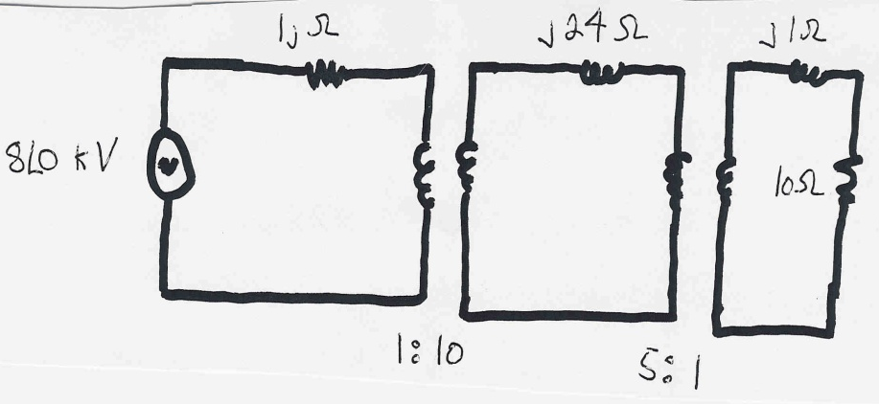
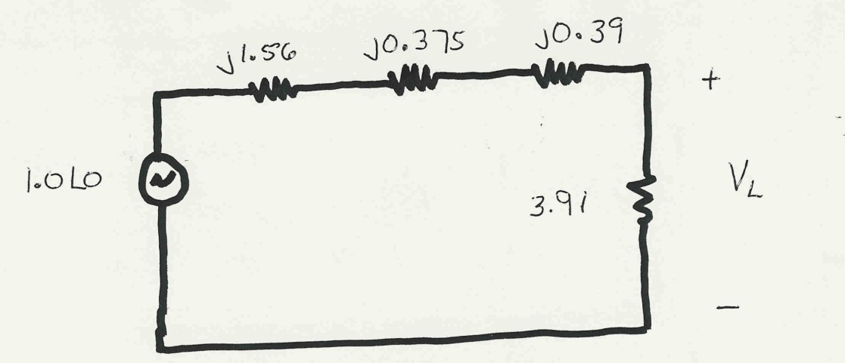
Per Unit Example, cont’d
Same circuit, with
values expressed
in per unit.

Slide 25
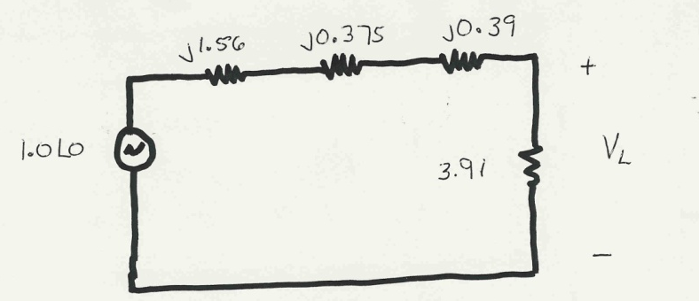
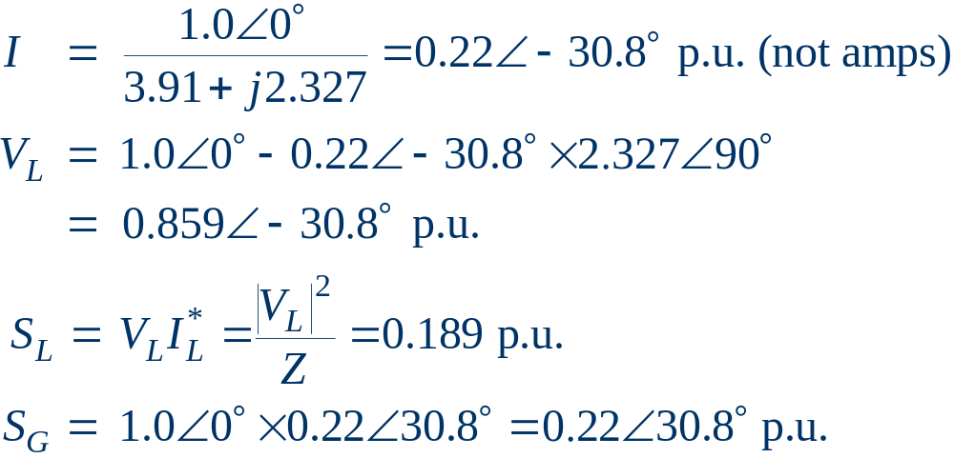
Per Unit Example, cont’d

Slide 26
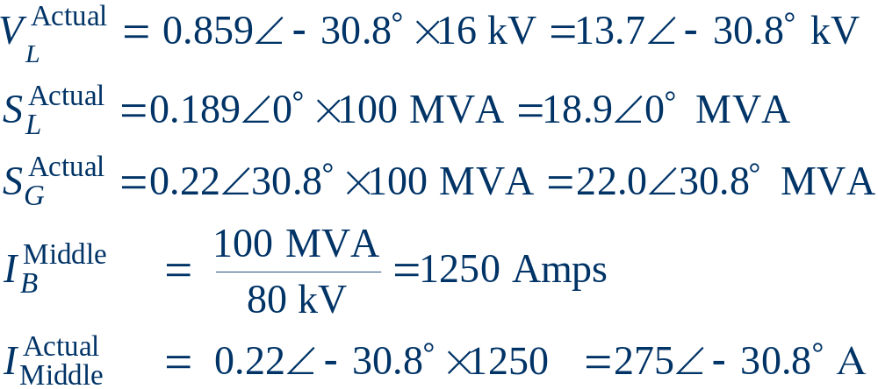
Per Unit Example, cont’d
To convert back to actual values just multiply the
per unit values by their per unit base

Slide 27

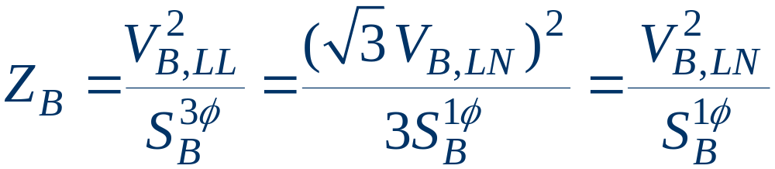
Three Phase Per Unit
Procedure is very similar to 1φ except we use a 3φ
VA base, and use line to line voltage bases
Pick a 3φ VA base for the entire system,
Pick a voltage base for each different voltage level, V_{B,LL}. Voltages are line to line.
Calculate the impedance base
Exactly the same impedance bases as with single phase!

Slide 28
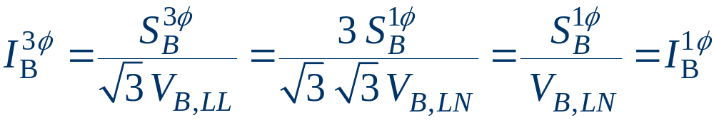
Three Phase Per Unit, cont'd
Calculate the current base, I_{B}
Convert actual values to per unit
Exactly the same current bases as with single phase!

Slide 29
Three Phase Per Unit Example
Solve for the current, load voltage and load power in the previous circuit, assuming:
  a 3φ power base of 300 MVA,
  and line to line voltage bases of 13.8 kV, 138 kV and 27.6 kV (square root of 3 larger than the 1φ example voltages)
  the generator is Y-connected so its line to line voltage is 13.8 kV.
Convert to per unit
as before.
Note the system is
exactly the same!

Slide 30
3φ Per Unit Example, cont'd
Again, analysis is exactly the same!

Slide 31
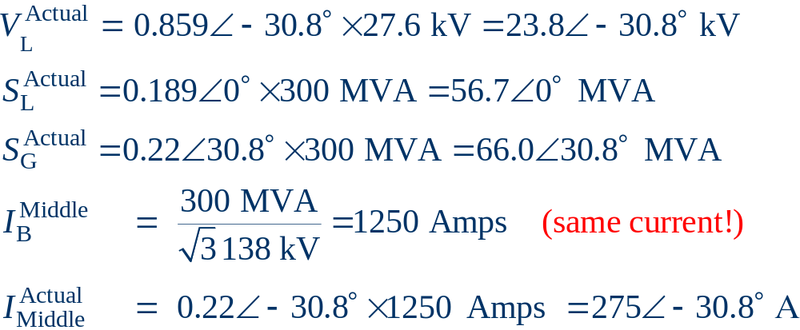
3φ Per Unit Example, cont'd
Differences appear when we convert back to actual values

