Slide 1
EE 369
POWER SYSTEM ANALYSIS
Lecture 9
Transformers, Per Unit Calculations
Tom Overbye and Ross Baldick

Slide 2
Announcements
For lectures 9 and 10 read Chapter 3.
Homework 7 is 3.1, 3.4, 3.8, 3.10, 3.14, 3.16, 3.19; due October 13.
Homework 8 is 3.21, 3.23, 3.28, 3.29, 3.38, 3.49, 3.60; due October 20.
Tour of ERCOT Met Center facility during class, November 3. Mr. John Adams will be showing you around the ERCOT facility, including the control room.
If you a foreign national please email me your nationality and your passport number.

Slide 3
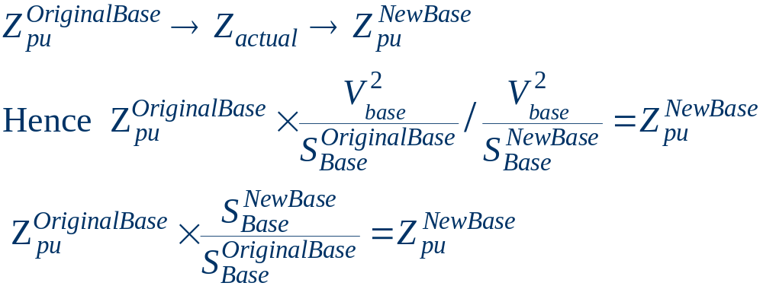
Per Unit Change of MVA Base
Parameters for equipment are often given using power rating of equipment as the MVA base
To analyze a system all per unit data must be on a common power base

Slide 4
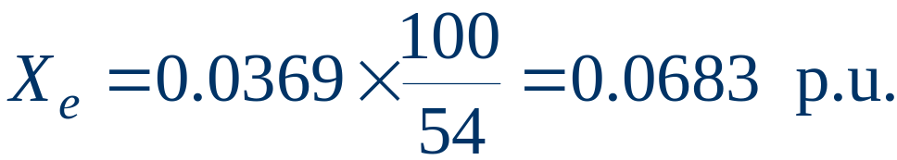
Per Unit Change of Base Example
A 54 MVA transformer has a leakage reactance of 3.69% (on its own MVA base).
What is the reactance on a 100 MVA base?

Slide 5
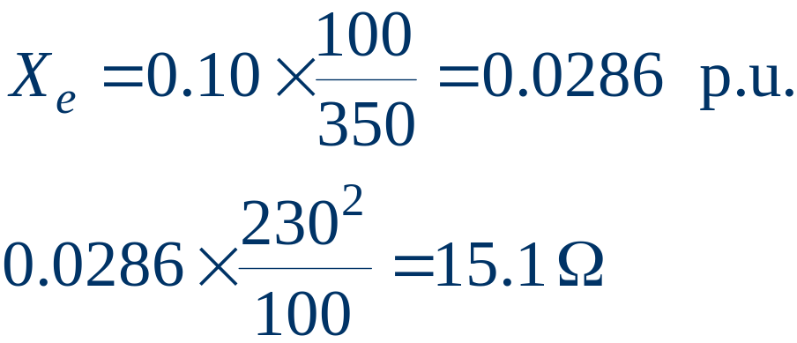
Transformer Reactance
Transformer reactance is often specified as a percentage, say 10%. This is a per unit value (divide by 100) on the power base of the transformer.
Example: A 350 MVA, 230/20 kV transformer has leakage reactance of 10%. What is p.u. value on 100 MVA base? What is value in ohms (230 kV)?

Slide 6
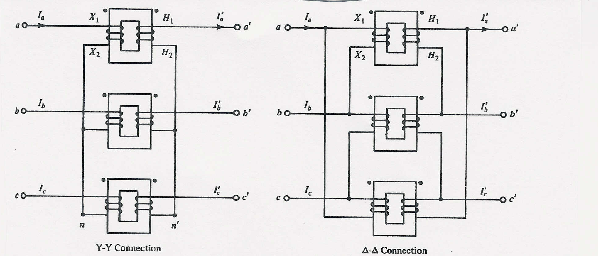
Three Phase Transformers
There are 4 different ways to connect 3φ transformers
Y-Y
Δ-Δ
Usually 3φ transformers are constructed so all windings
share a common core

Slide 7
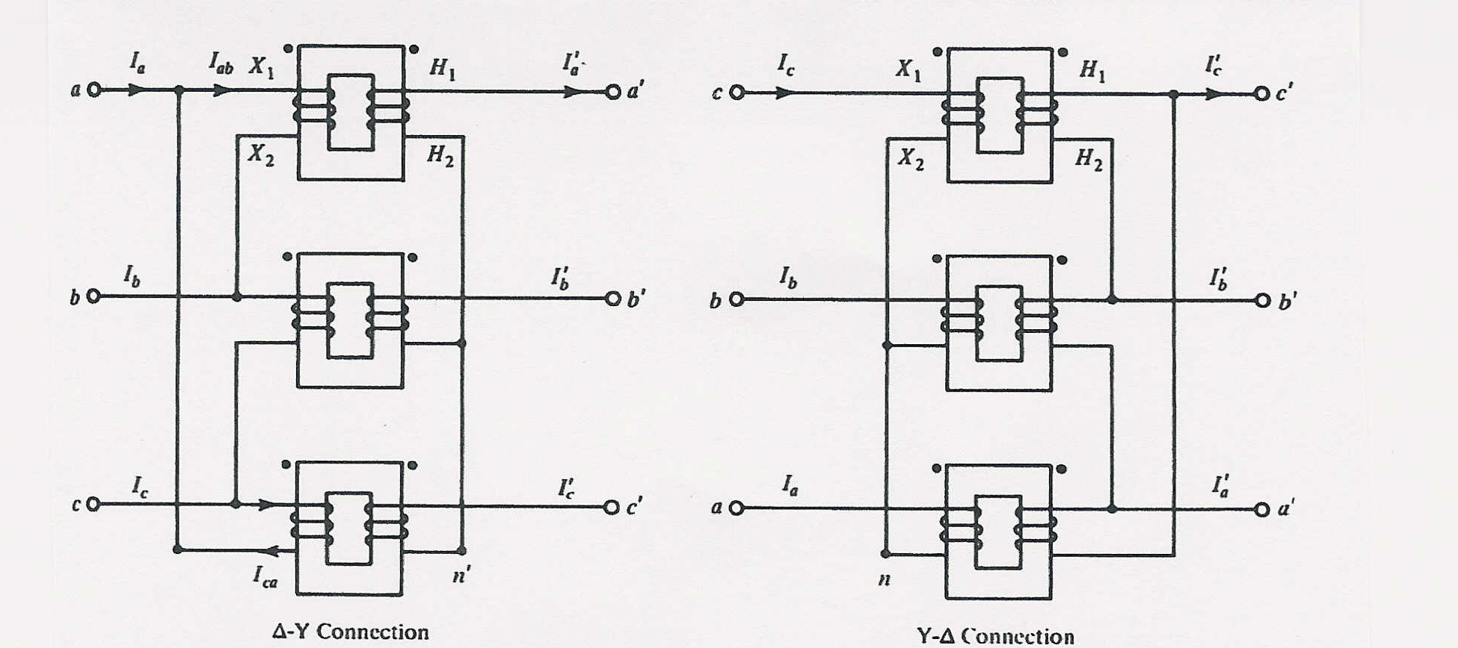
3φ Transformer Interconnections
Δ-Y
Y-Δ

Slide 8
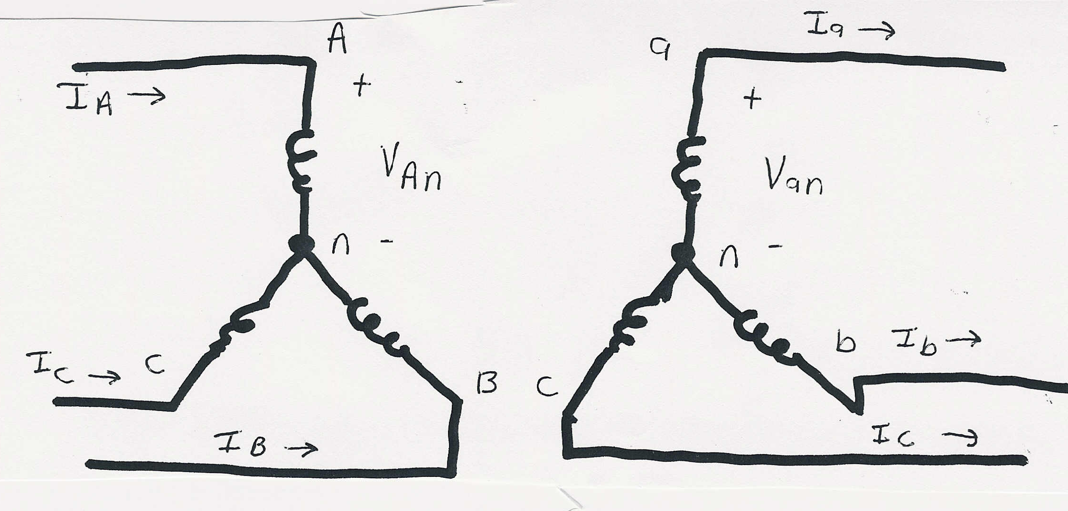
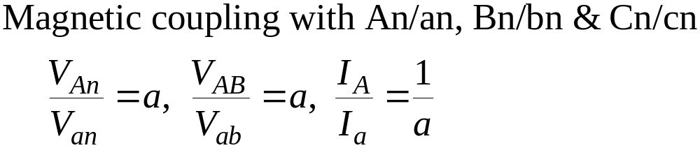
Y-Y Connection

Slide 9
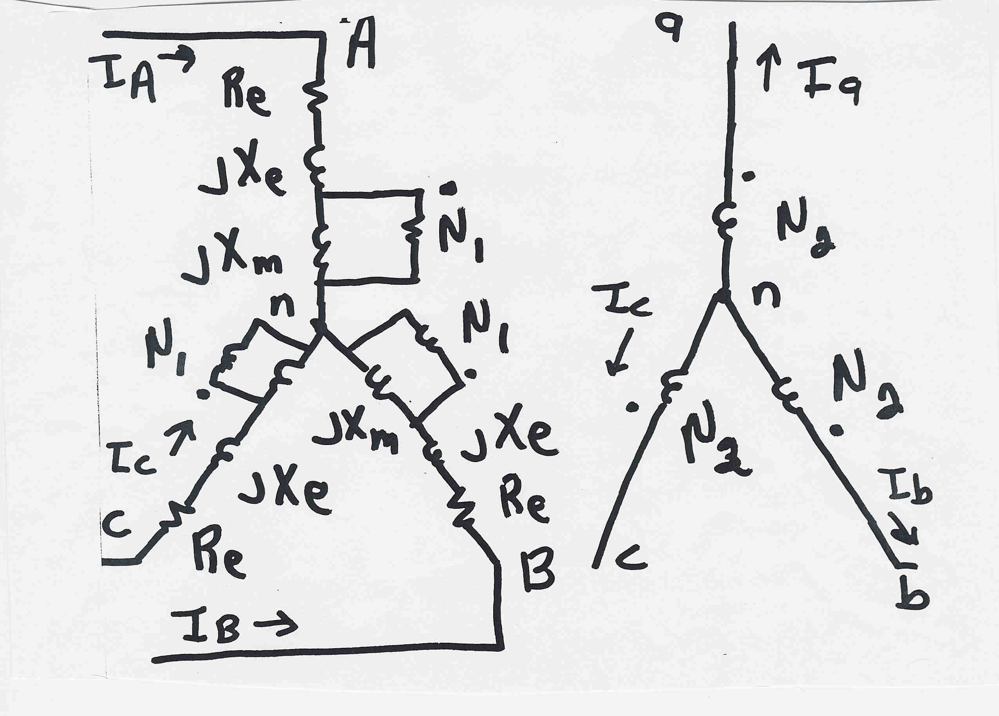
Y-Y Connection: 3φ Detailed Model

Slide 10
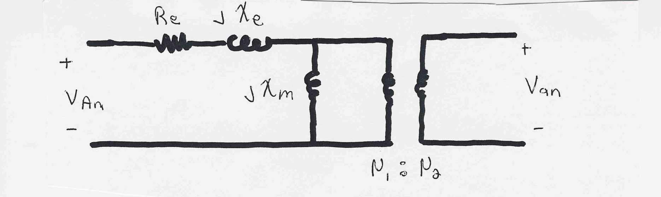
Y-Y Connection: Per Phase Model
Per phase analysis of Y-Y connections is exactly the
same as analysis of a single phase transformer.
Y-Y connections are common in transmission systems.
Key advantages are the ability to ground each side
and there is no phase shift is introduced.

Slide 11
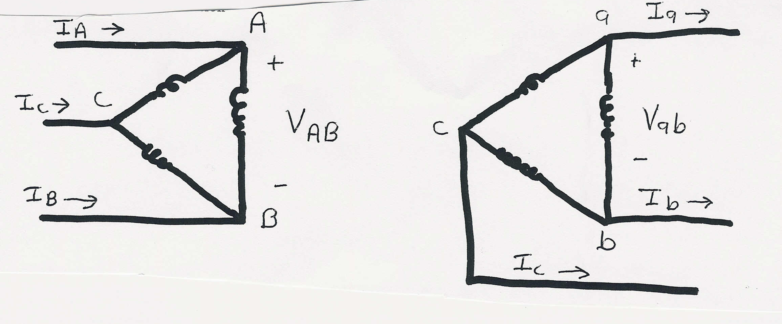
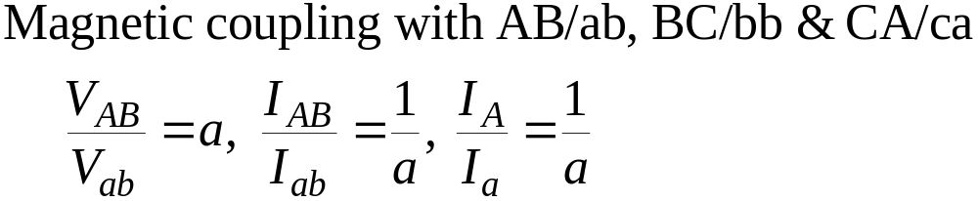
Δ-Δ Connection

Slide 12
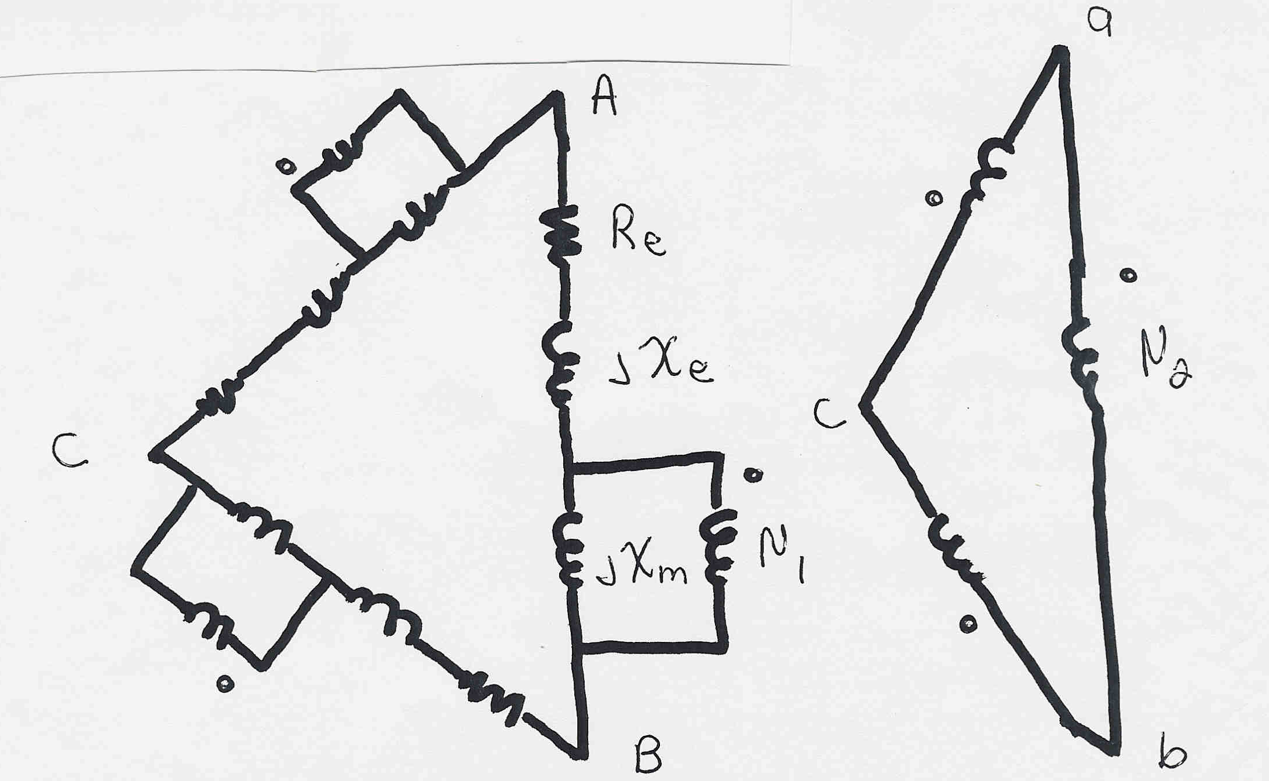
Δ-Δ Connection: 3φ Detailed Model
To use the per phase equivalent we need to use
the delta-wye load transformation

Slide 13
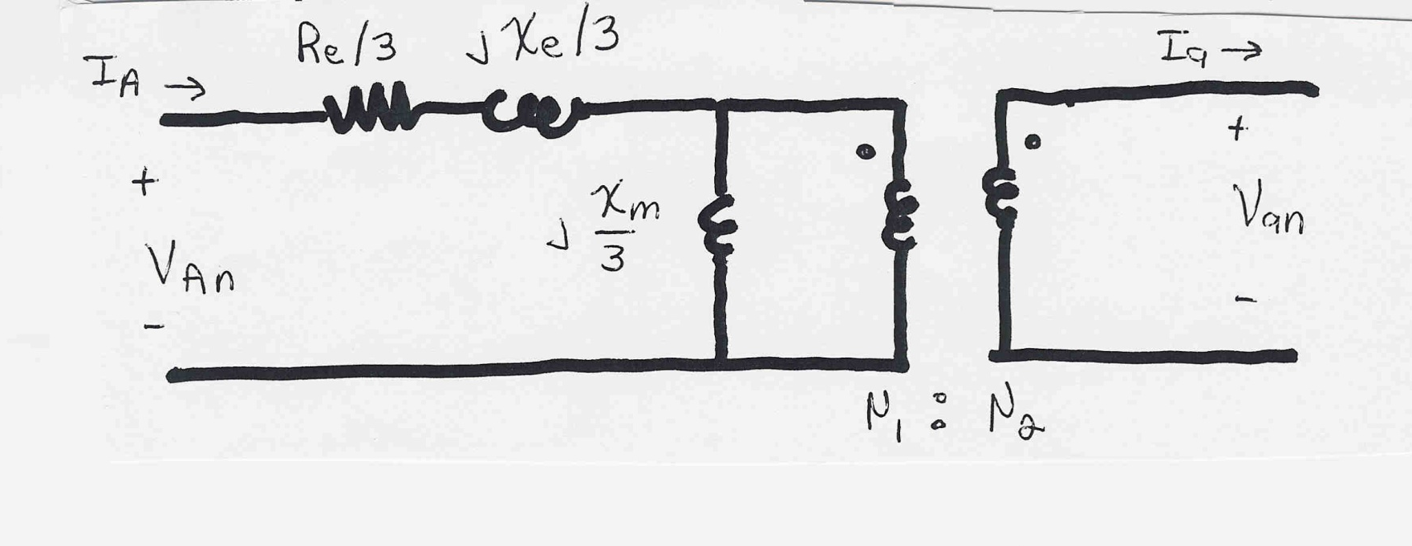
Δ-Δ Connection: Per Phase Model
Per phase analysis similar to Y-Y except impedances are decreased by a factor of 3.
Key disadvantage is Δ-Δ connections can not be grounded; not commonly used.

Slide 14
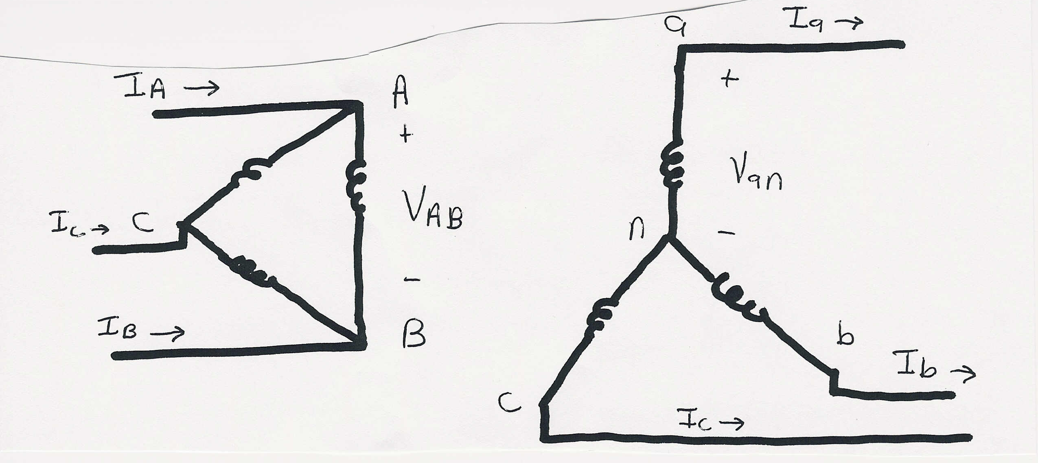
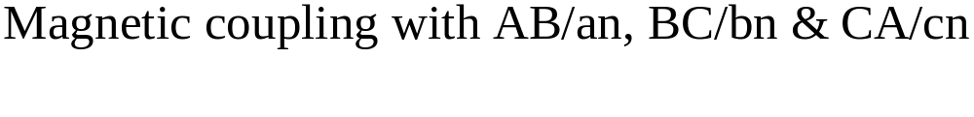
Δ-Y Connection

Slide 15
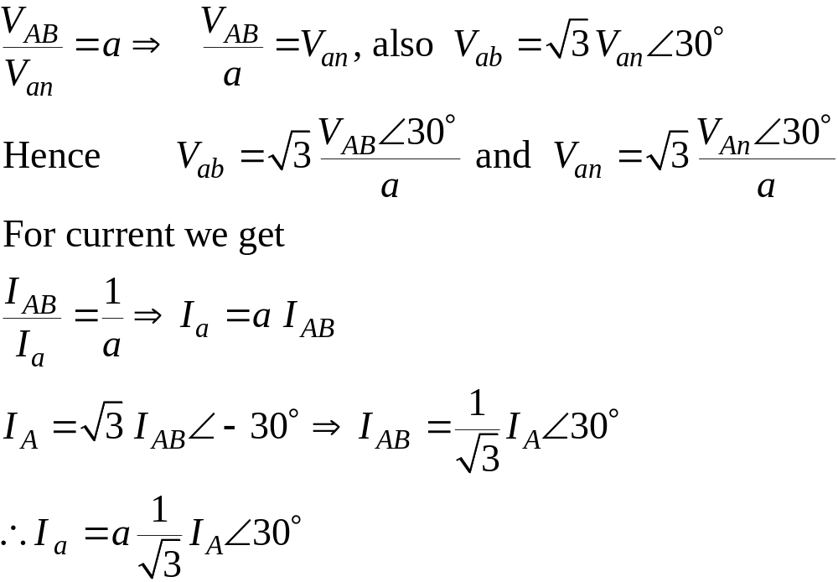
Δ-Y Connection V/I Relationships

Slide 16
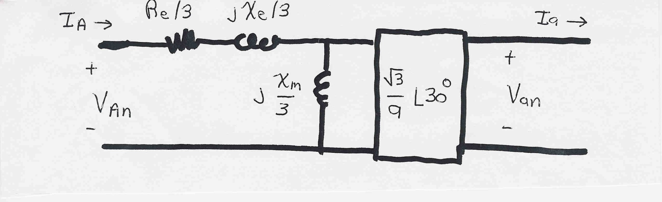
Δ-Y Connection: Per Phase Model
Note: Connection introduces a 30 degree phase shift!
Common for transmission/distribution step-down since
there is a neutral on the low voltage side.
Even if a = 1 there is a sqrt(3) step-up ratio

Slide 17
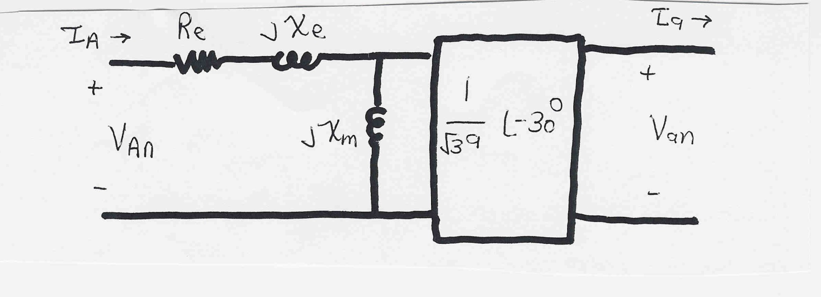
Y-Δ Connection: Per Phase Model
Exact opposite of the Δ-Y connection, now with a
phase shift of -30 degrees.

