Slide 1
The Science and Engineering of Materials, 4th ed
Donald R. Askeland – Pradeep P. Phulé
Chapter 19 – Magnetic Materials

Slide 2
Objectives of Chapter 19
To study the fundamental basis for responses of certain materials to the presence of magnetic fields.
To examine the properties and applications of different types of magnetic materials.

Slide 3
Chapter Outline
19.1 Classification of Magnetic Materials
19.2 Magnetic Dipoles and Magnetic Moments
19.3 Magnetization, Permeability, and the Magnetic Field
19.4 Diamagnetic, Paramagnetic, Ferromagnetic, Ferrimagnetic, and Superparamagnetic Materials
19.5 Domain Structure and the Hysteresis Loop
19.6 The Curie Temperature
19.7 Applications of Magnetic Materials
19.8 Metallic and Ceramic Magnetic Materials

Slide 4
Section 19.1 Classification of Magnetic Materials
Ferromagnetism
Ferrimagnetism
Diamagnetism
Antiferromagnetism
Hard magnet

Slide 5
Section 19.2 Magnetic Dipoles and Magnetic Moments
The magnetic behavior of materials can be traced to the structure of atoms.
Bohr magneton - The strength of a magnetic moment of an electron (μ_{B}) due to electron spin.

Slide 6
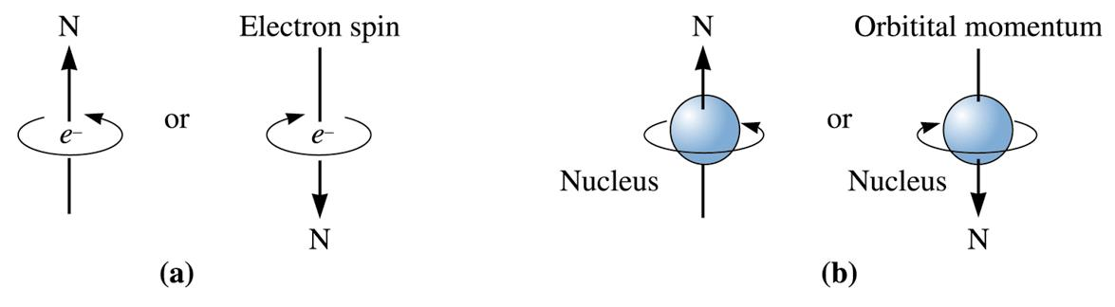
©2003 Brooks/Cole, a division of Thomson Learning, Inc. Thomson Learning™ is a trademark used herein under license.
Figure 19.1 Origin of magnetic dipoles: (a) The spin of the electron produces a magnetic field with a direction dependent on the quantum number m_{s}. (b) Electrons Electrons orbiting around the nucleus create a magnetic field around the atom.

Slide 7
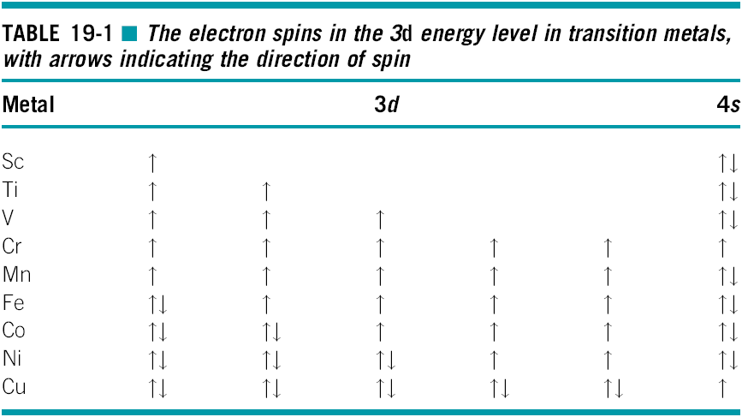

Slide 8
Section 19.3 Magnetization, Permeability, and the Magnetic Field
Magnetic permeability - The ratio between inductance or magnetization and magnetic field. It is a measure of the ease with which magnetic flux lines can ‘‘flow’’ through a material.
Magnetization - The total magnetic moment per unit volume.
Magnetic susceptibility - The ratio between magnetization and the applied field.

Slide 9
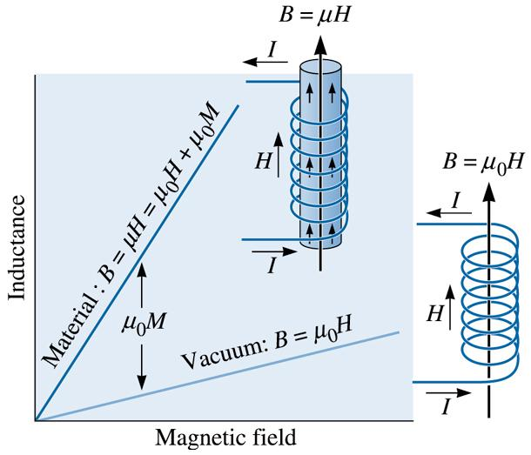
©2003 Brooks/Cole, a division of Thomson Learning, Inc. Thomson Learning™ is a trademark used herein under license.
Figure 19.2 A current passing through a coil sets up a magnetic field H with a flux density B. The flux density is higher when a magnetic core is placed within the coil.

Slide 10
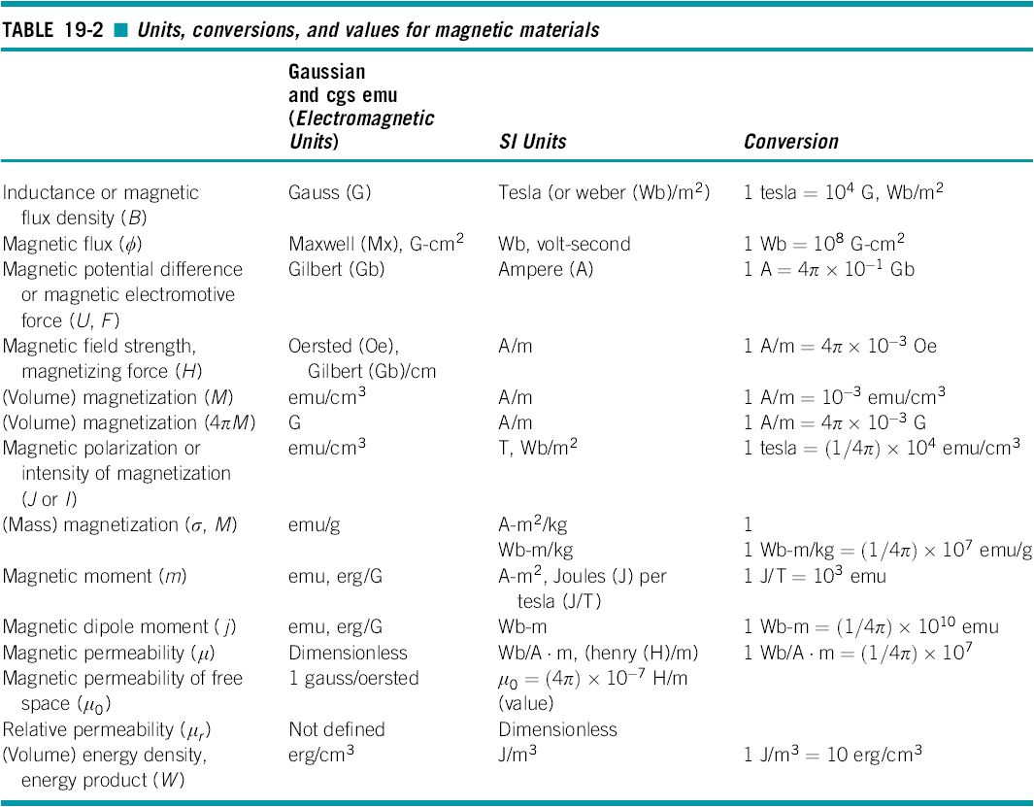

Slide 11

Example 19.1 Theoretical and Actual Saturation Magnetization in Fe
Calculate the maximum, or saturation, magnetization that we expect in iron. The lattice parameter of BCC iron is 2.866 Å . Compare this value with 2.1 tesla (a value of saturation flux density experimentally observed for pure Fe.)
Example 19.1 SOLUTION
Based on the unpaired electronic spins, we expect each iron atom to have four electrons that act as magnetic dipoles. The number of atoms per m³ in BCC iron is:

Slide 12
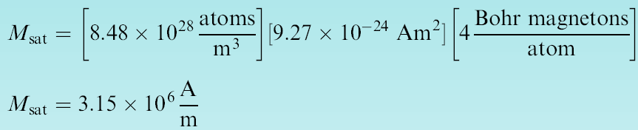

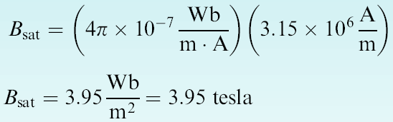
Example 19.1 SOLUTION (Continued)
The maximum volume magnetization (M_{sat}) is the total magnetic moment per unit volume:
To convert the value of saturation magnetization M into saturation flux density B in tesla, we need the value of μ₀M. In ferromagnetic materials μ₀M >> μ₀H and therefore, B μ₀M.
Saturation induction in tesla = B_{sat} = μ₀M_{sat}.

Slide 13
Section 19.4 Diamagnetic, Paramagnetic, Ferromagnetic, Ferrimagnetic, and Superparamagnetic Materials
Ferromagnetism - Alignment of the magnetic moments of atoms in the same direction so that a net magnetization remains after the magnetic field is removed.
Ferrimagnetism - Magnetic behavior obtained when ions in a material have their magnetic moments aligned in an antiparallel arrangement such that the moments do not completely cancel out and a net magnetization remains.
Diamagnetism - The effect caused by the magnetic moment due to the orbiting electrons, which produces a slight opposition to the imposed magnetic field.

Slide 14
Section 19.4 (Continued)
Antiferromagnetism - Arrangement of magnetic moments such that the magnetic moments of atoms or ions cancel out causing zero net magnetization.
Hard magnet - Ferromagnetic or ferrimagnetic material that has a coercivity > 10⁴ A . m⁻¹.

Slide 15
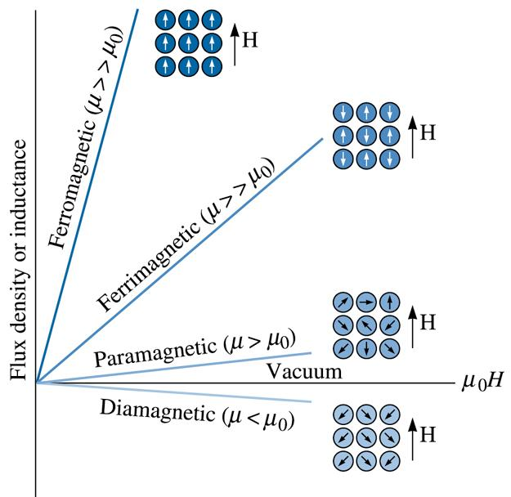
Figure 19.3 The effect of the core material on the flux density. The magnetic moment opposes the field in diamagnetic materials. Progressively stronger moments are present in paramagnetic, ferrimagnetic, and ferromagnetic materials for the same applied field.
©2003 Brooks/Cole, a division of Thomson Learning, Inc. Thomson Learning™ is a trademark used herein under license.

Slide 16
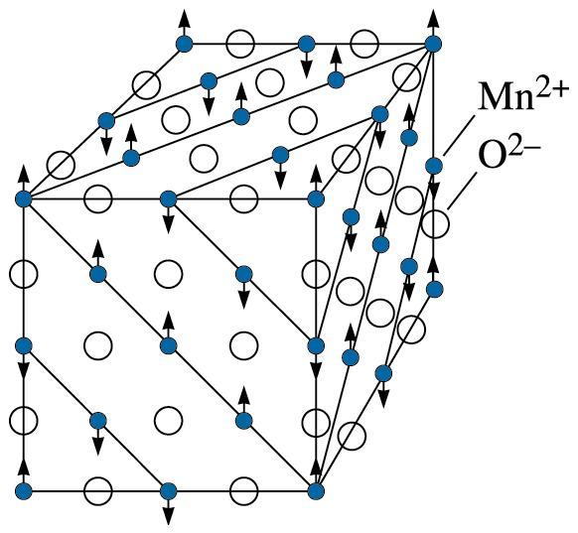
Figure 19.4 The crystal structure of Mn0 consists of alternating layers of {111} type planes of oxygen and manganese ions. The magnetic moments of the manganese ions in every other (111) plane are oppositely aligned. Consequently, Mn0 is antiferromagnetic.
©2003 Brooks/Cole, a division of Thomson Learning, Inc. Thomson Learning™ is a trademark used herein under license.

Slide 17
Example 19.2 Design/Materials Selection for a Solenoid
We want to produce a solenoid coil that produces an inductance of at least 2000 gauss when a 10-mA current flows through the conductor. Due to space limitations, the coil should be composed of 10 turns over a 1 cm length. Select a core material for the coil.

Slide 18
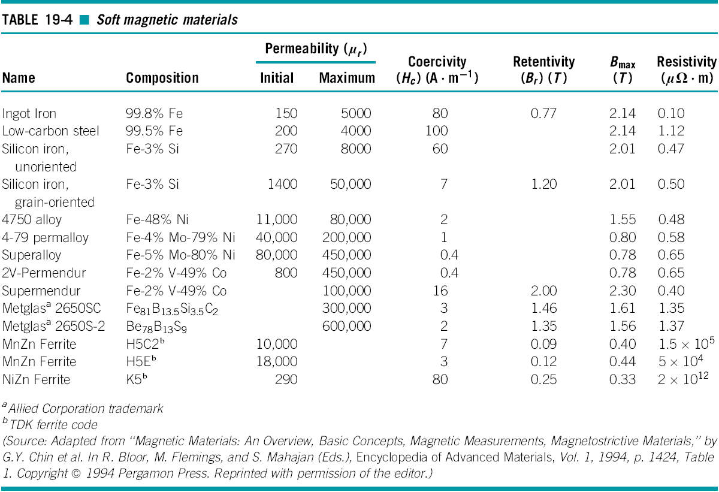

Slide 19
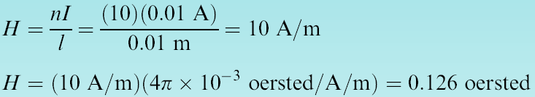


Example 19.2 SOLUTION
The magnetic field H produced by the coil.
The permeability of the core material must be:
The relative permeability of the core material must be at least:
From Table 19-4, we find that 4-79 permalloy has a maximum relative permeability of 80,000 and might be a good selection for the core material.

Slide 20
Section 19.5 Domain Structure and the Hysteresis Loop
Domains - Small regions within a single or polycrystalline material in which all of the magnetization directions are aligned.
Bloch walls - The boundaries between magnetic domains.
Saturation magnetization - When all of the dipoles have been aligned by the field, producing the maximum magnetization.
Remanance - The polarization or magnetization that remains in a material after it has been removed from the field.
Hysteresis loop - The loop traced out by magnetization in a ferromagnetic or ferrimagnetic material as the magnetic field is cycled.

Slide 21
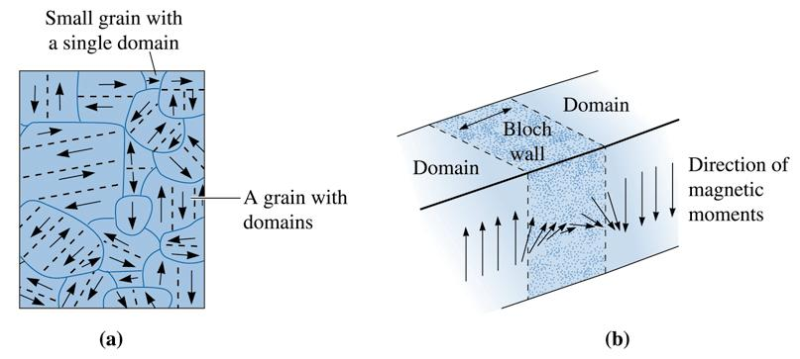
©2003 Brooks/Cole, a division of Thomson Learning, Inc. Thomson Learning™ is a trademark used herein under license.
Figure 19.5 (a) A qualitative sketch of magnetic domains in a polycrystalline material. The dashed lines show demarcation between different magnetic domains; the dark curves show the grain boundaries. (b) The magnetic moments in adjoining atoms change direction continuously across the boundary between domains.

Slide 22
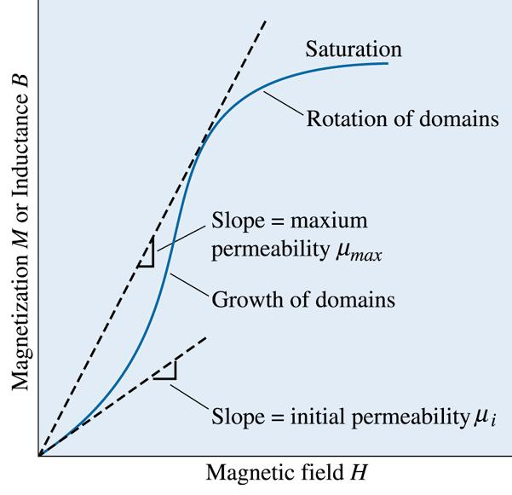
©2003 Brooks/Cole, a division of Thomson Learning, Inc. Thomson Learning™ is a trademark used herein under license.
Figure 19.6 When a magnetic field is first applied to a magnetic material, magnetization initially increases slowly, then more rapidly as the domains begin to grow. Later, magnetization slows, as domains must eventually rotate to reach saturation. Notice the permeability values depend upon the magnitude of H.

Slide 23
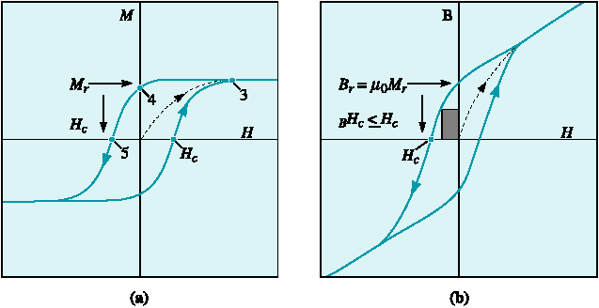
Figure 19.7 (a) The ferromagnetic hysteresis M-H loop showing the effect of the magnetic field on inductance or magnetization. The dipole alignment leads to saturation magnetization (point 3), a remanance (point 4), and a coercive field (point 5). (b) The corresponding B-H loop. Notice the end of the B-H loop, the B value does not saturate since B = μ₀H + μ₀M. (Source: Adapted from Permanent Magnetism, by R. Skomski and J.M.D. Coey, p. 3, Fig. 1-1. Edited by J.M.D. Coey and D.R. Tilley. Copyright © 1999 Institute of Physics Publishing. Adapted by permission.)

Slide 24
Section 19.6 The Curie Temperature
Curie temperature - The temperature above (T_{c}) which ferromagnetic or ferrimagnetic materials become paramagnetic.

Slide 25
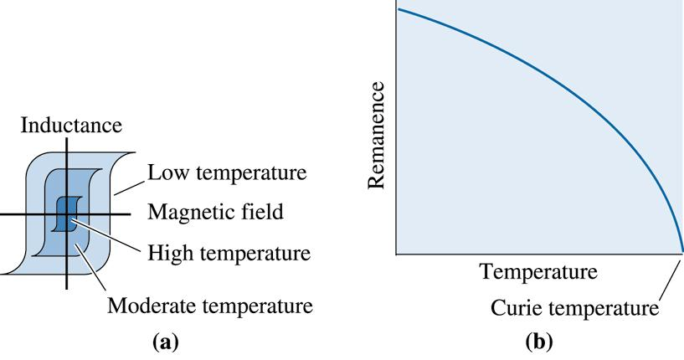
©2003 Brooks/Cole, a division of Thomson Learning, Inc. Thomson Learning™ is a trademark used herein under license.
Figure 19.8 The effect of temperature on (a) the hysteresis loop and (b) the remanance. Ferromagnetic behavior disappears above the Curie temperature.

Slide 26
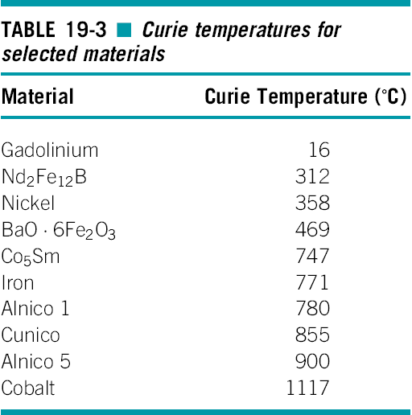

Slide 27
Example 19.3 Design/Materials Selection for a High-Temperature Magnet
Select a permanent magnet for an application in an aerospace vehicle that must re-enter Earth’s atmosphere. During re-entry, the magnet may be exposed to magnetic fields as high as 600 oersted and may briefly reach temperatures as high as 500ºC. We want the material to have the highest power possible and to maintain its magnetization after re-entry.

Slide 29
Example 19.3 SOLUTION
It is first necessary to select potential materials having sufficient coercive field H_{c} and Curie temperature that re-entry will not demagnetize them.
The Co₅Sm has four times the power of the Alnico 5 and, based on performance, might be our best choice.

Slide 30
Section 19.7 Applications of Magnetic Materials
Soft Magnetic Materials - Ferromagnetic materials are often used to enhance the magnetic flux density (B) produced when an electric current is passed through the material. Applications include cores for electromagnets, electric motors, transformers, generators, and other electrical equipment.
Data Storage Materials - Magnetic materials are used for data storage.
Permanent Magnets - Magnetic materials are used to make strong permanent magnets
Power - The strength of a permanent magnet as expressed by the maximum product of the inductance and magnetic field.

Slide 31
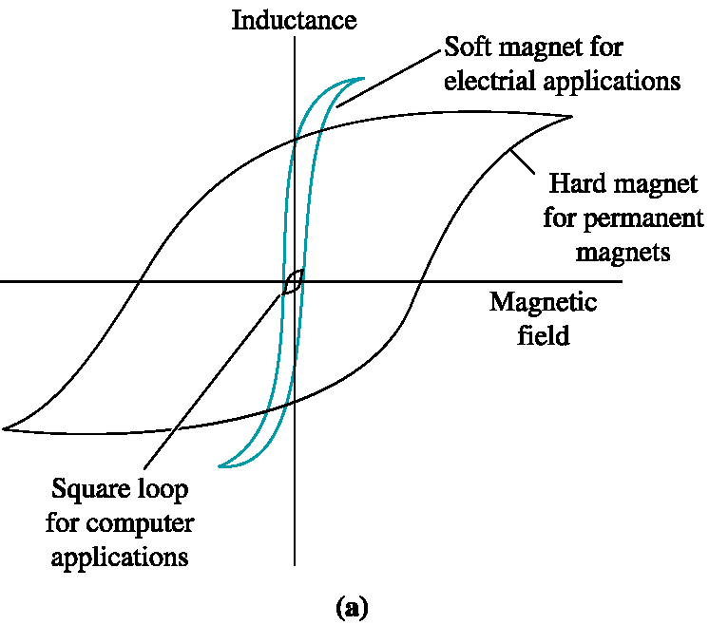
Figure 19.9 (a) Comparison of the hysteresis loops for three applications of ferromagnetic and ferrimagnetic materials.

Slide 32
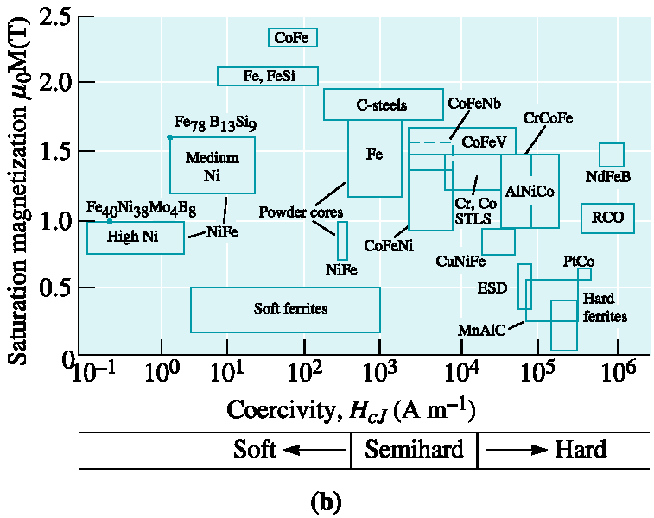
Figure 19.9 (b) Saturation magnetization and coercivity values for different magnetic materials. (Source: Adapted from ‘‘Magnetic Materials: An Overview, Basic Concepts, Magnetic Measurements, Magnetostrictive Materials,’’ by G.Y. Chin et al. In D. Bloor, M. Flemings, and S. Mahajan (Eds.), Encyclopedia of Advanced Materials, Vol. 1, 1994, p. 1423, Fig. 1. Copyright © 1994 Pergamon Press. Reprinted by permission of the editor.)

Slide 34
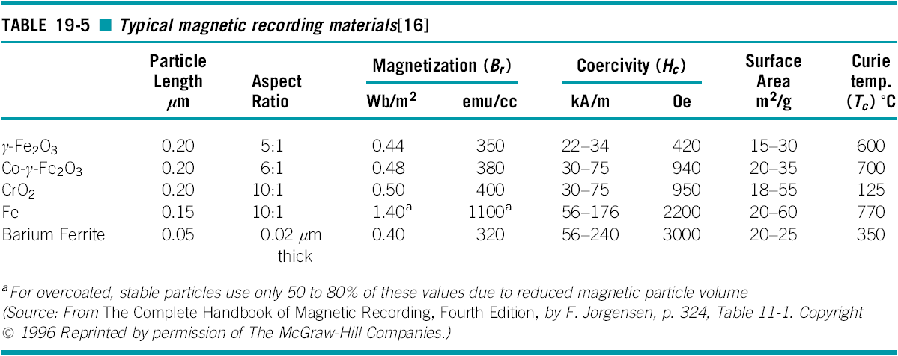

Slide 35
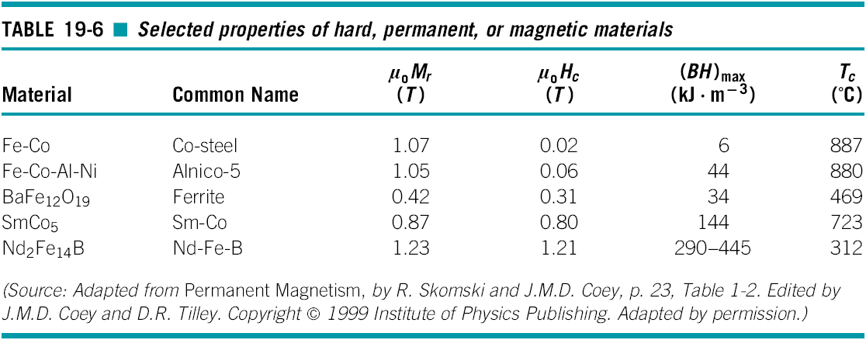

Slide 36
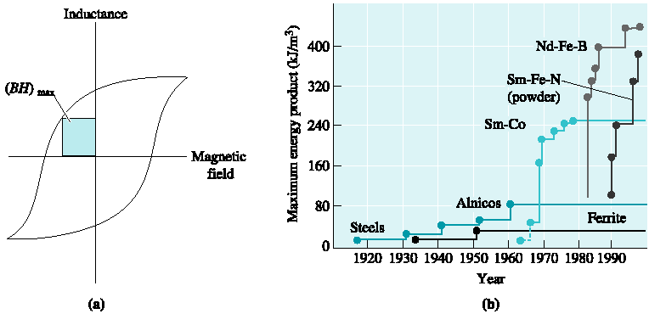
Figure 19.10 (a) The largest rectangle drawn in the second or fourth quadrant of the B-H curve gives the maximum BH product. (BH)_{max} is related to the power, or energy, required to demagnetize the permanent magnet. (b) Development of permanent magnet materials, maximum energy product is shown on the y -axis. (Source: Adapted from Permanent Magnetism, by R. Skomski and J.M.D. Coey, p. 23, Table 1-2. Edited by J.M.D. Coey and D.R. Tilley. Copyright © 1999 Institute of Physics Publishing. Adapted by permission.)

Slide 37
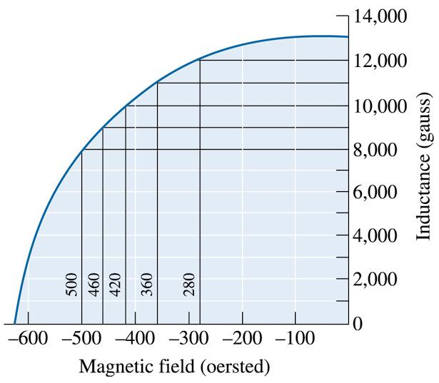
Example 19.4 Energy Product for Permanent Magnets
Determine the power, or BH product, for the magnetic material whose properties are shown in Figure 19.11.
Figure 19.11 The fourth quadrant of the B-H curve for a permanent magnetic material (for Example 19.4)
©2003 Brooks/Cole, a division of Thomson Learning, Inc. Thomson Learning™ is a trademark used herein under license.

Slide 38
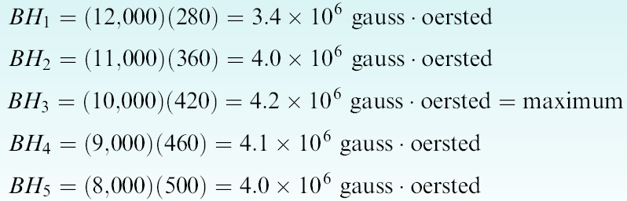
Example 19.4 SOLUTION
Several rectangles have been drawn in the fourth quadrant of the B-H curve. The BH product in each is:
Thus, the power is about 4.2 × 10⁶ gauss . oersted.

Slide 39
Example 19.5 Design/Selection of Magnetic Materials
Select an appropriate magnetic material for the following applications: a high-electrical-efficiency motor, a magnetic device to keep cupboard doors closed, a magnet used in an ammeter or voltmeter, and magnetic resonance imaging.
Example 19.5 SOLUTION
High-electrical-efficiency motor: To minimize hysteresis losses, we might use an oriented silicon iron, taking advantage of its anisotropic behavior and its small hysteresis loop.
Magnet for cupboard doors: The magnetic latches used to fasten cupboard doors must be permanent magnets; however, low cost is a more important design feature than high power. An inexpensive ferritic steel or a low-cost ferrite would be recommended.

Slide 40
Example 19.5 SOLUTION (Continued)
Magnets for an ammeter or voltmeter: For these applications, Alnico alloys are particularly effective. We find that these alloys are among the least sensitive to changes in temperature, assuring accurate current or voltage readings over a range of temperatures.
Magnetic resonance imaging: One of the applications for MRI is in medical diagnostics. In this case, we want a very powerful magnet. A Nd₂Fe₁₂B magnetic material, which has an exceptionally high BH product, might be recommended for this application. We can also make use of very strong electromagnets made using superconductors.

Slide 41
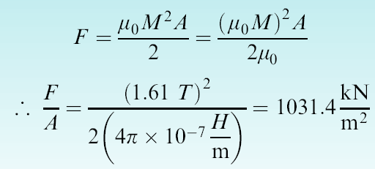
Example 19.6 Lifting Power of a Magnet
Calculate the force in kN for one square meter area of a permanent magnet whose saturation magnetization is 1.61 tesla.
Example 19.6 SOLUTION
We have been given the value of μ₀M = 1.61 tesla. We can rewrite the equation that provides the force due to a permanent magnet as follows.

Slide 42
Section 19.8 Metallic and Ceramic Magnetic Materials
Magnetocrystalline anisotropy - In single crystals, the coercivity depends upon crystallographic direction creating easy and hard axes of magnetization.

Slide 43
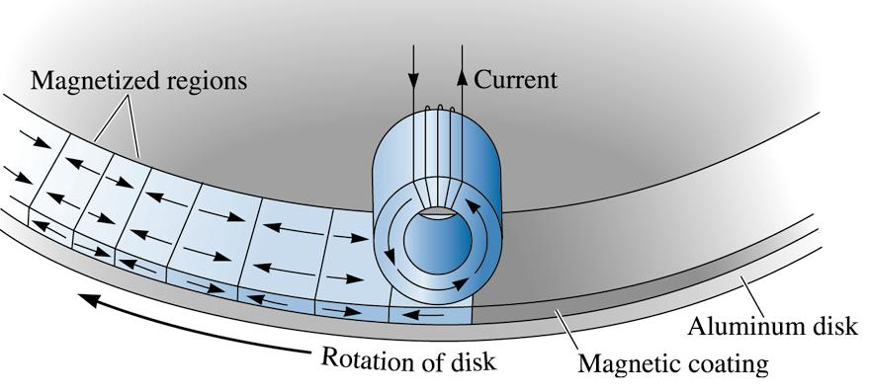
©2003 Brooks/Cole, a division of Thomson Learning, Inc. Thomson Learning™ is a trademark used herein under license.
Figure 19.12 Information can be stored or retrieved from a magnetic disk by use of an electromagnetic head. A current in the head magnetizes domains in the disk during storage; the domains in the disk induce a current in the head during retrieval.

Slide 44
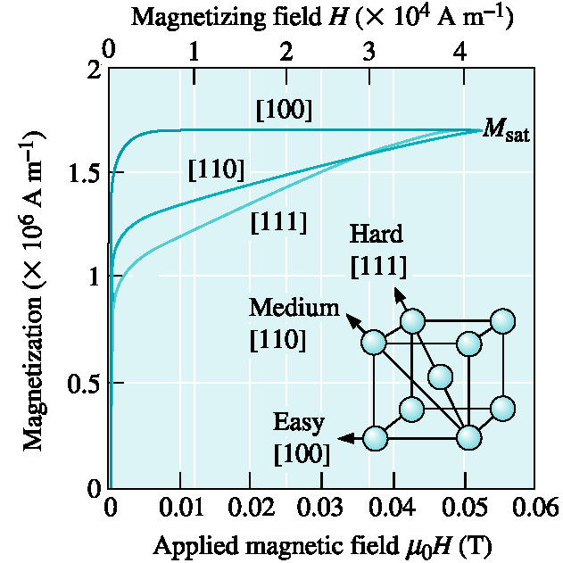

Figure 19.13 The initial magnetization curve for iron is highly anisotropic; magnetization is easiest when the directions are aligned with the field and hardest along [111]. (Source: From Principles of Electrical Engineering Materials and Devices, by S.O. Kasap, p. 623, Fig. 8-24. Copyright © 1997 Irwin. Reprinted by permission of The McGraw-Hill Companies.)

Slide 45
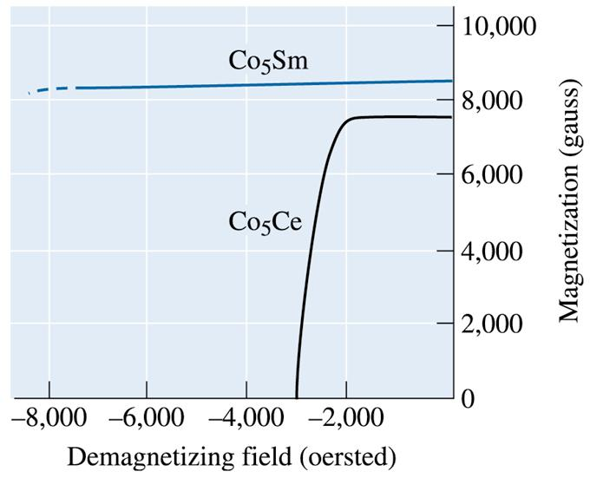
©2003 Brooks/Cole, a division of Thomson Learning, Inc. Thomson Learning™ is a trademark used herein under license.
Figure 19.14 Demagnetizing curves for Co₅Sm and Co₅Ce, representing a portion of the hysteresis loop.

Slide 46
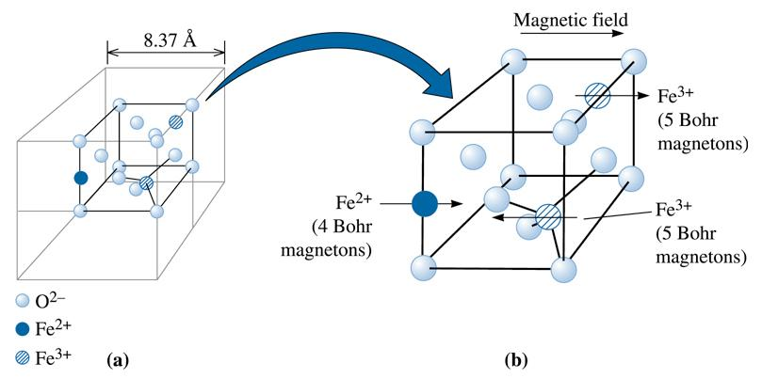
©2003 Brooks/Cole, a division of Thomson Learning, Inc. Thomson Learning™ is a trademark used herein under license.
Figure 19.15 (a) The structure of magnetite, Fe₃0₄. (b) The subcell of magnetite. The magnetic moments of ions in the octahedral sites line up with the magnetic field, but the magnetic moments of ions in tetrahedral sites oppose the field. A net magnetic moment is produced by this ionic arrangement.

Slide 47
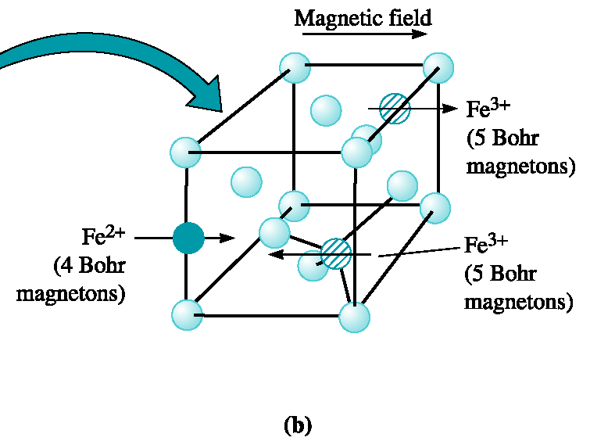
Example 19.7 Magnetization in Magnetite (Fe₃O₄)
Calculate the total magnetic moment per cubic centimeter in magnetite. Calculate the value of the saturation flux density (B_{sat}) for this material.
Figure 19.15 (b) The subcell of magnetite.

Slide 48
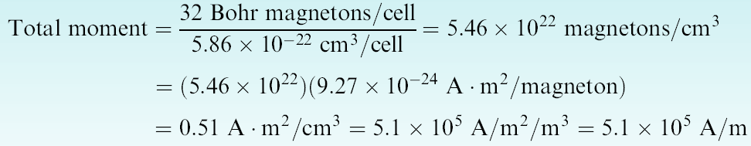

Example 19.7 SOLUTION
In the unit cell overall, there are eight subcells, so the total magnetic moment is 32 Bohr magnetons per cell. The size of the unit cell, with a lattice parameter of 8.37 × 10⁻⁸ cm, is:
The magnetic moment per cubic centimeter is:
This expression represents the magnetization M at saturation (M_{sat}). The value of B_{sat} μ₀M_{sat} will be = (4 × 10⁻⁷)(5.1 × 10⁵) = 0.64 Tesla.

Slide 49
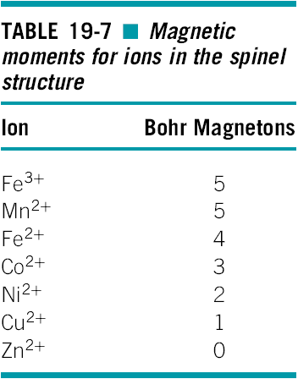

Slide 50
Example 19.8 Design/Materials Selection for a Ceramic Magnet
Design a cubic ferrite magnet that has a total magnetic moment per cubic meter of 5.5 × 10⁵ A/m.

Slide 51
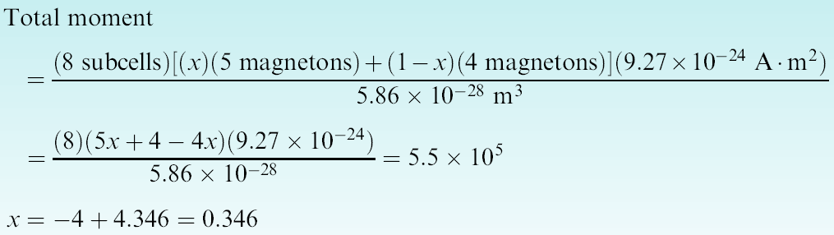
Example 19.8 SOLUTION
Assuming that the addition of Mn ions does not appreciably affect the size of the unit cell, we find from Example 19-7 that:
Let x be the fraction of Mn²⁺ ions that have replaced the Fe²⁺ ions, which have now been reduced to 1 - x. Then, the total magnetic moment is:
Therefore we need to replace 34.6 at% of the Fe²⁺ ions with Mn²⁺ ions to obtain the desired magnetization.

Slide 52
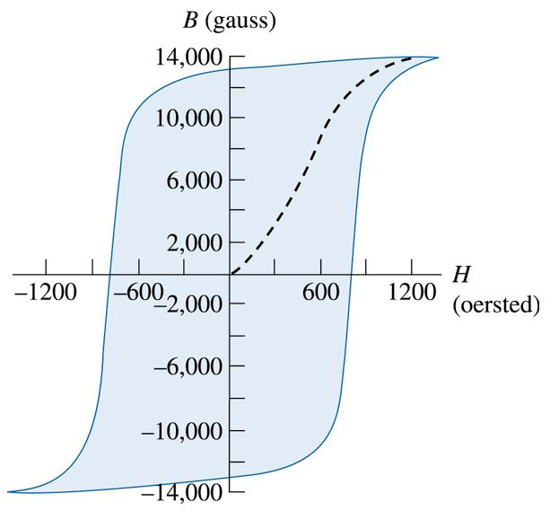
©2003 Brooks/Cole, a division of Thomson Learning, Inc. Thomson Learning™ is a trademark used herein under license.
Figure 19.16 Hysteresis curve for a hard magnetic material (for Problem 19.19).

Slide 53
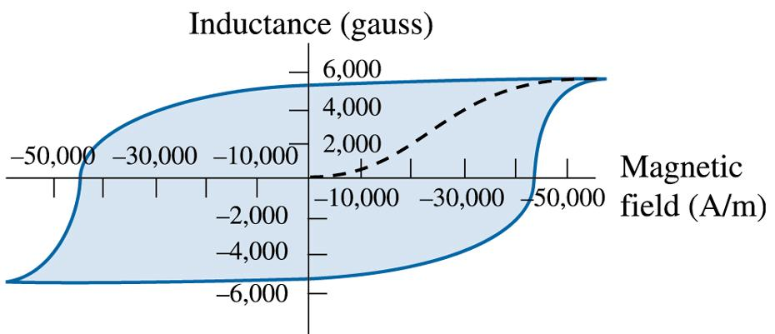
©2003 Brooks/Cole, a division of Thomson Learning, Inc. Thomson Learning™ is a trademark used herein under license.
Figure 19.17 Hysteresis curve for a hard magnetic material (for Problem 19.30).

Slide 54
©2003 Brooks/Cole, a division of Thomson Learning, Inc. Thomson Learning™ is a trademark used herein under license.
Figure 19.14 (Repeated for Problem 19.36.) Demagnetiz-ing curves for Co₅Sm and Co₅Ce, representing a portion of the hysteresis loop.

