Slide 1
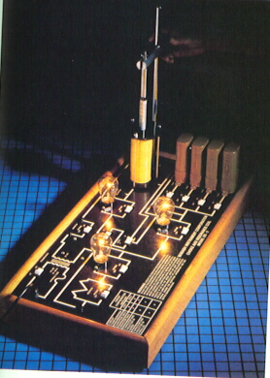
Electric Current
Chapter 19 problems
1-43 odd

Slide 2
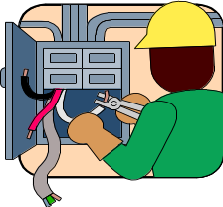
OBJECTIVES
After studying the material of this chapter the student should be able to:
1. Explain how a simple battery can produce an electrical current.
2. Define current, ampere, emf, voltage, resistance, resistivity, and temperature coefficient of resistance.
3. Write the symbols used for electromotive force, electric current, resistance, resistivity, temperature coefficient of resistance and poand state unit associated with each quantity.
4. Distinguish between a) conventional current and electron current and b) direct current and alternating current.

Slide 3
OBJECTIVES
After studying the material of this chapter the student should be able to:
5. Know the symbols used to represent a source of emf, resistor, voltmeter and ammeter and how to interpret a simple circuit diagram.
6. Given the length, cross-sectional area, resistivity and temperature coefficient of resistance,
determine a wire's resistance at room temperature and some higher or lower temperature
7. Solve simple dc circuit problems using Ohm's law.
8. Use the equations for electric power to determine the power and energy dissipated in a resistor and calculate the cost of this energy to the consumer.
9. Distinguish between the rms and peak values for current and voltage and apply these concepts in solving problems involving a simple ac circuit.

Slide 4
KEY TERMS AND PHRASES
  battery temperature coefficient of resistance
  electrodes Ohm's law
  electromotive force electric power
  emf kilowatt-hour (KWH)
  conventional current Joule heating
  electron current direct current (dc)
  ampere (amp) alternating current (ac)
  resistance electric generator
  resistivity sinusoidal
  ohm root-mean-square (rms)

Slide 5
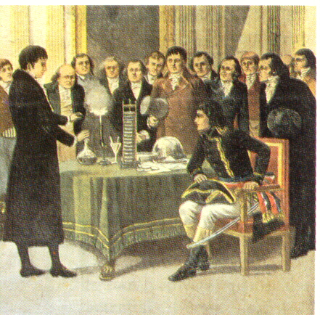
THE ELECTRIC BATTERY
A BATTERY is a source of electric energy. A simple battery contains two dissimilar metals, called ELECTRODES, and a solution called the ELECTROLYTE, in which the electrodes are partially immersed.

Slide 6
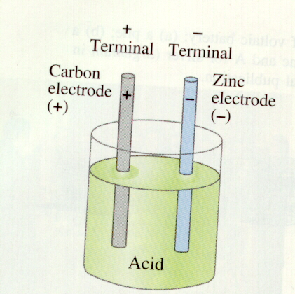
THE ELECTRIC BATTERY
An example of a simple battery would be one in which zinc and carbon are used as the electrodes, while a dilute acid, such as sulfuric acid (dilute), acts as the electrolyte. The acid dissolves the zinc and causes zinc ions to leave the electrode. Each zinc ion which enters the electrolyte leaves two electrons on the zinc plate. The carbon electrode also dissolves but at a slower rate. The result is a difference in potential between the two electrodes.

Slide 7
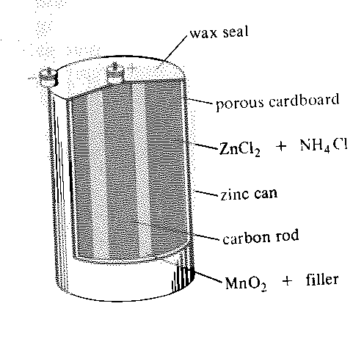
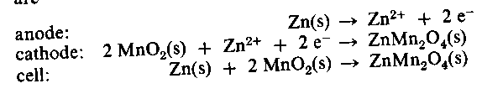
THE DRY CELL
The Dry cell is relatively inexpensive and quite portable. It has many uses such as in flashlights and radios. The anode consists of a Zinc can in contact with a moist paste of ZnCl₂ and NH₄Cl. A carbon rod surrounded by MnO₂ and filler is the cathode. The cell reaction appears to vary with the rate of discharge, but at low power the probable reactions are as follows:

Slide 8
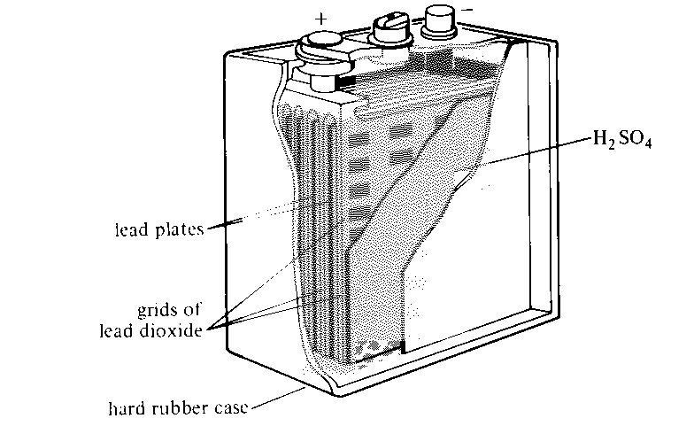

Lead Storage Cell
The basic features of the lead storage cell are electrodes of lead and lead dioxide, dipping into concentrated sulfuric acid
Both electrode reactions produce lead sulfate, which adheres to the electrode. When the cell discharges, sulfuric acid is used up and water is produced. The state of the cell can be determined by measuring the density of the electrolyte solution (the density of water is about 70% that of the sulfuric acid solution).

Slide 9
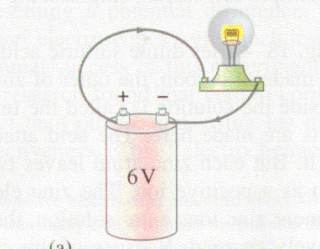
ELECTRIC CURRENT
An electric CURRENT exists whenever electric charge flows through a region, e.g., a simple light bulb circuit. The magnitude of the current is measured in AMPERES (Amps/A), where
1 ampere = 1coulomb/second
I = ΔQ/ Δ t.

Slide 10
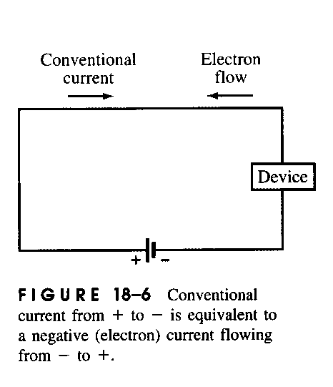
CONVENTIONAL CURRENT vs ELECTRON CURRENT
The direction of CONVENTIONAL CURRENT is in the direction in which positive charge flows. In gases and liquids both positive and negative ions move. Only negative charges, i.e., electrons, move through solids and this is referred to as ELECTRON CURRENT. For historical reasons, conventional current is used in referring to the direction of electric charge flow.

Slide 11
OHM'S LAW
The magnitude of the electric current that flows through a closed circuit depends directly on the voltage between the battery terminals and inversely to the circuit resistance. The relationship that connects current, voltage and resistance is known as OHM'S LAW and is written as follows:
I = V/R or V = IR
The current is measured in amperes, the voltage in volts and the resistance in ohms (Ω).

Slide 12
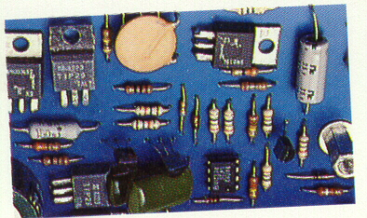
Resistors
Resistors are used to control the amount of current flowing in a circuit
Resistors have resistances from less than 1 ohm to millions of ohms
The two main types of resistors:
  Wire-wound (coil of fine wire)resistors
  Composition (carbon) resistors

Slide 13
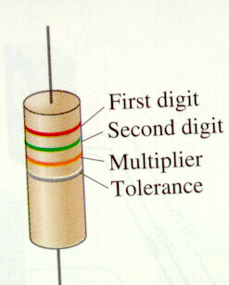
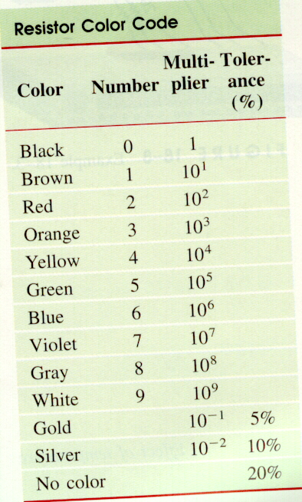
Resistors
Symbol on a schematic diagram
For the color code, the first two colors represent the first two digits in the value of the resistor, the third represents the power of ten that it must be multiplied by, and the fourth is the tolerance.

Slide 14
RESISTIVITY
RESISTIVITYWhen electric charge flows through a circuit it encounters electrical RESISTANCE. The resistance of a metal conductor is a property which depends on its dimensions, material and temperature. At a specific temperature, the resistance (R) of a metal wire of length L and cross-sectional area A is given by
R= ρ L/A
ρ is a constant of proportionality called the RESISTIVITY. The unit of resistance is the ohm(Ω) and the unit of resistivity is ohm-meter Ωm.

Slide 15
Resistivity and Temperature
The resistivity of a material depends somewhat on temperature
In general, the resistance of metals increases with temperature due to the increased movement and less orderly arrangement of the atoms
Within a certain range of temperature, the resistivity of a conductor changes according to the following equation:
ρ_{T} = ρ_{O} (1 + αT) ρ_{O} is the resistivity at some reference temperature such as 0 or 20 degrees , α is the temperature coefficient of resistivity
The resistance changes according to the equation: R_{T} = R_{O} (l + αT) R_{O} is the resistance at some reference temperature such as 0 or 20 degrees

Slide 16
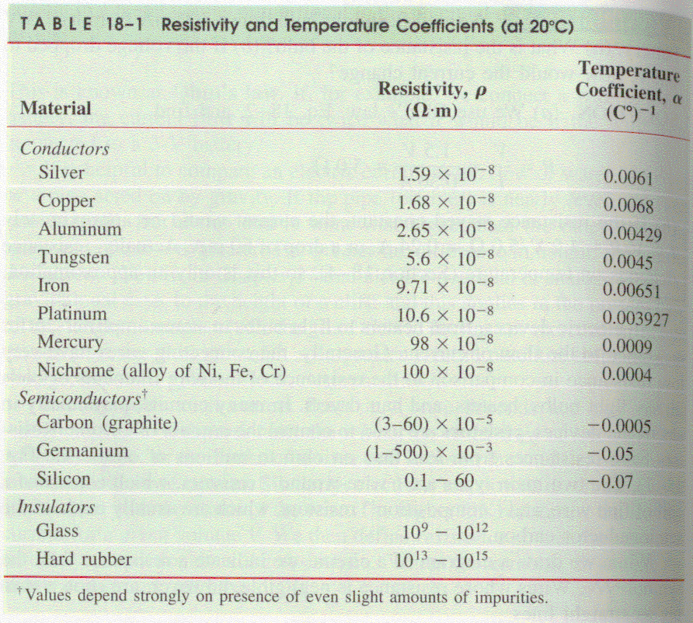
Resistivity and Temperature

Slide 17
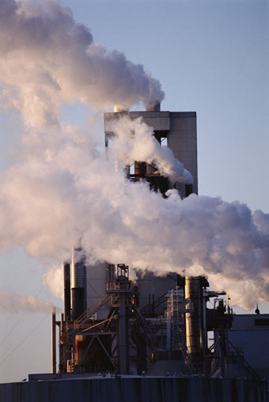
ELECTRIC POWER
Work is required to transfer charge through an electric circuit. The work required depends on the amount of charge transferred through the circuit and the potential difference between the terminals of the battery: W = QV.
The rate at which work is done to maintain an electric current in a circuit is termed ELECTRIC POWER

Slide 18
ELECTRIC POWER
ELECTRIC POWER equals the product of the current I and the potential difference V, i.e., P = IV.
The SI unit of power is the watt (W), where 1 W = 1 J/s. The kilowatt is a commonly used unit where I kilowatt = 1000 watts.
The electric energy produced by the source of emf is dissipated in the circuit in the form of heat.
The kilowatt hour (kWh) is commonly used to represent electric energy production and consumption where I kWh = 3.6 x 10⁶ J.

Slide 19
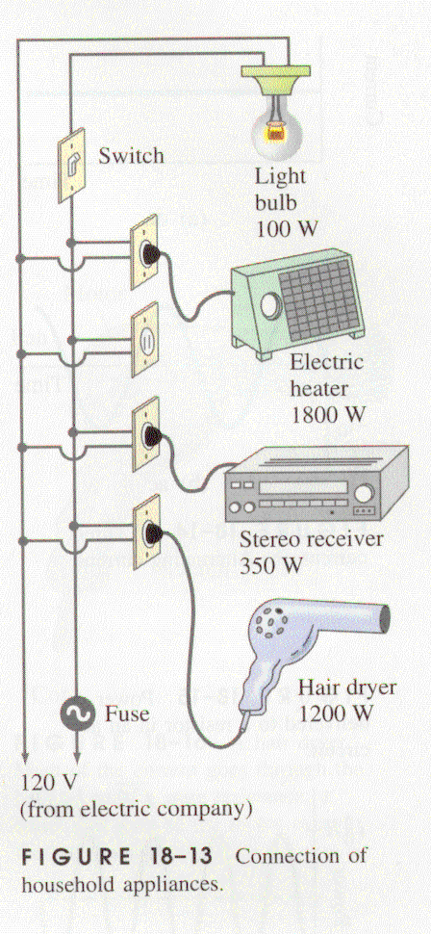
Electric Power
In a circuit of resistance R, the rate at which electrical energy is converted to heat energy is given by
P = IV but V = IR, then P = I(IR) =I²R
where I²R is known as JOULE HEATING.
An alternate formula for power can be written, since I = V/R, then P = IV = (V/R)V = V² /R
P=V² /R= I²R are power formulas which apply only to resistors
P = IV Applies to any device

Slide 20
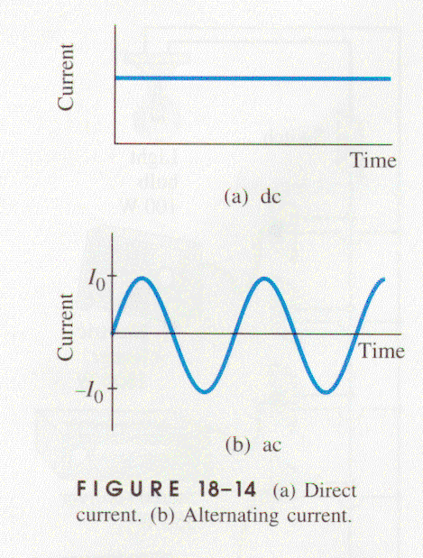
ALTERNATING CURRENT
In a DIRECT CURRENT (dc) circuit the current flows in one direction only.
In an ALTERNATING CURRENT (ac) circuit the direction of current flow through the circuit changes at a particular frequency (f).
The frequency used in the United States is 60 cycles per second or 60Hz.

Slide 21


ALTERNATING CURRENT
The emf produced by an ac ELECTRIC GENERATOR is SINUSOIDAL. The current produced in a closed circuit connected to the generator is also sinusoidal. The equations for the voltage and current are as follows:
V_{o} is referred to as the peak voltage
f = 60 Hz in the U.S.
Io = V_{o} /R is referred to as the peak current

Slide 22

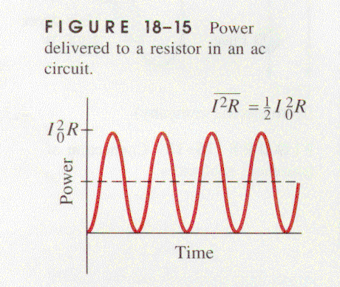
ALTERNATING CURRENT
Since the current oscillates between positive and negative values, the average current in an AC circuit is ZERO.
Electrons do move back and forth in the circuit so heat and power are produced
The power delivered to a resistor at any instant is:
Since sin² 2Πft varies between 0 and 1, its average value is 1/2. Thus the average power developed is equal to the dotted line in figure 18-15

