Slide 1
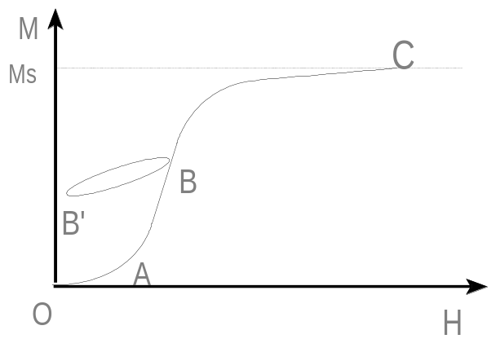
Magnetization of ferromagnetic body
Ms : saturation magnetization
OA : reversible region
Beyond OA : irreversible region
Susceptibility (χ) = M/H
χ_{rev} : BB’ χ_{ini} : OA
χ_{diff} :
χ_{tot} :
χ_{diff} = χ_{rev} + χ_{irr}

Slide 2
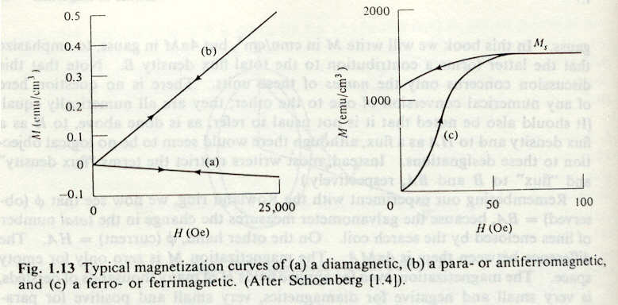
Hysteresis loop
Magnetization curve for
dia, para, antiferromagnetic
Magnetization curve for
ferromagnetic

Slide 3
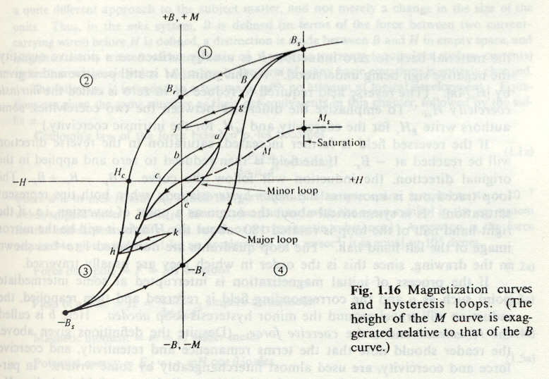
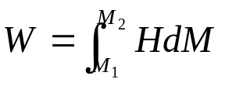
Remnant magnetization
(induction)
The work required to magnetize
a unit volume from M₁ to M₂
Coercive field
Area surrounded by the H(M) curve
Energy loss for one cycle:
area inside hysteresis loop

Slide 4
For application of magnetic materials
Soft magnetic materials
- high permeability, low coercive force, small hysteresis loop
- transformer, motor, generator
- Fe, Permalloy
Hard magnetic materials
- high coercive force, high remnant field, large hysteresis loss
- electric motors, loud speaker
- carbon steel, MK steel

Slide 5
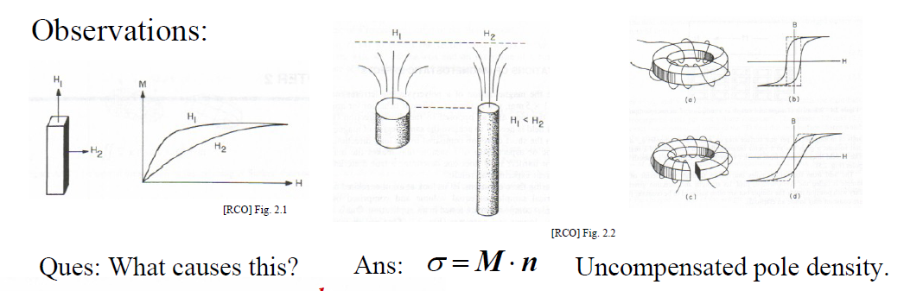
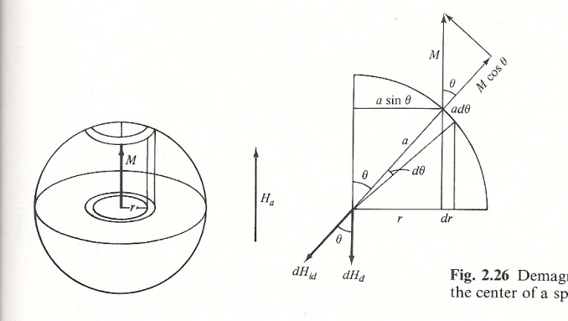
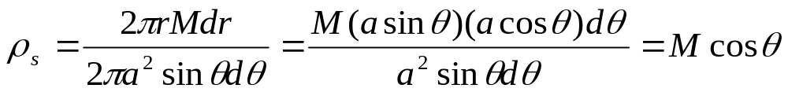

Example
+
+
+
+
+
+
M
+
M : pole strength per unit area on the cross section
ρ_{s} : pole density on the surface of the sphere
-
-
-
-
-
-
-

Slide 6



Boundary Conditions on M
1)
Inside: M₁
Outside: 0
(ρ_{s}: surface pole density)
M
In general
2) In the interior of the specimen
(Volume pole density)
Non-uniform magnetization interior pole

Slide 7
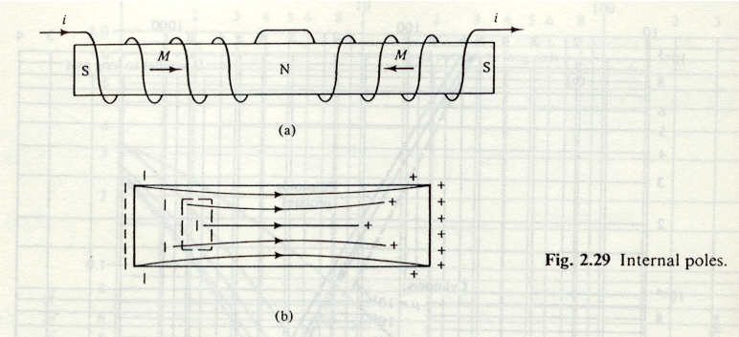





y
x
z
Net flux of M is not zero.
Assume
Along +x in right side positive ρ_{s}
Along +x in left side negative ρ_{s}

Slide 8

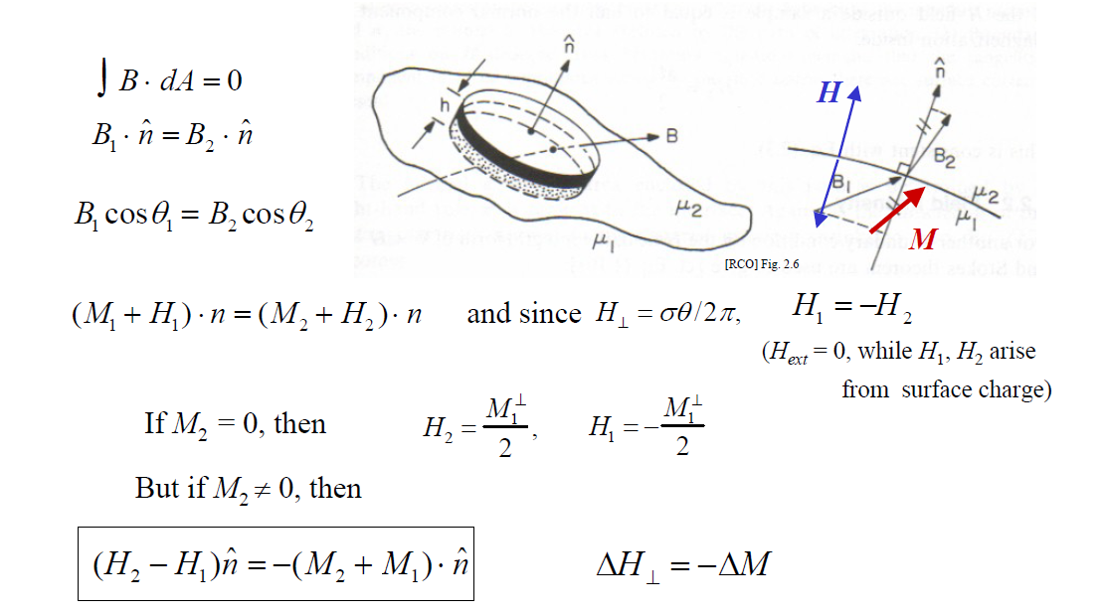
Boundary Conditions on B

Slide 9

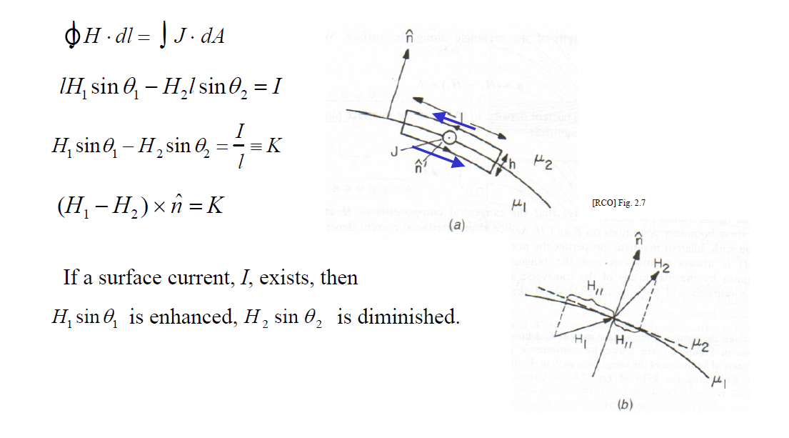
Boundary Conditions on H

Slide 10


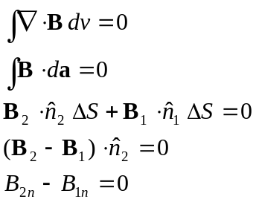
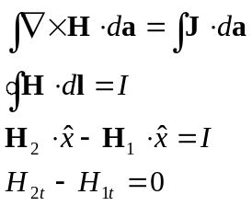
Boundary Conditions Summary
B₂
H₂
2
A
B
D
C
1
B₁
H₁
Divergence theorem
If I = 0
Normal component of B:
continuous
Tangential component of H:
continuous

Slide 11
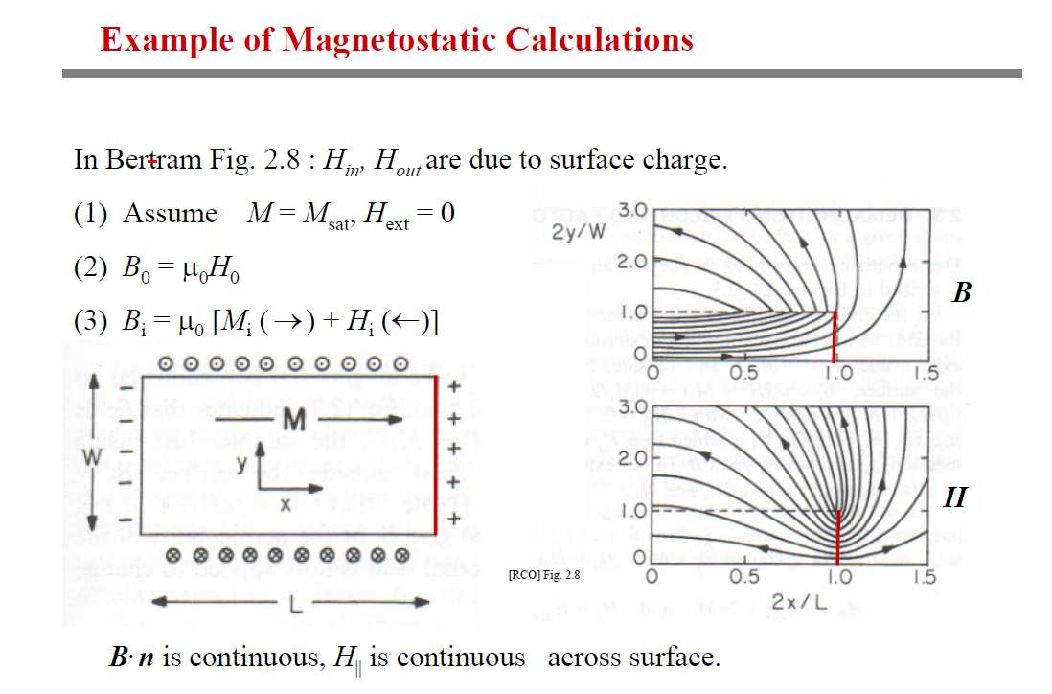

Slide 12
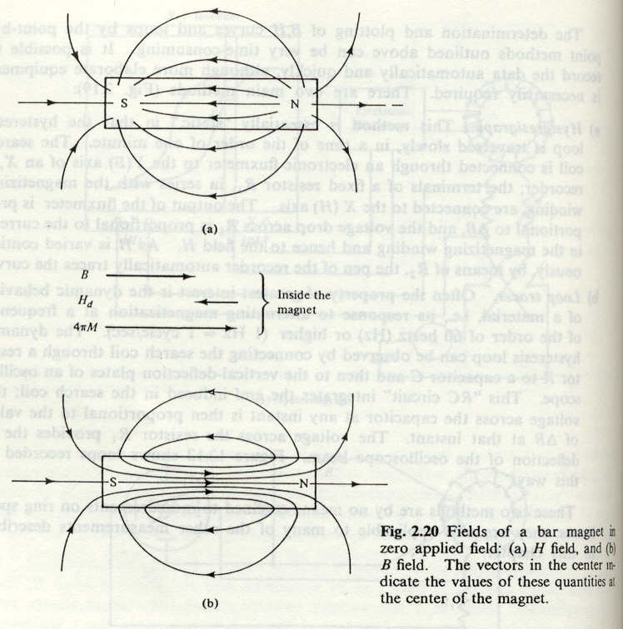
Demagnetization Field
Demagnetization field H_{d}
Lines of H originate at N and end at S
Lines of B are continuous.
H_{d} = N_{d}×M
N_{d} : demagnetization factor
depends mainly on the shape of the body

Slide 13
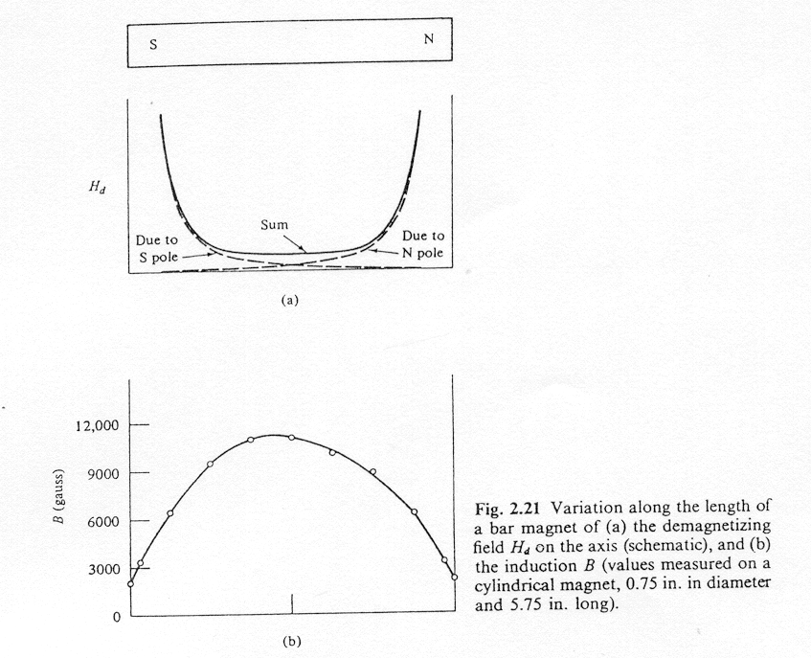
Variation of H_{d} along the length
of a bar magnet
Resulting magnetic induction

Slide 14
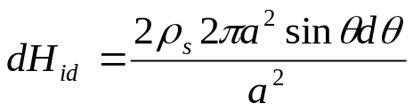

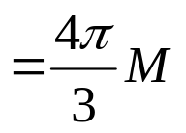
Demagnetization factor of sphere
+
+
+
+
+
M : pole strength per unit area on the cross section
ρ_{s} : pole density on the surface of the sphere
+
H_{a}
H_{d}
+
-
-
-
-
-
-
-
N_{d} = 4π/3

Slide 15
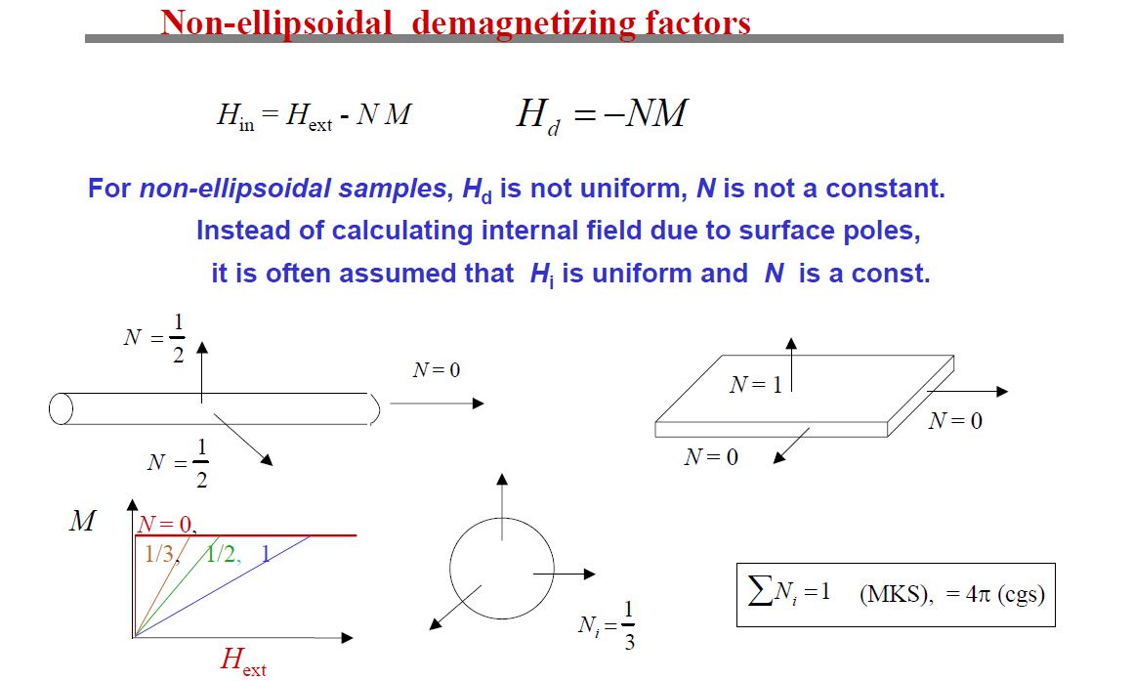

Slide 16
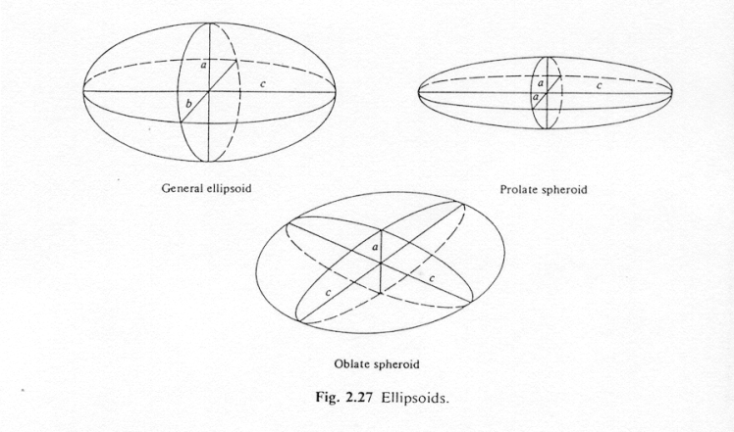
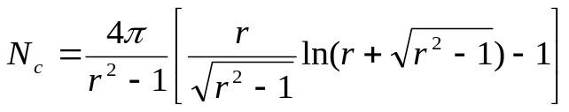
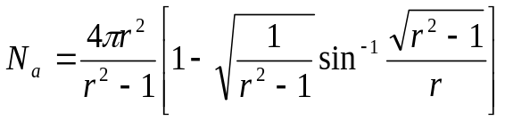
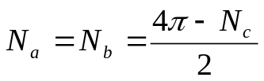
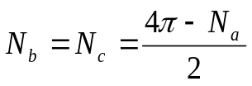
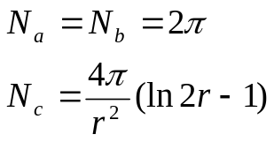
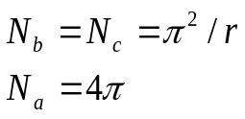
N_{a} + N_{b} + N_{c} = 4π
Prolate spheroid : a = b, c, c/a = r
Oblate spheroid or disc : a, b = c, c/a = r
For r >> 1
For r >> 1

Slide 17
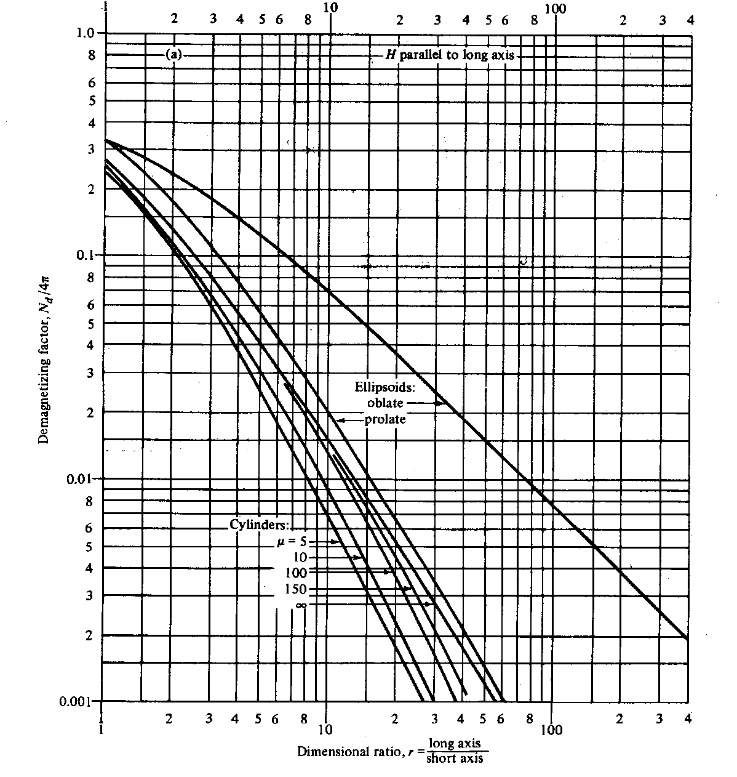

Slide 18
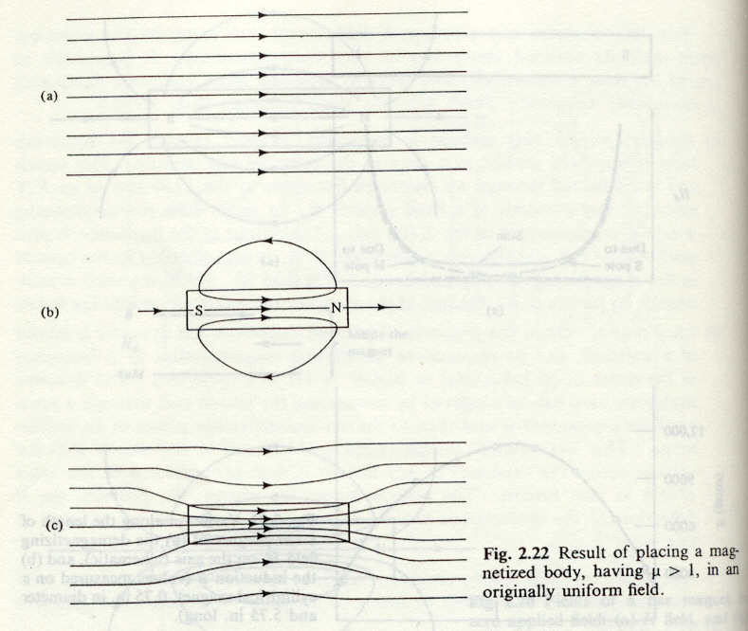
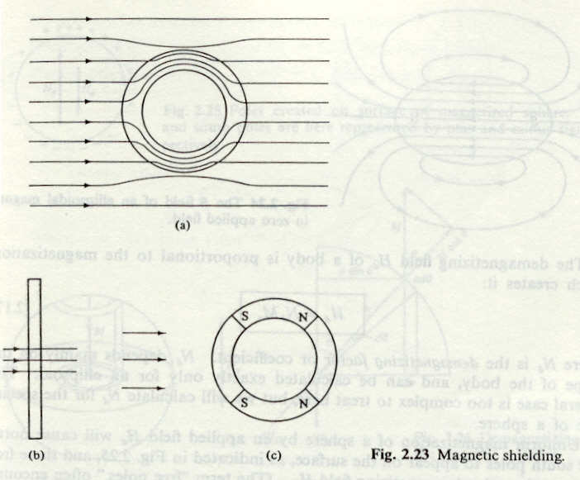
Magnetic shielding
B = μ H
μ > 1
Magnetic shielding
(μ >> 1)

Slide 19
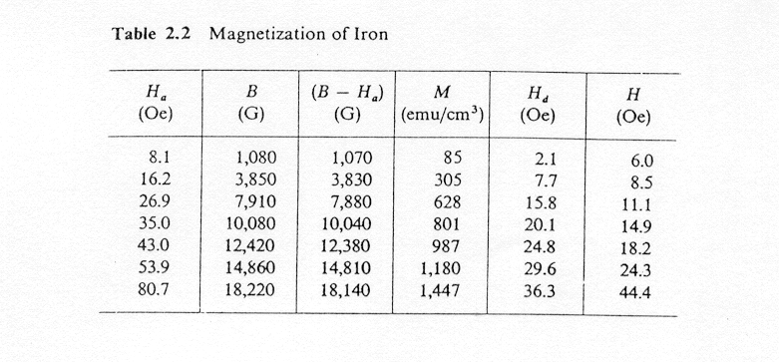
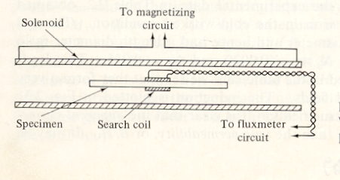



True field inside specimen
B = H + 4πM = H_{a} – N_{d}M + 4πM

Slide 20
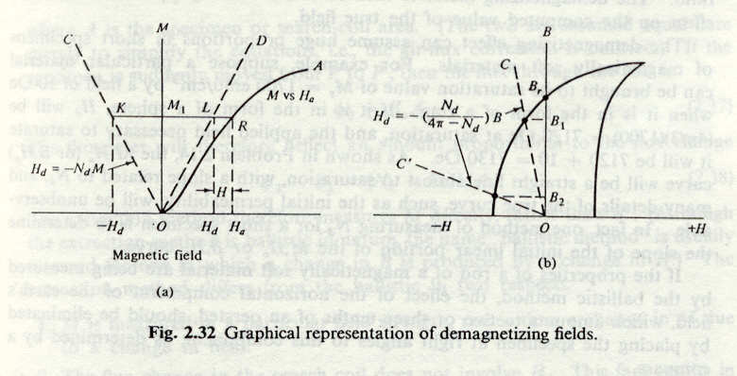

Graphical representation
4πM = B –H_{a} + H_{d}
H_{a} = 0 M = (B + H_{d})/4π
H_{d} = - N_{d} M
H_{d} = - N_{d} M = - N_{d} (B + H_{d})/4π

Slide 21
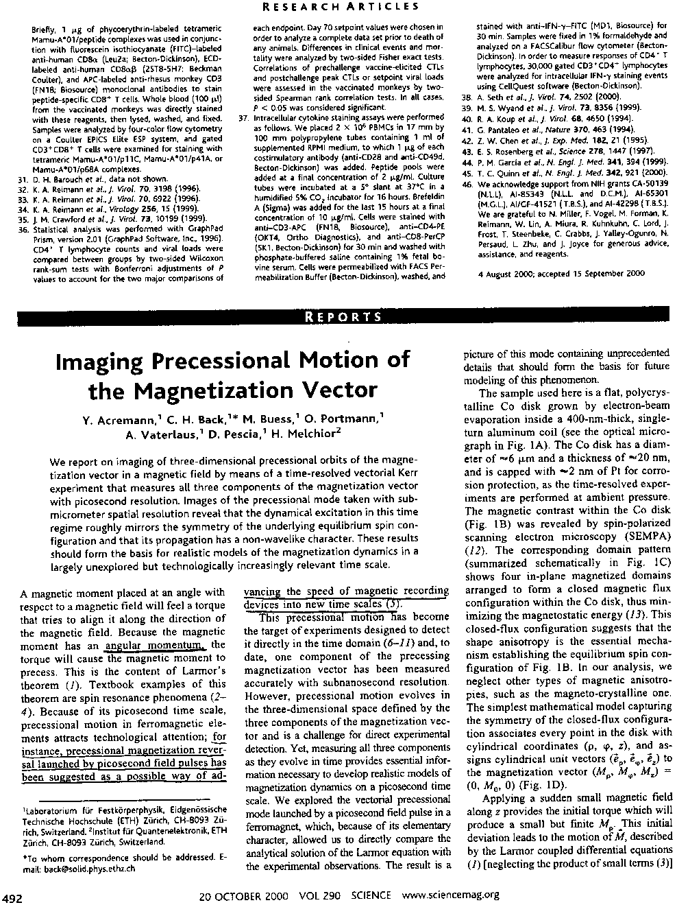
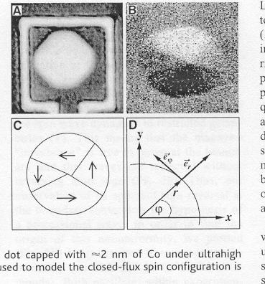
6 μm
20 nm thick Co
N_{ρ} = 0.17 N_{z} = 4π-0.17
Apply a short pulse field along z-axis
dM/dt = -gM×B

