Slide 1
Introduction to Electric Circuits
Mr. RAMESH BABU . J
(ASST.PROF)
EEE ,PBIT

Slide 2
Lecture 1
Introduction to Electric Circuits
  Voltage
  Current
  Current flow
  Voltage Sources
  Voltmeter (Multimeter)
Lumped circuits.
Reference directions.
Kirchhof’s current law (KCL).
Kirchhof’s voltage law (KVL).
Wavelength and dimension of the circuit.

Slide 3
Introduction to Electric Circuits
Here we are going to remind what are:
Voltage
Current
Current flow
Voltage Sources
Voltmeter (Multimeter)

Slide 4
What is Voltage?
V = “Electrical pressure”
- measured in volts.
H₂O
High Pressure
Low Pressure
Figure 1.1

Slide 5
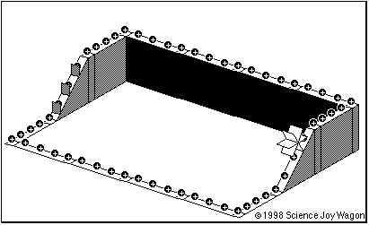
A battery in an electrical circuit plays the same role as a pump in a water system.

Slide 6

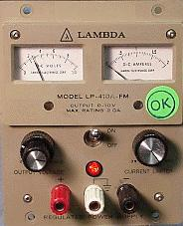
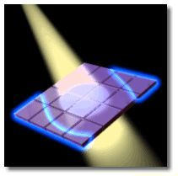
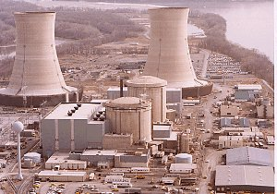

What Produces Voltage?
V = “Electrical pressure”
Lab Power Supply
A Battery
9 V
Solar Cell
1.5 V
Electric Power Plant
A few
Volts
13,500 V
Nerve Cell
A few millivolts
when activated by
a synapse

Slide 7
Other Symbols Used for
Specific Voltage Sources
+
+
~
_
_
Battery
Time-varying
source
Solar Cell
Generator
(power plant)
These are all…
.
Figure 1.2
Voltage Sources

Slide 8
A Typical Voltage Source
Lab Power Supply
This supply goes up
to 10 V
The voltage is adjustable
via this knob
The red (+) and black (-)
terminals emulate the two
ends of a battery.
The white terminal is
connected to earth ground
via the third prong of the
power cord
Remember:
A voltage is measured between two points

Slide 9

Measuring Voltages
We can measure voltage between two points with a meter
Set the meter to read
Voltage
Connect the V of the
meter to power supply red
+2.62
volts
Connect COM (common)
of the meter to power supply
black
I COM V
Read the Voltage white

Slide 10
Exercise
The power supply is changed to 3.2 V.
What does the meter read?
What’s the answer?
Find out
–3.2 V
Answer: –3.2 V
I COM V

Slide 11
What is “Ground”
“Ground” refers to the reference terminal to
which all other voltages are measured
V₁
+
V₂
+
V₃
+
_
_
_
Point of Reference
Figure 1.3

Slide 12

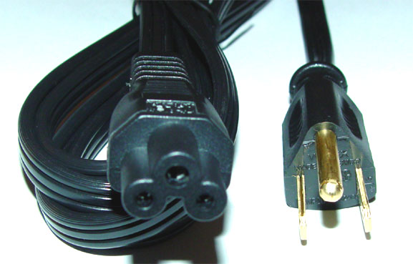
The earth is really just one big ground node.
Most people choose the earth as the
reference ground when a connection
to it is available.
V₂
+
_
A ground connection to earth is often made
via the third prong of a power cord.

Slide 13
Ground Symbol
Positive relative to ground
V₁
+
V₂
+
V₃
+
_
_
_
V₄
+
_
Figure 1.4
Negative relative to ground

Slide 14
Voltage Relative to Ground
The white terminal is connected to earth ground
Connect the black terminal to ground
The red terminal is
positive with respect to
“ground”
+

Slide 15
Negative Polarity Relative to Ground
The black terminal is
negative with respect to
ground.
+

Slide 16
What is Current?
Current is the flow of charge from a voltage source
1 Ampere (“Amp”) = Flow of 1 Coulomb/sec
+++

Slide 17
How Does Current Flow?
Current can only flow through conductors
Metal wires (conductors)
+++
Current
flow

Slide 18
When Does Current NOT Flow?
Current cannot flow through insulators
Plastic material (insulators)
+++
No current
flow

Slide 19
Note that Air is an Insulator
Current cannot flow through insulators
+++
Air
No current flow
That’s why a battery doesn’t discharge if left on its own.

Slide 20
What is Current?
Electricity flows when electrons travel through
a conductor.
We call this flow “current.”
Only some materials have free electrons inside.
YES!
glass
rubber
oil
asphalt
fiberglass
porcelain
ceramic
quartz
(dry) cotton
(dry) paper
(dry) wood
plastic
air
diamond
pure water
silver
copper
gold
aluminium
iron
steel
brass
bronze
mercury
graphite
dirty water
concrete
Conductors:
NO!
Insulators:
No free electrons = No current

Slide 21
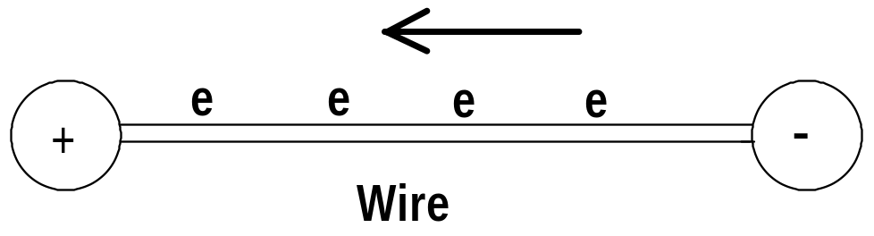
Current
Current is the amount of electric charge (coulombs) flowing past a specific point in a conductor over an interval of one second.
1 ampere = 1 coulomb/second
Electron flow is from a lower potential (voltage) to a higher potential (voltage).

Slide 22
Current
For historical reasons, current is conventionally thought to flow from the positive to the negative potential in a circuit.

Slide 23
Formal Definition of Current Flow
Rate of flow of “positive” charge
Measured in Coulombs per second of charge
(It’s really the electrons flowing in the
opposite direction)
1 Ampere = 1 Coulomb of electrons flowing by per second
in the wire

Slide 24
Sign Convention for Current Flow
Electrons carry negative charge
Positive current flow is in opposite direction
-
-
-
-
-
-
-
-
-
-
-
-
-
-
-
-
-
-
-
-
-
-
-
-
electron motion
positive current direction

Slide 25
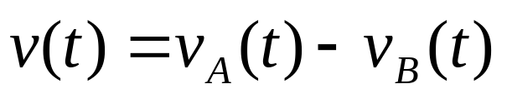
Reference Direction
Consider any two-terminal lumped element with terminals A and B as shown in Figure 1. It may be a resistor, inductor or diode. To suggest this generally , we refer to the two-terminal element as a branch.
A
i
+
The reference direction for the voltage is indicated by the plus and minus symbols located near terminals A and B. The reference direction for current is indicated by the arrow.
v
B
Given the reference direction for the voltage shown in Fig. by convention the branch voltage v is positive at time t ( that is, v(t)>0) whenever the electrical potential of A at time t is larger than the electrical potential of B at time t.
(1.1)
Associated reference direction

Slide 26
Power Flow
i
The current variable i is defined as positive
into the (+) terminal of the element
+
V
“Passive” sign convention
If the physical current is positive
Power flows into the element)
P = V i
The current variable i is defined as positive
into the (+) terminal of the element
i
+
Here the physical current is negative
Power flows out of the source
_
+
P = V i
V

Slide 27
Lumped circuits
Lumped circuits are obtained by connecting lumped elements
Typical lumped elements are
resistors,
capacitors,
inductors and
transformers
The key properties associated with lumped elements is their small size (compared to the wavelength corresponding to their normal frequency of operation).
From the more general electromagnetic field point of view, lumped elements are point singularities; that is they have negligible physical dimensions.

Slide 28
Network Topology
An interconnected set of electrical components is called a network.
Each component of a network is called
an element.
Elements are connected by wires.

Slide 29
Nodes and Branches
The interconnections between wires are
called nodes.
The wire paths between nodes are called
branches.
branches
nodes

Slide 30
Nodes Connected by Wires Only
Two or more nodes connected just by
wires can be considered as one single node.
A single node
One big node
Group of nodes connected only by wires
One big node
This network as three nodes

Slide 31
Current Flow
Current can flow through the branches of a network.
The direction of current flow is indicated by an arrow.
+
_
Note: The voltage sources in the network drive the flow
of current through its branches. (More on this idea later.)

Slide 32
Every Current has a Value and a Direction
The direction is defined by the person drawing the network.
The value is determined by the properties of the circuit.
i₁
_
+
A
_
+
Example:
The arrow above defines “positive” current flow i₁ as downward in branch A.
Suppose that 4 mA of current flows physically downward in branch A. Then i₁ = 4 mA.
Converse:
Suppose that 4 mA of current flows physically upward in branch A. Then i₁ = – 4 mA.

Slide 33
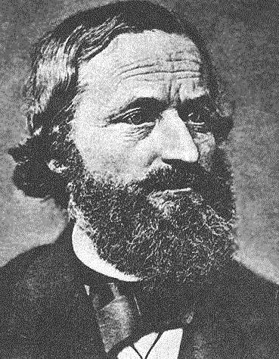
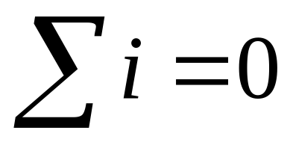
Kirchhoff’s Current Law
The sum of currents flowing into a node
must be balanced by the sum of currents
flowing out of the node.
node
i₁
i₂
i₃
Gustav Kirchoff was an 18th century German mathematician
i₁ flows into the node
i₂ flows out of the node
i₃ flows out of the node
i₁ = i₂ + i₃
(1.2)

Slide 34
Kirchhoff’s Current Law:
i₁ = i₂ + i₃
This equation can also be written in the following form:
i₁ – i₂ – i₃ = 0
i₁
node
i₂
i₃
A formal statement of Kirchhoff’s Current Law:
The sum of all the currents entering a node is zero.
(i₂ and i₃ leave the node, hence currents –i₂ and –i₃ enter the node.)

Slide 35
Example 1: Kirchhoff’s Current Law:
Q: How much is the current I_{o} ?
A: i_{o} = 2.5 mA + 4 mA = 6.5 mA
2.5 mA
4 mA
i_{o}
i₄
i₂
i₃
Note that a “node” need not be a discrete point
The dotted circle is a node with 2.5 mA entering
Hence i₂ = 2.5 mA exits the “node”.
Similarly, i₃ = 4 mA.
From KCL, i₄ = i₂ + i₃ = 6.5 mA, and I_{o} = i₄

Slide 36
Example 2: Kirchhoff’s Current Law:
Q: How much are the currents i₁ and i₂ ?
A: i₂ = 10 mA – 3 mA = 7 mA
i₁ = 10 mA + 4 mA = 14 mA
10 mA
node
i₁
3 mA
i₂
4 mA
+
_
4 mA + 3 mA + 7 mA = 14 mA

Slide 37
Sometimes Kirchhoff’s Current Law is abbreviated just by
KCL
Review: Different ways to state KCL:
The sum of all currents entering a node must be zero.
The net current entering a node must be zero.
Whatever flows into a node must come out.
more to follow…

Slide 38
General View of Networks
A network is an interconnection of elements via nodes and branches
There are many kinds of networks:
Elements Network Connection Paths
Electrical components
Circuit
Wires
Computers
Internet
Fiber Optics
Organs
Circulatory
System
Blood Vessels
Kirchoff’s Current Law applies to all these kinds of networks!

Slide 39
Kirchhoff’s Current Law applies to all types of networks
Fiber optic network (I is light intensity)
I₁
I₁
I₂
“KCL” for light:
I₁ = I₂ + I₃
I₃

Slide 40

Kirchhoff’s Current Law applies to all types of networks
Human Blood Vessels (f is blood flow rate)
f₂
f₁
Organ
f₁
“KCL” for blood flow:
f₁ = f₂ + f₃
f₃

Slide 41
Voltage
Voltages are measured across the branches of a network,
from one node to another.
The direction of a voltage is indicated by + and – signs.
+ v₂ –
+
v₁
–
+
v₃
–
+
v₄
–
+
_
Remember: The voltage sources in the network drive
the flow of current through the branches.

Slide 42
Every Voltage has a Value and a Polarity
The polarity is defined by the person drawing the network.
The value is determined by the properties of the circuit.
1
_
+
v₃
–
+
_
+
Example:
2
The plus and minus signs above define the polarity of v₃ as “positive” from node 1 to node 2.
Suppose that +5 V appears physically from node 1 to node 2 . Then v₃ = 5 V.
Converse:
Suppose that +5 V appears physically from node 2 to node 1 . Then v₃ = –5 V.

Slide 43
Kirchhoff’s Voltage Law
The voltage measured between any two nodes
does not depend of the path taken.
voltage
+ v₂ –
voltage
+
v₁
–
+
v₃
–
+
v₄
–
+
voltage
_
Example of KVL:
v₁= v₂ + v₃
Similarly:
v₁= v₂ + v₄
and:
v₃= v₄

Slide 44
Kirchhoff’s Voltage Law:
v₁ = v₂ + v₃
(1.3)
This equation can also be written in the following form:
–v₁ + v₂ + v₃ = 0
+ v₂ –
+
v₁
–
+
v₃
–
+
v₄
–
+
_
A formal statement of Kirchhoff’s Voltage Law:
The sum of voltages around a closed loop is zero.

Slide 45
Using the Formal Definition of KVL
“The sum of voltages around a closed loop is zero.”
Define an arrow direction around a closed loop.
Sum the voltages as the are encountered in going around the loop.
If the arrow first encounters a plus sign, enter that voltage with a
(+) into the KVL equation.
If the arrow first encounters a minus sign, enter that voltage with a
(–) into the KVL equation.
+ v₂ –
+
v₁
–
+
v₃
–
+
v₄
–
+
_
For the arrow shown above:
–v₁ + v₂ + v₃ = 0
For the outer arrow:
–v₄ – v₂ + v₁ = 0

Slide 46
Example 1: Kirchhoff’s Voltage Law:
Q: How much is the voltage V_{o} ?
A: V_{o} = 3.1 V + 6.8 V
+ 3.1V –
+
6.8 V
–
+
v₄
_
+
_
V_{o}
Q: How much is the voltage v₄ ?
A: v₄ = 6.8 V

Slide 47
Example 2: Kirchhoff’s Voltage Law:
Q: If v₁ = 10 V and v₅ = 2 V, what are v₂, v₃, and v₄?
A: v₂ = 10 V
v₃ = 10 V – 2 V = 8 V
v₄ = 2 V
+ v₃ –
+
v₁ = 10 V
–
+
v₂
–
+
v₄
–
+
v₅= 2 V
–
+
_

Slide 48



Wavelength and Dimension of the Circuit
What happens when the dimensions of a circuit become comparable to or even larger than the wavelength associated with the highest frequencies of interest?
Let d be the largest dimension of the circuit, c the velocity of propagation of electromagnetic waves, λ the wavelength of the highest frequency of interest, and f the frequency. The condition states that
d is of the order of a larger than λ
(1.4)
Now
Is the time required for electromagnetic waves to
propagate from one end of the circuit to the other.
Since
where T is the period of the highest frequency of interest
τ is of the order of a larger than T
(1.5)

Slide 49
Thus, recalling the remarks concerning the applicability of KCL and KVL at high frequencies, we may say that KCL and KVL hold for any lumped circuit as long as the propagation time of electromagnetic waves through the medium surrounding the circuit is negligible small compared with the period of the highest frequency of interest.
Example
Let us consider a dipole antenna of an FM broadcast receiver and the 300 Ω transmission line that connects it to the receiver.
+
The transmission line consists of two parallel copper wires that are held at a constant distance from one another by simple insulating plastic.
-
A
A
C
C
Transmission line
+
v
B
-
B
The transmission line is infinitely long to the right.

Slide 50
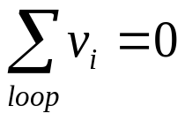
Summary
Kirchhoff’s laws and the lumped-element model of a circuit are valid provided that the largest physical dimension of a circuit is small compared with the wavelength corresponding to the highest frequency under consideration
KCL states that for any lumped electric circuit, for any of its nodes, and at any time, the algebraic sum of all the branch currents leaving the node is zero
KVL states that for any lumped electric circuit, for any of its loops, and at any time, the algebraic sum of all the branch voltages around the loop is zero
Kirchhoff’s laws are linear constraints on the branch voltages and branch currents. Furthermore, they are independent of the nature of the elements

