Slide 1
Lecture 2
Circuit Elements (i).
Resistors (Linear)
Ohm’s Law
Open and Short circuit
Resistors (Nonlinear)
Independent sources
Thevenin and Norton equivalent circuits

Slide 2

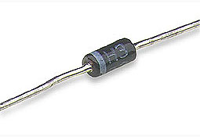
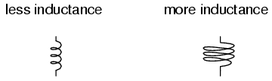
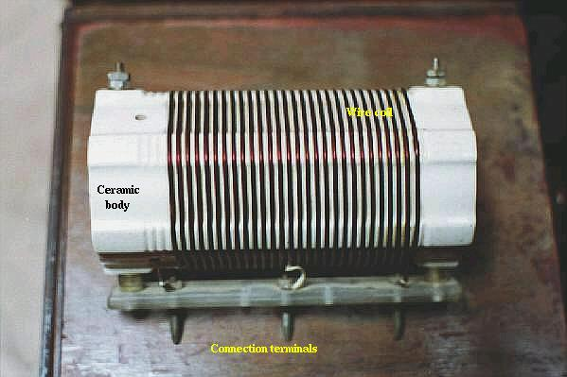
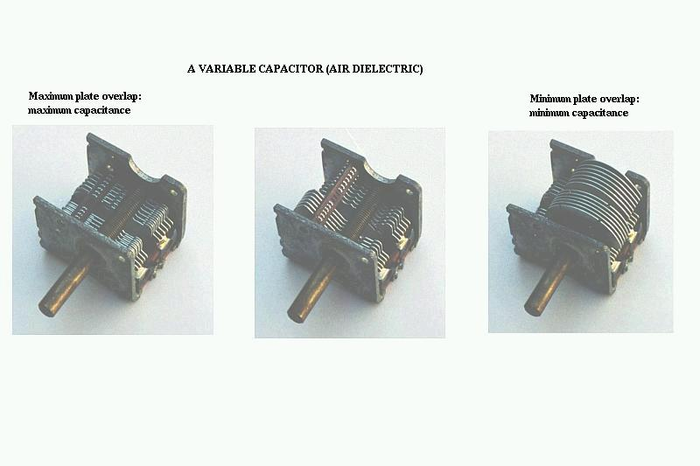
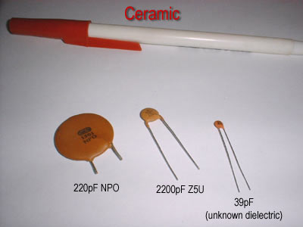
Circuit Elements
Capacitance

Slide 3
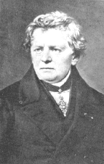
Ohm’s Law
Let us remind the Ohm’s Law
i
Georg Ohm
+
V
_
unknown resistive
element
Assume that the wires are “perfect conductors”
The unknown circuit element limits the flow
of current.
The resistive element has conductance G

Slide 4
I = GV
+
I
V
_
The voltage source has value V
The magnitude of the current flow is
given by Ohm’s Law:
I = G V
(2.1)
conductance

Slide 5
I = GV
+
I
V
_
The resistance of the element is defined
as the reciprocal of the conductance:
1
R = —
G
(ohms)
Ohm’s Law is usually written using R instead of G:
V
I = —
R
(2.2)

Slide 6
Three Algebraic Forms of Ohm’s Law
V
I = —
R
V = I R
(2.3)
V
R = —
I
(2.4)

Slide 7
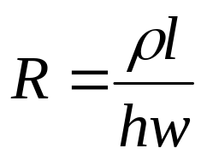
Resistance Depends on Geometry
w
h
l
Material has resistivity ρ (units of ohm-m)
Resistivity is an intrinsic property of the material, like it’s density and color.
When wires are connected to the ends of the bar:
Resistance between the wires will be
(2.5)

Slide 8
ρ l
R = ——
hw
The resistance…
Increases with resistivity ρ
Increases with length l
Decreases as the area hw increases
w
h
l
R

Slide 9
Here is the circuit symbol for a resistor
=
ρ l
h w
R
The symbol represents the physical resistor
when we draw a circuit diagram.
A two-terminal element will be called a resistor if at any instant time t, its voltage v(t) and its current i(t) satisfy a relation defined by a curve in the vi plane (or iv plane) This curve is called the characteristic of resistor at time t.

Slide 10
The most commonly used resistor is time-invariant; that is, its characteristics does not vary with time
A resistor is called time-varying if its characteristic varies with time
Any resistor can be classified in four ways depending upon whether it is
linear
non-linear
time-varying
time-invariant
A resistor is called linear if its characteristic is at all times a straight line through the origin

Slide 11

A linear time-invariant resistor, by definition has a characteristic that does not vary with time and is also a straight line through the origin (See Fig. 2.1).
Therefore, the relation between its instantaneous voltage v(t) and current i(t) is expressed by Ohm’s law as follows:
v
Slope R
(2.3)
R and G are constants independent of i,v and t
i
The relation between i(t) and v(t) for the linear time-invariant resistor is expressed by a linear function .
Fig. 2.1 The characteristic of a linear resistor is at all times a straight line through the origin; the slope R in the iv plane gives the value of the resistance.

Slide 12
Open and short circuits
A two-terminal element is called an open circuit if it has a branch current identical to zero, whatever the branch voltage may be.
v
Characteristic of an open circuit
i(t)=0
The Rest of the Circuit
+
i
v(t)
R=∞; G=0
-
Fig. 2.2 The characteristic of an open circuit coincides with the v axis since the current is identically zero

Slide 13
A two-terminal element is called an short circuit if it has a branch voltage identical to zero, whatever the branch current may be.
v
Characteristic of a short circuit
i(t)
The Rest of the Circuit
+
i
v(t)=0
R=0; G=∞
-
Fig. 2.3 The characteristic of an short circuit coincides with the i axis since the voltage is identically zero

Slide 14
Exercise
Justify the following statements by Kirchhoffs laws:
A branch formed by the series connection of any resistor R and an open circuit has the characteristic of open circuit.
A branch formed by the series connection of any resistor R and a short circuit has the characteristic of the resistor R
A branch formed by the parallel connection of any resistor R and an open circuit has the characteristic of the resistor R
A branch formed by the parallel connection of any resistor R and a short circuit has the characteristic of a short circuit

Slide 15
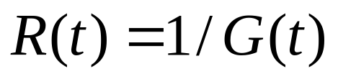
The Linear Time-varying Resistor
The characteristic of a linear time-varying resistor is described by the following equations:
(2.4)
where
The characteristic obviously satisfies the linear properties, but it changes with time
Let us consider for example a linear time varying resistor with sliding contact of the potentiometer that is moved back or forth by servomotor so that the characteristic at time t is given by

Slide 16
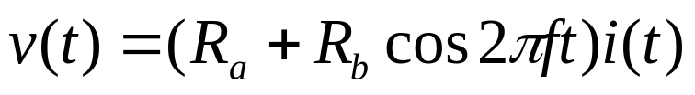
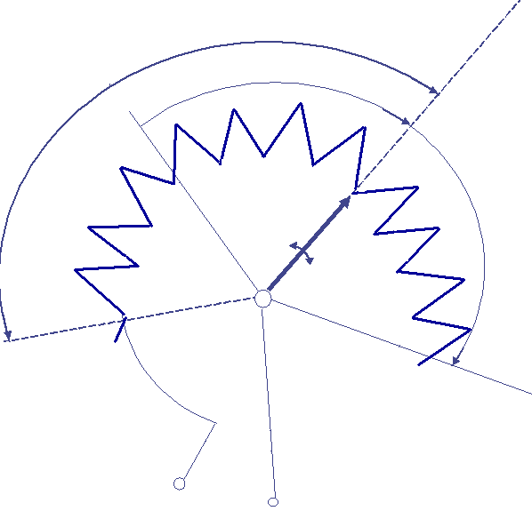
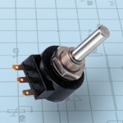
(2.5)
Where R_{a}, R_{b}, and f are constants and R_{a}>R_{b}>0. In the iv plane, the characteristic of this linear time-varying resistor is a straight line that passes at all times through the origin; its slope depends on the time.
R_{b}
R_{a}
Slope R_{a}+R_{b}
v
Slope R_{a}+R_{b}cos2πft
Slope R_{a}-R_{b}
R_{b}
i
Fig.2.5 Characteristic at time t of the potentiometer of Fig. 2.5
Fig. 2.4 Example of linear time-varying resistor ;a potentiometer with a sliding contact R(t)= Ra+Rbcos2πft
1
2
3

Slide 17
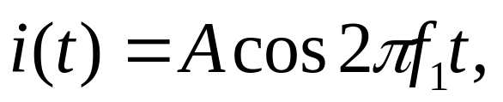
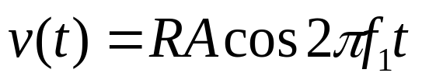
Example 1
Linear time-varying resistors differ from time-invariant resistors in a fundamental way. Let i(t) be a sinusoid with frequency f₁; that is
(2.6)
where A and f₁ are constants.
Then for a linear time-varying resistor
with resistance R, the branch voltage due to this current is given by Ohm’s law as follows:
(2.7)
Thus, the input current and the output voltage are both sinusoids having the same frequency f₁. However, for the linear time-varying resistors the result is different. The branch voltage due to the sinusoidal current described by (2.6) for linear time-varying resistor specified by (2.5) is

Slide 18
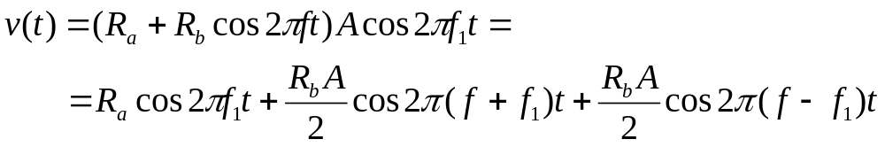
(2.8)
This particular linear time-varying resistor can generate signals at two new frequencies which are, respectively, the sum and the difference of the frequencies of the input signal and the time-varying resistor .
Thus, linear time-varying resistor can be used to generate or convert sinusoidal signals. This property is referred to as “modulation“.

Slide 19
Example 2
Ideal switch
R₁
R₂
Fig 2.6 Model for a physical switch which has a resistance R₁+R₂ when opened and a resistance R₁ when closed; usually R₁ is very small, and R₂ is very large.
A switch can be considered a linear time-varying resistor that changes from one resistance level to another at its opening or closing. An ideal switch is an open circuit when it is opened and a shirt circuit when it is closed.

Slide 20
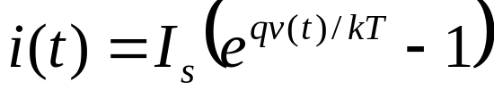
The Nonlinear Resistor
The typical example of a nonlinear resistor is a germanium diode. For pn –junction diode shown in Fig. 2.7 the branch current is a nonlinear function of the branch voltage, according to
(2.9)
i
i
+
where I_{s} is a constant that represents the reverse saturation current, i.e., the current in the diode when the diode is reverse-biased (i.e., with v negative) with a large voltage.
I_{s}
v
v
-
The other parameters in (2.9) are q (the charge of electron), k (Boltsman’s constant), and T (temperature in Kelvin degrees).
Fig. 2.7 Symbol for a pn –junction diode and its characteristic plotted in the vi plane.

Slide 21
By virtue of its nonlinearity, a nonlinear resistor has a characteristic that is not at all times a straight line through the origin of the vi plane
Other typical examples of nonlinear two-terminal device that may be modeled as non-linear resistor are the tunnel diode and the
i
gas tube .
i
+
+
i
v
i
v
-
v
Fig.2.8 Symbol of a tunnel diode and its characteristic plotted in the vi plane
-
v
Fig.2.9 Symbol of a gas diode and its characteristic plotted in the vi plane

Slide 22
In the case of tunnel diode the current i is a single valued function of the voltage v; consequently we can write i=f(v). Such a resistor is said to be voltage-controlled.
On the other hand in the characteristic of gas tube the voltage v is a single valued function of the current i and we can write v=f(i). Such a resistor is said to be current-controlled.
These nonlinear devices have a unique property in that slope of the characteristic is negative in some range of voltage or current; they are often called negative-resistance devices.
i
The diode, the tunnel diode and the gas tube are time invariant resistors because their characteristics do not vary with time
i=f(v)
v
Fig.2.10 A resistor which has a monotonically increasing characteristic is both voltage-controlled and current-controlled.

Slide 23
Ideal diode
To analyze circuits with nonlinear resistors the method of piecewise linear approximation is often used. In this approximation non-linear characteristics are described by piecewise straight-line segments.
An often-used model in piecewise linear approximation is the ideal diode.
i
When v<0, i=0; that is for negative voltages the ideal diode behaves as an open circuit.
i
+
v
ideal
When i>0, v=0; that is for positive currents the ideal diode behaves as a short circuit.
-
Fig.2.11 Symbol for an ideal diode and its characteristic
Let us also introduce a bilateral diode, which characteristic is symmetric with respect to the origin; whenever the point (v,i) is on the characteristic, so is the point (-v,-i). Clearly, all linear resistors are bilateral but most of nonlinear are not.

Slide 24
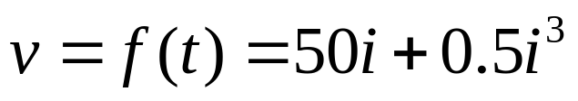
Example
Consider a physical resistor whose characteristic can be approximated by the nonlinear resistor defined by
where v is in volts and i is in amperes
Let v₁,v₂ and v₃ be the voltages corresponding to i₁=2 amp, i₂(t)=2sin2π60t and i₃=10 amp.
Calculate v₁,v₂ and v₃ . What frequencies are present in v₂?
Let v₁₂ be the voltage corresponding to the current i₁+i₂.
Is v₁₂=v₁+v₂ ?
Let v’ be the voltage corresponding to the current ki₂.
Is v'=kv₂ ?
Suppose we considering only currents of at most 10 mA. What will be the maximum percentage error in v if we were calculate v by approximating the nonlinear resistor by a 50 ohm linear resistor?

Slide 25

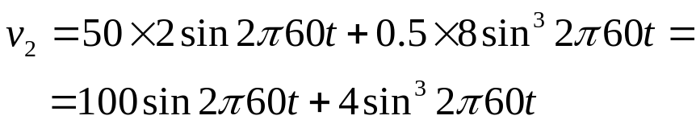
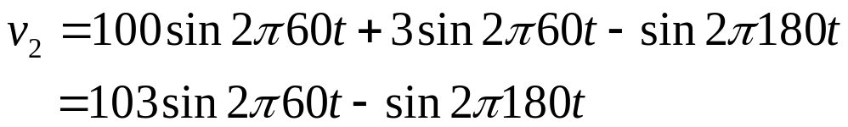
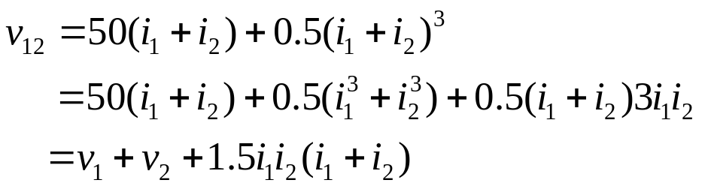

Solution
All voltages below are expressed in volts
a.
Recalling that for all θ, sin3θ =3sinθ-4sin³ θ ,we obtain
Frequencies present in v₂ are 50 Hz (the fundamental) and 150 Hz (the third harmonic of the frequency of i₂ )
Obviously, v₁₂≠v₁+v₂ , and the difference is given by

Slide 26
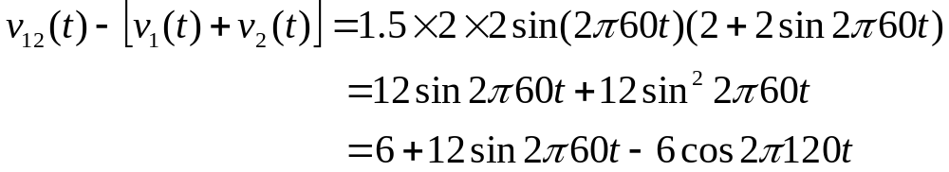
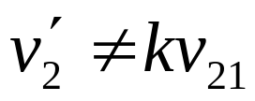
Hence
v₁₂ thus contains the third harmonic as well as the second harmonic.
Therefore
and
b.
For i=10 mA,
The percentage error due to linear approximation equals to 0.0001 percent at the maximum current of 10 mA. Therefore, for small currents the nonlinear resistor may be approximated by a linear 50- Ohm resistor

Slide 27
Independent Sources
In this section we’ll introduce two new elements, the independent voltage source and the independent current source.
Voltage source
Independent voltage sources -> by KVL v = v_{s}
i
v
v_{s}(t)
+
+
V₀
v
v_{s}
_
+
_
_
0
i
(b)
(a)
Fig. 2.13 Characteristic at time t of a voltage source. A voltage source may be considered as a current-controlled nonlinear resistor
Fig.2.12 (a) Independent voltage source connected to any arbitrary circuit
(b) Symbol for a constant voltage source of voltage V₀

Slide 28
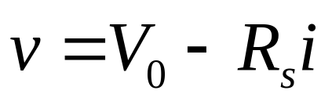
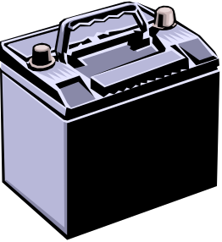

Example
An automobile battery has a voltage and a current which depend on the load to which it is connected, according to the equation
(2.10)
where v and –i are the branch voltage and the branch current, respectively, as shown in Fig.2.14a
Characteristic of the automobile battery
i
v
Auto
battery
Load
V₀
+
-
Slope -R_{s}
0
i
Fig.2.14 Automobile battery and its chrematistic
The intersection of the characteristic with the v axis is V₀. V₀ can be interpreted as the open-circuit voltage of the battery. The constant R_{s} can be considered as the internal resistance of the battery.

Slide 29
The automobile battery can be represented by an equivalent circuit that consists of the series connection of a constant voltage source V₀ and a linear time-invariant resistor with resistance R_{s}, as shown in Fig.2.15
One can justify the equivalent circuit by writing the KVL equation for the loop in Fig. 2.15 and obtaining Eq.(2.10). If resistance R_{s} is very small, the slope in Fig. 2.14 is approximately zero, and the intersection of the characteristic with the i axis will occur far off this sheet of paper.
i
Load
R_{s}
+
+
v
V₀
_
-
Fig.2.15 Equivalent circuit of the automobile battery
If R_{s}=0, the characteristic is a horizontal line in the iv plane, and the battery is a constant voltage source is defined above.

Slide 30
Current source
A two-terminal element is called an independent current source if it maintains a prescribed current i_{s}(t) into the arbitrary circuit to which it is connected; that is whatever the voltage v(t) across the terminals of the circuit may be, the current into the circuit is i_{s}(t)
A current source is a two-terminal circuit element that maintains a current through its terminals.
The value of the current is the defining characteristic of the current source.
Any voltage can be across the current source, in either polarity. It can also be zero. The current source does not “care about” voltage. It “cares” only about current.
i
v
Independent current sources -> by KCL i = i_{s}
+
i_{s}(t)
v
i_{s}
0
i
_

Slide 31
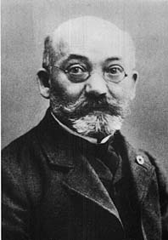
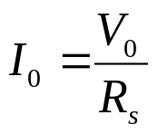
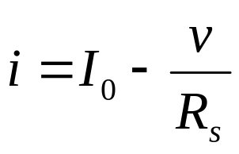
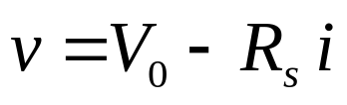
Thevenin and Norton Equivalent Circuits
M. Leon Thévenin (1857-1926), published
his famous theorem in 1883.
R_{s}
i
i
+
+
+
V₀
v
R_{s}
v
_
_
_
Fig.2.17 (a) Thevenin equivalent circuit ; (b) Norton equivalent circuit
The equivalence of these two circuits is a special case of the Thevenin and Norton Theorem

Slide 32
Thevenin & Norton Equivalent Circuits
Thevenin's Theorem states that it is possible to simplify any linear circuit, no matter how complex, to an equivalent circuit with just a single voltage source and series resistance connected to a load.
A series combination of Thevenin equivalent voltage source V₀ and Thevenin equivalent resistance R_{s}
Norton's Theorem states that it is possible to simplify any linear circuit, no matter how complex, to an equivalent circuit with just a single current source and parallel resistance connected to a load. Norton form:
  A parallel combination of Norton equivalent current source I₀ and Norton equivalent resistance R_{s}

Slide 33
Thévenin’s Theorem: A resistive circuit can be represented
by one voltage source and one resistor:
R_{Th}
V_{Th}
Resistive Circuit
Thévenin Equivalent Circuit

