Slide 1
Lecture 3
Some typical Waveforms
The Sinusoid
The unit step function
The Pulse
The unit impulse
Capacitors (Linear and Nonlinear).
Inductors (Linear and Nonlinear). Hysteresis.
Summary of Four way Classification of Two-terminal Elements

Slide 2

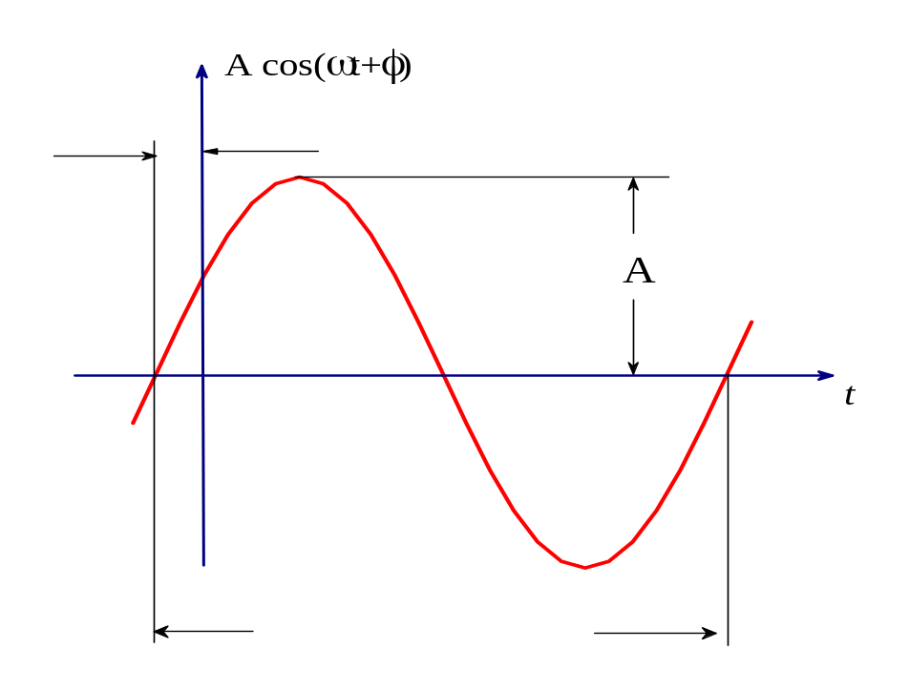
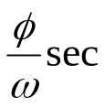

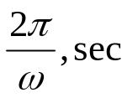
Waveforms and their Notation
Let us now define some of the more useful waveforms that we shall use repeatedly later
The constant
This is the simplest waveform; it is described by
where K is a constant
The sinusoid
To represent a sinusoidal waveform or sinusoid for short, we use the traditional notation
where the constant A is called amplitude of sinusoid, the constant ω is called the (angular) frequency (measured in radians per second), and the constant φ is called phase (See Fig.3.1)
Period=
Fig.3.1 A sinusoidal waveform of amplitude A and phase φ

Slide 3
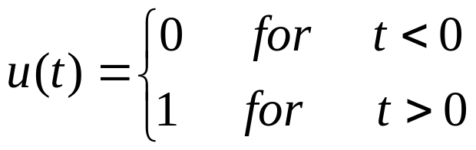

The unit step
The unit step function as shown in Fig.3.2 is denoted by u(⋅) and is defined by
(3.1)
And its value at t=0 may be taken to be 0, , or 1. Throughout this curse we shall use the letter u exclusively for the unit function.
Suppose we delayed a unit step by t₀ sec. The resulting waveform has u(t-t₀)as an ordinate at time t. Indeed, for t<t₀, the argument is negative, and hence the ordinate is zero; for t>t₀, the argument is positive and the ordinate is equal to 1 (See Fig.3.3).
u(t)
u(t-t₀)
1
1
t
t
Fig.3.2 The unit step function u(.)
Fig.3.3 The delayed unit step function

Slide 4

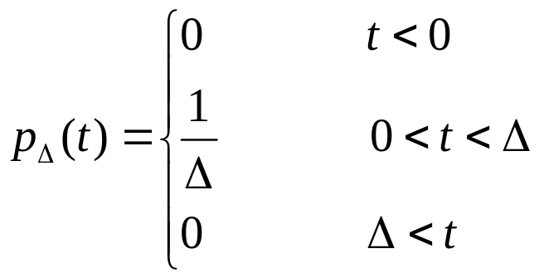
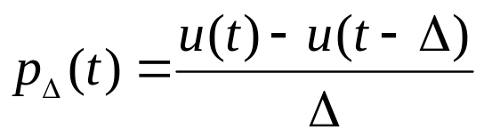

The pulse
We shall frequently have to use a rectangular pulse and for his purpose we define pulse function
(3.2)
In other words, p_{Δ} is a pulse of height 1/Δ, of width Δ, and starting at t=0. Note that whatever the value of the positive parameter Δ, the area under p_{Δ} (⋅) is 1 (see Fig.3.4). Note that
p_{Δ}(t)
for all t
(3.3)
Fig.3.4 A pulse function p_{Δ} (⋅)
t

Slide 5
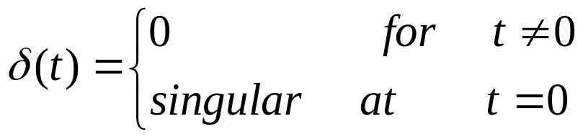
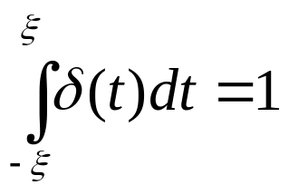
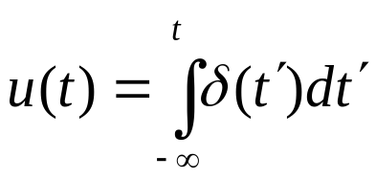
The unit impulse
The unit impulse δ(⋅) (also called the Dirac delta function) is not a function in the strict mathematical sense of the term. For our purposes we state that
(3.4)
and the singularity at the origin is such that for any ξ>0 (See Fig.3.5)
δ(t)
(3.5)
The impulse function can be considered as the limit, as Δ→∞, of the pulse p_{Δ}. Physically δ can be considered as charge density of a unit point charge located at t=0 on the t axis
0
t
Fig.3.5 A unit impulse function δ(⋅)
From the definition of δ and u we get formally
(3.6)

Slide 6
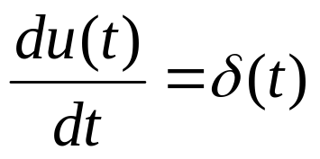
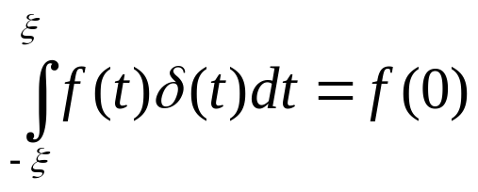
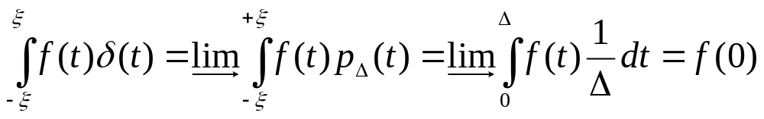

and
(3.7)
Another frequently useful property is the sifting property of the unit impulse
(3.8)
for any positive ξ
This is easily made reasonable by approximation δ by p_{Δ} as follows:
Remarks
1.
Related to the unit step function is the unit ramp r(⋅) (See Fig.3.6), defined by
(3.9)

Slide 7
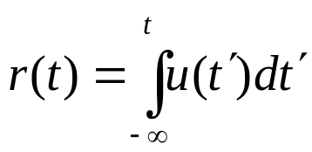
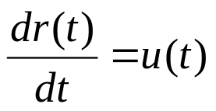
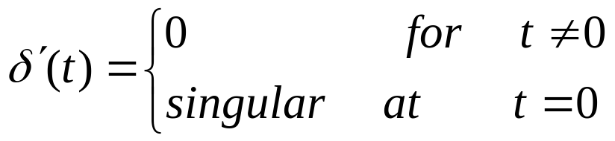
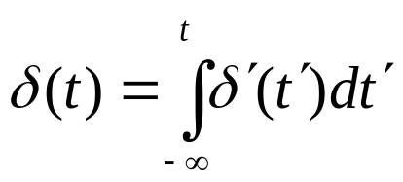
From (2.3) and (2.11) we can show that
(3.10)
and
r(t)
(3.11)
1
Fig.3.6 A unit ramp function
0
1
t
2.
Closely related to the unit impulse function is the unit doublet δ’(⋅), which is defined by
(3.12)
And the singularity at t=0 is such that
(3.13)

Slide 8
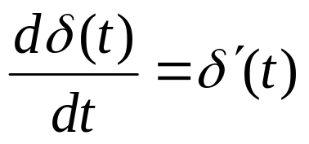
and
(3.14)
δ(t)
0
t
Fig.3.7 A doublet δ’(⋅),

Slide 9
What is a Capacitor?
Capacitors
Two conductors separated by an insulator:
A simple capacitor:
i(t)
+
v(t)
–
q(t)
Fig.3.8 Symbol for a capacitor
We shall always call q(t) the charge at time t on the plate to which the reference arrow of the current i(t) points

Slide 10
εA
C =
d
Area A
d
ε = “Permittivity” of dielectric material
d = Separation distance
A = Area of electrodes ⊥ d
Note: ε₀ for air = 8.85 × 10^{–12} farads/meter
Most plastics: ε = 2 to 4 ε₀

Slide 11
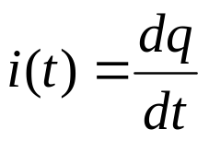
When i(t) is positive, positive charges are brought (at time t) to the top plate whose charge is labeled q(t); hence the rate of change of q is also positive. Thus we have
(3.15)
In this formula currents are given in amperes and charges in coulombs
i(t)
+q
+ + + + + + + + + + + + + + + + + +
v(t)
_ _ _ _ _ _ _ _ _ _ _ _ _ _ _ _ _ _ _
q
A capacitor whose characteristic is at all times a straight line through the origin of the vq plane is called a linear is called linear capacitor.
Conversely, if at any time the characteristic is not a straight line through the origin of the vq plane, the capacitor is called nonlinear.

Slide 12
A capacitor whose characteristic does not change with time is called a time-invariant capacitor.
If the characteristic changes with time, the capacitor is called time-varying capacitor.
As in the case of resistors we have a four way classification of Capacitors
linear
non-linear
time-invariant
time-varying

Slide 13
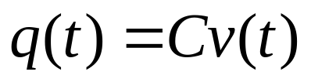
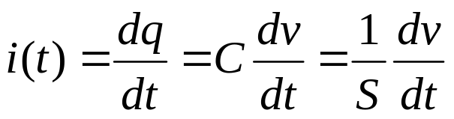
The Linear Time-Invariant Capacitor
From definition of linearity and time invariance, the characteristic of a linear time invariant capacitor can be written as
(3.16)
where C is constant (independent of t and v) which measures the slope of the characteristic and which is called capacitance.
The units are
C=Farads
q = Columbs
v = Volts
The equation relating the terminal voltage and the current is
(3.17)
Where S=C⁻¹, and is called the elastance. Integrating (3.17) between 0 and t we get

Slide 14
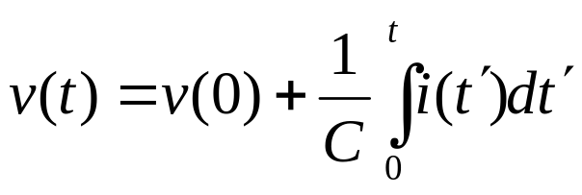
(3.18)
Thus a linear time invariant capacitor is completely specified as a circuit element only if the capacitance C ( the slope or its characteristic) and the initial voltage v(0) are given
Equation (3.17) defines a function expressing i(t) in terms of dv/dt; that is i(t)=f(dv/dt). It is fundamental to observe that this function f(⋅) is linear.
On the other hand, Eq.(3.18) defines a function expressing v(t) in terms of v(0) and the current waveform i(⋅) over the interval [0,t]. Only if v(0)=0, the function defined by (3.18) is a linear function that gives the value of v(t), the voltage at time t, in terms of the current waveform over the interval [0,t].
The integral in (3.18) represents the net area under the current curve between time 0 and t; we say “net are” to remind that sections on the curve i(⋅) above the time axes contribute positive areas, and those below contribute negative areas.

Slide 15
The value of v at time t, v(t) depends on its initial value v(0) and all the values of the current between time 0 and time t; this fact is often alluded to by saying that “capacitors have memory”.
Exercise 1
Let a current source i_{s}(t) be connected to a linear time-invariant capacitor with capacitance C and v(0)=0.
Determine the voltage form v(⋅) across the capacitor for
i_{s}(t)=u(t)
i_{s}(t)=δ(t)
i_{s}(t)=Acos(ωt+φ)
Exercise 2
Let a voltage source v_{s}(t) be connected to a linear time-invariant capacitor with capacitance C and v(0)=0.
Determine the current form i(⋅) across the capacitor for
v_{s}(t)=u(t)
v_{s}(t)=δ(t)
v_{s}(t)=Acos(ωt+φ)

Slide 16


Example
A current source is connected to the terminals of a linear time-invariant capacitor with a capacitance of 2 Farads and an initial voltage v(0)=-1/2 volt (see Fig.3.10 a)
i(t)
i, amp
+
v(t)
–
2
C=2F
i(t)
0
1
2
t
-2
(a)
(b)
v, volts
Fig.3.10 Voltage and current waveform across a linear time-invariant capacitor
0
1
2
t
(c)

Slide 17
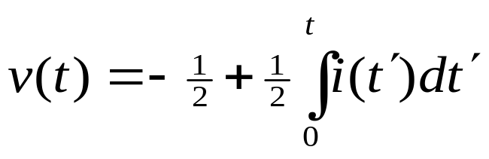
Let the current source be given by the simple waveform i(⋅) shown in Fig.3.10 b. The branch voltage across the capacitance can be computed immediately from Eq.3.18. as
and the voltage waveform v(⋅) is plotted in Fig.3.10c. The voltage is - ½ volt for t negative. At t=0 it starts to increase and reaches ½ volt at t=1 sec as a result of the contribution of the positive portion of the current waveform. The voltage then decreases linearly to -½ volt because of the constant negative current for 1<t<2, and stays constant for t ≥2 sec.
This simple example clearly points out that v(t) for t ≥ 0 depends on the initial value v(0) and on all the values of the waveform i(⋅) between time 0 and time t. Furthermore it is easy to see that v(t) is not a linear function of i(⋅) when v(0) is not zero. On the other hand if the initial value v(0) is zero, the branch voltage at time t, v(t) is a linear function of the current waveform i(⋅)

Slide 18
Remarks
Equation 3.18 states that time t the branch voltage v(t), where t≥0, across a linear time-invariant capacitor is a sum of two terms.
The first term is the voltage v(0) at t=0, that is the initial voltage cross the capacitor. The second term is the voltage at time t across a capacitor C farads if at t=0 this capacitor is initially uncharged.
Thus, any linear time-invariant capacitor with an initial voltage v(0) can be considered as the series connection of a dc voltage source E=v(0) and the same capacitor with zero initial voltage, as shown in Fig. 3.11
i(t)
i(t)
+
v(t)
__
Uncharged at t=0
+
v(t)
__
+
v(0)=V₀
__
C
C
E=V₀
Fig. 3.11 The initial charged capacitor with v(0)=V₀ in (a) is equivalent to the series connection of the same capacitor, which is initial uncharged and a constant voltage source E=V₀ in (b)

Slide 19
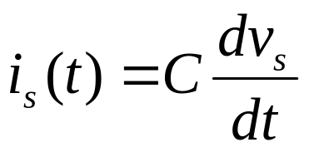
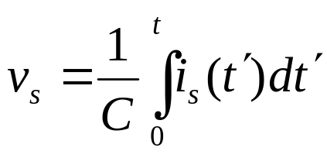
Consider a linear time-invariant capacitor with zero initial voltage; that is, v(0)=0. It is connected in series with an arbitrary independent voltage source v_{s}(t) as shown in Fig. 3.12a. The series connection is equivalent to the circuit (as shown in Fig. 3.12b) in whish the same capacitor is connected in parallel with a current source i_{s}(t), and
(3.19)
The voltage source v_{s}(t) in Fig. 3.12a is given in terms of the current source i_{s}(t), in Fig. 3.12b.
(3.20)
i(t)
i(t)
+
v(t)
__
C
v_{s}(t)
i_{s}(t)
C
Fig. 3.12 Thevenin and Norton equivalent circuits fro a capacitor with an independent source

Slide 20
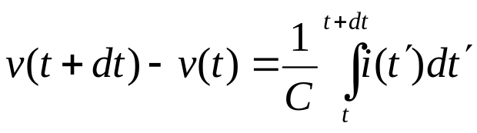
The results in Fig.3.12a and b are referred to as Thevenin and the Norton equivalent circuits respectively. The proof is similar to that of the resistor case. In particular, if the voltage source v_{s} in Fig. 3.12 a is a unit step function, by Eq.(3.19) the current source i_{s} in Fig. 3.12b is an impulse function Cδ(t).
Consider Eq.(3.19) again at instant t and at instant t+dt; by subtraction we get
(3.21)
Let us assume that i(t) is bounded for all t; that is a finite constant M such that Ii(t)I≤M for all t under consideration. The area under the waveform i(⋅) over the interval [t,t+dt] will go to zero as dt→0. Also from (3.21), as dt → 0, v(t+dt) →v(t), or stated in another way, the voltage waveform v (⋅) is continuous.
We can thus state an important property of the linear time-invariant capacitor:

Slide 21
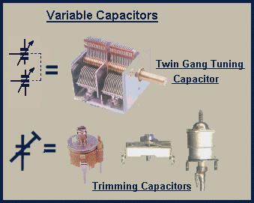
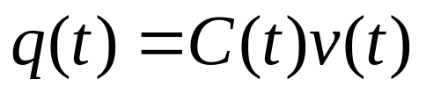
If the current i (⋅) in a linear time-invariant capacitor remains bounded for all time in the closed interval [0,T], the voltage v across the capacitor is a continuous function in the open interval (0,T); that is the branch voltage for such a capacitor cannot jump instantaneously from one value to a different value as long as the current remains bounded.
The Linear Time-varying Capacitor
If the capacitor is linear but time varying its characteristic is at all times a straight line through the origin, but its slope depends on time. Therefore, the charge at time t can be expressed in term of the voltage at time t by an equation of the form
(3.22)
where C(⋅) is prescribed function of time that specifies for each t the slope of the capacitor characteristic.

Slide 22
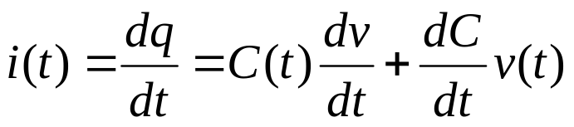
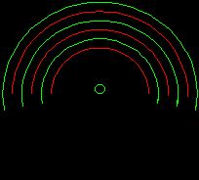
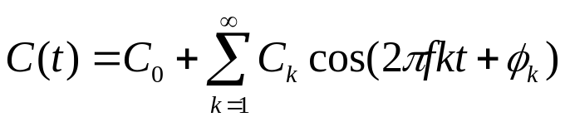


This function C(⋅) is part of the specification of the linear time-varying capacitor. Equation (3.15) then becomes
(3.23)
The capacitance of periodically varying capacitor may be expressed in a Fourier series as
(3.24)
where f represents the frequency of rotation of the moving plate.
Exercise
i(t)
Consider the circuit shown in Fig. 3.13. Let the voltage be a sinusoid,
+
v(t)
-
C(t)
where the constant
is the angular
frequency.
Fig.3.13 A linear time-varying capacitor is driven by a sinusoidal voltage source

Slide 23

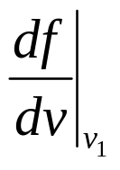
Let the linear time varying capacitor be specified by
where C₀ and C₁ are constants. Determine the current i(t) for all t.
The Nonlinear Capacitor
Let us consider the nonlinear capacitor specified by its characteristic q=f(v) (See Fig.3.14)
Slope=
q
The first term v₁ is a constant voltage applied to the capacitor by a biasing battery (dc bias), and the second term v₂ is a small varying voltage. For example, v₂ might be voltage in an input stage of a receiver.
q=f(v)=f(v₁+v₂)
q₁=f(v₁)
v₁
0
v₁+v₂
v
Fig.3.14
Characteristic q=f(⋅)

Slide 24
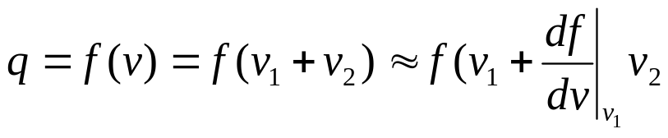

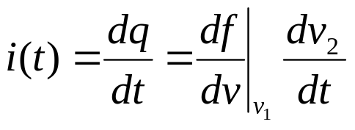
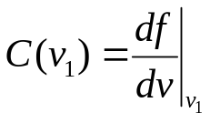
Using a Taylor series expansion, we have
(3.25)
In Eq.(3.25) we neglecting second order terms; this introduces negligible errors provided v₂ is sufficient small. More precisely, v₂ must be sufficient small so that the part of characteristic corresponding to the abscissa v₁+v₂ is well approximated by a straight line segment passing through the point (v₁,f(v₁)) and having slope .
The current i(t) form Eq. (3.15) is
(3.26)
+
i(t)
+
v₂(t)
-
v
q=f(v)
Note that v₁ is a constant. Thus, as far as the small-signal v₂ is concerned , the capacitance is a linear time-invariant capacitance and is equal to the slope of the capacitor characteristic in the vq plane at the operating point
v₁
-
Fig. 3.15 A nonlinear capacitor is driven by a voltage v which is the sum of a dc voltage v₁ and a small varying voltage v₂.

Slide 25

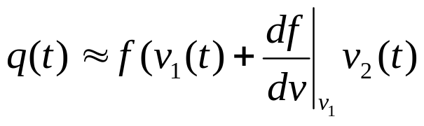
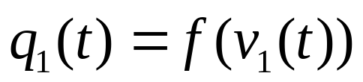

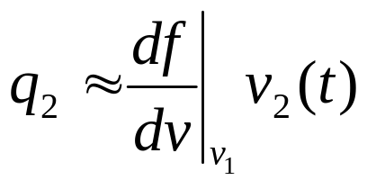
If the nonlinear capacitance is used in a parametric amplifier, the voltage v₁ is not a constant ; however v₂, which represents the time varying signal is still assumed to be small so that the approximations used in writing (3.25) are still valid.
The voltage across the capacitor is v₁(t)+v₂(t). Consequently, the charge is
Since v₂(t) is small for all t, we have
Let
Δ
(3.27)
The charge q1(t) can be considered to be the charge due to v1(t). The remaining charge is given approximately by
Δ
(3.28)

Slide 26
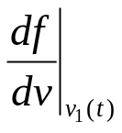
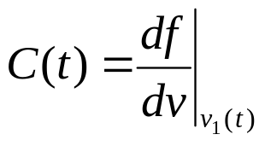
This charge q₂ is proportional to v₂ and can be considered as the small-signal charge variation due to v₂. Since v₁ is now a given function of time can be identified as a linear time-varying capacitor C(t), where
A nonlinear capacitance can be modeled a a linear time-varying capacitor in the small-signal analysis.
This type of analysis is basic to understanding the parametric amplifiers.

Slide 27
Inductors
Inductor are used in electrical circuits because they store energy in their magnetic fields.
Flux
What is an Inductor?
i
Current
A coil of wire that can carry current
Current produces a magnetic field
Energy is stored in the inductor

Slide 28
μN²A
Inductance Formula:
L =
h
Inductor formula:
Area A
φ = Li
N turns
h
φ = Flux linkage in volt-sec
i = Amperes
L = Henries (physical property of inductor)
φ = Flux × no. of turns
Material of permeability μ
μ₀ = 4π × 10^{–7} henries/meter
μ can vary between μ₀ and 10,000μ₀

Slide 29
φ
Inductor formula:
φ = Li
i
d λ
Definition of voltage:
v =
+
v
–
dt
d i
∴
v = L
dt

Slide 30
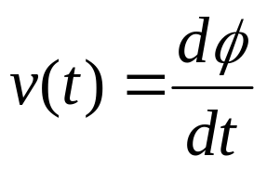
The two-terminal element will be called an inductor if at any time t its flux φ(t) and its current i(t) satisfy a relation defined by a curve in the i φ plane. This curve is called the characteristic of the inductor at time t.
There is a relation between instantaneous value of the flux φ(t) and the instantaneous value of the current i(t).
A
i(t)
+
v(t)
–
The voltage across the inductor (measured with reference direction (see Fig 3.16) is given by Faraday’s induction law as
B
Fig.3.16 Symbol for an inductor
(3.29)
where v is in volts and φ is in webers

Slide 31

Let us verify that (3.29) agrees with Lenz’s law which states that the electromotive force induced by a rate change of flux will have a polarity such that it will oppose the cause of that rate of change of flux.
Consider the following case: The current i increases; that is,
The increasing current creates an increasing magnetic field; hence the flux φ increases; that is dφ/dt>0. According to (3.29), v(t)>0, which means that the potential of node A is larger than the potential of node B; this is precisely the polarity required to oppose any further increase in current.
As in the case of resistors and capacitance we have a four way classification of Inductors
linear
non-linear
time-invariant
time-varying

Slide 32
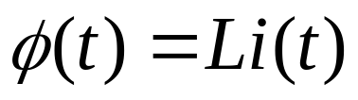
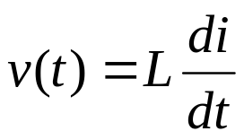
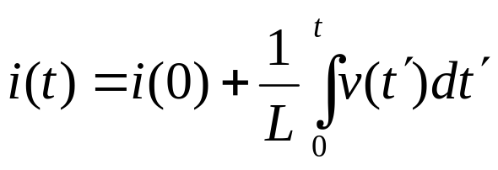
The Linear Time-Invariant Inductor
By definition the characteristic of the linear time invariant inductor has an equation of the form
(3.30)
where L is constant (independent of t and i) and is called the inductance.
The characteristic is a fixed straight line through the origin whose slope is L.
The equation relating the terminal voltage and current is easily obtained from (3.29) and (3.30). Thus
(3.31)
Integrating Eq.(3.31) between 0 and t, we get
(3.32)

Slide 33

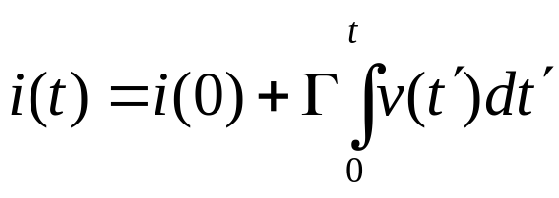
Δ
Let
, and let Γ be called the reciprocal inductance . Then
(3.33)
In Eqs. (3.32) and (3.33) the integral is the net area under the voltage curve between time 0 and time t. Clearly, the value i at time t, i(t), depends on its initial value i(0) and on all the values of the voltage waveform v(⋅) in the interval [0,t]. This fact, as in the case of capacitors, is often alluded to be saying the “inductors have memory”
It is important that linear time invariant inductor is completely specified as a circuit element only if the inductance L and the initial current i(0) are given (see. Eq. 3.32)
It should be stressed that Eq. (3.31) defines a linear function expressing the instantaneous voltage v(t) in terms of the derivative of the current evaluated at time t. Equation (3.32) defines a function expressing i(t) in terms of i(0) and the waveform v(⋅) over the interval [0,t]. Only if i(0)=0, the function defined by (3.32) is a linear function which gives the value of the current i at time t, i(t), in terms of the voltage waveform v(⋅) over the interval [0,t].

Slide 34
Exercise 1
Let a current source i_{s}(t) be connected to a linear time-invariant inductor with inductance L and i(0)=0.
Determine the voltage form v(⋅) across the inductor for
i_{s}(t)=u(t)
i_{s}(t)=δ(t)
Exercise 2
Let a voltage source v_{s}(t) be connected to a linear time-invariant inductor with inductance L and i(0)=0.
Determine the current form i(⋅) in the inductor for
v_{s}(t)=u(t)
v_{s}(t)=δ(t)
v_{s}(t)=Acosωt, where A and ω are constants

Slide 35
Remarks
Equation (3.32) states that time t the branch current i(t), (where t≥0), in a linear time-invariant inductor is a sum of two terms.
The first term is the current i(0) at t=0, that is the initial current in the inductor. The second term is the current at time t in an inductor L if at t=0 this inductor has zero initial current.
Thus, given any linear time-invariant inductor with an initial current i(0), can be considered as the parallel connection of a dc current source I₀=i(0) and the same inductor with zero initial current, as shown in Fig. 3.17
i(t)
i(t)
Zero initial current
+
v(t)
__
v (t)
I₀
L
L
i(0)=I₀
(b)
(a)
Fig. 3.17 The inductor with an initial current i(0)=I₀ in (a) is equivalent to the parallel connection of the same inductor with zero initial current and a constant current source I₀ in (b)

Slide 36
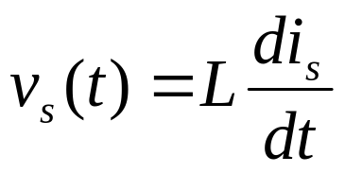
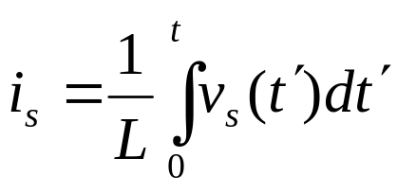
Consider a linear time-invariant inductor with zero initial voltage; that is, i(0)=0. It is connected in parallel with an arbitrary voltage current source i_{s}(t) as shown in Fig. 3.18a. The parallel connection is equivalent to the circuit shown in Fig. 3.18b in where the same inductor is connected in series with a voltage source v_{s}(t), and
(3.34)
The current source i_{s}(t) in Fig. 3.18a is given in terms of the voltage source v_{s}(t), in Fig. 3.18b.
i(t)
(3.35)
i(t)
+
v(t)
__
+
v(t)
__
L
i_{s}(t)
L
v_{s}(t)
Fig. 3.18 Thevenin and Norton equivalent circuits fro a capacitor with an independent source

Slide 37
The results in Fig.3.18a and b are referred to as Norton and the Thevenin equivalent circuits respectively. In particular, if the v_{s} in Fig. 3.18a is a unit step function, the voltage source v_{s} in Fig. 3.18b is an impulse function Lδ(t).
Following reasoning similar to that used in the case of capacitors, we may conclude with the following important property of inductors:
If the voltage v across a linear time-invariant inductor remains bounded for all times in the closed interval [0,t], the current i is a continuous function in the open interval (0,t); that is, the current in such an inductor cannot jump instantaneously from one value to a different value as long as the voltage across it remains bounded.

Slide 38
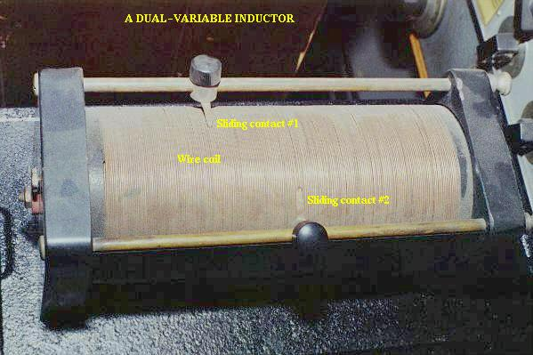
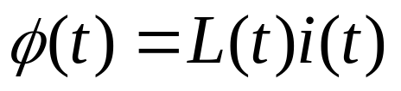
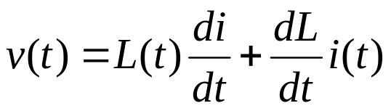
The Linear Time-varying Inductor
If the inductor is linear but time-varying its characteristic is at all times a straight line through the origin, but its slope depends on time. Therefore, the flux is expressed in terms of the current by
(3.36)
where L(⋅) is prescribed function of time. Indeed, this function L(⋅) is a part of the specification of the time-varying inductance. Equation (3.29) becomes
(3.37)

Slide 39


The Nonlinear Inductor
Most physical inductors have nonlinear characteristics. Only for certain specific ranges of currents can inductors be modeled by linear time invariant inductors. A typical characteristic of physical inductor is shown in Fig.3.19.
Example
φ
Suppose the characteristic of a nonlinear time-invarint inductor can be represented by
i
Let us calculate the voltage across the inductor, where the current is sinusoidal and is given by
Fig.3.19 Characteristic of a nonlinear inductor

Slide 40

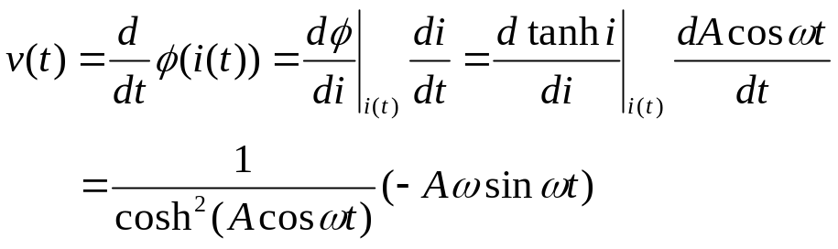

The flux is thus
By (3.29) we have
We conclude that
Thus the amplitude A and the angular frequency ω of the current,the voltage across the inductor is completely specified as a function of time.
Hysteresis
A special type of nonlinear inductor, such as a ferromagnetic-core inductor, has a characteristic that exhibits the hyteresis phenomenon. In terms of the current-flux plot, a hysteresis charcteristic is shown in Fig.3.20.

Slide 41

Assume that we start at the origin in the iφ plane; as current ia increased, the flux builds up to curve 1. etc.,
φ
φ₁
i₁,φ₁
2
1
-i₃
-i₂
3
0
i₄
i
i₁
2
3
(-i₃ ,-φ₃)
-φ₃
Fig.3.20 Hysteresis phenomenon

Slide 42






























Table 3.1. Summary of Four-way Classification of Two-terminal Elements
 | Time-invariant | Time varying | Time-invariant | Time varying
Resistors
Capacitors
Inductors
Linear
Nonlinear
i
v
Current-controlled
Current-controlled
+
-
Voltage-controlled
Voltage-controlled
v
i
-
+
v
+
-
i

