Slide 1
Lecture 4
Power and Energy.
Powered entering a resistor, passivity.
Energy stored in time-invariant capacitors.
Energy stored in time-invariant inductors.
Physical components versus circuit elements.

Slide 2

ℰP
Energy in two terminal circuit
ℰℋ
Suppose that we have a circuit, and from this circuit we draw two wires which we connect to another circuit which we call a generator (See Fig. 4.1). We shall call such a cicuit a two-terminal circuit since we are only interted 9in the voltage and teh current at the two terminals and the power transfere that occurs at these terminals.
i(t)
Generator
One-port
In modern terminology a two-terminal circuit is called a one-port.
+
v(t)
-
P
i(t)
The term one-port is appropriate since by port we mean a pair of terminals of a circuit in which, at all times,
Fig. 4.1 Instantaneous power entering the
one-port P at time t is
the instantaneous current flowing into one terminal is equal to the instantaneous current flowing out of the other.
The current i(t) entering the top terminal of the one-port P is equal to the current i(t) leaving the bottom terminal of teh one-port P.

Slide 3
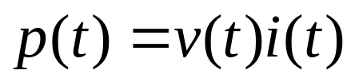
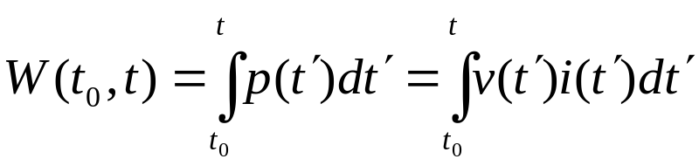
The current i(t) entering the port is called the port current, and the voltage v(t) across the port is called the port voltage.
It is a fundamental fact of physics that the instantaneous power entering the one-port is equal to the product of the port voltage and the port current provided the reference directions of the port voltage and the port current are associated reference directions as indicated in Fig. 4.1.
Let p(t) denote the instantaneous power in watts delivered by the generator to the one-port at time t. Then
(4.1)
Where v is in volts and i is in amperes. Since the energy (in joules) is the integral of power (in watts), it is follows that the energy delivered by the generator to the one-port from t₀ to time t is
(4.2)

Slide 4
Power Entering a resistor, Passivity
Since a resistor is characterized by a curve in the vi plane or iv plane, the instantaneous power entering a resistor at time t is uniquely determined once the operating point (i(t), v(t)) on the characteristic is specified, the instantaneous power is equal to the are of the rectangle formed by the operating point and the axes of the iv plane as shown in Fig. 4.2.
If the operating point is in the first or third quadrant (hence iv>0), the power entering the resistor is positive, that is the resistor receives power from the outside world.
v
Second quadrant
First quadrant
(i(t),v(t))
v(t)
0
If the operating point is in the second or fourth quadrant (hence iv<0), the power entering the resistor is negative; that is the resistor delivers power to the outside world
i(t)
i
Third quadrant
Fourth quadrant
Fig. 4.2. The power entering the resistor at time t is v(t)i(t)

Slide 5
A resistor is passive if for all time t the characteristic lies in the first and third quadrants. Here the first and third quadrants include the i axis and the v axis. The geometrical constraint on the characteristic of a passive resistor is equivalent to p(t)≥0 at all times irrespective of the current waveform through the resistor. This is the fundamental property of passive resistors: a passive resistor never delivers power to the outside world.
A resistor is said to be active if it is not passive. Any voltage source for example ( for which v_{s} is not identically zero) and any current source ( for which i_{s} is not identically zero) is an active resistor since its characteristic at all time is parallel to either the i axis or the v axis, and thus it is not restricted to the first and third quadrant.
A linear resistor is active if and only if R(t) is negative for some time t.

Slide 6
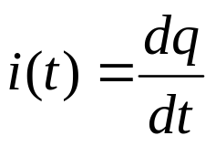


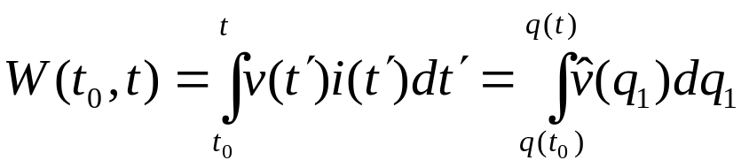

Energy stored in Time-invariant Capacitor
Let us apply Eq.(4.2) to calculate the energy stored in a capacitor. For simplicity we assume that it is time-invariant, but it can be nonlinear.
Suppose that one-port of Fig. 4.1, which is connected to the generator is a capacitor. The current through the capacitor is
(4.3)
Let the capacitor characteristic be described by the function
(4.4)
The energy delivered by the generator to the capacitor from time t₀ to t is then
(4.5)
To obtain (4.5) we first used (4.3) and wrote
according
to (4.3), where q₁ is a dummy integration variable representing the charge.

Slide 7
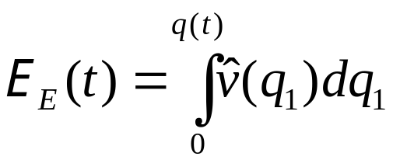

We used (4.4) to express the voltage v(t’) by the characteristic of the capacitor, i.e. function
in terms of the integration variable
q₁
Let us assume that the capacitor is initially uncharged; that is q(t₀)=0
It is natural to use the uncharged state of the capacitor as the state corresponding to zero energy stored in the capacitor. Since the capacitor stores energy but not dissipate it, we conclude that the energy stored at time t, ℰ _{E}(t), is equal to the energy delivered to the capacitor by the generator from time t₀ to t, W(t₀,t). Thus, the energy stored in the capacitor is, from (4.5)
v
q
(4.6)
(v(t),q(t))
In terms of the capacitor characteristic on the vq plane the shaded area represents the energy stored above the curve.
i(t)
v
0
Characteristic
Fig. 4.3. The shaded area gives the energy stored at time t in the capacitor

Slide 8
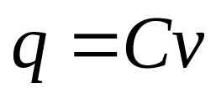
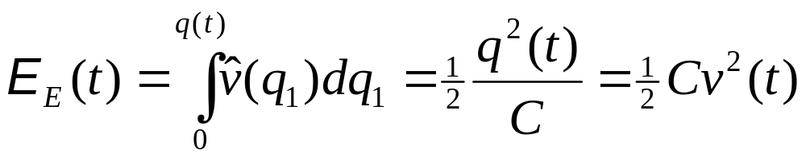
Obviously, if the characteristic passes through the origin of the vq plane and lies in the first and third quadrant, the stored energy is always nonnegative. A capacitor is said to be passive if its stored energy is always nonnegative. For a linear time-invariant capacitor, the equation on the characteristic is
(4.7)
Where C is a constant independent of t and v. Equation (4.6) reduces to the familiar expression
(4.8)
Accordingly, a linear time-invariant capacitor is passive if its capacitance is nonnegative and active if its capacitance is negative.
An active capacitor stores negative energy; that is, it can deliver energy to the outside.???

Slide 9
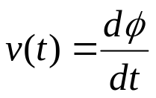


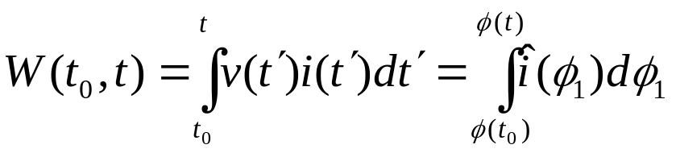

Energy Stored in Time-invariant inductors.
The calculation of the energy stored in an inductor is very similar to the same calculation for the capacitor.
For an inductor Faraday’s law states that
(4.9)
Let the inductor characteristic be described by the function
(4.10)
Let the inductor be the one-port that is connected the generator in Fig. 4.1. Then the energy delivered by the generator to the inductor from time t₀ to t is
(4.11)
To obtain (4.11) we used (4.9) and wrote
, where the
dummy integration variable φ₁ represents flux. Equation (4.10) was used
to express current in terms of flux.

Slide 10
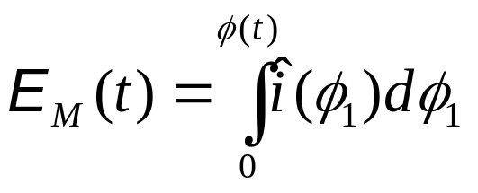
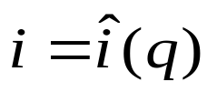
Let us assume that initially the flux is zero; that is φ(t₀)=0
Again choosing this state of the inductor to be the state corresponding to zero energy stored, and observing that an inductor stores energy but not dissipate it, we conclude that the magnetic energy stored at time t, ℰ _{M}(t), is equal to the energy delivered to the inductor by the generator from time t₀ to t, W(t₀,t). Thus, the energy stored in the inductor is
(4.12)
φ
(i(t), φ(t))
In terms of the inductor characteristic on the iφ plane, the shaded area represents the energy stored above the curve.
φ(t)
i(t)
i
0
Characteristic
Fig. 4.4. The shaded area gives the energy stored at time t in the inductor

Slide 11
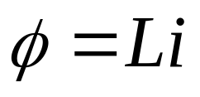
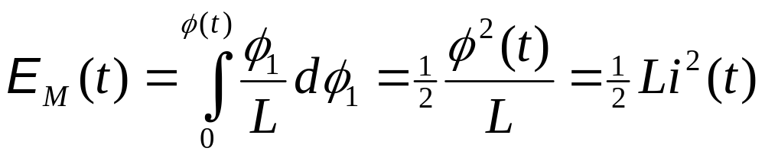
Similarly, if the characteristic in the iφ plane passes through the origin and lies in the first and third quadrant, the stored energy is always nonnegative. An inductor is said to be passive if its stored energy is always nonnegative. A linear time-invariant inductor has a characteristic of the form
(4.13)
where L is a constant independent of t and i. Hence Eq. (4.12) leads to the familiar form
(4.14)
Accordingly, a linear time-invariant inductor is passive if its inductance is nonnegative and active if its inductance is negative.

Slide 12
Energy Storage Elements
Capacitors store energy in an electric field
Inductors store energy in a magnetic field
Capacitors and inductors are passive elements:
  Can store energy supplied by circuit
  Can return stored energy to circuit
  Cannot supply more energy to circuit than is stored
Voltages and currents in a circuit without energy storage elements are linear combinations of source voltages and currents
Voltages and currents in a circuit with energy storage elements are solutions to linear, constant coefficient differential equations

Slide 13
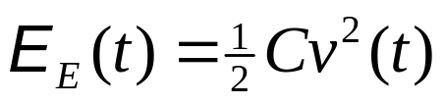
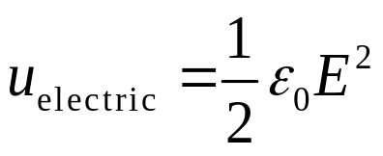

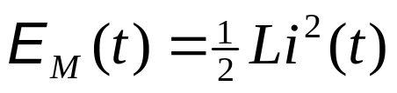
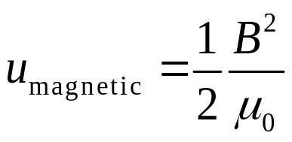
How does it work?
How we can store the energy?
+
+
+
+
+
+
+
+
Energy stored in a capacitor ...
dielectric
E
-
-
-
-
-
-
-
-
… energy density…
Energy stored in an inductor ….
B
… energy density ...

Slide 14
General Review
Electrostatics
    motion of “q” in external E-field
    E-field generated by Σq_{i}
Magnetostatics
    motion of “q” and “I” in external B-field
    B-field generated by “I”
Electrodynamics
    time dependent B-field generates E-field
      AC circuits, inductors, transformers, etc.
    time dependent E-field generates B-field
      electromagnetic radiation - light!

Slide 15
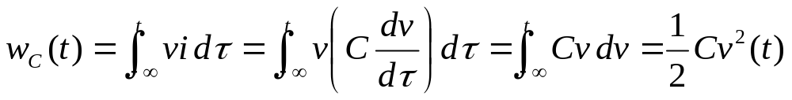
Energy Storage in Capacitors
The energy accumulated in a capacitor is stored in the electric field located between its plates
An electric field is defined as the position-dependent force acting on a unit positive charge
Mathematically,
where v(-∞) = 0
Since w_{c}(t) ≥ 0, the capacitor is a passive element
The ideal capacitor does not dissipate any energy
The net energy supplied to a capacitor is stored in the electric field and can be fully recovered

Slide 16
Inductor
An inductor is a two-terminal device that consists of a coiled conducting wire wound around a core
A current flowing through the device produces a magnetic flux φ forms closed loops threading its coils
Total flux linked by N turns of coils, flux linkage λ = Nφ
For a linear inductor, λ = Li
L is the inductance
Unit: Henry (H) or (V•s/A)
i
+
v
N
_
Nφ

Slide 17
Induction Effects
Faraday’s Law (Lenz’ Law)
  Energy Conservation with induced currents?
Faraday’s Law in terms of Electric Fields
Cool Applications

Slide 18
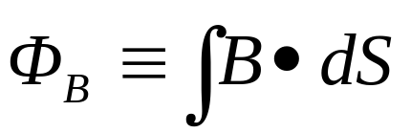
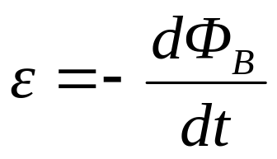

Faraday's Law
Define the flux of the magnetic field through an open surface as:
dS
B
B
Faraday's Law:
  The emf ε induced in a circuit is determined by the time rate of change of the magnetic flux through that circuit.
So what is
this emf??
  The minus sign indicates direction of induced current (given by Lenz's Law).

Slide 19
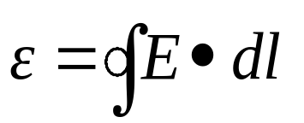
Electro-Motive Force or emf
time
A magnetic field, increasing in time, passes through the blue loop
An electric field is generated “ringing” the increasing magnetic field
Circulating E-field will drive currents, just like a voltage difference
Loop integral of E-field is the “emf”
Note: The loop does not have to be a wire—the emf exists even in vacuum! When we put a wire there, the electrons respond to the emf → current.

Slide 20
Lenz's Law
Lenz's Law:
  The induced current will appear in such a direction that it opposes the change in flux that produced it.
B
B
S
N
N
S
v
v
Conservation of energy considerations:
  Claim: Direction of induced current must be so as to oppose the change; otherwise conservation of energy would be violated.
    Why???
      If current reinforced the change, then the change would get bigger and that would in turn induce a larger current which would increase the change, etc..

Slide 21
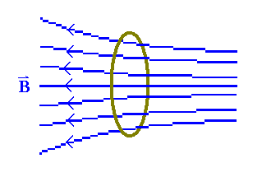
Preflight 16:
A copper loop is placed in a non-uniform magnetic field. The magnetic field does not change in time. You are looking from the right.
2) Initially the loop is stationary. What is the induced current in the loop?
a) zero b) clockwise c) counter-clockwise
3) Now the loop is moving to the right, the field is still constant. What is the induced current in the loop?
a) zero b) clockwise c) counter-clockwise

Slide 22
When the loop is stationary: the flux through the ring does not change!!!
⇒ dΦ/dt = 0 ⇒ there is no emf induced and no current.
When the loop is moving to the right: the magnetic field at the position of the loop is
increasing in magnitude. ⇒ |dΦ/dt| > 0
⇒ there is an emf induced and a current flows through the ring.
Use Lenz’ Law to determine the direction: The induced emf (current) opposes the change!
The induced current creates a B field at the ring which opposes the increasing external B field.

Slide 23
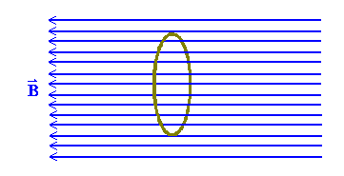
Preflight 16:
5) The ring is moving to the right. The magnetic field is uniform and constant in time. You are looking from right to left. What is the induced current?
a) zero b) clockwise c) counter-clockwise
6) The ring is stationary. The magnetic field is decreasing in time. What is the induced current?
a) zero b) clockwise c) counter-clockwise

Slide 24
When B is decreasing:
dB/dt is nonzero ⇒ dΦ/dt must also be nonzero, so there is an emf induced.
Lenz tells us: the induced emf (current) opposes the change.
B is decreasing at the position of the loop, so the induced current will try to keep the external B field from decreasing
⇒ the B field created by the induced current points in the same direction as the external B field (to the left)
⇒ the current is clockwise!!!

Slide 25
A conducting rectangular loop moves with constant velocity v in the +x direction through a region of constant magnetic field B in the -z direction as shown.
  What is the direction of the induced current in the loop?
y
X X X X X X X X X X X X
X X X X X X X X X X X X
v
X X X X X X X X X X X X
X X X X X X X X X X X X
x
(a) ccw
(b) cw
(c) no induced current
y
I
  A conducting rectangular loop moves with constant velocity v in the -y direction and a constant current I flows in the +x direction as shown.
    What is the direction of the induced current in the loop?
v
x
(a) ccw
(b) cw
(c) no induced current

Slide 26
y
A conducting rectangular loop moves with constant velocity v in the +x direction through a region of constant magnetic field B in the -z direction as shown.
  What is the direction of the induced current in the loop?
X X X X X X X X X X X X
X X X X X X X X X X X X
v
X X X X X X X X X X X X
X X X X X X X X X X X X
1A
2A
x
(a) ccw
(b) cw
(c) no induced current
There is a non-zero flux Φ_{B} passing through the loop since B is perpendicular to the area of the loop.
Since the velocity of the loop and the magnetic field are CONSTANT, however, this flux DOES NOT CHANGE IN TIME.
Therefore, there is NO emf induced in the loop; NO current will flow!!

Slide 27
  A conducting rectangular loop moves with constant velocity v in the -y direction and a constant current I flows in the +x direction as shown.
    What is the direction of the induced current in the loop?
I
y
2B
v
x
(a) ccw
(b) cw
(c) no induced current
The flux through this loop DOES change in time since the loop is moving from a region of higher magnetic field to a region of lower field.
Therefore, by Lenz’ Law, an emf will be induced which will oppose the change in flux.
Current is induced in the clockwise direction to restore the flux.

Slide 28
Demo E-M Cannon
v
Connect solenoid to a source of alternating voltage.
The flux through the area ⊥ to axis of solenoid therefore changes in time.
~
side view
F
•
B
•
B
•
F
B
top view

Slide 29
v
Connect solenoid to a source of alternating voltage.
The flux through the area ⊥ to axis of solenoid therefore changes in time.
~
side view
A conducting ring placed on top of the solenoid will have a current induced in it opposing this change.
F
•
B
•
B
There will then be a force on the ring since it contains a current which is circulating in the presence of a magnetic field.
•
F
B
top view

Slide 30
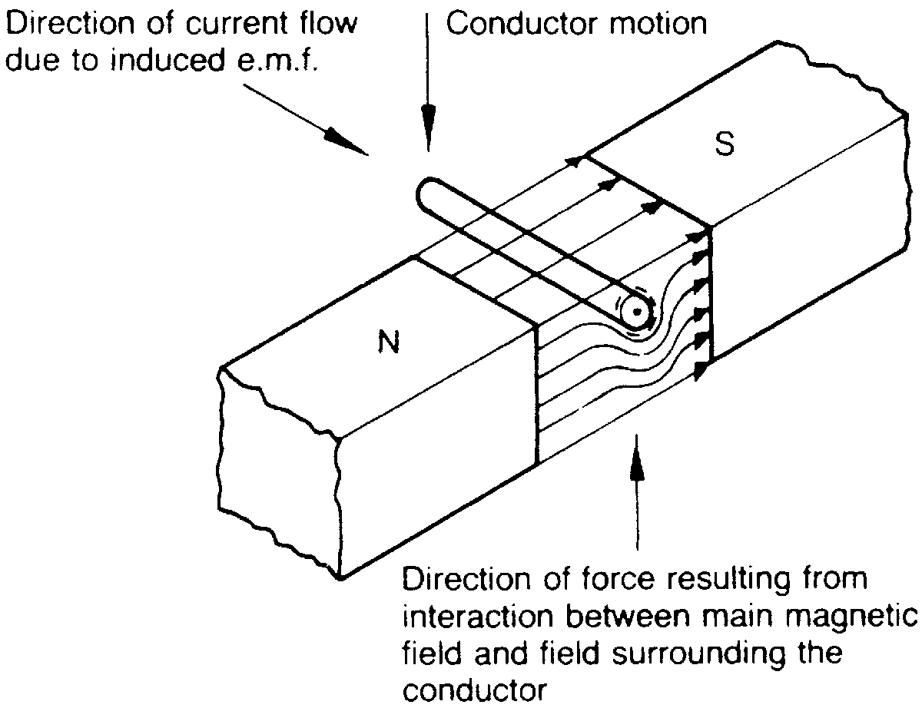
Figure 5.24 Illustrating Lenz’s law—conductor moving

Slide 31
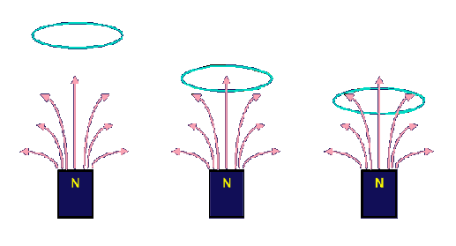
Preflight 16:
A copper ring is released from rest directly above the north pole of a permanent magnet.
8) Will the acceleration of the ring be any different, than it would be under gravity alone?
a) a > g b) a = g c) a < g
d) a = g but there is a sideways component a

Slide 32
When the ring falls towards the magnet, the B field at the position of the ring is increasing.
The induced current opposes the increasing B field,
so that the B field due to the induced current is in the opposite direction (down) to the
external B field (up).
A current loop is itself a magnetic dipole. Here the current loop’s north pole points towards
the magnet’s north pole resulting in a repulsive force (up).
Since gravity acts downward, the net force on the ring is reduced, hence a < g

Slide 33

For this act, we will predict the results of variants of the electromagnetic cannon demo which you just observed.
  Suppose two aluminum rings are used in the demo; Ring 2 is identical to Ring 1 except that it has a small slit as shown. Let F₁ be the force on Ring 1; F₂ be the force on Ring 2.
3A
(a) F₂ < F₁
(b) F₂ = F₁
(c) F₂ > F₁
3B
Suppose two identically shaped rings are used in the demo. Ring 1 is made of copper (resistivity = 1.7X10⁻⁸ Ω-m); Ring 2 is made of aluminum (resistivity = 2.8X10⁻⁸ Ω-m). Let F₁ be the force on Ring 1; F₂ be the force on Ring 2.
(a) F₂ < F₁
(b) F₂ = F₁
(c) F₂ > F₁

Slide 34
For this act, we will predict the results of variants of the electromagnetic cannon demo which you just observed.
  Suppose two aluminum rings are used in the demo; Ring 2 is identical to Ring 1 except that it has a small slit as shown. Let F₁ be the force on Ring 1; F₂ be the force on Ring 2.
3A
(a) F₂ < F₁
(b) F₂ = F₁
(c) F₂ > F₁
The key here is to realize exactly how the force on the ring is produced.
A force is exerted on the ring because a current is flowing in the ring and the ring is located in a magnetic field with a component perpendicular to the current.
An emf is induced in Ring 2 equal to that of Ring 1, but NO CURRENT is induced in Ring 2 because of the slit!
Therefore, there is NO force on Ring 2!

Slide 35
For this act, we will predict the results of variants of the electromagnetic cannon demo which you just observed.
  Suppose two identically shaped rings are used in the demo. Ring 1 is made of copper (resistivity = 1.7X10⁻⁸ Ω-m); Ring 2 is made of aluminum (resistivity = 2.8X10⁻⁸ Ω-m). Let F₁ be the force on Ring 1; F₂ be the force on Ring 2.
3B
(a) F₂ < F₁
(b) F₂ = F₁
(c) F₂ > F₁
The emf’s induced in each case are equal.
The currents induced in the ring are NOT equal because of the different resistivities of the materials.
The copper ring will have a larger current induced (smaller resistance) and therefore will experience a larger force (F proportional to current).

Slide 36
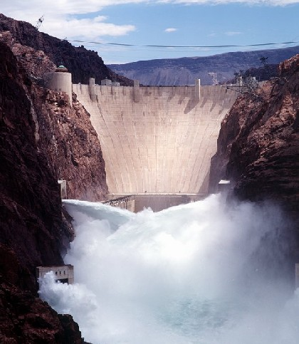
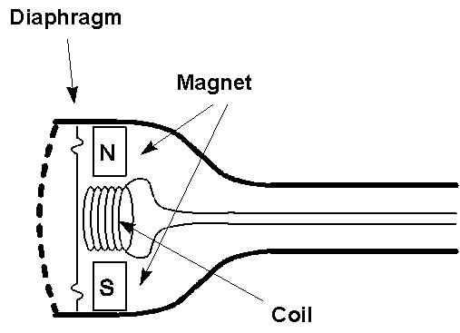
AC Generator
  Water turns wheel
  → rotates magnet
  → changes flux
  → induces emf
  → drives current
“Dynamic” Microphones
  (E.g., some telephones)
  Sound
  → oscillating pressure waves
  → oscillating [diaphragm + coil]
  → oscillating magnetic flux
  → oscillating induced emf
  → oscillating current in wire
  Question: Do dynamic microphones need a battery?

Slide 37
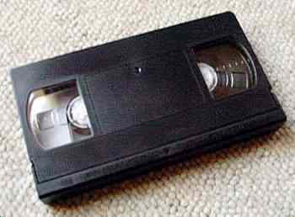
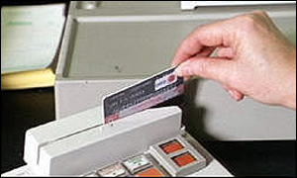
More Applications of Magnetic Induction
Tape / Hard Drive / ZIP Readout
  Tiny coil responds to change in flux as the magnetic domains (encoding 0’s or 1’s) go by.
  Question: How can your VCR display an image while paused?
Credit Card Reader
  Must swipe card
  → generates changing flux
  Faster swipe → bigger signal

Slide 38
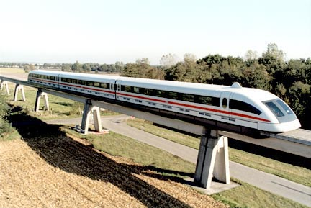
More Applications of Magnetic Induction
Magnetic Levitation (Maglev) Trains
  Induced surface (“eddy”) currents produce field in opposite direction
  → Repels magnet
  → Levitates train
  Maglev trains today can travel up to 310 mph
  → Twice the speed of Amtrak’s fastest conventional train!
  May eventually use superconducting loops to produce B-field
    → No power dissipation in resistance of wires!
S
N
rails
“eddy” current

Slide 39
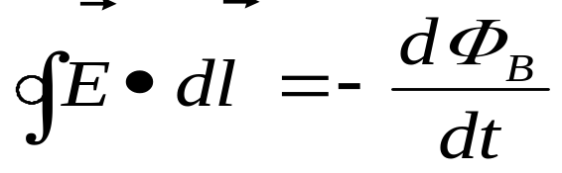
Summary
Faraday’s Law (Lenz’s Law)
  a changing magnetic flux through a loop induces a current in that loop
negative sign indicates that the induced EMF opposes the change in flux
Faraday’s Law in terms of Electric Fields

Slide 40
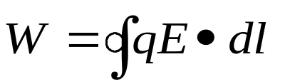
ΔB/Δt → E
Faraday's law ⇒ a changing B induces an emf which can produce a current in a loop.
In order for charges to move (i.e., the current) there must be an electric field.
Thus, we can state Faraday's law more generally in terms of the E field which is produced by a changing B field.
E
x x x x x x x x x x
x x x x x x x x x x
x x x x x x x x x x
x x x x x x x x x x
x x x x x x x x x x
E
r
B
E
E
Suppose B is increasing into the screen as shown above. An E field is induced in the direction shown. To move a charge q around the circle would require an amount of work =
This work can also be calculated from ε = W/q.

Slide 41
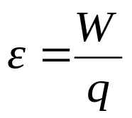

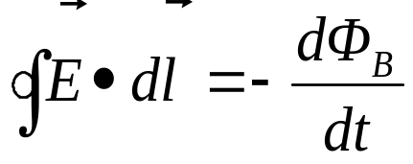
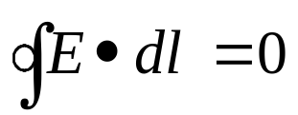
ΔB/Δt → E
Putting these 2 eqns together:
E
x x x x x x x x x x
x x x x x x x x x x
x x x x x x x x x x
x x x x x x x x x x
x x x x x x x x x x
E
⇒
r
B
Therefore, Faraday's law can be rewritten in terms of the fields as:
E
E
Line integral
around loop
Rate of change of
flux through loop
Note: In Lect. 5 we claimed , so we could define a potential independent of path. This holds only for charges at rest (electrostatics). Forces from changing magnetic fields are nonconservative, and no potential can be defined!

Slide 42
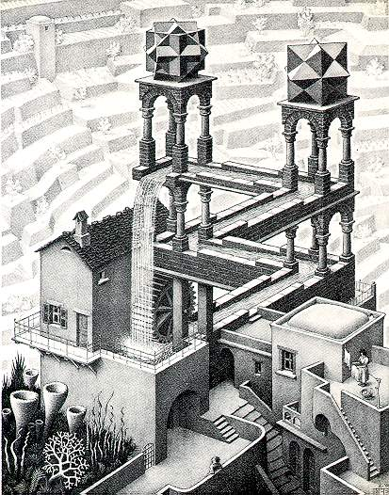
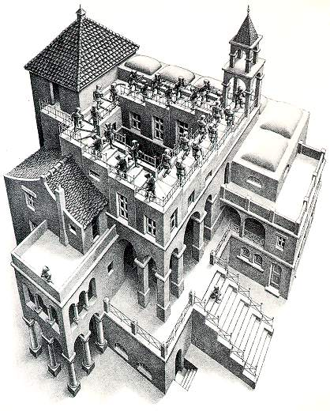
Escher depiction of nonconservative emf

Slide 43
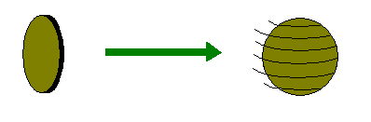
Preflight 16:
Buzz Tesla claims he can make an electric generator for the cost of one penny. “Yeah right!” his friends exclaim. Buzz takes a penny out of his pocket, sets the coin on its side, and flicks it causing the coin to spin across the table. Buzz claims there is electric current inside the coin, because the flux through the coin from the Earth’s magnetic field is changing.
10) Is Buzz telling the truth?
a) yes
b) no

Slide 44
Physical Components versus Circuit Elements
Circuit elements are circuit models which have simple but precise characterizations
In reality the physical components such as real resistors, diodes, coils and condensers can only be approximated with the circuit models.
We have to understand under what conditions the model is valid, and more importantly, under what situation the model needs to be modified.
There three principle considerations that are of importance in modeling physical components
Range of operation
Any physical component is specified in terms of its normal range of operation. Typically the maximum voltage, the maximum current and the maximum power are almost always specified for any device.

Slide 45
Another specified range of operation is the range of frequencies.
Example
At very high frequencies a physical resistor cannot be modeled only as a resistor.
Whenever there is a voltage difference, there is an electric field, hence some electrostatic energy is stored. The presence of current implies that some magnetic energy is stored. At low frequencies such effects are negligible, and hence a physical resistor can be modeled as a single circuit element, a resistor.
However, at high frequencies a more accurate model will include some capacitive and inductive elements in addition to the resistor.
Temperature effect
Resistors, diodes and almost all circuit components are temperature sensitive. Circuits made up of semiconductors often contain additional schemes, such as feedback which counteract the changes due to temperature variation

Slide 46
Parasitic Effect
One the most noticeable phenomenon in a physical inductor in addition to its magnetic field when current passes through, its dissipation. The wiring of a physical inductor has a resistance that may have substantial effects in some circuits. Thus, in modeling a physical inductor we often use a series connection of an inductor and resistor.

Slide 47
Summary
Circuit elements are ideal models that are used to analyze and design circuits. Physical components can be approximately modeled by circuit elements.
Each two-terminal element is defined by a characteristic, that is by a curve drawn in an appropriate plan. Each element can be subjected to a four-way classification according to its linearity and its time invariance.
A resistor is characterized, for each t, by a curve in the iv (or vi) plane.

