Slide 1
Series and Parallel connection of R L C
Mr. RAMESH BABU . J
(ASST.PROF)
EEE ,PBIT
1

Slide 2
Lecture 5
Simple Circuits.
Series connection of resistors.
Parallel connection of resistors.
Series and Parallel connection of resistors.
Small signal analysis.
Circuits with capacitors and inductors.
Series connection of capacitors.
Parallel connection capacitors
Series connection of inductors.
Parallel connection inductors.

Slide 3
Here’s How Resistors Add in Series
Series Connection of Resistors
+
=
R₁
R₂
R₁ + R₂
=
R₁
R₂
R₁ + R₂
Equivalent Resistance

Slide 4
Easy to prove:
Put together two resistors end-to-end
R₁
w
R₂
h
l₁
ρ (l₁ + l₂)
R_{tot} = ————
hw
l₂
Resistors add in “series”
Can also be written as…
ρ l₁ ρ l₂
R_{tot}= —— + —— = R₁ + R₂
hw hw

Slide 5


Example 1
Let us consider the circuit in Fig. 5.1, where two nonlinear resistors R₁ and R₂ are connected at node B. Nodes A and C are connected to the rest of the circuit, which is designed by P. The one-port, consisting of resistor R₁ and R₂ , whose terminals are nodes A and C, is called the series connection of resistors R₁ and R₂ .
The two resistors R₁ and R₂ are specified by their characteristics, as shown in the vi plane in Fig.1.2. We wish to determine the characteristic of the series connection of R₁ and R₂ that is the characteristic of a resistor equivalent to the series connection.
A
i₁
+
v₁
₋
R₁
B
i₂
First KVL for the mesh ABCA requires that
P
+
v₂
₋
(5.1)
R₂
Next KCL for the nodes A,B, and C requires that
C
Fig. 5.1 The series connection of R₁ and R₂

Slide 6

Clearly, one of the above three equations is redundant; they may be summarized by
(5.2)
Thus, Kirchohoffs laws state that R₁ and R₂ are traversed by the same current, and the voltage across the series connection is the sum of the voltage across R₁ and R₂ .
Series connection of R₁ and R₂
v
R₂
R₁
Thus,the characteristic of the series connection is easily obtained graphically; for each fixed i we add the values of the voltages allowed by the characteristics of R₁ and R₂
0
i₀
i
In this example R₂ is a linear resistor, and R₁ is a voltage controlled nonlinear resistor; I.e. the current in R₁ is specified by a function of the voltage.
Fig.5.2 Series connection of two resistors R₁ and R₂
In Fig.5.2 it is seen that if the current is I , the characteristic R₁ allows three possible values for the voltage; hence, R₁ is not current-controlled.

Slide 7
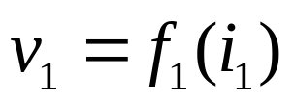




Analytically we can determine the characteristic of the resistor that is equivalent to the series connection of two resistors R₁ and R₂ only if both are current-controlled.
Current controlled resistors R₁ and R₂ have that may be described by equations of the form
(5.3)
where the reference directions are shown in Fig.1.1. In view of Eqs (5.1) and (5.2) the series connection has a characteristic given by
(5.4)
Therefore we conclude that the two-terminal circuit as characterized by the voltage relation Eq.(5.4) is another resistor specified by
(5.5a)
where
(5.5b)

Slide 8
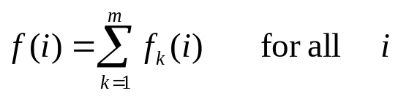
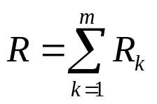
Equations (5.5a) and (5.5b) show that the series connection of the two current controlled resistors is equivalent to a current-controlled resistor R, and its characteritic is described by the function f(⋅) defined in (5.5b) (see fig.5.3).
Using analogous reasoning, we can state that the series connection of m current controlled resistors with characteristic described by v_{k}=f_{k}(i_{k}), k=1,2,…,m is equivalent to a single current controlled resistor whose characteristic is described by v=f(i), where
Series connection of R₁ and R₂
R₂
v
R₁
0
i₀
i
Fig. 5.3 Series connection of two current controlled resistors
If, in particular, all resistors are linear; that is v_{k}=f_{k}(i_{k}), k=1,2,…,m, the equivalent resistor is also linear, and v=Ri, where
(5.6)

Slide 9
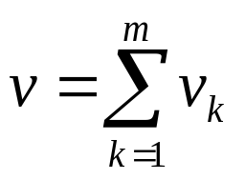
Example 2
Consider a circuit in Fig.5.4 where m voltage sources are connected in series. Clearly, this is only a special case of the series connection of m current controlled resistors.
Extending Eq.(5.1), we see that the series combination of m voltage sources is equivalent to a single voltage source whose terminal voltage is v,
v₁
v₂
≡
v
(5.7)
v_{m}
v_{m}
Fig. 5.4 Series connection of voltage sources.

Slide 10
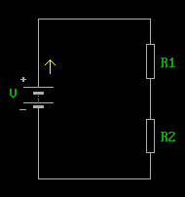
Example 3
Consider the series connection of m current sources as shown in Fig.5.5. Such a connection usually violets KCL;indeed, KCL applied to nodes B and C requires i₁=i₂=i₃=…
Therefore, it does not make sense physically to consider the series connection of current sources unless this connection is satisfied. Then series connection of m identical current sources is equivalent to one such current source.
i₁
B
i₂
≡
i₁
C
i_{m}
Fig 5.5. Series connection of current sources can be made only if i₁=i₂=…=i_{m}

Slide 11
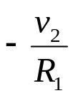
Example 4
Consider the series connection of a linear resistor R₁ and a voltage source v₂, as shown in Fig 5.6a
i
v
v
+
v₂
v₂
+
v₁
-
R₁
v
0
i
0
i
+
v₂
-
Slope R₁
(b)
(c)
Their characteristics are plotted on the same iv plane and are shown in Fig. 5.6b. The series connection has a characteristic as shown in Fig.5.c. in terms of functional characterization we have
_
(a)
Fig. 5.6 Series connection of a linear resistor and a voltage source.

Slide 12
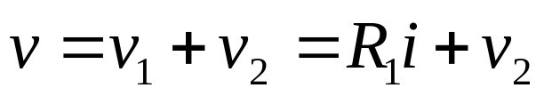
(5.8)
Sine R₁ is a known constant and v₂ known, Eq.(5.8) relates all possible values of v and i. It is equation of a straight line as shown in Fig. 5.6c.
Example 5
Consider the circuit of Fig.5.7a where a linear resistor is connected to an ideal diode. Their characteristics are plotted on the same graph and are shown in Fig.5.7b. The series connection has a characteristic as shown Fig.5.7c. The series connection has a characteristic as shown in Fig. 5.7c it is obtained by reasoning as follows.
v
i
+
Slope R₁
v
R₁
Ideal
diode
0
i
-
(a)
Ideal diode
(b)
Fig.5.7 Series connection of an ideal diode and a linear resistor

Slide 13
First for the positive current we can simply add the ordinates of the two curves. Next, for negative voltage across the ideal diode is an open circuit; Hence the series connection is again an open circuit. The current i cannot be negative
v
Slope R₁
i
0
i
+
(c)
v
v
R₁
Ideal
diode
-
0
i
Fig..5.8The series connection is analogous to that of Fig.5.7 except that the diode is reversed
Slope R₁

Slide 14
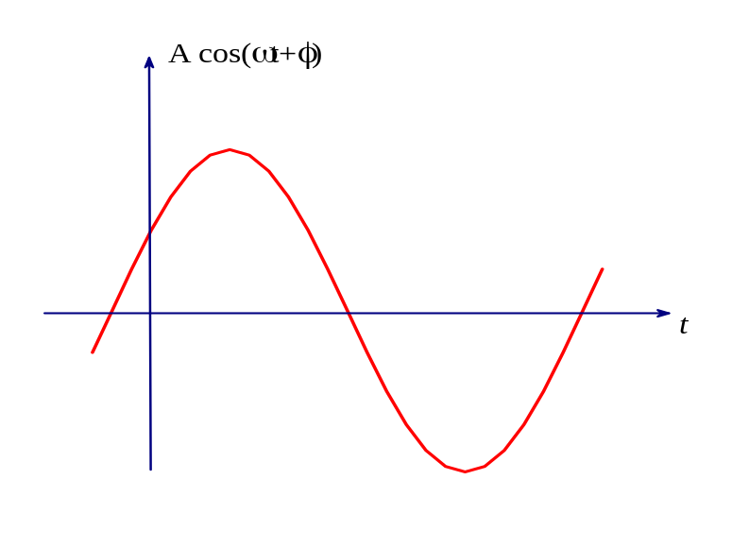

Let us assume that a voltage source is connected to the one-port of Fig 5.7a and that is has a sinusoidal waveform
(a)
(5.9)
As shown in Fig. 5.9a.
The current i passing through the series connection is a periodic function of time as shown in fig 5.9b
(b)
Fig.5.9 For an applied voltage shown in (a) the resulting current is shown in (b) for the circuit Fig 5.7a

Slide 15
Observe that the applied voltage v(⋅) is a periodic function of time with zero average value. The current i(⋅) is also a periodic function of time with the same period, but it is always nonnegative. By use of filters it is possible to make this current almost constant; hence a sinusoidal signal can be converted into a dc signal.
Summary
For the series connection of elements, KCL forces the currents in all elements (branches) to be the same, and KVL requires that the voltage across the series connection be the sum of the voltages of all the brunches.
Thus, if all the nonlinear resistors are current controlled, the equivalent resistor of the series connection has a characteristic v=f(i) which is obtained by adding the individual functions f_{k}(⋅) which characterize the individual current-controlled resistors.
For linear resistors the sum of individual resistance gives the resistance of the equivalent resistor, i.e., for m linear resistors in series.

Slide 16
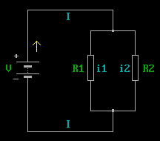
Here’s How Resistors Combine in Parallel
Parallel Connection of Resistors
1
R
Express them as Conductances G =
G₁
G₁ + G₂
+
=
G₂
Equivalent Conductance

Slide 17
Parallel Resistance Formula
G₁ + G₂
1 1
R₁ R₂
G₁ + G₂ =
+
1
1
R₁ R₂
R₁ + R₂
R_{eq} = =
1 1
R₁ R₂
=
G₁ + G₂
+
Shorthand Notation:
R₁ || R₂

Slide 18
Easy to prove:
Put together two resistors side by side
R₂
w₂
w₁
h
l
R₁
For the entire bar:
ρ l
R_{eq} = ————
h(w₁ + w₂)
Total width

Slide 19
ρ l
R_{eq} = ————
h(w₁ + w₂)
Multiply num. and den. by
ρ l
(h w₁)(h w₂)
Equation becomes…
(ρ l) [(ρ l)/ (h w₁)(h w₂)]
R_{eq}= —————————
h(w₁ + w₂) [(ρ l)/ (h w₁)(h w₂)]
R_{eq} =
Resistors combine in “parallel”
[(ρ l)/ (h w₁)] [(ρ l)/ (h w₂)]
R₁ R₂
R₁ + R₂
[ρ l/h w₁] + [ρ l/ h w₂]
=

Slide 20
Three or More Resistors in Parallel
R₁
R₂
R₃
R_{n}
For n resistors:
–1
1 1 1 1
R₁ R₂ R₃ R_{n}
R_{eq} =
+
+
+
+
. . .

Slide 21
Let us consider the circuit in Fig.5.10 where two resistors R₁ and R₂ are connected in parallel at nodes A and B. Nodes A and B are also connected to the rest of circuit designated by P. Let the two resistors be specified by their characteristics, which are shown in Fig.5.11 where they are plotted on the vi plane.
Parallel connection of R₁ and R₂
A
+
i₁
i₂
+
v₁
₋
+
v₂
₋
v
R₁
P
v
R₁
R₂
R₂
-
B
0
i
Fig.5.10 Parallel connection of two resistors
Fig.5.11 Characteristics of R₁ and R₂ and their parallel connection

Slide 22
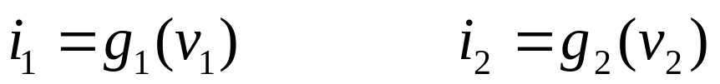
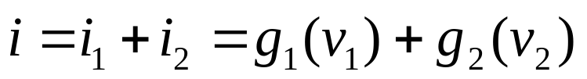
Let us find the characteristic of the parallel connection of R₁ and R₂ . Thus, Kirchhhofç laws imply that R₁ and R₂ have the same branch voltage, and the current through the parallel connection is the sum of the currents through each resistor. The characteristic of the parallel connection is thus obtained by adding, for each fixed v, the values of the current allowed by the characteristic of R₁ and R₂ . The characteristic obtained in Fig. 5.11 is that of the resistor equivalent to the parallel connection.
Analytically, if R₁ and R₂ are voltage controlled, their characteristics may be described by equation of the form
(5.10)
and in view of Kirchoff’s laws, the parallel connection has a characteristic described by
(5.11)
In other words the parallel connection is described by the function g(⋅), defined by

Slide 23

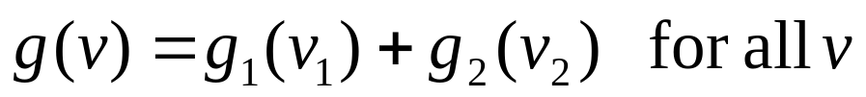
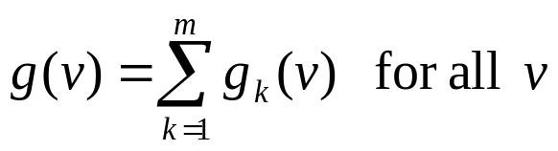
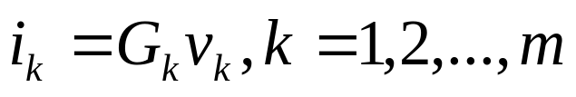

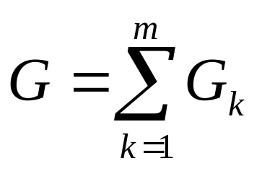
(5.12a)
where
(5.12b)
Extending this result to the general case, we can state that the parallel connection of m voltage controlled resistors with characteristic described by i_{k}=g_{k}(v_{k}), k=1,2,…,m is equivalent to a single voltage-controlled resistor whose characteristic i=g(v), where
If, in particular, all resistors are linear, that is
the equivalent resistor is also linear, and
, where
(5.13)
G is the conductance of the equivalent resistor.

Slide 24
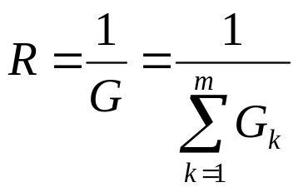
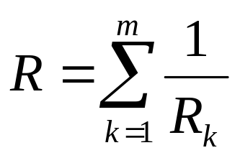
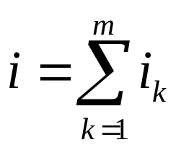
In terms of resistance value
or
(5.14)
Example 1
As shown in Fig.5.12, the parallel connection of m current sources is equivalent to a single current source
≡
i₁
⋅⋅⋅
i_{m}
i₂
Fig. 5.12 Parallel connection of current sources

Slide 25
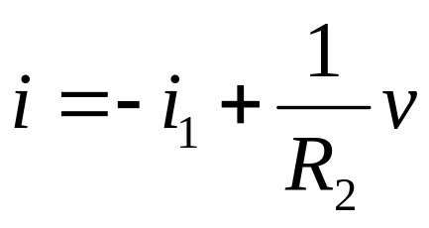
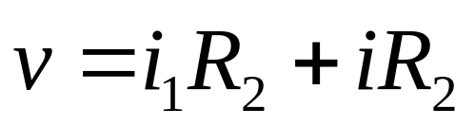
Example 2
The parallel connection of voltage sources violates KVL with exception of the trivial case where all voltage sources are equal.
Example 3
The parallel connection of a current sources i₁ and linear resistor with resistance R₂ as shown in Fig. 5.13 a can be represented by the equivalent resistor that is characterized by
(5.15)
Eq.(2.7) can be written as
(5.16)
The alternative equivalent circuit can be drawn by interpreting the voltage v as the sum of two terms, a voltage source v₁=i₁R₂ and a linear resistor R₂ as shown in Fig. 5.13b

Slide 26
i
+
v₁=i₁R₂
+
₊
₋
v
i₁
R₂
≡
v
-
R₂
(a)
-
(b)
Fig.5.13 Equivalent one-ports illustrating a simple case of the Thevenin and Norton equivalent circuit theorem
v
Example 4
Ideal
diode
Current source
i
+
i₃
i₁
v
i₁
R₂
Ideal
diode
-
0
i
Fig.5.14 Parallel connection of a current source, a linear resistor, and an ideal diode.
Slope G₂
(b)

Slide 27
The parallel connection of a current source, a linear resistor, and an ideal diode is shown in Fig. 5.14.a. Their characteristics re shown in Fig. 5.14b. The equivalent resistor has the characteristic shown in Fig 5.14c. For v negative the characteristic of the equivalent resistor is obtained by the addition of the thee curves.
v
For i₃ positive the ideal diode is a short circuit; thus the voltage v across it is always zero.
i₁
Summary
0
i
(c)
Slope G₂
For the parallel connection of elements, KVL requires that all the voltages across the elements be the same,
and KCL requires that the currents through
the parallel connection be the sum of the currents in all the brunches.
For nonlinear voltage-controlled resistors, the equivalent resistor of the parallel connection has a characteristic i=g(v) which is obtained by adding the individual functions g_{k}(⋅) which characterize each individual voltage-controlled resistor. For linear resistors the sum of individual conductances gives the conductance the equivalent resistor.

Slide 28
Series and Parallel Connection of Resistors
Example 1
Let us consider the circuit in Fig. 5.15, where a resistor R₁ is connected in series with the parallel connection of with the parallel connection of R₂ and R₃.
+
i
+
i₁
i
R₁
+
+
v₁
R₁
i₂
i₃
≡
R
≡
-
v
+
v₂
₋
+
v₃
₋
v
-
R₂
R₃
+
v
v*
-
-
-
Fig.5.15 Series-parallel connection of resistors and its successive reduction

Slide 29
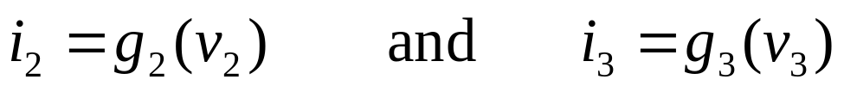
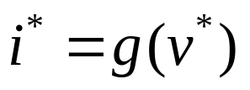
If the characteristics of R_{1,} R₂ and R₃ are specified graphically, we need first to determine graphically the characteristic of R*, the resistor equivalent to the parallel connection of R₂ and R₃ , and second to determine graphically the characteristic of R, the resistor equivalent to the series connection of R₁ and R*.
Let us assume that the characteristics of R₂ and R₃ are voltage controlled and specified by
(5.17)
where g₂(⋅), and g₃(⋅), are single-valued functions. The parallel connection has an equivalent resistor R*, which is characterized by
(5.18)
where i* and v* are the branch current and voltage of the resistor R* as shown in Fig. 5.15. The parallel connection requires the voltages v₂ and v₃ to be equal to v*. The resulting current i* is the sum of i₂ and i_{3 .} Thus, the characteristic of R*, is related to those of R₂ and R₃ by

Slide 30
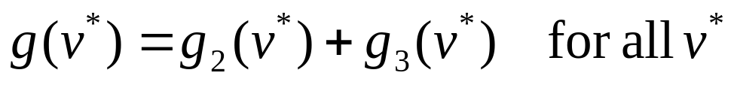
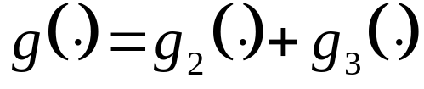
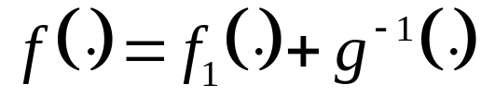
(5.19)
Let g₂(⋅), and g₃(⋅), be specified as shown in Fig.5.16. Then g(⋅) is obtained by adding the two functions
Current
Voltage
g
f
g₂
g⁻¹
g₃
f₁
0
Voltage
0
Current
(a)
(b)
Fig. 5.16 Example 1: the series-parallel connection of resistors

Slide 31

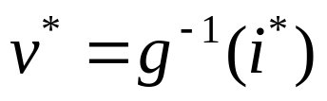
The next step is to obtain the series connection of R₁ and R*. Let us assume that the characteristic of R₁ is current controlled an specified by
(5.20)
where f₁(⋅) is a single-valued function as shown in Fig. 5.16b. The series connection of R₁ and R* has an equivalent resistor R as shown in Fig 5.15. The characteristic of R as specified by
(5.21)
Is to be determined. Obviously the series connection forces the currents i₁ and i* to be the same and equal to i. The voltage v is simply the sum ofv₁ and v*. However in order to add the two voltages we must first to be able to express v* in terms of i* . From (5.18) we can write
(5.22)
where g⁻¹(⋅) is inverse of the function g₁(⋅) (See Fig. 5.16b). Thus the series connection of R₁ and R* is characterized by f(⋅) of (5.21) where

Slide 32
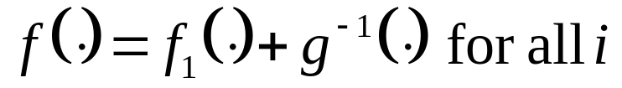
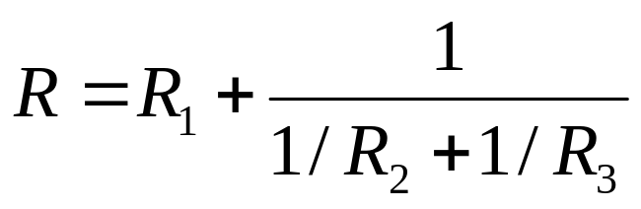
Thus, the critical step in the derivation is the question of whether g⁻¹(⋅) exists as a single –valued function. If the inverse does not exist, the reduction procedure fails; indeed, no equivalent representation exist in terms of single –valued functions.
One simple criterion that guarantees the existence of such a representation is that all resistors have strictly monotonically increasing characteristics.
In the case of linear resistors with positive resistance and monotonic increasing we can easily write the following:
(5.23)
where R, R₁,R₂ and R₃ are respectively, the resistances R, R₁,R₂ and R₃

Slide 33
Exercise
The circuit in Fig. 5.17 is called an infinite-ladder network. All resistors are linear; the series resistors have resistance R_{s} and shunt resistors have resistance R_{p}.
Determine the input resistance R, that is the resistance of the equivalent one-port.
R_{s}
R_{s}
R_{s}
R
R_{p}
R_{p}
R_{p}
Fig. 5.17 An infinite ladder of linear resistors. R_{s} is called the series resistance, and R_{p} is called the shunt resistance. R is input resistance.

Slide 34
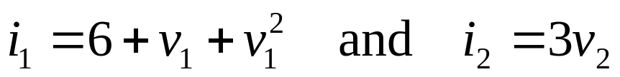
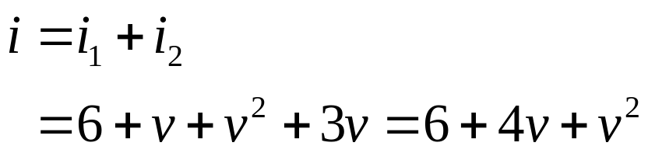
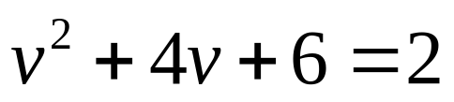
Example 2
Consider the simple circuit, shown in Fig. .18, where R₁ and R₂ are voltage-controlled resistors characterized by
(5.24)
+
i₀ is a constant source of 2 amp. We wish to determine the currents i₁ and i₂ the voltage v. Since v=v₁=v₂, the characteristic of the equivalent resistor of the parallel combination is simply
i₁
i₂
+
v₁
₋
+
v₂
₋
v
R₁
R₂
i₀
-
(5.25)
Fig. 5.18 Parallel connection of resistors and a current source.
To obtain the voltage v for i=i₀=2 amp, we need to solve Eq.(5.25). Thus
or

Slide 35
v=-2 volts
(5.26)
Since v=v₁=v₂ , substituting (5.26) in (5.24) we obtain
i
i₁=8 amp
and
i₂=-6 amp
Exercise
Determine the power dissipated in each resistor and show that the sum of their power dissipations is equal to the power delivered by the current source
Example 3
In the ladder of Fig.5.19, where all resistors are linear and time-invariant, there are four resistors shown. A voltage source of V₀=10 volts is applied. Let R_{s}=2 ohm and R_{p}=1ohm.
Determine the voltage v_{a} and v_{b}.

Slide 36
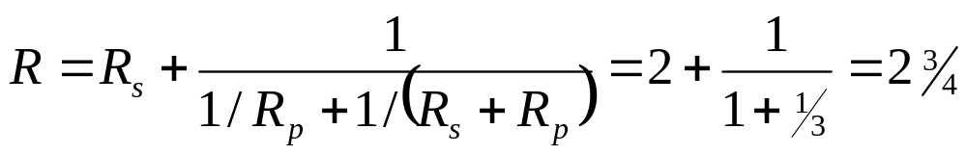
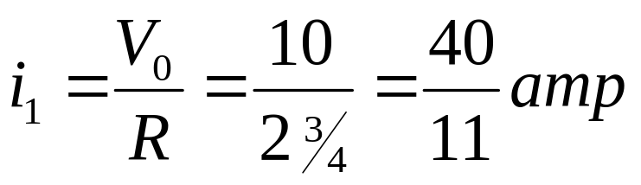
i₁
R_{s}
R_{s}
i₂
+ v₁ -
+ v₂ -
+
v_{b}
₋
+
v_{a}
₋
V₀
R_{p}
R_{p}
Fig. 5.19 A ladder with linear resistors
We first compute the input resistance R of the equivalent one-port that is face by the voltage source V₀. Base on the method of series-parallel connection of resistors we obtain a formula similar to Eq.5.23; thus
ohms
Thus the current i₁ is given by

Slide 37
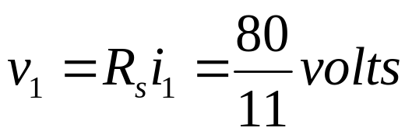
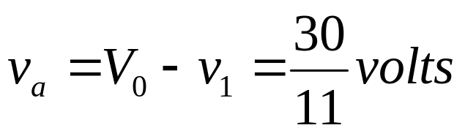
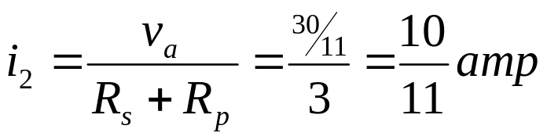
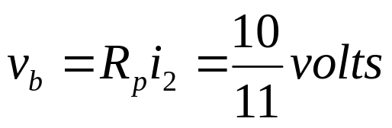
The branch voltage v₁ is given by
Using KVL for the first mesh, we obtain
Knowing v_{a}, we determine
From Ohm’s law we have
Thus by successive use of Kirchhoffs laws and Ohm’s law we can determine the voltages and currents of any series-parallel connection of linear resistors.

Slide 38
Example 4
Consider the bridge circuit of Figure 5.20. Note that this is not of the form of a series-parallel connection. Assume that the four resistance are the same. Obviously, because of Symmetry the battery current i_{b} must divide equally at node A and also at node B; that is i₁=i₂=i_{b}/2 and i₃=i₄=i_{b}/2 . Consequently the current i₅ must be zero.
i_{b}
A
i₁
i₂
R
R
R_{D}
E
i₅
R
i₃
R
i₄
B
i_{b}
Fig.5.20 A symmetric bridge circuit

Slide 39
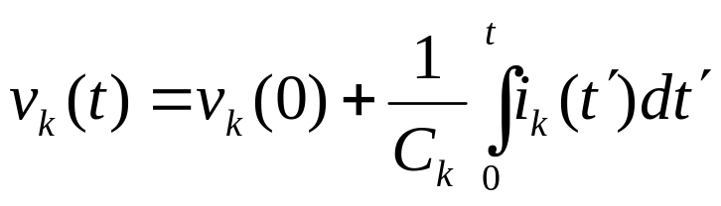

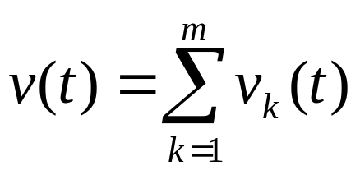
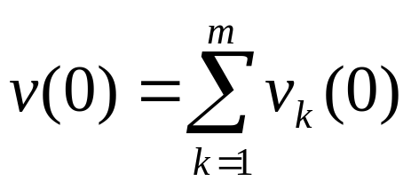
Circuits with Capacitors or Inductors
Series Connection of Capacitors
Consider the series connection of capacitors as illustrated by Fig. 5.21. The branch characterization of linear-invariant capacitor is
i₁
i
(5.27)
+
C₁
v₁
-
i₂
Using KCL at all nodes, we obtain
+
C
+
≡
v₂
C₂
v
-
(5.28)
-
Using KVL, we have
+
i_{m}
v_{m}
C_{m}
-
(5.29)
At t=0
Fig. 5.21 Series connection of capacitors
(5.30)

Slide 40
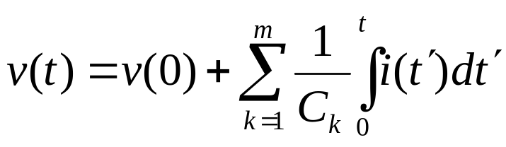
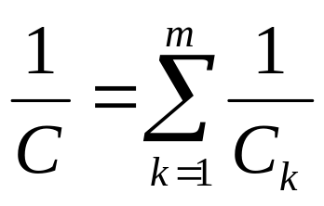
Combining Eqs. (5.27) to (5.30), we obtain
(5.31)
Therefore the equivalent capacitor is given by
(5.32)
The series connection of m linear time-invariant capacitors, each with value C_{k} and initial voltage v_{k}(0), is equivalent to a single linear time-invariant capacitor with value C, which is given by Eq. (5.32) and initial voltage
(5.33)

Slide 41
Connecting Capacitors in Series
What is the Equivalent Capacitance?
i
C₁
+
v₁
–
Can find using….
Circuit theory
C₂
+
v₂
–
Physical argument
Here’s the result:
C₁C₂
C_{eq} =
C₁ + C₂
Let’s show why…

Slide 42
Circuit method
i₁
C₁
+
v₁
–
+
v_{tot}
–
q₁ = C₁v₁
i₂
C₂
+
v₂
–
q₂ = C₂v₂
i₁ increases q₁; i₂ increases q₂
Δq₁ = i₁ Δt Δq₂ = i₂ Δt
But i₁ = i₂
Δq₁ = Δq₂

Slide 43
Δq₁ = Δq₂
Assume C₁ and C₂ are uncharged until current turned on
q₁ = q₂
i
Goal: Find C_{eq} such that
q = C_{eq}v_{tot}
C₁
+
v₁
–
+
v_{tot}
–
Where:
v_{tot} = v₁ + v₂
C₂
+
v₂
–
q₁ q₂
v_{tot} = +
C₁ C₂
1 1
v_{tot} = q +
C₁ C₂
C₁C₂
q
q q
1
1 1
C_{eq} =
= +
= +
C_{eq}
C₁ C₂
C_{eq}
C₁ C₂
C₁ + C₂

Slide 44
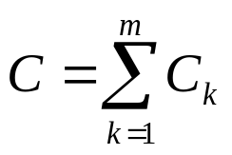
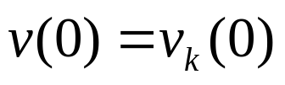
Parallel Connection of Capacitors
For the parallel connection of m capacitors we must assume that all capacitors have the same initial voltages, for otherwise KVL is violated at t=0. It is easy to show that for the parallel connection of m linear time invariant capacitors with the same voltage v_{k}(0), the equivalent capacitor is equal to
(5.34)
and
(5.35)
i
See Fig. 5.22.
+
+
+
+
v₁
v₂
•••
≡
C
C₁
C₂
v_{m}
C_{m}
v
-
-
-
-
Fig. 5.22 Parallel connection of linear capacitors

Slide 45


Example
Let us consider the parallel connection of two linear time invariant capacitors with different voltages. In Fig. 5.23, capacitor 1 has capacitance C₁ and voltage V₁, and capacitor 2 has capacitance C₂ and voltage V₂. At t=0, the switch is closed so that the two capacitors are connected in parallel. What is a voltage across the parallel connection right after the closing of the switch?
From (5.34) the parallel connection has an equivalent capacitance
(5.36)
At t=0- the charge store in two capacitance is
Ideal switch
(5.37)
Since it is a fundamental principle of physics that electric charge is conserved at t=0+
+
+
C₁
V₁
V₂
C₂
(5.38)
-
-
From (5.36) through (5.38) we can derive the new voltage across the parallel connection of the capacitors
Fig.5.23 The parallel connection of two capacitors with different voltages

Slide 46
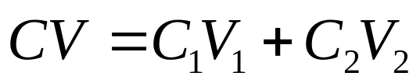
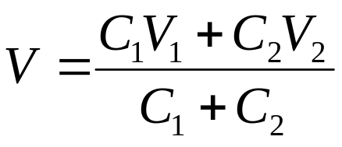
Let the new voltage be V; then
or
(5.39)
Physically this phenomenon can be explained as follows: Assume V₁ is larger than V₂ and C₁ is equal C₂; thus, at time t=0-, the charge Q₁(0-) is bigger than Q₂(0-). At the time when the switch is closed, t=0, some charge is dumped from the first capacitor to the second instantaneously. This implies that an impulse of current flows from capacitor 1 to capacitor 2 at t=0. As a result, at t=0+, the voltages across the two capacitors are equalized to the intermediate value V required by the conservation of charge.

Slide 47
Connecting Capacitors in Parallel
What is the Equivalent Capacitance?
i
C₁
C₂
+
v
–
Can find using….
Circuit theory
Physical argument

Slide 48
i
Circuit Method
What do we know?
C₁
C₂
+
v₁
–
+
v₂
–
v₁ = v₂ = v
Q₁ = C₁v₁
Q₂ = C₂v₂
dQ₁
dQ₂
i = +
dt
dt
Combine:
Constants
dC₁v₁
dC₂v₂
dv
Same voltage
i = +
= (C₁ + C₂)
dt
dt
dt

Slide 49
i
dv
i = (C₁ + C₂)
dt
C₁
C₂
+
v₁
–
+
v₂
–
Equivalent Capacitance
Capacitors in Parallel:
C_{eq} = C₁ + C₂
dv
i = C_{eq}
dt

Slide 50
Physical Motivation:
Area A₁
Area A₂
εA₁
εA₂
C₁ =
d
C₂ =
d
d
d
Area A₁ + A₂
d
ε(A₁ + A₂)
C_{eq} =
d
C_{eq} = C₁ + C₂

Slide 51
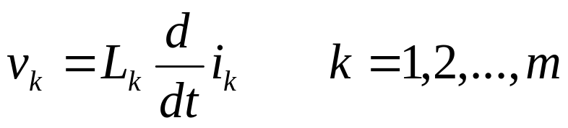

Series Connection of Inductors
The series connection of m linear time-invariant inductors is shown in Fig.5.24. Let the inductors be specified by
(5.40)
i₁
+
and let the initial currents be i_{k}(0). Using KCL at all nodes,we have
v₁
L₁
i
(5.41)
-
i₂
+
Thus, at t=0, i(0)=i_{k}(0), k=1,2,..,m. KCL requires that in the series connection of m inductors all the initial value of the currents through the inductors must be the same. Using KVL, we obtain
+
v₂
≡
L
L₂
v
-
-
i_{m}
+
v_{m}
L_{m}
(5.42)
-
Fig. 5.24. Series connection of linear inductors

Slide 52
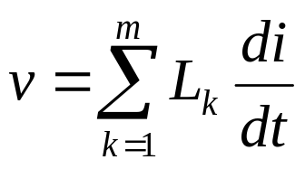
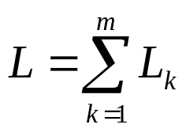
Combining Eqs. (5.40) to (5.42), we have
(5.43)
Therefore, the equivalent inductance is given by
(5.44)
The series connection of m linear time-invariant inductors each with L_{k} and initial current i(0), is equivalent to single inductor of inductance with the same initial current i(0).
Parallel Connection of Inductors
i
+
i₁
i₂
i_{m}
L₂
≡
L
L₁
•••
L_{m}
v
-

Slide 53
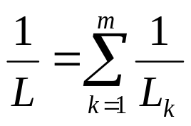

Parallel Connection of Inductors
We can similarly derive the parallel connection of linear time-invariant inductors shown in Fig.5. 25. This result is simply expressed by the following equations:
(5.45)
and
(5.46)
i
+
i₁
i₂
i_{m}
L₂
≡
L
L₁
•••
L_{m}
v
-
Fig. 5.25 Parallel connection of linear inductors

Slide 54
Inductors in Series and Parallel
Inductors combine like resistors
Series
L₁
L₂
L_{eq} =
L₁ + L₂
L₁L₂
Parallel
L_{eq} =
L₁
L₂
L₁ + L₂

Slide 55
Summary
In a series connection of elements, the current in all elements is the same. The voltage across the series connection is the sum of voltage across each individual element.
In parallel connection of elements, the voltage across all elements is the same. The current through the parallel connection is the sum of the currents through each individual element.
Type of elements | Series connection of m elements | Parallel connection of m elements
Resistors R=resistance G=conductance
C=capacitance S=elastance
Inductors L=inductance

Slide 56


