Slide 1
Lecture 6
First order Circuits (i).
Linear time-invariant first-order circuit, zero input response.
The RC circuits.
  Charging capacitor
  Discharging capacitor
The RL circuits.
The zero-input response as a function of the initial state.
Mechanical examples.
Zero-state response (Constant current input, Sinusoidal input).
Complete response: transient and steady-state.

Slide 2
Why first order?
In this lecture we shall analyze circuits with more than one kind of element; as a consequence, we shall have to use differentiation and/or integration.
We shall restrict ourselves here to circuits that can be described by first-order differential equations; hence we give them the name first-order circuits

Slide 3
Linear Time –invariant First order Circuit. Zero-input Response
The RC Circuits
In the circuit of Fig.6.1., the linear time-invariant capacitor with capacitance C is charged to a potential V₀ by a constant voltage source. At t=0 the switch k₁ is opened, and switch k₂ is closed simultaneously.
k₁
k₂
i(t)
+
v=V₀
E=V₀
_
C
R
Fig.6.1 A charged capacitor is connected to a resistor (k₁, opens and k₂ closes at t=0).

Slide 4
Thus the charged capacitor is disconnected from the source and connected to the linear time-invariant resistor with resistance R at t=0.
Let us describe physically what is going to happen. Because of the charges stored in the capacitor (Q₀=CV₀) a current will flow in the direction specified by the reference direction assigned to i(t), as shown in Fig. 6.1. The charge across the capacitor will decrease gradually and eventually will become zero; the current i will do the same. During the process the electric energy stored in the capacitor is dissipated as heat in the resistor.
Let us restricting our attention to t≥0, we redraw the RC circuit as shown in Fig.6.2. Note that the reference direction for branch voltages and branch currents are clearly indicated. V₀ along with the positive and negative sins next to the capacitor, specifies the magnetite and polarity of the initial voltage.
i_{c}(t)
i_{R}(t)
+
+
v_{C}(t)
-
+
v_{R}(t)
₋
v_{c}(t)=V₀
-
Fig.6.2 An RC circuit, v_{c}(0)=V₀

Slide 5
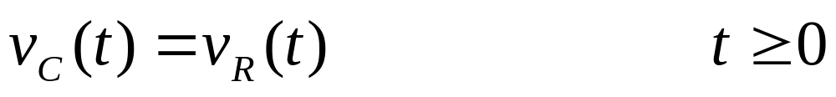
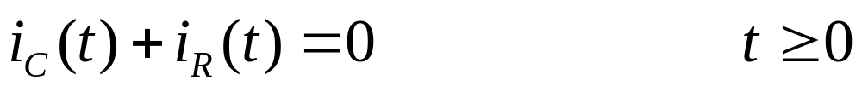
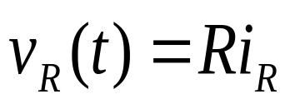
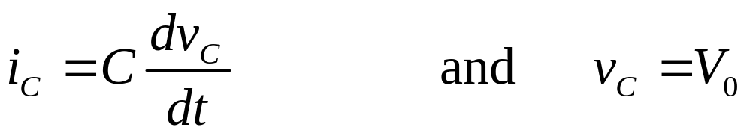
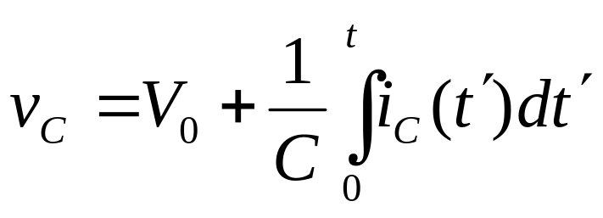
Kirchoff`’s laws and topology dictate the following equations:
(6.1)
KVL:
KCL:
(6.2)
The two branch equations for the two circuit elements are
Resistor:
(6.3)
Capacitor:
(6.4a)
or, equivalently
(6.4b)
In Eq.(6.4a) we want to emphasize that the initial condition

Slide 6
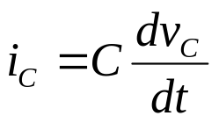
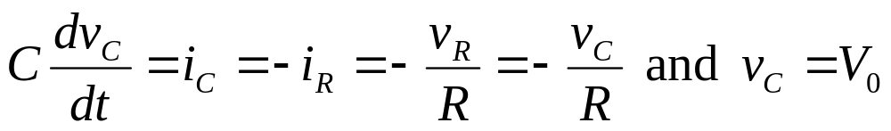
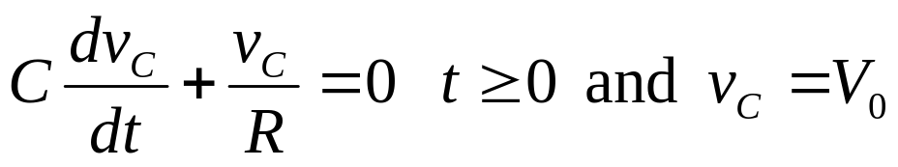
Of the capacitor voltage must be written together with
; otherwise, the state of the capacitor is not completely specified.
This is made obvious by the alternate branch equation (6.4b)
Finally we have four equations for four unknown in the circuit, namely, the two branch voltages v_{C} and v_{R} and two branch currents i_{C} and i_{R}.
A complete mathematical description of the circuit has been given and we can solve for any or all of the unknown parameters. If we wish to find the voltage across the capacitor, the combining Eqs (6.1) to (6.4a) we obtain for t≥0,
(6.5)

Slide 7
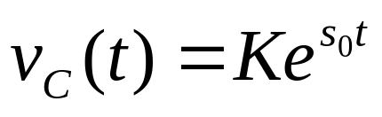
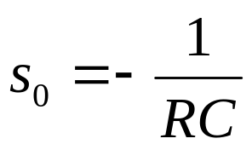
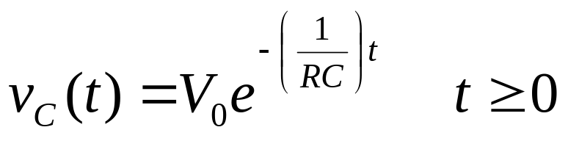
This is a first-order linear homogeneous differential equation with constant coefficients. Its solution is of the exponential form
(6.6)
where
(6.7)
This easily verified by direct substitution of Eqs. (6.6) and (6.7) in the differential equation (6.5). In (6.6) K is a constant to be determined from the initial conditions. Setting t=0 in Eq.(6.6), we obtain v_{C}(0)=K=V₀. Therefore, the solution to the problem is given by
(6.8)

Slide 8
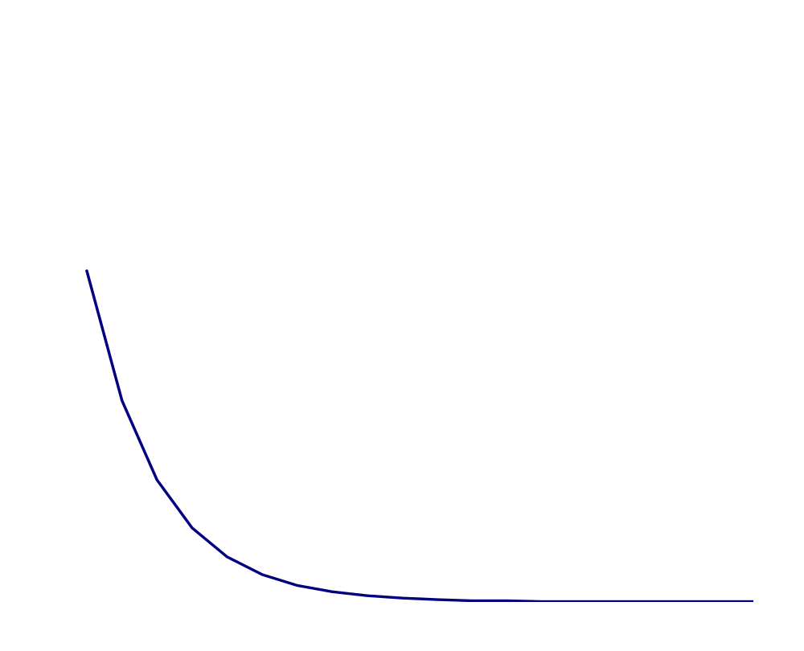
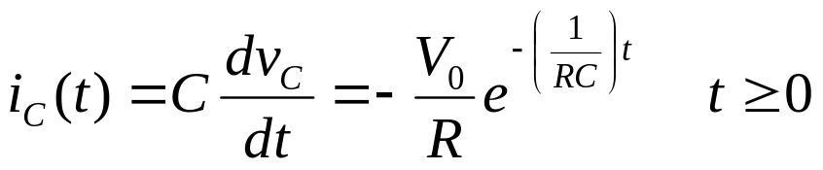
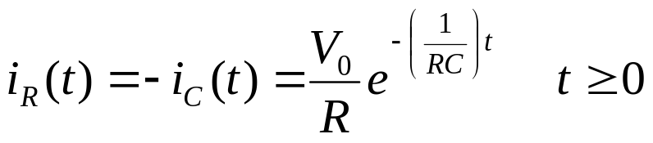

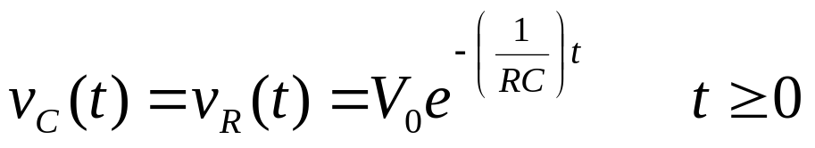
In Eq.(6.8), v_{C}(t) is specified for t≥0 since for negative t the voltage across the capacitor is a constant, according to our original physical specification.
The voltage v_{C}(t) is plotted in Fig. 6.3 as a function of time. Of course, we can immediately the other three branch variables once v_{C}(t) is known. From Eq.(6.4a) we have
v_{C}
(6.9)
From Eq.(6.2) we have
V₀
(6.10)
From Eq. (6.3) we have
0.377V₀
(6.11)
0
4T
t
T
2T
3T
Fig.6.3 The discharge of the Capacitor of Fig. 6.2 is given by an experimental curve

Slide 9
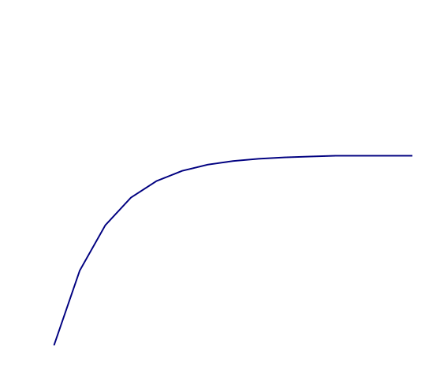
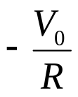
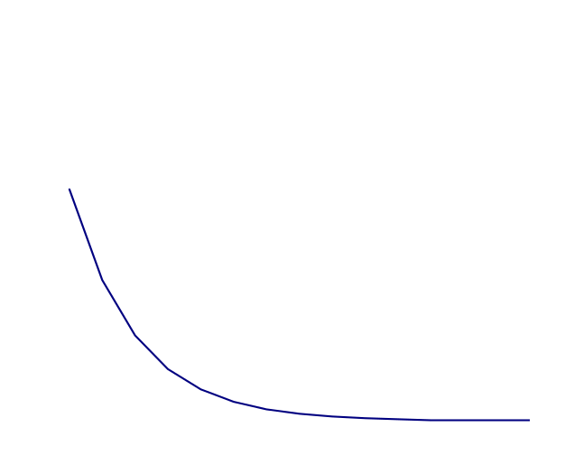
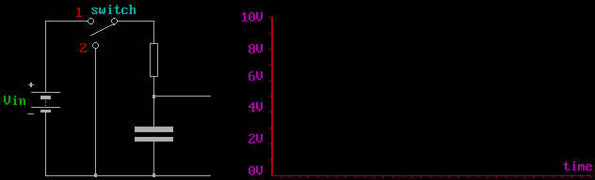


i_{C}
Exercise
Show that the red line in Fig. 6.3, which is tangent to the curve v_{c}(t)=0+, intersects the time axis at the abscissa T
t
0
i_{R}
t
v_{R}
Fig.6.4. Network variables i_{C} ,i_{R} and v_{R} against time for t≥0.
t

Slide 10

Let us study the waveform v_{c}(⋅) more carefully. The voltage across the capacitor decreases exponentially with time, as shown in Fig. 6.3. An exponential curve can be characterized by two numbers, namely the ordinate of the curve at a reference time say t=0 and the time constant T which is defined by .
In Fig. 6.3 we have f=V₀ and T=RC.
Remark
The term s₀=-1/T=-1/RC in Eqs.(6.6) and (6.7 has a dimension of reciprocal time of frequency and is measured in radians per second. It is called the natural frequency of the circuit.
Exercise
Recall that the unit of capacitance is the farad and the unit of resistance is the ohm. Show that the unit of T=RC is the second.
In the circuit analysis we are almost always interested in the behavior of a particular network called the response. In general we give the name of zero-input response to the response of the circuit with no applied input

Slide 11
The RL (Resistor –Inductor) Circuit
The other typical first-order circuit is the RL circuit. We shall study its zero-input response. As shown in Fig. 6.5 for t<0, switch k₁ is on terminal B, k₂ is open, and the linear time-invariant inductor with inductance L is supplied with a constant current I₀. At t=0 switch k₁ is flipped to terminal C and k₂ is closed. Thus for t≥0 the inductor with initial current I₀ is connected to a linear time-invariant resistor with resistance R. The energy stored in the magnetic field as a result of I₀ in the inductance decreases gradually and dissipate in the resistor in the form of heat. The current in the RL loop decreases monotonically and eventually tends to zero.
k₂
Fig. 6.5.for t<0, switch k₁ is on terminal B, k₂ is open; therefore for t<0, the current I₀ goes through the inductor L
A
B
k₁
L
I₀
R

Slide 12
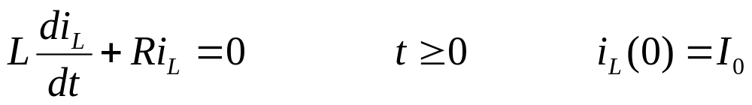
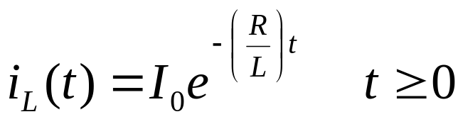
In the same way as in RC case we redraw the RL circuit for t≥0 as shown in Fig.6.6. Note that the reference direction of all branch voltages and branch currents are clearly indicated. KCL says i_{R}=-i_{L} and KVL states v_{L}-v_{R}=0. Using the branch equations for both elements that is ,
, we obtain the
following differential equation in terms of the current i_{L}:
(6.12)
This is a first-order linear homogeneous differential equation with constant coefficients; it has precisely the same form as the previous Eq.6.5. Therefore the solution is the same except notations
(6.13)
+
v_{L}(t)
-
+
v_{R}
₋
where L/R=T is the time constant and s₀=-R/L is the natural frequency
i_{L}(0)=I₀
i_{R}
Fig.6.6 An RL circuit with i_{L}(0)=I₀ and the waveforms for t≥0

Slide 13
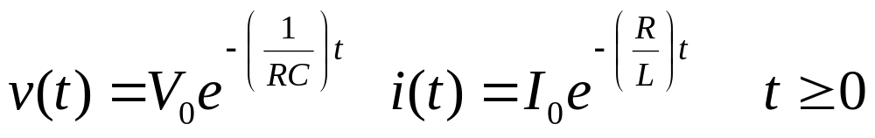
The zero-input response as a function of the initial state
For the RC circuit and the RL circuit considered above, the zero-input responses are respectively
(6.14)
The initial conditions are specified by V₀ and I₀, respectively. The numbers V₀ and I₀ are also called the initial state of the RC circuit and of the RL circuit, respectively. The following conclusion could be reached if we consider the way in which the waveform of the zero-input response depends on the initial state.
For first-order linear time invariant circuits, the zero-input response considered as a waveform defined for 0≤ t <∞ is a linear function of the initial state
Let us prove this statement by considering the RC circuit. We wish to show that the waveform v(⋅) in Eq. (6.14) is a linear function of the initial state V₀. It is necessary to check the requirements of homogeneity and addittivity for the function.

Slide 14




Homogeneity is obvious; if the initial state is multiplied by a constant k, (Eq. (6.14)show that the whole waveform is multiplied by k. Adittivity as just as simple.
The zero input response corresponding to the initial state V₀’ is
and the zero-input response corresponding to some other initial state V₀” is
Then the zero-input response corresponding to the initial state
This waveform is the sum of the two preceding waveforms. Hence addittivity holds.

Slide 15
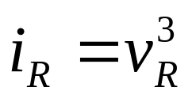
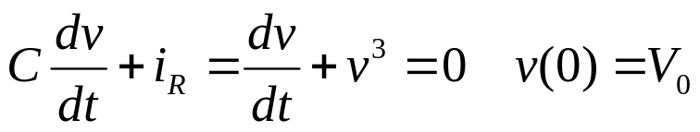
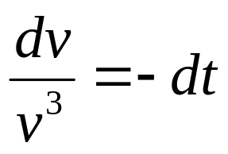
Remark
This property does not hold in the case of nonlinear circuits. Consider the RC circuit shown in Fig. 6.7a. The capacitor is linear and time invariant and has a capacitance of 1 farad, and the resistor is nonlinear with characteristic
The two elements have the same voltage v, and expressing the branch currents in terms of v, we obtain from KCL
+
v
-
Hence
i_{R}
+
v_{R}
₋
C=1 F
If we integrate between 0 an t, the voltage takes the initial value V₀ and the final value v(t); hence
Fig.6.7a Nonlinear RC circuit and two of its zero-input resistance. The capacitor is linear and the resistor

Slide 16
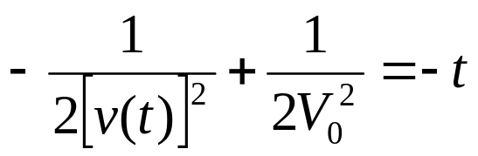
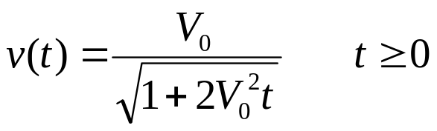
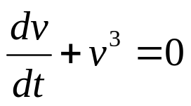
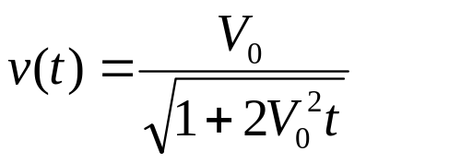
or
(6.15)
This is the zero-input response of this nonlinear RC circuit starting from the initial state V₀ at time 0. The waveforms corresponding to V₀=0.5 and V₀=2 are plotted in Fig 6.7b.
v
It is obvious that the top curve (V₀=2) cannot be obtained from the lower one (for V₀=0.5) by multiplying its ordinates by 4.
2.0
1.5
V₀=2
1.0
0.5
V₀=0.5
Fig. 6.7b
t

Slide 17
Mechanical example
Let us consider a familiar mechanical system that has a behavior similar to that of the linear time invariant RC and RL circuits above.
Figure 6.8 shows a block of mass M moving at an initial velocity V₀ at t=0.
v(t) v(0)=V₀
M
Bv (friction forces)
Fig. 6.8 A mechanical system which is described by a first order differential equation
As time proceeds, the block will slow down gradually because friction tends to oppose the motion. Friction is represented by friction forces that are all ways in the direction opposite to the velocity v, as shown in the figure. Let us assume that these forces are proportional to the magnitude of the velocity; thus, f=Bv, where the constant B is called the damping coefficient. From Newton’s second law of motion we have, for t≥0,

Slide 18
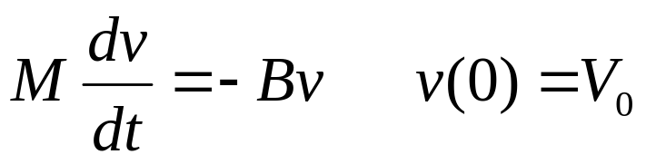

(6.16)
Therefore
(6.17)
where M/B represents the time constant for the mechanical system and –B/M is the natural frequency

Slide 19
Zero-state Response
Constant Current Input
In the circuit of Fig. 6.9 a current source i_{s} is switched to a parallel linear time invariant RC circuit. For simplicity we consider first the case when the current i_{s} is constant and equal to I. Prior to the opening of the switch the current source produces a circulating current in the short circuit. At t =0, the switch is opened and thus the current source is connected the RC circuit. From KVL we see that the voltage across all three elements is the same. Let us design this voltage by v and assume that v is the response of interest. Writing the KCL equation in terms of v, we obtain the following network equation:
i_{s}(t)=I
k
C
R
Fig.6.9 RC circuit with current source input. At t=0, switch k is opned

Slide 20
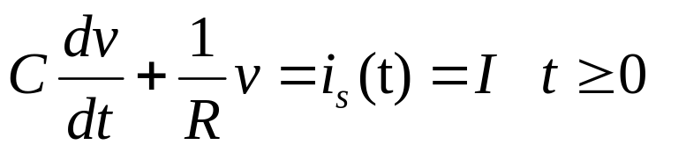

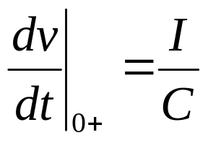
(6.18)
where I is a constant. Let us assume that the capacitor is initially uncharged. Thus, the initial condition is
(6.19)
Before we solve Eqs. (6.18) and (6.19), let s figure out what will happen after we open the switch. At t=0+, that is, immediately after the opening of the switch, the voltage across the capacitor remains zero, because as we learned the voltage across a capacitor cannot jump abruptly unless there is an infinitely large current. At t=0+, since the voltage is still zero, the current in the resistor must be zero by Ohm’s law. Therefore all the current from the source enters the capacitor at t=0+. Thus implies a rate of increase of the voltage specified by Eq.(6.19), thus
(6.20)

Slide 21


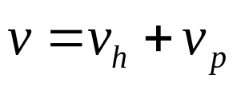
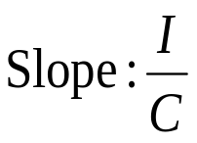
As time proceeds, v increases, and v/R, the current through the resistor, increases also. Long after the switch is opened the capacitor is completely charged, and the voltage is practically constant. Then and thereafter, dv/dt≈0. All the current from the source goes through the resistor, and the capacitor behaves as an open circuit, that is
(6.21)
This fact is clear form Eq.(6.18), and it is also shown in Fig.6.10. The circuit is said to have reached a steady state. It only remains to show how the whole change of voltage takes place. For that we rely on the following analytical treatment.
The solution of a linear no homogeneous differential equation can be written in the following form:
v
(6.22)
RI
Fig. 6.10. Initial and final behavior of the voltage across the capacitor.
t

Slide 22
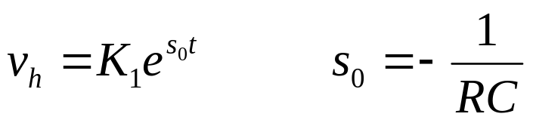
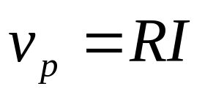

where v_{h} is a solution of the homogeneous differential equation and v_{p} is any particular solution of the nonhomogenous differential equation. v_{p} depends on the input.
The general solution of the homogeneous equation is of the form
(6.23)
where K₁ is any constant. The most convenient particular solution for a constant current input is a constant
(6.24)
since the constant RI satisfies the differential equation (6.18). Substituting (6.23) and (6.24) in (6.22), we obtain the general solution of (6.18)
(6.25)
where K₁ is to be evaluated from the initial condition specified by Eq.(6.19). Setting t=0 in (6.25), we have

Slide 23
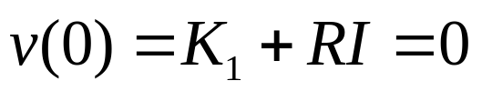


Thus,
(6.26)
The volt age as a function of time is then
(6.27)
The graph in Fig.6.11 shows the voltage approaching its steady-state value exponentially. At about four times the time constant, the voltage is with two percent of its final value RI
v
0.05RI
0.02RI
RI
0.63 RI
T
3T
4T
2T
t
Fig. 6.11. Voltage response for the RC circuit due to a constant source I as shown in Fig. 6.10 where v=0

Slide 24
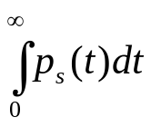
Exercise 1
Sketch with appropriate scales the zero state response of the of Fig.6.10 with
I=200 mA, R=1 kΩ, and C=1μF
I=2 mA, R=50 Ω, and C=5 nF
Exercise 2
Calculate and sketch the waveforms p_{s}(⋅) (the power delivered by the source), p_{R}(⋅) (the power dissipated by the resistor) and E_{C}(⋅), (the energy stored in the capacitor)
Calculate the efficiency of the process, i.e the ratio of the energy eventually stored in the capacitor to the energy delivered by the source [ ]

Slide 25


Sinusoidal Input
We consider now the same circuit but with a different input; the source is now given by a sinusoid
(6.28)
where the constant A₁ is called the amplitude of the sinusoids and the constant ω is called the (angular) frequency. The frequency is measure in radians per second. The constant φ₁ is called phase.
The solution of the homogeneous differential equation if of the same form (See Eq.(6.23)), since the circuit is the same except input. The most convenient particular solution of a linear differential equation with a constant coefficient for a sinusoidal input is a sinusoid of the same frequency. Thus v_{p} is taken to be of the form
(6.29)
where A₂ and φ₂ are constants to be determined. To evaluate them , we substitute (6.29) in the given differential equation, namely

Slide 26
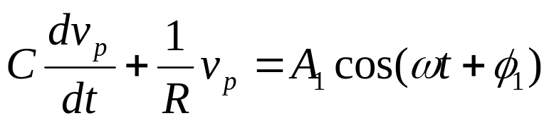
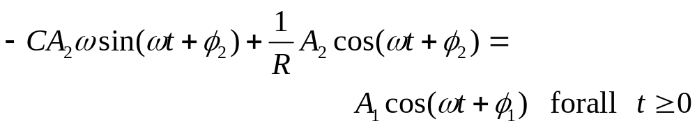




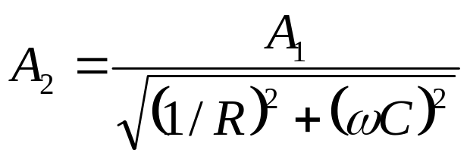
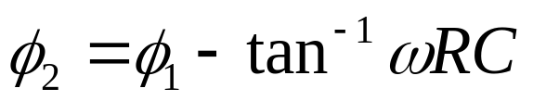
(6.30)
We obtain
(6.31)
Using standard trigonometric identities to express
and
as a linear combination of
and
, and
equating separately the coefficients of
and
we obtain
the following results:
(6.32)
and
(6.33)

Slide 27
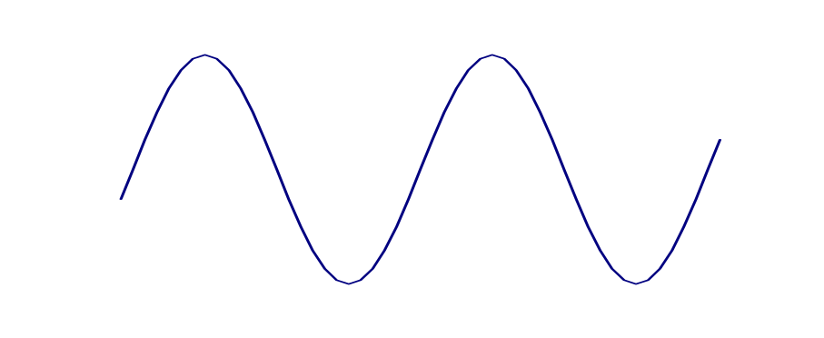


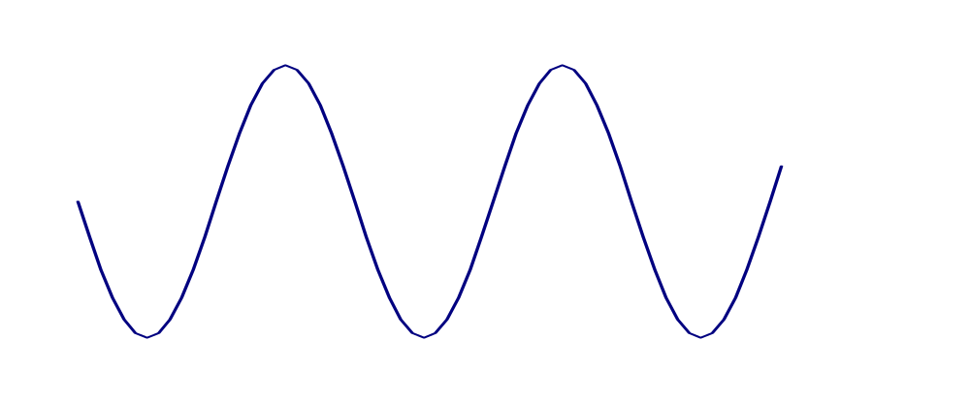
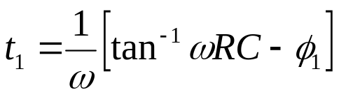
Here tan⁻¹ωRC denotes the angle between 0 and 90º whose tangent is equal to ωRC . This particular solution and the input current are plotted in Fig. 6.12.
i_{s}
A₁
t
Fig.6.12 Input current and a particular solution for the output voltage of the RC circuit in Fig.6.9.
v_{p}
A₂
t₁
t

Slide 28


Exercise
Derive Eqs. (6.32) and (6.33) in detail.
The general solution of (6.31) is therefore of the form
(6.34)
Setting t=0, we have
(6.35)
that is
(6.36)
Therefore the response is given by
(6.37)
where A₂ and φ₂ are defined in Eqs.(6.32) and (6.33). The graph of v, that is the zero-state response to the input A₁ cos(ωt+φ₁), is plotted in Fig.6.13.

Slide 29
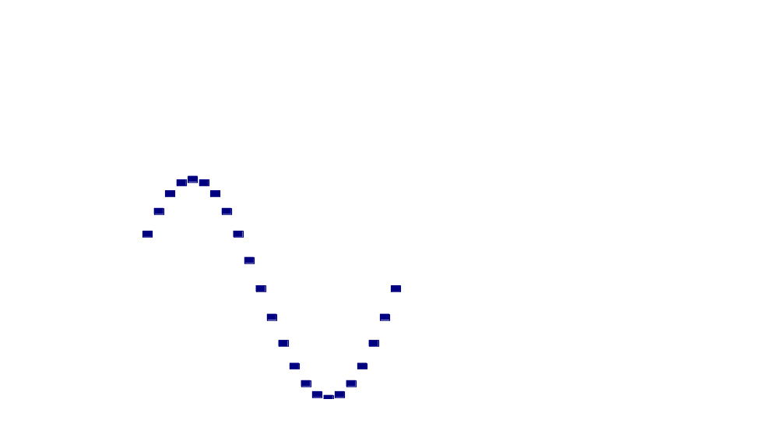
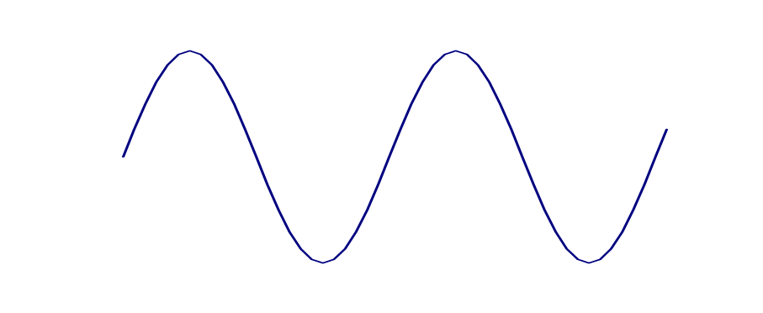
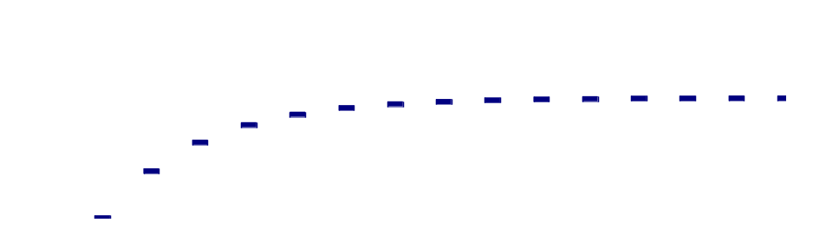
In the two cases treated in this lecture we considered the voltage v as the response and the current source i_{s} as the input. The initial condition in the circuit is zero; that is, the voltage across the capacitor is zero before the application of the input. In general we say that a circuit is in the zero state is all the initial conditions in the circuit are zero. The response of a circuit which starts from the zero state, is due exclusively to the input. By definition, the zero-state response is the response of a circuit to an input applied at some arbitrary time, say, t₀, subject to the condition that the circuit be in the zero state just prior to the application of the input (that is, at time t₀-).
v
In calculating zero-state responses, our primary interest is the behavior of the response for t≥t₀. It means that the input and the zero-state response are taken to be identically zero at t<t₀.
v_{p}
v(t)
t
v_{h}
Fig.6.13. Voltage response of the circuit in Fig. 6.13 with v(0)=0 and i_{s}(t)=A₁cos(ωt+φ₁)

Slide 30
Complete Response: Transient and Steady state
Complete response.
The response of the circuit to both an input and the initial conditions is called the complete response of the circuit. Thus the zero-input response and the zero-state response are special cases of the complete response.
Let us demonstrate that for the simple linear RC circuit considered, the complete response is the sum of the zero-input response and the zero-state response.
B
Consider the circuit in Fig. 6.14 where the capacitor is initially charged; that isv(0)=V₀≠0, and a current input is switched into the circuit at t=0.
k
+
A
+
V₀
C
v
R
i_{s}(t)
-
-
Fig.6.14 RC circuit with v(0)=V₀ is excited by a current source i_{s}(t). The switch k is flipped from A to B at t=0.

Slide 31
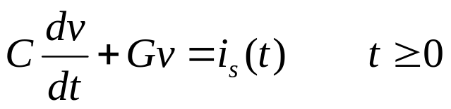

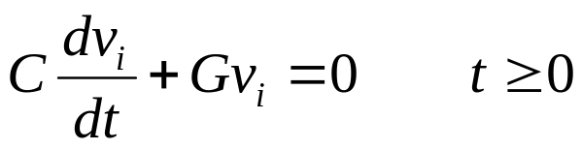



By definition, the complete response is the waveform v(⋅) caused by both the input and the initial i_{s}(⋅) state V₀.
(6.38)
with
(6.39)
Where V₀ is the initial voltage of the capacitor. Let v_{i} be the zero-input response; by definition, it is the solution of
with
Let v₀ be the zero-state response; by definition, it is the solution of
with

Slide 32



From these four equations we obtain, by addition
and
However these two equations show that the waveform v_{i}(⋅)+v₀(⋅) satisfies both the required differential equation (6.38) and the initial condition (6.39). Since the solution of a differential equation such as (6.38), subject to initial conditions such as (6.39), is unique, it follows that the complete response v is given by
that is, the complete response v is the sum of the zero-input response v_{i} and the zero-state response v₀.

Slide 33


Example
If we assume that the input is a constant current source applied at t=0, that is, i_{s}=I, the complete response of the current can be written immediately since we have already calculated the zero-input response and the zero-state response. Thus,
From Eq.(6.8) we have
And from Eq.(6.27) we have
Thus the complete response is
(6.40)
Complete
response
Zero-input
Response v_{i}
Zero-state
Response v₀
The responses are shown in Fig.(6.15)

Slide 34




Remark
We shall prove later that for the linear time invariant parallel RC circuit the complete response can be explicitly written in the following form for any arbitrary input i_{s}:
Complete
response
Zero-input
Response
Zero-state Response
Exercise
By direct substitution show that the expression for the complete response given in the remark satisfies (6.38) and (6.39)
v
RI
v₀
v_{i}
t
Fig.6.15 Zero-input, zero state and complete response of the simple RC circuit. The input is a constant current source I applied at t=0.

Slide 35

Transient and steady state.
In the previous example we can also partition the complete response in a different way. The complete response due to the initial state V₀ and the constant current input I in Eq.(6.40) 9s rewritten as follows
(6.41)
Complete
response
Steady state
Transient
The first term is a decaying exponential as represented by the shaded area, i.e., the difference of the waveform v(⋅) and the constant RI in Fig.6.15. For very large t, the first term is negligible, and the second term dominates. For this reason we call the first term the transient and the second term the steady state. In this example it is evident that transient is contributed by both the zero-input response and the zero-state response, whereas the steady sate is contributed only by the zero-state response.
Physically, the transient is a result of two cases, namely, the initial conditions in the circuit and a sudden application of the input.

Slide 36



The steady state is a result of only the input and has a waveform closely related to that of the input. If the input, for example, is a constant, the steady state response is also a constant; if the input is a sinusoid of angular frequency ω, the steady state response is also a sinusoid of the same frequency. In the example of sinusoid inpput, the input is
,the response has a steady state
portion
and a transient portion
Exercise
The circuit shown in Fig. 6.16 contains 1-farad linear capacitor and a linear resistor with a negative resistance. When the current source is applied, it is in the zero state at time t=0, so that for t≥0, i_{s}=I_{m}cosωt.
Calculate and sketch the response v.
+
1F
v
-1Ω
i_{s}
Is there a sinusoidal steady state?
-
Fig.6.16 Exercise on steady state.

Slide 37
Circuits with Two Time Constants
Problems involving the calculation of transients occur frequently in circuits with switches. Let us illustrate such a problem with the circuit shown in Fig. 6.17. Assume that the capacitor and resistors are linear and time invariant, and that the capacitor is initially uncharged. For t<0 switch k₁ is closed and switch k₂ is open. Switch k₁is opened at t=0 and thus connects the constant current source to the parallel RC circuit. The capacitor is gradually charged with the time constant T₁=R₁C₁. Suppose that t=T₁ ,switch k₂ is closed. The problem is to determine the voltage waveform across the capacitor for t≥0.
k₂
We can divide the problem into to parts, the interval [0,T₁] and the interval [T₁, ∞]. First we determine the voltage in [0,T₁] before switch k₂ closes.
+
I
C
R₁
R₂
k₁
v
-
Fig.6.17 A simple transient problem. The switch k₁ is opened at t=0; the switch k₂ is closed at t=T₁=R₁C₁.

Slide 38




Since v(0)=0 by assumption, the zero-state response can be found immediately. Thus,
(6.42)
At t=T₁
(6.43)
Which represents the initial condition for the second part of our problem. For t>T₁ , since switch k₂ is closed we have a parallel combination of C, R₁ and R₂; the time constant is
(6.44)
and the input is I. The complete response for this second part is, for t≥T₁.
(6.45)

Slide 39

v
R₁I
Time constant T₁
Time constant T₂
0
T₁
t
Fig.6.18 Waveform of voltage for the circuit in Fig.6.17.

Slide 40




RC Circuits
I
a
I
I
a
I
R
R
b
b
+
+
C
C
ε
ε
-
-
RC
2RC
Cε
RC
2RC
Cε
q
q
0
0
t
t

Slide 41
Calculate Charging of Capacitor through a Resistor
Calculate Discharging of Capacitor through a Resistor

Slide 42
Last time--Behavior of Capacitors
Charging
  Initially, the capacitor behaves like a wire.
  After a long time, the capacitor behaves like an open
  switch.
Discharging
  Initially, the capacitor behaves like a battery.
  After a long time, the capacitor behaves like a wire.

Slide 43

The capacitor is initially uncharged, and the two switches are open.
E
3) What is the voltage across the capacitor immediately after switch S₁ is closed?
a) V_{c} = 0 b) V_{c} = E
c) V_{c} = 1/2 E
4) Find the voltage across the capacitor after the switch has been
closed for a very long time.
a) V_{c} = 0 b) V_{c} = E
c) V_{c} = 1/2 E

Slide 44
Initially: Q = 0 V_{C} = 0 I = E/(2R)
After a long time:
V_{C} = E Q = E C I = 0

Slide 45
Preflight 11:
E
6) After being closed a long time, switch 1 is opened and switch 2 is closed. What is the current through the right resistor immediately after the switch 2 is closed?
a) I_{R}= 0
b) I_{R}=E/(3R)
c) I_{R}=E/(2R)
d) I_{R}=E/R

Slide 46
After C is fully charged, S1 is opened and S2 is closed.
Now, the battery and the resistor 2R are disconnected from the circuit. So we now have a different circuit.
Since C is fully charged, V_{C} = E. Initially, C acts like a battery, and I = V_{C}/R.

Slide 47



RC Circuits
(Time-varying currents)
a
I
I
Charge capacitor:
  C initially uncharged; connect switch to a at t=0
R
b
C
ε
    Calculate current and
    charge as function of time.
Would it matter where R is placed in the loop??
• Loop theorem ⇒
Convert to differential equation for Q:
No!
⇒

Slide 48






RC Circuits
(Time-varying currents)
a
I
I
Charge capacitor:
R
b
C
ε
• Guess solution:
Check that it is a solution:
Note that this “guess” incorporates the boundary conditions:
⇒
!

Slide 49


RC Circuits
(Time-varying currents)
Charge capacitor:
a
I
I
R
b
C
Current is found from differentiation:
ε
⇒
Conclusion:
Capacitor reaches its final charge(Q=Cε ) exponentially with time constant τ = RC.
Current decays from max (=ε /R) with same time constant.

Slide 50



Charging Capacitor
Charge on C
Max = Cε
63% Max at t=RC
RC
2RC
Cε
Q
0
t
Current
Max = ε /R
37% Max at t=RC
ε /R
I
0
t

Slide 51


At t=0 the switch is thrown from position b to position a in the circuit shown: The capacitor is initially uncharged.
  At time t=t₁=τ, the charge Q₁ on the capacitor is (1-1/e) of its asymptotic charge Q_{f}=Cε.
  What is the relation between Q₁ and Q₂ , the charge on the capacitor at time t=t₂=2τ ?
a
I
I
R
b
ε
C
R
(a) Q₂ < 2Q₁
(b) Q₂ = 2Q₁
(c) Q₂ > 2Q₁
The point of this ACT is to test your understanding of the exact time dependence of the charging of the capacitor.
Charge increases according to:
So the question is: how does this charge increase differ from a linear increase?
2Q₁
From the graph at the right, it is clear that the charge increase is not as fast as linear.
In fact the rate of increase is just proportional to the current (dQ/dt) which decreases with time.
Therefore, Q₂ < 2Q₁.
Q₂
Q₁
Q
τ
2τ

Slide 52



RC Circuits
(Time-varying currents)
Discharge capacitor:
  C initially charged with Q=Cε
  Connect switch to b at t=0.
  Calculate current and charge as function of time.
a
I
I
R
b
+
+
C
ε
-
-
Loop theorem ⇒
• Convert to differential equation for Q:
⇒

Slide 53




RC Circuits
(Time-varying currents)
Discharge capacitor:
I
I
a
R
b
+
+
C
ε
-
-
• Guess solution:
Q = C
ε
e
-t/RC
• Check that it is a solution:
Note that this “guess” incorporates the boundary conditions:
⇒
R
dQ
+
Q
=
−
ε
e
−
t
/
RC
+
ε
e
−
t
/
RC
=
0
!
dt
C

Slide 54

RC Circuits
(Time-varying currents)
Discharge capacitor:
I
I
a
Q = C
ε
e
-t/RC
R
b
+
+
C
ε
-
-
Current is found from differentiation:
⇒
Conclusion:
Capacitor discharges exponentially with time constant τ = RC
Current decays from initial max value (= -ε/R) with same time constant
Minus sign:
original definition
of current “I” direction

Slide 55

Discharging Capacitor
RC
2RC
Charge on C
Max = Cε
37% Max at t=RC
Cε
Q = C
ε
e
-t/RC
Q
0
zero
t
0
Current
Max = -ε/R
37% Max at t=RC
I
-ε /R
t

Slide 56

Preflight 11:
The two circuits shown below contain identical fully charged capacitors at t=0. Circuit 2 has twice as much resistance as circuit 1.
8) Compare the charge on the two capacitors a short time after t = 0
a) Q₁ > Q₂
b) Q₁ = Q₂
c) Q₁ < Q₂

Slide 57
Initially, the charges on the two capacitors
are the same. But the two circuits have
different time constants:
τ₁ = RC and τ₂ = 2RC. Since τ₂ > τ₁ it takes circuit 2 longer to discharge its capacitor. Therefore, at any given time, the charge on capacitor is bigger than that on capacitor 1.

Slide 58



At t=0 the switch is connected to position a in the circuit shown: The capacitor is initially uncharged.
  At t = t₀, the switch is thrown from position a to position b.
  Which of the following graphs best represents the time dependence of the charge on C?
a
b
R
2R
ε
C
(a)
(b)
(c)
For 0 < t < t₀, the capacitor is charging with time constant τ = RC
For t > t₀, the capacitor is discharging with time constant τ = 2RC
  (a) has equal charging and discharging time constants
  (b) has a larger discharging t than a charging τ
  (c) has a smaller discharging t than a charging τ

Slide 59



Charging Discharging
RC
2RC
RC
2RC
Cε
Cε
Q = C
ε
e
-t/RC
Q
Q
0
0
t
t
ε /R
0
I
I
0
-ε /R
t
t

Slide 60


A very interesting RC circuit
I₁
I₂
I₃
ε
C
R₂
R₁
First consider the short and long term behavior of this circuit.
Short term behavior:
Initially the capacitor acts like an ideal wire. Hence,
and
  Long term behavior:
Exercise for the student!!

Slide 61

Preflight 11:
The circuit below contains a battery, a switch, a capacitor and two resistors
10) Find the current through R₁ after the switch has been closed for a long time.
a) I₁ = 0 b) I₁ = E/R₁ c) I₁ = E/(R₁+ R₂)

Slide 62
After the switch is closed for a long time …..
The capacitor will be fully charged, and I₃ = 0. (The capacitor acts like an open switch).
So, I₁ = I₂, and we have a one-loop circuit with two resistors in series,
hence I₁ = E/(R₁+R₂)
What is voltage across C after a long time?
C is in parallel with R₂ !!
V_{C} = I₁R₂ = E R₂/(R₁+R₂) < E

Slide 63






Very interesting RC circuit continued
Loop 2
Loop 1:
I₁
I₂
Loop 2:
Loop 1
I₃
ε
C
R₂
Node:
R₁
Eliminate I₁ in L₁ and L₂ using Node equation:
Loop 1:
eliminate I₂ from this
Loop 2:
Final differential eqn:

Slide 64




Very interesting RC circuit continued
Final differential eqn:
Loop 2
I₁
I₂
Loop 1
I₃
ε
C
R₂
time constant: τ
parallel combination
of R₁ and R₂
R₁
Try solution of the form:
  and plug into ODE to get parameters A and τ
Obtain results that agree with initial and final conditions:

Slide 65


Very interesting RC circuit continued
Loop 2
I₁
I₂
What about discharging?
  Open the switch...
Loop 1
I₃
ε
C
R₂
R₁
Loop 1 and Loop 2 do not exist!
I₂ is only current
only one loop
  start at x marks the spot...
I₂
ε
C
R₂
R₁
Different time constant for discharging

Slide 66

Kirchoff’s Laws apply to time dependent circuits they give differential equations!
Exponential solutions
  from form of differential equation
time constant τ = RC
  what R, what C?? You must analyze the problem!
series RC charging solution
series RC discharging solution
Q = C
ε
e
-t/RC
Q = C
ε
e
-t/RC

