Slide 1
Lecture 7
First order Circuits (ii).
The linearity of the zero- state response
Linearity and time invariance.
Step response.
The time invariance property.
The shift operator.
Impulse response.
Step and impulse response for simple circuits.
Time varying circuits and nonlinear circuits.

Slide 2
Linearity of the Zero-state Response
The zero-state response of any linear circuit is a linear function of the input; that is, the dependence of the waveform of the zero-state response on the input waveform is expressed by linear function.
Any independent source in a linear circuit is considered as an input.
Let illustrate this fact with the linear time-invariant RC circuit that we studied (See Fig.7.1) Let the input be the current waveform i_{s} (⋅), and let the response be the voltage waveform v(⋅).
The zero-response state of the linear time-invariant parallel RC circuit is a linear is a linear function of the input: that is the dependence of the zero-response waveform on the input waveform has the property of additivity and homogeneity
+
C
v
R=1/G
i_{s}
-
Fig.7.1 Linear time-invariant RC circuit with input i_{s} and response v

Slide 3
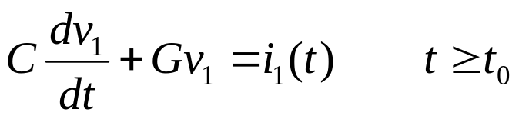
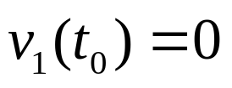
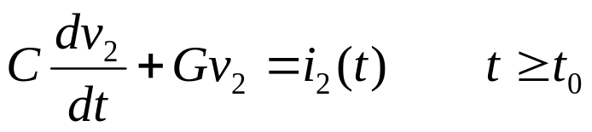
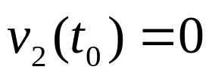
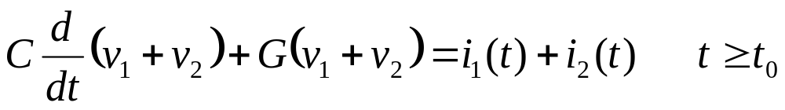
1. Let us check additivity. Consider two input currents i₁ and i₂ that are both applied at t₀. Note that by i₁ (and also i₂ )we mean current waveform that starts at t₀ and goes forever. Call v₁ and v₂ the corresponding zero-state responses. By definition, v₁ is the unique solution of the differential equation
(7.1)
with
(7.2)
Similarly, v₂ is the unique solution of
(7.3)
with
(7.4)
Adding (7.1) and (7.3), and taking (7.2) and (7.4) into account, we see that the function v₁ + v₂ satisfies
(7.5)

Slide 4
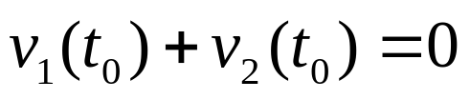
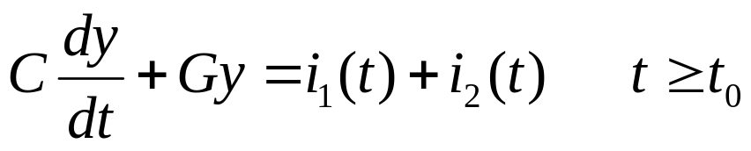
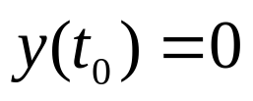
with
(7.6)
By definition the zero-state response to the input i₁+i₂ applied at t=t₀ is the unique solution of the differential equation
(7.7)
with
(7.8)
By the uniqueness theorem for the solution of such differential equations and by comparing (7.5) and (7.6) with (7.7) and (7.8), we arrive at the conclusion that the waveform v₁(⋅)+v₂(⋅) is the zero-state response to the input waveform i₁(⋅)+i₂(⋅). Since this reasoning applies to any input i₁(⋅) and any i₂(⋅) applied at any time t₀, we have shown that the zero-state response of the RC circuit is a function of the input, which obeys the additivity property.
2. Let us check homogeneity. We consider the input i₁(⋅) (applied at t₀) and the input ki₁(⋅) , where k is an arbitrary real constant.

Slide 5
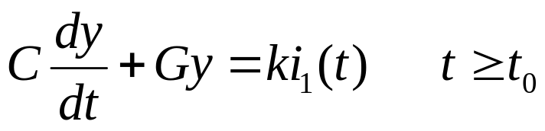
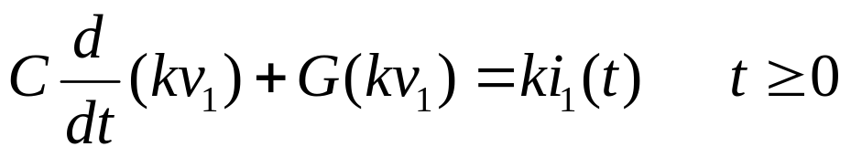
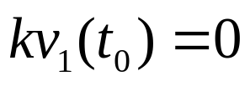
By definition, the zero-state response due to i₁ satisfies (7.1) and (7.2). Similarly, the zero-state response due to ki₁(⋅) satisfies the differential equation
(7.9)
with
(7.10)
By multiplying (7.1) and (7.2) by the constant k, we obtain
(7.11)
with
(7.12)
Again, the comparison of the four equations above, together with the uniqueness theorem of ordinary differential equations, leads to the conclusion that the zero-state response due to ki₁ is kv₁. Since this reasoning applies to any input waveform i₁(⋅), any initial time t₀ and any constant k, we have shown that the zero-state response of the RC circuit is a function of the input, which obeys the homogeneity property.

Slide 6
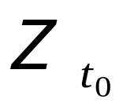



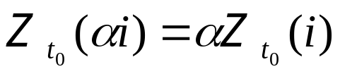
The
The linearity of the zero-state response can be expressed symbolically by introducing the operator . For the RC circuit in Fig.7.1, let denote the waveform of the zero-state
operator
Response of the RC circuit to the input i₁(⋅). The subscript t₀ in is used to indicate that the RC circuit is in the zero state at time t₀ and that the input is applied at t₀. Therefore, the linearity of the zero-state response means precisely the following:
1. For all input waveforms i₁(⋅) and i₂(⋅) defined for t≥t₀ and taken to be identically zero for t<t₀ ), the zero state response due to the input i₁(⋅) + i₂(⋅) is the sum of the zero-state response due to i₁(⋅) alone and the zero-state response due to i₂(⋅) alone; That is,
(7.13)
2. For all real numbers α and all input waveforms i(⋅) , the zero-state response due to the input α i(⋅) is equal to α times the zero-state response due to the input i(⋅); that is
(7.14)

Slide 7
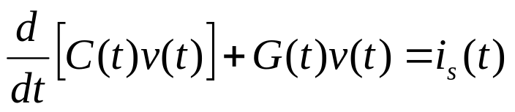
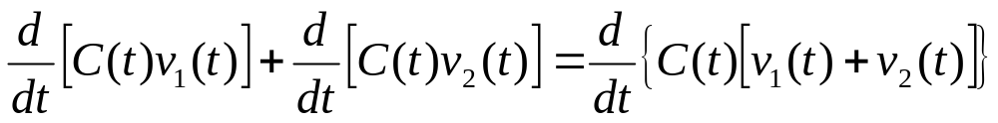
Remarks
1. If the capacitor and resistor in Fig.7.1 are linear and time varying, the differential equation is, for t≥t₀
(7.15)
The zero-state response is still a linear function of the input; indeed the proof of additivity and homogeneity would require only slight modifications. This proof still works because
(7.16)
2. The following fact is true although we have only proven it for a special case. Consider any circuit that contains linear (time invariant or time varying) elements. Let the circuit be driven by a single independent source, and let the response be a branch voltage or branch current. Then the zero-state response is a linear function of the input.
3. The complete response is not a linear function of the input (unless the circuit starts from the zero state.

Slide 8
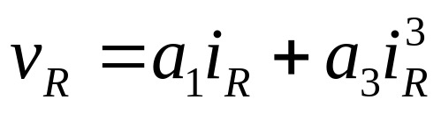
If the circuit is in an initial state V₀≠0, that is v₁(t)=V₀ in Eq.(7.2) and v₂=V₀ in Eq. (7.4), then in Eq.(7.6) [v₁(t)+v₂(t)]=2V₀, which is not a specified initial state. It means that initial conditions, together with the differential equation, characterize the input-response relation of a circuit.
Exercise
Show that if a circuit includes nonlinear elements, the zero state response is not necessary a linear function of the input. Consider the circuit shown in Fig.7.2 and let the resistor be nonlinear with the characteristic
where a₁ and a₃ are positive constants. Show that the operator
does not posses the additivity property
i_{R}
L
+
e_{s}
v
R
Fig.7.2 RL circuit with input e_{s} and response i_{R}
+
-
-

Slide 9
Linearity and Time Invariance
Step Response
Up to this point, whenever we connected an independent source to a circuit, we used a switch to indicate that a certain time t=0 the switch closes or opens, and the input starts acting on the circuit. An alternate description of the operation of applying an input starting at a specified time, say t=0, can be supplied by using a step function. For a example, a constant current source that is applied to a circuit at t=0 can be represented by a current source permanently connected to the circuit (without the switch) but with a step function waveform plotted in Fig.7.3.
i(t)=Iu(t)
I
Fig. 7.3 Step function of magnitude I
0
t

Slide 10
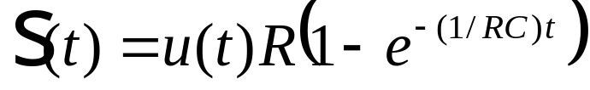
Thus for t<0, i(t)=0, and for t>0, i(t)=I. At t=0 the current jumps from 0 to I.
We call the step response of a circuit its zero-state response to the unit step input u(⋅); we denote the step response by s. More precisely, s(t) is the response at time t of the circuit provided that (1) its input is the step function u(⋅) and (2) the circuit is in zero state just prior the application of the unit step. As mentioned before, we adopt the convention that s(t)=0 for t<0. For the linear time-invariant RC circuit in Fig. 7.4 the step response is for all t
(7.17)
s(t)
+
R
C
v
R
Time Constant T=RC
-
u(t)
t
Fig. 7.4 Step response of simple RC circuit

Slide 11


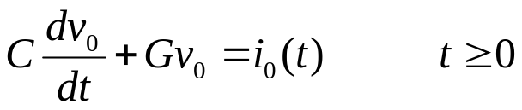

The Time-Invariance Property
Let us consider any linear time-invariant circuit driven by a single independent source, and pick a network variable as a response. For example we might use the parallel RC circuit previously considered: Let the voltage v₀ be the zero-state response of the circuit due to the current source input i₀ starting at t=0. In terms of the operator we have
(7.18)
The subscript 0 of the operator denotes specifically the starting time t=0. Thus, v₀is the unique solution of the differential equation
(7.19)
with
(7.20)
In solving (7.19) and (7.20) we are only interested in t≥0. By a previous convention, we assume i₀(t)=0 and v₀(t)=0 for t<0. Suppose that without changing the shape of the waveform i₀(⋅), we shift it horizontally so that it starts now at time τ, with τ ≥0 (See Fig. 7.5).

Slide 12

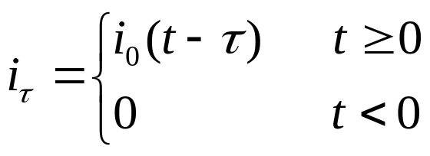

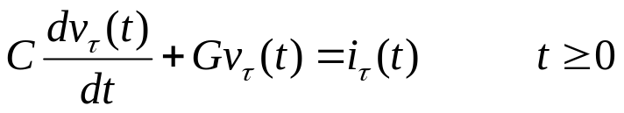

The new graph defies a new function i_{τ}(⋅), ; the subscript τ represents the new starting time. Obviously from graph, the ordinate of i_{τ} at time τ +t₁ is equal to the ordinate of i₀ at time t₁; thus, since t₁ is arbitrary
If we set t=τ+t₁, we obtain
(7.21)
Consider now v_{τ}, the response of the RC circuit to i_{τ} ,given that the circuit is in the zero state at time0; that is
(7.22)
i₀
More precisely, v_{τ} is the unique solution of
i_{τ}
(7.23)
t₁
τ
τ+t₁
t
with
Fig. 7.5. The waveform i_{t} is the result of shifting the waveform i₀ by τ sec.
(7.24)

Slide 13

Intuitively, we expect that the waveform v_{τ} will be the waveform v₀ shifted by τ. Indeed, the circuit is time invariant; therefore, its response to i_{τ} applied at time τ is, except for a shift of time, the same as its response to i₀ applied at time t=0. This fact illustrated in Fig. 7.6.
i₀
Let us prove this statement. We’ll proceed in two steps.
t
1. On the interval (0,τ), v_{τ} is identical to zero; indeed, v_{τ}≡0 satisfies Eq.(7.23) for 0 ≤ t ≤ τ (because i_{τ}≡0 on that interval) and the initial condition (7.24). Since on v_{τ}≡0 on 0 ≤ t ≤ τ , it follows that
v₀
i₀
t
(7.25)
τ
2. Now we must determine v_{τ} for t ≥ τ . In this task we use Eq. (7.25) as our initial condition.
v₀
t
t
Fig. 7.6. Illustration of the time-invariant property.
τ

Slide 14
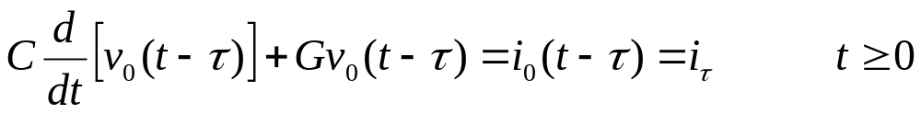
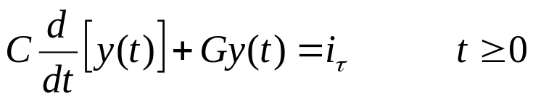
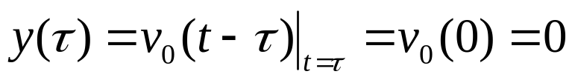

We assert that the waveform obtained by shifting v₀ by τ satisfies Eq. (7.23) for t ≥ τ and Eq. (7.25). To prove this statement, let us verify that the function y, defined by y(t)=v₀(t-τ), satisfies the differential equation (7.23) for t ≥ τ and the initial condition (7.25)
Replacing t by t-τ in Eq.(7.19), we obtain
(7.26)
or, by definition,
(7.27)
which is precisely Eq.(7.23) for t ≥ τ . The initial condition is obviously satisfied since
In other words, the function y(t)=v₀(t-τ), satisfies the differential equation (7.23) for t ≥ τ and the initial condition (7.25). This fact, together with v_{τ}≡0 on (0,τ), ,implies that the waveform v₀ shifted byτ
is , the zero-state response to i_{τ}.

Slide 15





Example
If
then
and the zero-state response to
is
Remarks
The reasoning outlined above does not depend upon the particular value τ≥ 0 , nor does it depend upon the shape of the input waveform i₀ . In other words, for all τ≥ 0 and all i₀, is identical with the waveform shifted by τ. This fact called the time-invariance property of the linear time-invariant RC circuit.
It is crucial to observe that the constancy of C and G was used in arguing that Eq.(7.26) and (7.27) was simply Eq.(7.19) in which t-τ was substitute for t.

Slide 16





The Shift Operator
The idea of time invariance can be expressed precisely by the use of a shift operator. Let f(⋅) be a waveform defined for all t. Let F_{τ} be an operator which when applied to f yields an identical waveform except that it has been delayed by τ ; the shifted waveform is called f_{τ}(⋅) and its ordinates are given by
In other words, the result of applying the operator F_{τ} to the waveform f is a new waveform denoted by F_{τ}f , such that the value at any time t of the new waveform, denoted by (F_{τ}f)(t), is related to the values of f by
In the notation of our previous discussion we have
. The
operator
is called a shift operator. Shift operator is a linear operator.
Indeed it is additive. Thus,
that is, the result of shifting f+g is equal to the sum of the shifted f and the shifted g.

Slide 17


It also homogeneous. If α is any real number and f is any waveform
That is, if we multiply the waveform f by the number α and shift the result, we have the very same waveform that would have had if we first shifted f and then multiplied it by α .
Let us use the shift operator to express the time-invariance property. As before let be the response of the circuit to the input i₀ provided that the circuit is in the zero state at time 0. Previously, we used v₀(t) to denote the value of the zero-state response at time t (see Eq. (7.18)). The reason that is used now is to emphasize the dependence of the zero-state response on the whole input waveform i₀(⋅) and to emphasize the time at which the circuit is in the zero state.
(7.28)
Equation (7.28) states the time-invariant property of linear time-invariant circuits.

Slide 18
Remark
The time-invariance property as expressed by (7.28) may be interpreted as that the operators F_{τ} and Z₀ commute; i.e., the order of applying the two operations is immaterial.
It is a remarkable fact that the operators F_{τ} and Z₀ commute for linear time-invariant circuits, because in the large majority of cases if the order of two operations is interchanged, the results are drastically different.
Example
Let us consider an arbitrary linear time invariant circuit. Suppose that we measured the zero-state response v₀ to the pulse i₀ shown in Fig. 7.7 and have a record o the waveform v₀ . Using our previous notations, this means that v₀= Z₀ (i₀). The problem is to find the zero-state response v to the input i shown in Fig.7.8, where
i₀
v₀
Z₀ (i₀)=v₀
Fig. 7.7 Current i₀
and corresponding zero-state response v₀
1
1
1
1
t
0
t
0

Slide 19
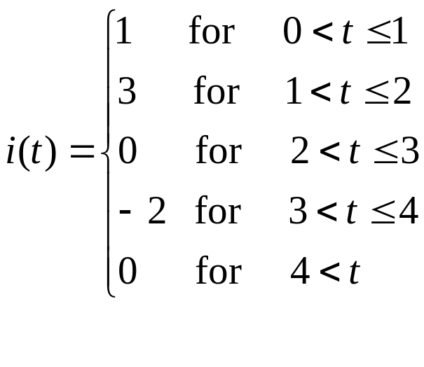
i
3
Fig. 7.8 Input i(t)
2
1
3
4
0
t
1
2
5
-1
-2
3τ₁(i₀)
-2τ₃(i₀)
i
3
1
t
3
4
1
2
0
1
0
2
1
0
t
t
Fig. 7.9 Decomposition of i in terms of shifted pulses
-2

Slide 20
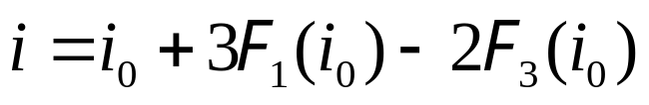
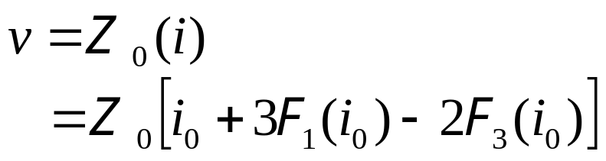
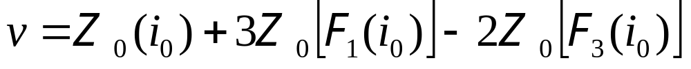
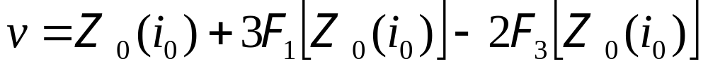
The key observation is that the given input can be represented as a linear combination of i₀ and multiplies of i₀ shifted in time. The process is illustrated in Fig. 7.9; the sum of the three functions is shown is i. It is obvious from the graphs of i and i₀ that
Now call v the zero-state response we get
By the linearity of the zero-state response we get
and by the time-invariance property
Since

Slide 21
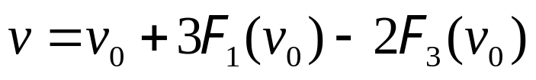
or
Remark
The method used to calculate v in terms of v₀ is usually refereed to as the superposition method. It is fundamental to realize that we have to invoke the time-invariance property and the fact that the zero-state response is a linear function of the input.
R
Exercise
+
2
C=1
i_{s}
v
R=2
-
1
(a)
2
t
1
Fig.7.10 (a) A simple RC circuit; (b) time-varying resistor characteristic
(b)

Slide 22
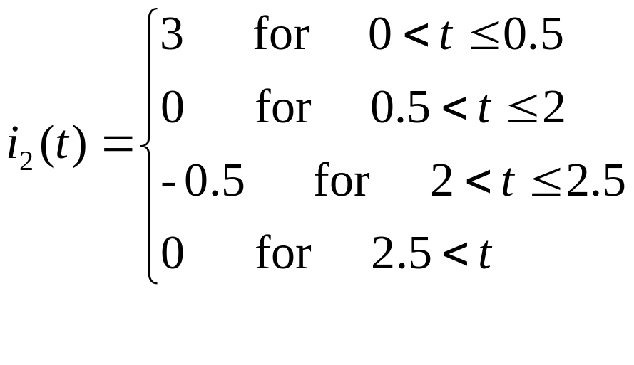
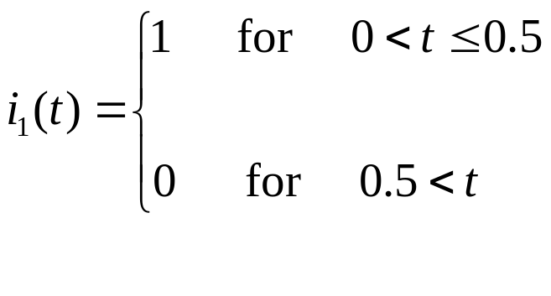
Consider the linear time-invariant RC circuit shown in Fig. 7.10a; i_{s} is its input, and v is its response
a.
Calculate and sketch the zero-state response to the following inputs:
b.
Suppose now that the resistor is time-varying but still linear. Let its resistance be a function of time as shown in Fig.7.10b.

Slide 23
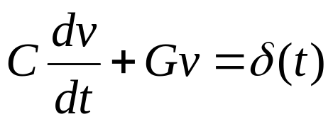

Impulse Response
The zero state-response of a time-invariant circuit to a unit impulse amplitude at t=0 is called impulse response of a circuit and is denoted by h. More precisely, h(t) is the response at time t of the circuit provided that (1) its input is the unit impulse δ and (2) it is in the zero state just prior to the application of the impulse. For convenience we shall define h to be zero for t>0.
1st method
Let us approximate the impulse by the pulse function p_{Δ} and let us calculate the impulse response of the parallel RC circuit shown in Fig.7.11. The input to the circuit is the current source i_{s}, and the response is the output voltage v. Since the impulse response is defined to be zero-state response to δ , the impulse response is the solution of the differential equation
(7.29)
+
C
v
R
with
i_{s}
(7.30)
-
where the symbol 0- designates the time immediately before t=0.
Fig.7.11 Linear time-invariant circuit

Slide 24
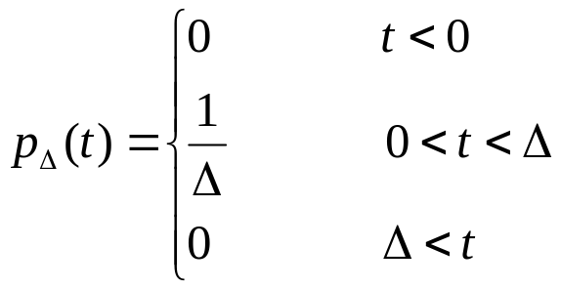

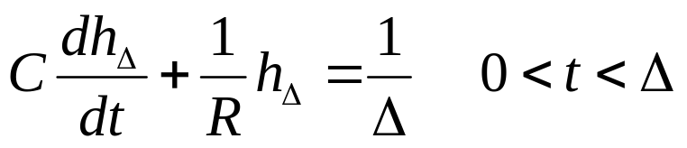
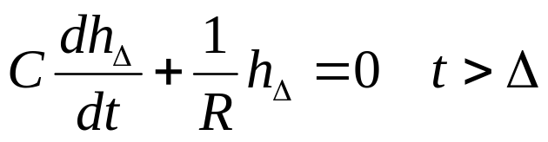
Equation (7.30) states that the circuit is in the zero state just prior to the application of the input. In order to solve (7.29) we run into some difficulties since, strictly speaking, δ is not a function. Therefore, the solution will be obtained by approximating unit impulse δ by the pulse function p_{Δ} , computing the resulting solution, and then letting Δ→0. Recall that p_{Δ} is defined by
p_{Δ}(t)
Δ
t
and it is plotted in Fig. 7.12. The first step is to solve for h_{Δ} ,the zero state response of the RC circuit to p_{Δ}, where Δ is chosen to be much smaller than the time constant RC. The waveform is the solution of
(7.31)
(7.32)

Slide 25
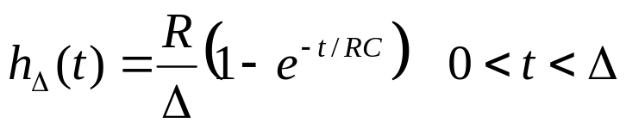





with h_{Δ} =0. Clearly, 1/Δ is a constant; hence from (7.31)
(7.33)
and it is the zero-state response due to a step (1/Δ)u(t). From (7.32), h_{Δ} for t>0 is the zero-input response that starts from h_{Δ}(Δ) at t=Δ; thus
(7.34)
The total response h_{Δ} from (7.31) and (7.32) is shown in Fig. 7.13a.
h
h_{Δ}(Δ)
h_{Δ}
h_{Δ}
0
Δ
t
0
t
–
Δ=1
Fig.7.13 (a) Zero-sate response of p_{Δ} ; (b) the response as Δ→0

Slide 26
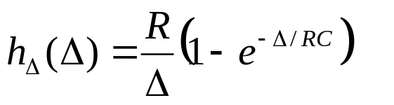
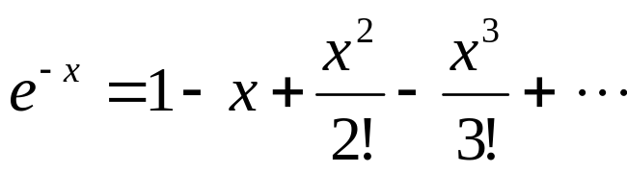
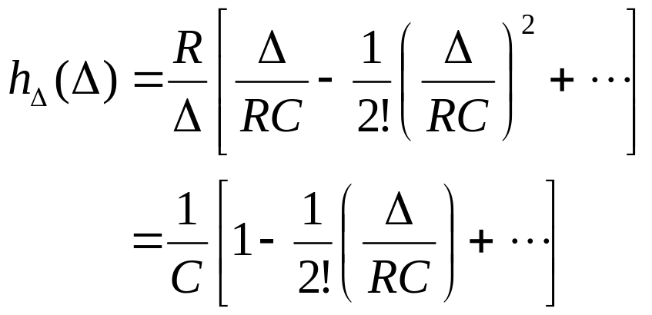
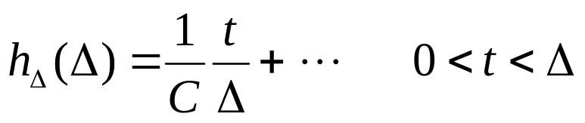
From (7.33)
Since Δ is much smaller than RC, using
we obtain
Similarly, from (7.33) for Δ very small and 0<t<Δ, expanding the exponential function, we obtain

Slide 27
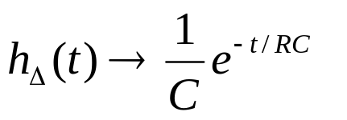
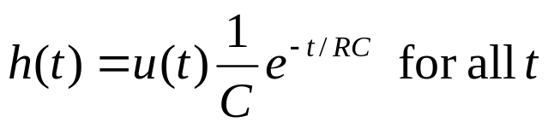

Note that the slope of the curve h_{Δ} over (0,Δ) is 1/CΔ. This slope is very large since Δ is small. As Δ→0, the curve h_{Δ} over (0,Δ) becomes steeper and steeper, and h_{Δ}(Δ) →1/C. In the limit, h_{Δ} jumps from 0 to 1/C at the instant t=0. For t>0, we obtain, form (7.34)
As Δ approaches zero, h_{Δ} approaches the impulse h as shown in Fig.7.13b. Recalling that by convention we set h(t)=0 for t<0, we can therefore write
(7.35)
The impulse response h is shown in Fig. 7.14.
h
Time constant =RC
Fig. 7.14. Impulse response of the RC of Fig. 7.11
0
t

Slide 28
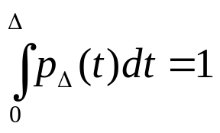


Remarks
1.
The calculating of the impulse response is a straightforward procedure; it requires only the approximation of δ by a suitable pulse, here p_{Δ} . The only requirements that p_{Δ} must satisfy are that it be zero outside the interval (0,Δ) and that are under p_{Δ} be equal to 1; that is
It is a fact that the slope of p_{Δ} is irrelevant ; therefore we choose a shape that requires the least amount of work. We might very well chosen a triangular pulse as shown in Fig.7.15. Observe that the
Maximum amplitude of the triangular pulse is now 2/Δ; this is required in order that the are under the pulse be unity for all Δ>0.
0
Δ
t
2.
Since δ(t)=0 for t>0 (that is, the input is identically zero for t>0), it follows that the impulse response h(t)is, for t>0, identical to a particular zero-input response.
Fig.7.15 A triangular pulse can also be used for impulse approximation

Slide 29
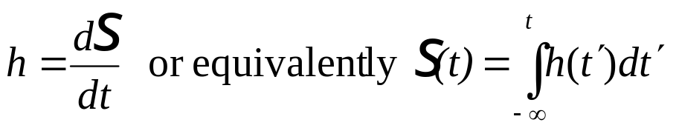
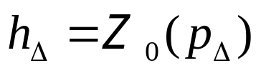
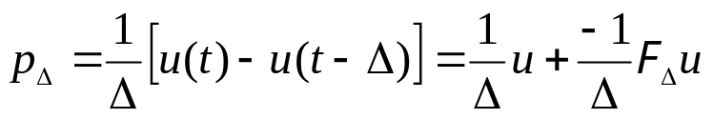
Relation between impulse response and step response
We want to show that the impulse response of a linear time-invariant circuit is the time derivative of its step response
Symbolically
(7.36)
We prove this important statement by approximation the impulse by the pulse function p_{Δ} . Let h_{Δ} be the zero-state response to the input p_{Δ}; that
As Δ→0, the pulse function p_{Δ} approaches δ , the unit impulse, and the zero-state response to the pulse input, approaches the impulse response h. Now consider p_{Δ} as a superposition of a step and delayed step as shown in Fig.7.16. Thus,

Slide 30
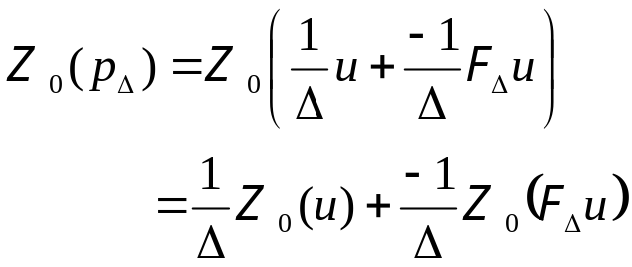

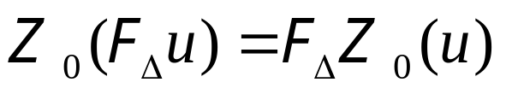


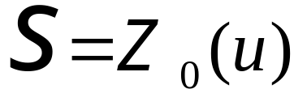

By the linearity of the zero-state response, we have
(7.37)
p_{Δ}
Since the circuit is linear and time-invariant, the operator and the shift operator commute; thus
Δ
t
(a)
(7.38)
Δ
Let us denote the step response by
t
t
(b)
(c)
Equations (7.37) and (7.38) can be combined to yield
Fig. 7.16 The pulse function p_{Δ} in (a) can be considered as the sum of a step function in (b)and delayed step function in (c)

Slide 31
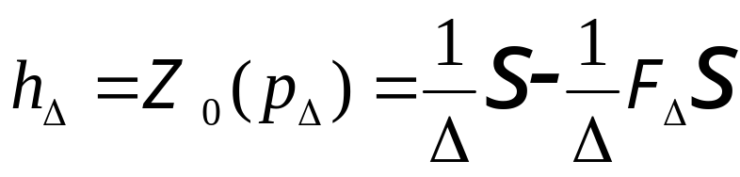


or
hence
If Δ→0 the right-hand side becomes the derivative;
Remark
The two equations in (7.36) do not hold for linear time-varying circuits; this should be expected since time invariance is used in a key step of derivation. Thus, for linear time-varying circuits the time derivative of the step function is not the impulse response.

Slide 32





2nd method
We use
Again considering the parallel circuit in Fig.7.11, we recall that its step response s is given by
If we consider the right hand side as a product of two functions and use the rule of differentiation we obtain the impulse response
The first term is identically zero because for t≠0, δ(t)=0, and for t=0,
, Therefore,
That result checks with previously obtained in (7.35)

Slide 33




3^{d} method
We use the differential equation directly. We propose to show that h defined by
is the solution to the differential equation
(7.39)
In order not to prejudice the case, let us call y the solution to (7.39). Thus, we propose to show that y=h. Since δ(t)=0 for t>0 and y is the solution of (7.39)., we must have
(7.40)
This is shown in Fig.7.17a. Since δ(t)=0 for t<0 and the circuit is in the zero state at time 0-, we must also have
(7.41)

Slide 34




This is shown in Fig. 7.17b. Combining (7.40) and (7.41), we conclude that
(7.42)
It remains to calculate y(0+), that is, the magnitude of the jump in the curve y at t=0.
From (7.42) and by considering the right-hand side as a product of the functions, we obtain
y
y(0+)
(a)
0+
t
0-
(b)
Fig.7.17 Impulse response for the parallel RC circuit. (a) y(t)>0; (b) y(t)<0

Slide 35




In the first term, since δ(t) is zero everywhere except t=0, we may t
to zero in the factor of δ(t) ; thus
Substituting this result into (7.39), we obtain
Inserting this value of y(+0) into (7.42), we conclude that the solution of (7.39) is actually h, the impulse response calculated previously.
Remark
WE shown that the solution of the differential equation
for t>0 is identical with the solution of
(7.43)
for t>0

Slide 36






This can be seen by integrating both sides of (7.39) form t=0- to t=0+ to obtain
Since v is finite,
, and since
v(0-)=0,
we obtain
Step and Impulse Response for Simple Circuits
Example 1
Let us calculate the impulse response and the step response of RL circuit shown in Fig.7.1. the series connection of the linear time-invariant resistor and inductor is driven by a voltage source.
i
L
h
+
v_{s}
v
R
-
(a)
Fig.7.18 (a) Linear time-invariant RL circuit; v_{s} is the input and i is the response; (c) impulse step response
0
t
(b)

Slide 37






As far as the impulse response concerned, the differential equation for the current i is let to that of the same circuit with no voltage source but with the initial condition i(0+)=1/L; that is, for t>0
(7.44)
The solution is
(7.45)
The step response can be obtained either from integration of (7.45) or directly from the differential equation
(7.46)
As the step of voltage is applied to the circuit, that is at 0+, the current in the circuit remains zero because, the current through an inductor cannot change instantaneously unless there is an infinitely large voltage across it.
0
t
Fig.7.18(c)

Slide 38

Since the current is zero, the voltage cross the resistor must be zero. Therefore, at 0+ all the voltage of the voltage source appear across the inductor; in fact
As time increases, the current increases monotonically, and after a long time, the current becomes practically constant. Thus , for large t, di/dt≈0; that the voltage across the inductor is zero, and all the voltage of the source is across the resistor. Therefore, the current is approximately 1/R. In the limit we reach what is called the steady state and i=1/R. → The inductor behaves as a short circuit in the steady state for a step voltage input.
Example 2
Consider the circuit in Fig. 7.19, where the series connection of a linear time invariant resistor R and a capacitor C is driven by a voltage source. The current through the resistor is the response of interest, and th problem is to find the impulse and step responses. The equation for the current i is given by writing KVL for the loop; thus

Slide 39




(7.47)
Let us use the charge on the capacitor as the variable; then (7.47) becomes
(7.48)
Since we have to find the step and impulse responses, the initial conditions is q(0-)=0. If v_{s} is a unit step,(7.48) gives
C
i
v_{s}
T=RC
R
0.377R
0
T
–
t
(a)
(b)
Fig.7.19 (a) Linear time-invariant RC circuit; v_{s} is the input and i is the response; (b) step response; (c) impulse response.

Slide 40





And by differentiation, the step response for the current is
And by differentiation, the step response for the current is
If v_{s} is a unit impulse, (7.48) gives
And by differentiation, the impulse response for the current is

Slide 41

We observe that in response to a step, the current is discontinuous at t=0; i_{s}(0+)=1/R as we expect, since at t=0 there is no charge (hence no voltage) on the capacitor. In response to an impulse, the current includes an impulse of value 1/R, and, for t>0, the capacitor discharges through the resistor.
h
0
t
Fig.7.19 (c)

Slide 42

7.1

Slide 43

7.1

Slide 44

Time-varying Circuits and Nonlinear Circuits
If the first –order circuits are linear (time invariant or time varying), then
The zero-input response is a linear function of the initial state
The zero-state response is a linear function of the input
The complete response is the sum of the zero-input response and of the zero-state response
We have also seen that if the circuit is linear and time invariant, then
1.
which means that the zero-state response (starting in the zero state at time zero) to the shifted input is equal to the shift of the zero-state response (starting also in the zero state at time zero) to the original input.
The impulse response is the derivative of the step response
For time-varying circuit sand nonlinear circuits the analysis problem is in general difficult and there is no general methods except numerical solutions.

Slide 45
Example 1
Consider the parallel RC circuit presented in Fig.7.20
+
v
-
i_{R}
+
v_{R}
₋
C=1 F
Fig.7.20

Slide 46
Summary
A lumped circuit is said to be linear if each of its element is either a linear element or an independent source. A lumped circuit is said to be time invariant if each of its elements is ether time –invariant or an independent source
The zero-input response of a circuit is defined to be response of the circuit when no input is applied to it; thus, the zero-input response is due to the initial state only
The zero-state response of a circuit is defined to be a response of the circuit due to an input applied at some time, say t₀, subject to the condition that the circuit be in the zero state just prior to the application of the input (that is, at time t₀₋); thus the zero-state response is due to the input only
The step response is defined to be zero-state response due to a unit step input

Slide 47
The impulse response is defined to be the zero-state response due to a unit impulse
For a linear first-order circuits we have shown that
  The zero-input response is a linear function of the initial state
  The zero-state response is a linear function of the input
  The complete response is the sum of the zero-input response and of the zero-state response
1.
which means that the zero-state response (starting in the zero state at time zero) to the shifted input is equal to the shift of the zero-state response (starting also in the zero state at time zero) to the original input.
The impulse response is the derivative of the step response

