Slide 1
Lecture 8
Second order circuits (i).
Linear time invariant RLC-circuits,
  zero-input response.
  Energy and Q factor
Linear time invariant RLC-circuits, zero-state response
  Step response,
  Impulse response
The State-space approach
  state equations and trajectory,
  matrix representation,
  approximate method for the calculation of trajectory,
  state equations and complete response

Slide 2

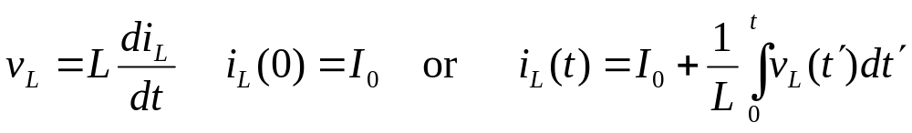
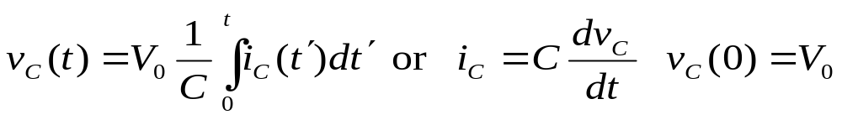


Linear Time-invariant RLC Circuit, Zero-input response
In Fig. 8.1 we have a parallel connection of three linear time invariant and passive elements: a resistor, an inductor, and a capacitor. Their branch equations are
(8.1)
(8.2)
(8.3)
i_{R}
where R, G, L, and C are positive numbers representing respectively, the resistance, conductance, inductance and capacitance. I₀ represents the initial current in the inductor, and V₀ represents the initial voltage across the capacitor.
+
v_{c}
-
i_{c}
i_{L}
+
v_{L}
-
+
v_{R}
₋
Fig. 8.1 Parallel RLC circuit; the three elements are linear time invariant and passive

Slide 3
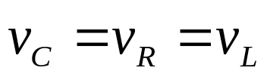
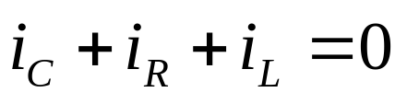
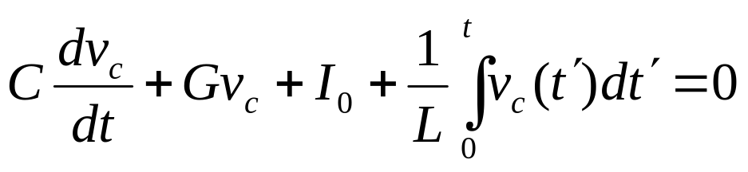
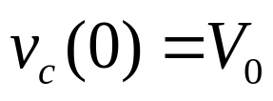
From KVL we have
(8.4)
and from KCL we have
(8.5)
Altogether we have six equations. This leads us to expect that the six unknown network variable can be uniquely determined.
Let us use the capacitor voltage v_{c} as the most convenient variable. Using Eqs. (8.1) to (8.5) we obtain the following integrodifferential equation in terms of the voltage v_{c}:
(8.6)
and
(8.7)

Slide 4
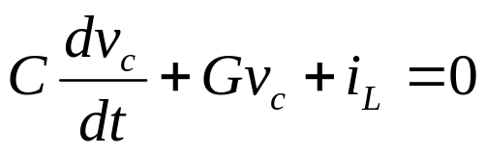
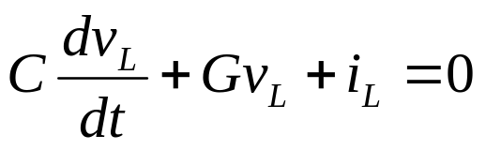
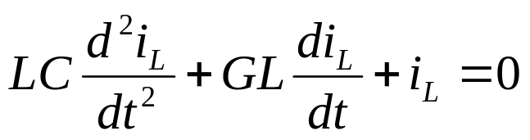

Once the voltage v_{c} is obtained, the five other network variables can be found from Eqs.(8.1) to (8.4). An alternate approach is to choose the inductor current i_{L} as the variable. If we use the branch equations for the capacitor, we obtain from (8.5)
Since in (8.4) v_{c}=v_{R}=v_{L}, the above equation becomes
(8.8)
Now we use the branch equation for the inductor to obtain the following second-order differential equation with i_{L} as the dependent variable:
(8.9)
The necessary initial conditions are
(8.10)

Slide 5
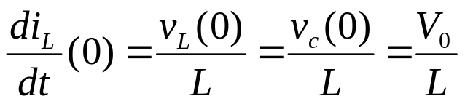
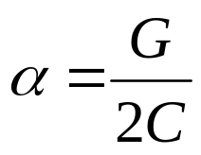
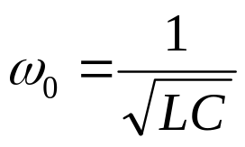
and
(8.11)
The differential equation (8.9) with initial conditions (8.10) and (8.11) has a unique solution i_{L}. Once the current i_{L} is obtained, we can find the five other network variables from Eqs. (8.1) to (8.5). Let us find i_{L} form Eqs. (8.9) to (8.11). Since no source is driving the circuit, the response i_{L} is the zero-input response.
For convenience in manipulation let us define two parameters α and ω₀ as
(8.12)
The parameter α is called the dumping constant, and the parameter ω₀ ( in radians per second) is called the (angular) resonant frequency.
ω₀ =2πf₀, where f₀ (in hertz) is the resonant frequency of the inductor and the capacitor. These two α and ω₀ parameters characterize the behavior of the RLC circuit. Dividing Eq.(8.9) by LC, we obtain

Slide 6
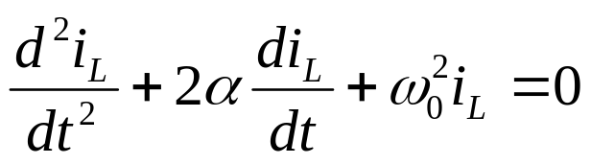
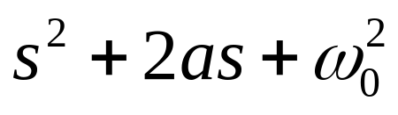
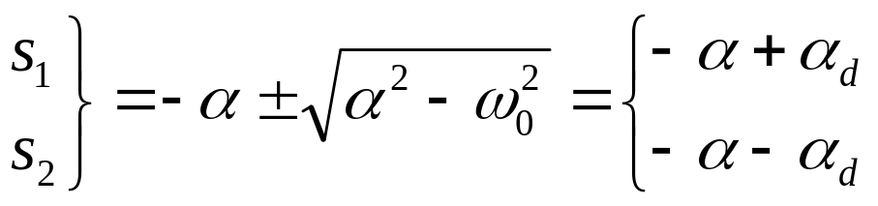
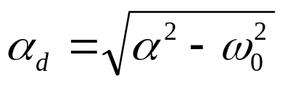
(8.13)
This is the second-order homogeneous differential equation with constant coefficients. The characteristic polynomial for this differential equation is
(8.14)
The zeros of the characteristic polynomial are called the characteristic roots or, better, the natural frequencies of the circuit; they are
(8.15)
where

Slide 7
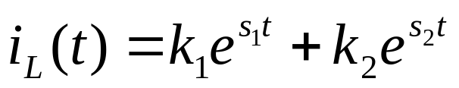
The form of the zero-input response of the circuit depends upon the relative values of α and ω₀ . According to the relative values of α and ω₀ ,we can classify the zero-input response into four classes:
overdumped,
critically dumped,
underdamped
losses
The first three cases give waveforms i_{L}(⋅) that are some forms of damped exponentials, whereas the last case corresponds to a sinusoidal waveform.
1.
Overdamped (α >ω₀ ). The two natural frequencies s₁ and s₂ are equal and negative. The response is the sum of two damped exponentials
(8.16)
where the constants k₁ and k₂ depend on the initial conditions.
2.
Critically damped (α =ω₀ ). The two natural frequencies are equal and real; that is, s₁=s₂ =α. The response is

Slide 8
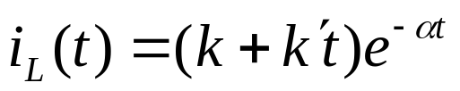

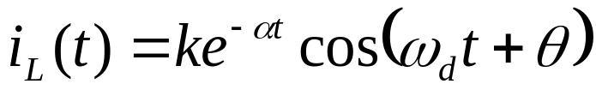
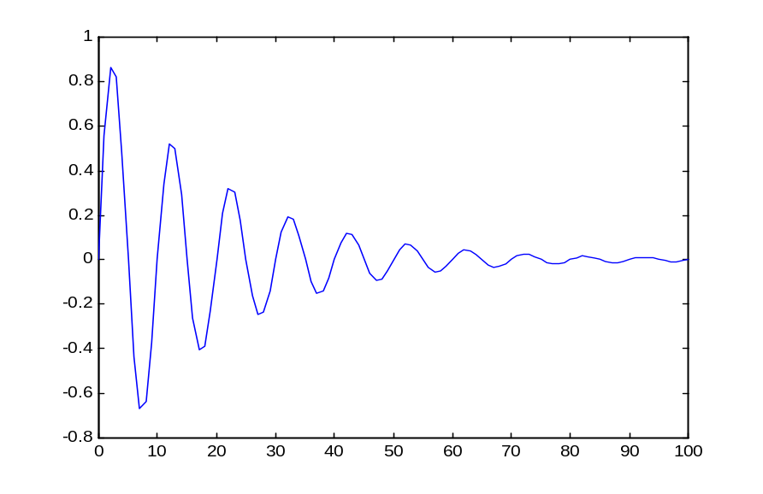



(8.17)
where k and k‘ are constants that depend upon the initial conditions
3.
Underdamped (α <ω₀ ). The two natural frequencies are complex conjugate (s₁=-α +jω_{d} , and s₂=-α -jω_{d} , where ). The response is of the form
(8.18)
where k and θ are real constants that depend upon the initial conditions. A typical plot of the waveform i_{L}(⋅) is shown in Fig 8.2. where the exponential curves are called envelops. Note that the peaks of the waveform in amplitude according to the damped exponential envelopes.
Fig.8.2 Waveform i_{L}(⋅) for the underdamped case (α <ω₀ ) of the parallel RLC circuit.
t

Slide 9
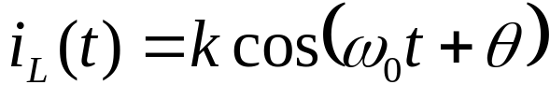
4.
Lossless (α=0, hence G=0 ). The two natural frequencies are imaginary ( s₁=jω₀ , and s₂= -jω₀ ). The response is
(8.19)
where k and θ are real constants that depend upon the initial conditions.
The four cases can also be classified in terms of natural frequencies, i.e., the two roots s₁ and s₂ of the characteristic polynomial of the differential equation. Since natural frequencies can be real, complex, or imaginary, it is instructive to locate them in the complex plane, called the complex frequency plane.
In the complex frequency plane (s plane), the horizontal axis represents the real part, and the vertical axis represents, the imaginary part. The four cases are illustrated in Fig. 8.3, where the location of the natural frequencies is plotted in the s plane on the left, and the corresponding waveform i_{L}(⋅) is plotted on the right.

Slide 10
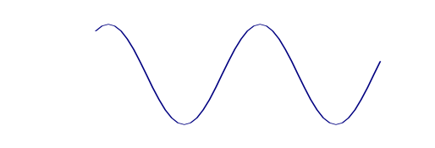
Im s
i_{L}
s plane
I₀
t
s₁
s₂
Re s
(a) Overdamped α >ω₀
Im s
i_{L}
s plane
I₀
=
t
s₁
s₂
Re s
=-ω₀
(b) Critically damped (α =ω₀ )
Im s
i_{L}
jω_{d}
s plane
I₀
-α
Re s
t
-jω_{d}
(c) Underdamped (α <ω₀ )
Im s
i_{L}
jω₀
s plane
I₀
Re s
t
-jω₀
(d) Lossless (α=0)

Slide 11
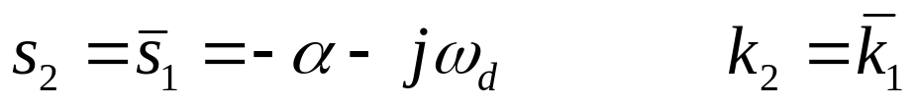
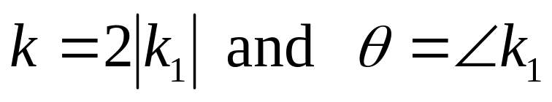
Exercise
The solution of the homogeneous differential equation (8.13) for the underdamped case can also written as
where s₁, s₂, k₁ and k₂ are complex numbers, and
The bars denote the complex conjugate. Derive Eq.(8.18) from the above and show that
Evaluation of arbitrary constants
Let us consider the overdamped case. The current i_{L} is given by (8.16) as
We wish to determine the constants k₁ and k₂ from the initial conditions

Slide 12
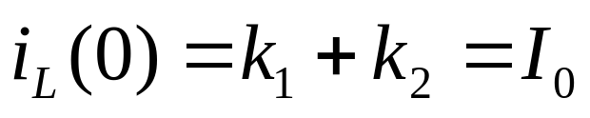
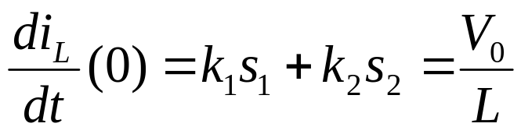
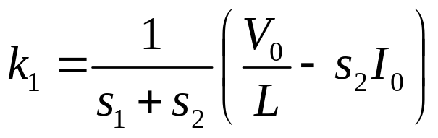
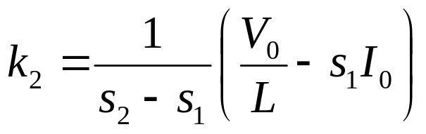
specified in Eqs (8.10) and (8.11). Evaluating i_{L}(t) in (8.16) at t=0, we obtain
(8.20)
Differentiating (8.16) and evaluating the derivative at t=0, we obtain
(8.21)
Solving for k₁ and k₂ in Eqs.(8.20) and (8.21), we obtain
(8.22)
and
(8.23)

Slide 13
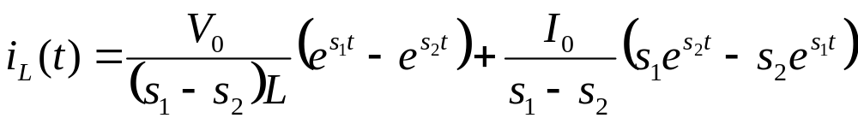
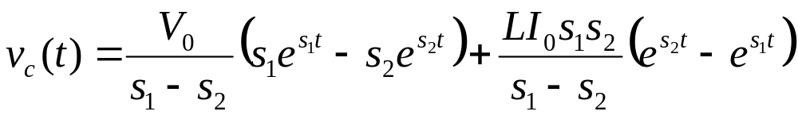
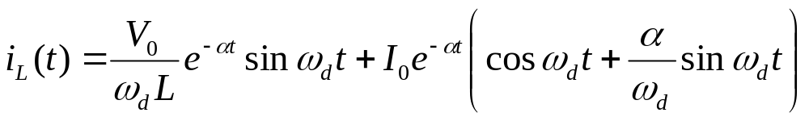
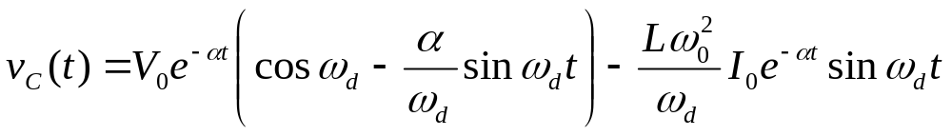
Substituting k₁ and k₂ in (8.16), we obtain a general expression of the current waveform i_{L}(⋅) in terms of the initial stat of the circuit, i.e., the initial current I₀ in the inductor and the initial voltage V₀ across the capacitor. Thus
(8.24)
The voltage v_{c} across the capacitor can be calculated from i_{L} since v_{c}=v_{L} and v_{L}=Ldi_{L}/dt. Thus
(8.25)
Similarly, we can derive, for underdamped case, the inductor current and the capacitor voltage as
(8.26)
(8.27)

Slide 14
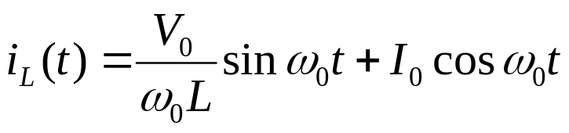

Exercise 1
Prove the formula in Eqs. (8.26) and (8.27).
Exercise 2
Show that for the lossless case the inductor current and the capacitor voltage are given by
(8.28)
(8.29)
Exercise 3
Given I₀=1 amp and V₀=1 volt, determine the zero-input responses and plot the waveforms i_{L}(⋅) and v_{C}(⋅) vs t or each of the following RLC circuit:
R=1 Ω, L=1 henry, and C=1 farad
R=1 Ω, L=4 henrys, and C=0.25 farad
R=∞, L=4 henrys, and C=1 farad

Slide 15



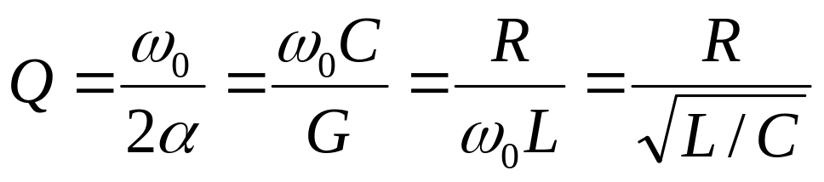
Energy and Q factor
Recall that the initial state is given by the initial current I₀ in the inductor and the initial voltage V₀ across the capacitor at t=0. Thus, the initial stored energy is the sum of (in the magnetic field) and (in the electric field).
Let us consider the underdamped case. As time proceeds, the energy is being transferred back and both from the capacitor to the inductor. Meanwhile the resistor dissipates part of the energy into heat as oscillations goes on. Thus the total energy left in the electric and magnetic fields gradually diminishes. For R=∞, the current in the resistor is always zero, and there is no energy loss; hence we have a sustained oscillation.
The parameter ω₀ is related to the frequency of the damped oscillation, , whereas the parameter α determines the rate of exponential decaying. The relative damping in a damped oscillation is the often characterized by a number Q, defined by
(8.30)

Slide 16



Q can be considered as a quality factor of a physical resonant circuit. The less damping, the larger Q. For the parallel RLC circuit, to decrease the damping we must to increase the resistance. A lossless resonant circuit has zero damping or infinite Q.
The four cases we have studied can also be classified according to the value of Q. The overdamped case has a Q<1/2, the critically damped case has Q=1/2, the underdamped case has Q>1/2, and the lossless case has a Q=∞. In Fig.8.4 the values of Q are related to the locations of a natural frequencies in the four cases.
Im s
Q=∞
-α+jω_{d}
jω₀
Q=0.707
jω_{d}
s plane
Fig. 8.4. Locus of the natural frequencies of the four cases; in the characteristic equation
45º
0
Re s
-jω_{d}
Q=0.707
The resonant frequency
-α+jω_{d}
-jω₀
is kept constant and Q varies. This corresponds to a circuit with L and C fixed and R varying
Q=∞

Slide 17
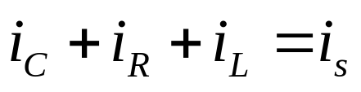
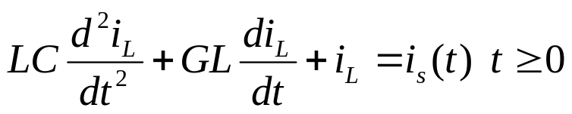
Linear time invariant RLC-circuits, zero-state response
Let us continue with the same linear time-invariant parallel RLC circuit to illustrate the computation and properties of the zero state response
By zero-state response we mean the response of a circuit due to an input applied at some arbitrary time t₀ subject to the condition that the circuit is in the zero state at t₀-.
KCL for the circuit in Fig. 8.5 gives
(8.31)
Following the same procedure that in previous section we obtain the network equation in terms of inductor current i_{L}. Thus
i_{R}
i_{L}
+
v_{c}
-
i_{c}
+
v_{R}
₋
+
v_{L}
-
i_{s}
(8.32)
Fig. 8.5 Parallel RLC circuit with current source as input
and

Slide 18

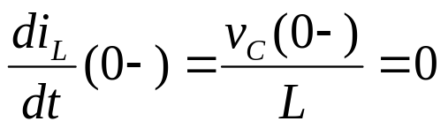
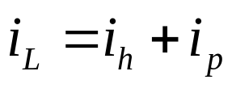
(8.33)
(8.34)
The three equations above correspond to Eqs.(8.9), (8.10) and (8.11) of the previous section. The differences are that previously the input was zero and the initial conditions were nonzero and presently the forcing function is i_{s}(t) as in (8.32) and the initial conditions are zero as given by (8.33) and (8.34). We remember that the solution of a linear nonhomogeneous differential equation with constant coefficients is the sum of two terms; that is
(8.35)
where i_{h} is a solution of the homogeneous differential equation, that is Eq. (8.32) with i_{s}=0 and i_{p} as a particular solution of the nonhomogeneous differential equation . For our problem i_{h} has been calculated in the previous section since it is the zero-input response; recall that it contains two arbitrary coefficients. Except for the critically damped case, i_{h} can be written in the form

Slide 19
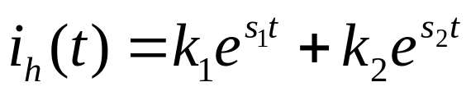
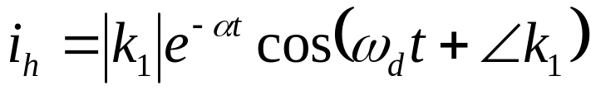
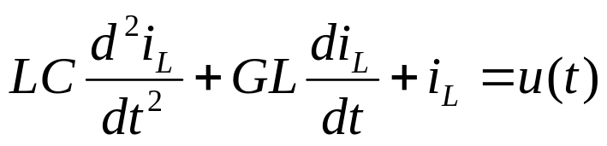
(8.36)
If the natural frequencies are complex, then
(8.37)
and i_{h} can also be written as
(8.38)
On the other hand, i_{p} depends upon the input. It is convenient to pick i_{p} to be a constant if the input is a step function and to be a sinusoid if the input is a sinusoid.
Step Response
Let us calculate the step response of the parallel RLC circuit shown in Fig.8.5. By definition the input is a unit step, and the initial conditions are zero; hence from Eqs.(8.32) to (8.34) we have
(8.39)

Slide 20

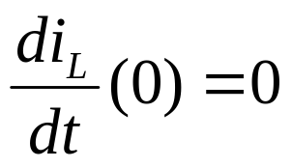

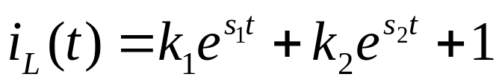
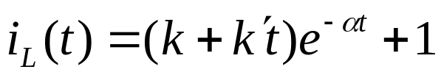
(8.40)
(8.41)
The most convenient particular solution of (8.39) is
(8.42)
Therefore, the general solution is of the form
(8.43)
if the natural frequencies are distinct, and
(8.44)
if they are equal.
Let us determine the constants k₁ and k₂ in (8.43) using the initial conditions (8.40) and (8.41). At t=0, Eqs. (8.40) and (8.43) yield

Slide 21
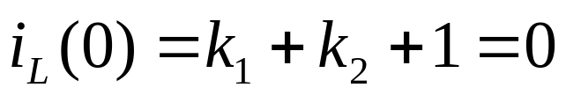
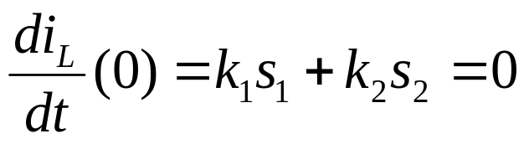
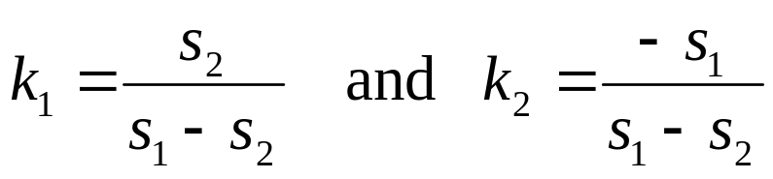
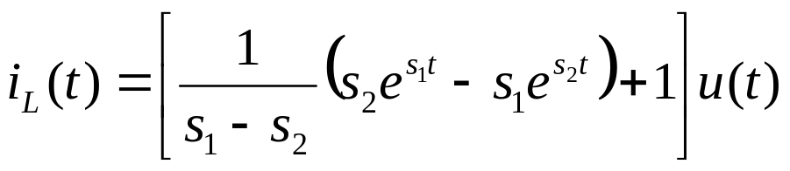
(8.45)
Differentiating (8.43) and evaluating the derivative at t=0, we obtain
(8.46)
Solving the two equations above for k₁ and k₂ , we have
(8.47)
The unit step response is therefore
(8.48)
In the underdamped case the natural frequencies are complex; thus,

Slide 22
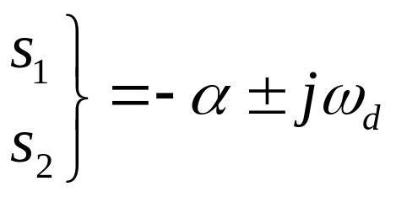
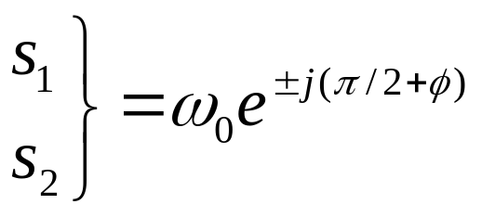


Im s
s₁
jω_{d}
φ
s plane
ω₀
or in polar coordinates (See Fig. 8.6)
-α
Re s
0
s₂
-jω_{d}
Fig. 8.6 Representing natural frequencies
where
(8.49)
The first term in (8.48) can be expressed as follows:
(8.50)

Slide 23



The unit response becomes
(8.51)
Typical plots of the step response for the overdamped and the underdamped cases are given in Fig.8.7
i_{L}
i_{L}
Envelope
1
1
0
t
0
(a)
t
(b)
Fig. 8.7 Step response for the inductor current of the parallel RLC circuit. (a) Overdamped; (b) underdamped.

Slide 24


It is practical to separate the step response into two parts; the term that is either a damped exponential or a damped sinusoid represents the transient, and the constant term equal to unity is the steady state. In both cases, the current i_{L} starts at zero and reaches unity at t=∞.
The voltage across the capacitor of the parallel RLC circuit can be determined immediately by calculating Ldi_{L}/dt. Thus,
(8.52)
and for the underdamped case
(8.53)
These are plotted in Fig.8.8. In this case the steady state is identically zero. Eventually all the current from the source goes through the inductor, and since the current is constant, the voltage across the inductor is identically zero.

Slide 25






v_{C}
v_{C}
0
t
t
(a)
(b)
Fig.8.8 Step response for the capacitor voltage of the parallel RLC circuit
Physical interpretation
With the parallel RLC circuit in the zero state, a constant current source is applied in parallel to the circuit. Clearly, the voltage across the capacitor and the current through the inductor cannot change instantaneously, so they stay at zero immediately after the input is applied. This implies that initially the current in the resistor must also be zero, since the voltage v_{R}(0)=v_{C}(0)=0. Thus, at t=0 all the current from the source goes through the capacitor, which causes a gradual rise of the voltage. At t=0+ the capacitor acts as a short circuit to a suddenly applied finite constant current source.

Slide 26

As time progresses, the voltage across the capacitor increases, and the current will flow in both the resistor and inductor. after a long time the circuit reaches a steady state, that is
Hence, according to Eq. (8.32), all current from the source goes through the inductor. Therefore, the voltage across the parallel circuit is zero because the current in the resistor is zero. At t=∞ the inductor acts as a short circuit to a constant current source.
Exercise
For the parallel RLC circuit with R=1Ω, C=1 farad, and L=1 henry, determine the currents in the inductor, the capacitor and the resistor as a result of an input step of current of 1 amp. The circuit is in the zero state at t=0-. Plot the waveforms.

Slide 27



Impulse Response
Let us calculate the impulse response for the parallel RLC circuit. By definition, the input is a unit impulse, and the circuit is in the zero state at 0-; hence, the impulse response i_{L} is the solution of
(8.54)
(8.55)
(8.56)
First method
We use the differential equation directly. Since the impulse function δ(t) is identically zero for t>0, we can consider the impulse response as a zero-input response starting at t=0+. The impulse at t=0 creates an initial condition at t=0+, and the impulse response for t>0 is essentially the zero-input response due to the initial condition. The problem then is to determine this initial condition.

Slide 28




Let us integrate both sides of Eq.(8.54) from t=0- to t=0+. We obtain
(8.57)
where the right-hand side is obtained by using the fact that
We know that i_{L} cannot jump at t=0, or equivalently, that i_{L} is a continuous function; that is
If it were not continuous, di_{L}/dt would contain an impulse d²i_{L}/dt² would contain a doublet, and (8.54) could never be satisfied since there is no doublet on the right-hand side. From (8.57) we obtain
(8.58)

Slide 29



as far as t>0 is concerned, the nonhomogeneous differential equation (8.54) , with the initial condition given in ( 8.55) and (8.56), is equivalent to
(8.59)
with
(8.60)
and
(8.61)
For t≤0, clearly, i_{L}(t) is zero. The solution of the above is therefore
(8.62)
The waveform is shown in Fig. 8.9a. Note that (8.62) can also be obtained from the zero-input response (8.26) for a given initial state I₀=0 and V₀=1/C.

Slide 30







i_{L}
v_{C}
Envelope
Envelope
t
t
(a)
(b)
Fig.8.9 Impulse response of the parallel RLC circuit for the underdamped case (Q<1/2)
Remark
Consider the parallel connection of the capacitor and the current source i_{s}. In Lecture 3, we showed that the parallel connection is equivalent to the series connection of the same capacitor and a voltage source v_{s}, where

Slide 31


Thus for an impulse current source, the equivalent voltage source is (1/C)u(t). For t<0, the voltage source is identically zero, and for t>0, the voltage source is a constant 1/C. The series connection to a charged capacitor with initial voltage 1/C. Therefore, the impulse response of a parallel RLC circuit due to a current impulse in parallel is the same as a zero-input response with v_{C}(0+)=1/C. These equivalence are illustrated in Fig.8.10.
i_{s}(t)=δ(t)
C
L
R
C
+
-
L
R
(a)
(b)
+
-
C
L
R
Fig.8.10 The problem of the impulse response of a parallel RLC circuit is reduced to that of the zero-input response of an RLC circuit
(c)

Slide 32


Direct substitution
Let us verify by direct substitution into Eqs.(8.54) to (8.56) that (8.62) is the solution. This is a worthwhile exercise for getting familiar with manipulations involving impulses. First, i_{L} as given by (8.62) clearly satisfies the initial conditions of (8.55) and (8.56); that is, i_{L} (0-)=0 and (di_{L}/dt)(0-)=0. It remains for us to how that (8.62) satisfies the differential equation (8.54). Differentiating (8.62), we obtain
(8.63)
Now the first term is of the form δ(t)f(t). Since is δ(t) zero whenever t≠0, we may set t=0 in the factor and obtain δ(t)f(0); however f(0)=0 . Hence the first term in (8.63) disappears and
(8.64)
Differentiating again, we obtain

Slide 33



(8.65)
Substituting (8.62), (8.64) and (8.65) in (8.54), which is rewritten below in terms of ω₀ and α,
we shall see that the left-hand side is equal to δ(t) as it should be.
Exercise
Show that the impulse response for the capacitor voltage of the parallel RLC circuit is
(8.66)
The waveform is shown in Fig.8.9b.

Slide 34


Second method
We use the relation between the impulse response and the step response. This method is applicable only to circuits with linear time-invariant elements for it is only for such circuits that the impulse response is the derivative of the step response.
Exercise
Show that the impulse response for i_{L} in Eq.(8.62) and v_{C} in (8.66) are obtainable by differentiating the step response for i_{L} in (8.51) and v_{C} in (8.53)
Physical interpretation
Let us use the pulse input
as shown in Fig. 8.11a to explain
the behavior of all the branch currents and voltages in the parallel RLC circuit. Remember that as Δ→0, pulse p_{Δ} approaches an impulse, and the response approaches the impulse response. To start with, we assume Δ is finite and positive but very small. At t=0+ all the current from the source goes into the capacitor; that is, i_{C}(0+)=i_{s}(0+)=1/Δ, and i_{R}(0+)=i_{L}(0+)=0.
The current in the capacitor forces a gradual rise of the voltage across it at an initial rate of

Slide 35







v_{C}
i_{s}= p_{Δ}
Δ
t
0
Δ
t
0
(a)
(b)
Δ
t
Δ
t
Δ
t
(c)
(d)
(e)
Fig.8.11 Physical explanation of impulse response of a parallel RLC circuit; p_{Δ} is the input pulse; the resulting v_{C}, i_{C}, i_{R}, and i_{L} are shown.
Let us assume that during the short interval (0,Δ) the slope of the voltage curve remains constant; then the voltage reaches 1/C at time Δ (Fig8.11b). The current through the resistor is proportional to the voltage v_{C}, and hence it is linear in t (Fig.8.1d). The inductor current, being proportional to the integral of v_{L}, is parabolic in t (Fig.8.11e). The current through the capacitor remains constant during the interval, as shown in Fig. 8.11c.

Slide 36


The State-space Approach
State equations and trajectory
Consider the same parallel circuit as was illustrated in Fig. 8.1. Let there be no current source input. Let us compute the zero-input response and let us use i_{L} and v_{C} as variables and rewrite (8.2) and (8.8) as follows:
(8.67)
(8.68)
The variables v_{C} and i_{L} have great physical significance since they are closely related to the energy stored in the circuit. Equations (8.67) and (8.68) are first-order simultaneous differential equations and are called the state equations of the circuit. The pair of numbers (i_{L}(t),v_{C}(t)) is called the state of the circuit at time t. The pair (i_{L}(0),v_{C}(0)) is naturally called the initial state; it is given by initial conditions

Slide 37



(8.69)
From the theory of differential equations we know that the initial state specified by (8.69) defines uniquely, by Eqs. (8.67) and (8.68), the value of (i_{L}(t),v_{C}(t)) for all t≥0. Thus, if we consider (i_{L}(t),v_{C}(t)) as the coordinates of a point on the i_{L}-v_{C} plane, then, as t increases from 0 to ∞, the point (i_{L}(t),v_{C}(t)) traces a curve that starts at (I₀,V₀). The curve is called the state-space trajectory, and the plane (i_{L},v_{C}) is called the state space for the circuit. We can present the pair of numbers (i_{L}(t),v_{C}(t)) as the components of a vector x(t) whose origin is at the origin of the coordinate axes; thus we write
The vector x(t) is called the state vector or, briefly, the state. Thus, vector x(t) is a vector defined for all t≥0 in the state space. Its components, the current i_{L} through the inductor and the voltage v_{C} across the capacitor, are called the state variables. Knowing the state at time t that is the pair of numbers (i_{L}(t),v_{C}(t)) we can obtain the velocity of the trajectory from the state equations.

Slide 38
Example 1
Consider the overdamped, underdamped and lossless cases of the parallel RLC circuit. Let the initial state be I₀=1 amp and V₀= 1 volt.
Overdamped. R=3 ohms, L=4 henrys, and C= 1/12 farad (α=2 and ω₀=√3) Thus the natural frequencies are s₁=-1 and s₂=-3. From Eqs.(8.24) and (8.25) we obtain
and
The waveforms are plotted in Fig.8.12a. Next we use t as a parameter, and plot for each value of t the state (i_{L}(t),v_{C}(t)) in the state space., i.e., the plane with i_{L}(t),as abscissa and v_{C}(t) as ordinate. The result is shown in Fig.8.12b. Note that the trajectory starts at (1,1) when t=0 and ends at the origin when t=∞.

Slide 39



v_{C}
i_{L}
1
1
0.62
4
2
5
3
0
t
0
1
5
2
3
4
-1
(a)
-2
v_{C}
t=0
1
t=∞
1
0
0.5
i_{L}
-1
t=2
-2
Fig.8.12 Overdamped parallel RLC circuit. (a) Waveform for i_{L} and v_{C}; (b) state trajectory
t=1
-3
t=0.62
(b)

Slide 40


Underdamped. R=1 ohm, L=1henry and C=1 farad (α=2 and ω₀=1, and ω_{d}=√3/2). From Eqs.(8.24) and (8.25) we have
and
The waveforms are plotted in 8.13a, and the trajectory is plotted in Fig.8.13b. Note that the trajectory is a spiral starting at (1,1) and terminating at the origin.
Lossless. L=1/4 henry and C=1 farad (α=0 and ω₀=2). From Eqs.(8.24) and (8.25) we have

Slide 41



i_{L}
v_{C}
t=0
0
1
1
3
2
4
5
1
v_{C}
0
1
i_{L}
1
1
2
3
0
4
5
(b)
(a)
Fig.8.13 Underdamped parallel RLC circuit. Overdamped parallel RLC circuit. (a) Waveform for i_{L} and v_{C}; (b) state trajectory

Slide 42








and
i_{L}
v_{C}
1
8
0
t
-1
t=0,π…
0
v_{C}
-1
1
i_{L}
1
-8
0
t
(b)
-1
(a)
Fig. 8.14 Lossless parallel LC circuit

Slide 43




Matrix Representation
In terms of state variables, Eqs.(8.67) and (8.68) may be written in matrix form as follows:
(8.70)
and
(8.71)
where
(8.72)
and
(8.73)

Slide 44







The matrix equations (8.70) and (8.71) are very similar to the scalar equations
(8.74)
The scalar equation has the well known solution
(8.75)
where
is a matrix that depends upon t and A. Geometrically
speaking, it maps the initial-state vector x₀ into the state vector x(t) at time t. In fact, just as ordinary exponential is given by the power series (valid for all t)
the matrix is given by the power series (valid for all t)
where I is the unit matrix. In this last series each term is a matrix; hence

Slide 45

is also a matrix. Each element of a matrix is a function of t.
It is important to observe that (8.75) represents a linear function that maps the vector x₀ (the initial-state vector) into the vector x(t) (the state vector at time t).
Approximate method for the calculation of the trajectory
With reference to Eqs.(8.70) and (8.71) we may view (8.70) as defining, for each t, the velocity (dx/dt)(t) along the trajectory at the point x(t) of the state space. In particular, given the initial state x(0), Eq.(8.70) gives the initial velocity of the state vector (dx/dt)(t) . We may use a simple step-by-step method to compute an approximation to the trajectory. This method is based on the assumption that if a sufficiently small interval of time Δt is considered, then during that interval the velocity dx/dt is approximately constant; equivalently the trajectory is approximately a straight-line segment. Thus starting with the initial state x₀ at time 0 we have
(8.76)

Slide 46




and since we assume the velocity to be constant during the small interval (0,Δt),
(8.77)
For the next interval, (Δt, 2Δt), we again assume the velocity to be constant and calculate it on the basis of the approximate value of x(Δt) given by (8.77). Thus,
(8.78)
hence
(8.79)
We continue to calculate successive approximate values of the state
(8.80)

Slide 47

In practice, the value of Δt that should be selected depends
On number of significant figures carried in the computation
On the accuracy required
On the constants of the problem
On the length of the time interval over which the trajectory is desired
Once the trajectory is computed, the response of the circuit is easily obtained since it is either one component of the state or a linear combination of them.
Example 2
Let us employ the method to calculate the state trajectory of the under damped parallel RLC circuit in Example 1. The state equation is

Slide 48





Let us pick Δt=0.2 sec. We can use (8.77) to obtain the state at Δt ; thus
Next the state at 2Δt is obtained from (8.79)
From (8.80) we can actually write the sate at (k+1)Δt in terms of the state at kΔt as
Fig.8.15 State trajectory calculation using the step-by step method for example 2 with Δt=0.2 sec.

Slide 49


Exercise
Compute the state trajectory by using
Δt=0.1 sec
Δt=0.5 sec
Remark
If we consider a parallel RLC circuit in which the resistor, inductor, and capacitor are nonlinear but time-invariant, then, under fairly general assumptions concerning their characteristics, we have equations of the form
(8.81)
where the functions f₁ and f₂ are obtained in terms of the branch characteristics.
It is fundamental to note that the general method of obtaining the approximate calculation of the trajectory still holds; the equations are
(8.82)
And the equations corresponding to (8.77) and (8.79) are now
(8.83)

Slide 50


State Equations and Complete Response
If the parallel RLC circuit is driven by a current source as in Fig.8.5, the stat equations can be similar written. First, the voltage across the parallel circuit is the same as if there were no source. We obtain, as in
Eq. (8.67),
Next for the KCL equation we must include the effect of the current source. Thus, an additional term is needed in comparison with Eq. (8.68), and we have
The initial state, the same as given by Eq. (8.69)

Slide 51





If we use the vector x to denote the state vector, that is,
the state equation in matrix form is
(8.84)
and the initial state is
(8.85)
In (8.84)
(8.86)
and
(8.87)

Slide 52



The matrices A and b depend upon the circuit elements, whereas the input is denoted by w. Equation (3.18) is a first-order nonhomogeneous matrix differential equation and is similar to the first-order scalar nonhomogeneous linear differential equation
(8.88)
The solution of this scalar equation, satisfying the specified initial condition x(0) = x₀, is
(8.89)
Note that the complete response is written as the sum of two terms.
The first term, e^{at}x₀, is the zero-input response, and the second term,
which is represented by the integral, is the zero-state response.
Similarly matrix equation (8.84) has the solution
(8.90)
The first term, e^{A t}x₀ is the zero-input response, and the second term, which is represented by the integral, is the zero-state response.

