Slide 1
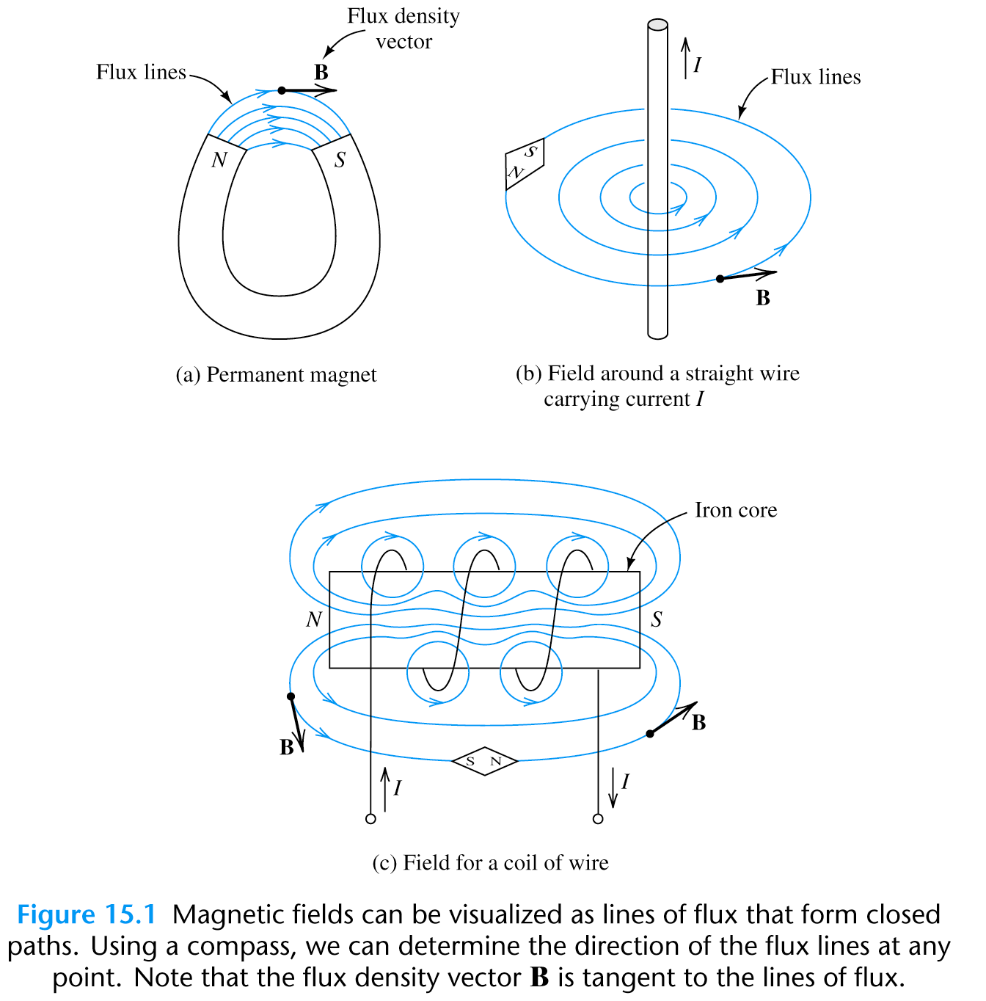
Magnetic and Electromagnetic Fields

Slide 2
Magnetic Materials
Iron, Cobalt and Nickel and various other alloys and
compounds made using these three basic elements

Slide 3
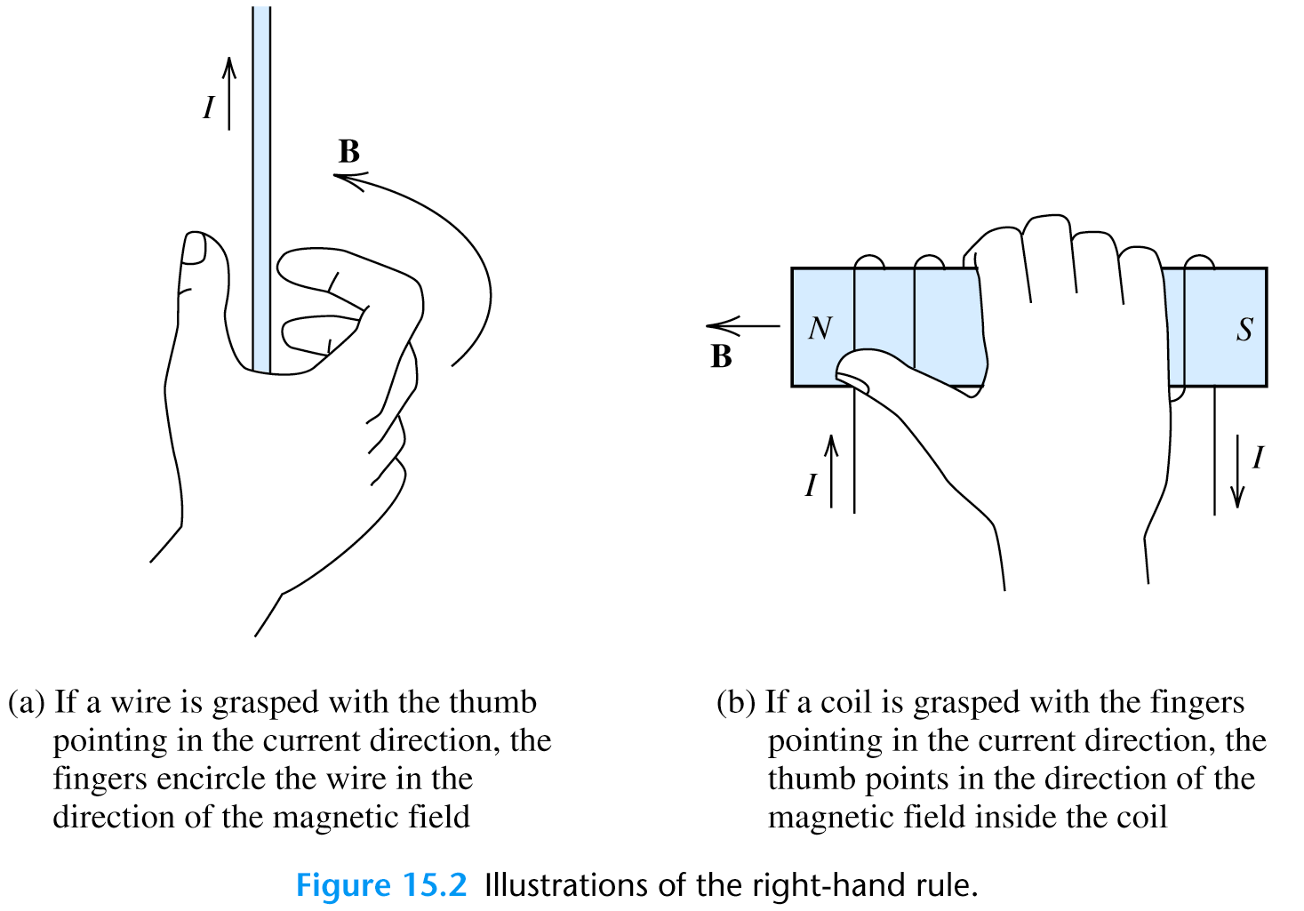
Electric Current and Magnetic Field

Slide 4

A Few Definitions Related to Electromagnetic Field
(Unit is Weber (Wb)) = Magnetic Flux Crossing a Surface of
Area ‘A’ in m².
B (Unit is Tesla (T)) = Magnetic Flux Density = Φ/A
H (Unit is Amp/m) = Magnetic Field Intensity =
μ = permeability = μ_{o} μ_{r}
μ_{o} = 4π*10⁻⁷ H/m (H ⇒Henry) = Permeability of free space (air)
μ_{r} = Relative Permeability
μ_{r} >> 1 for Magnetic Material

Slide 5
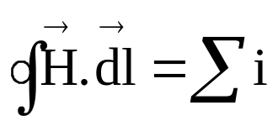
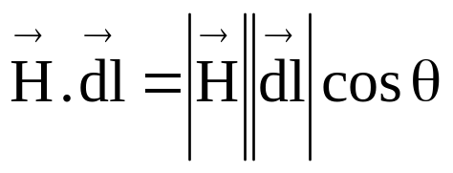
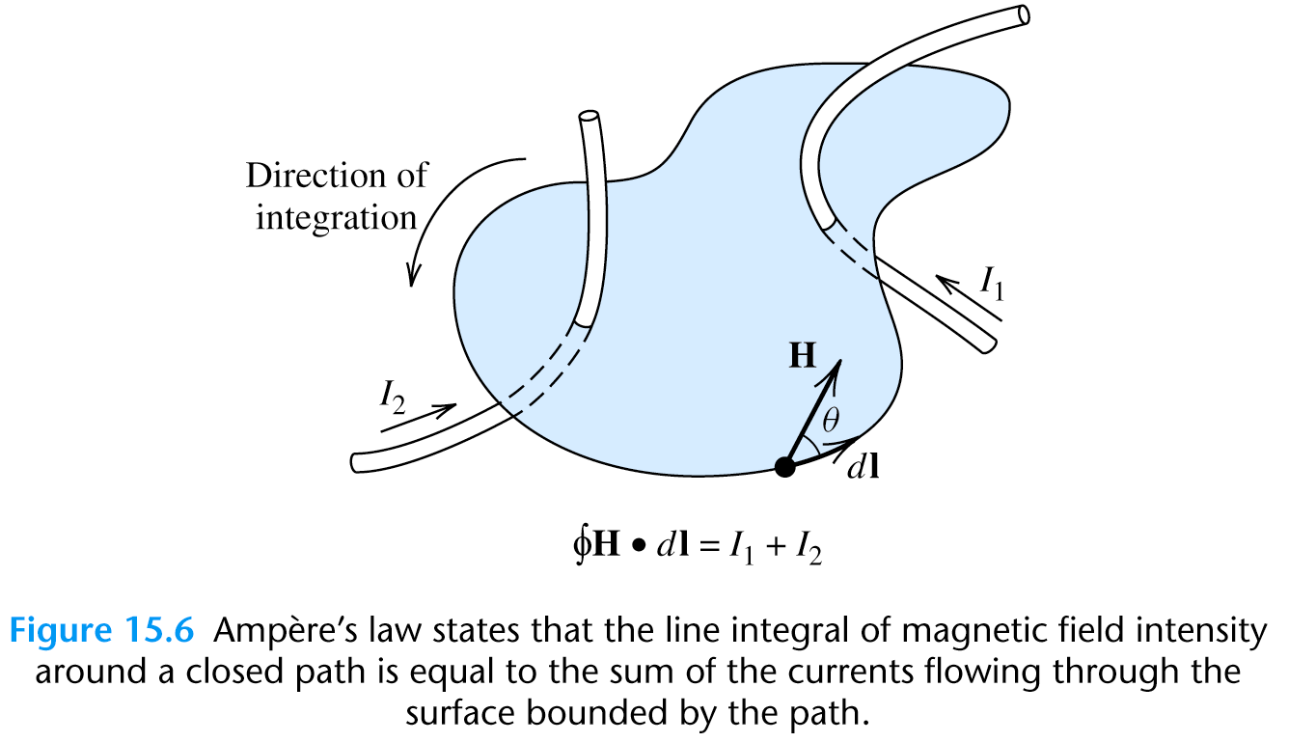
Ampére’s Law
The line integral of the magnetic field intensity around a closed path is
equal to the sum of the currents flowing through the area enclosed by
the path.

Slide 6
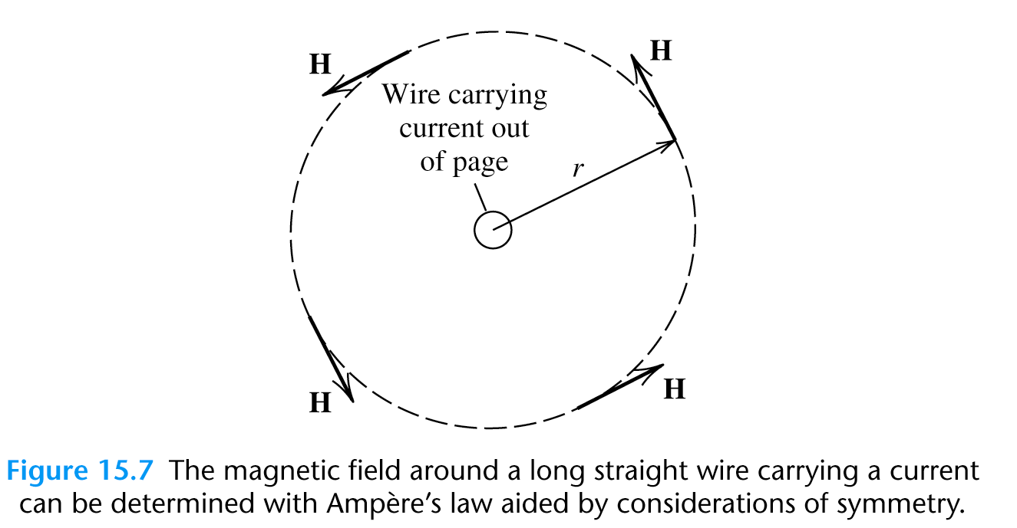


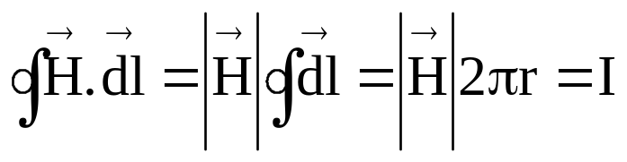
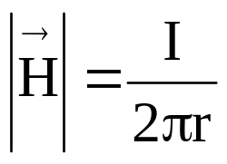
Example of Ampére’s Law
Find the magnetic field along a circular path around an infinitely long
Conductor carrying ‘I’ ampere of current.
B,H
90⁰
r
dl
Since both
and
are perpendicular to radius ‘r’ at any point ‘A’
on the circular path, the angle θ is zero between them at all points. Also since all the points on the circular path are equidistant from the current carrying conductor is constant at all points on the circle
or

Slide 7
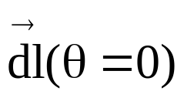
Magnetic Circuits
They are basically ferromagnetic structures(mostly Iron, Cobalt,
Nickel alloys and compounds) with coils wound around them
Because of high permeability most of the magnetic flux is confined
within the magnetic circuit
Thus is always aligned with
Examples: Transformers,Actuators, Electromagnets, Electric Machines

Slide 8
Magnetic Circuits (1)
w
I
N
d
= mean length

Slide 9
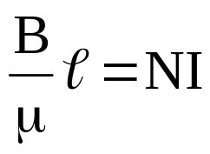
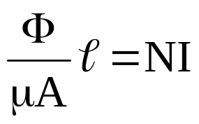
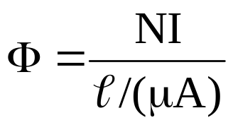
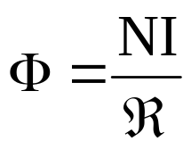

Magnetic Circuits (2)
F =NI= Magneto Motive Force or MMF = # of turns * Current passing through it
F = NI = H (why!)
or
or
or
or
= Reluctance of magnetic path

Slide 10
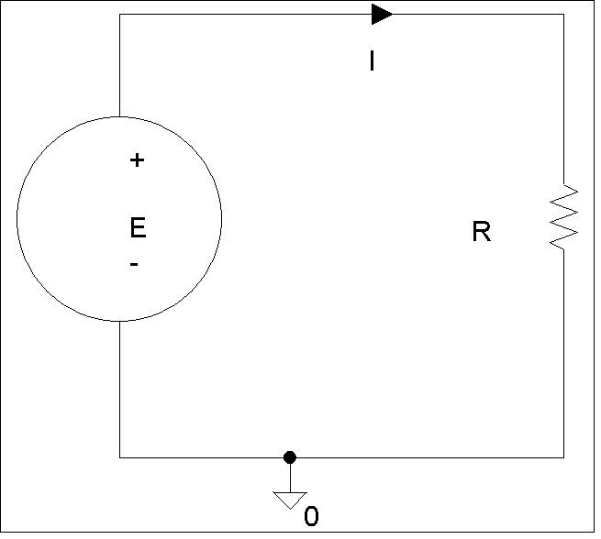
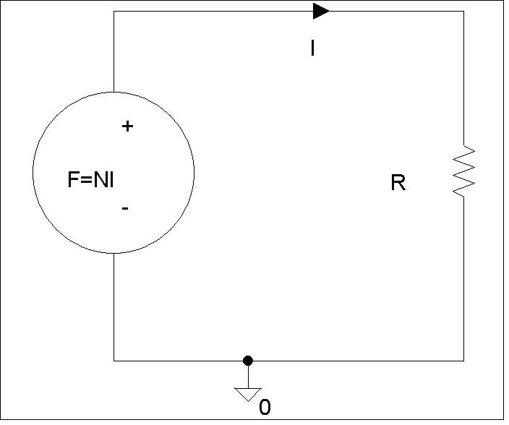

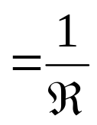
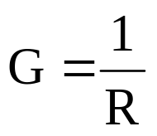

Analogy Between Magnetic and Electric
Circuits
F =MMF is analogous to Electromotive force (EMF) =E
= Flux is analogous to I = Current
= Reluctance is analogous to R = Resistance
= Permeance
= Analogous to conductance

Slide 11
Magnetization Curves
saturation
B
knee
B
Linear
H
H
Magnetization curve
(linear) (Ideal)
Magnetization curve
(non-linear) (Actual)
(see also Fig. 1.6 in the text)

Slide 12
Magnetization Curves(2)
One can linearize magnetic circuits by including air-gaps
However that would cause a large increase in ampere-turn
requirements.
Ex: Transformers don’t have air-gaps. They have very little
magnetizing current (5% of full load)
Induction motors have air-gaps. They have large magnetizing
current (30-50%)
Question: why induction motors have air –gap and
transformers don’t?

Slide 13
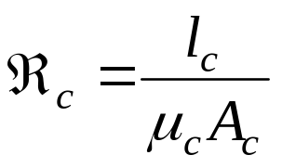
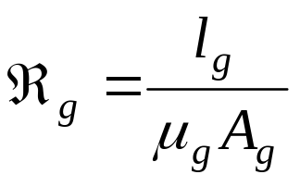
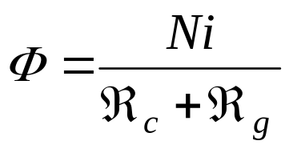
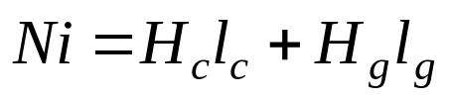
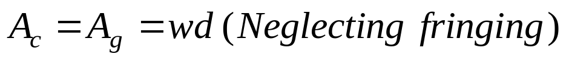
Magnetization Circuits with Air-gap
_{c}
w
i
_{g}
N
d

Slide 14
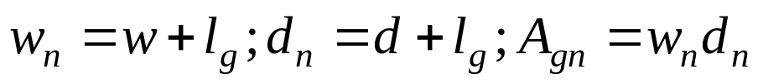
Fringing
_{c}
w
i
N
With large air-gaps, flux tends to leak outside the air –gap. This is
called fringing which increases the effective flux area. One way to
approximate this increase is:

Slide 15
Example of Magnetic Circuits On Greenboard

Slide 16
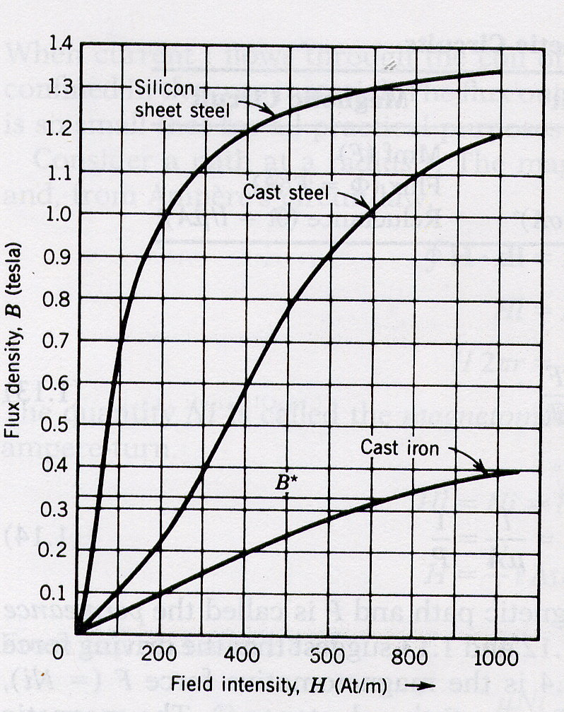
Magnetization Curves (for examples)

Slide 17

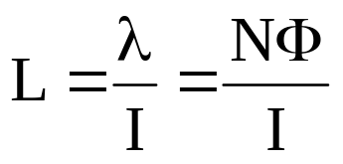
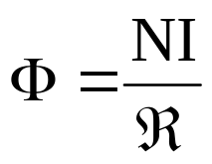
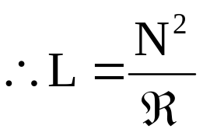
Inductance(L)
Definition: Flux Linkage(λ) per unit of current(I) in a magnetic circuit
Ι
Ν
Thus inductance depends on the geometry of construction

Slide 18
Example of Inductances On Greenboard

Slide 19
How to find exact Inductances with magnetic circuit with finite thickness (say a torroid with finite thickness)
see problem 1.16

Slide 20
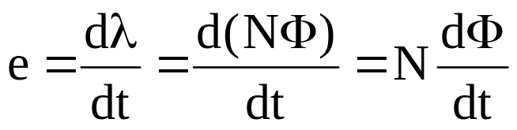

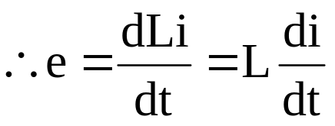
Faraday’s law of Electromagnetic
Induction
The EMF (Electromotive Force) induced in a magnetic circuit is
Equal to the rate of change of flux linked with the circuit

Slide 21
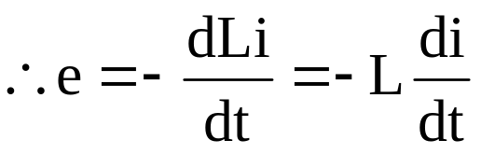
Lenz’s Law
The polarity of the induced voltage is given by Lenz’s law
The polarity of the induced voltage will be such as to oppose the very
cause to which it is due
Thus sometimes we write

Slide 22
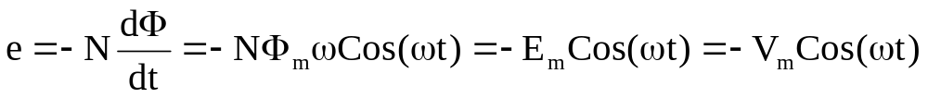
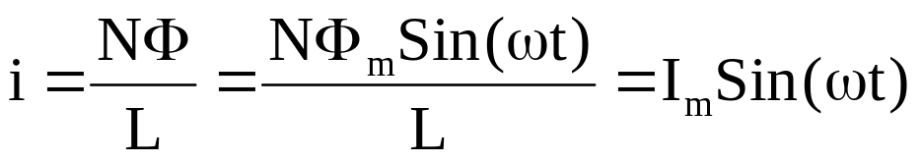
A precursor to Transformer
Φ =Φ_{m} Sin(ωt)
V = V_{m} Cos(ωt)
+
i
Ν
e
−
Ideally

Slide 23
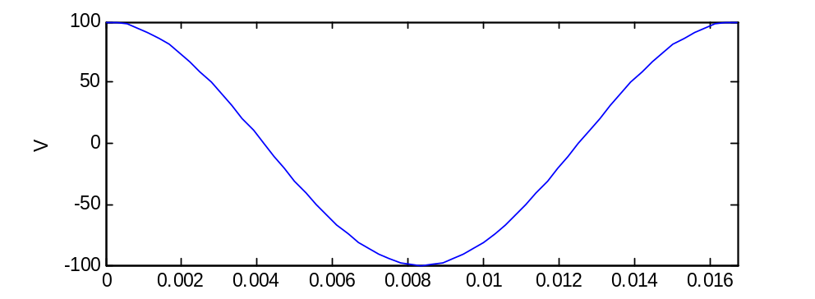
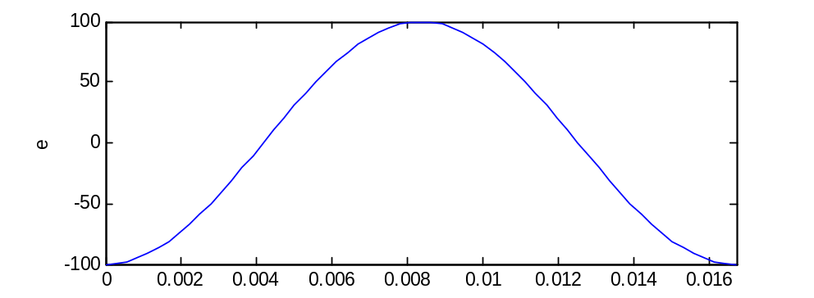
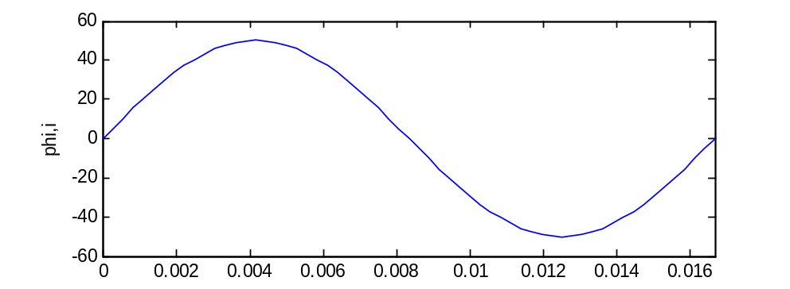
A Precursor to Transformer(2)
time

Slide 24
Example on excitation of magnetic circuit with sinusoidal flux On greenboard

Slide 25
Example on excitation of magnetic
circuit with square flux on greenboard
(Important for Switched Mode Power
Supplies)

Slide 26
What will non-linearity in magnetic
circuit lead to?
It would cause distortion in current waveforms since by Faraday’s
and Lenz’s law the induced voltage always has to balance out the
applied voltage that happens to be sinusoidal

Slide 27
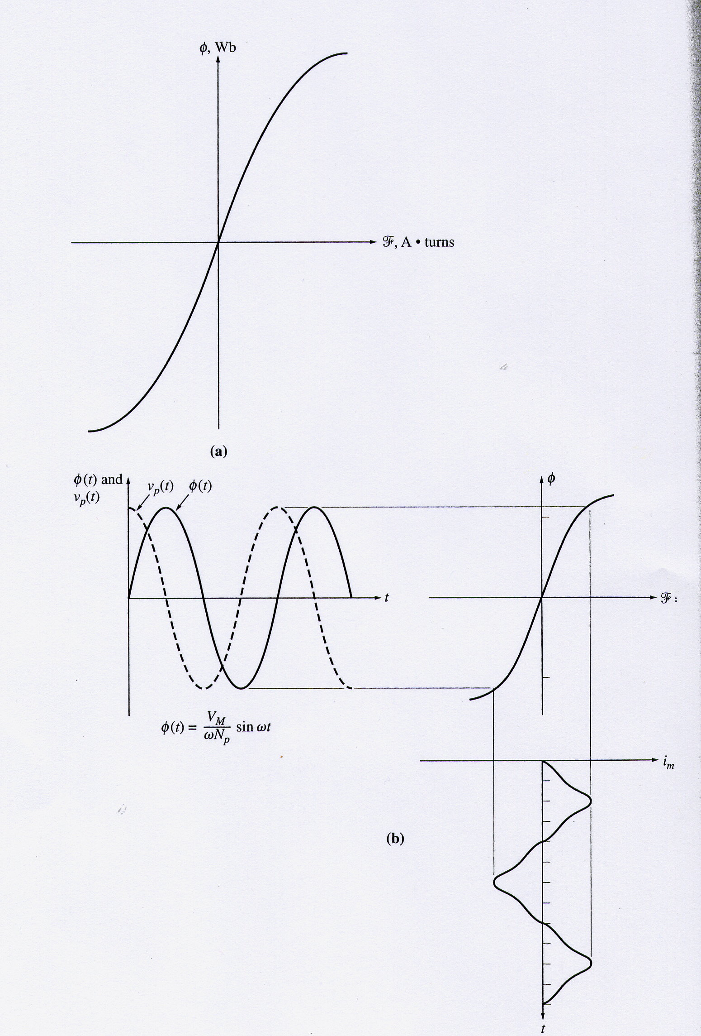
Sinusoidal voltage non-sinusoidal current

Slide 28
Iron Losses in Magnetic Circuit
There are two types of iron losses
Hysteresis losses
Eddy Current Losses
Total iron loss is the sum of these two losses

Slide 29
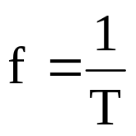
Hysteresis losses
i
f =frequency
of sine source
B
B-H or Hysteresis loop
i
B_{r}
saturation
3
knee point
4
5
0
1
2
0
1
2
3
t
H_{c}
H
4
5
B_{r} = Retentive flux density (due to property of retentivity)
H_{c}= Coercive field intensity (due to property of coercivity)

Slide 30
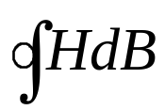
Hysteresis losses (2)
The lagging phenomenon of B behind H is called hysteresis
The tip of hysteresis loops can be joined to obtain the
magnetization characteristics
In each of the current cycle the energy lost in the core is
proportional to the area of the B-H loop
Energy lost/cycle = V_{core}
P_{h} = Hysteresis loss = f V_{core}
= k_{h}B^{n}_{max}f
k_{h} = Constant, n = 1.5-2.5, B_{max}= Peak flux density

Slide 31
Eddy current loss
Laminations
flux
flux
Current
Because of time variation of flux flowing through the magnetic
material as shown, current is induced in the magnetic material,
following Faraday’s law. This current is called eddy current.
The direction of the current is determined by Lenz’s law. This current
can be reduced by using laminated (thin sheet) iron structure, with
Insulation between the laminations.
P_{e} = Eddy current loss
= k_{e}B²_{max}f
k_{e} = Constant
,
B_{max}= Peak flux density

Slide 32
Permanent Magnets
Alloys of Iron, Cobalt and Nickle
Have large B-H loops, with large B_{r} and –H_{c}
Due to heat treatment becomes mechanically hard and are thus
called HARD IRON
Field intensity is determined by the coercive field required to
demagnetize it
Operating points defined by B_{m},H_{m} in the second quadrant of
the B-H loop

Slide 33
Using Permanent Magnets for providing magnetic field
SOFT IRON
l_{m}
PM
l_{g}
SOFT IRON

Slide 34
Designing Permanent Magnets
The key issue here is to minimize the volume V_{m} of material
required for setting up a required B_{g} in a given air gap
It can be shown that V_{m} =B_{g}²V_{g}/μ_{o}B_{m}H_{m} (see derivation in text)
where V_{g}= A_{g}l_{g} Volume of air-gap,l_{g} = length of air-gap, A_{g} =area
of air-gap
Thus by maximizing B_{m}, H_{m} product V_{m} can be minimized
Once B_{m}, H_{m} at the maximum B_{m}, H_{m} product point are known, l_{m} =length of permanent magnet, A_{m} =area of permanent magnet can be found as
l_{m}=-l_{g}H_{g}/H_{m} (applying ampère’s law),
A_{m}=B_{g}A_{g}/B_{m} (same flux flows through PM as well as air-gap)

Slide 35
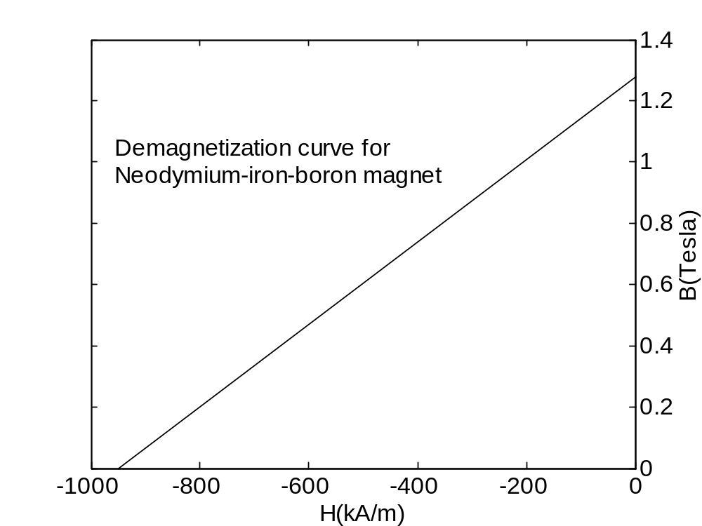
Finding the maximum product point

Slide 36
Finding the maximum product point (2)
B= mH+c, m and c are constants.
To find maximum BH product, we need to differentiate
BH=mH²+cH;
and set it equal to 0. Thus we get
H_{m}=-c/2m. and B_{m} =c/2

Slide 37
Finding the maximum product point (3)
Answer:
B_{m}=0.64 T, H_{m} = -475 kA/m

