Slide 1
Circuit Theorems
ELEC 202
Electric Circuit Analysis II

Slide 2
Superposition Principle
The voltage across or current through an element in a linear circuit with multiple independent sources can be determined as the algebraic sum of such voltages or currents due to each source acting alone one at a time.

Slide 3
Observations
The total response (voltage or current) is the sum of the responses contributed by each independent source separately.
Superposition cannot be used for calculating POWER (not a linear quantity).
Voltage source is turned off or deactivated by replacing it with a short circuit.
Current source is turned off or deactivated by replacing it with an open circuit.

Slide 4
Observations
Dependent sources are left intact.
The response due to each active source can be determined by using basic circuit analysis laws and techniques (Ohm’s, KVL, KCL, voltage and current divider, and series/parallel combinations.)

Slide 5
Superposition for AC Circuits
Usual procedures for DC circuits apply.
However, phasor transformation must be carefully carried out if the circuit has sources operating at different frequencies
➔ a different phasor circuit for each
source frequency because impedance is
a frequency-dependent quantity.
inductor → a short circuit for DC
capacitor → an open circuit for DC

Slide 6
Superposition for AC Circuits
For sources of different frequencies, the total response must be added in the time domain
DO NOT ADD INDIVIDUAL RESPONSES IN THE PHASOR DOMAIN IF THE SOURCES HAVE DIFFERENT FREQUENCIES.

Slide 7
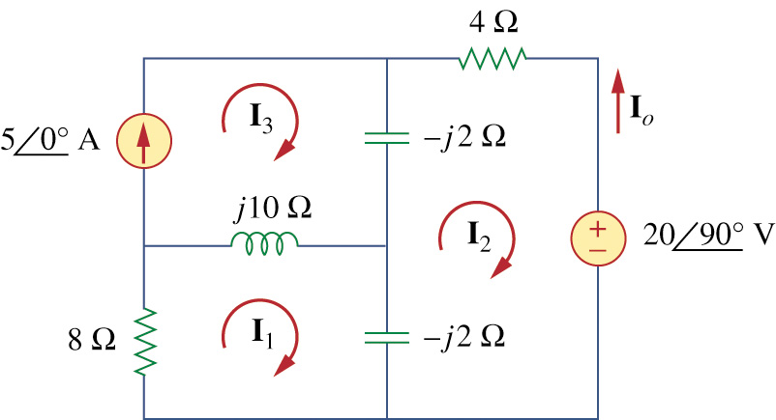
Example 1
Find I₀ in the circuit using superposition.

Slide 8
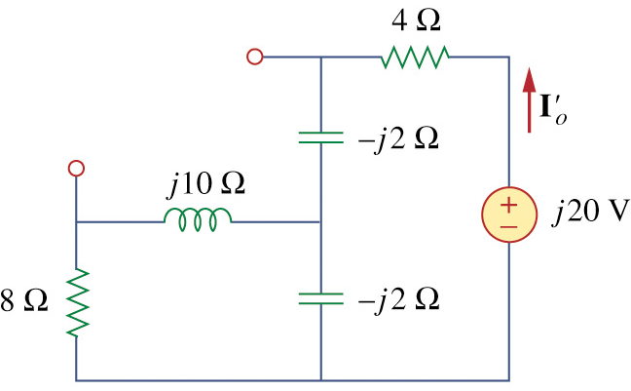
Example 1 (cont’d)

Slide 9
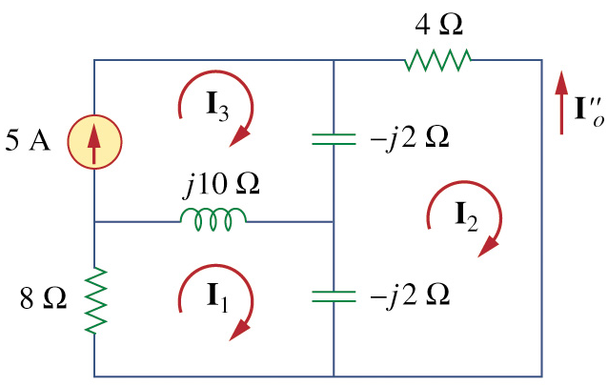
Example 1 (cont’d)

Slide 10
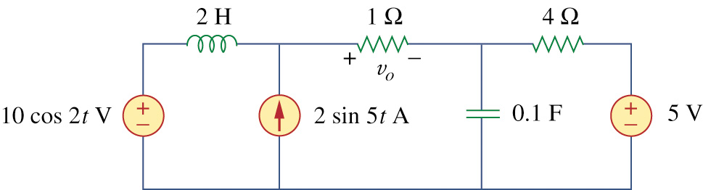
Example 2
Find v₀ in the circuit using superposition.

Slide 11
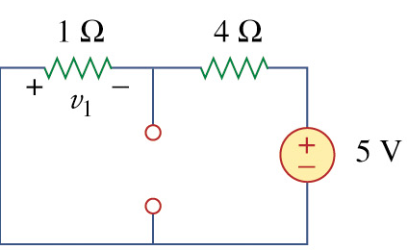
Example 2 (cont’d)

Slide 12
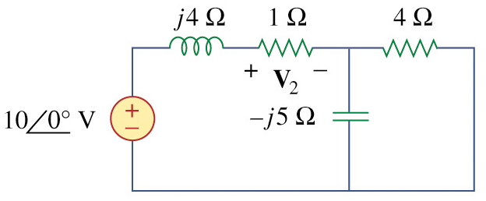
Example 2 (cont’d)

Slide 13
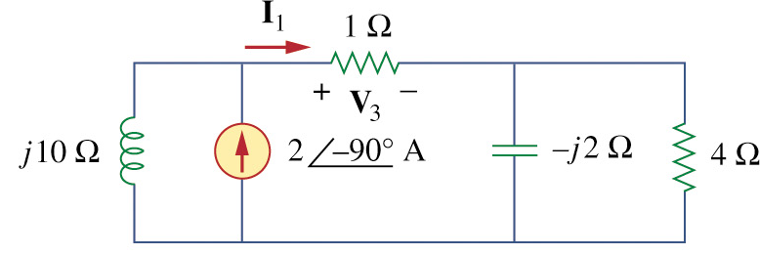
Example 2 (cont’d)

Slide 14
Thevenin and Norton
Equivalent Circuits
Thevenin’s and Norton’s Theorems can be used to analyze AC circuits in the same way as in the analysis of DC circuits.
3 cases of interest:
a) independent sources only, no
dependent sources;
b) both independent and dependent
sources;
c) dependent sources only, no
independent sources;

Slide 15
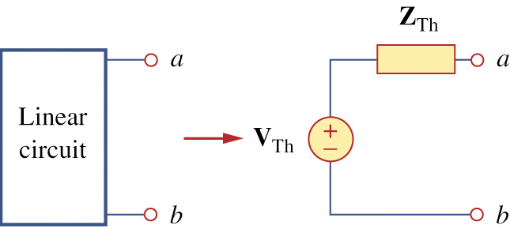
Thevenin Equivalent Circuits

Slide 16
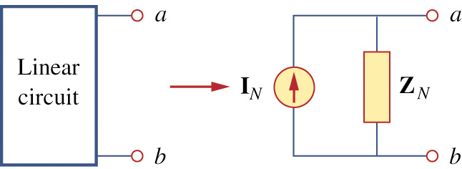
Norton Equivalent Circuits

Slide 17
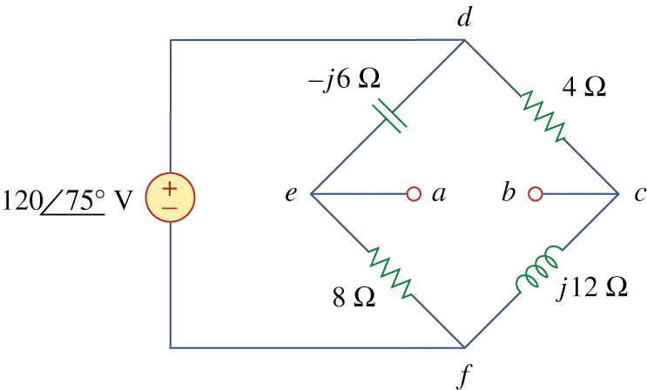
Example 1
Obtain the Thevenin equivalent circuit at
terminals a-b.

Slide 18
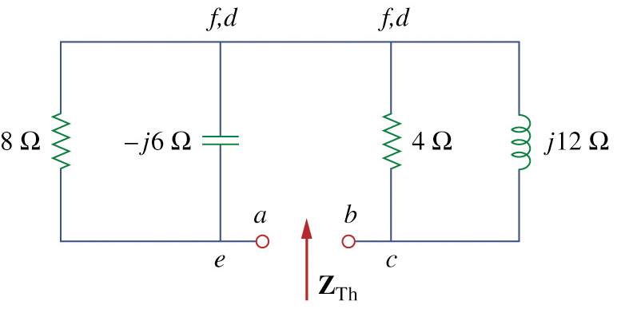
Example 1 (cont’d)

Slide 19
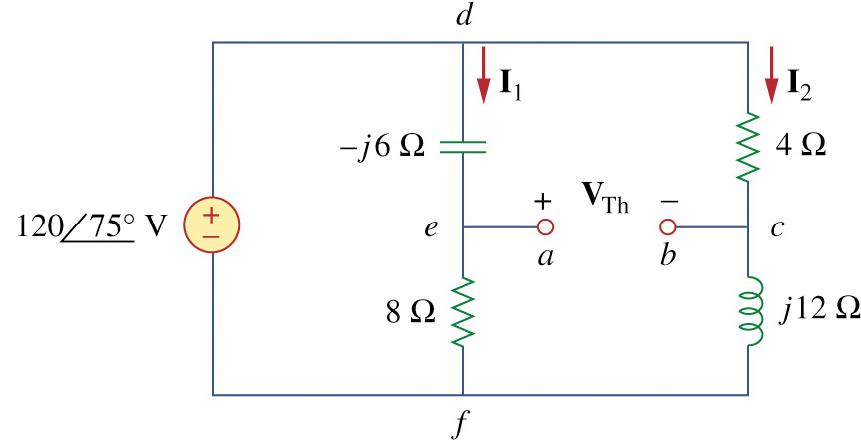
Example 1 (cont’d)

Slide 20
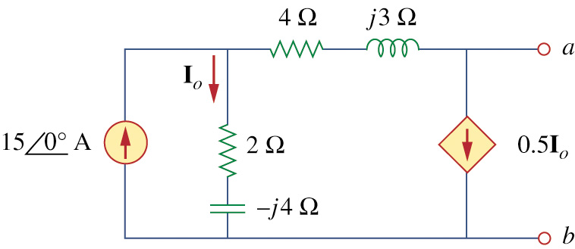
Example 2
Obtain the Thevenin equivalent circuit at
terminals a-b.

Slide 21
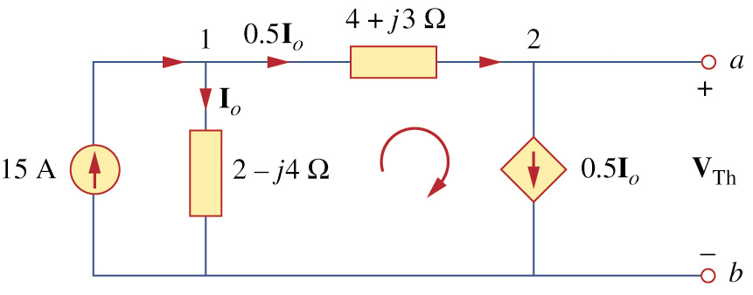
Example 2 (cont’d)

Slide 22
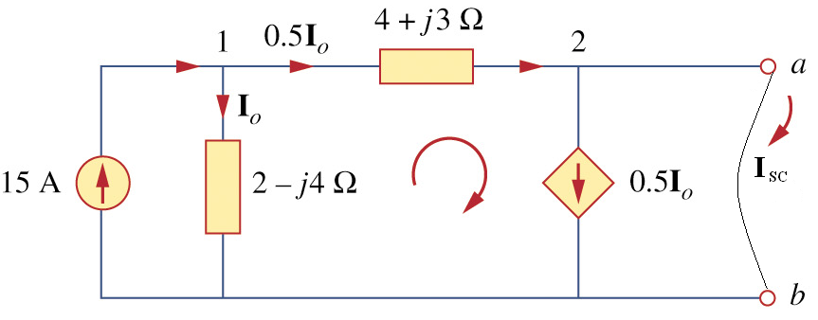
Example 2 (cont’d)

Slide 23
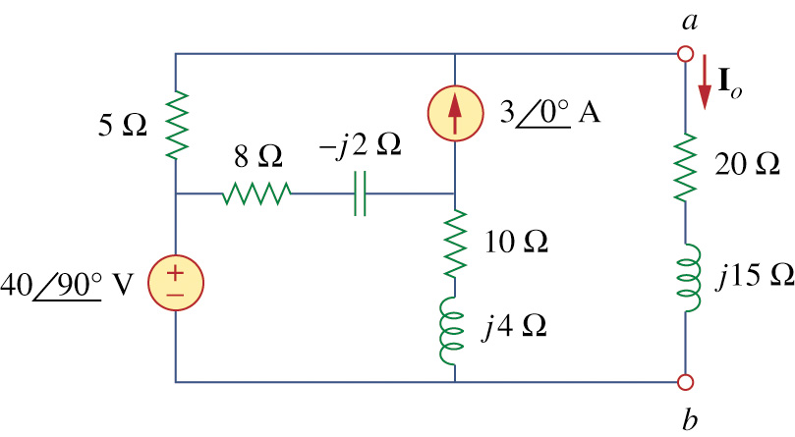
Example 3
Obtain current I_{o} using Norton’s theorem
at terminals a-b.

Slide 24
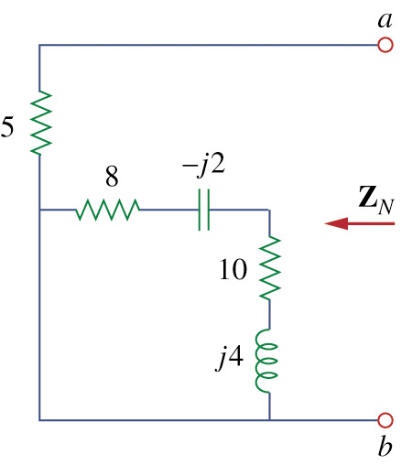
Example 3 (cont’d)

Slide 25
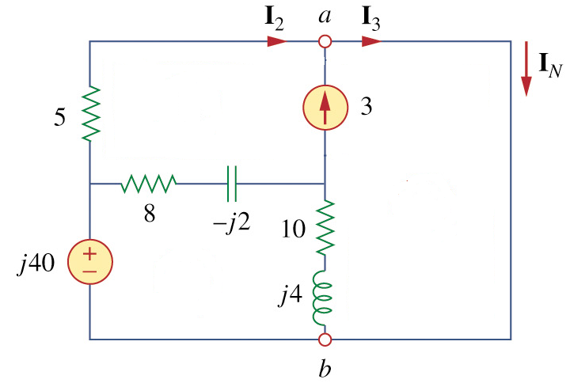
Example 3 (cont’d)

Slide 26
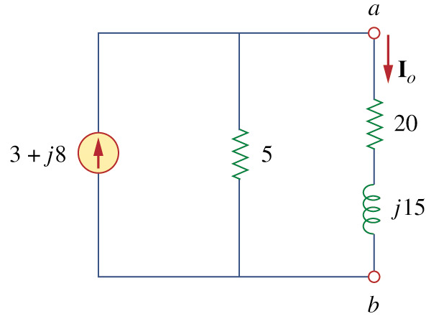
Example 3 (cont’d)

