Slide 1
Mesurement Of High Voltages
& High Currents
Unit 4

Slide 2
Measurement Of High AC Voltage
Electrostatic voltmeter
Series impedance voltmeter
Potential dividers : Resistance or Capacitance type
Potential transformers : Electromagnetic or CVT
Sphere gaps

Slide 3
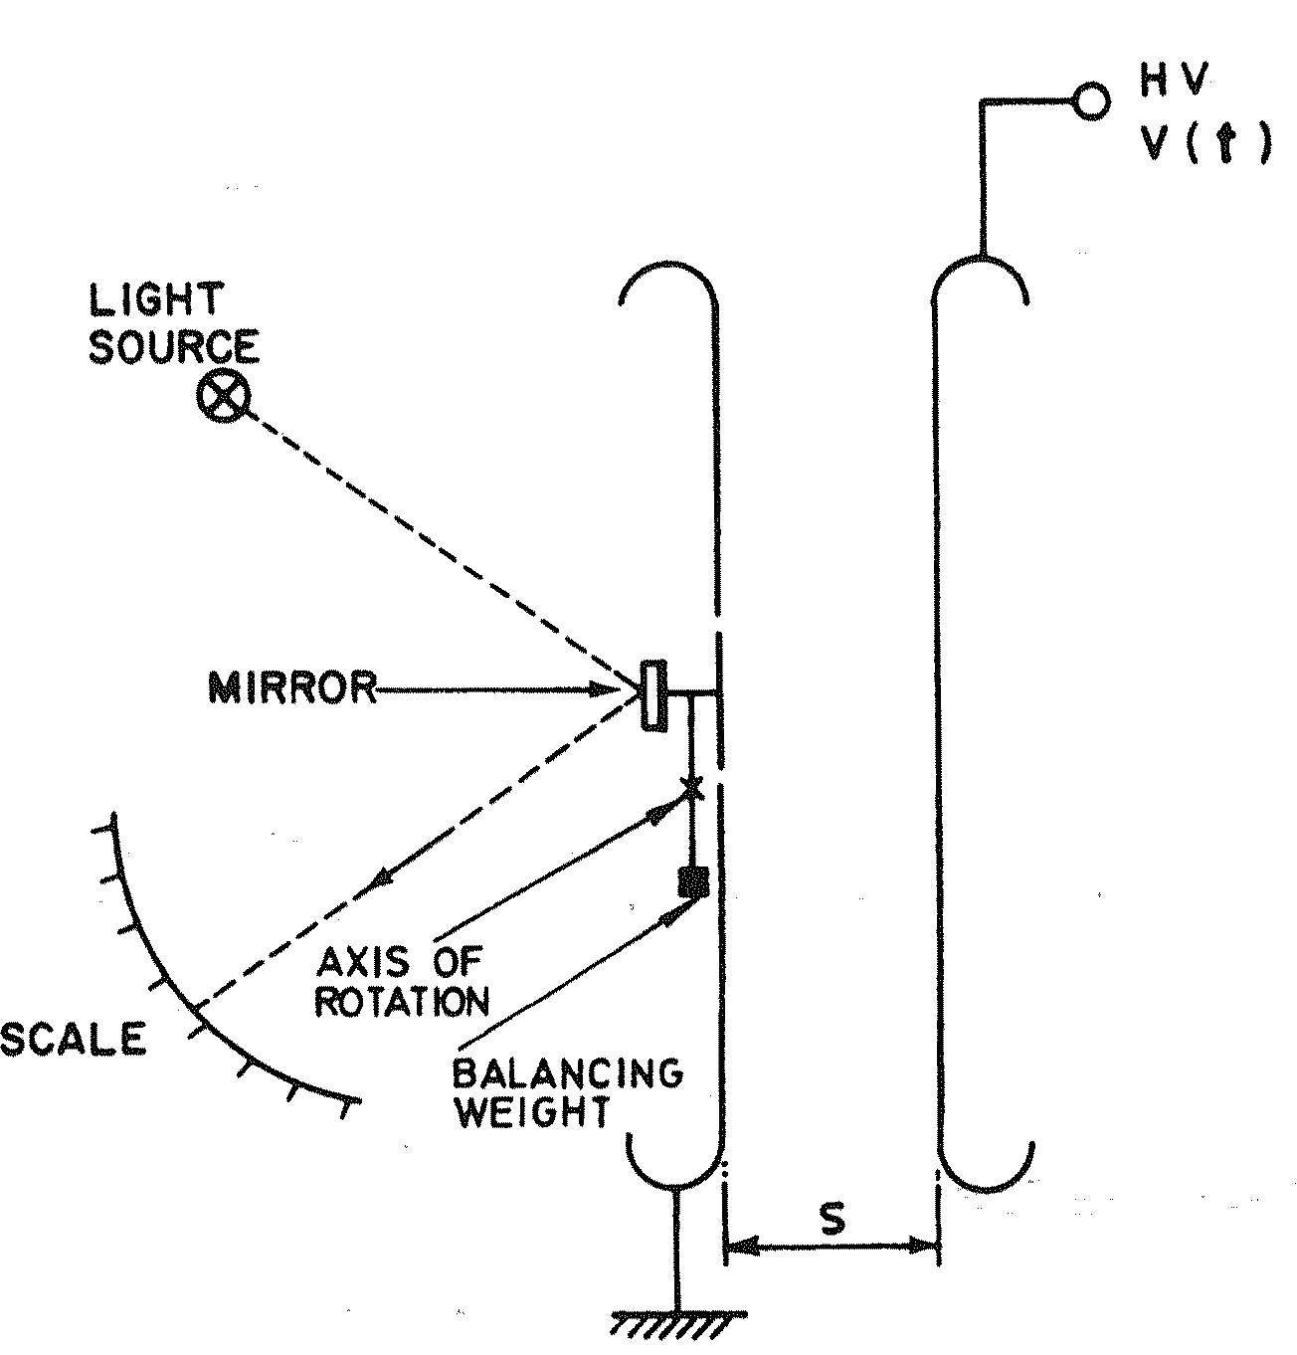
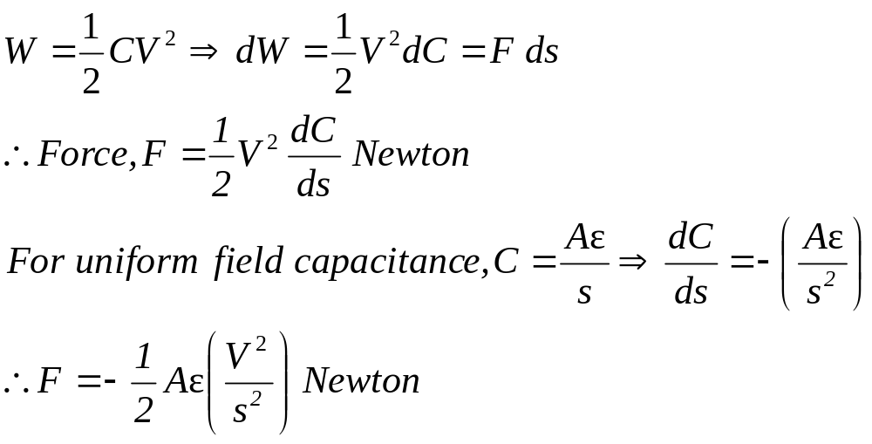
Electrostatic Voltmeter
One of the direct methods of measuring high voltages is by means of electro-static voltmeters.
For voltages above 10 kV, generally the attracted disc type of electrostatic voltmeter is used.
When two parallel conducting plates (cross section area ‘A’ and spacing ‘s’) are charged q and have a potential difference V, then the energy stored in the is given by
It is thus seen that the force of attraction is proportional to the square of the potential difference applied, so that the meter reads the square value (or can be marked to read the rms value).

Slide 5
Electrostatic Voltmeter
Electrostatic voltmeters of the attracted disc type may be connected across the high voltage circuit directly to measure up to about 200 kV, without the use of any potential divider or other reduction method. [The force in these electrostatic instruments can be used to measure both a.c. and d.c. voltages].
The right hand electrode forms the high voltage plate.
The centre portion of the left hand disc is cut away and encloses a small disc which is movable and is geared to the pointer of the instrument.
The range of the instrument can be altered by setting the right hand disc at pre-marked distances.
The force of attraction F(t) created by the applied voltage causes the movable part-to which a mirror is attached-to assume a position at which a balance of forces takes place.
An incident light beam will therefore be reflected toward a scale calibrated to read the applied voltage magnitude.

Slide 6
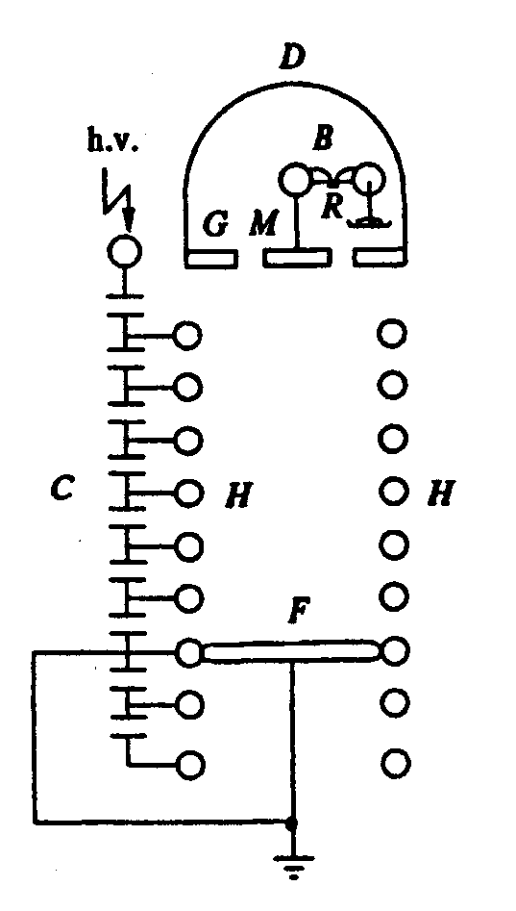
Electrostatic Voltmeter
Advantages:
  Low loading effect
  Active power losses are negligibly small
  Voltage source loading is limited to the reactive power needed to charge the system capacitance.(i.e., For 1V Voltmeter- Capacitance is few Pico farad)
  Voltages upto 600kV can be measured.
Disadvantage:
  For constant distance ‘s’, F α V², the sensitivity is small. This can be overcome by varying the gap distance d in appropriate steps.
Absolute Electrostatic Voltmeter

Slide 7
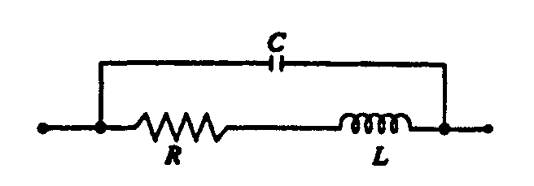
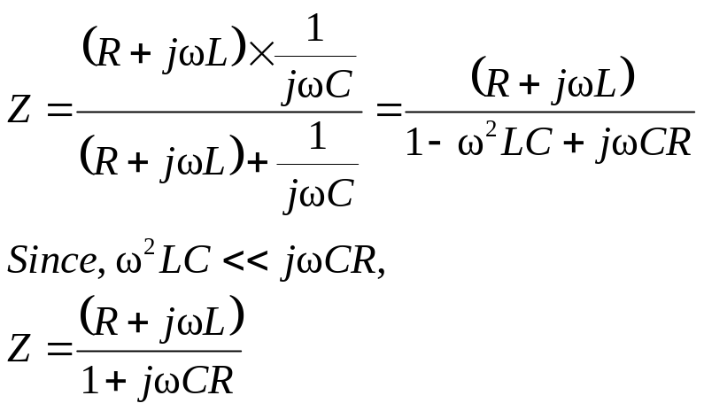
Series Impedance Voltmeter
For power frequency a.c. measurements the series impedance may be a pure resistance or a reactance.
But use of resistances yields the followings,
  Power losses
  Temperature problem
  Residual inductance of the resistance gives rise to an impedance different from its ohmic resistance.
High resistance units for high voltages have stray capacitances and hence a unit resistance will have an equivalent circuit as shown in Fig.
At any frequency ω of the a.c. voltage, R+jX_{L} is connected in parallel with –jX_{C}.

Slide 8
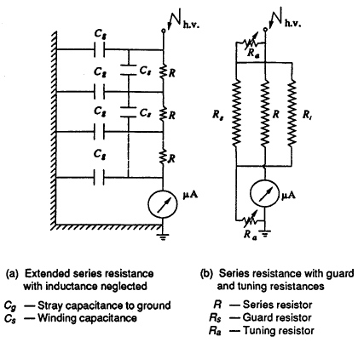
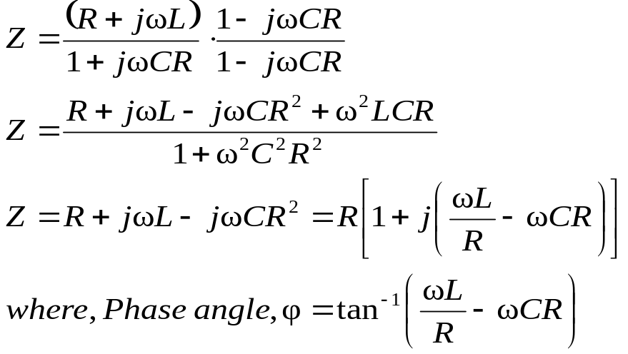
Series Impedance Voltmeter
Extended Series Resistance neglecting inductance is shown in figures.
Resistor unit then has to be taken as a transmission line equivalent, for calculating the effective resistance.
Ground or stray capacitance of each element influences the current flowing in the unit, and the indication of the meter results in an error.
Stray ground capacitance effects can be removed by shielding the resistor ‘R’ by a second surrounding spiral R_{S} which shunts the actual resistor but does not contribute to the current through the instrument.

Slide 9
Series Impedance Voltmeter
By tuning the resistors R_{a} the shielding resistor end potentials may be adjusted with respect to the actual measuring resistor so that the resulting compensation currents between the shield and the measuring resistors provide a minimum phase angle.

Slide 10
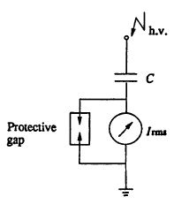

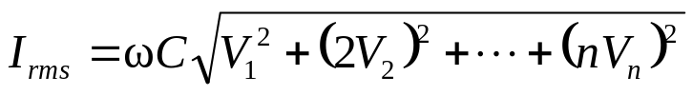
Series Capacitance Voltmeter
To avoid the drawbacks pointed out Series impedance voltmeter, a series capacitor is used instead of a resistor for a.c. high voltage measurements.
Current through the instrument, I_{c}=V/X_{c}=jωCV
The rms value of the voltage V with harmonics is given by,
where V₁,V₂ ,... ,V_{n} represent the rms value of the fundamental, second... and n^{th} harmonics.
The currents due to these harmonics are
I₁=ωCV₁ , I₂=2ωCV₂ , ……I_{n}=nωCV_{n}
With a 10% fifth harmonic only, the current is 11.2% higher, and hence the error is 11.2% in the voltage measurement
Not recommended when a.c. voltages are not pure sinusoidal waves but contain considerable harmonics.
Used for measuring rms values up to 1000 kV.

Slide 11
Series Capacitance Voltmeter
A rectifier ammeter was used as an indicating instrument and was directly calibrated in high voltage rms value.
The meter was usually a (0-100)μA moving coil meter and the over all error was about 2%.

Slide 12
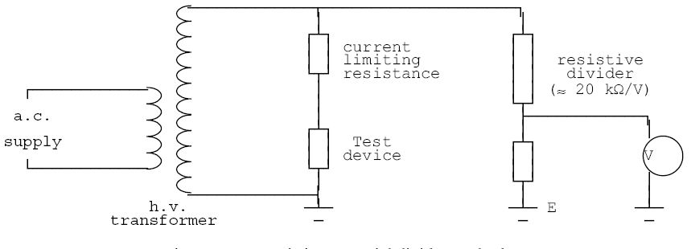
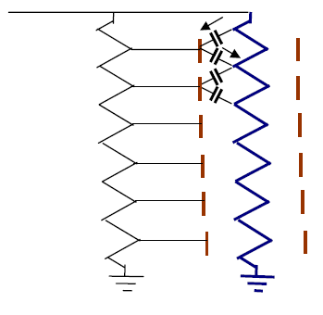
Resistive Potential Divider
In this method, a high resistance potential divider is connected across the high-voltage winding, and a definite fraction of the total voltage is measured by means of a low voltage voltmeter.
Under alternating conditions there would be distributed capacitances.
One method of eliminating this would be to have a distributed screen of many sections and using an auxiliary potential divider to give fixed potential to the screens.
The currents flowing in the capacitances would be opposite in directions at each half of the screen so that there would be no net capacitive current.

Slide 14
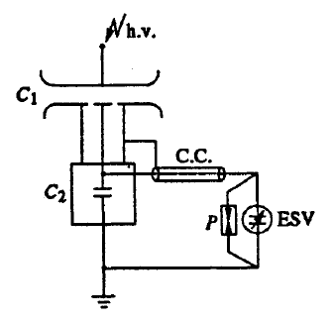
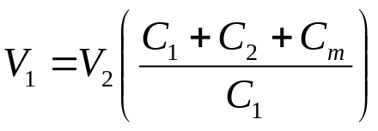
Capacitance Potential Dividers
Harmonic Effects can be eliminated by use of CPD with ESV.
Long Cable needs calibration
Gas filled condensers C₁ and C₂ are used as shown in figure.
C₁ is a three terminal capacitor, connected to C₂ by shielded cable.
C₂ is shielded to avoid stray capacitance
Applied voltage V₁ is given by,
where,
  C_{m} - Capacitance of the meter and cable leads
  V₂ - Reading of Voltmeter
C₁ - Standard Compressed Gas H.V. Condenser
C₂ - Standard Low Voltage Condenser
ESV- Electrostatic Voltmeter
P -Protective Gap
C.C - Connecting Cable

Slide 15
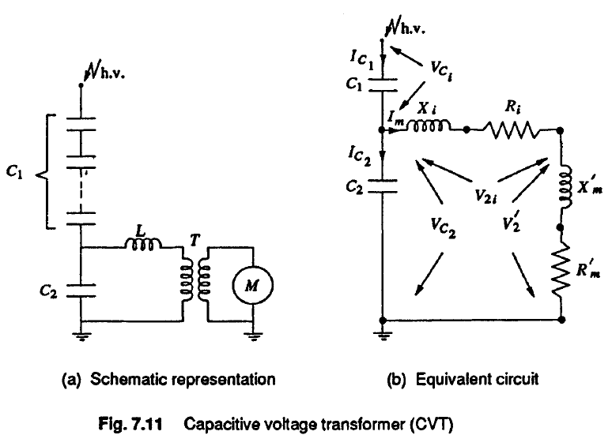
Capacitance Voltage Transformer

Slide 16
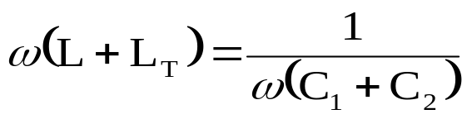
Capacitance Voltage Transformer
Capacitive Voltage Transformer: Capacitance divider with a suitable matching or isolating potential transformer tuned for resonance condition is often used in power systems for voltage measurements.
CPD can be connected only to high impedance VTVM meter or ESV. But, CVT can be connected to low impedance device like pressure coil of wattmeter or relay coil.
CVT can supply a load of few VA
C₁ is few units of HV capacitance, and the total capacitance will be around a few thousand picofarads
C₂ is a non-inductive capacitance
A matching transformer is connected between the load or meter M and C₂
Transformer ratings: HV side - 10 to 30 kV; LV side - 100 to 500 V
Value of the tuning choke L is chosen to to bring resonance condition. This condition is satisfied when,
where,
L - Inductance of the choke
L_{T} - Equivalent inductance of the transformer referred to h.v. side

Slide 17
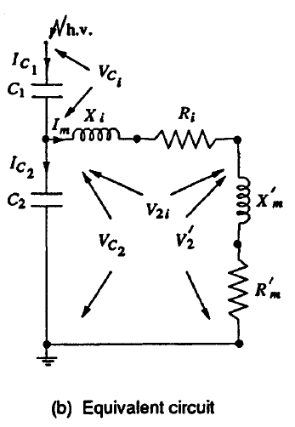
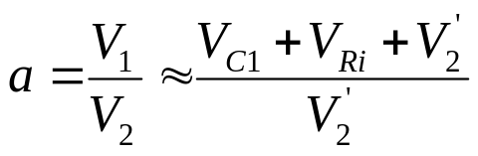
Capacitance Voltage Transformer
If we neglect X_{m}’,
V₁=V_{C1}+V_{C2}
V₁ is in phase with V₂’.
Voltage ratio,

Slide 18
Capacitance Voltage Transformer
Advantages:
  simple design and easy installation,
  can be used both as a voltage measuring device for meter and relaying purposes and also as a coupling condenser for power line carrier communication and relaying.
  frequency independent voltage distribution along elements as against conventional magnetic potential transformers which require additional insulation design against surges, and
  provides isolation between the high voltage terminal and low voltage metering.
Disadvantages:
  the voltage ratio is susceptible to temperature variations, and
  the problem of inducing ferro-resonance in power systems.

Slide 19
Peak Reading Voltmeters
For Sine wave,
  Peak Value=RMS Value X √2
  Maximum dielectric strength may be obtained by non-sine wave. In that case,
  Peak Value ≠ RMS Value X √2
Therefore, peak measurement is important.
Types:
  Series Capacitance Peak Voltmeter (Chubb-Frotscue Method)
  Digital Peak Voltmeter
  Peak Voltmeter with potential divider

Slide 20
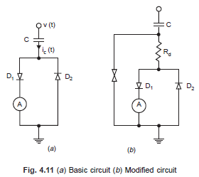

Peak Reading Voltmeters
Chubb Frotscue Method:
  Chubb and Fortescue suggested a simple and accurate method of measuring peak value of a.c. voltages.
  The basic circuit consists of a standard capacitor, two diodes and a current integrating ammeter (MC ammeter) as shown in Fig. 4.11 (a).
  The displacement current i_{c}(t), Fig. 4.12 is given by the rate of change of the charge and hence the voltage V(t) to be measured flows through the high voltage capacitor C and is subdivided into positive and negative components by the back to back connected diodes
  The voltage drop across these diodes can be neglected (1 V for Si diodes) as compared with the voltage to be measured
  The measuring instrument (M.C. ammeter) is included in one of the branches. The ammeter reads the mean value of the current,
  An increased current would be obtained if the current reaches zero more than once during one half cycle

Slide 21
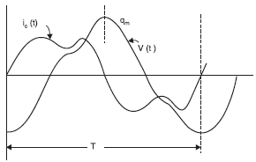
Peak Reading Voltmeters
(Chubb Frotscue Method Continued…)
This means the wave shapes of the voltage would contain more than one maxima per half cycle.
The standard a.c. voltages for testing should not contain any harmonics and, therefore, there could be very short and rapid voltages caused by the heavy predischarges, within the test circuit which could introduce errors in measurements.
To eliminate this problem filtering of a.c. voltage is carried out by introducing a damping resistor in between the capacitor and the diode circuit, Fig. 4.11 (b).
The measurement of symmetrical a.c. voltages using Chubb and Fortescue method is quite accurate and it can be used for calibration of other peak voltage measuring devices.

Slide 22
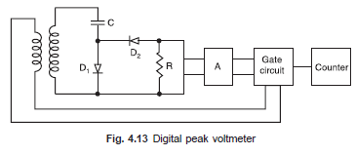

Peak Reading Voltmeters
Digital Peak Voltmeter:
In contrast to the method discussed just now, the rectified current is not measured directly, instead a proportional analog voltage signal is derived which is then converted into a proportional medium frequency for using a voltage to frequency convertor (Block A in Fig. 4.13).
The frequency ratio fm/f is measured with a gate circuit controlled by the a.c. power frequency (supply frequency f) and a counter that opens for an adjustable number of period Δt = p/f. The number of cycles n counted during this interval is
where ‘p’ is a constant of the instrument.

Slide 23
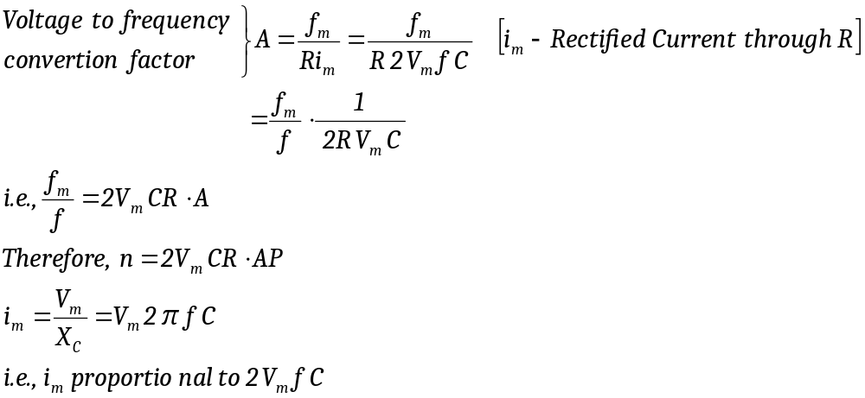
Peak Reading Voltmeters
Digital Peak Voltmeter continued….
By proper selection of R and P, Voltage can be measured immediately.
Accuracy is less than 0.35%

Slide 24
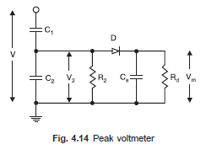
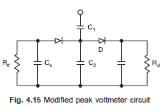
Peak Reading Voltmeters
Peak voltmeter with Potential divider:
Diode D is used for rectification
Voltage across C₂ is used to charge C₃
Resistance R_{d} permits the variation of V_{m} when
V₂ is reduced
Electrostatic Voltmeter as indicating instrument
Voltage across C_{s} α Peak value to be measured
Discharge time constant=C_{s}R_{d}≈1 to 10 sec
This arrangement gives discharge error.
Discharge error depends on frequency of the supply

Slide 25
Measurement of High Currents
Type of Current | Method used
D.C Current | Resistant shunt Hall Generator
High Power frequency A.C | Current Transformer with electro-optical technique
High frequency and impulse currents | Resistive shunts Magnetic potentiometers or probes Magnetic links Hall generators Faraday Generators
Impulse Voltages and Currents | Cathode Ray Oscilloscope

Slide 26
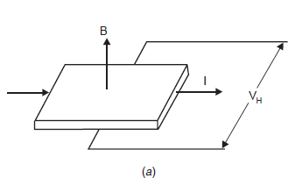
Hall Generators
Hall effect is used to measure very high direct current.
Whenever electric current flows through a metal plate placed in a magnetic field perpendicular to it, Lorenz force will deflect the electrons in the metal structure in a direction perpendicular to the direction of both the magnetic field and the flow of current.
The change in displacement generates an e.m.f called “Hall Voltage”

Slide 27
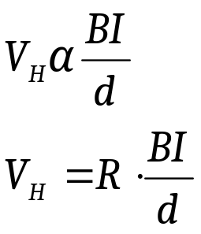
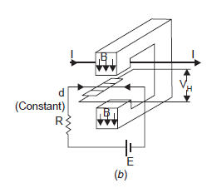
Hall Generators
Hall Voltage,
  where, B-Magnetic Flux density
  I-Current
  d-Thickness of the metal plate
  R-Hall Coefficient (depends on Material of the plate & temperature)
  R is small for metals and High for semiconductors
When large d.c. currents are to be measured the current carrying conductor is passed through an iron cored magnetic circuit

Slide 28
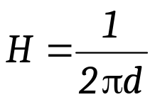
Hall Generators
The magnetic field intensity produced by the conductor in the air gap at a depth ‘d’ is given by,
The Hall element is placed in the air gap and a small constant d.c. current is passed through the element.
The voltage developed across the Hall element is measured and by using the expression for Hall voltage the flux density B is calculated and hence the value of current I is obtained.

Slide 29
Faraday Generator or Magneto Optic Method
These methods of current measurement use the rotation of the plane of polarisation in materials by the magnetic field which is proportional to the current (Faraday effect).
When a linearly polarised light beam passes through a transparent crystal in the presence of a magnetic field, the plane of polarisation of the light beam undergoes rotation. The angle of rotation is given by,
θ = α Bl
where,
α = A constant of the cyrstal which is a function of the wave length of the light.
B = Magnetic flux density due to the current to be measured in this case.
l = Length of the crystal.

Slide 30
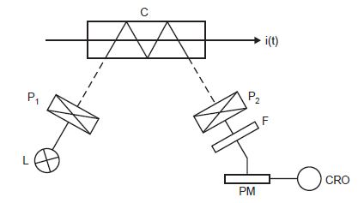
Faraday Generator or Magneto Optic Method
Fig. shows a schematic diagram of Magneto-optic method.
Crystal C is placed parallel to the magnetic field produced by the current to be measured.
A beam of light from a stabilised light source is made incident on the crystal C after it is passed through the polariser P₁.
The light beam undergoes rotation of its plane of polarisation.
After the beam passes through the analyser P₂, the beamis focussed on a photomultiplier, the output of which is fed to a CRO.

Slide 31
Faraday Generator or Magneto Optic Method
The filter F allows only the monochromatic light to pass through it. Photoluminescent diodes too, the momentary light emission of which is proportional to the current flowing through them, can be used for current measurement.
Advantages:
  It provides isolation of the measuring set up from the main current circuit.
  It is insensitive to overloading.
  As the signal transmission is through an optical system no insulation problem is faced. However, this device does not operate for D.C current.

Slide 32
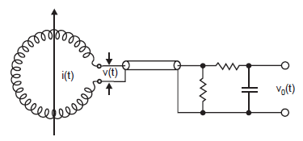
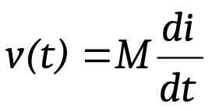
Magnetic Potentiometer(Rogowski Coil)
If the current to be measured is flowing through a conductor which is surrounded by a coil as shown in Fig.
and M is the mutual inductance between the coil and the conductor, the voltage across the coil terminals will be:
Usually the coil is wound on a non-magnetic former in the form of a toroid and has a large number of turns, to have sufficient voltage induced which could be recorded.

Slide 33
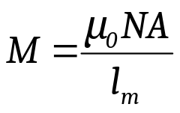
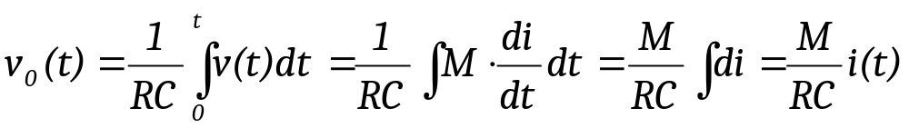
Magnetic Potentiometer(Rogowski Coil)
The coil is wound cross-cross to reduce the leakage inductance.
If N is the number of turns of the coil, A the coil area and l_{m} its mean length, the mutual inductance is given by
Usually an integrating circuit RC is employed as shown in Fig to obtain the output voltage proportional to the current to be measured. The output voltage is given by
The frequency response of the Rogowski coil is flat upto 100 MHz but beyond that it is affected by the stray electric and magnetic fields and also by the skin effect.

Slide 34
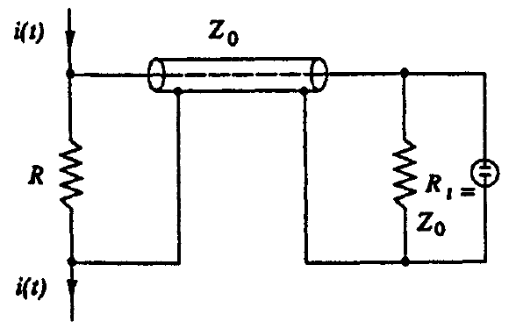
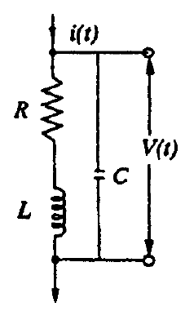
Resistive Shunt
(a) Ohmic shunt (b) Equivalent circuit of the shunt
Used for high impulse current measurements is a low ohmic pure resistive shunt.
Current through the resistive element R produces a voltage drop v(t)=i(t)R.
v(t) is transmitted to a CRO through a coaxial cable of surge impedance Z₀.
Cable at oscilloscope end is terminated by a resistance R_{i} = Z₀ to avoid reflections.
s

Slide 35
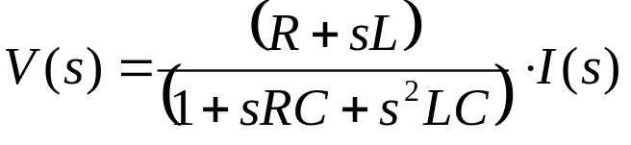

Resistive Shunt
Large dimension resistance will have a residual inductance L and a terminal capacitance C.
L may be neglected for low frequencies (ω), but becomes appreciable at higher frequencies when ω L is of the order of R.
C has to be considered when the reactance 1/ ωC is of comparable value
L and C are important above 1MHz Frequency.
Resistance: 10µΩ to few milliohms makes few volts drop.
Resistance value is determined by the thermal capacity and heat dissipation of the shunt.
Voltage drop is given by,
  where, V(s) and I(s) are the transformed quantities of the signals v(t) and i(t)
  s- Laplace Operator or Complex Frequency

Slide 36
Resistive Shunt
Types:
  Bifilar flat strip design,
  Coaxial tube or Park's shunt design, and
  Coaxial squirrel cage design

Slide 37
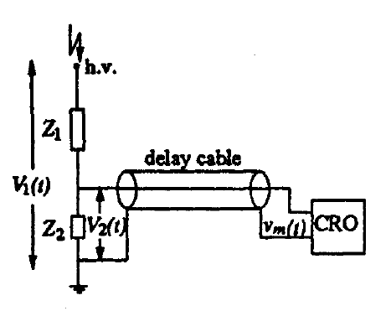
Potential Dividers for Impulse Voltage Measurements
Resistive or capacative or mixed element type potential dividers are used for high voltage impulse measurements, high frequency a.c measurements, or for fast rising transient voltage measurements.
The low voltage arm of the divider is usually connected to a fast recording oscillograph or a peak reading instrument through a delay cable.
In high voltage dividers, Each element has a self resistance or capacitance. In addition, the resistive elements have residual inductances, a terminal stray capacitance to ground, and terminal to terminal capacitances.
Fig. a. Schematic diagram of a potential divider with a delay cable and oscilloscope
Z₁-Resistor or Series of resistors in Resistor Dividers (or) Capacitor or No. of Capacitors in Capacitance divider
Z₂-A resistor or a capacitor or an R-C impedance depending upon the type of the divider

Slide 38

Potential Dividers for Impulse Voltage Measurements
The equivalent circuit of the Resistance divider with inductance neglected have been discussed already.
A capacitance potential divider also has the same equivalent where C_{S} will be the capacitance of each elemental capacitor, C_{g} will be the terminal capacitance to ground, and R will be the equivalent leakage resistance and resistance due to dielectric loss in the element.
When a step or fast rising voltage is applied at the high voltage terminal, the voltage developed across the element Z₂ will not have the true waveform as that of the applied voltage.
The cable can also introduce distortion in the waveshape.
Eq. Circuit of resistive element

Slide 39
Potential Dividers for Impulse Voltage Measurements
The following elements mainly constitute the different errors in the measurement:
Residual inductance in the elements;
Stray capacitance occurring
  between the elements,
  from sections and terminals of the elements to ground, and
  from the high voltage lead to the elements or sections;
The impedance errors due to
  connecting leads between the divider and the test objects, and
  ground return leads and extraneous current in ground leads; and
Parasitic oscillations due to lead and cable inductances and capacitance of high voltage terminal to ground.

Slide 40
Potential Dividers for Impulse Voltage Measurements
The effect to residual and lead inductances becomes pronounced when fast rising impulses of less than one microsecond are to be measured.
The residual inductances damp and slow down the fast rising pulses.
Secondly, the layout of the test objects, the impulse generator, and the ground leads also require special attention to minimize recording errors.

