Slide 1
A Vision-Based Framework for PM2.5 Classification Using Supervised and Self-Supervised Learning

Slide 2
Dr. Raihan Ul Islam
Associate Professor Department of Computer Science & Engineering
Rafia Noor Nithin
01
2022-2-60-120
Fahimah Karim Oishi
02
2022-2-60-134
Mohammad Ashiquzzaman Hadi
03
2021-3-60-143
Sahla Fabia Safa
04
2021-2-60-061

Slide 3
Table of contents
01
02
03
04
Model’s Used
Momentum Contrast(MoCo) Architecture
SimClr Framework
Masked Autoencoders(MAE) Architecture
05
Byol Algorithm
06
Performance Table Pre-Trained Model’s
07
Performance Table Self Supervise Model’s

Slide 4
Model’s Used
Pre-trained Models
SimClr
MoCo
MAE
BYOL
DINOv2

Slide 5
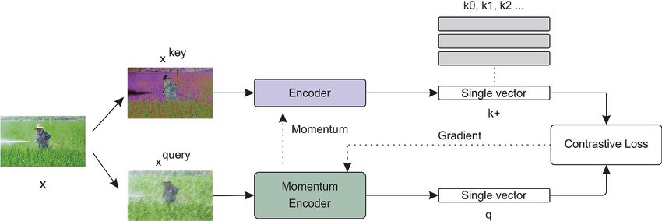


Momentum Contrast(MoCo) Architecture
Two augmented views of one image → query (xᵠ) and key (xᵏ).
Query encoder updated by back-propagation.
Momentum encoder updated using moving average of query encoder weights.
Dictionary queue stores large set of negative samples efficiently.
InfoNCE contrastive loss pulls positives together, pushes negatives apart.

Slide 6
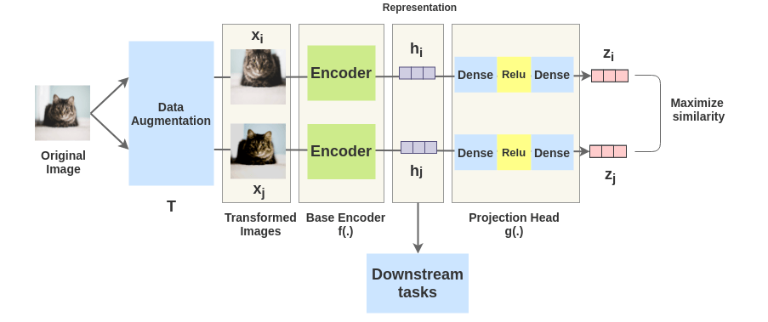
SimClr Framework

Slide 7
How SimClr Work
Self-supervised via contrast: From one image, make two heavy augmentations T: xi,xj are a positive pair. All other views in the batch act as negatives. No labels needed.
Encoder vs. projection head:
The base encoder f(⋅) (e.g., ResNet) produces representations hi,hj.
A small projection head g(⋅) maps h→ z where the contrastive loss is applied. Crucial insight: training the contrastive objective in the projection space yields better representations in h. At the end, you discard g and use f for downstream tasks.
Learning objective (NT-Xent / InfoNCE): Maximize similarity (usually cosine) between zi and zj while minimizing similarity to all negatives in the batch, with a temperature τ to scale the softmax. Bigger batches = more negatives = stronger signal.
Augmentations are the secret ingredient: Strong, stochastic transforms (random crop/resize, color jitter, blur, flip, grayscale) are essential. The model learns invariances to these, which generalize well.

Slide 8
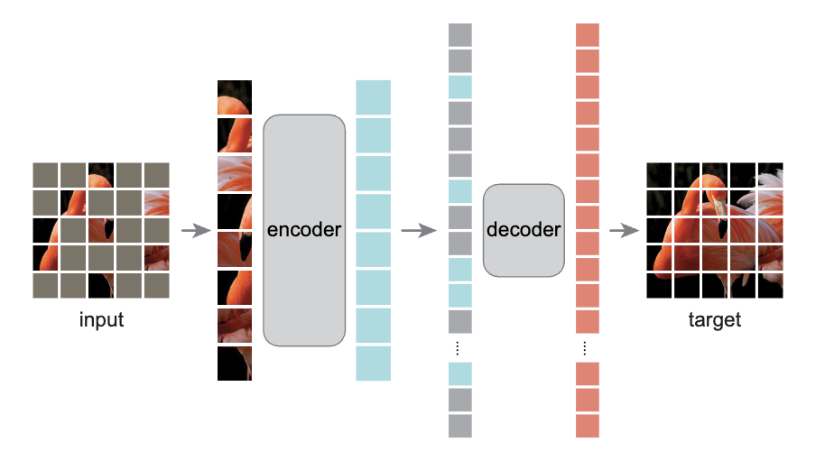
Masked Autoencoders(MAE) Architecture
Input: Image divided into patches (e.g., 16×16).
Masking: Randomly hide about 75% of patches.
Encoder: Processes only visible patches (efficient).
Decoder: Reconstructs the full image from encoded + mask tokens.
Objective: Minimize reconstruction loss between predicted and original patches.

Slide 9
Byol Algorithm
Take one image → make two augmented views​
View 1: crop the left side​
View 2: add color distortion or flip horizontally​
2. Pass each view into two networks​
3. Online Network (parameters θ) → this is what you train by gradient descent,tries to predict something​
Target network (parameters ξ)→ provides the reference output​
Both networks take one version each:​
Online sees V​
Target sees v′

Slide 10
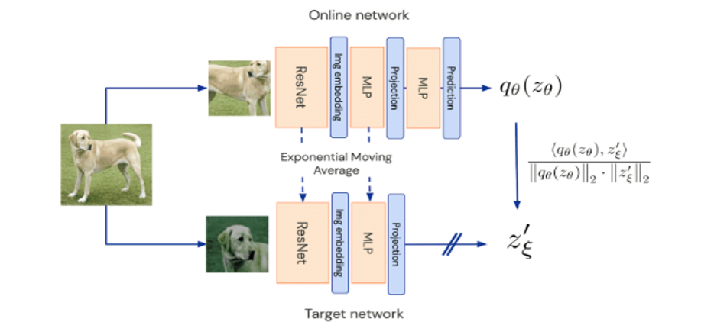
How it Works

Slide 11
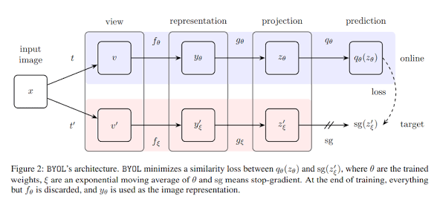
How it Works

Slide 12
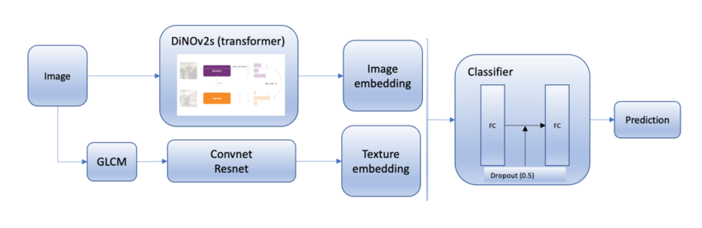
DINOv2 Architecture
Images are split into patches and encoded using a Vision Transformer (ViT)
Multi-Head Self-Attention learns global and local visual relationships
Student–Teacher self-distillation enables learning without labels
Final output is a powerful image embedding for downstream tasks

Slide 13
Performance Table Pre-Trained Model’s
Model | Train:Test Split | Overall Accuracy (%) | Precision | Recall | F1-Score
ViT (Vision Transforme) | 80:20 | 63.30 | 0.6868 | 0.6462 | 0.6611
EfficientNet -B0 | 80:20 | 68.26 | 0.7270 | 0.7140 | 0.8300
ResNet-50 | 90:10 | 67.60 | 0.6992 | 0.6934 | 0.6960
VGG16 | 90:10 | 66.10 | 0.6880 | 0.6935 | 0.6890
GoogLeNet | 40:60 | 37.99 | 0.5600 | 0.3278 | 0.3339

Slide 14
Performance Table Self Supervise Model’s
Model | Classifiers | Overall Accuracy (%) | Precision | Recall | F1-Score
MoCo | RF | 0.5887 | 0.6778 | 0.5974 | 0.6249
BYOL | SVM | 0.6255 | 0.6908 | 0.6403 | 0.6605
SimCLR | SVM | 0.6020 | 0.6672 | 0.6148 | 0.6347
DinoV2 | MLP | 0.6590 | 0.6920 | 0.6670 | 0.6780
MAE | MLP | 0.4806 | 0.5282 | 0.4969 | 0.5054

Slide 15
Thanks!

