Slide 1












AI Coding Assistants
Transforming Software Development
PRESENTED BY
[Shima Vosoogh
Gulpari Alandarova
[Rafia Riana
Presenter 1
Presenter 2
Course CEP146
Instructor Professor Raymond Wong
Date Summer2026

Slide 2
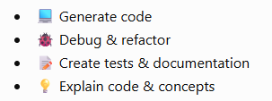
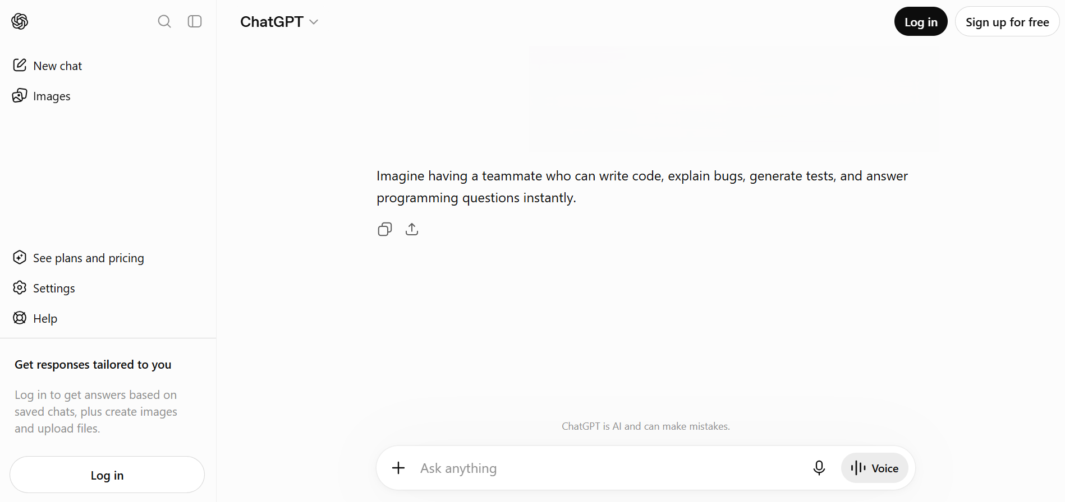
Would You Hire a Junior Developer Who Never Sleeps?
What Are AI Coding Assistants?
Software development is no longer just about writing code—it's increasingly about collaborating with AI. AI coding assistants help developers generate, debug, explain, and improve code, making software development faster and more efficient.

Slide 3




The Evolution of AI Coding Tools
GEN 1 (Pre-2020)
Rule-Based Autocomplete
GEN 4 (2025–2026)
Syntax-aware suggestions using predefined language rules.
Traditional IDE autocomplete
Language & syntax completion
No understanding of developer intent
Agentic AI
AI autonomously executes development tasks from start to finish.
Autonomous coding
Testing & debugging
Workflow automation
GEN 2 (2021)
LLM-Powered Coding
Large Language Models introduced natural language code generation.
GitHub Copilot
Prompt-to-code generation
AI-assisted code completion
GEN 3 (2023–2024)
Context-Aware Assistants
AI understands your project, not just the current file.
Chat-based coding
Project-wide context
Multi-file editing

Slide 4
The Old Way vs. Today
Before AI: With AI:
💡 Idea 💡 Idea
│ │
▼ ▼
🔍 Search 🤖 Ask AI
│ │
▼ ▼
📚 Documentation 💻 Generate code
│ │
▼ ▼
💬 Stack Overflow 🔍 Review
│ │
▼ ▼
⌨️ Code 🚀 Deliver
Tools | Primary Strength
GitHub Copilot | IDE code completion
ChatGPT | Reasoning & debugging
Cursor | Repository-wide editing
Claude Code | Long-context & agentic workflows
Gemini Code Assist | Google Cloud development
Amazon Q Developer | AWS development
Less searching → More problem-solving

Slide 5
Benefits & Impact of AI Coding Assistants
AI coding assistants have transformed software development by making programming faster, easier, and more efficient. They help developers complete repetitive tasks, improve code quality, and support learning throughout the development process.
⚡ Faster Development
Generate code quickly and reduce repetitive coding tasks.
🐞 Smarter Debugging
Identify bugs faster and receive explanations for error messages.
📚 Learning Support
Help students and developers understand programming concepts through examples and explanations.
📝 Automatic Documentation
Generate comments, README files, and documentation automatically.
"AI acts like a coding partner. It can generate code, explain functions, help debug errors, and even create unit tests."

Slide 6
Challenges of AI Coding Assistants
Although AI coding assistants provide many advantages, they also introduce several challenges. Developers should use these tools responsibly and always review AI-generated code before using it in real projects.
🔒 Security Risks
AI may generate insecure code or introduce software vulnerabilities.
🔐 Privacy Concerns
Sensitive information such as passwords, API keys, and company code should never be shared with public AI tools.
📄 Copyright Issues
AI-generated code may create licensing or intellectual property concerns.
❌ Incorrect Code
Generated code is not always correct and must be tested carefully.
🧠 Developer Overreliance
Depending too much on AI can reduce programming and problem-solving skills.
"AI is fast, but it doesn't truly understand your project or your users. Developers still need to review and guide its output."

Slide 7
Real-World Industry Adoption
Today, AI coding assistants are widely used across different industries. From startups to large technology companies, these tools help developers build software faster, improve code quality, and increase overall productivity.
🚀 Startup Development
AI helps startups build Minimum Viable Products (MVPs) more quickly and with fewer resources.
🏢 Enterprise Development
Large companies use AI for code reviews, debugging, documentation, and maintaining complex codebases.
🌍 Open Source Projects
AI supports contributors by suggesting bug fixes, improving documentation, and generating pull requests.
🔄 Legacy Software Modernization
Organizations use AI to understand, refactor, and modernize older software systems.
"The future isn't AI replacing developers. It's developers who know how to work effectively with AI becoming more productive.“

Slide 8
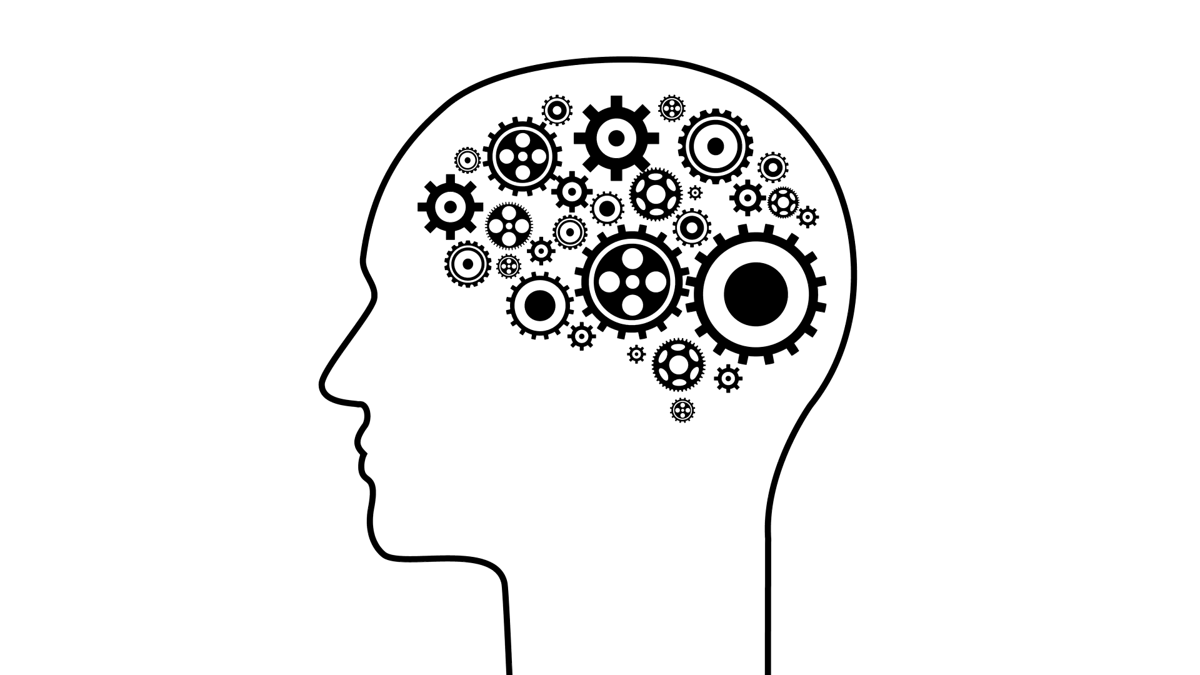
As AI coding assistants become more powerful, should future software developers focus less on writing code and more on designing, reviewing, and managing AI-generated solutions?
Thank you for your attention!

