Slide 1


Team Details
a.
Team name:
Assay
b.
Team leader name:
Rafida Aziz
c.
Problem Statement:
AI study tools dispense answers instead of building reasoning. Assay forces the learner to defend their understanding in Socratic dialogue, and verifies every claim against the source document.
Google Cloud AI Builder Cup 2026 · Track 4 — Media, Content & Digital Experiences

Slide 2

Note: Please download this template to make your edits and submit the final version.
To download, go to File > Download > Microsoft PowerPoint (.PPTX). Kindly refrain from sending edit requests.

Slide 3
Brief about the idea
Every AI study tool answers questions.Assay questions your answers.
THE LOOP
01
Intake
Intent + target role + optional PDF
The problem. Students feed material into an AI, get a summary or a quiz, and mistake recognition for understanding. The cognitive muscle is never exercised — and there is no way to tell comprehension from confident recall.
What Assay does. It ingests a PDF or a topic, builds a gated syllabus anchored to page numbers, then runs a Socratic oral defense. The learner must derive, not recite. Every answer is verified against the source; ungrounded claims are refused instead of rewarded.
The mechanism. Deterministic honeypot terms — plausible but fictional — are injected into the dialogue. A learner who explains one fluently is bluffing, and the engine catches it.
02
Scope checklist
Live-streamed topics, user-curated
03
Gated syllabus
Chapters anchored to page numbers
04
Socratic defense
Adversarial oral examination
05
Verified dossier
Bloom-level report, citations intact

Slide 4
Opportunities
Existing toolsAnswer dispensers
AssayAnswer interrogators
ChatGPT / NotebookLM: summarise, then stop
Quiz generators: multiple choice, guessable
Flashcards: recognition, not derivation
No verification that the learner understood
Learner must derive under adversarial probing
Open-ended defense, no multiple choice
Every claim grounded to a page or refused
Honeypot terms expose bluffing deterministically
Unique selling proposition
Assay is the only study tool whose output is a defense transcript, not a summary. It is adversarial by design: the system actively tries to catch you bluffing, using fictional terms and false premises, and it scores the refusal. Grounding is enforced at the retrieval layer — recall@3 of 0.909 over 22 questions, with a 100% refusal rate on the 2 unanswerable ones.

Slide 5
List of features offered by the solution
Intake & calibration
Realtime scope checklist
Topic prompt or PDF upload, target engineering role, and three rigor levels (Foundation / Applied / Rigorous) that set the depth of questioning.
Topics are streamed live via SSE as they are extracted, tagged by origin — document, role taxonomy, or grounded external — and the learner curates them.
Gated syllabus
Socratic oral defense
Content is chunked into chapters anchored to page numbers, so every later claim can be traced back to a specific page.
Turn-based adversarial dialogue. The learner must derive; the engine pushes back on hand-waving and follows up on weak answers.
Anti-hallucination verifier
Honeypot detection
Each response is checked against the retrieved source. Ungrounded claims are flagged and refused rather than accepted.
Deterministic fictional terms are seeded into the dialogue. Explaining one fluently is scored as a hallucination, not as knowledge.
Competency dossier
Deterministic fallback cache
A verified report with Bloom-level profiling, rubric scores per competency, and an audit record of the session.
A pre-computed response cache keeps the demo and the eval harness alive with zero crashes when the model API is unavailable.

Slide 6
Process flow diagram or Use-case diagram
Process flow — the gate is the product: a chapter never unlocks until it is defended
1
Intake
Gate condition: a chapter unlocks only when its defense scores ≥ 75. Fail → the same chapter is re-read, not the whole course restarted. Pass → the next chapter unlocks. The dossier is assembled only after the last chapter, from transcripts that actually happened.
Prompt or PDF, target role, rigor level
2
Realtime checklist
Topics streamed over SSE, learner curates
Dossier
Bloom profile, audit record
3
Gated syllabus
Chapters chunked, every claim page-anchored
yes
Last
chapter?
4
Gated chapter reader
no
Source text and Socratic ask, side by side
no
5
Oral defense
Defense
score ≥ 75?
Adversarial turns, honeypot injected
yes

Slide 7
Wireframes/Mock diagrams of the proposed solution (optional)

Slide 8
Architecture diagram of the proposed solution
CLIENT
Pages
State
Gemini
React 18 + Vite + TypeScript
27 routes
Dashboard · Intake · Reader · Exam · Report
Zustand stores
routing via react-router 7
google-genai SDK
gemini-3-flash / 3.1-pro
API
Endpoints
Streaming
Verifier
FastAPI · Python 3.11 · SSE
intake · syllabus · interview · report · calibration
SSE via sse-starlette
intake checklist partial events
grounding check per turn
6/6 caught in eval
ENGINE
Repositories
Retrieval
Fallback
Assay core · Gemini · retrieval
SessionStore · ChapterStore · InterviewStore (in-memory, Firestore port stubbed)
PyMuPDF page-anchored extraction
recall@3 = 0.909
deterministic cache
zero-crash demo mode
Deployment: two Cloud Run services — nginx serving the built Vite bundle, proxying /api to the FastAPI service. FirestoreStore activates when credentials are present; otherwise the in-memory store is used, so no database is required to run the demo.

Slide 9
Technologies to be used in the solution
FRONTEND
BACKEND
AI
PLATFORM
· React 18
· TypeScript
· Vite
· Tailwind CSS
· Zustand
· react-router 7
· Lucide icons
· KaTeX
· Python 3.11
· FastAPI
· Uvicorn
· Pydantic v2
· sse-starlette
· PyMuPDF
· Gemini 3 Flash
· Gemini 3.1 Pro
· google-genai SDK
· Deterministic honeypot catalog
· Grounded verifier
· Google Cloud Run
· Docker
· GitHub
· pytest (219 tests)
Why this stack: everything Google-side is the official SDK and the Gemini API, so the AI layer is a thin, auditable wrapper rather than a framework. The frontend stays on Vite because the whole app is a client-rendered SPA behind one API origin — no server rendering needed, and the build ships as static assets inside the same container.
219 automated backend tests · 11 test modules · deterministic eval harness in eval/

Slide 10
Estimated implementation cost (optional)
Monthly estimate at three scales. Gemini list price: $0.50 / 1M input, $3.00 / 1M output (gemini-3-flash, paid tier).
Pilot
Classroom
Department
Active learners
10
100
1,000
Defense turns / learner / month
60
60
60
Gemini input tokens
0.6M
6M
60M
Gemini output tokens
0.9M
9M
90M
Gemini cost
$2.43
$24.30
$243.00
Cloud Run (2 vCPU / 2 GiB, scale-to-zero)
≈ $3
≈ $12
≈ $60
Total / month
≈ $5
≈ $36
≈ $303
Cost per learner
≈ $0.24
≈ $0.24
≈ $0.24
Assumptions, stated so they can be challenged: 60 defense turns per learner per month at ~1k input and ~1.5k output tokens per turn. Cloud Run figures are order-of-magnitude for a scale-to-zero service and exclude the free tier. Gemini pricing is the published paid-tier list price; the free tier covers the pilot.

Slide 11
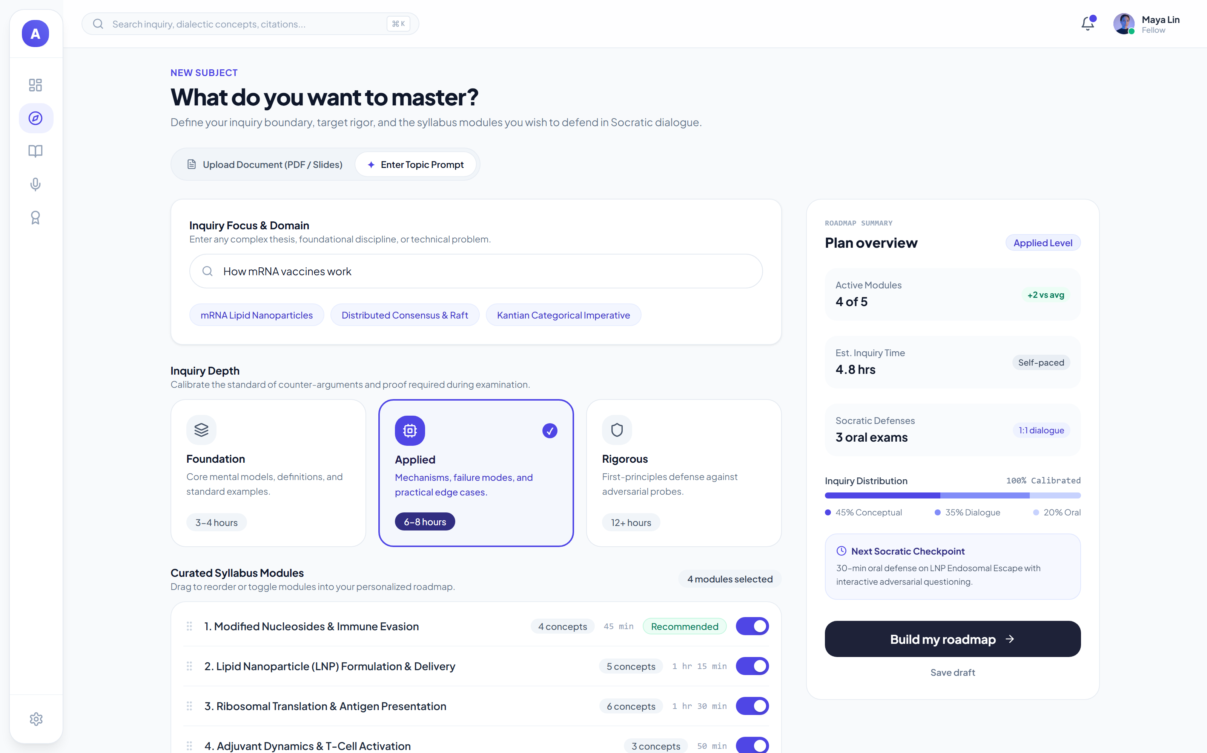
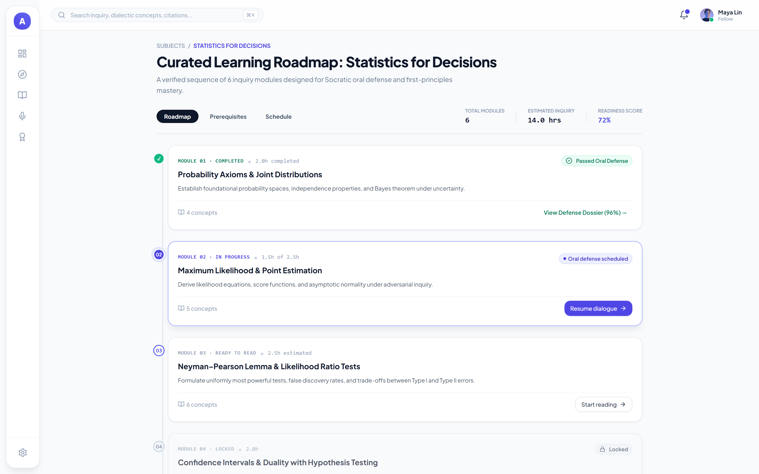
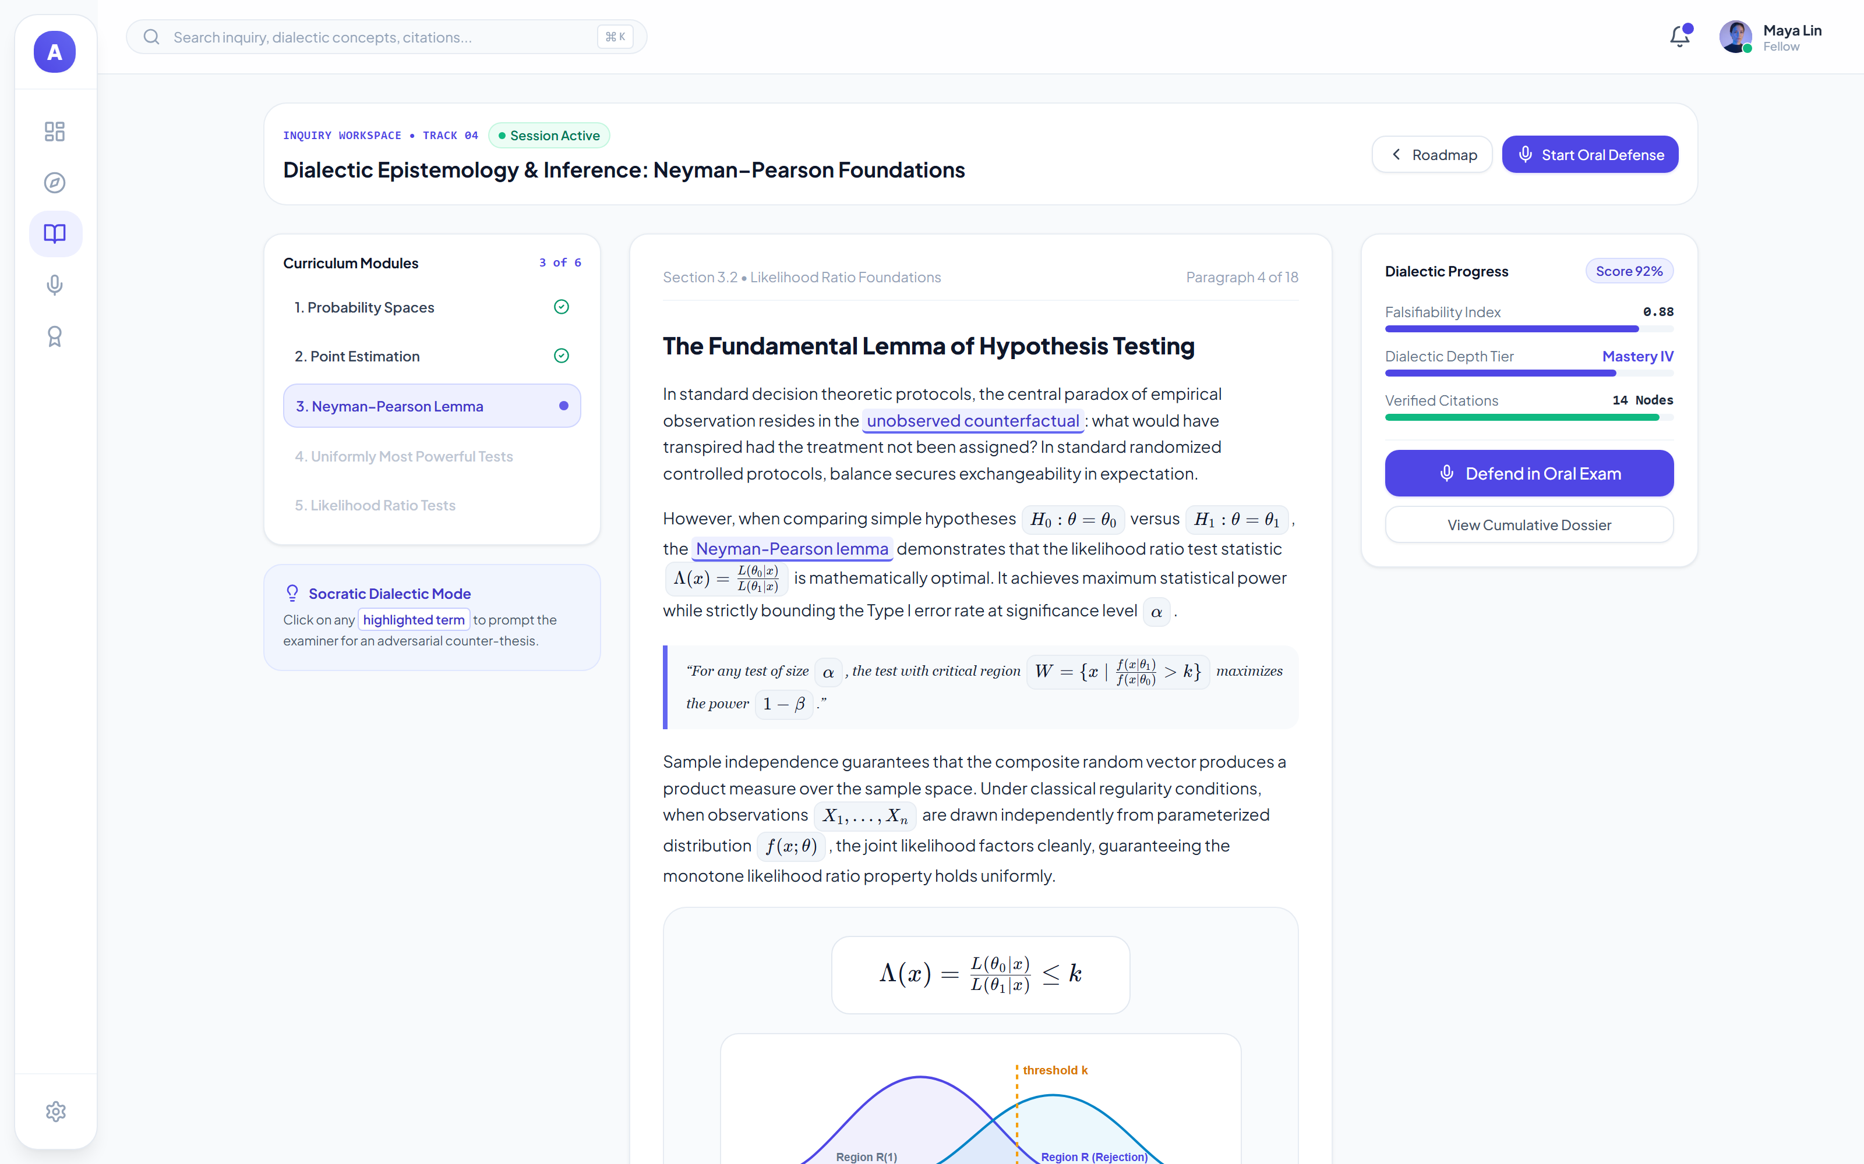
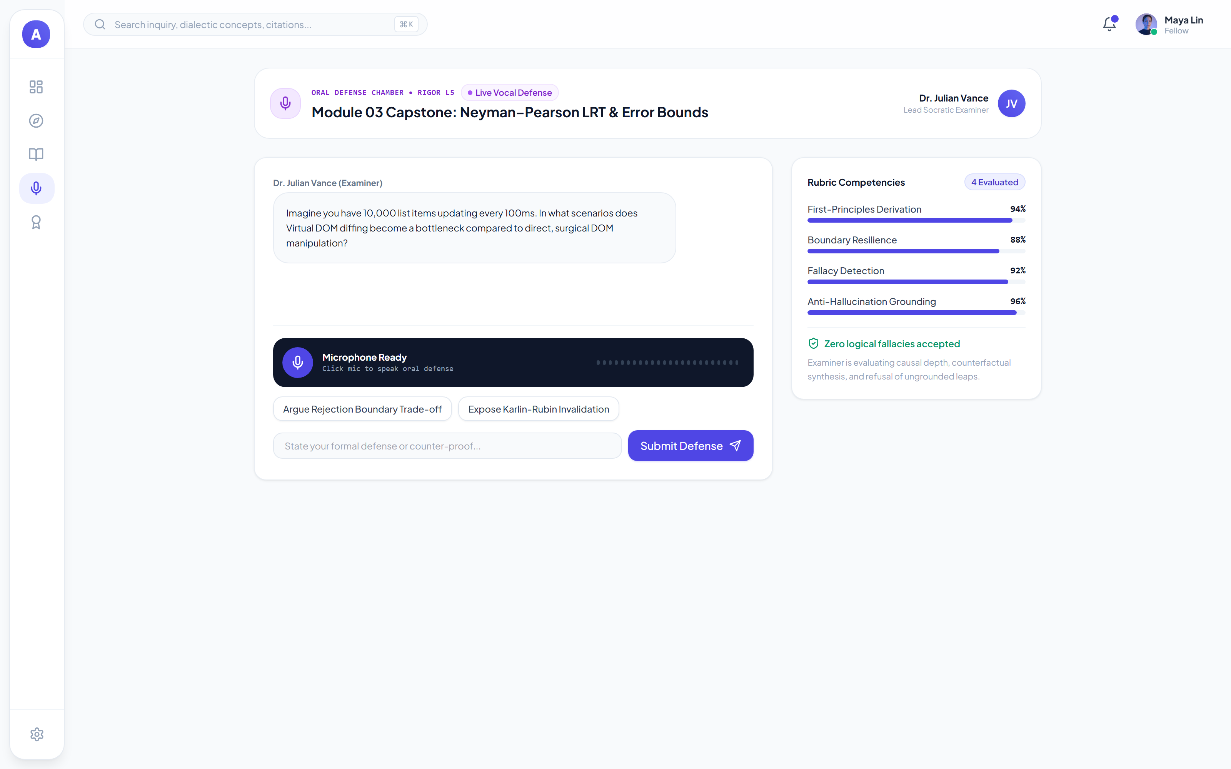
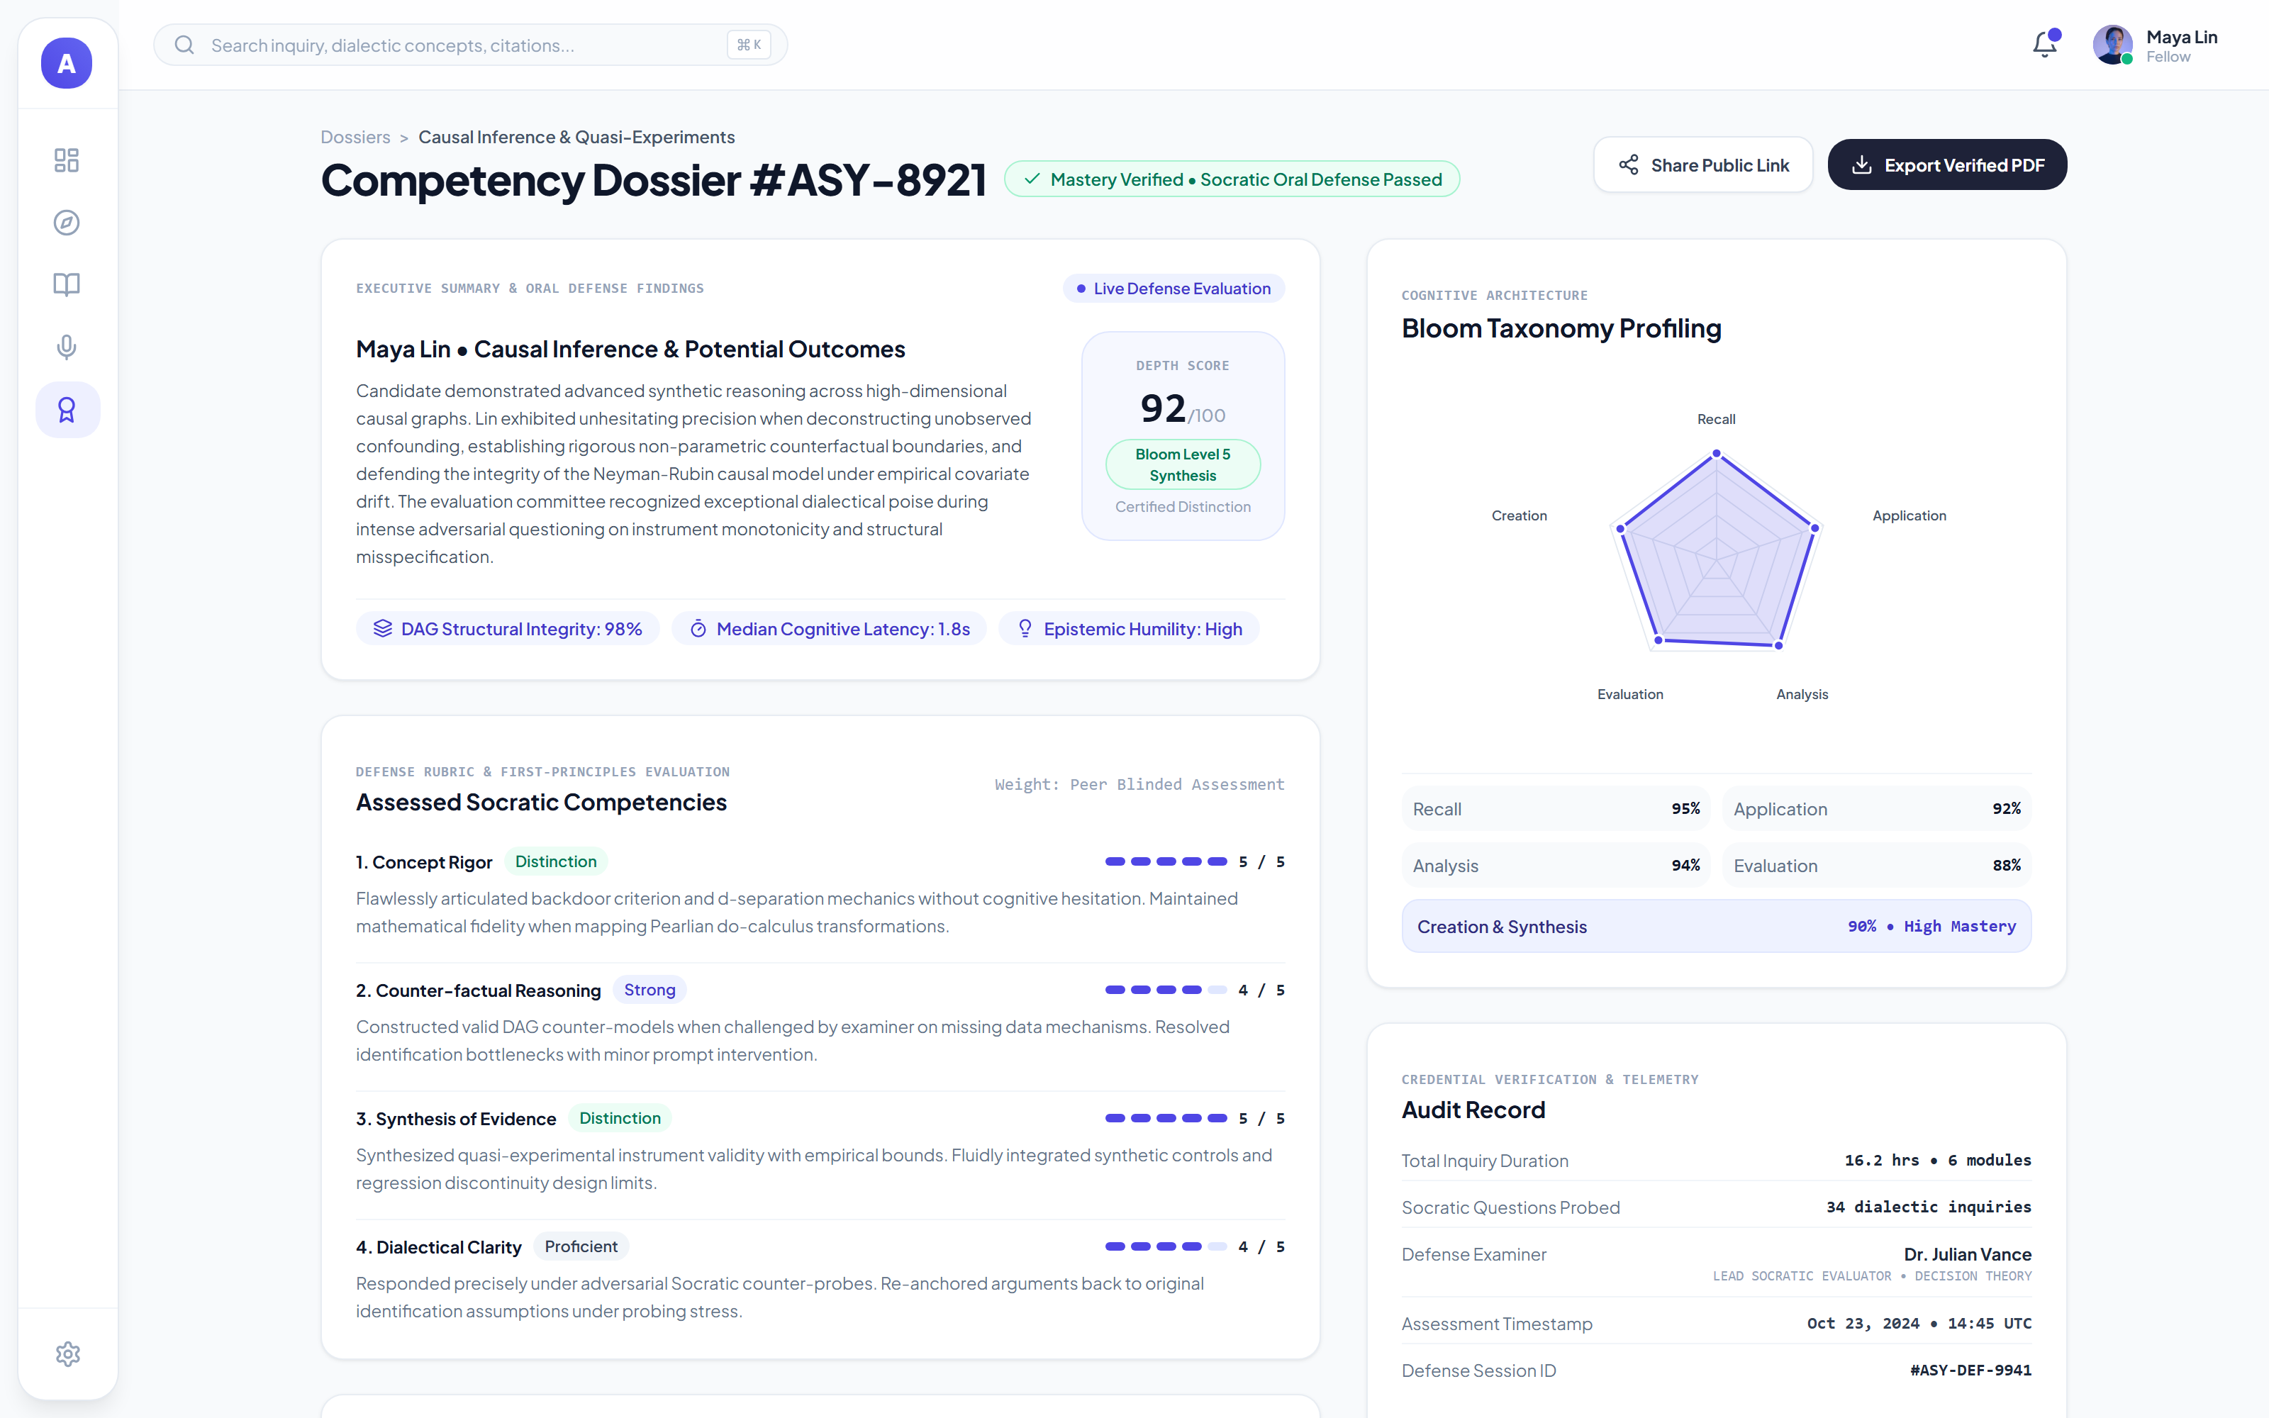
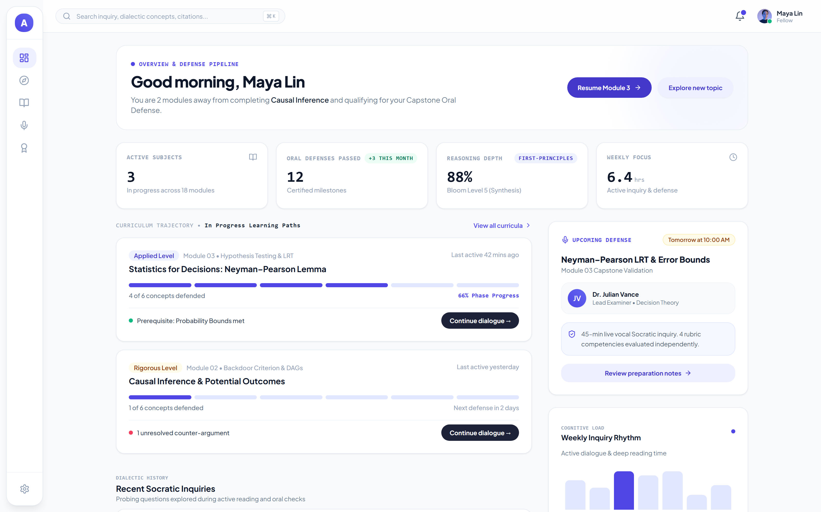
Snapshots of the prototype
Intake
Gated syllabus
Deep reader
Prompt or PDF, role, and rigor calibration
Modules with concept counts and duration
Source text and Socratic dialogue side by side
Oral defense
Dossier
Dashboard
Adversarial turn with live rubric scores
Bloom profile, rubric, audit record
Progress, defenses passed, upcoming defense

Slide 12
Prototype Performance report/Benchmarking
All figures from the deterministic harness in eval/ — no LLM judge, no rounding up.
Metric
Result
n
Read this before quoting the numbers
Verifier catch rate
6 / 6 (100%)
6
The harness also measures how often the raw model hallucinates on fictional terms: 87.5% (n=8, product run) against a 54% research baseline (n=80). That is the problem we measure, not our accuracy. Assay's own score is the verifier catch rate above.
Structured output validity
2 / 2 (100%)
2
Trap: fictional term detected
100%
2
Trap: trap number detected
100%
2
Trap: false premise detected
50%
2
RAG recall@3
0.909
22
RAG page-hit@1
0.682
22
Sample sizes are small and stated
RAG refusal accuracy
100%
2
n=2 for most trap categories. The 100% figures are directionally strong but not statistically tight, and we say so rather than hiding the n. The RAG metrics (n=22) and the verifier (n=6) carry the most weight.
Backend test suite
219 tests
11 files

Slide 13
Additional Details/Future Development (if any)
Now — shipped
Next — 90 days
Later — 12 months
· Intake, gated syllabus, deep reader, oral defense
· Anti-hallucination verifier + honeypot catalog
· Verified dossier with Bloom profiling
· 219 backend tests, deterministic eval harness
· Firestore port for multi-tenant sessions
· Voice-first defense (live speech, not typed)
· Instructor dashboard with cohort analytics
· Institutional SSO and roster import
· Adaptive honeypot generation per domain
· Cross-session knowledge decay modelling
· LMS integrations (Canvas, Moodle)
· Public competency credential with verifiable link
Known limits we are not hiding: trap categories still have n=2, the Firestore layer is a stub, and the oral defense is typed rather than spoken. Each of these is scheduled above, not glossed over.

Slide 14
Provide links to your:
GitHub Public Repository
Demo Video Link (3 Minutes)
Final Product Link
https://github.com/rafidaaziz23/assay
[ISI: URL video demo 3 menit]
https://assay-web-icejnb6gya-as.a.run.app
Team: Assay — Rafida Aziz (lead), M. Zulfi Fahreza, Wildan Fajar Maulana. Stack: React 18 + Vite, FastAPI, Gemini 3 via the google-genai SDK, deployed on Google Cloud Run.

Slide 16


