Slide 1
Chapter 7: Normalization
Modified by: Farhan Anan Himu

Slide 2
Recall: Database design
Requirements analysis
User needs; what must database do?
Conceptual design
High-level description; often using E/R model
Logical design
Translate E/R model into relational schema
Schema refinement
Check schema for redundancies and anomalies
Physical design/tuning
Consider typical workloads, and further optimise

Slide 3
What is Normalization
process of organizing data in a database to minimize redundancy and dependency
Advantages
improving data integrity
reducing data redundancy
making the database more efficient in terms of storage and retrieval
over-normalization can also lead to performance issues
it's essential to strike a balance based on the specific requirements of the application

Slide 4
Anomalies
unexpected or undesirable outcomes that can occur when data is not properly organized or structured
Insert anomaly
Delete anomaly
Update anomaly

Slide 5
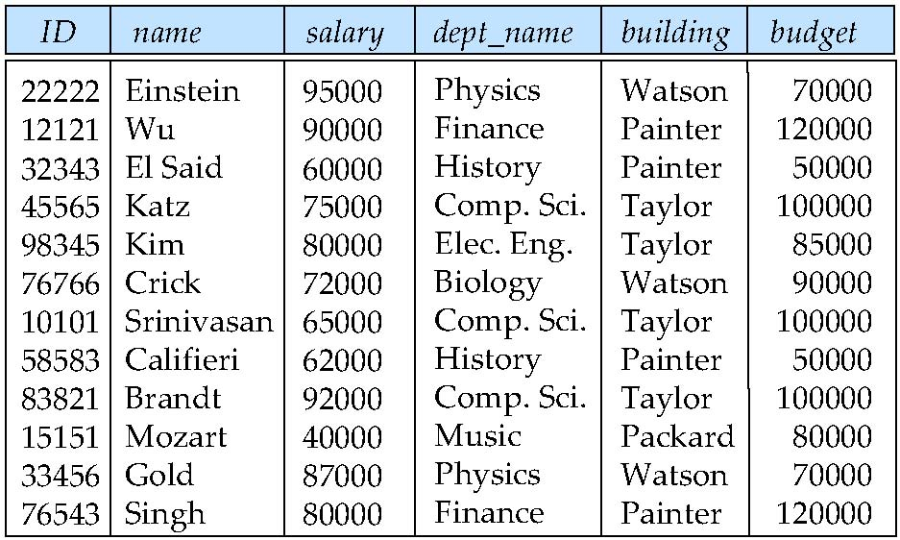
Features of Good Relational Designs
Suppose we combine instructor and department into in_dep, which represents the natural join on the relations instructor and department
There is repetition of information
Need to use null values (if we add a new department with no instructors)

Slide 6
A Normalisation Example

Slide 7

Take the following table. StudentID is the primary key.
Is it 1NF?

Slide 8
No. There are repeating groups (subject, subjectcost, grade)
How can you make it 1NF?

Slide 9

Create new rows so each cell contains only one value
But now look – is the studentID primary key still valid?

Slide 10
No – the studentID no longer uniquely identifies each row
You now need to declare studentID and subject together to uniquely identify each row.
So the new key is StudentID and Subject.

Slide 11
So. We now have 1NF.
Is it 2NF?

Slide 12
Studentname and address are dependent on studentID (which is part of the key) This is good.
But they are not dependent on Subject (the other part of the key)

Slide 13
And 2NF requires…
All non-key fields are dependent on the ENTIRE key (studentID + subject)

Slide 14
So it’s not 2NF
How can we fix it?

Slide 15
Make new tables
Make a new table for each primary key field
Give each new table its own primary key
Move columns from the original table to the new table that matches their primary key…

Slide 16
Step 1
STUDENT TABLE (key = StudentID)

Slide 17

Step 2
STUDENT TABLE (key = StudentID)
SUBJECTS TABLE (key = Subject)

Slide 18



Step 3
STUDENT TABLE (key = StudentID)
SUBJECTS TABLE (key = Subject)
RESULTS TABLE (key = StudentID+Subject)

Slide 19
Step 3
STUDENT TABLE (key = StudentID)
SUBJECTS TABLE (key = Subject)
RESULTS TABLE (key = StudentID+Subject)

Slide 20
Step 4 - relationships
STUDENT TABLE (key = StudentID)
SUBJECTS TABLE (key = Subject)
RESULTS TABLE (key = StudentID+Subject)

Slide 21
Step 4 - cardinality
STUDENT TABLE (key = StudentID)
1
Each student can only appear ONCE in the student table
SUBJECTS TABLE (key = Subject)
RESULTS TABLE (key = StudentID+Subject)

Slide 22
Step 4 - cardinality
STUDENT TABLE (key = StudentID)
1
SUBJECTS TABLE (key = Subject)
1
Each subject can only appear ONCE in the subjects table
RESULTS TABLE (key = StudentID+Subject)

Slide 23
Step 4 - cardinality
STUDENT TABLE (key = StudentID)
1
SUBJECTS TABLE (key = Subject)
1
A subject can be listed MANY times in the results table (for different students)
8
RESULTS TABLE (key = StudentID+Subject)

Slide 24
Step 4 - cardinality
STUDENT TABLE (key = StudentID)
1
SUBJECTS TABLE (key = Subject)
1
A student can be listed MANY times in the results table (for different subjects)
8
8
RESULTS TABLE (key = StudentID+Subject)

Slide 25
A 2NF check
STUDENT TABLE (key = StudentID)
1
SUBJECTS TABLE (key = Subject)
1
SubjectCost is only dependent on the primary key,
Subject
8
8
RESULTS TABLE (key = StudentID+Subject)

Slide 26
A 2NF check
STUDENT TABLE (key = StudentID)
1
SUBJECTS TABLE (key = Subject)
1
8
8
Grade is only dependent on the primary key (studentID + subject)
RESULTS TABLE (key = StudentID+Subject)

Slide 27
A 2NF check
STUDENT TABLE (key = StudentID)
1
Name, Address are only dependent on the primary key
(StudentID)
SUBJECTS TABLE (key = Subject)
1
8
8
RESULTS TABLE (key = StudentID+Subject)

Slide 28
But is it 3NF?
STUDENT TABLE (key = StudentID)
1
So it is 2NF!
SUBJECTS TABLE (key = Subject)
1
8
8
RESULTS TABLE (key = StudentID+Subject)

Slide 29
A 3NF check
STUDENT TABLE (key = StudentID)
1
Oh oh…
What?
SUBJECTS TABLE (key = Subject)
1
8
8
RESULTS TABLE (key = StudentID+Subject)

Slide 30
A 3NF check
STUDENT TABLE (key = StudentID)
1
HouseName is dependent on both StudentID + HouseColour
SUBJECTS TABLE (key = Subject)
1
8
8
RESULTS TABLE (key = StudentID+Subject)

Slide 31
A 3NF check
STUDENT TABLE (key = StudentID)
1
Or HouseColour is dependent on both StudentID + HouseName
SUBJECTS TABLE (key = Subject)
1
8
8
RESULTS TABLE (key = StudentID+Subject)

Slide 32
A 3NF check
STUDENT TABLE (key = StudentID)
1
But either way,
non-key fields are dependent on MORE THAN THE PRIMARY KEY (studentID)
SUBJECTS TABLE (key = Subject)
1
8
8
RESULTS TABLE (key = StudentID+Subject)

Slide 33
A 3NF check
STUDENT TABLE (key = StudentID)
1
And 3NF says that non-key fields must depend on nothing but the key
SUBJECTS TABLE (key = Subject)
1
8
8
RESULTS TABLE (key = StudentID+Subject)

Slide 34
A 3NF check
STUDENT TABLE (key = StudentID)
1
WHAT DO WE DO?
SUBJECTS TABLE (key = Subject)
1
8
8
RESULTS TABLE (key = StudentID+Subject)

Slide 35

Again, carve off the offending fields
1
SUBJECTS TABLE (key = Subject)
8
8
1
RESULTS TABLE (key = StudentID+Subject)

Slide 36

A 3NF fix
1
SUBJECTS TABLE (key = Subject)
8
8
1
RESULTS TABLE (key = StudentID+Subject)

Slide 37
A 3NF fix
8
1
1
SUBJECTS TABLE (key = Subject)
8
8
1
RESULTS TABLE (key = StudentID+Subject)

Slide 38
A 3NF win!
8
1
1
8
8
1
SUBJECTS TABLE (key = Subject)
RESULTS TABLE (key = StudentID+Subject)
Or…

Slide 39
The Reveal
Before…
After…
1
8
1
1
8
8
SUBJECTS TABLE (key = Subject)
RESULTS TABLE (key = StudentID+Subject)

Slide 40
Functional Dependencies
There are usually a variety of constraints (rules) on the data in the real world.
For example, some of the constraints that are expected to hold in a university database are:
Students and instructors are uniquely identified by their ID.
Each student and instructor has only one name.
Each instructor and student is (primarily) associated with only one department.
Each department has only one value for its budget, and only one associated building.

Slide 41
Functional Dependencies (Cont.)
An instance of a relation that satisfies all such real-world constraints is called a legal instance of the relation;
A legal instance of a database is one where all the relation instances are legal instances
Constraints on the set of legal relations.
Require that the value for a certain set of attributes determines uniquely the value for another set of attributes.
A functional dependency is a generalization of the notion of a key.

Slide 42
Functional Dependencies (in simple term)
relationship between two attributes in a relation (table) where the value of one attribute determines the value of another attribute.
means that given the value of the attribute(s) in X, we can uniquely determine the value of the attribute(s) in Y

Slide 43
Functional Dependencies Definition
Let R be a relation schema
α ⊆ R and β ⊆ R
The functional dependency
α → β
holds on R if and only if for any legal relations r(R), whenever any two tuples t₁ and t₂ of r agree on the attributes α, they also agree on the attributes β. That is,
t₁[α] = t₂ [α] ⇒ t₁[β ] = t₂ [β ]
Example: Consider r(A,B ) with the following instance of r.
On this instance, B → A hold; A → B does NOT hold,
4
1 5
3 7

Slide 44
Keys and Functional Dependencies
K is a superkey for relation schema R if and only if K → R
K is a candidate key for R if and only if
K → R, and
for no α ⊂ K, α → R
Functional dependencies allow us to express constraints that cannot be expressed using superkeys. Consider the schema:
in_dep (ID, name, salary, dept_name, building, budget ).
We expect these functional dependencies to hold:
dept_name→ building
ID → building
but would not expect the following to hold:
dept_name → salary

Slide 45
Use of Functional Dependencies
We use functional dependencies to:
To test relations to see if they are legal under a given set of functional dependencies.
If a relation r is legal under a set F of functional dependencies, we say that r satisfies F.
To specify constraints on the set of legal relations
We say that F holds on R if all legal relations on R satisfy the set of functional dependencies F.
Note: A specific instance of a relation schema may satisfy a functional dependency even if the functional dependency does not hold on all legal instances.
For example, a specific instance of instructor may, by chance, satisfy name → ID.

Slide 46
Trivial Functional Dependencies
A functional dependency is trivial if it is satisfied by all instances of a relation
Example:
ID, name → ID
name → name
In general, α → β is trivial if β ⊆ α

Slide 47
Armstrong’s Axioms
set of inference rules used in database normalization and the study of functional dependencies
Reflexive rule: if β ⊆ α, then α → β
Augmentation rule: if α → β, then γ α → γ β
Transitivity rule: if α → β, and β → γ, then α → γ
These rules are
Sound -- generate only functional dependencies that actually hold, and
Complete -- generate all functional dependencies that hold.

Slide 48
Example
R = (A, B, C, G, H, I) F = { A → B A → C CG → H CG → I B → H}
Check some FD
A → H
by transitivity from A → B and B → H
AG → I
by augmenting A → C with G, to get AG → CG and then transitivity with CG → I
CG → HI
by augmenting CG → I to infer CG → CGI,
and augmenting of CG → H to infer CGI → HI,
and then transitivity

Slide 49
Armstrong’s Axioms
Additional rules:
Union rule: If α → β holds and α → γ holds, then α → β γ holds.
Decomposition rule: If α → β γ holds, then α → β holds and α → γ holds.
Pseudotransitivity rule:If α → β holds and γ β → δ holds, then α γ → δ holds.
The above rules can be inferred from Armstrong’s axioms.

Slide 50
Closure of a Set of Functional Dependencies
Given a set F set of functional dependencies, there are certain other functional dependencies that are logically implied by F.
If A → B and B → C, then we can infer that A → C
etc.
The set of all functional dependencies logically implied by F is the closure of F.
We denote the closure of F by F⁺.

Slide 51
Procedure for Computing F⁺
To compute the closure of a set of functional dependencies F:
F ⁺ = F repeat for each functional dependency f in F⁺ apply reflexivity and augmentation rules on f add the resulting functional dependencies to F ⁺ for each pair of functional dependencies f₁and f₂ in F ⁺ if f₁ and f₂ can be combined using transitivity then add the resulting functional dependency to F ⁺ until F ⁺ does not change any further
NOTE: We shall see an alternative procedure for this task later

Slide 52
Closure of Attribute Sets
Given a set of attributes α, define the closure of α under F (denoted by α⁺) as the set of attributes that are functionally determined by α under F
Algorithm to compute α⁺, the closure of α under F
result := α; while (changes to result) do for each β → γ in F do begin if β ⊆ result then result := result ∪ γ end

Slide 53
Example of Attribute Set Closure
R = (A, B, C, G, H, I)
F = {A → B A → C CG → H CG → I B → H}
(AG)⁺
1. result = AG
2. result = ABCG (A → C and A → B)
3. result = ABCGH (CG → H and CG ⊆ AGBC)
4. result = ABCGHI (CG → I and CG ⊆ AGBCH)
Is AG a candidate key?
Is AG a super key?
Does AG → R? == Is R ⊇ (AG)⁺
Is any subset of AG a superkey?
Does A → R? == Is R ⊇ (A)⁺
Does G → R? == Is R ⊇ (G)⁺
In general: check for each subset of size n-1

Slide 54
Uses of Attribute Closure
There are several uses of the attribute closure algorithm:
Testing for superkey:
To test if α is a superkey, we compute α^{+,} and check if α⁺ contains all attributes of R.
Testing functional dependencies
To check if a functional dependency α → β holds (or, in other words, is in F⁺), just check if β ⊆ α⁺.
That is, we compute α⁺ by using attribute closure, and then check if it contains β.
Is a simple and cheap test, and very useful
Computing closure of F
For each γ ⊆ R, we find the closure γ⁺, and for each S ⊆ γ⁺, we output a functional dependency γ → S.

Slide 55
Determine all candidate keys
﻿1. Consider a relation R(A, B, C, D, E, F) with the following functional dependencies:
A → BC
BD → E
EF → A
C→ F
2. Let's say we have a relation R(A, B, C, D, E, F) with the following functional dependencies:
A → BC
AB → D
DE → F
C→ E
3. Suppose we have a relation R(A, B, C, D, E, F) with the following functional dependencies:
AB → C
BC → D
DE → A
EF → B
4. Consider a relation R(A, B, C, D, E, F) with the following functional dependencies.
AB → C
C→ DE
EF → A
A → B

Slide 56
Minimal Cover
simplified and reduced version of the given set of functional dependencies.
Also known as irreducible set and canonical cover
There is a slight difference between minimal and canonical cover.

Slide 57
Steps to find Minimal Cover
Split the right-hand attributes of all FDs
A->XY, then A->X, A->Y
Remove all redundant FDs
{ A->B, B->C, A->C }
A->C is redundant
Find the Extraneous attribute and remove it
AB->C, either A or B or none can be extraneous. If A closure contains B then B is extraneous and it can be removed. If B closure contains A then A is extraneous and it can be removed.

Slide 58
Example
Minimize {A->C, AC->D, E->H, E->AD}
Step 1: {A->C, AC->D, E->H, E->A, E->D}
Step 2: {A->C, AC->D, E->H, E->A} Here Redundant FD : {E->D}
Step 3: {AC->D} {A}+ = {A,C} Therefore C is extraneous and is removed. {A->D}
Minimal Cover = {A->C, A->D, E->H, E->A}

Slide 59
How to check redundant FD
If an FD can be inferred from the closure of other FDs, it's redundant and can be removed.
Armstrong's Axioms and closure computation can be used
Step 2: {A->C, AC->D, E->H, E->A, E->D}
For each FD p->q, calculate the closure of p.
TWICE
one with all the given FDs. Another one excluding p->q
If closure of p remains same, then p->q is redundant.

Slide 60
Extraneous Attributes
attributes of a functional dependency (FD) that are unnecessary for expressing the dependency

Slide 61
Minimize {AB->CE, D->E, E->C}

Slide 62
Decomposition
The only way to avoid the repetition-of-information problem in the in_dep schema is to decompose it into two schemas – instructor and department schemas.
Not all decompositions are good. Suppose we decompose
employee(ID, name, street, city, salary)
into
employee1 (ID, name)
employee2 (name, street, city, salary)
The problem arises when we have two employees with the same name
The next slide shows how we lose information -- we cannot reconstruct the original employee relation -- and so, this is a lossy decomposition.

Slide 63
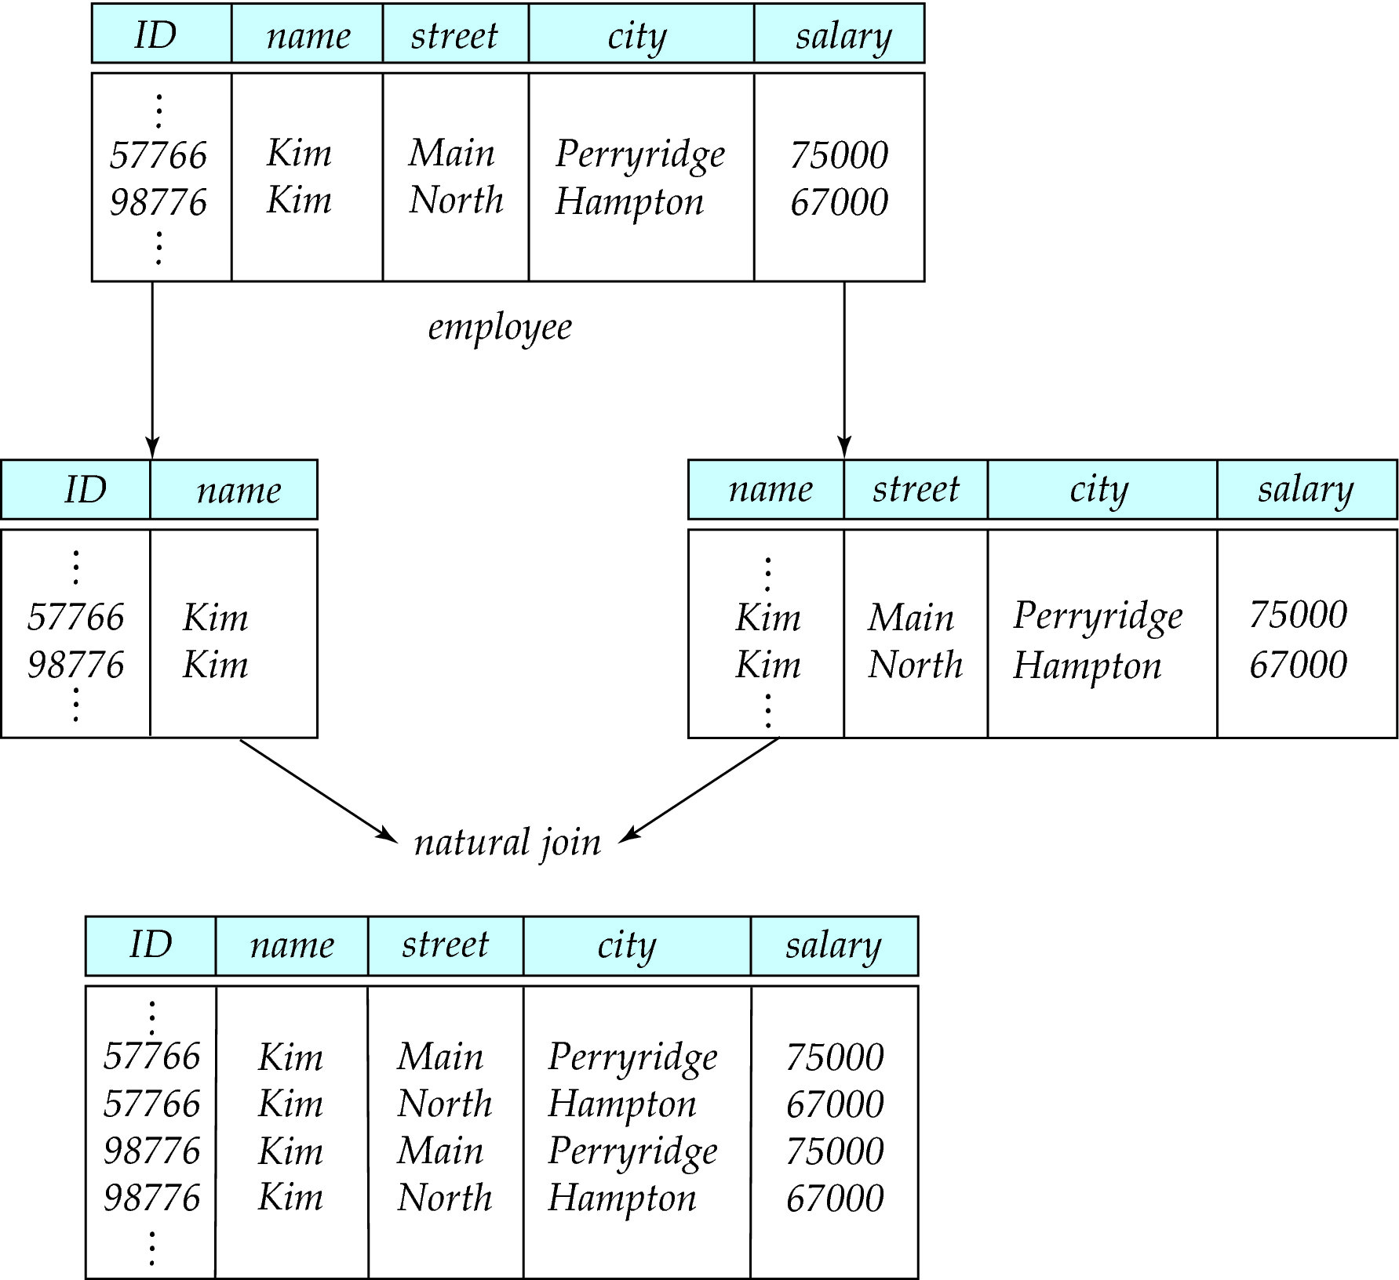
A Lossy Decomposition

Slide 64
Lossless Decomposition
Let R be a relation schema and let R₁ and R₂ form a decomposition of R . That is R = R₁ U R₂
We say that the decomposition is a lossless decomposition if there is no loss of information by replacing R with the two relation schemas R₁ U R₂
Formally,
∏ _{R1} (r) ∏ _{R2} (r) = r
And, conversely a decomposition is lossy if
r ⊂ ∏ _{R1} (r) ∏ _{R2} (r) = r

Slide 65
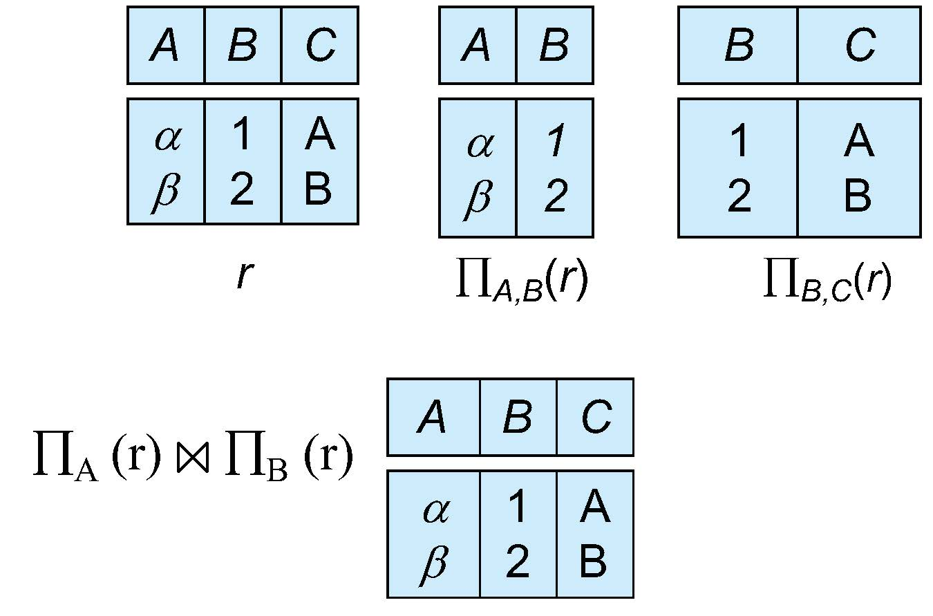
Example of Lossless Decomposition
Decomposition of R = (A, B, C) R₁ = (A, B) R₂ = (B, C)

Slide 66
Lossless Decomposition
We can use functional dependencies to show when certain decomposition are lossless.
For the case of R = (R₁, R₂), we require that for all possible relations r on schema R
r = ∏_{R1} (r ) ∏_{R2} (r )
A decomposition of R into R₁ and R₂ is lossless decomposition if at least one of the following dependencies is in F⁺:
R₁ ∩ R₂ → R₁
R₁ ∩ R₂ → R₂
The above functional dependencies are a sufficient condition for lossless join decomposition; the dependencies are a necessary condition only if all constraints are functional dependencies

Slide 67
Example
R = (A, B, C) F = {A → B, B → C)
R₁ = (A, B), R₂ = (B, C)
Lossless decomposition:
R₁ ∩ R₂ = {B} and B → BC
R₁ = (A, B), R₂ = (A, C)
Lossless decomposition:
R₁ ∩ R₂ = {A} and A → AB
Note:
B → BC
is a shorthand notation for
B → {B, C}

Slide 68
Dependency Preservation
Testing functional dependency constraints each time the database is updated can be costly
It is useful to design the database in a way that constraints can be tested efficiently.
If testing a functional dependency can be done by considering just one relation, then the cost of testing this constraint is low
When decomposing a relation it is possible that it is no longer possible to do the testing without having to perform a Cartesian Produced.
A decomposition that makes it computationally hard to enforce functional dependency is said to be NOT dependency preserving.

Slide 69
Dependency Preservation Example
Consider a schema:
dept_advisor(s_ID, i_ID, department_name)
With function dependencies:
i_ID → dept_name
s_ID, dept_name → i_ID
In the above design we are forced to repeat the department name once for each time an instructor participates in a dept_advisor relationship.
To fix this, we need to decompose dept_advisor
Any decomposition will not include all the attributes in
s_ID, dept_name → i_ID
Thus, the composition NOT be dependency preserving

Slide 70
Dependency Preservation
Let F_{i} be the set of dependencies F ⁺ that include only attributes in R_{i}.
A decomposition is dependency preserving, if
(F₁ ∪ F₂ ∪ … ∪ F_{n} )⁺ = F ⁺
Using the above definition, testing for dependency preservation take exponential time.
Not that if a decomposition is NOT dependency preserving then checking updates for violation of functional dependencies may require computing joins, which is expensive.

Slide 71
Dependency Preservation (Cont.)
Let F be the set of dependencies on schema R and let R₁, R₂ , .., R_{n} be a decomposition of R.
The restriction of F to R_{i} is the set F_{i} of all functional dependencies in F ⁺ that include only attributes of R_{i} .
Since all functional dependencies in a restriction involve attributes of only one relation schema, it is possible to test such a dependency for satisfaction by checking only one relation.
Note that the definition of restriction uses all dependencies in in F ⁺, not just those in F.
The set of restrictions F₁, F₂ , .. , F_{n} is the set of functional dependencies that can be checked efficiently.

Slide 72
Testing for Dependency Preservation
To check if a dependency α → β is preserved in a decomposition of R into R₁, R₂, …, R_{n} , we apply the following test (with attribute closure done with respect to F)
result = α repeat for each R_{i} in the decomposition t = (result ∩ R_{i})⁺ ∩ R_{i} result = result ∪ t
until (result does not change)
If result contains all attributes in β, then the functional dependency α → β is preserved.
We apply the test on all dependencies in F to check if a decomposition is dependency preserving
This procedure takes polynomial time, instead of the exponential time required to compute F⁺ and (F₁ ∪ F₂ ∪ … ∪ F_{n})⁺

Slide 73
Example
R = (A, B, C ) F = {A → B B → C} Key = {A}
R is not in BCNF
Decomposition R₁ = (A, B), R₂ = (B, C)
R₁ and R₂ in BCNF
Lossless-join decomposition
Dependency preserving

Slide 74
R(A,B,C,D)
F = {A → B , C → D}
decomposition R1(AB) and R2(CD)
R(A,B,C,D)
F = { A → B , A → C , C → D}
R1(A,B,C) and R2(C,D)

Slide 75
R(A,B,C,D,E)
F = { A → BCD
B → AE
BC → AED
D → E
C → DE }
decompose it into R1(A,B)
R2(B,C)
R3(C,D,E)

