Slide 1
Telco Customer Churn Analysis
Predicting Customer Retention Using Machine Learning
By Rafid Reezwan Fahim

Slide 2
Why Predict Customer Churn?
Customer churn refers to customers leaving a service provider.
Retaining existing customers is more cost-effective than acquiring new ones.
Predicting churn helps the business:
Improve customer experience.
Offer targeted retention strategies.
Reduce revenue loss.

Slide 3
Dataset Summary
Total customers: ~7,034
Features include:
Contract type
Internet service
Monthly and total charges
Payment method
Tenure
Target variable: Churn (Yes/No)

Slide 4
Customer Churn Patterns
Month-to-month contracts have the highest churn.
Customers with higher monthly charges tend to churn more.
.
Tenure is inversely related to churn . new customers churn more.

Slide 5
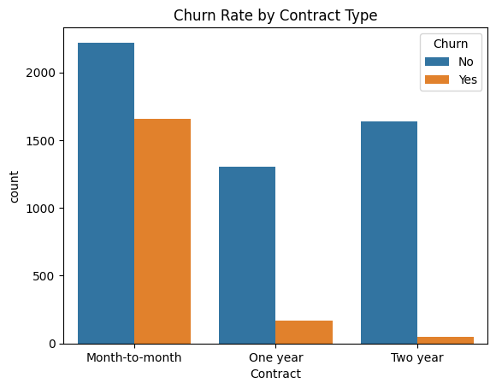
Churn by Contract Type

Slide 6
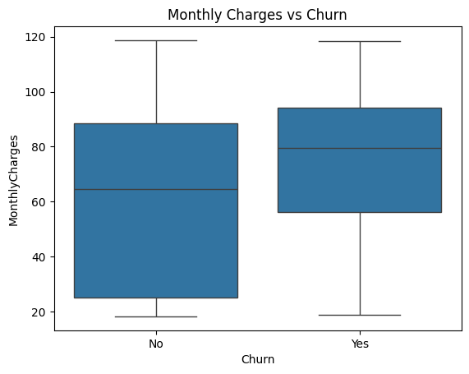
Monthly Charges vs Churn

Slide 7
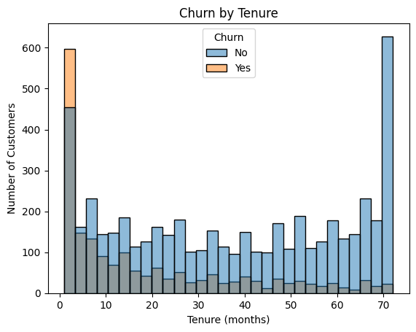
Churn by Tenure

Slide 8
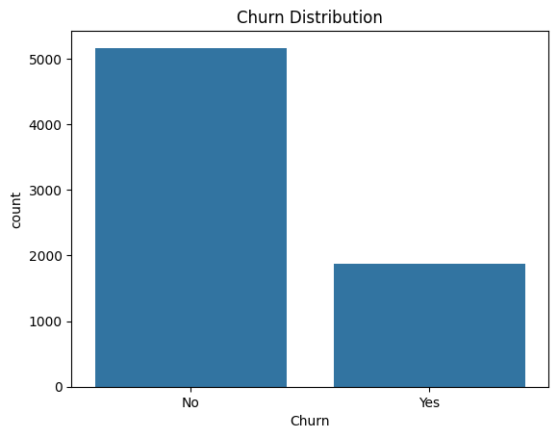
Churn Distribution

Slide 9
Random Forest Classifier
1
3
5
Model trained to predict churn using 70% of the data.
Good at predicting non-churners.
True Positives: 272 / False Negatives: 289
Achieved 78% accuracy on test data.
Moderate performance in detecting actual churners.
2
4
‹#›

Slide 10
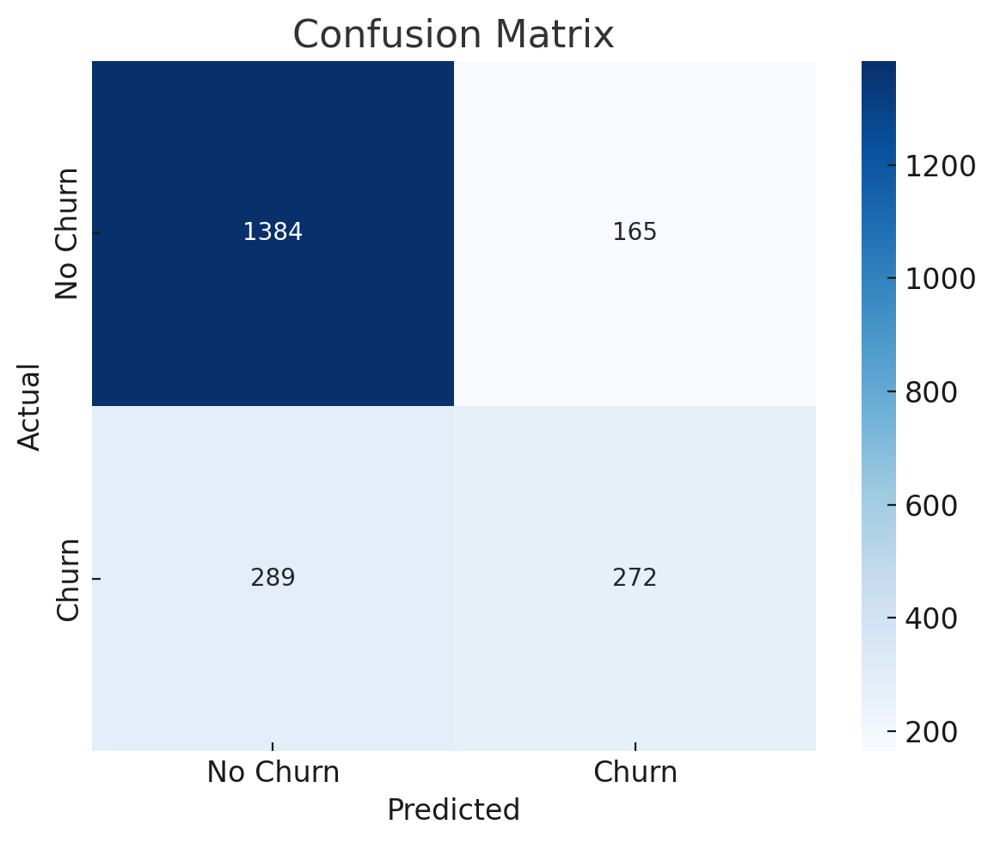
Confusion Matrix

Slide 11
Top Churn Indicators
Contract type (month-to-month) is the most influential feature.
MonthlyCharges and tenure also have strong effects.
Feature importance reveals business levers for improving retention.

Slide 12
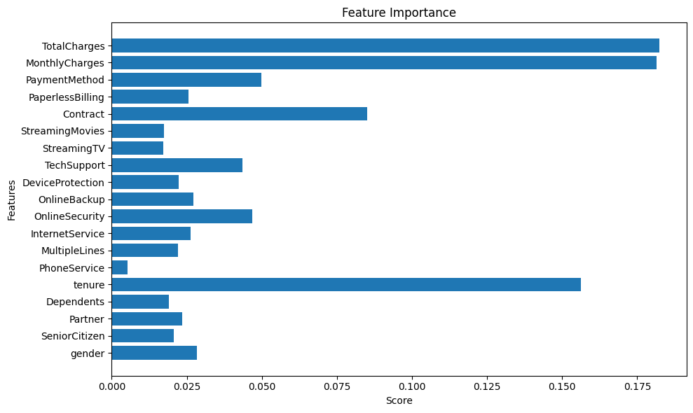

Slide 13
What Can the Business Do?
Offer long-term contracts or incentives to reduce month-to-month churn.
Identify and engage customers with high monthly charges early.
Improve onboarding and support for new customers (low tenure).
Monitor key churn-driving metrics through dashboards.

Slide 14
Thank you!

