Slide 1
DJANGO
Rafie Tarabay eng_rafie@mans.edu.eg

Slide 2
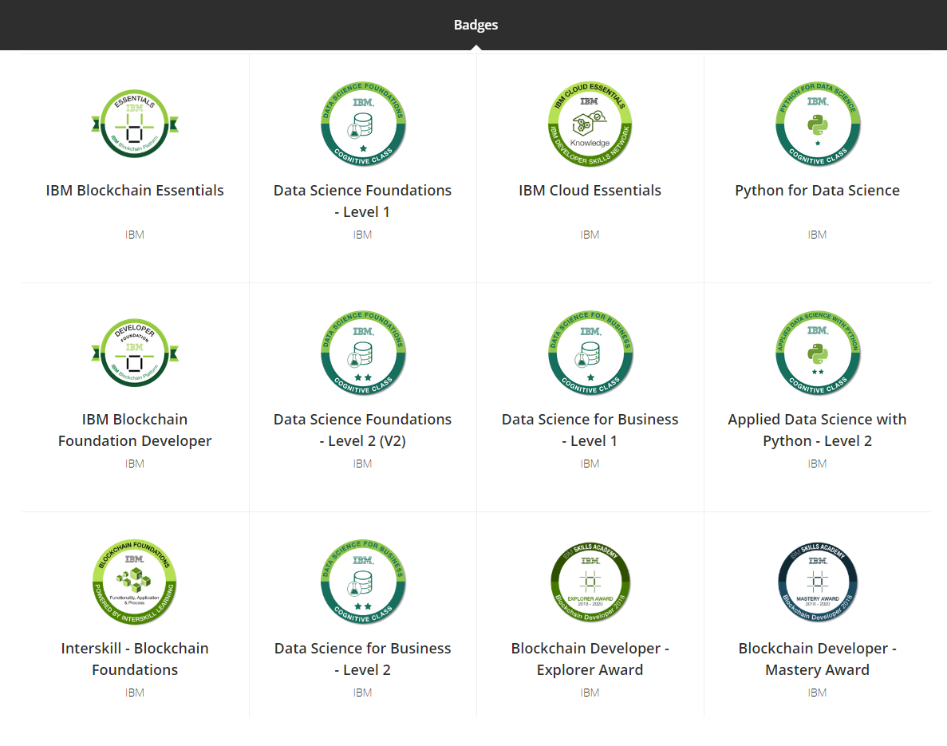

Slide 3
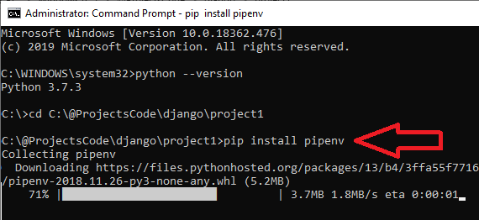
Prepare machine for Django
to setup your machine to run django
1) set latest python 3.7 with Pip support (Django 2.xx needs Python version > 3.4)
2) Install Pipenv
pip install pipenv
Notes:
Pipenv used to install python packages:
$ pipenv install [package names]
The user can provide these additional parameters:
--two — Performs the installation in a virtualenv using the system python2 link.
--three — Performs the installation in a virtualenv using the system python3 link.
--python — Performs the installation in a specific Python version, ie, pipenv --python 3.6
(for more information about pipenv check https://realpython.com/pipenv-guide/)

Slide 4
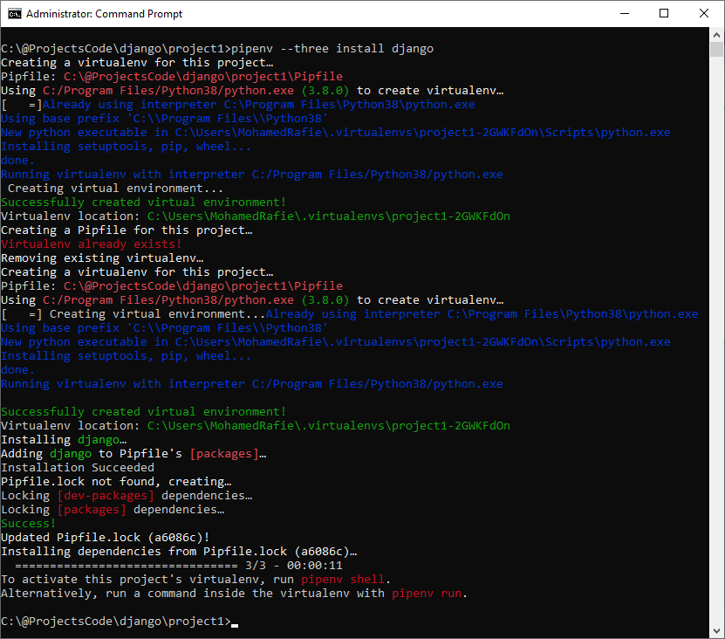
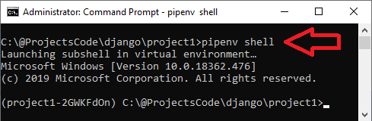
Install Django in specific folder
$ mkdir project1 $ cd project1 $ pipenv --three install Django
Activate virtual env
$ pipenv shell

Slide 5
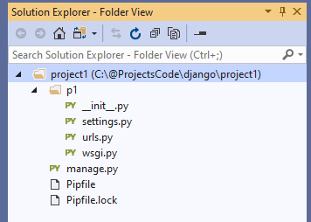
Create New Project on Current Directory
$ django-admin startproject <Project Name> .
manage.py: The command-line utility that allows you to interact with the Django project.
p1: project name that contains the files every Django project needs, which are
. /__init__.py: This is an empty file that is only needed to make the other files importable.
. /settings.py: This file contains all the configuration of our project, and can be customized at will.
. /urls.py: This file contains all the URL mappings to Python functions. Any URL that needs to be handled by the project must have an entry here.
. /wsgi.py: This is the entry point that will be used when deploying our site to production.
Pipfile: The list of Python libraries the project is using. At this point it is only Django.
Pipfile.lock: The internal Pipenv file.

Slide 6
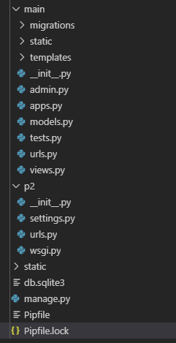
Create New App
$ ./manage.py startapp main
Where main is the App name
this will create a new folder with name main contains these items
main/:
__init__.py
admin.py
apps.py
models.py
views.py
tests.py
migrations

Slide 7
Prepare machine to run DJANGO project
$ ./manage.py makemigrations [Prepare DB SQL Commands]
$ ./manage.py migrate [Push SQL Commands to DB]
$ ./manage.py createsuperuser [Create DJANGO Admin]
$ ./manage.py runserver [Run Project]

Slide 8
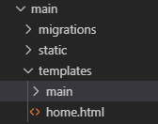
Prepare new App module for development
To start work with new module, you should create ( inside module folder)
1) templates directory : this folder will contains all HTML files
2) templates\main : create 'main' directory inside templates folder (main is the NewApp we just created)
3) static directory: this folder will contains JS and Images and any other static contents
4) create HTML start page "\main\templates\home.html"
5) add {% load static %} on the beginning of HTML page and call static resources located in static directory like this {% static 'images/logo.png’ %}
6) Update INSTALL_APPS found on settings.py, Add NewApp we just create with name "main" to the list
7) update views.py file to define start page
8) create main\urls.py file inside new app directory
9) update original urls.py to include new app routes file (urls.py)
10) update main\models.py to define Database structure
11) run the next commands to push new DB tables
$ ./manage.py makemigrations main
$ ./manage.py migrate

Slide 9
Django Templates

Slide 10
{% extends %} and {% block %}
Index.html
Body.html
<html>
<head>
<title>
{% block title %} Page Title {% endblock %}
</title>
</head>
<body>
{% block content %}
Body content
{% endblock %}
</body>
</html>
{% extends “Index.html" %}
{% block title %}
My Hello Page
{% endblock %}
{% block content %}
Hello World!!!
{% endblock %}

Slide 11
IF/For statement in Template
{% if today.day == 1 %}
the first day of month.
{% elif today.day == 30 %}
the last day of month.
{% else %}
I don't know.
{%endif%}
{% for number in range(10) %}
{{number}}
{% endfor %}

Slide 12
How to Handle Static Files?
STATIC_ROOT/STATIC_URL handle system static files
during development all static folders inside any App we create, will be accessible using static URL, but in run time we will write command ./manage.py collectstatic to copy all static files from all app folders and put them to STATIC_ROOT folder
_ROOT: means where these files are located on HD
_URL: means how you can call these files in the URL
Add the next 2 line to settings.py
STATIC_URL = '/static/'
STATIC_ROOT = os.path.join(BASE_DIR, 'static/')

Slide 13
Django URLs

Slide 14
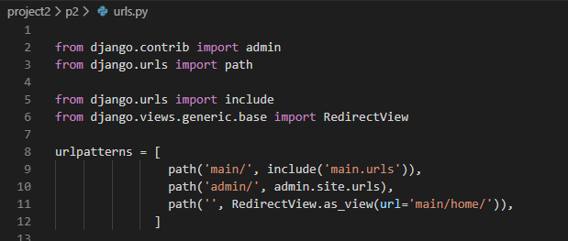
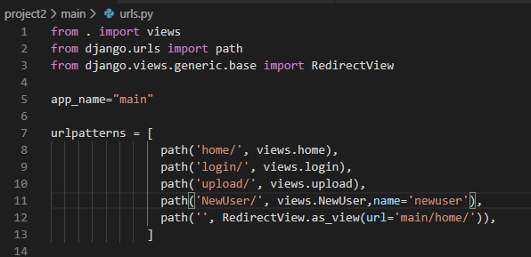
include [helps Create New URLs File inside new APP] RedirectView.as_view(url=)

Slide 15
Redirect to another page
Django provides tools for performing URL reversing that match the different layers where URLs are needed:
In templates: Using the url template tag.
In Python code: Using the reverse() function.

Slide 16
url.py
from django.urls import path
from . import views
urlpatterns = [
path('articles/<int:year>/', views.year_archive, name='news-year-archive’), ]
HTML Template
<a href="{% url 'news-year-archive' 2012 %}">2012 Archive</a>
View.py
from django.shortcuts import redirect
from django.urls import reverse
def redirect_to_year(request):
year = 2006
return redirect( reverse('news-year-archive', args=(year,)) )

Slide 17
View

Slide 18
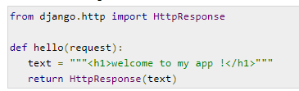
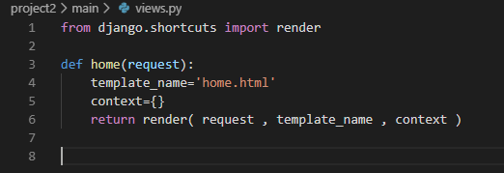
render vs HttpResponse

Slide 19
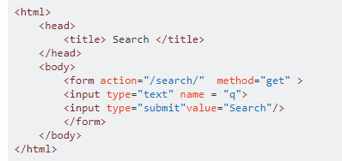
Read (Get, Post) values in view.py
Send value by Template
Read value from view
q = request.GET.get("q", None) #method get
q = request.POST.get("q", None) #method post

Slide 20
View can be Method or Class
urls.py
path('Messages1/', view.MyFormView.as_view(), name='MyFormView'),
path('Messages2/', view. myview, name='myview'),
view.py
view.py
def myview(request):
if request.method == "POST":
form = form_class(request.POST)
if form.is_valid():
return HttpResponseRedirect('/success/')
else:
form = MyForm(initial={'key': 'value'})
return render(request, 'form_template.html', {'form': form})
from django.views import View class MyFormView(View):
template_name = 'form_template.html’
def get(self, request):
return render(request, self.template_name, {'form': form})
def post(self, request):
form = form_class(request.POST)
if form.is_valid():
return HttpResponseRedirect('/success/')
return render(request, self.template_name, {'form': form})

Slide 21
Messages

Slide 22
How to Use Messages
View
from django.contrib import messages
messages.success(request, 'Your profile was successfully updated!')
messages.error(request, 'Please correct the error below.')
Template
{% if messages %}
<div class="alert alert-secondary" role="alert">
{% for message in messages %}
{{ message }}
{% endfor %}
</div>
{% endif %}

Slide 23
Sessions

Slide 24
Set/Get Session
#Set Session request.session['username'] = “username”
#Get Session
if request.session.has_key('username'):
username = request.session['username']

Slide 25
Django Model
Database Tables

Slide 26
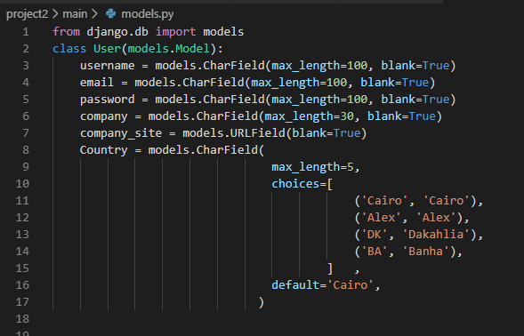

Slide 27
Push Tables Structure to DB
.\manage.py makemigrations
.\manage.py migrate

Slide 28
Django Form
How to View Model on GUI

Slide 29
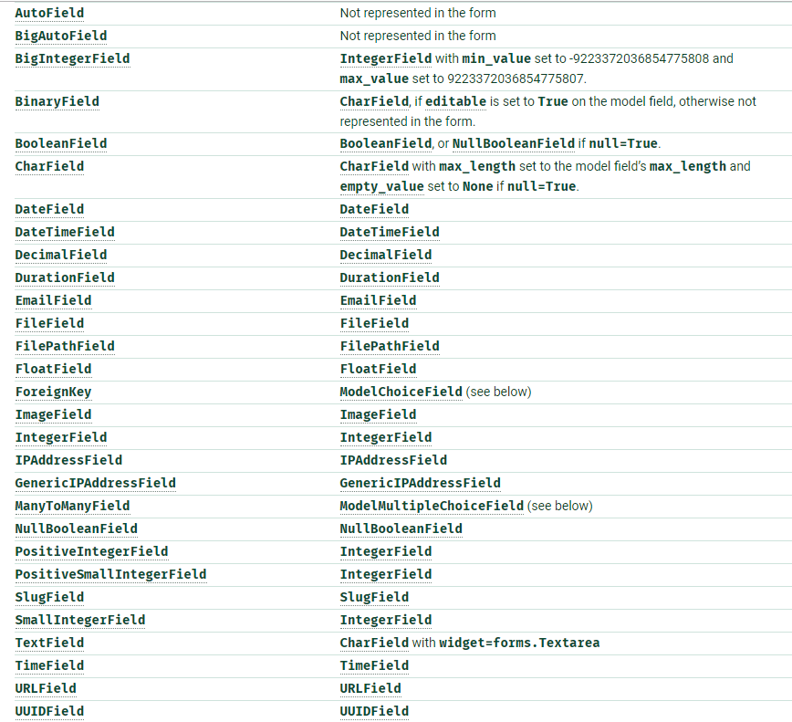
Form Fields
Form Can Control
HTML Field Class
Place Holder
Label
Validation
For more information https://docs.djangoproject.com/en/2.2/topics/forms/modelforms/

Slide 30
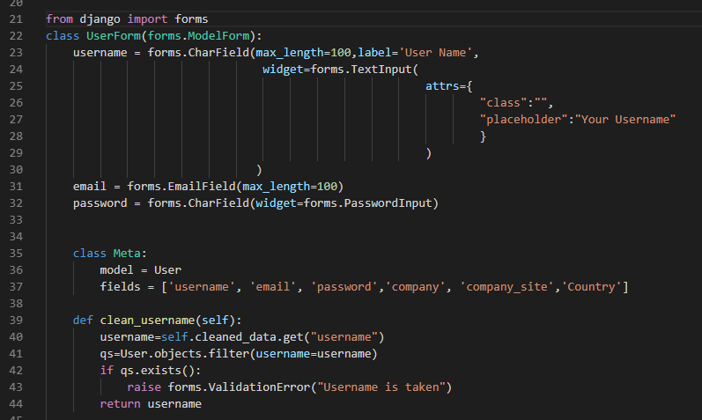
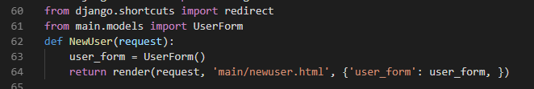
How to create Form for a model table
How to call Form from view.py

Slide 31
Template Draw Form
<form method="POST" enctype="multipart/form-data">
{% csrf_token%}
{% for field in user_form %}
<label>{{field.label_tag}}</label>
{{field}}
<div>{{field.errors}}</div>
{% endfor%}
<button type="submit">Submit</button>
<button type="reset">Reset</button>
</form>

Slide 32
Template Draw Form in one step
Based on Form we can draw GUI without loop in one line!
{{ form.as_table }} will render them as table cells wrapped in <tr> tags
{{ form.as_p }} will render them wrapped in <p> tags
{{ form.as_ul }} will render them wrapped in <li> tags
Note
you’ll have to provide the surrounding <table> or <ul> elements yourself.

Slide 33
Template Draw Form using {{ form.as_table }}
<form method="POST" enctype="multipart/form-data">
{% csrf_token%}
<table> {{ form.as_table }} </table> <button type="submit">Submit</button>
<button type="reset">Reset</button>
</form>

Slide 34
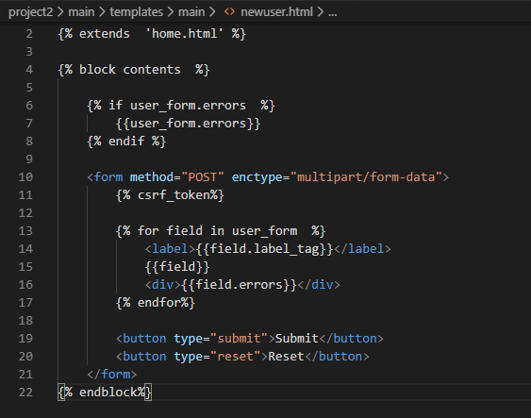
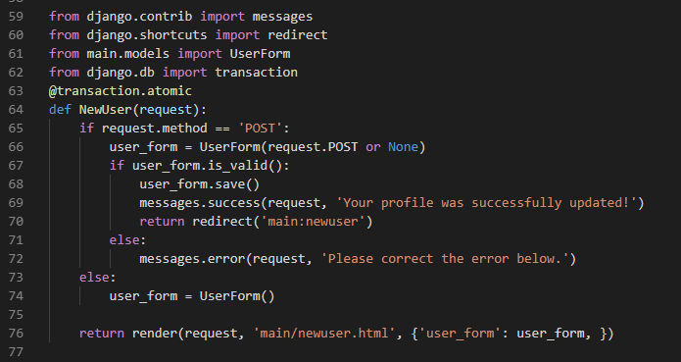
Related Form Template
Form handel get/post calls in View.py

Slide 35
Use Form to insert DB Record
#PreLoad Form class from DB
articleRow = Article.objects.get(pk=1)
form = ArticleForm(instance= articleRow)
form.save()
#PreLoad Form class from Post
profile_form = ProfileForm(request.POST or None ) profile_form.save(commit=True)

Slide 36
Django DB
How to handle DB inside view.py

Slide 37
Configure Django default DB using settings.py?
Postgresql
Mysql
a) install the PostgreSQL drivers
b) run pipenv install psycopg2
c) update setting.py
DATABASES = {
'default': {
'NAME': 'app_data',
'ENGINE': 'django.db.backends.postgresql',
'USER': 'postgres_user',
'PASSWORD': 'xxxx'
}
}
a) install mysql drivers
b) run pipenv install mysqlclient
c) update setting.py
DATABASES = {
'default': {
'NAME': 'user_data',
'ENGINE': 'django.db.backends.mysql',
'USER': 'mysql_user',
'PASSWORD': 'xxxx',
'HOST': '127.0.0.1',
'PORT': '3306',
'charset':'utf8',
'use_unicode':'True'
}
}

Slide 38
Select From DB Table
#Select All Records
RecordType=MarcRecordType.objects.all()
#Select One Record
bibliographies = marc_bibliographies.objects.get(pk=100)
#Select Record with condition
Marc = RawMarc.objects.filter(BibID=BibID).order_by('Treeid')
if Marc.count()<=0:
print('No records')
#Select row using SQL
people = Person.objects.raw('SELECT id, first_name,age FROM myapp_person')

Slide 39
Insert / Update / Delete
#Insert in two tables in Transaction
with transaction.atomic():
rootObj = Table1.objects.create(title_ar='',price=price,source_id=Providerid,created_by=userid)
rootObj.save()
marc=Table2.objects.create(BibID=rootObj.pk,Type='0',Treeid=str(Treeid),Key=tags.tag,Value=tags.data)
marc.save()
#Update Record
rootObj = marc_bibliographies.objects.get(pk=BibID)
rootObj.price=price
rootObj.parent_id=parent_id
rootObj.save()
#Delete Record
marc_Dump.objects.filter(BibID=BibID).delete()

Slide 40
Transaction
from django.db import transaction #put all function inside transaction
@transaction.atomic
def NewUser(request):
pass
################################################
#Insert rows in two tables in Transaction
with transaction.atomic():
rootObj = marc_bibliographies.objects.create(title_ar='',price=price,source_id=Providerid)
rootObj.save()
marc=RawMarc.objects.create(BibID=rootObj.pk, Key=tags.tag,Value=tags.data)
marc.save()

Slide 41
Django Free DB SQL
How to write free sql commands to update DB inside view.py

Slide 42
Custom Insert/Update/Delete/Select
from django.db import connection
def custom_sql_insert(SQL):
try:
cursor = connection.cursor()
cursor.execute(SQL)
return cursor.lastrowid
except Exception as e:
return 0
def custom_sql_insert_update_delete(SQL):
cursor = connection.cursor()
cursor.execute(SQL)
def custom_sql_select(SQL):
with connection.cursor() as cursor:
cursor.execute(SQL)
rows = cursor.fetchall()
return rows

Slide 43
File Upload
settings.py\ MEDIA_ROOT is the default upload location
example MEDIA_ROOT = os.path.join(BASE_DIR ,'static', 'FileUpload/')

Slide 44
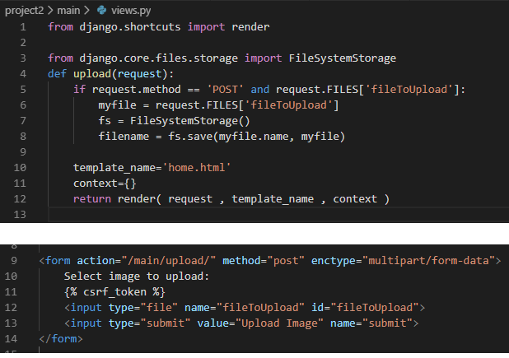
Template

Slide 45
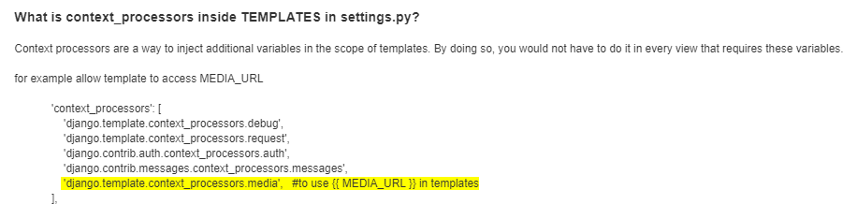
How to Handle Files uploaded at run time using settings.py?
MEDIA_ROOT/MEDIA_URL, handle files uploaded on runtime by users _ROOT: means where these files are located on HD _URL: means how you can call these files in the URL MEDIA_URL = '/FileUpload/' MEDIA_ROOT = os.path.join(BASE_DIR ,'static', 'FileUpload/')

