Slide 1
DJANGO
Rafie Tarabay eng_rafie@mans.edu.eg mrafie@eg.ibm.com

Slide 2
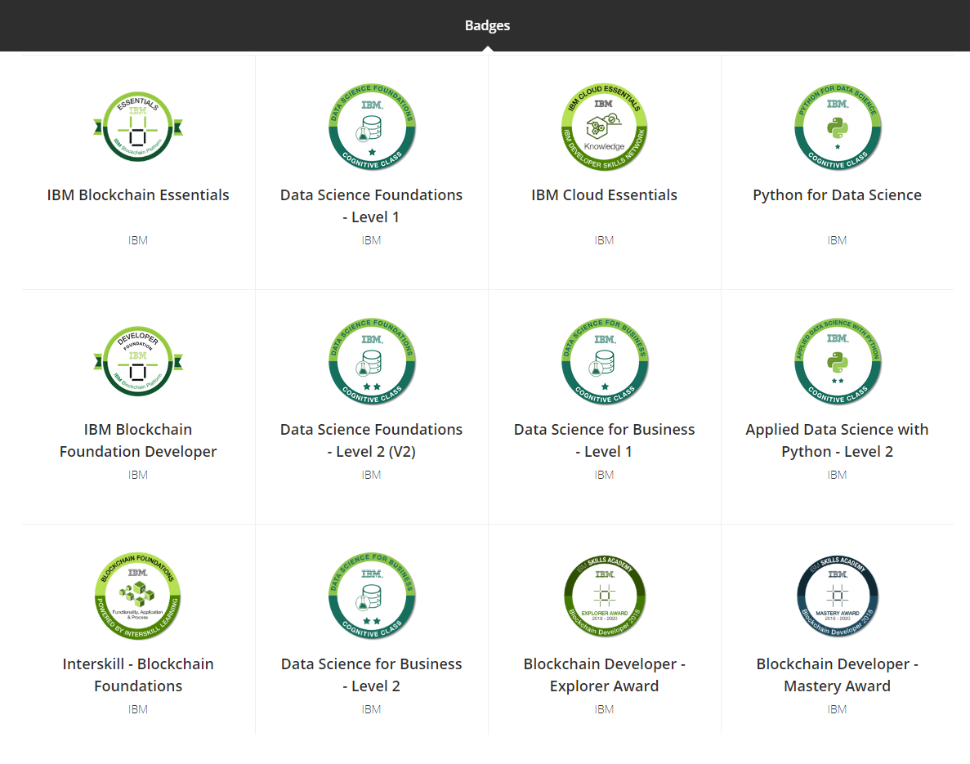

Slide 3
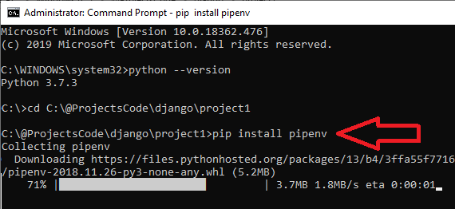
Prepare machine for Django
to setup your machine to run django
1) set latest python 3.7 with Pip support (Django 2.xx needs Python version > 3.4)
2) Install Pipenv
pip install pipenv
Notes:
Pipenv used to install python packages:
$ pipenv install [package names]
The user can provide these additional parameters:
--two — Performs the installation in a virtualenv using the system python2 link.
--three — Performs the installation in a virtualenv using the system python3 link.
--python — Performs the installation in a specific Python version, ie, pipenv --python 3.6
(for more information about pipenv check https://realpython.com/pipenv-guide/)

Slide 4
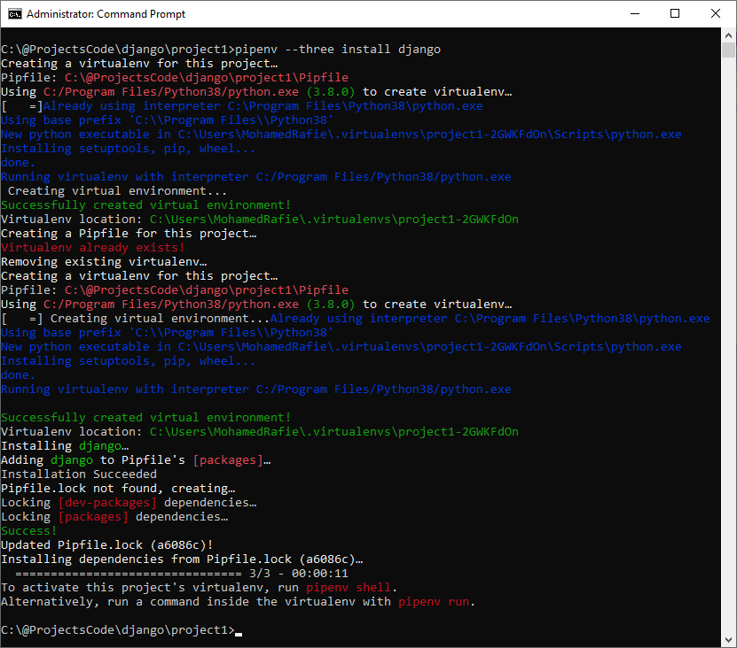
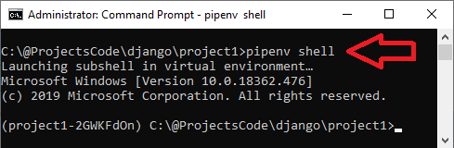
Install Django in specific folder
$ mkdir project1 $ cd project1 $ pipenv --three install Django
Activate virtual env
$ pipenv shell

Slide 5
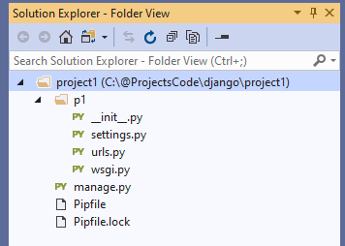
Create New Project on Current Directory
$ django-admin startproject <Project Name> .
manage.py: The command-line utility that allows you to interact with the Django project.
p1: project name that contains the files every Django project needs, which are
. /__init__.py: This is an empty file that is only needed to make the other files importable.
. /settings.py: This file contains all the configuration of our project, and can be customized at will.
. /urls.py: This file contains all the URL mappings to Python functions. Any URL that needs to be handled by the project must have an entry here.
. /wsgi.py: This is the entry point that will be used when deploying our site to production.
Pipfile: The list of Python libraries the project is using. At this point it is only Django.
Pipfile.lock: The internal Pipenv file.

Slide 6
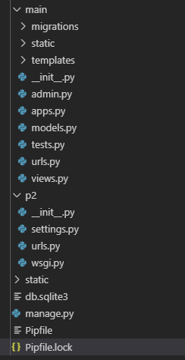
Create New App
$ .\manage.py startapp main
Where main is the App name
this will create a new folder with name main contains these items
main/:
__init__.py
admin.py
apps.py
models.py
views.py
tests.py
migrations

Slide 7
Prepare machine to run DJANGO project
$ .\manage.py makemigrations [Prepare DB SQL Commands]
$ .\manage.py migrate [Push SQL Commands to DB]
$ .\manage.py createsuperuser [Create DJANGO Admin]
$ .\manage.py runserver [Run Project]

Slide 8
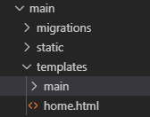
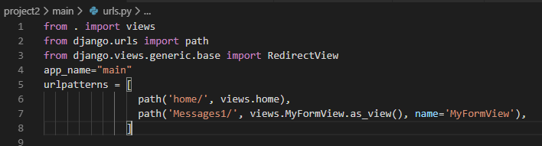

Prepare new App module for development
To start work with new module, you should create ( inside module folder)
1) templates directory : this folder will contains all HTML files
2) templates\main : create 'main' directory inside templates folder (main is the NewApp we just created)
3) static directory: this folder will contains JS and Images and any other static contents
4) create HTML start page "\main\templates\home.html"
5) add {% load static %} on the beginning of HTML page and call static resources located in static directory like this {% static 'images/logo.png’ %}
6) Update INSTALL_APPS found on settings.py, Add NewApp we just create with name "main" to the list
7) update views.py file to define start page
8) create main\urls.py file inside new app directory
9) update original urls.py to include new app routes file (urls.py)
10) update main\models.py to define Database structure
11) run the next commands to push new DB tables
$ ./manage.py makemigrations main
$ ./manage.py migrate

Slide 9
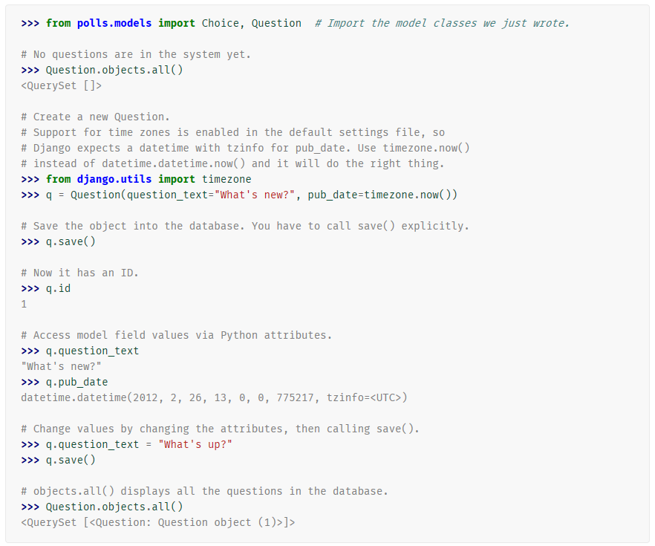
How to open DJANGO project in Shell to test a function
$ python manage.py shell

Slide 10
Django Templates

Slide 11
{% extends %} and {% block %}
Index.html
Body.html
<html>
<head>
<title>
{% block title %} Page Title {% endblock %}
</title>
</head>
<body>
{% block content %}
Body content
{% endblock %}
</body>
</html>
{% extends “Index.html" %}
{% block title %}
My Hello Page
{% endblock %}
{% block content %}
Hello World!!!
{% endblock %}

Slide 12
IF/For statement in Template
{% if today.day == 1 %}
the first day of month.
{% elif today.day == 30 %}
the last day of month.
{% else %}
I don't know.
{%endif%}
{% for number in range(10) %}
{{number}}
{% endfor %}

Slide 13
How to Handle Static Files?
STATIC_ROOT/STATIC_URL handle system static files
during development all static folders inside any App we create, will be accessible using static URL, but in run time we will write command ./manage.py collectstatic to copy all static files from all app folders and put them to STATIC_ROOT folder
_ROOT: means where these files are located on HD
_URL: means how you can call these files in the URL
Add the next 2 line to settings.py
STATIC_URL = '/static/'
STATIC_ROOT = os.path.join(BASE_DIR, 'static/')

Slide 14
Django URLs

Slide 15
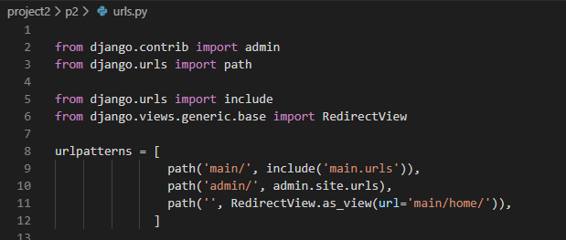
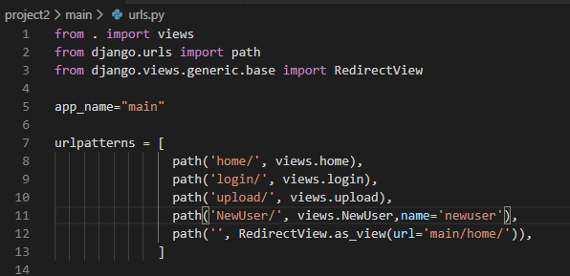
include [helps Create New URLs File inside new APP] RedirectView.as_view(url=)

Slide 16
Redirect to another page
Django provides tools for performing URL reversing that match the different layers where URLs are needed:
In templates: Using the url template tag.
In Python code: Using the reverse() function.

Slide 17
url.py
from django.urls import path
from . import views
urlpatterns = [
path('articles/<int:year>/', views.year_archive, name='news-year-archive’), ]
HTML Template
<a href="{% url 'news-year-archive' 2012 %}">2012 Archive</a>
View.py
from django.shortcuts import redirect
from django.urls import reverse
def redirect_to_year(request):
year = 2006
return redirect( reverse('news-year-archive', args=(year,)) )

Slide 18
View

Slide 19
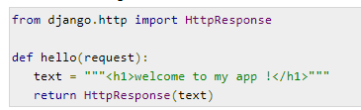
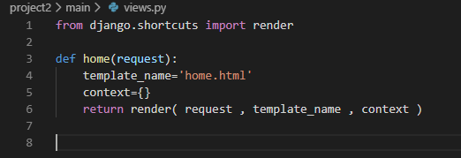
render vs HttpResponse

Slide 20
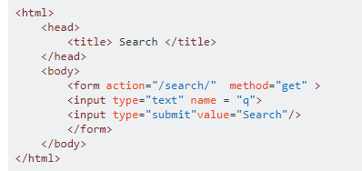
Read (Get, Post) values in view.py
Send value by Template
Read value from view
q = request.GET.get("q", None) #method get
q = request.POST.get("q", None) #method post

Slide 21
View can be Method or Class
urls.py
path('Messages1/', view.MyFormView.as_view(), name='MyFormView'),
path('Messages2/', view. myview, name='myview'),
view.py
view.py
def myview(request):
if request.method == "POST":
form = form_class(request.POST)
if form.is_valid():
return HttpResponseRedirect('/success/')
else:
form = MyForm(initial={'key': 'value'})
return render(request, 'form_template.html', {'form': form})
from django.views import View class MyFormView(View):
template_name = 'form_template.html’
def get(self, request):
return render(request, self.template_name, {'form': form})
def post(self, request):
form = form_class(request.POST)
if form.is_valid():
return HttpResponseRedirect('/success/')
return render(request, self.template_name, {'form': form})

Slide 22
Messages

Slide 23
How to Use Messages
View
from django.contrib import messages
messages.success(request, 'Your profile was successfully updated!')
messages.error(request, 'Please correct the error below.')
Template
{% if messages %}
<div class="alert alert-secondary" role="alert">
{% for message in messages %}
{{ message }}
{% endfor %}
</div>
{% endif %}

Slide 24
Sessions

Slide 25
Set/Get Session
#Set Session request.session['username'] = “username”
#Get Session
if request.session.has_key('username'):
username = request.session['username']

Slide 26
Django Model
Database Tables

Slide 27
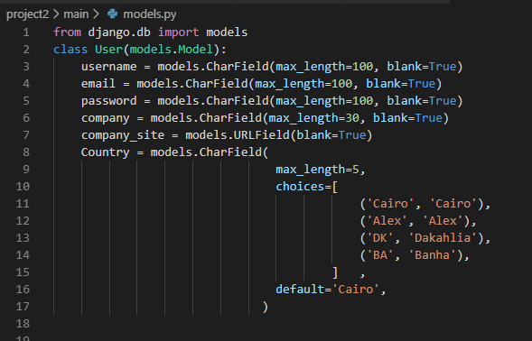

Slide 28
Push Tables Structure to DB
.\manage.py makemigrations
.\manage.py migrate

Slide 29
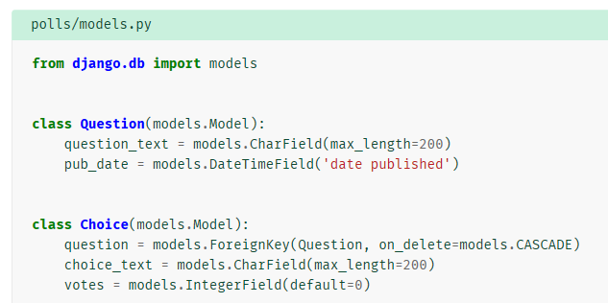
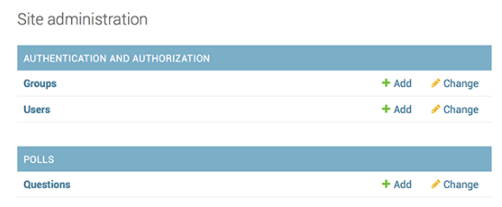
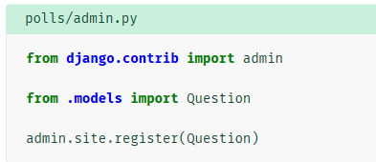
Manage model through admin site
.\manage.py runserver
http://127.0.0.1:8000/admin/
Login using super user account

Slide 30
Django Form
How to View Model on GUI

Slide 31
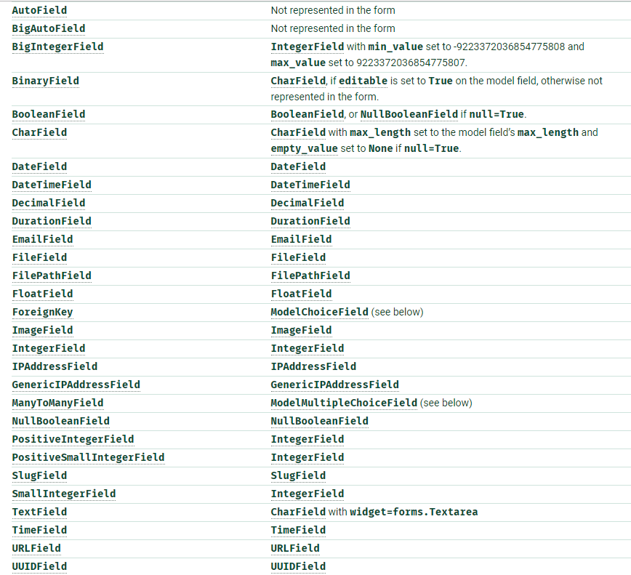
Form Fields
Form Can Control
HTML Field Class
Place Holder
Label
Validation
For more information https://docs.djangoproject.com/en/2.2/topics/forms/modelforms/

Slide 32
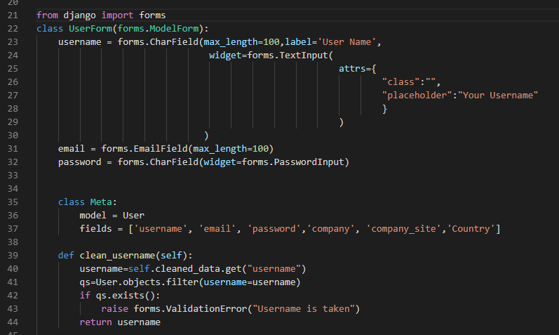
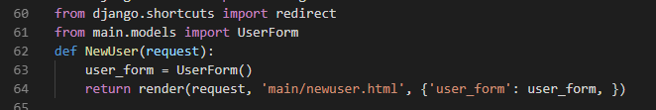
How to create Form for a model table
How to call Form from view.py

Slide 33
Template Draw Form
<form method="POST" enctype="multipart/form-data">
{% csrf_token%}
{% for field in user_form %}
<label>{{field.label_tag}}</label>
{{field}}
<div>{{field.errors}}</div>
{% endfor%}
<button type="submit">Submit</button>
<button type="reset">Reset</button>
</form>

Slide 34
Template Draw Form in one step
Based on Form we can draw GUI without loop in one line!
{{ form.as_table }} will render them as table cells wrapped in <tr> tags
{{ form.as_p }} will render them wrapped in <p> tags
{{ form.as_ul }} will render them wrapped in <li> tags
Note
you’ll have to provide the surrounding <table> or <ul> elements yourself.

Slide 35
Template Draw Form using {{ form.as_table }}
<form method="POST" enctype="multipart/form-data">
{% csrf_token%}
<table> {{ form.as_table }} </table> <button type="submit">Submit</button>
<button type="reset">Reset</button>
</form>

Slide 36
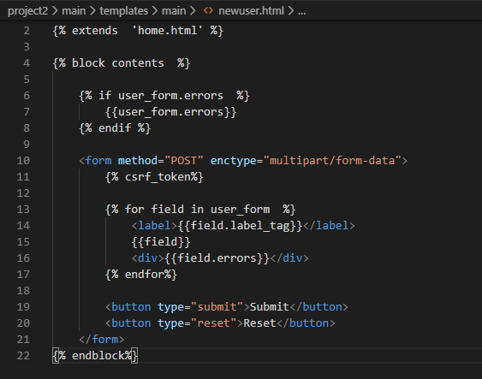
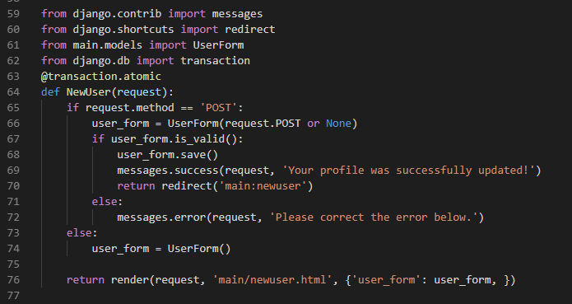
Related Form Template
Form handel get/post calls in View.py

Slide 37
Use Form to insert DB Record
#PreLoad Form class from DB
articleRow = Article.objects.get(pk=1)
form = ArticleForm(instance= articleRow)
form.save()
#PreLoad Form class from Post
profile_form = ProfileForm(request.POST or None ) profile_form.save(commit=True)

Slide 38
Django DB
How to handle DB inside view.py

Slide 39
Configure Django default DB using settings.py?
Postgresql
Mysql
a) install the PostgreSQL drivers
b) run pipenv install psycopg2
c) update setting.py
DATABASES = {
'default': {
'NAME': 'app_data',
'ENGINE': 'django.db.backends.postgresql',
'USER': 'postgres_user',
'PASSWORD': 'xxxx'
}
}
a) install mysql drivers
b) run pipenv install mysqlclient
c) update setting.py
DATABASES = {
'default': {
'NAME': 'user_data',
'ENGINE': 'django.db.backends.mysql',
'USER': 'mysql_user',
'PASSWORD': 'xxxx',
'HOST': '127.0.0.1',
'PORT': '3306',
'charset':'utf8',
'use_unicode':'True'
}
}

Slide 40
Select From DB Table
#Select All Records
RecordType=MarcRecordType.objects.all()
#Select One Record
bibliographies = marc_bibliographies.objects.get(pk=100)
#Select Record with condition
Marc = RawMarc.objects.filter(BibID=BibID).order_by('Treeid')
if Marc.count()<=0:
print('No records')
#Select row using SQL
people = Person.objects.raw('SELECT id, first_name,age FROM myapp_person')

Slide 41
Insert / Update / Delete
#Insert in two tables in Transaction
with transaction.atomic():
rootObj = Table1.objects.create(title_ar='',price=price,source_id=Providerid,created_by=userid)
rootObj.save()
marc=Table2.objects.create(BibID=rootObj.pk,Type='0',Treeid=str(Treeid),Key=tags.tag,Value=tags.data)
marc.save()
#Update Record
rootObj = marc_bibliographies.objects.get(pk=BibID)
rootObj.price=price
rootObj.parent_id=parent_id
rootObj.save()
#Delete Record
marc_Dump.objects.filter(BibID=BibID).delete()

Slide 42
Transaction
from django.db import transaction #put all function inside transaction
@transaction.atomic
def NewUser(request):
pass
################################################
#Insert rows in two tables in Transaction
with transaction.atomic():
rootObj = marc_bibliographies.objects.create(title_ar='',price=price,source_id=Providerid)
rootObj.save()
marc=RawMarc.objects.create(BibID=rootObj.pk, Key=tags.tag,Value=tags.data)
marc.save()

Slide 43
Django Free DB SQL
How to write free sql commands to update DB inside view.py

Slide 44
Custom Insert/Update/Delete/Select
from django.db import connection
def custom_sql_insert(SQL):
try:
cursor = connection.cursor()
cursor.execute(SQL)
return cursor.lastrowid
except Exception as e:
return 0
def custom_sql_insert_update_delete(SQL):
cursor = connection.cursor()
cursor.execute(SQL)
def custom_sql_select(SQL):
with connection.cursor() as cursor:
cursor.execute(SQL)
rows = cursor.fetchall()
return rows

Slide 45
File Upload
settings.py\ MEDIA_ROOT is the default upload location
example MEDIA_ROOT = os.path.join(BASE_DIR ,'static', 'FileUpload/')

Slide 46
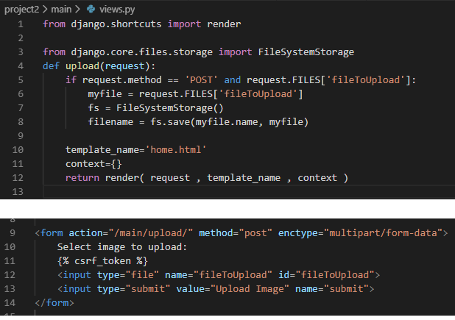
Template

Slide 47
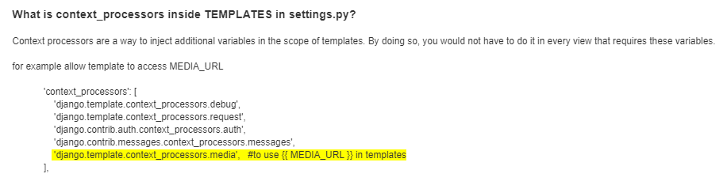
How to Handle Files uploaded at run time using settings.py?
MEDIA_ROOT/MEDIA_URL, handle files uploaded on runtime by users _ROOT: means where these files are located on HD _URL: means how you can call these files in the URL MEDIA_URL = '/FileUpload/' MEDIA_ROOT = os.path.join(BASE_DIR ,'static', 'FileUpload/')

Slide 48
Generic Views
ListView – CreateView – UpdateView - DeleteView

Slide 49
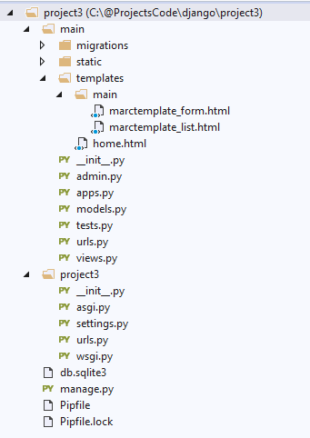
Project Tree

Slide 50
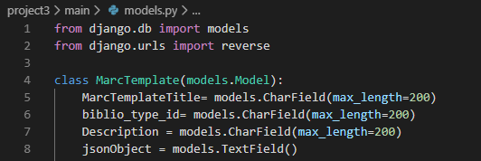
model

Slide 51
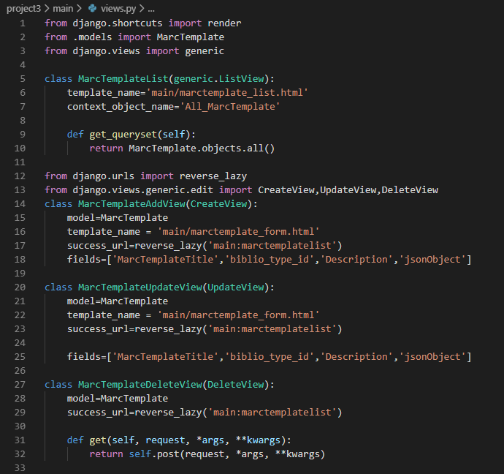
Views

Slide 52
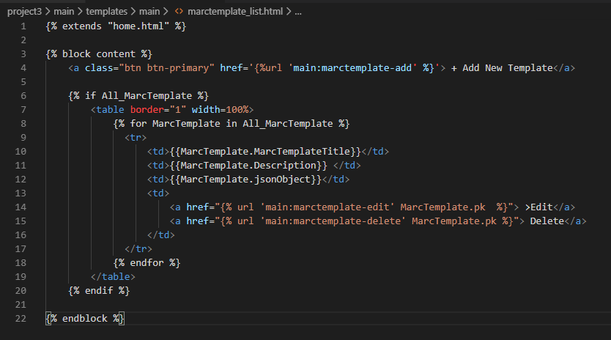

Slide 53
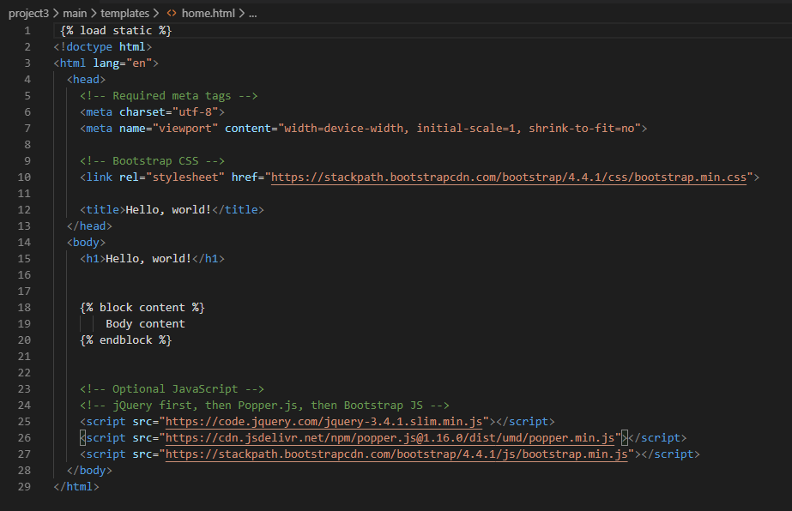

Slide 54
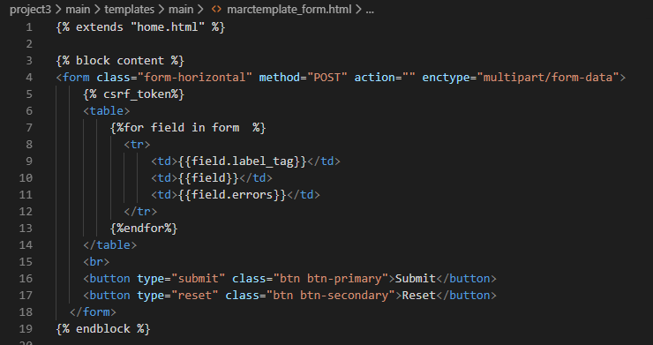

Slide 55
