Slide 1
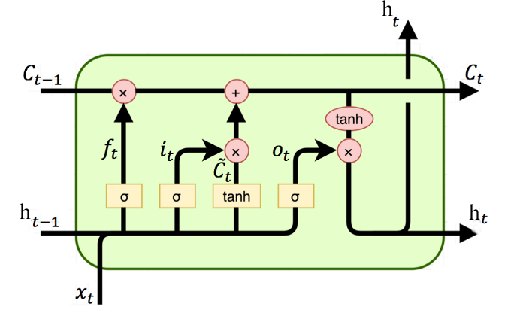
_{Y(t)}
×
+
_{C(t-1)}
_{C(t)}
×
_{f(t)}
_{i(t)}
_{g(t)}
_{σ}
_{σ}
_{tanh}
_{tanh}
_{H(t-1)}
_{σ}
×
_{H(t)}
_{o(t)}
_{X(t)}

