Slide 1
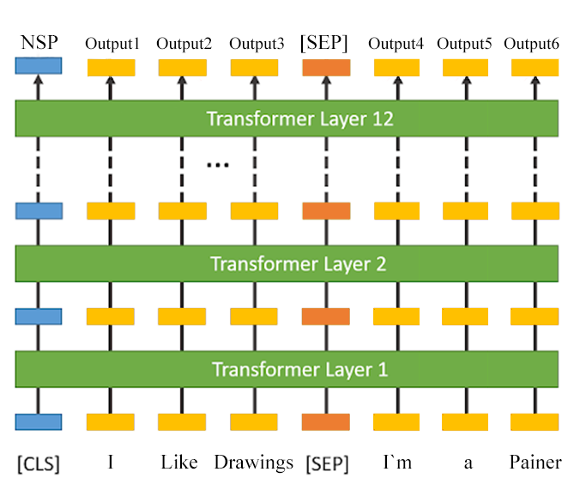
0<NSP<1 | I | read | a | book | [SEP] | It | was | amazing
---
---
---
---
---
---
---
---
---
_{رمزنگار ترنسفورمر}
_{لایه ۱۲}
……..
---
---
---
---
---
---
---
---
---
_{رمزنگار ترنسفورمر}
_{لایه ۲}
---
---
---
---
---
---
---
---
---
_{رمزنگار ترنسفورمر}
_{لایه ۱}
---
---
---
---
---
---
---
---
---
[CLS] | I | read | a | [MASK] | [SEP] | It | was | amazing

