Slide 1
ALGORITMA & PEMOGRAMAN
02
SDLC
Fakultas Ilmu Komputer
Sistem Informasi
Hariesa Budi Prabowo, ST, MM
Pembuka
Daftar Pustaka
Akhiri Presentasi

Slide 2
Kenapa Analisa Pengembangan System diperlukan ?
Menyamakan definisi, persepsi dan pengertian dalam rencana pengembangan system, sehingga apa yang dideskripsikan oleh user merupakan sesuatu yang dibutuhkan dan bisa diimplementasikan oleh pengembang system

Slide 3
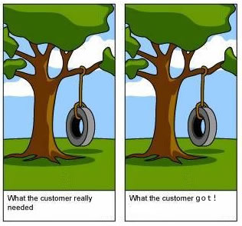

Slide 4
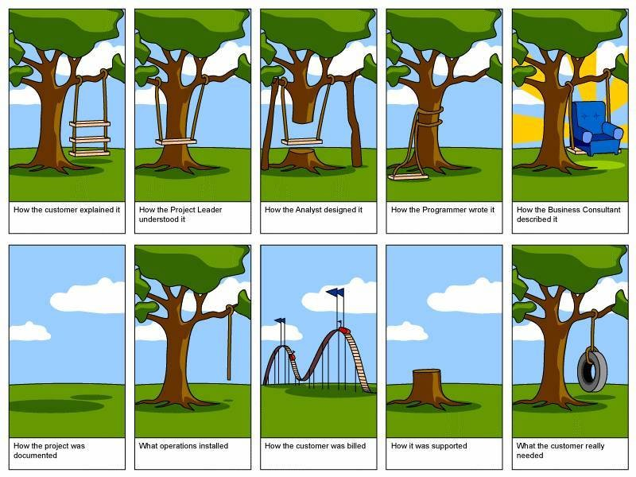
Bila Persepsi berbeda ?

Slide 5
Why do need a formal process?
Failures occur (too) often
Creating systems is not intuitive
Projects are late, over budget or delivered with fewer features than planned

Slide 6
Who is the person to analyst ?
Designs a system to add value
Must understand the business processes
Job is rewarding, yet challenging
Requires specific skill sets

Slide 7
System Development Life Cycle (SDLC)
Planning
Analysis
Design
Implementation

Slide 8
SDLC Process
The process consists of four phases
Each phase consists of a series of steps
Each phase is documented (deliverables)
Phases are executed sequentially, incrementally, iteratively or in some other pattern

Slide 9
Questions to be Answered
Planning phase
Why should we build this system?
What value does it provide?
How long will it take to build?
Analysis phase
Who will use it?
What should the system do for us?
Where & when will it be used?
Design phase
How should we build it?

Slide 10
SDLC: The Planning Phase
Project Initiation
Develop/receive a system request
Conduct a feasibility analysis
Project Management
Develop the work plan
Staff the project
Monitor & control the project

Slide 11
SDLC: The Analysis Phase
Develop an analysis strategy
Model the current system
Formulate the new system
Gather the requirements
Develop a system concept
Create a business model to represent:
Business data
Business processes
Develop a system proposal

Slide 12
SDLC: The Design Phase
Develop a design strategy
Design architecture and interfaces
Develop databases and file specifications
Develop the program design to specify:
What programs to write
What each program will do

Slide 13
SDLC: Methodologies
Methodology: a formalized approach to implementing the SDLC
Categories
Process oriented
Data centered
Object-oriented
Structured
Rapid action development
Agile development

Slide 14
Classes of Methodologies
Structured Development
Waterfall Development
Parallel Development
Rapid Application Development
Phased
Prototyping
Agile Development
eXtreme Programming
SCRUM

Slide 15
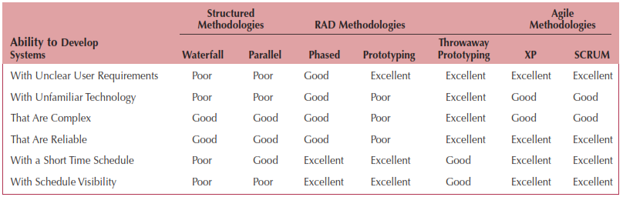
Which Methodology to Use?

Slide 16
D. Jeya Mala dan S. Geetha. 2013. Object Oriented Analysis and Design using UML. McGraw-Hill Education (India)
Denis, Wixom,Tegarden. (2015). Systems Analysis and Design: An Object-Oriented Approach with UML. 5th edition. ISBN: 978-1-118-80467-4, John Wiley & Sons, Inc, Denver (USA)

Slide 17
Harwikaya, dkk, Dasar Pemrograman, Penerbit Andi, 2017
Kjell Backman, Structured Programmming with c++, 2012
Sumber Internet :
https://bitlabs.id/blog/algoritma-adalah/
https://www.kelaspintar.id/blog/tips-pintar/algoritma-dan-pemrograman-11197/
https://idcloudhost.com/algoritma-pemrograman-pengertian-fungsi-cara-kerja-dan-contohnya/
https://www.jagoanhosting.com/blog/algoritma-pemrograman/

