Slide 1
ALGORITMA & PEMOGRAMAN
05
Operator & Operand
Fakultas Ilmu Komputer
Sistem Informasi
Hariesa Budi Prabowo, ST, MM
Pembuka
Daftar Pustaka
Akhiri Presentasi

Slide 2

Perkenalan
Operator is a symbol to process values in result for a new value
Operand is part which specifies what data is to be manipulated or operated on

Slide 3
Type Operator
Assignment Operator
Arithmetic Operator
Relational Operator
Logical Operator

Slide 4

Assignment Operator
Digunakan untuk memberikan nilai ke variable

Slide 5
Assignment Operator
Contoh :
X = 2 //contanta
X = y // memberikan nilai dari variable lain
X = 2 * y // penggunaan ekspresi (rumus)
X = sin (y) // memberikan nilai dari fungsi
Int x = 7/2 // result 3 not 3.5
float y = 7/2 // result 3.5

Slide 6
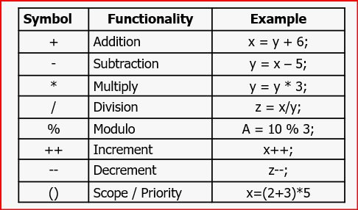
Arithmetic Operator

Slide 7
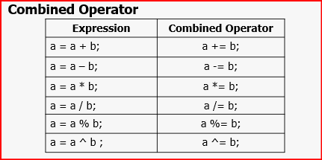
Arithmetic Operator

Slide 8
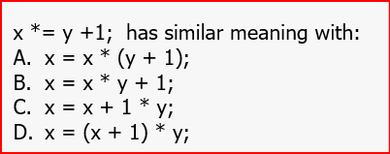
Arithmetic Operator
Soal

Slide 9

Arithmetic Operator

Slide 10
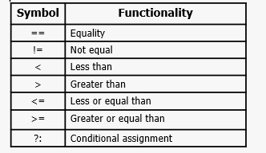
Relational Operator
Penggunaan akan dibahas lebih detail di conditional expressions

Slide 11
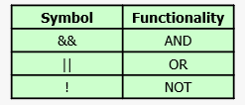
Logical Operator
Logical operator symbols

Slide 12
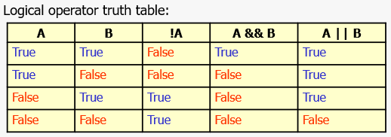
Logical Operator

Slide 13
LATIHAN 1

Slide 14
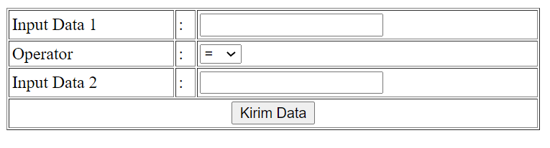
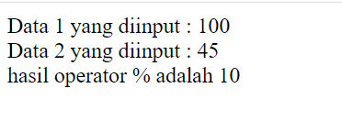
Output Program

Slide 15
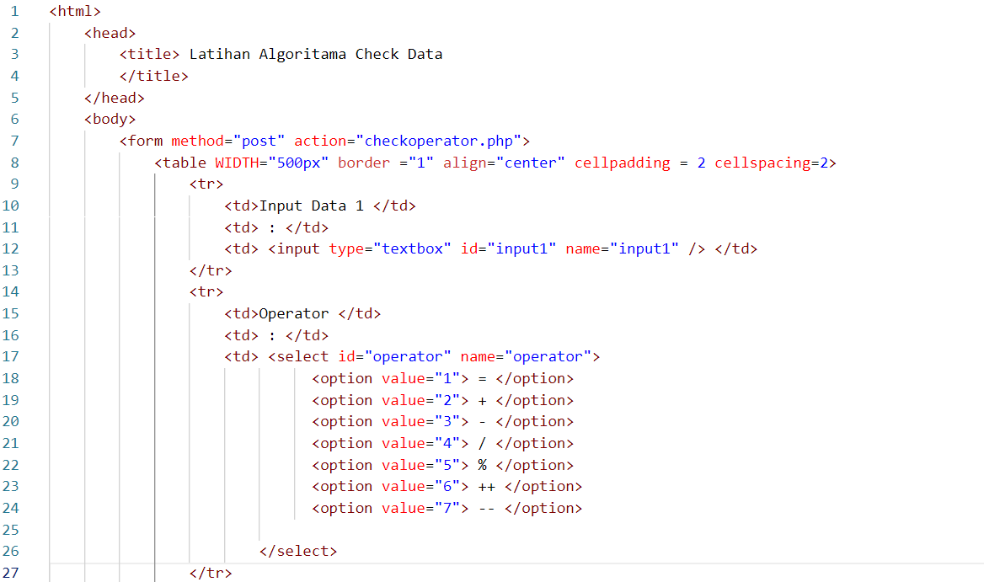
Latihancheckdata.php

Slide 16
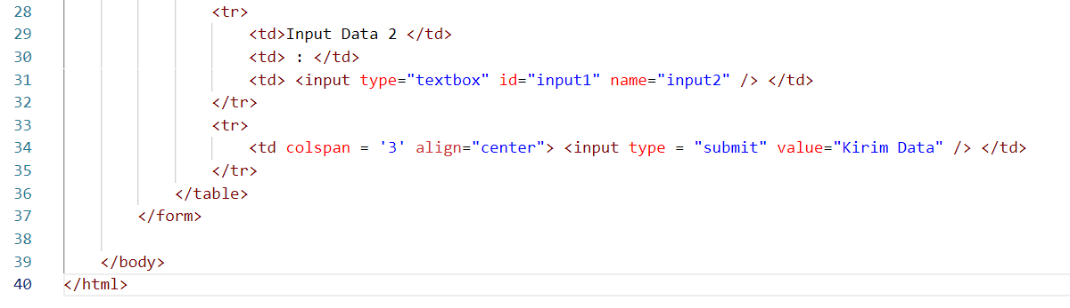
Latihancheckdata.php

Slide 17
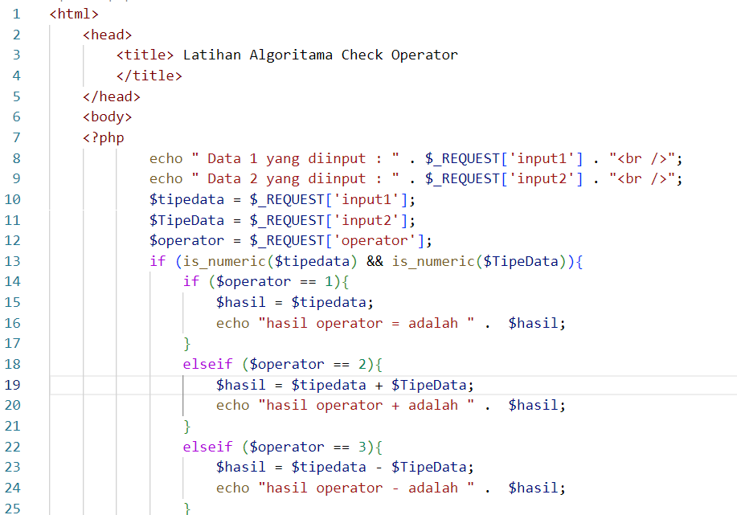
Checkoperator.php

Slide 18
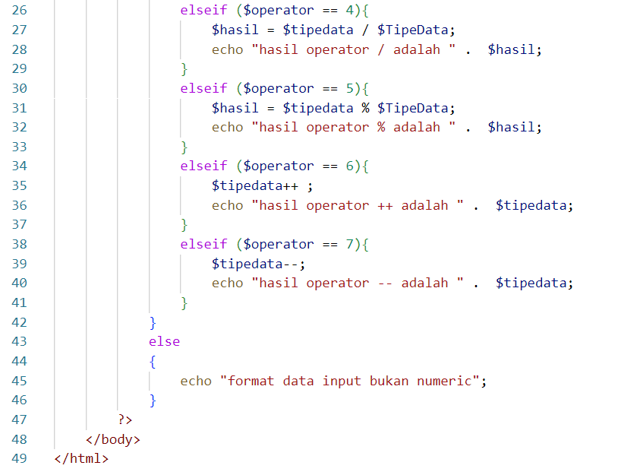
Checkoperator.php

Slide 19
Harwikaya, dkk, Dasar Pemrograman, Penerbit Andi, 2017
Kjell Backman, Structured Programmming with c++, 2012
Sumber Internet :
https://jagongoding.com/web/php/dasar/tipe-data-dan-variabel/
https://www.duniailkom.com/tutorial-belajar-php-cara-pengecekan-tipe-data-argumen-untuk-fungsi-php/

