Slide 1
IT Project Management HUMA 1001 / INSY 714
Original by Prof. Dr. Ralf Klischewski
Prof. Dr. Inas Ezz (Minor Editing)
GUC Spring Semester 2020

Slide 2
Motivation
Information Technology
→ Information Systems
→ → Projects
→→ → Management
What’s the Problem?!?
GUC Student

Slide 3
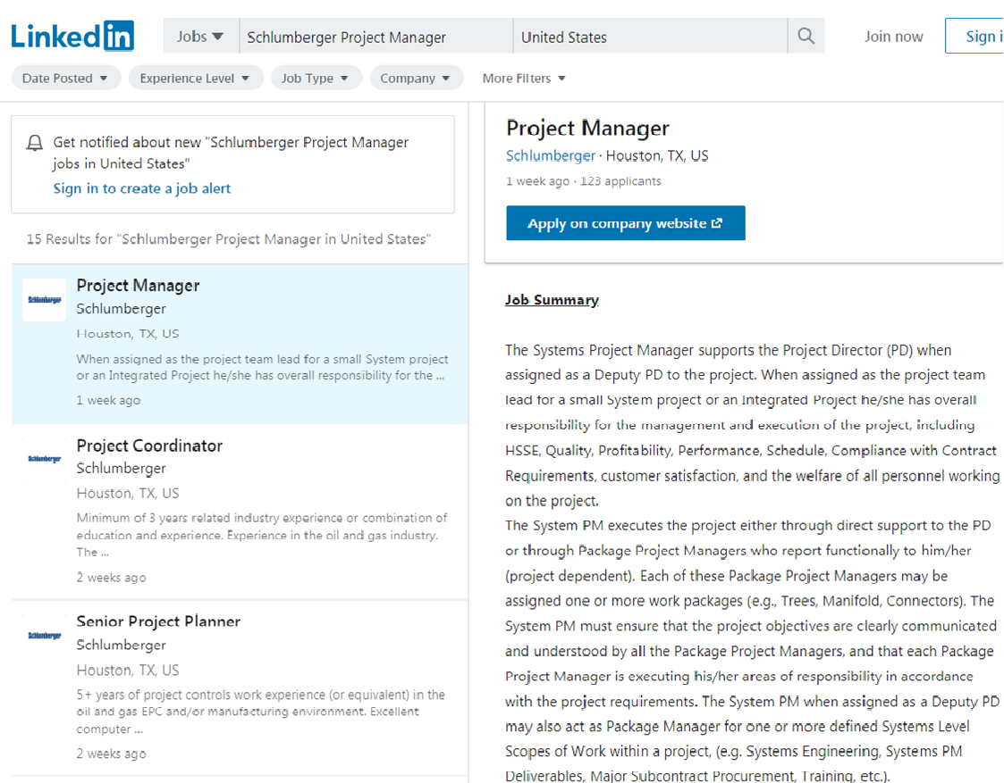

Slide 4
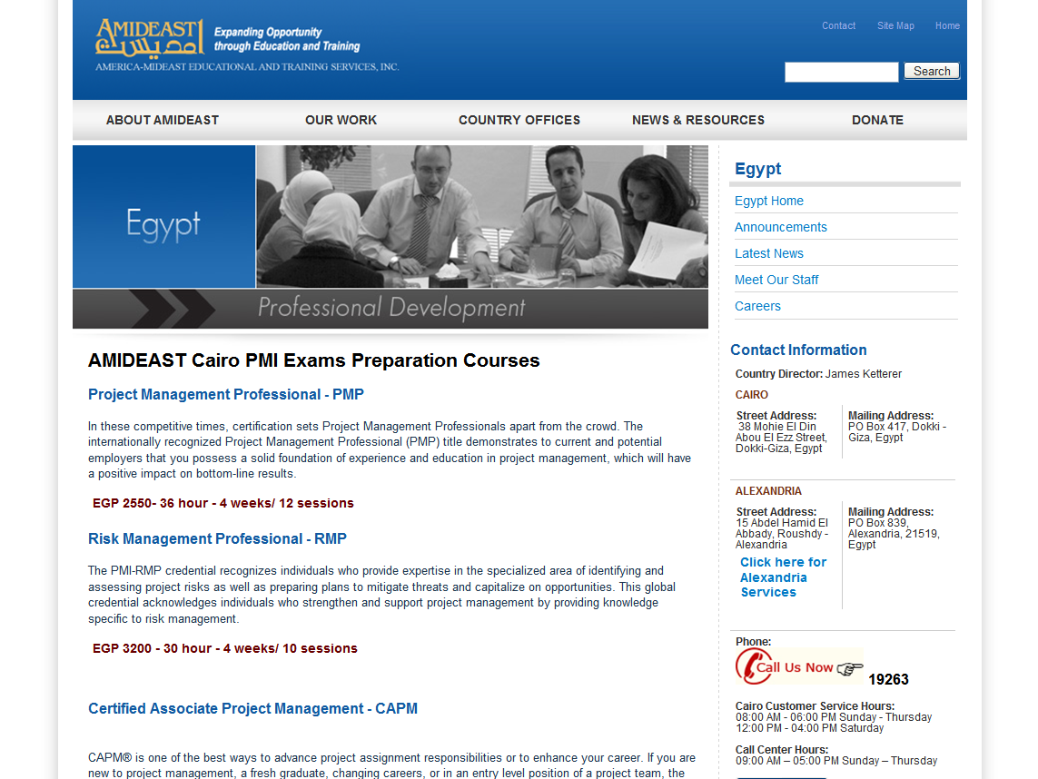

Slide 5
Project Management Certification
The Project Management Institute (PMI) is an international professional society for project managers founded in 1969
PMI provides certification as a Project Management Professional (PMP)
A PMP has documented sufficient project experience, agreed to follow a code of ethics, and passed the PMP exam
The number of people earning PMP certification is increasing quickly

Slide 6
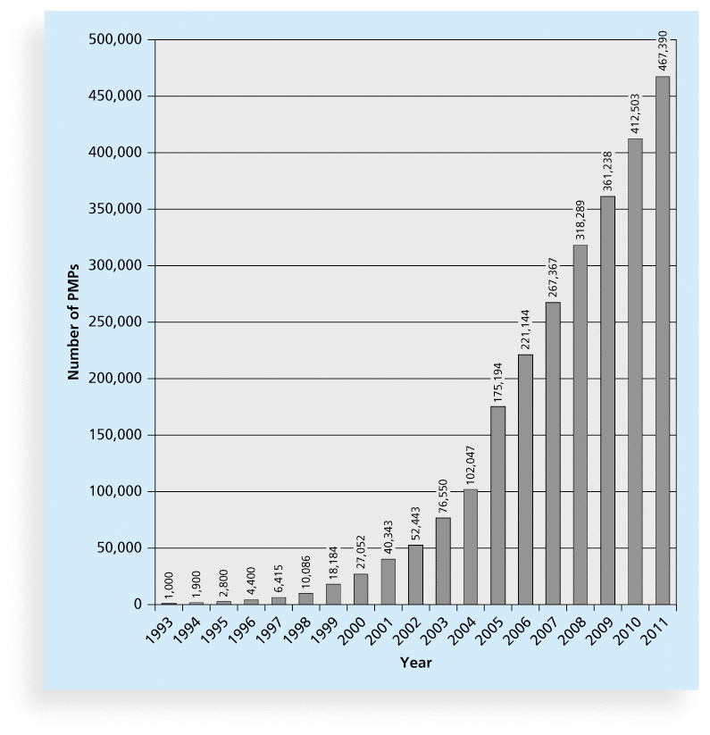
Growth in PMP Certification, 1993-2011

Slide 7

Some copies of textbook available at GUC Library
(or electronic copies…)

Slide 8

Chapter 1: Introduction to Project Management
Information Technology Project Management, Seventh Edition

Slide 9
Learning Objectives
Understand the growing need for better IT project management,
Explain what a project is (examples, attributes), and describe the triple constraint of project management
Describe project management and project success
Discuss the relationship between project, program, and portfolio management
Understand the role of project managers
Describe the project management profession

Slide 10
Introduction
Many organizations today have a new or renewed interest in project management
Computer hardware, software, networks, and the use of interdisciplinary and global work teams have radically changed the work environment
The world as a whole spends nearly $10 trillion of its $40.7 trillion gross product on projects of all kinds
More than 16 million people regard project management as their profession

Slide 11
Project Management Statistics
The overall information and communications technology market grew by 6 percent to almost $3 trillion in 2010
In the U.S. the size of the IT workforce topped 4 million workers in 2008, and the unemployment rate for IT professionals is half the rate for the overall labor market
In 2011 the total compensation for the average senior project manager in U.S. dollars was $105,000 per year in the United States and $160,409 in the Switzerland.
The number of people earning their Project Management Professional (PMP) certification continues to increase.

Slide 12
Motivation for Studying Information Technology (IT) Project Management
IT Projects have a terrible track record, as described in the What Went Wrong?
A 1995 Standish Group study (CHAOS) found that only 16.2% of IT projects were successful in meeting scope, time, and cost goals; over 31% of IT projects were canceled before completion
A PricewaterhouseCoopers study found that overall half of all projects fail and only 2.5% of corporations consistently meet their targets for scope, time, and cost goals for all types of project.

Slide 13
Advantages of Using Project Management Techniques
Better control of financial, physical, and human resources
Improved customer relations
Shorter development times
Lower costs
Higher quality and increased reliability
Higher profit margins
Improved productivity
Better internal coordination
Higher worker morale

Slide 14
What Went Right?
Improved Project Performance
The Standish Group’s CHAOS studies show improvements in IT projects in the past decade:
The number of successful IT projects has more than doubled, from 16 percent in 1994 to 37 percent in 2010
The number of failed projects decreased from 31 percent in 1994 to 21 percent in 2010
Success rates were the highest ever in the most recent CHAOS study

Slide 15
Why the Improvements?
"The reasons for the increase in successful projects vary. First, the average cost of a project has been more than cut in half. Better tools have been created to monitor and control progress and better skilled project managers with better management processes are being used. The fact that there are processes is significant in itself.”*
*Standish Group, "CHAOS 2001: A Recipe for Success" (2001)

Slide 16
What Is a Project?
A project is “a temporary endeavor undertaken to create a unique product, service, or result” (PMBOK® Guide, 5th Edition, 2012)
Projects end when their objectives have been reached or the project has been terminated
Projects can be large or small and take a short or long time to complete

Slide 17
Examples of IT Projects
A team of students creates a smartphone application and sells it online
A company develops a driverless car
A small software development team adds a new feature to an internal software application for the finance department
A college upgrades its technology infrastructure to provide wireless Internet access across the whole campus

Slide 18
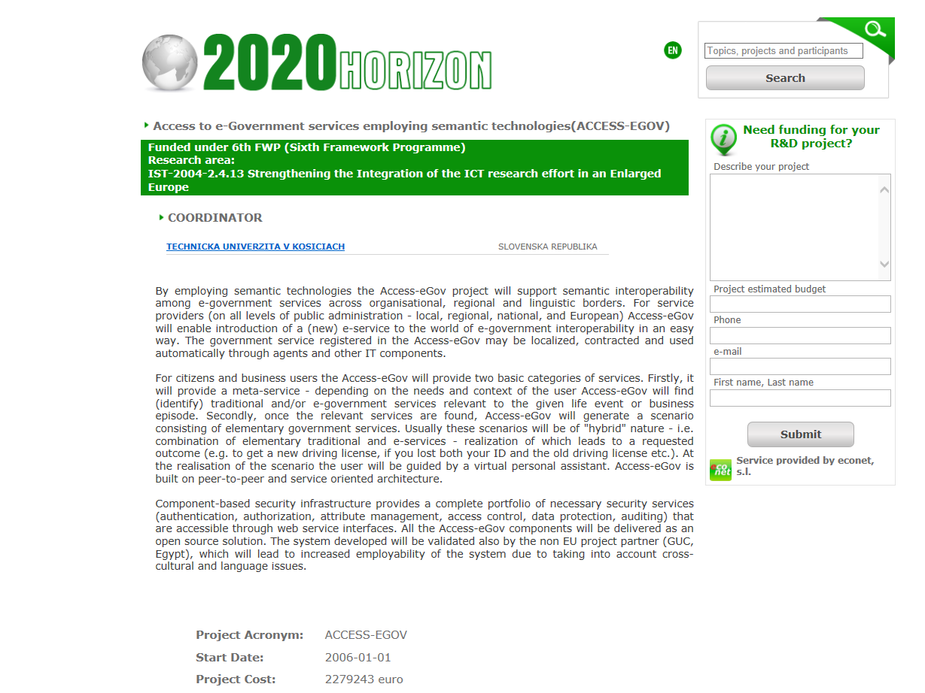

Slide 19
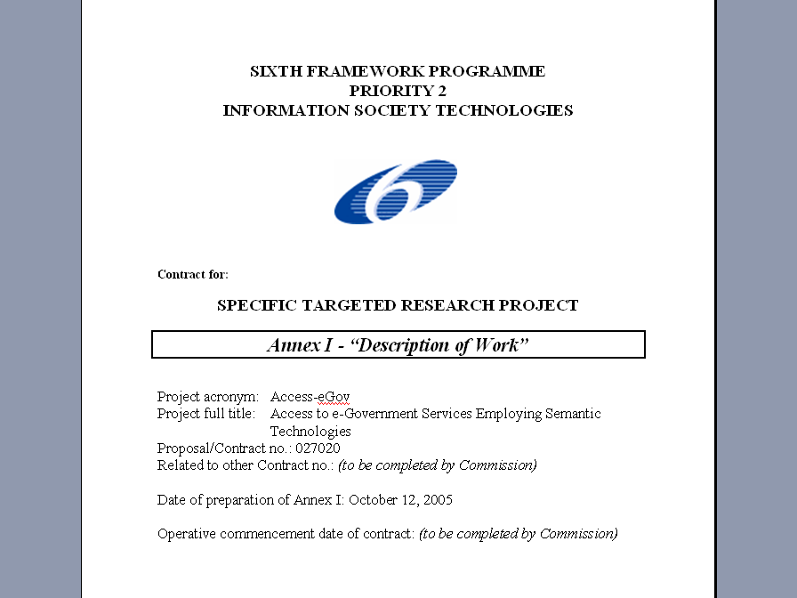

Slide 20
ACCESS-EGOV Work Breakdown Structure
Deliv-erable | End month | Start month | Person-months | Lead contractor | Workpackage title | Work-package
D1 1-4 | M36 | M0 | 51 | TUK | Project management | WP1
D2 1-2 | M6 | M0 | 29 | GUC | User requirements analysis and state of the art | WP2
D3 1-2 | M10 | M4 | 23 | IS | Functional specification and architecture design | WP3
D4 1-2 | M27 | M10 | 50 | UR | Development of basic components for management of e-government service mark-up | WP4
D5 1-2 | M27 | M10 | 66 | EMA | Development of basic components for personal assistant platform | WP5
D6 1-2 | M36 | M27 | 42 | TUK | Integration of the components | WP6
D7 1-2 | M20 | M5 | 36 | IS | Knowledge modelling and semantic mark-up | WP7
D8 1-4 | M34 | M10 | 56 | KSR, COI | Pilot projects | WP8
D9 1-8 | M36 | M0 | 57 | ISO | Dissemination and exploitation | WP9
 |  |  | 410 |  | TOTAL

Slide 21
Project Attributes
A project
has a unique purpose
has structure, but is temporary
is developed using progressive elaboration
requires resources, often from various areas
should have a primary customer or project sponsor who usually provides the direction and funding for the project
involves uncertainty

Slide 22
What is Project Management?
Project management is “the application of knowledge, skills, tools and techniques to project activities to meet project requirements” (PMBOK® Guide, 5th Edition, 2012)
Project managers strive to meet the triple constraint (project scope, time, and cost goals) and also facilitate the entire process to meet the needs and expectations of project stakeholders

Slide 23
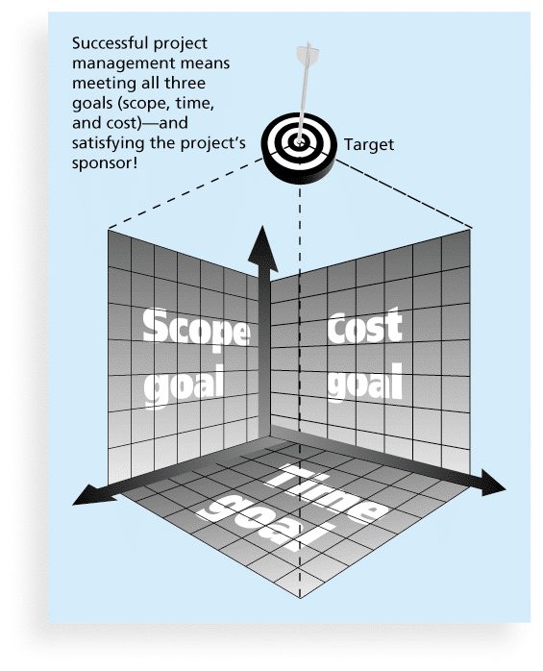
Triple Constraint of Project Management

Slide 24
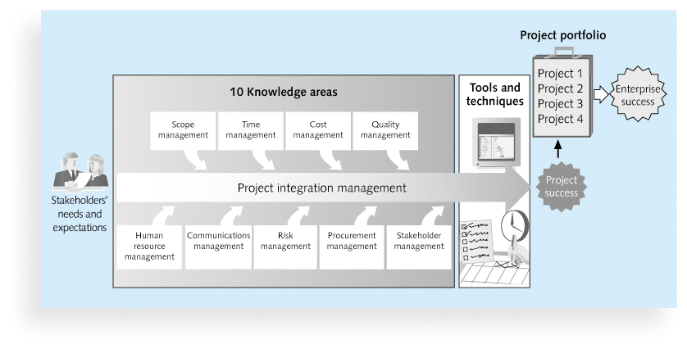
Project Management Framework

Slide 25
Project Stakeholders
Stakeholders are the people involved in or affected by project activities
Stakeholders include
the project sponsor
the project manager
the project team
support staff
customers
users
suppliers
opponents to the project

Slide 26
PM Knowledge Areas
Knowledge areas describe the key competencies that project managers must develop
Project managers must have knowledge and skills in all 10 knowledge areas: project integration, scope, time, cost, quality, human resource, communications, risk, procurement, and stakeholder management

Slide 27
Project Management Tools and Techniques
assist project managers and their teams in various aspects of project management
Some specific ones include
Project charter, scope statement, and WBS (scope)
Gantt charts, network diagrams, critical path analysis, critical chain scheduling (time)
Cost estimates and earned value management (cost)

Slide 28
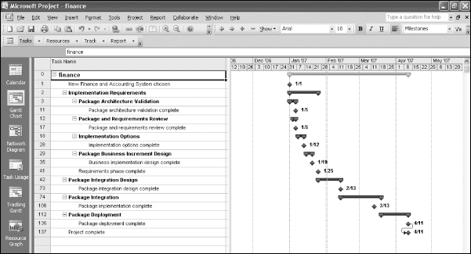
Sample Gantt Chart (created with MS Project 2010)

Slide 29
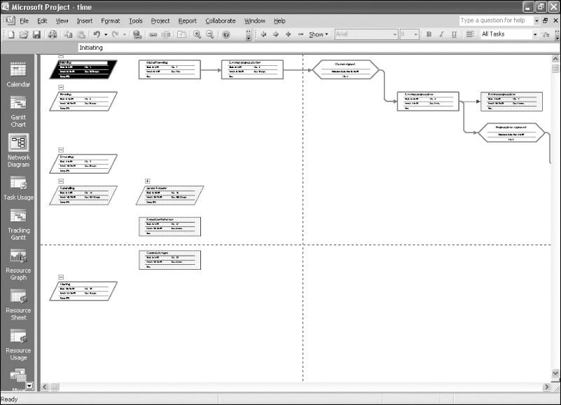
Sample Network Diagram (created with MS Project 2010)

Slide 30
Project Management Software
There are hundreds of different products to assist in performing project management
Three main categories of tools:
Low-end tools: Handle single or smaller projects well, cost under $200 per user
Midrange tools: Handle multiple projects and users, cost $200-$1,000 per user, MS Project 2010 most popular
High-end tools: Also called enterprise project management software, often licensed on a per-user basis, like Microsoft Enterprise Project Management solution

Slide 31
Project Portfolio Management
Organizations group and manage projects and programs as a portfolio of investments that contribute to the entire enterprise’s success
Portfolio managers help their organizations make wise investment decisions by helping to select and analyze projects from a strategic perspective

Slide 32
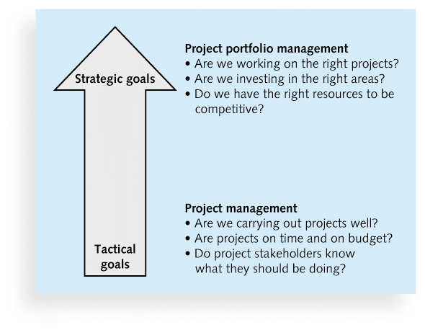
Project Management Compared to Project Portfolio Management

Slide 33
Project and Program Managers
Project managers work with project sponsors, project team, and other people involved in a project to meet project goals
Program: group of related projects managed in a coordinated way to obtain benefits and control not available from managing them individually (PMBOK® Guide, 5th Edition, 2012)
Program managers oversee programs; often act as bosses for project managers

Slide 34
The Role of the Project Manager
Job descriptions vary, but most include responsibilities like planning, scheduling, coordinating, and working with people to achieve project goals
Remember that 97% of successful projects were led by experienced project managers, who can often help influence success factors

Slide 35
Most Important Skills and Competencies for Project Managers*
People skills
Leadership
Listening
Integrity, ethical behavior, consistent
Strong at building trust
Verbal communication
Strong at building teams
Conflict resolution, conflict management
Critical thinking, problem solving
Understands, balances priorities
*Jennifer Krahn, Effective Project Leadership, PMI Research Conference 2006

Slide 36
Ethics in Project Management
Ethics, loosely defined, is a set of principles that guide our decision making based on personal values of what is “right” and “wrong”
Project managers often face ethical dilemmas
In order to earn PMP certification, applicants must agree to PMI’s Code of Ethics and Professional Conduct and answer exam questions related to professional responsibility, including ethics

Slide 37
Importance of Leadership Skills
Effective project managers provide leadership by example
A leader focuses on long-term goals and big-picture objectives while inspiring people to reach those goals
A manager deals with the day-to-day details of meeting specific goals
Project managers often take on the role of both leader and manager

Slide 38
Different Skills Needed in Different Situations
Large projects: Leadership, relevant prior experience, planning, people skills, verbal communication, and team-building skills were most important
High uncertainty projects: Risk management, expectation management, leadership, people skills, and planning skills were most important
Very novel projects: Leadership, people skills, having vision and goals, self confidence, expectations management, and listening skills were most important

Slide 39
Suggested Skills for Project Managers
The Project Management Body of Knowledge
Application area knowledge, standards, and regulations
Project environment knowledge
General management knowledge and skills
Soft skills or human relations skills

Slide 40
Project Management Offices
Many companies began creating PMOs to help them handle the increasing number and complexity of projects
A Project Management Office (PMO) is an organizational group responsible for coordinating the project management function throughout an organization
PMOs promote best practice as “an optimal way recognized by industry to achieve a stated goal or objective”

Slide 41
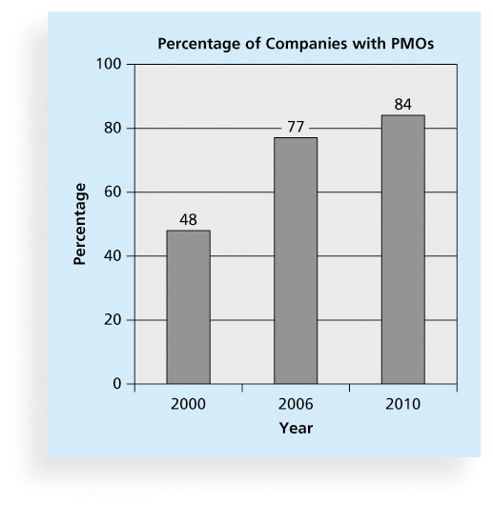
Growth in the Number of Project Management Offices

Slide 42
Project Success
The project met scope, time, and cost goals
The project satisfied the customer/sponsor
The results of the project met its main objective

Slide 43
What helps projects succeed?
User involvement
Executive support
Clear business objectives
Emotional maturity
Optimizing scope
Agile process
Project management expertise
Skilled resources
Execution
Tools and infrastructure

Slide 44
Chapter Summary
A project is a temporary endeavor undertaken to create a unique product, service, or result
Project management is the application of knowledge, skills, tools, and techniques to project activities to meet project requirements
A program is a group of related projects managed in a coordinated way
Project portfolio management involves organizing and managing projects and programs as a portfolio of investments
Project managers play a key role in helping projects and organizations succeed
The project management profession continues to grow and mature

Slide 45
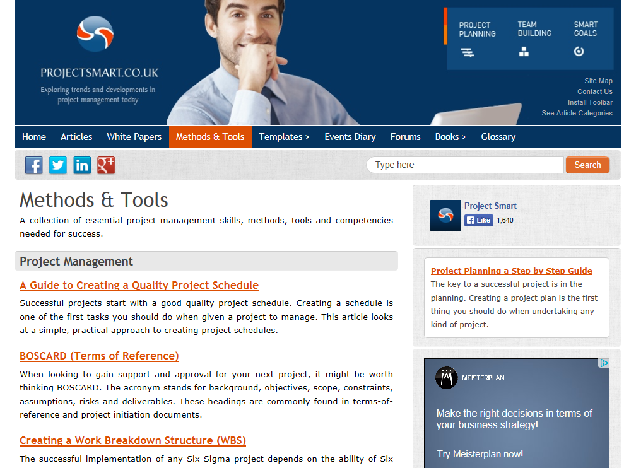

Slide 46
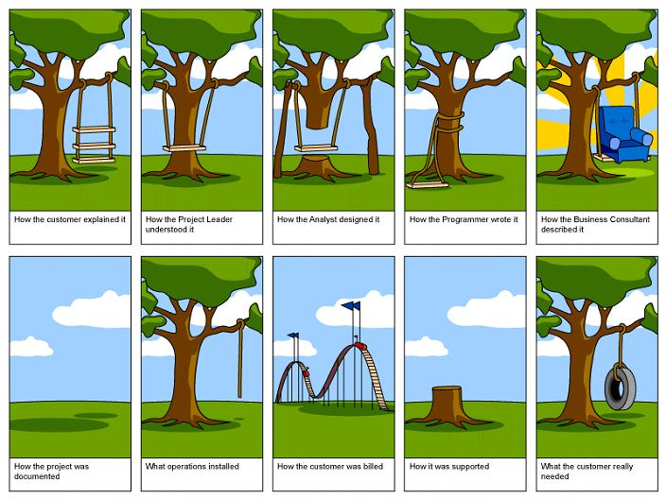
What Project Management seeks to avoid?

