Slide 1
Address Book System
Name: RAFIKA SULTANA
ID: 151-35-1050
Date: 12-12-2017

Slide 2
Introduction
Address Book is an application based project. It is design for people to store their information. It holds a collection of entries, each recording a person’s first name, last name, address, city, state and phone number

Slide 3
USE CASE DIAGRAM FOR THE SYSTEM

Slide 4
System Sequence Diagram For Record Information (success scenario)

Slide 5
Sequence Diagram For Record Information

Slide 6
Class Diagram

Slide 7
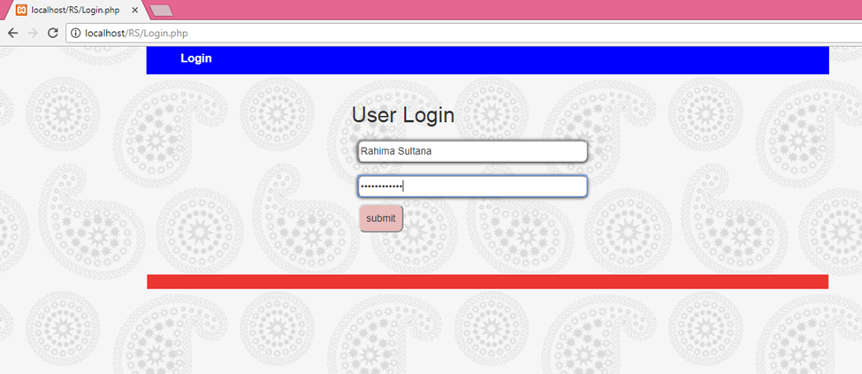
Record Information Log In Page

Slide 8
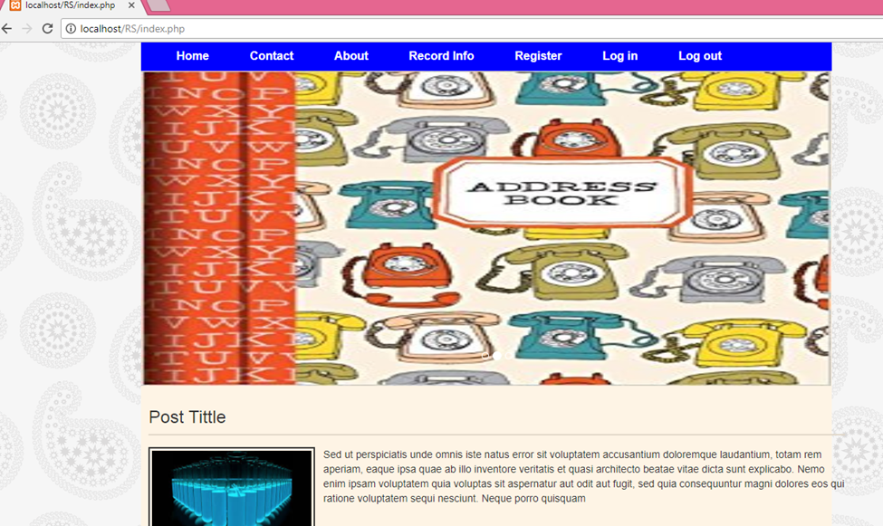
Record Information Home Page

Slide 9
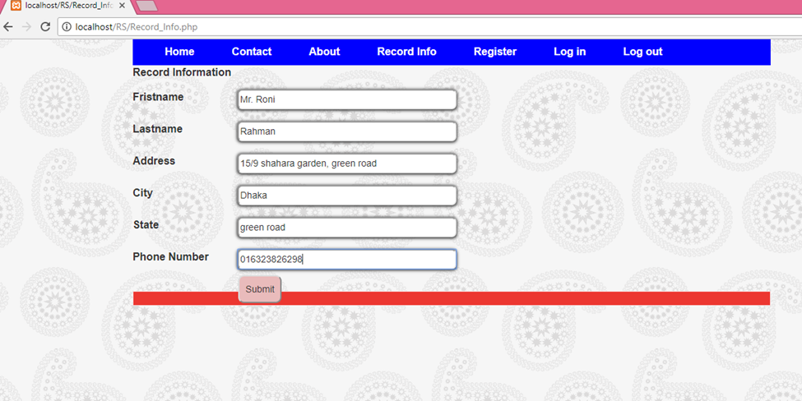
Record Information

Slide 10
Thank you

