Slide 1
DS8009 The Importance of being Linked
Rafik Matta
Dec 10, 2018

Slide 2
Introduction

Slide 3
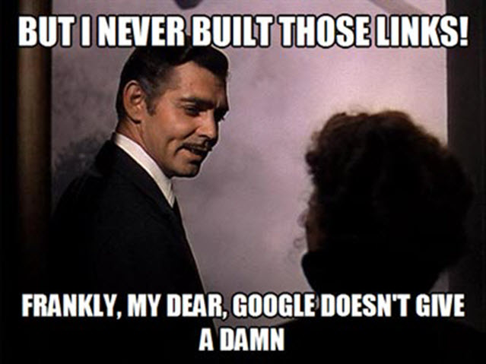
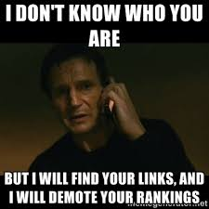
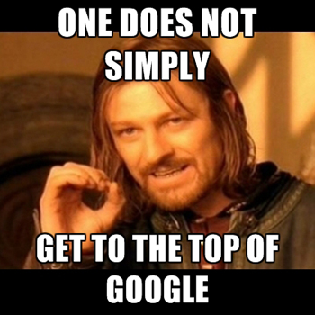
How important is web presence?

Slide 4
How important is web presence?
Most large companies have a website
Most large companies have a “social media” strategy
Search Engine Optimization is a real and big industry ($80 Billion)
https://www.forbes.com/sites/tjmccue/2018/07/30/seo-industry-approaching-80-billion-but-all-you-want-is-more-web-traffic/#4e12213c7337
Being discovered on the Web matters!
Companies pay lots of money to do it
But who really dominates the Web?

Slide 5
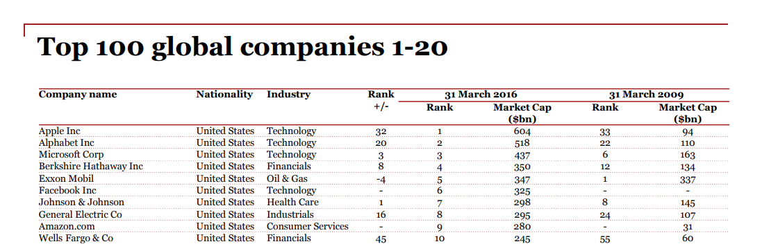
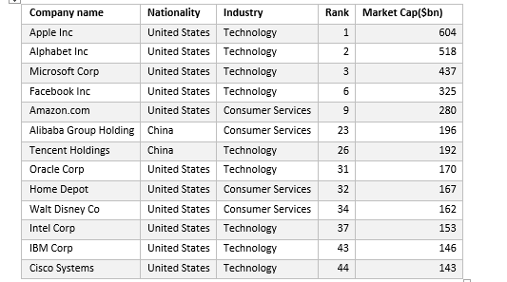
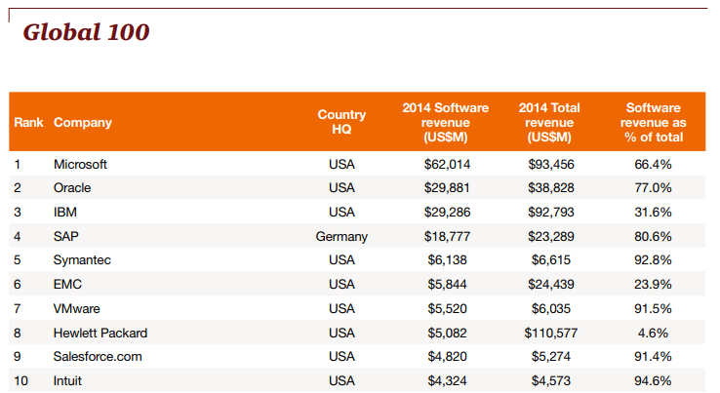
Who dominates in the real world?

Slide 6
So how about the Web? Let’s find out

Slide 7
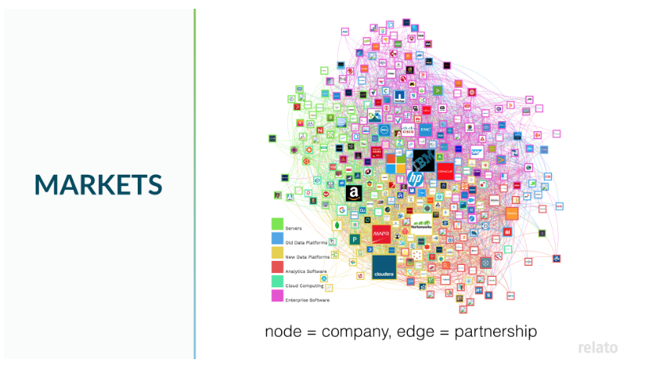

Dataset
Name: Relato Business Graph Database
Link: https://data.world/datasyndrome/relato-business-graph-database

Slide 8
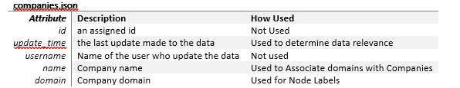
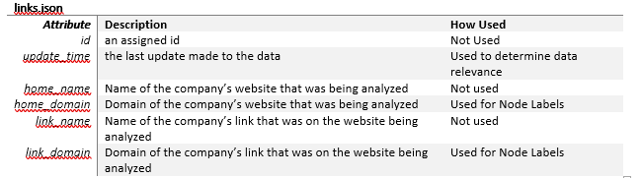
Dataset

Slide 9
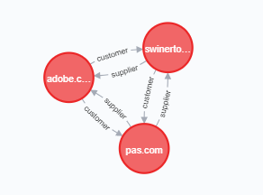
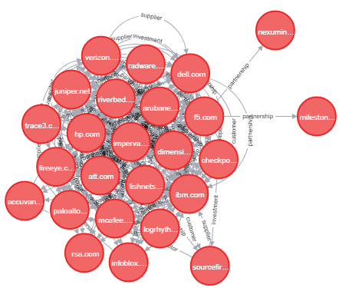
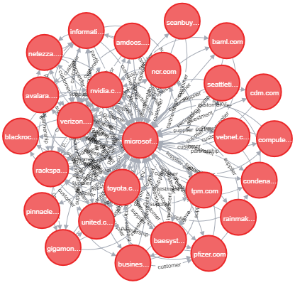
Dataset- Preview (Neo4j)

Slide 10
Dataset - Preprocessing
Converted JSON files to CSV
Removed null fields
Selected fields for analysis

Slide 11
Methodology
Focused analysis on top companies that are primarily Internet/Software/Technology Companies
Did community detection, node centrality analysis, and similarity measures
Aimed to who the top Web companies are, if they are related to top real companies, and how they related to each other

Slide 12



Technologies Used
Neo4J
Json2csv
Excel

Slide 13

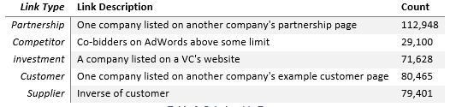
Analysis + Results

Slide 14
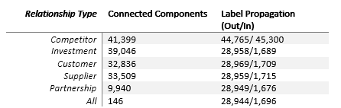
Analysis – Community Detection
Used Connected Components
Used Label Propagation

Slide 15
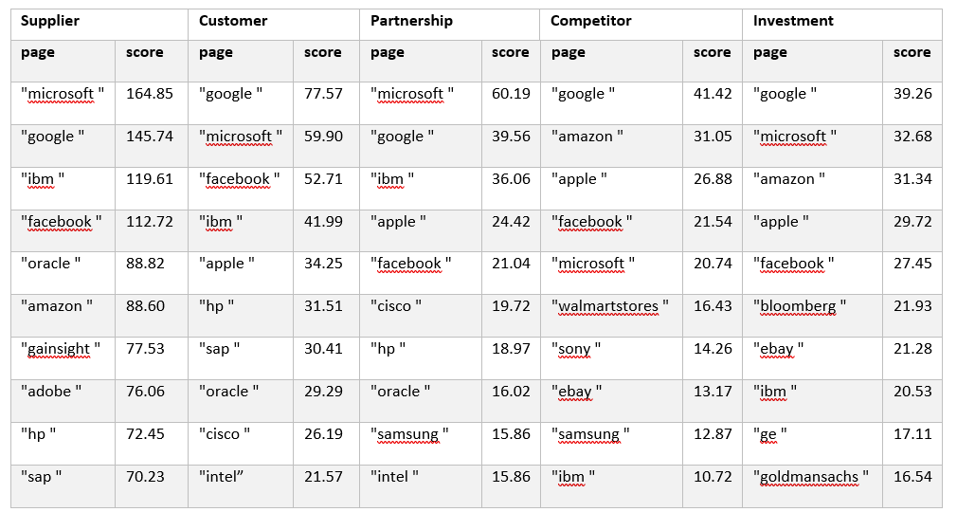
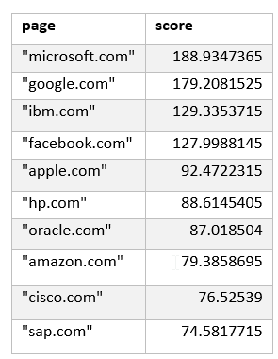
Analysis – Node Centrality
Used PageRank on whole graph
Used PageRank on Relationships

Slide 16
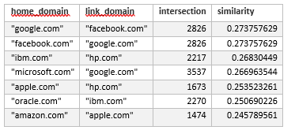
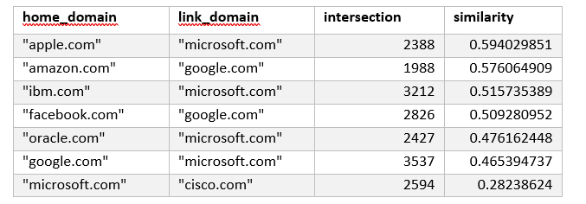
Analysis – Similarity Measure
Used Jaccard vs Overlap Similarity on whole graph vs. top domains

Slide 17
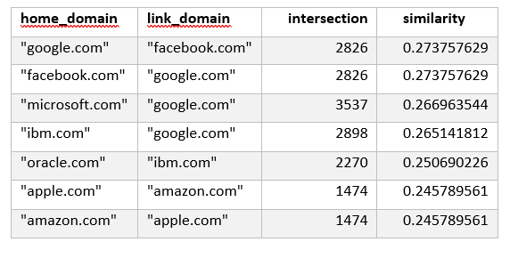
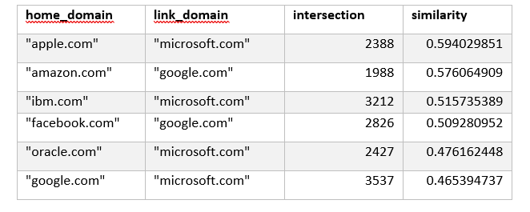
Analysis – Similarity Measure
Used Jaccard vs Overlap Similarity on whole graph vs. top domains

Slide 18












Conclusions
Top web companies are:

Slide 19
Conclusions
Top web companies are usually top real companies
Web is not as global as originally thought since two big technology companies aren’t showing up (Alibaba + Tencent)
Jaccard Similarity can show’s us accurately relationships between companies, Overlap Similarity is characteristic of entire graph but not good for relationships

Slide 20
Lessons Learned
Good graph data is hard to come by
Lots of pre-processing needed
Different techniques will show different characteristics of graph data
Neo4j + graph databases are good for analysis
Spark + GraphX are great too, but steep learning curve

Slide 21
Q & A?

