Slide 1
CA-3 · AGENTIC AI · DOMAIN: CODE REVIEW
CodeMind AI
An agentic code review assistant for AI-generated code
The problem
Students and “vibe coders” ship AI-generated code they did not write and do not fully understand.
It runs, so it gets accepted, but it hides boundary bugs, swallowed errors and security holes (eval, SQL injection, shell=True, hard-coded keys).
Code review is the normal quality gate, but it does not scale to this volume, and a beginner has no reviewer at all.
Why this domain
Code is verifiable: it can be parsed, diffed and tested.
So every claim the agents make can be backed by evidence, not just text.
Notes:
30s. Problem: AI writes code people accept without understanding. Code review is the gate, but it doesn't scale and beginners have no reviewer. Code is a good domain for agents because claims can be checked: parsed, diffed, tested.

Slide 2
EXISTING CHALLENGE → PROPOSED SOLUTION
Review like a careful human reviewer, but prove it
Linters give terse warnings
→
Each finding has evidence (file + line), why, impact, fix and how it will be validated
Chat assistants rewrite whole files
→
Minimal single-finding patch shown as a unified diff
“Fixed” code is never proven
→
Real pytest run on an isolated copy; retry with a different strategy if it fails
Tools act without consent
→
Hard human approval bound to the exact patch hash; original never written
Only one answer offered
→
Advisor compares alternatives and trade-offs, incl. “keep current approach”
Core loop: ANALYZE → EXPLAIN WITH EVIDENCE → COMPARE → HUMAN APPROVAL → APPLY TO COPY → VALIDATE → REPORT
CodeMind AI · Agentic Code Review Assistant · CA-3
2/8
Notes:
45s with slide 3. Each existing tool fails in one way; our response to each is a concrete feature you will see in the demo.

Slide 3
AGENT ROLES AND ORCHESTRATION
A planner and five agents share one typed workflow state
1 · Repository Understanding
Planner / Orchestrator (state machine)
README, structure, entry points, dependencies, import graph, doc gaps, with line evidence
RECEIVED → PLANNED → ANALYZING → FINDINGS_READY
→ PATCH_PROPOSED → critic review → AWAITING_APPROVAL
→ human approves → APPLYING (copy) → VALIDATING
→ VALIDATED | failed → retry new strategy (max 2) → BLOCKED
Guarantees
• only path to applying a patch is human approval
• illegal transitions raise errors (tested)
• every transition logged with its reason
• plan adapts: no tests → baseline skipped; untrusted upload → tests not run
2 · Bug & Risk Analysis
Python AST rules R001–R009: division by zero, eval, SQL injection, shell=True, secrets, mutable defaults…
3 · Solution & Architecture Advisor
Current approach vs alternatives and trade-offs; says when current code is fine
4 · Code Improvement
Minimal patch + diff, risks, suggested tests; picks a new strategy from test-failure feedback
5 · Critic & Validation
Baseline tests on original, reviews every patch, then syntax + rule re-check + real pytest on a copy
CodeMind AI · Agentic Code Review Assistant · CA-3
3/8
Notes:
Agentic, not a chatbot: a planner builds a plan from what the repo contains, agents write structured results to shared state, the critic can send work back, and validation failure feeds the next strategy.

Slide 4
COMPLETE ARCHITECTURE
From upload to verified report
Developer
(human reviewer)
Streamlit UI
7 views
Repository ingestion
unsafe ZIP (traversal, symlink, bomb) → BLOCKED
Original repo
read-only · hashed · never written
Planner / Orchestrator · state machine · decision log
Shared structured findings & workflow state
A1 Repository
Understanding
A2 Bug & Risk
AST rules R001–R009
A5 Baseline tests
confirm findings
A3 Solution &
Architecture Advisor
A4 Code
Improvement (patch)
A5 Critic
scope · compile
failed → retry (max 2)
accepted
Tools: ast · difflib · compile()
pytest subprocess (timeout, env)
Final report
JSON · Markdown
A5 Validate
syntax · re-check · tests
Isolated working copy
patch applied here only
Human approval
bound to patch hash
passed
approve
BLOCKED → escalate
retries exhausted
Reject → back to findings
original untouched
CodeMind AI · Agentic Code Review Assistant · CA-3
4/8
Notes:
Walk top to bottom: upload is checked, the original is frozen, the planner runs the agents over shared state. The only way to a changed file is the approval diamond, and changes go to a separate copy. Failed validation loops back to the improvement agent; after 2 retries it is BLOCKED. Full Mermaid diagram: docs/architecture.png.

Slide 5
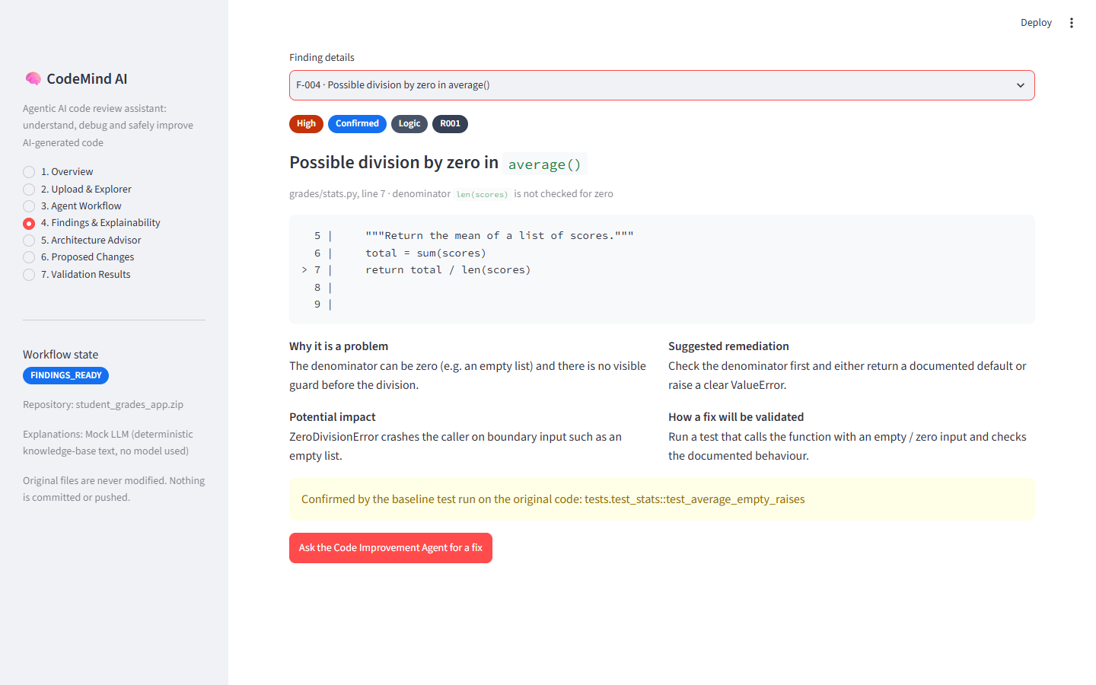
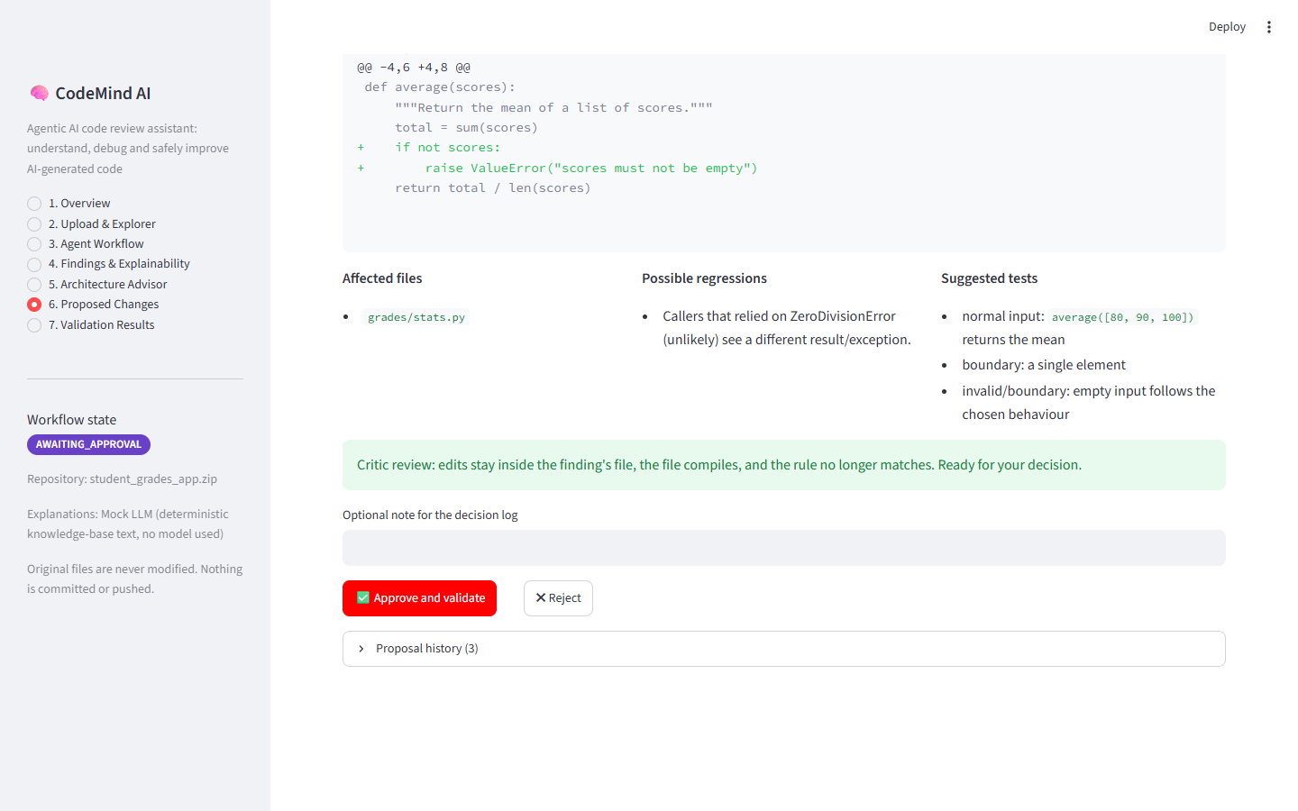
WORKING STREAMLIT POC (SYNTHETIC DATA)
Demo: confirmed bug → failed fix → retry → verified
F-004 division by zero is Confirmed: the sample's own test fails on that exact line in the baseline run.
Attempt 1 (return 0.0) failed a real test, so the agent proposes “Raise ValueError”. Approved → 9/9 tests pass, original unchanged.
CodeMind AI · Agentic Code Review Assistant · CA-3
5/8
Notes:
2 minutes LIVE DEMO (see DEMO_SCRIPT.md). Backup: these are screenshots from a real run.

Slide 6
OUTPUT VALIDATION AND ACTUAL RESULTS
Every number below is from a real run
105
9 / 9
8 / 9
0
automated tests passed
planted issues found
fixes validated
originals modified
Windows 11, Python 3.13
exact rule+file+line, 0 extra
7 first try, 1 after retry
re-hashed after every run
How results are validated
• statuses: Passed / Failed / Not run / Blocked / Partially verified
• pass = compiles + rule no longer matches + no regressions vs baseline + linked tests pass
• browser end-to-end run in real Chrome with assertions on the downloaded report
• fresh install from requirements.txt: 104 passed, 1 optional skip
Found and fixed in testing
First Windows run: 4 tests failed. Pytest prints grades\stats.py on Windows, so the bug was not linked to its failing test. Fixed (one line) + regression test. Linux runs could not have caught it.
Honest caveat
9/9 is on our synthetic sample, so it shows the rules work as designed, not real-world accuracy.
CodeMind AI · Agentic Code Review Assistant · CA-3
6/8
Notes:
45s. Emphasise: no number is estimated; evidence files are in docs/test-evidence. Mention the Windows bug as proof the testing was real.

Slide 7
LIMITATIONS AND FUTURE SCOPE
What it cannot do yet, and where it goes next
Limitations
Future scope
• 9 deterministic rules, Python only; no cross-function data flow
• fix templates for 8 rules; R008 has no auto-fix by design
• explanations from a knowledge base (labelled Mock LLM); Ollama optional, only rewords
• tests run in a subprocess, not a security sandbox; Windows enforces only a timeout
• validation is only as good as the repo's own tests
• single user, no database, no GitHub URL input
• LLM reviewer for fixes beyond templates, kept behind the same critic + approval + test gates
• Pull-request integration: comment on changed lines, suggest patches, never push
• Container / microVM sandbox for safe testing of any upload
• Bandit, Semgrep, Ruff, ESLint as tools for the risk agent; more languages
• Propose a failing test first when the repo has none
• Evaluate on real labelled bug datasets
CodeMind AI · Agentic Code Review Assistant · CA-3
7/8
Notes:
45s. Say the limitations plainly; the design keeps the guardrails when an LLM is added later.

Slide 8
SUMMARY
Understand → evidence → compare → approve → verify
• Agentic code review with a planner, five agents, a critic loop and bounded retries
• Every finding cites real lines; confirmed findings are reproduced by a real test
• Nothing changes without the developer's approval of the exact patch, and the original is never touched
• Fixes are proven by real test runs, and failures are reported, not hidden
• Fully offline, no paid API: Python, Streamlit, ast, pytest
Thank you · Questions?
CodeMind AI · Agentic Code Review Assistant · CA-3
8/8
Notes:
Close in 15s and invite questions. Viva prep: presentation/VIVA_QA.md.

