Slide 1
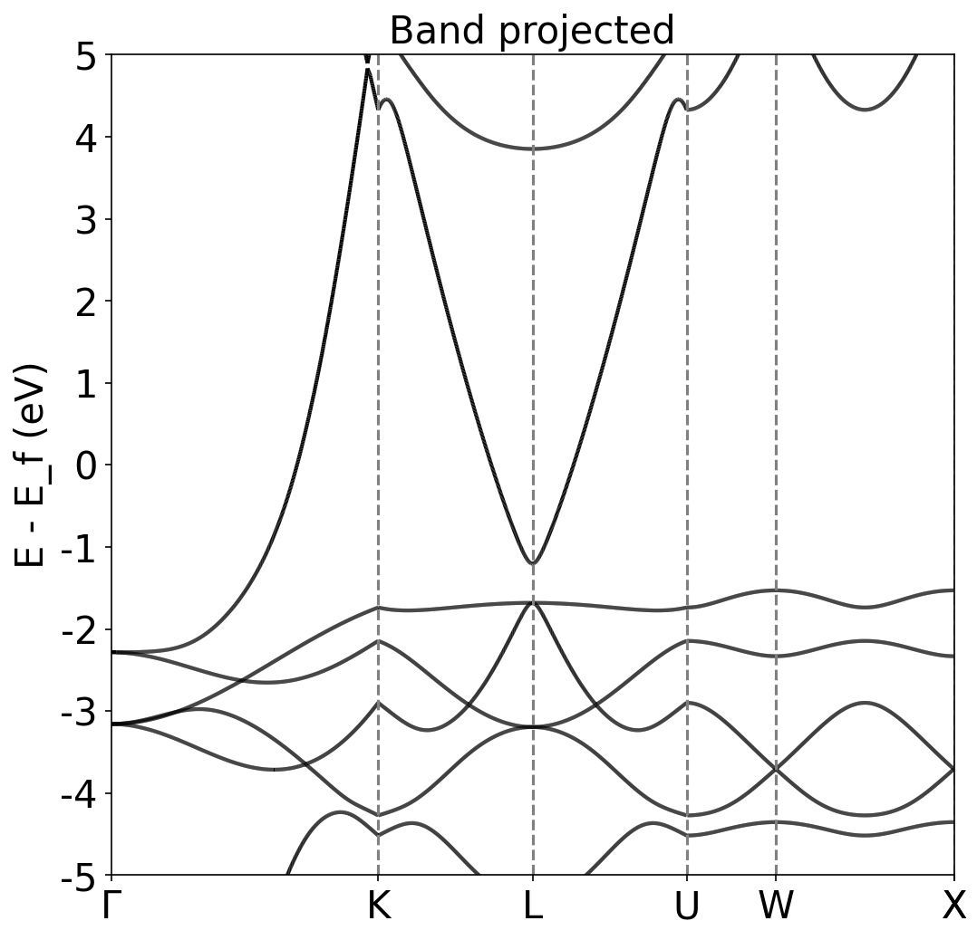
Band Structure Cu

Slide 2
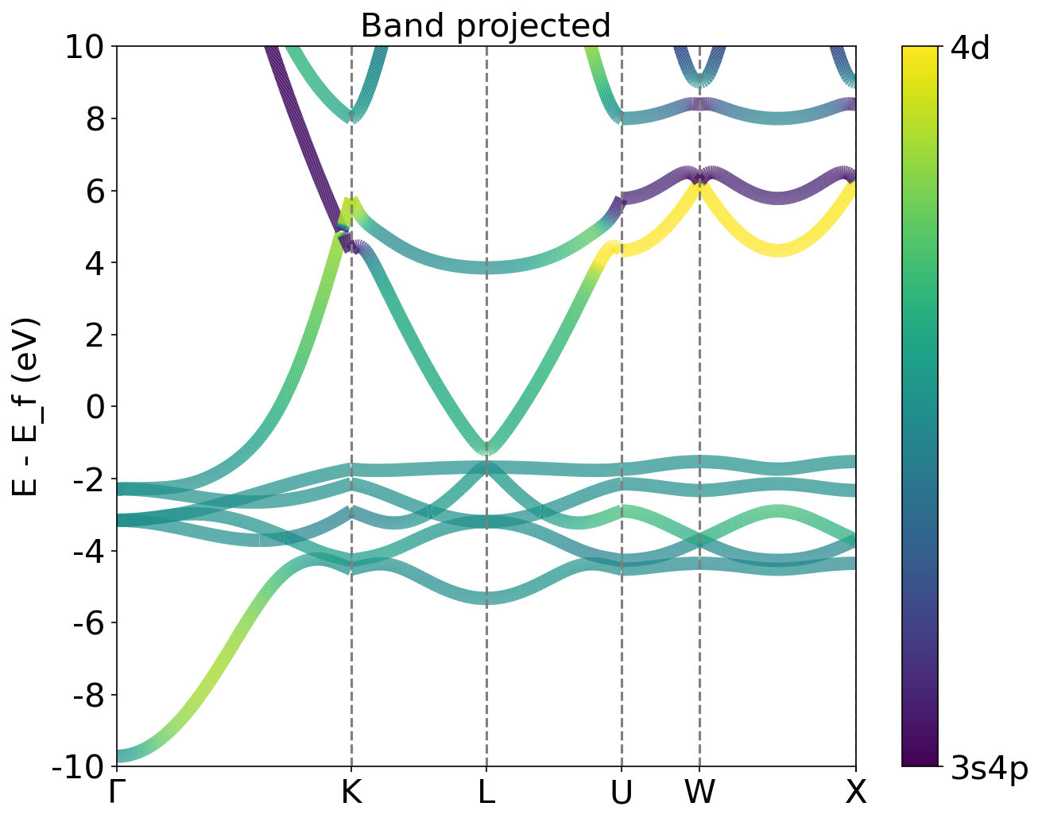
Projected Band Structure Cu between 4d and 4s orbitals
4p
3d4s

Slide 3
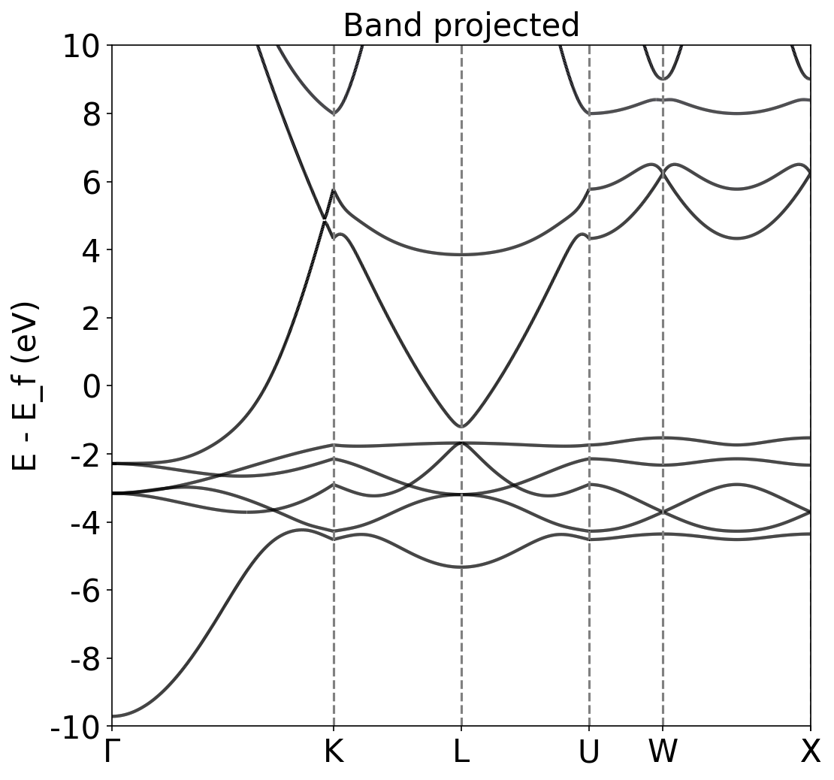
Band Structure Cu

Slide 4
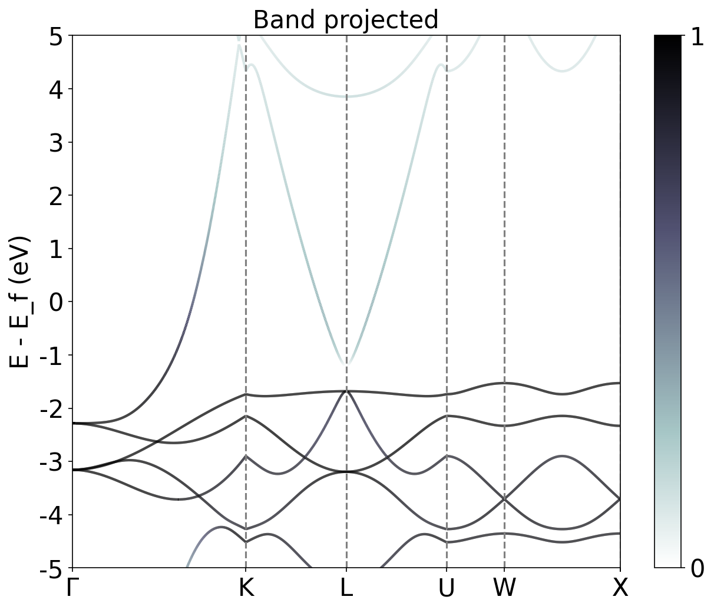
Band Structure Cu projected 3d orbital

Slide 5
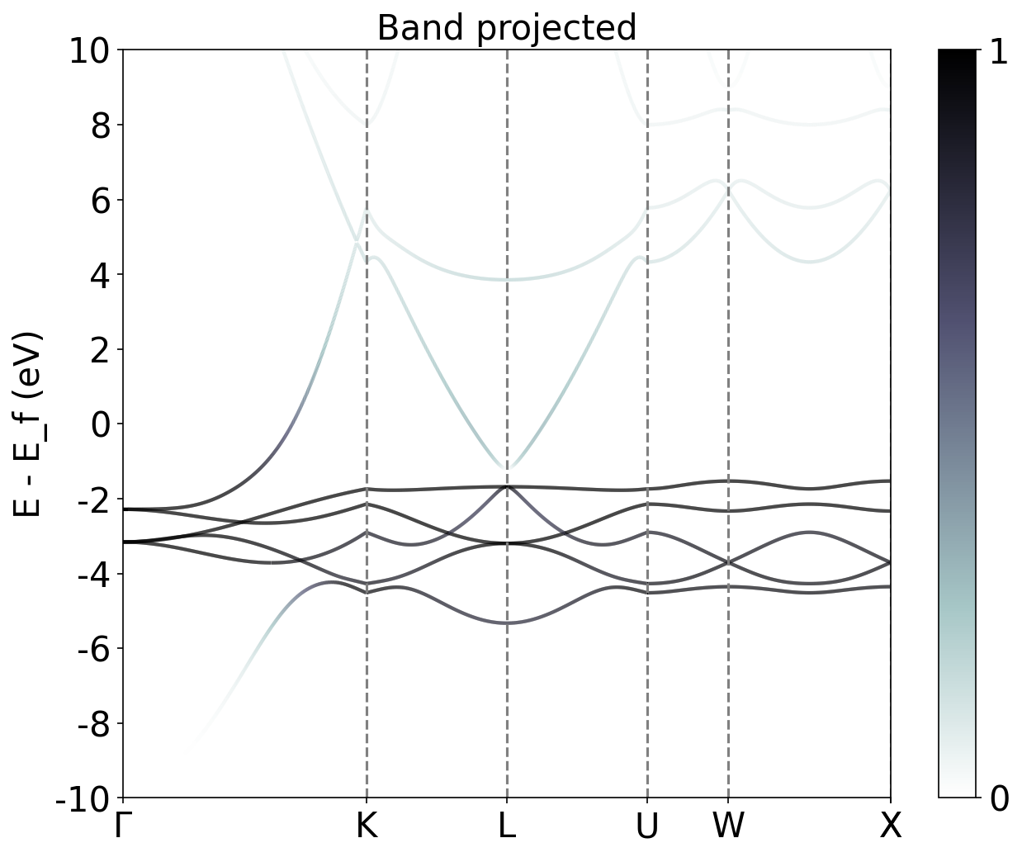
Band Structure Cu projected 3d orbital

Slide 6
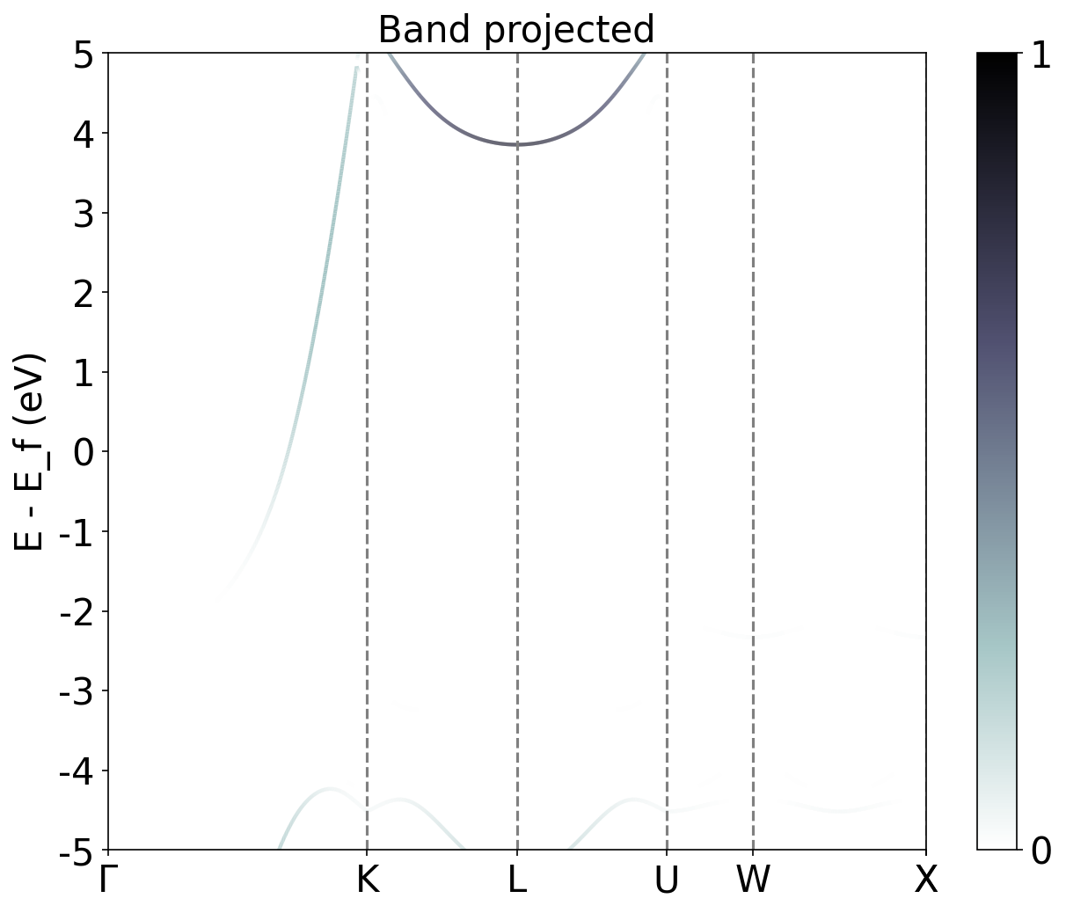
Band Structure Cu projected 4s orbital

Slide 7
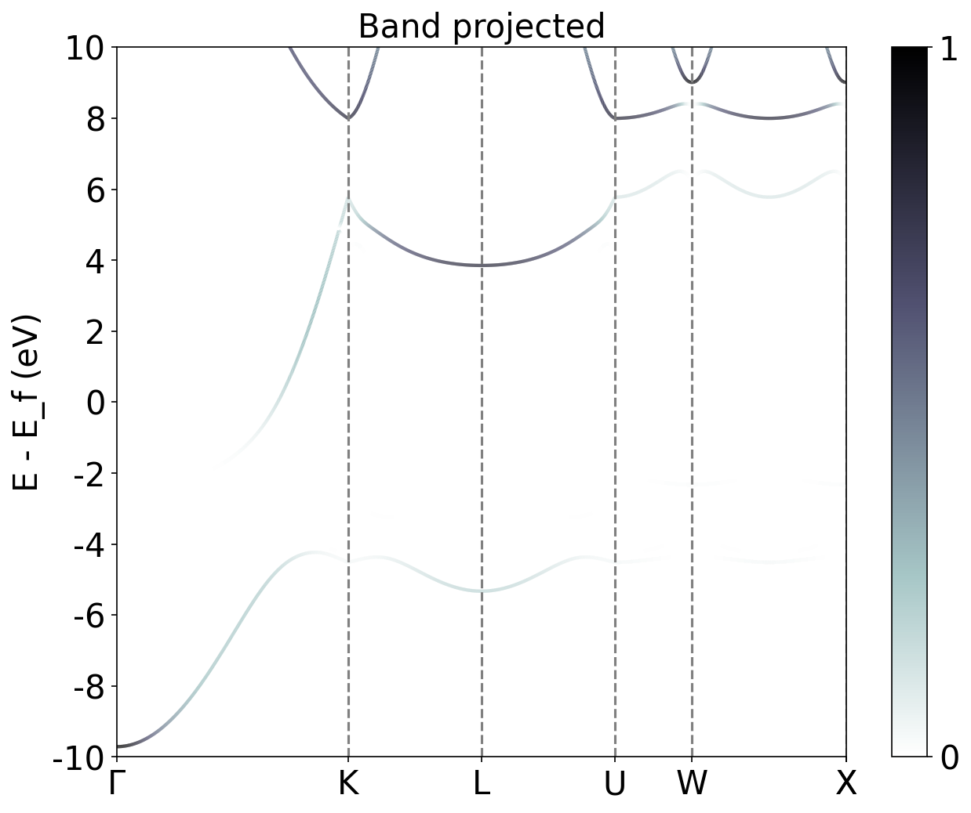
Band Structure Cu projected 4s orbital

Slide 8
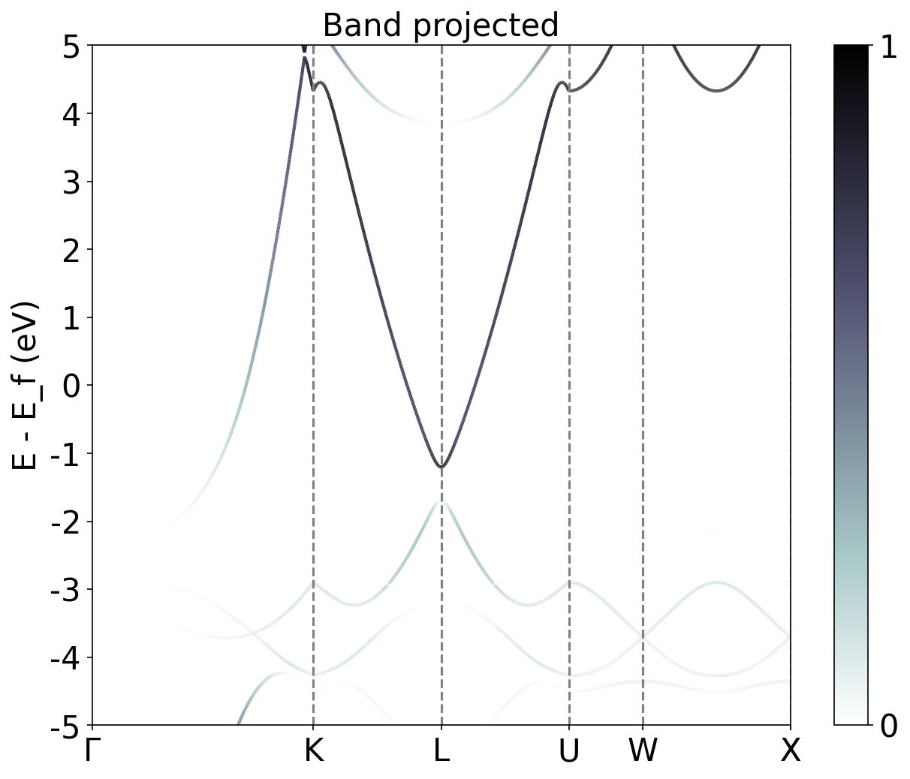
Band Structure Cu projected 4p orbital

Slide 9
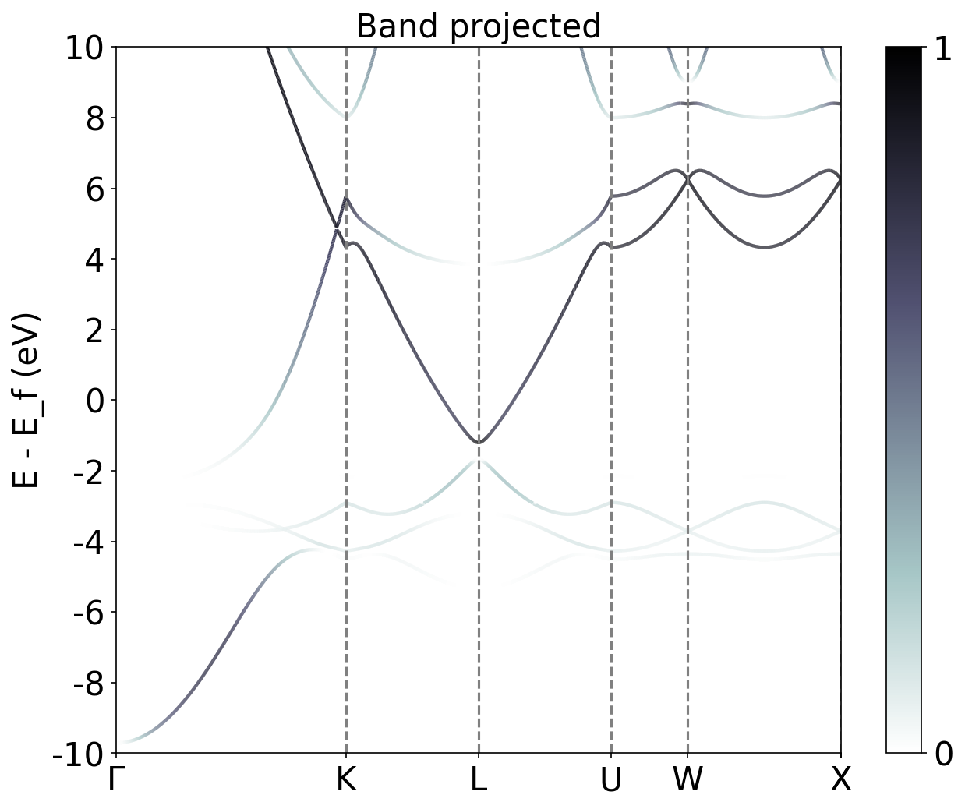
Band Structure Cu projected 4p orbital

