Slide 1
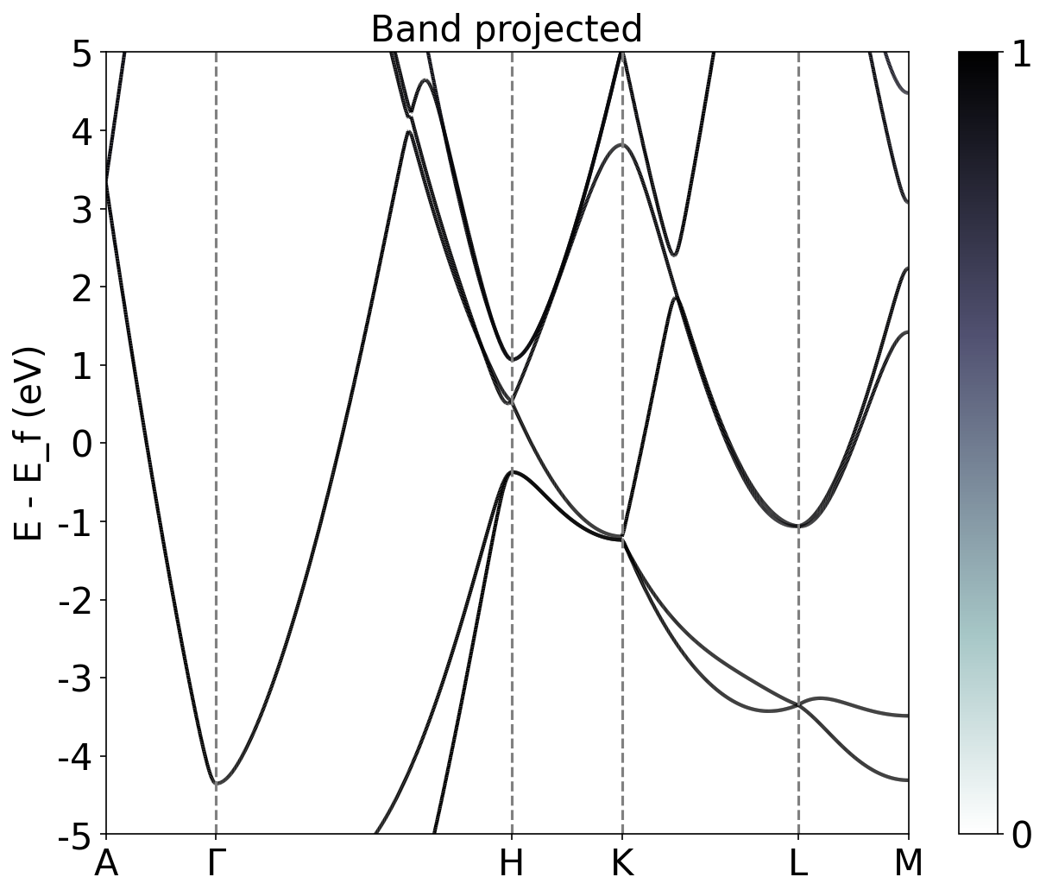
Band Structure Cu
Band Structure Zn

Slide 2
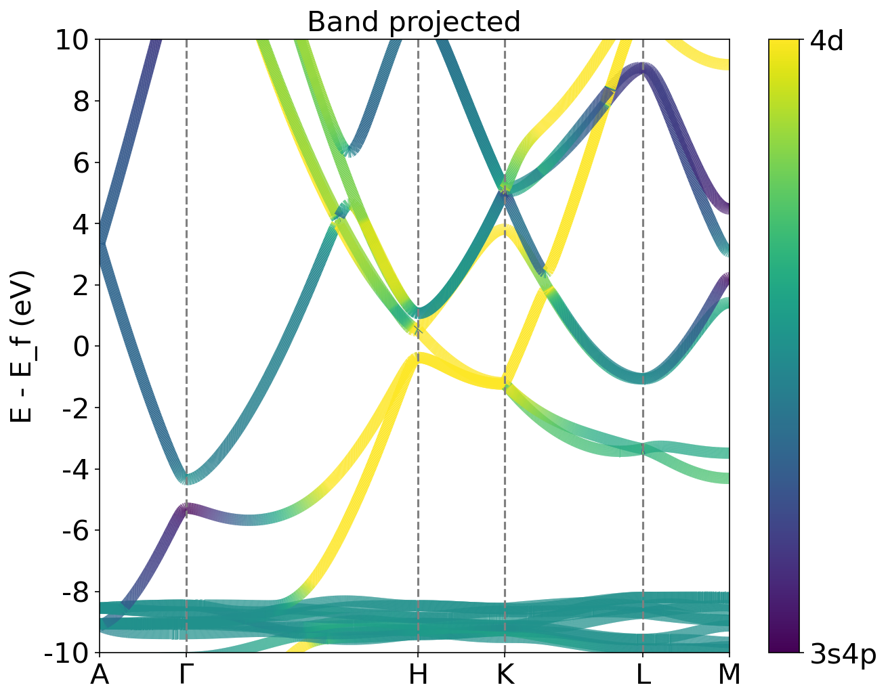
Band Structure Cu
Projected Band Structure Zn between 4d and 4s orbitals
4p
3d4s

Slide 3
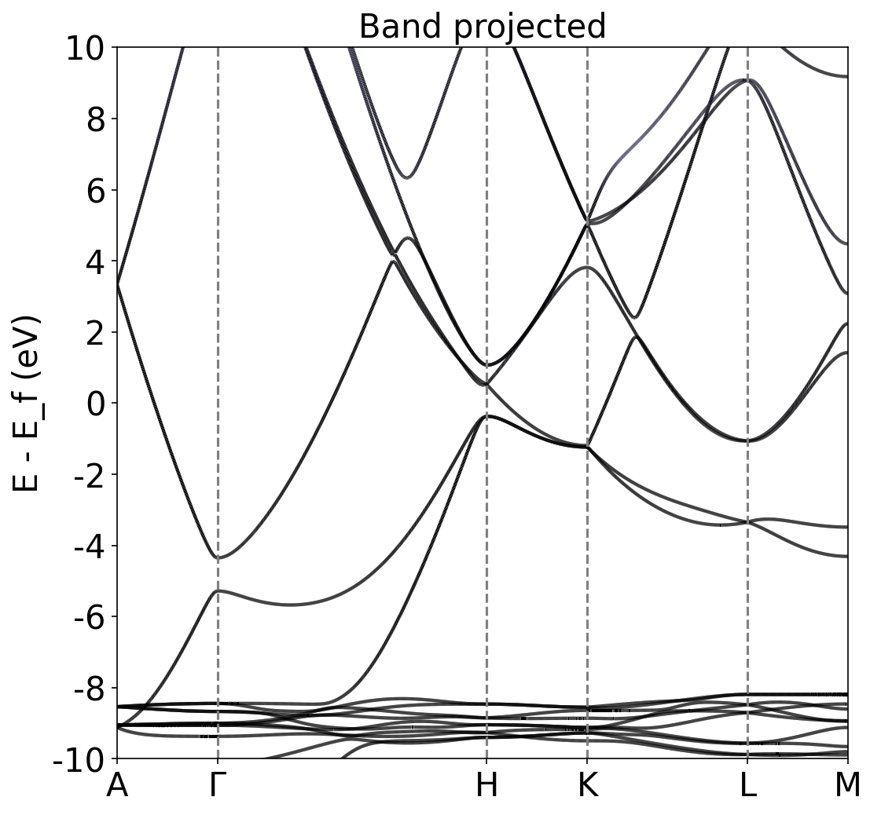
Band Structure Cu
Band Structure Zn

Slide 4
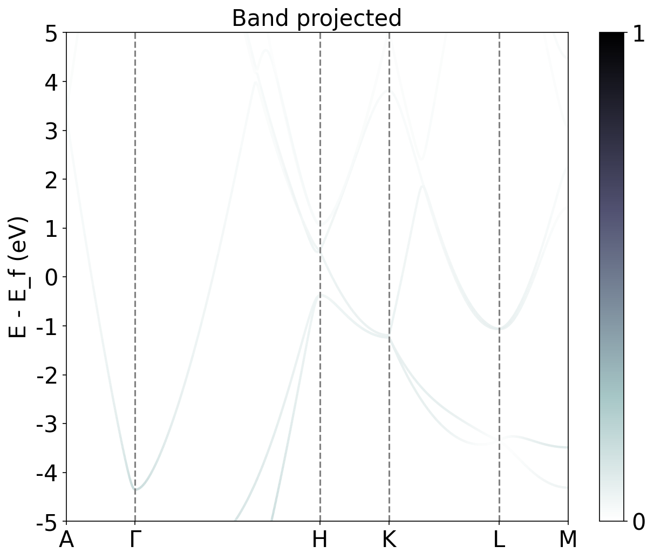
Band Structure Cu
Band Structure Zn projected 3d orbital

Slide 5
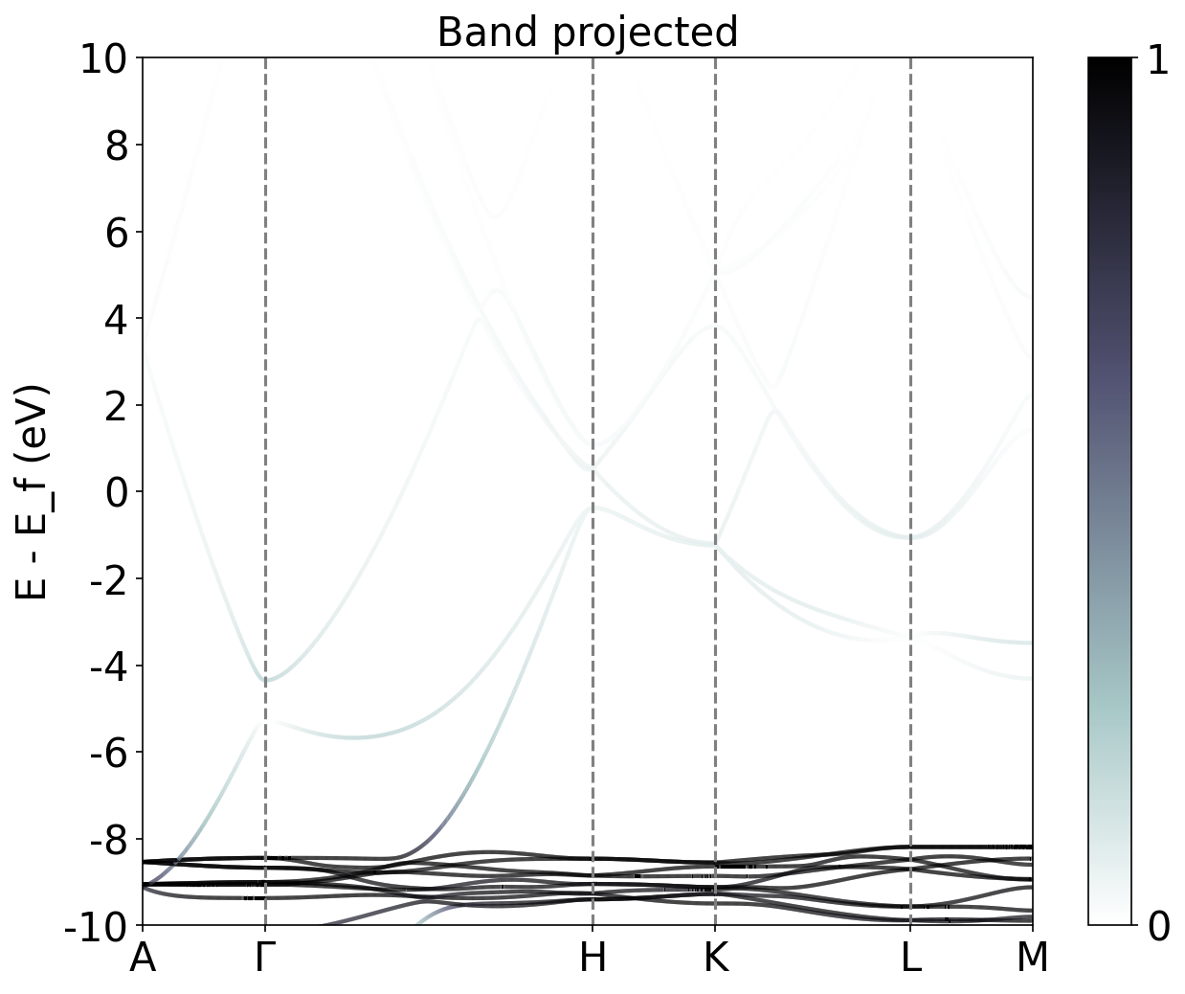
Band Structure Cu
Band Structure Zn projected 3d orbital

Slide 6
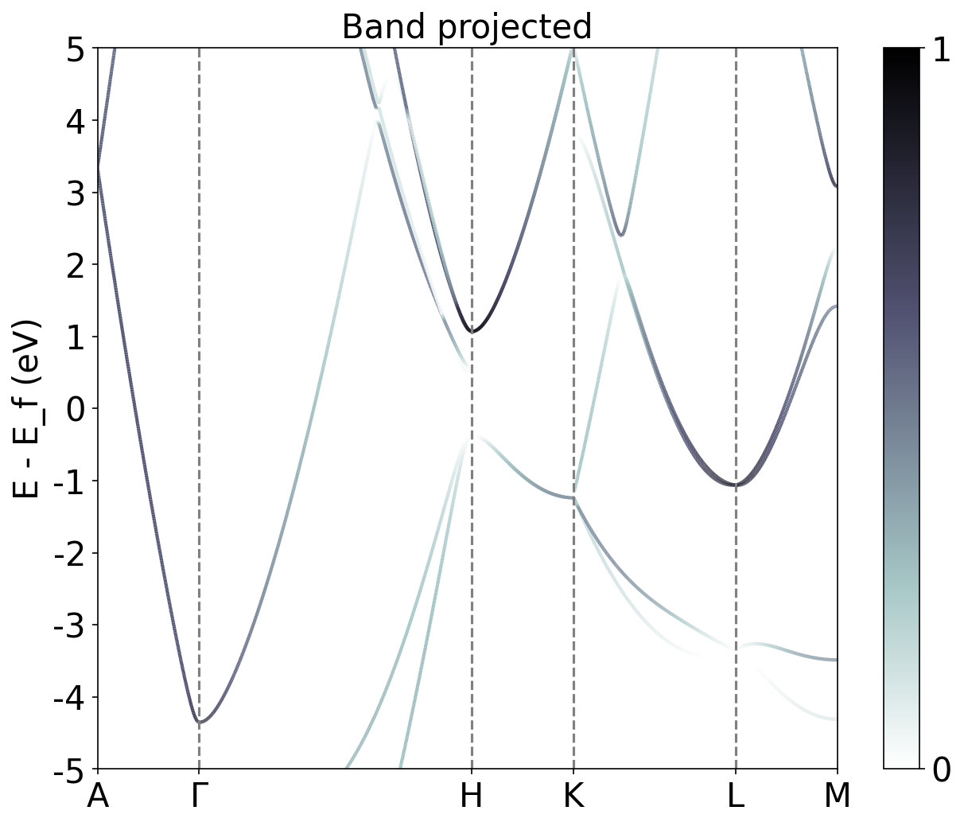
Band Structure Cu
Band Structure Zn projected 4s orbital

Slide 7
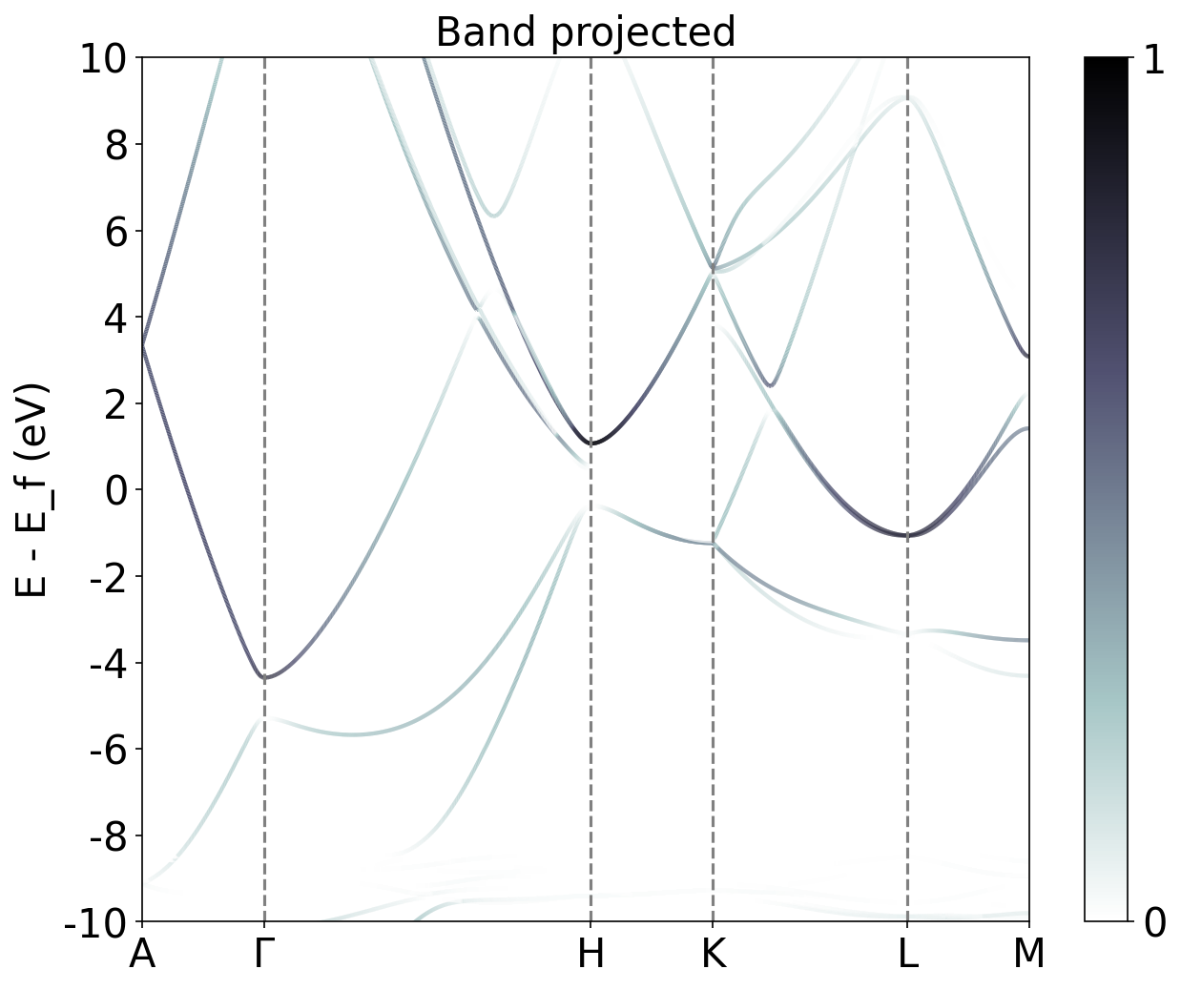
Band Structure Cu
Band Structure Zn projected 4s orbital

Slide 8
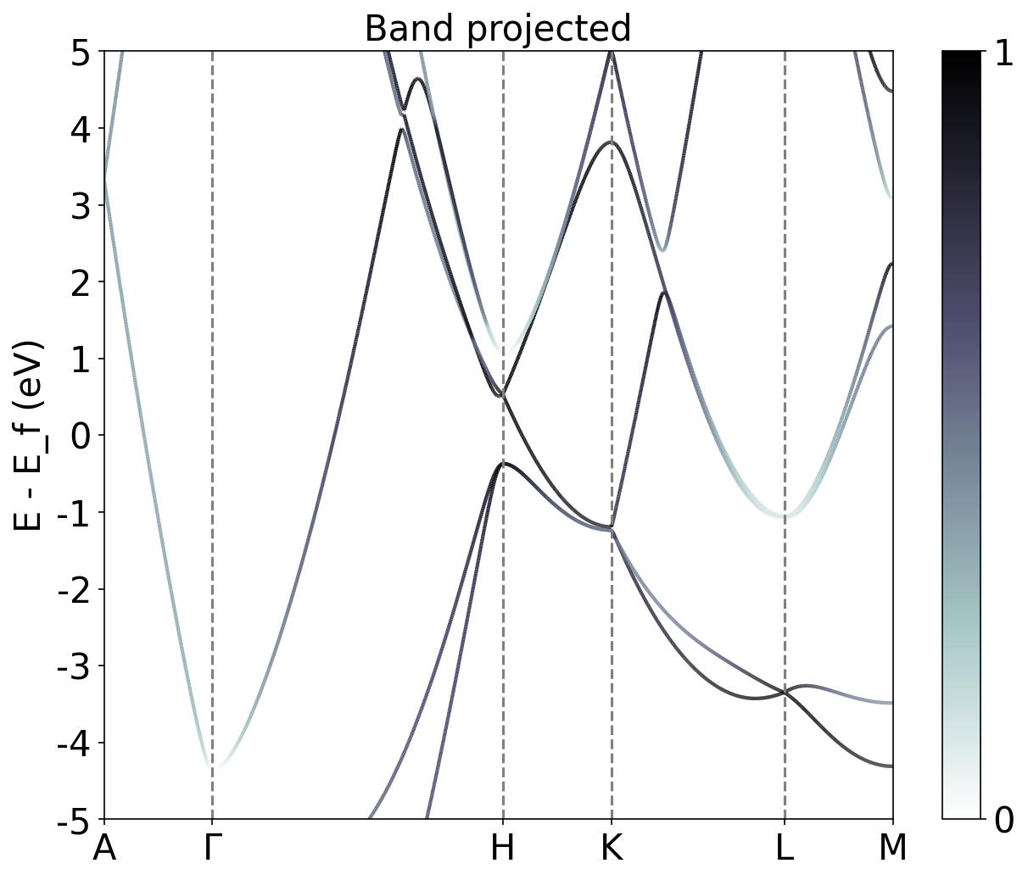
Band Structure Cu
Band Structure Zn projected 4p orbital

Slide 9
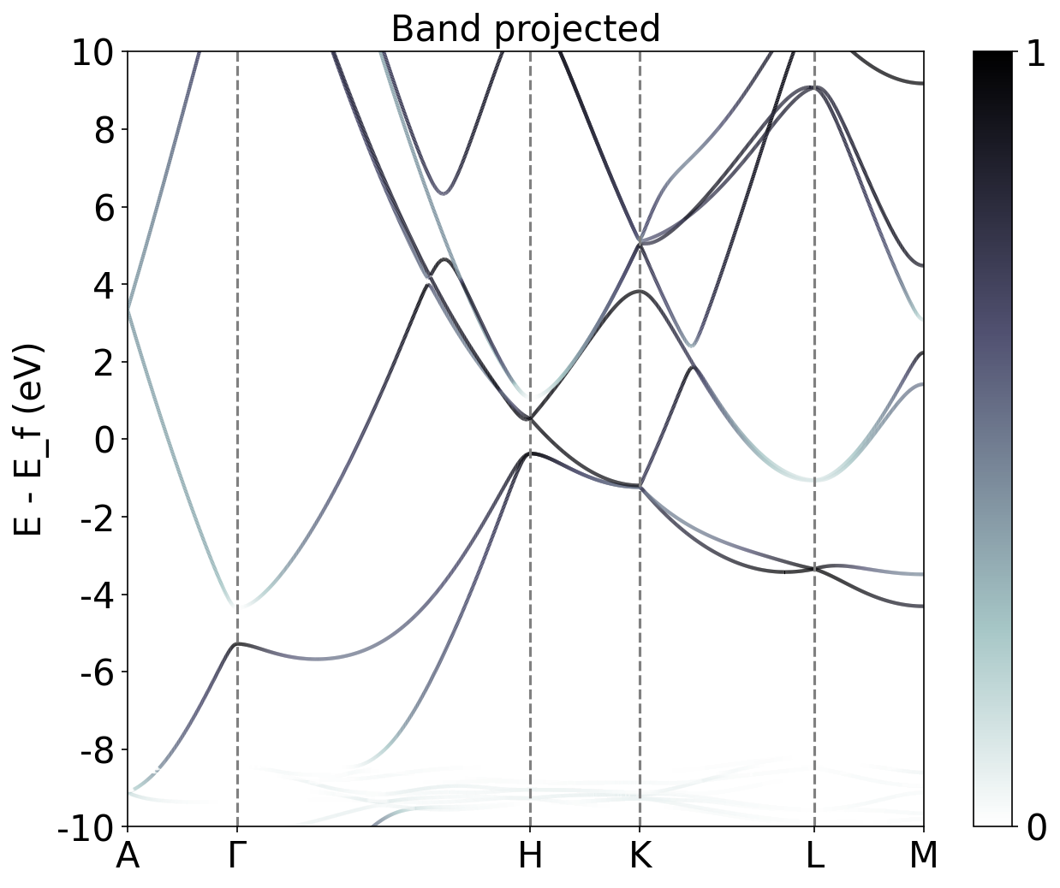
Band Structure Cu
Band Structure Zn projected 4p orbital

