Slide 1
Project Name: PHP Travels

Slide 2
Group Members
1. Akash K
2. Divagar Manivasagan
3. Meesala ManiKanta
4. Mokra Sai varshitha
5. Nallabothula Anvitha
6. Poojasri S
7. Rafiq J
8. Vikas K N

Slide 3
Objective
To create a robust and maintainable automation framework for testing the PHP Travels (https://phptravels.net/) Website,
covering various functionalities and generating comprehensive test reports.

Slide 4
Test Scenarios
1) Navigate to the URL, Create the account.
2) Navigate to the URL, Click on the Flight. Perform end to end operation.
3) Navigate to the URL, Click on the hotel. Perform end to end operation.
4) Navigate to the URL, Click on the Tours. Perform end to end operation.
5) Navigate to the URL, Click on the Cars. Perform end to end operation
6) Navigate to the URL, Click on the blogs. Perform end to end operation
7) Navigate to the URL, Click on the featured Flight. Perform booking process.
8) Navigate to the URL, Click on the Recommended Transfer Cars. Perform booking process.

Slide 5
Need Of Maven Project
Maven is a tool which is used for building and managing Java Based Projects
Providing quality project information
Easy Documentation
Best practices development

Slide 6
Importance of pom.xml
A Project Object Model or POM is the fundamental unit of work in Maven.
It is an XML file that contains information about the project and configuration details used by Maven to build the project

Slide 7
Technologies:
Page Object Model
Selenium WebDriver
TestNG
Data Driven Frame Work (DDF)
Keyword Driven Framework(KDF)
Cucumber
Listeners
Assertions
Logs
Reports

Slide 8
Page Object Model
The Page Object Model (POM) is a design pattern used in test automation to create an abstraction layer between test scripts and the user interface of a web application. In simpler terms
it organizes and structures your automation code in a way that makes it more maintainable and readable.

Slide 9
Advantages of POM
Page Objects
Reusable Code
Improved Readability
Easier Maintenance
Reduces code redundancy and complexity

Slide 10
Selenium WebDriver
Selenium is a suite of tools for automating web browsers, with WebDriver being the core component.
Selenium WebDriver allows you to interact with web elements, simulate user actions (e.g., clicking buttons, filling forms), and navigate web pages.

Slide 11
TestNG
TestNG (Test Next Generation) is a testing framework for Java that is widely used in software development for automated testing of applications.
It is designed to make it easier to write and manage test cases, perform parallel testing, and generate detailed test reports.

Slide 12
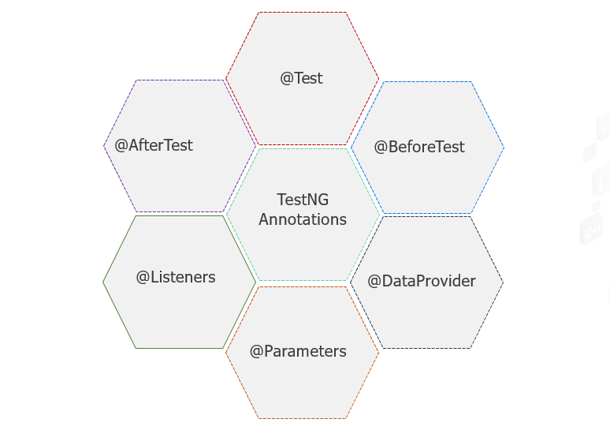
Various Annotations in TestNG

Slide 13
Advantages of TestNG
Annotation are easy to Understand
Easy to Group Test Cases
Parallel Testing is Possible
Supports Parameterized and Dependency Tests

Slide 14
Data Driven Frame Work(DDF)
Data-driven Testing is an automation framework that allows input values to be read from data files and stored into variables in test scripts.
Generates test data automatically.

Slide 15
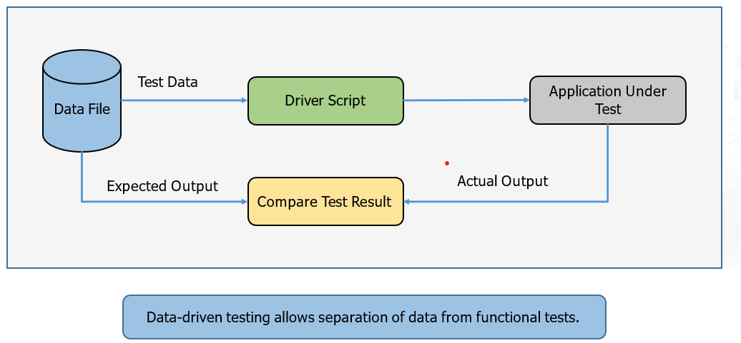
Data Driven Frame Work Workflow

Slide 16
Keyword-Driven-Development(KDD)
It is a type of functional testing framework, uses data files to store the keywords related to the application under test.
It is also called as table-driven testing or action word-based testing

Slide 17
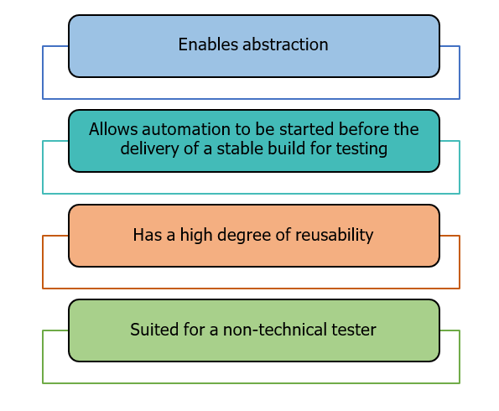
Advantages of KDD

Slide 18
Cucumber
Cucumber is a testing framework that allows developers and testers to write executable specifications for software in a natural language format that can be easily understood by non-technical stakeholders, such as business analysts and product owners.

Slide 19
Gherkin Language
Gherkin is a domain-specific language used in Cucumber for writing feature files in a human-readable format.
Gherkin uses a set of keywords to structure and describe the behavior of software features. These keywords help define the scenarios and steps that are part of a feature

Slide 20
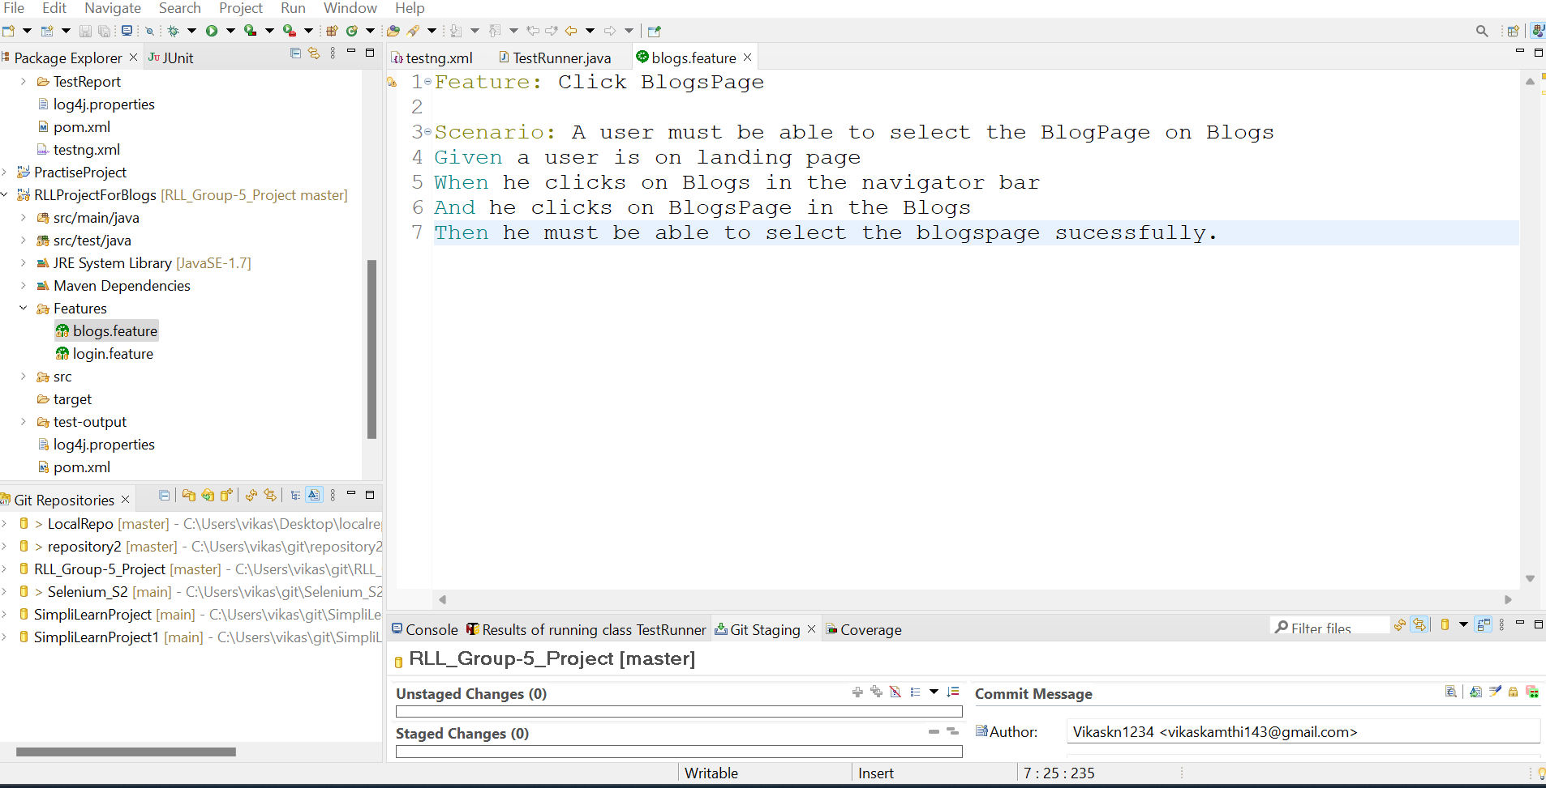
Gherkin Key Words

Slide 21
Test Runner Class
With a cucumber-based framework, we cannot run a feature file on its own. We need to create a java class, which in turn will run this cucumber feature file. We call this class as cucumber test runner class
With a test runner class, we have the option to run either a single feature file, or multiple feature files as well.

Slide 22
Imported Statements
@CucumberOptions: It will give some important information to run the file in cucumber with the help of parameters
AbstractTestNGCucumberTests: It will give some important information to run the file in cucumber with the help of parameters

Slide 23
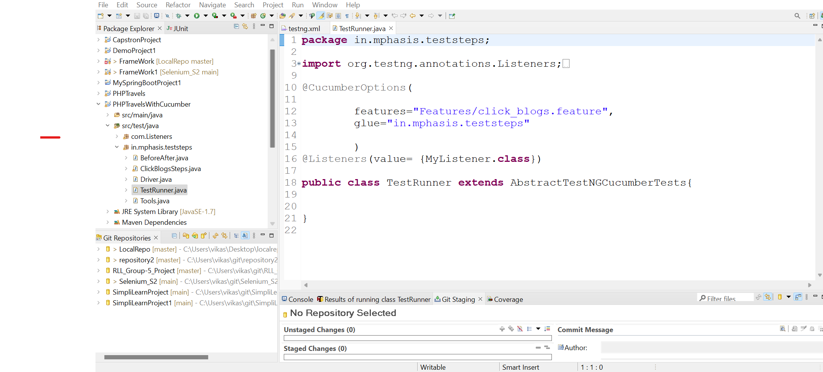
Test Runner Class

Slide 24
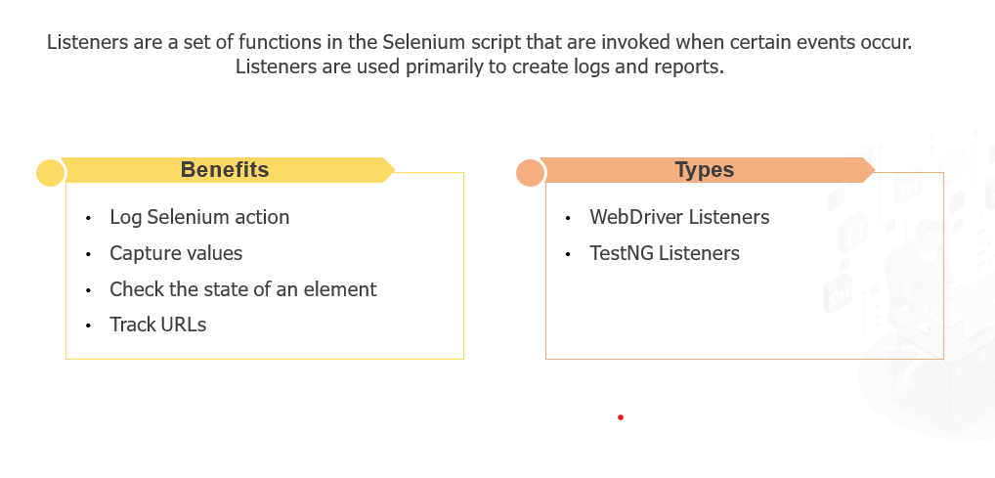
Listeners

Slide 25
Assertions
Assertions are statements in software testing that verify the expected behavior of the code being tested.
It is essential for validating the code.

Slide 26
Assertion Types
There are two types of Assertion:-
Hard Assertions:
Throws an exception immediately
Soft assertions:
Do not throws an exception immediately

Slide 27
Hard Assertions types
Assert.assertEquals(actual, expected);
Assert.assertEquals(actual, expected);
, expected);
assert Equals: Checks if two values are equal.
Syntax: Assert.assertEquals(actual, expected);
assertNotEquals: Checks if two values are not equal.
Syntax: Assert.assertNotEquals(actual, expected, message):
assertTrue: Checks if a given condition is true.
Syntax: Assert.assertTrue(condition);

Slide 28
Hard Assertions
assertFalse: Checks if a given condition is false.
Syntax: Assert.assertFalse(condition);
assertNull: Checks if a value is null.
Syntax: Assert.assertNull(object);
assertNotNull: Checks if a value is not null.
Syntax: Assert.assertNotNull(object);

Slide 29
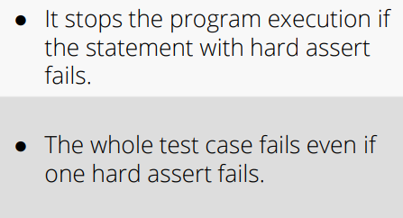
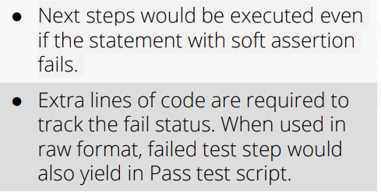
Difference between hard and soft Assertion
Hard Assertion
Soft Assertion

Slide 30
Advantages Of Assertions
Automated Verification
Clear Test Intent
Documentation and Debugging
Immediate Failure Reporting

Slide 31
Logs
Captures detailed information for debugging and monitoring of our Test scripts
Syntax :
Logger logger = Logger.getLogger("SignUp");
PropertyConfigurator.configure("log4j.properties");
logger.setLevel(Level.DEBUG);

Slide 32
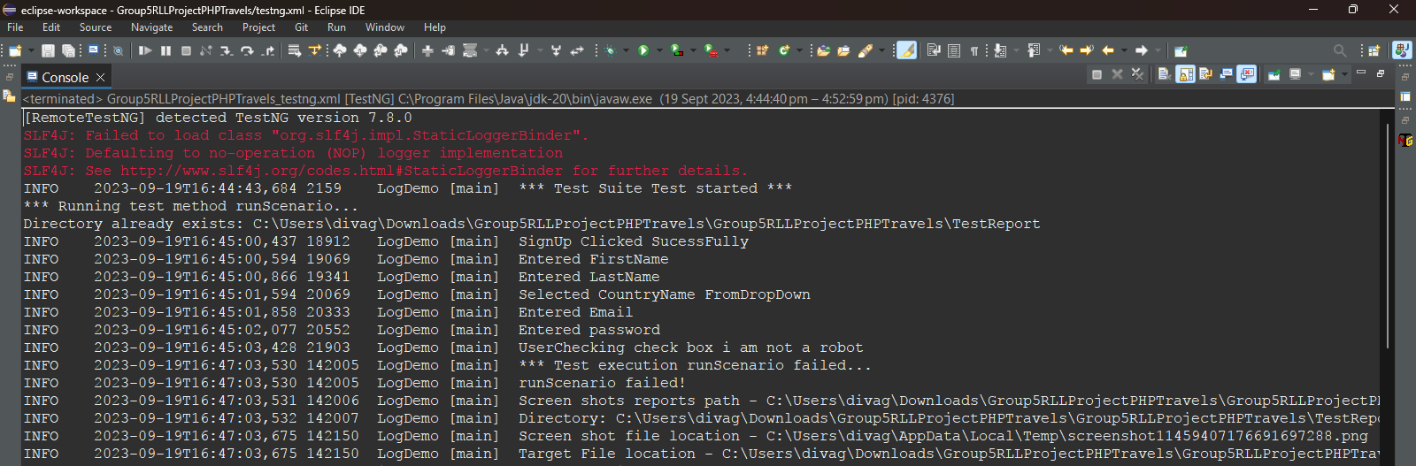
Logs Output

Slide 33
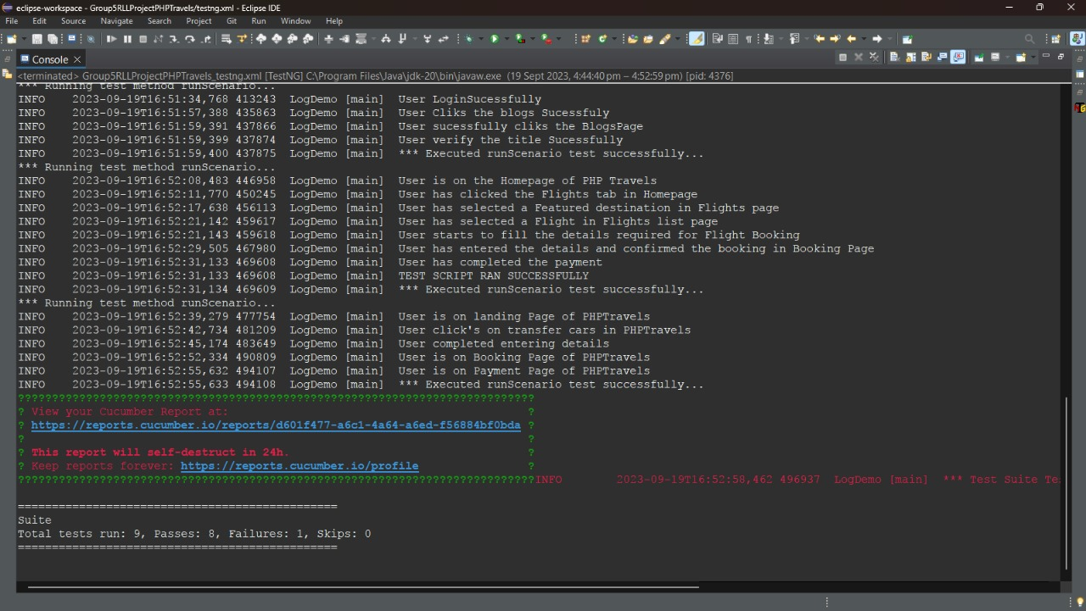
Logs Output

Slide 34
TestNG Report
A TestNG report is a document that provides information about the execution of TestNG test cases.
It includes details such as the number of test cases passed, failed, and skipped, as well as the execution time and any errors that occurred.
TestNG reports can be generated in a variety of formats, including HTML, XML, and JUnit.

Slide 35
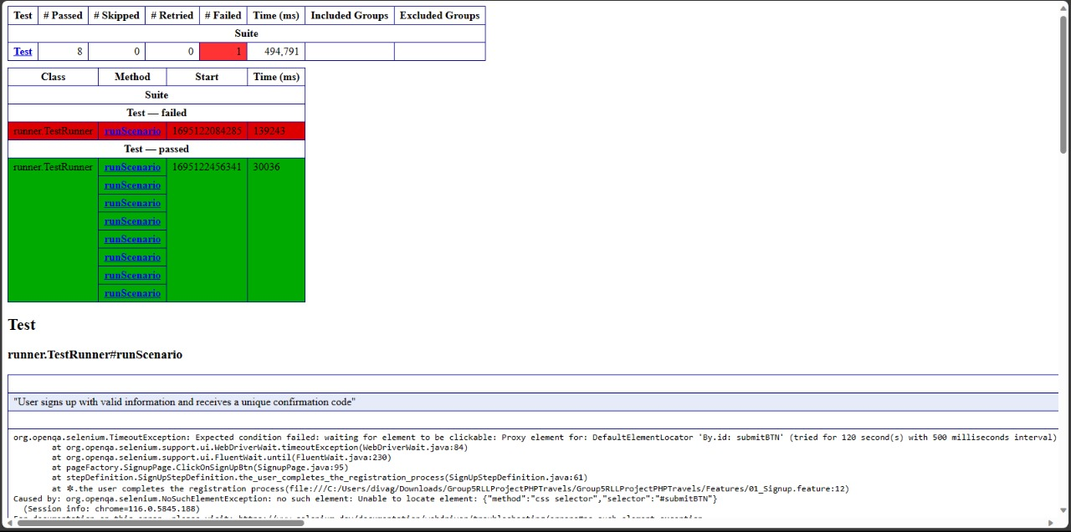
TestNG Report

Slide 36
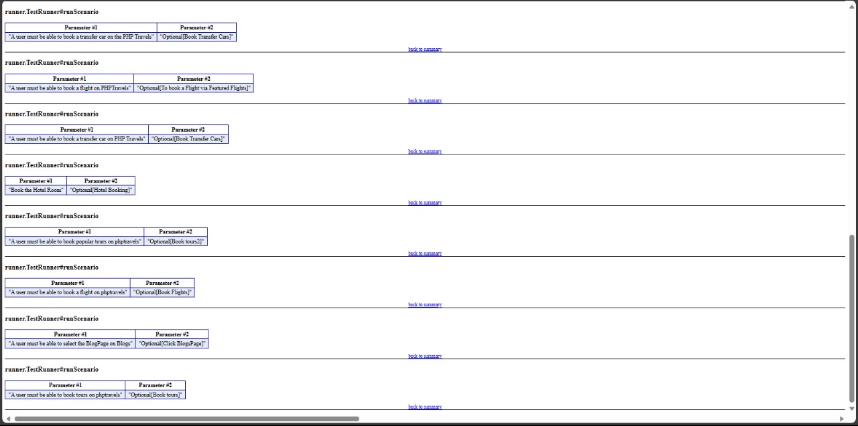
TestNG Report

Slide 37
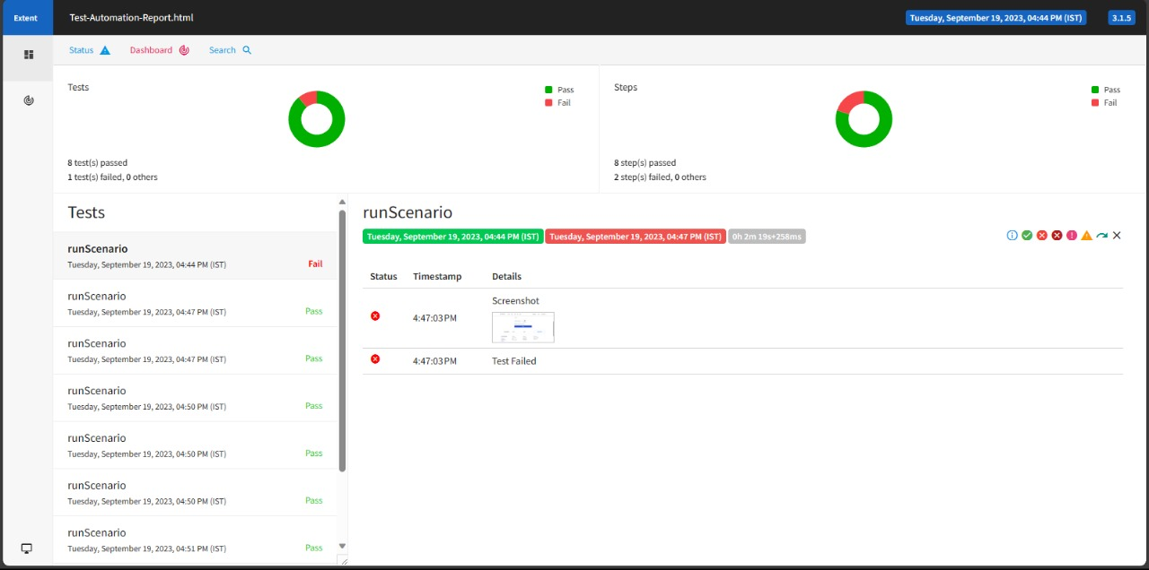
Extent Report

Slide 38
Cucumber Report
A Cucumber report is a document that provides information about the execution of Cucumber Scenarios.
It includes details such as the number of scenarios passed, failed, and skipped, as well as the execution time and any errors that occurred.
Cucumber reports can be generated in a variety of formats, including HTML, XML, and Json.

Slide 39
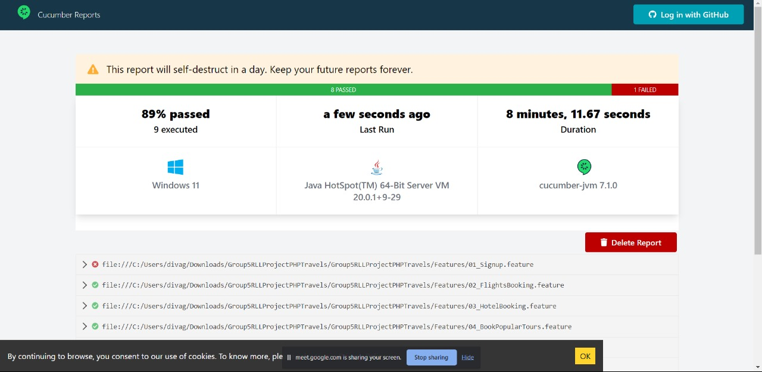
Cucumber Report

Slide 40
Thank You

