Slide 1
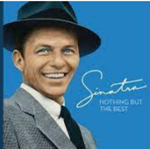
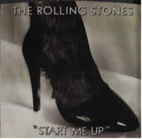
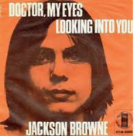


Playlist
 | Body and Soul | Frank Sinatra
 | Start Me Up | The Rolling Stones
 | Doctor My Eyes | Jackson Browne
-
⬆️
⬇️
-
⬆️
⬇️
-
⬆️
⬇️
Enter Song Title:
Submit
Songs matching: Body And Soul
 | Body And Soul | Frank Sinatra
 | Body And Soul | Amy Winehouse
… | … | …
 | Body And Soul | Billie Holiday
+
+
+

