Slide 1
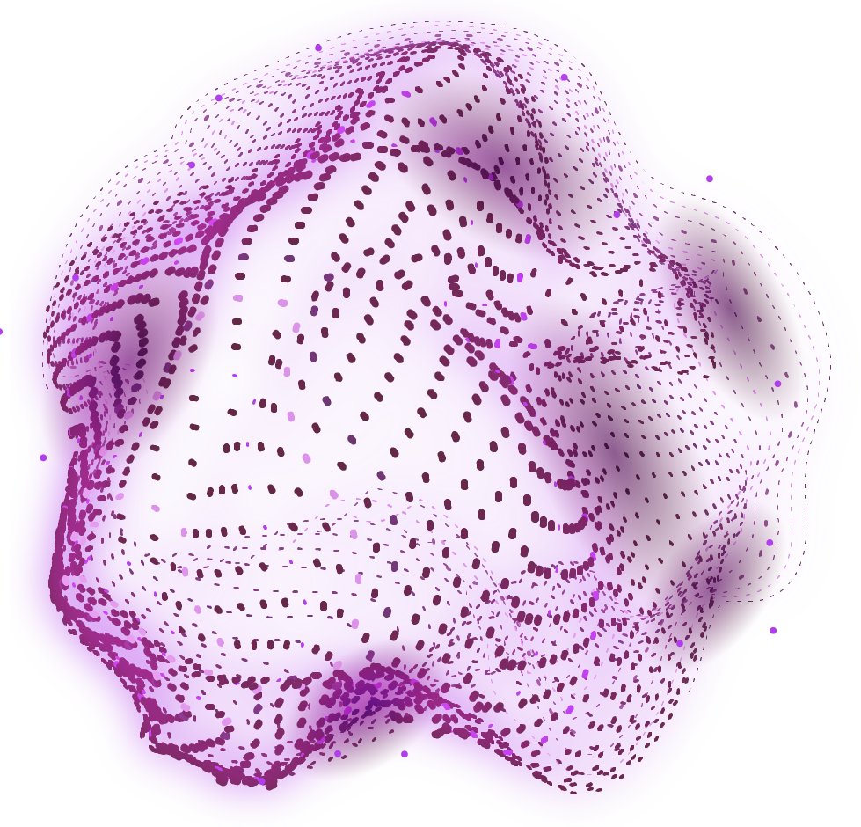
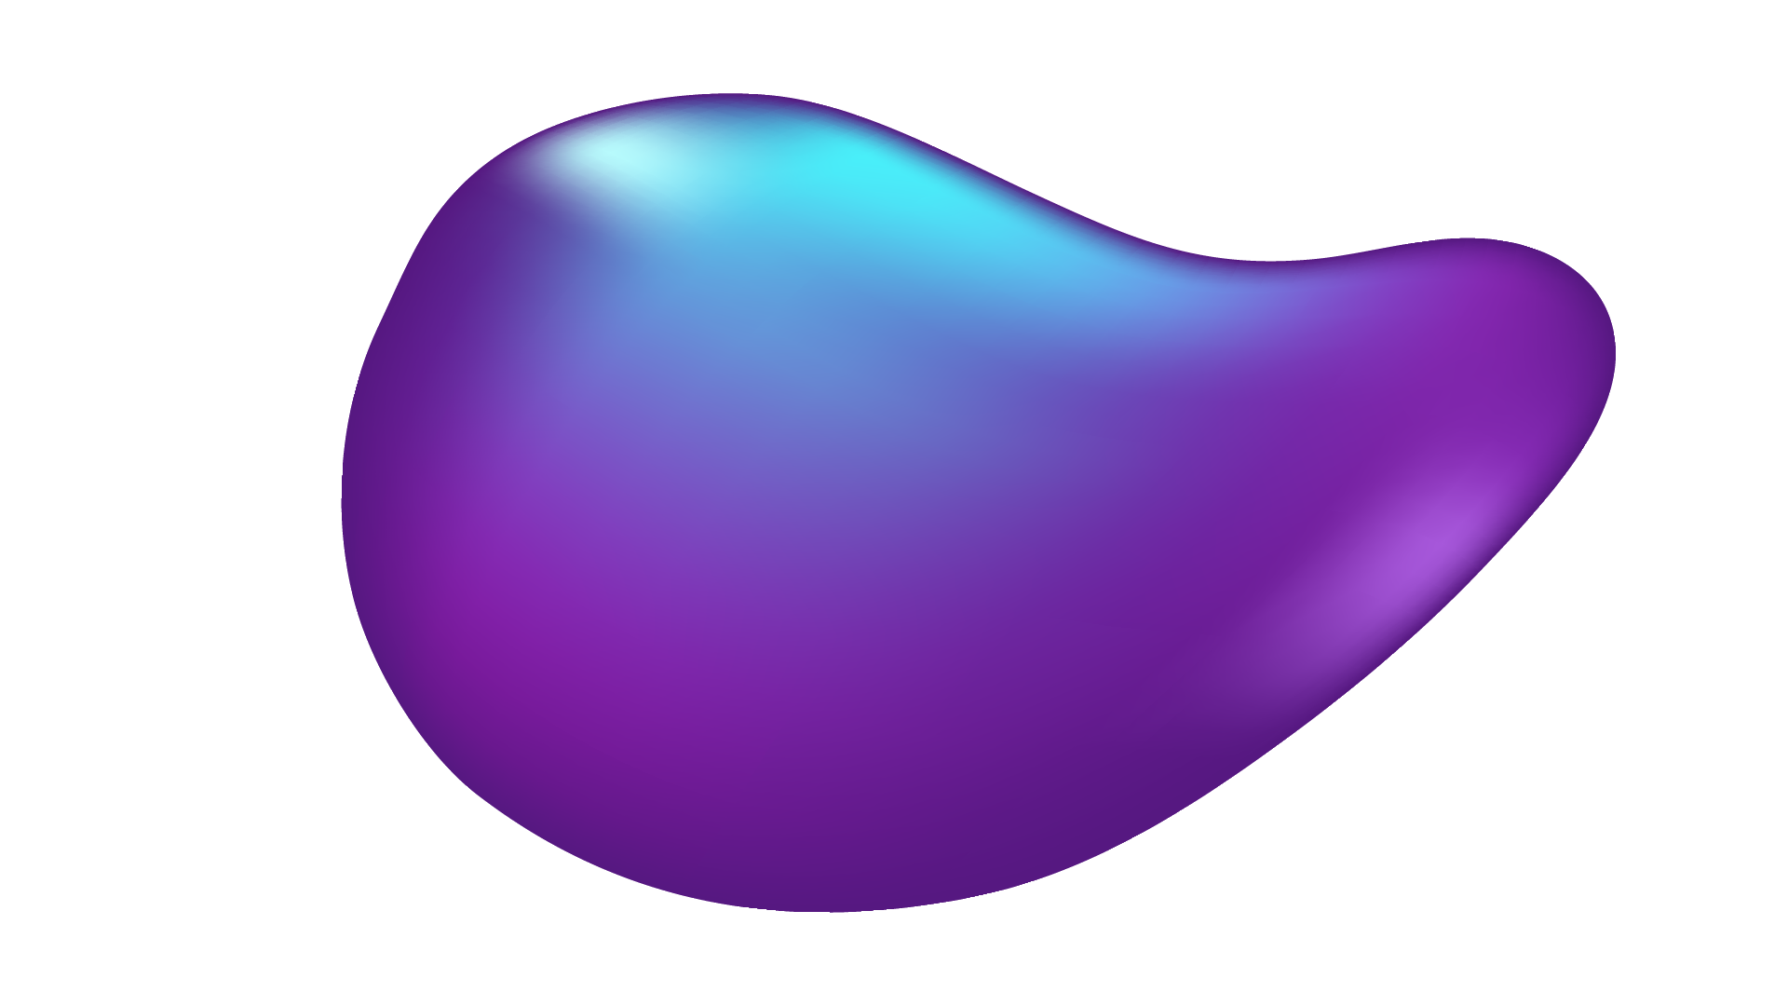
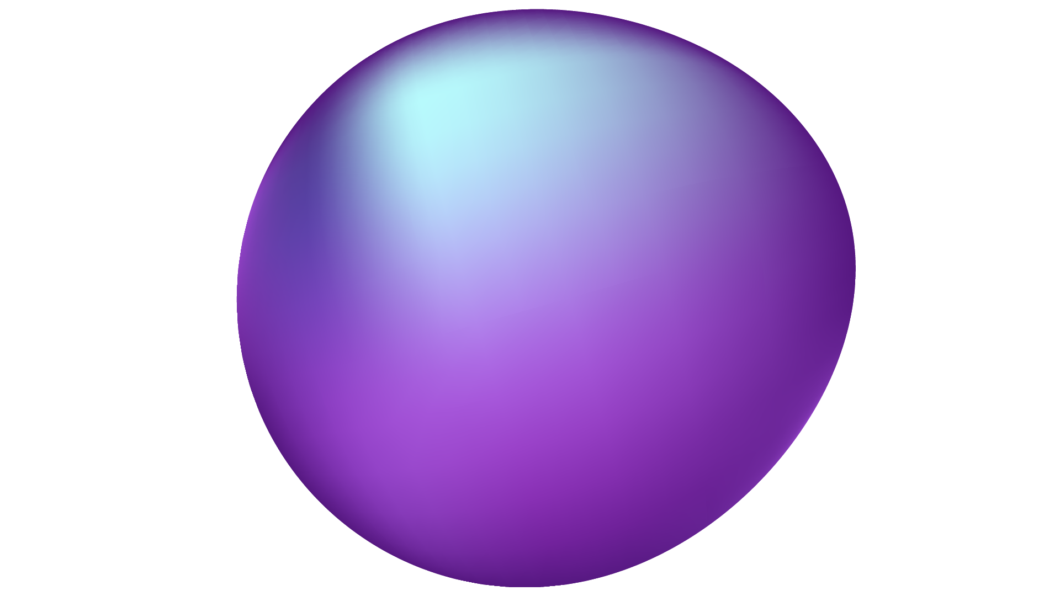
Play to Learn: Tic-Tac-Toe Using Reinforcement Learning
Group Members:
Name: Ruhsafa Haque Id:1912488642
Name: Rafiqul islam Id:1821991042
Name: Rifat Ibna Azad Id:1812298042

Slide 2
Introduction
Tic-Tac-Toe is a classic two-player game where the goal is to align three marks in a row on a 3x3 grid. Instead of using traditional rule-based programming, we implemented machine learning (ML) to create an AI that learns to play strategically using Q-Learning, a type of reinforcement learning. The AI trains by playing thousands of games, improving its decision-making based on rewards and penalties. Our goal is to develop a console-based Tic-Tac-Toe game where users can compete against a trained AI that becomes smarter over time.

Slide 3
Background Study
Tic-Tac-Toe is a well-known strategy game with a finite number of possible moves, making it an ideal testbed for AI learning.
Traditional AI approaches use Minimax algorithms, which exhaustively search all possible game states.
Instead of predefined rules, machine learning (ML) allows AI to learn optimal strategies through experience.
Reinforcement Learning (RL) enables an AI agent to learn by interacting with an environment and receiving rewards for good moves and penalties for bad ones.
Q-Learning is a model-free RL algorithm where the AI stores and updates Q-values (expected future rewards) for different moves.
Reinforcement learning is used in robotics, autonomous driving, gaming AI (e.g., AlphaGo), and financial modeling.
Teaching AI to play games like Tic-Tac-Toe provides a foundation for developing more advanced AI systems.

Slide 4
Motivation
This project provides a hands-on experience in Reinforcement Learning (RL) and Q-Learning, key concepts in artificial intelligence.
Understanding how AI can learn and improve without predefined rules is an exciting challenge.
Unlike rule-based AI, a Q-learning agent learns from experience, making it more dynamic and unpredictable.
Reinforcement learning is used in robotics, gaming AI (AlphaGo, Chess AI), finance, and self-driving cars.
Learning these techniques now opens the door to more advanced AI projects in the future.
Seeing an AI improve and eventually become unbeatable is a rewarding experience.
Many ML concepts are learned theoretically, but this project applies them in a real-world scenario.

Slide 5
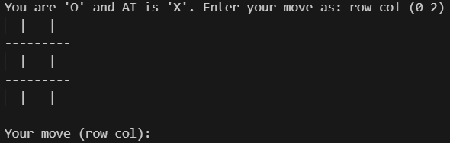
Working Progress
Game Environment Setup:
Created a 3x3 Tic-Tac-Toe board using Python, handling move validation, win conditions, and draw detection.

Slide 6
Working Progress
Implementation of Q-Learning Algorithm : Developed the Q-learning agent that learns optimal strategies through self-play by updating a Q-table based on rewards after each action.
Training the AI: Trained the AI agent over thousands of game episodes, allowing it to gradually improve its decision-making ability.
Human Interaction Integration: Developed a console-based interface enabling human players to compete interactively against the AI.
Game Logic Enhancements: Implemented win/loss/draw outcome detection and added user-friendly print statements to display the status of the game after each move.

Slide 7
Future Improvement
Graphical User Interface (GUI):Implement a more interactive and user-friendly GUI using frameworks like Tkinter or Pygame to replace the current console-based interface.
Deep Q-Learning (DQN): Enhance the Q-learning model by integrating Deep Q-Networks (DQN) to improve AI performance, decision-making efficiency, and generalization to unseen game states.
AI Performance Visualization: Display AI performance metrics in the console, such as win/loss/draw statistics, to provide real-time feedback on the AI's learning progress.
Adaptive Difficulty Levels: Introduce dynamic difficulty adjustments by altering the exploration rate or other learning parameters, allowing the AI to adjust its strategy based on the player's skill level.
Multiplayer Mode: Implement multiplayer support, either for online play or local network play, to enable human vs. human or human vs. AI games.
Move Analytics and Heatmaps: Introduce features to visualize the AI's decision-making process, such as move heatmaps or Q-value visualizations, to better understand the strategies the AI develops over time.

Slide 8
Conclusion
The Q-Tac-Toe project successfully applies Q-Learning to create an AI agent for Tic-Tac-Toe, allowing human players to interact with it. While currently console-based, it offers a foundation for reinforcement learning. Future improvements, such as a graphical interface, deep Q-learning, real-time learning, and multiplayer support, will enhance both functionality and user experience.

Slide 9
Thank You

