Slide 1

APPLICATION THREAT MODELLING FOR an online learning PLATFORM
Raftopoulos Marios
MPKED24034
University of Piraeus
05/03/2025

Slide 2
Contents
1. Intro and Methodology
2.Application Analysis - DFDs
3. STRIDE - Threat Identification
4. DREAD – Threat Ranking
5. OWASP ASVS – Mitigations
6. Conclusion and Next Steps

Slide 3
Threat Modeling Methodology
• Decompose the Application
• STRIDE Threat Categorization
• DREAD Risk Assessment
• OWASP ASVS Security Controls

Slide 4
APPLICATION OVERVIEW
Key Elements:
Users: Student, Teacher
Web Client: the platform between users and server
Web Server: Business logic, authentication, authorization, …
Database: Stores User’s Data (username/password, grades, …)
File Storage: Stores lectures, assignments, …
Security Boundaries: 1) Between the public internet and the web client/ web server, 2) Between the web server and the database / file system

Slide 5
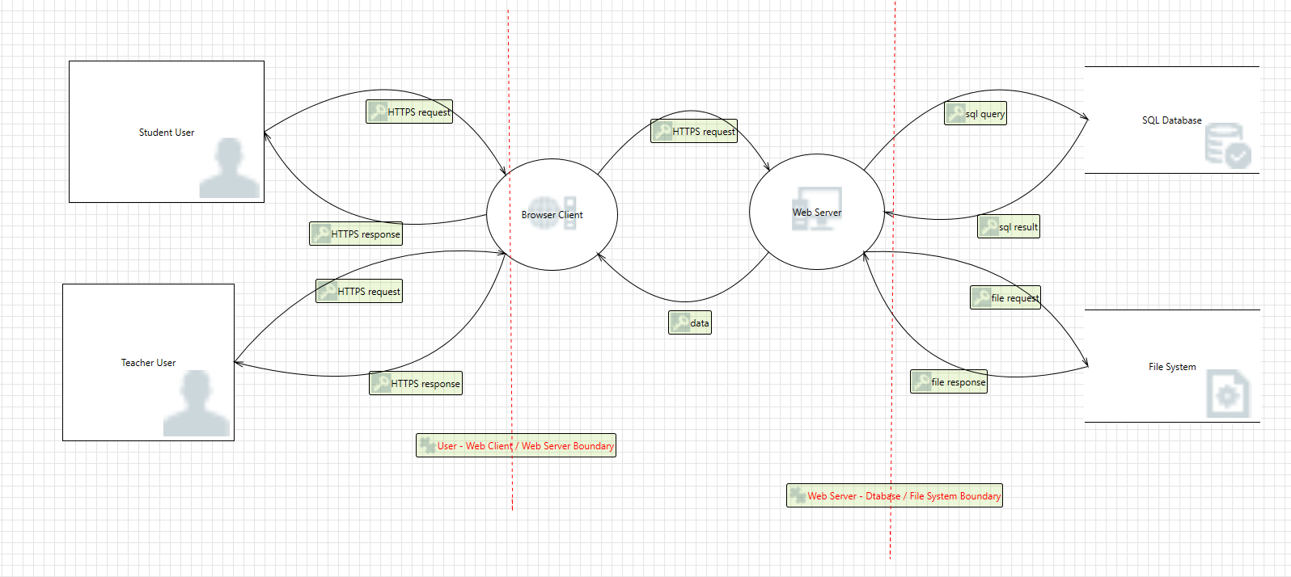
High-Level DATA FLOW DIAGRAM

Slide 6
STRIDE Threat Categorization
• Spoofing: Authentication Threats
• Tampering: Integrity Threats
• Repudiation: Non-Repudiation Threats
• Information Disclosure: Confidentiality Threats
• Denial of Service: Availability Threats
• Elevation of Privilege: Authorization Threats

Slide 7
DREAD Risk Scoring
• Damage Potential (D): Impact on data & operations
• Reproducibility (R): How easy the attack can be repeated
• Exploitability (E): Difficulty of executing the attack
• Affected Users (A): Number of users impacted
• Discoverability (D’): Likelihood of discovering the vulnerability

Slide 8
THREAT EXAMPLES
Spoofing: Teacher User Spoofing
Tampering: SQL injection
Repudiation: Insufficient Logging
Information Disclosure: Unauthorized File Access
Denial of Service: Large File Upload
Elevation of Privilege: Teacher User Escalation

Slide 9
Threat DREAD Scoring
• Teacher Spoofing: Critical (41.5 DREAD Score)
• SQL Injection: Critical (40.5 DREAD Score)
• Insufficient Logging: High (34 DREAD Score)
• Unauthorized File Access: High (35.5 DREAD Score)
• Large File Upload : Critical (40.5 DREAD Score)
• Teacher Escalation: High (38.5 DREAD Score)
Damage + Reproducibility + Exploitability + Affected Users + Discoverability = DREAD Score
Scale: 0-10 for each category
DREAD Score Scales:
Low= 0-10, Medium=11-24, High=25-39, Critical=40-50

Slide 10

OWASP ASVS Security CATEGORIE Mapping
• V2 Authentication - Secure password policies, brute force protection
• V3: Session Management - Secure session handling, secure tokens
• V4: Access Control – RBAC, least privilege
• V5: Input Validation - Preventing SQL Injection, prepared statements,
• V7: Logging & Monitoring - Audit logging, anomaly detection
• V11: Business Logic – Business logic security – rate limits
• V12: File Uploading –maximum file size, file integrity

Slide 11
THREAT MAPPING
Threat | STRIDE | Damage | Reproducability | Exploitability | Affected Users | Discoverability | DREAD SCORE | RISK | ASVS Categories
Teacher User Spoofing | Spoofing | 9 | 7.5 | 5 | 10 | 10 | 41.5 | Critical | V2 (Authentication ), V3 (Session Management)
SQL Injection | Tampering | 10 | 7.5 | 5 | 10 | 8 | 40.5 | Critical | V5(Validation, Sanitization and Encoding)
Insufficient Logging | Repudiation | 10 | 5 | 5 | 6 | 8 | 34 | High | V7 (Error Handling & Logging)
Unauthorized File Access | Information Disclosure | 5 | 7.5 | 5 | 10 | 8 | 35.5 | High | V4 (Access Control)
Large File Upload | Denial Of Service | 10 | 7.5 | 5 | 10 | 8 | 40.5 | Critical | V12 (File Upload), V11.1 (Business Logic)
Teacher User Escalation Of Privilege | Elevation of Privilege | 9 | 7.5 | 5 | 10 | 7 | 38.5 | High | V4 (Access Control)

Slide 12
OWASP ASVS Security MITIGATIONS
V2: Authentication -> V2.4 Credential Storage -> ASVS V2.4.1: Χρήση αλγορίθμων hashing
V2: Authentication -> V2.2 General Authenticator Security -> ASVS V2.2.1: Rate limiting, CAPTCHA
V3: Session Management - > V3.2 Session Binding -> ASVS V3.2.1: μοναδικά και τυχαία session Ids
V5: Validation, Sanitization and Encoding -> V5.3 Output Encoding and Injection Prevention -> ASVS V5.3.4 Parameterized queries, prepared statements for database calls.
V5: Validation, Sanitization and Encoding -> V5.1 Input Validation -> ASVS V5.1.3 Verify that all input is validated using positive validations ( allow lists)
V7: Error Handling and Logging -> V7.1 Log Content -> ASVSV7.1.4 Καταγραφή όλων των απαραίτητων στοιχείων που επιτρέπουν μελλοντικό investigation ( userIDs, events , Ips, Timestamps, …)
V7: Error Handling and Logging -> V7.3 Log Protection -> ASVSV7.3.3 Protect logs from unauthorized access
V4: Access Control Verification -> V4.1 General Access Control Design -> ASVS V4.1.3 least privilege
V4: Access Control Verification -> V4.1 General Access Control Design -> ASVS V4.1.2 RBAC
V4: Access Control Verification -> V4.2 Operational Level Access Control-> ASVS V4.2.1 IDOR protection
V11: Business Logic -> V11.1 Business Logic Security -> ASVS V11.1.4 rate limiting/ for requests like file uploads
V12 File and Resources Verification -> V12.1 File Upload -> ASVS V12.1.1 don’t accept large files that could cause dos
V12 File and Resources Verification -> V12.2 File Integrity -> ASVS V12.2.1 validate the file type

Slide 13
Phased Implementation Strategy
• Phase 1: Immediate Fixes (Critical and High Dread Score Threats)- Secure passwords, rate limiting, SQLi prevention, access control measures
• Phase 2: Hardening and Enhancements – MFA, WAF
• Phase 3: Monitoring and Improvement- code revies, alerting, penetration testing and continuous improvements

Slide 14
Conclusion
• Comprehensive threat modeled an application using OWASP, STRIDE, and DREAD
• Prioritized risks based on severity
• Applied OWASP ASVS controls for mitigation
• Implemented a phased security plan

Slide 15

THANK YOU!

